Slide 1
A radiation-induced nanostructure evolution model for Fe-C, Fe-C-Cr and other alloys
V. Jansson, M. Chiapetto, L. Malerba
(coll. D. Terentyev, N. Castin, N. Anento*, A. Serra*)
Structural Materials: Modelling and Microstructure
Institute of Nuclear Materials Science – SCK•CEN
Boeretang 200 – 2400 Mol (Belgium)
lmalerba@sckcen.be
*Universidad Politécnica de Catalunya, Barcelona, Spain

Slide 2
What did we do
Combined all information available from experiments and atomistic simulations to describe quantiatively the properties of radiation defects in Fe
Rationalised the effect of C on nanostructure evolution under irradiation in Fe based also on review of experiments and ad-hoc simulations
Developed a physics-based model that describes satisfactorily the nanostructure evolution under irradiation in Fe-C under a variety of conditions
Added to Fe-C the effect of Cr (in 1st approximation)

Slide 3
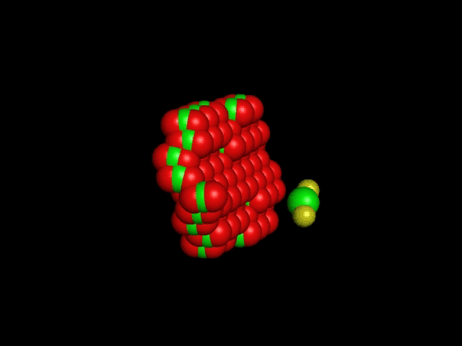
Key process: Carbon-vacancy complexes trap loops
N. Anento, A. Serra, J. Nucl. Mater., accepted
This process allows 50 yrs of irradiation experiments on Fe-C alloys and mild steels to be rationalised
complex | E_{b<111>} (eV) /E_{m<111>}~0.05 eV | E_{b<100>} (eV) /E_{m<100>}~1 eV
C | 0.6-0.7 (edge) | 1.0 (edge)
C-V | 0.75 (edge) | n.c.
C-V₂ | 1.4 (centre) / 0.6 (edge) | n.c.
C₂-V | 1.5 (edge) | 0.6 (edge)

Slide 4
Parameters for effect of C
C and C₂-V complexes are dominant traps for SIA clusters at 300°C (C-V₂ at <100°C)
They are modelled as immobile traps
Mainly <100> loops observed experimentally at T_{irr}=300°C ⇒
At <100°C only <111> loops observed ⇒ all of this type
Assumptions
Invisible loops are a mixture of <111> & <100>
  Mig. energy ~0.2 eV
  Trapping energy ~111
Visible loops <100>
  Mig. energy ~0.9 eV
  Trapping energy ~100
Key assumption
When loops are small interaction occurs with edge and is weaker

Slide 5
T_{irr} < 100°C

Slide 6
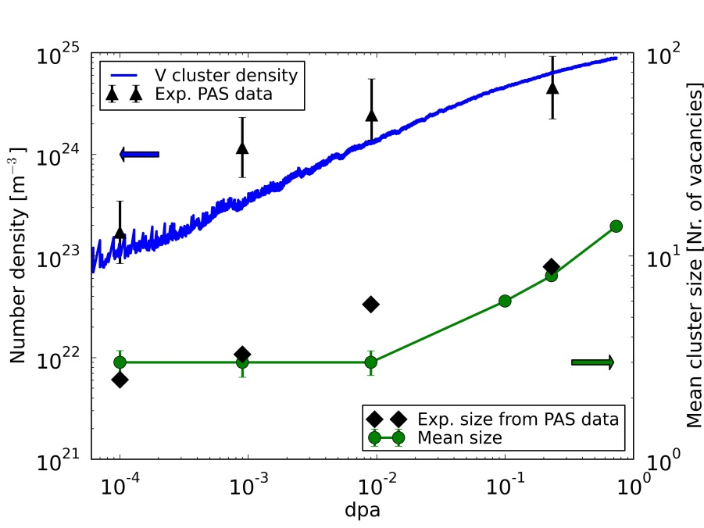
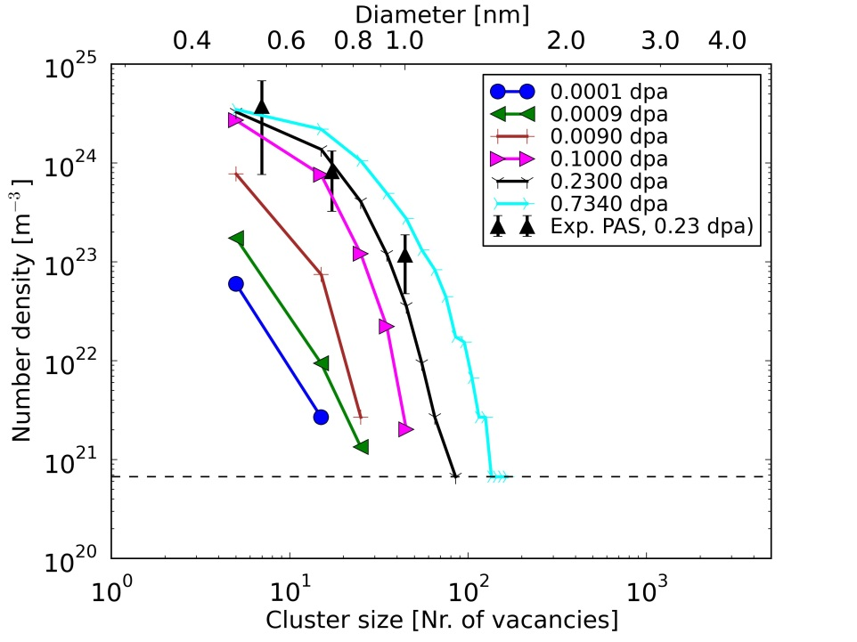
Vacancy clusters vs dpa
Fe ~100 appm C
Irradiation in HFIR @ 70°C & ~10⁻⁸ dpa/s up to ~0.8 dpa
Zinkle & Singh, J. Nucl. Mater. 351 (2006) 269
Threshold for loop/CV₂ interaction with centre is ~30 SIA (< 1 nm ∅)
Good reproduction of density, with slight underestimation of size
Notes:
6

Slide 7
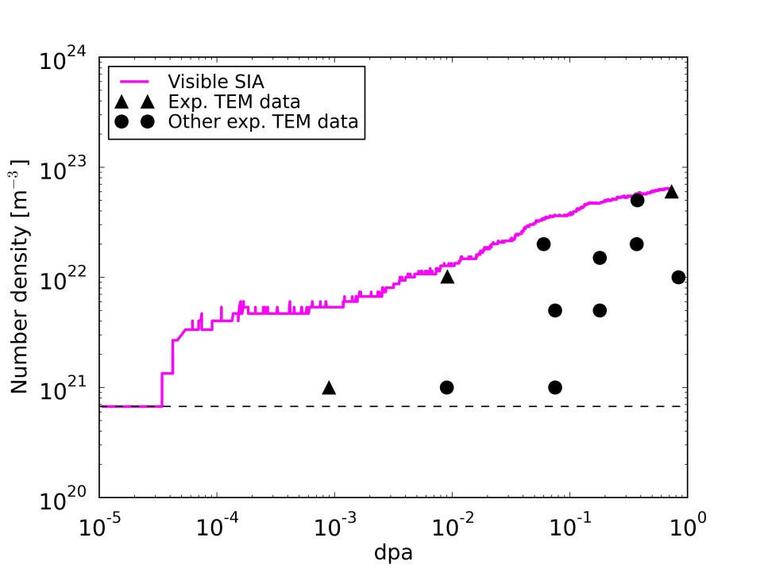
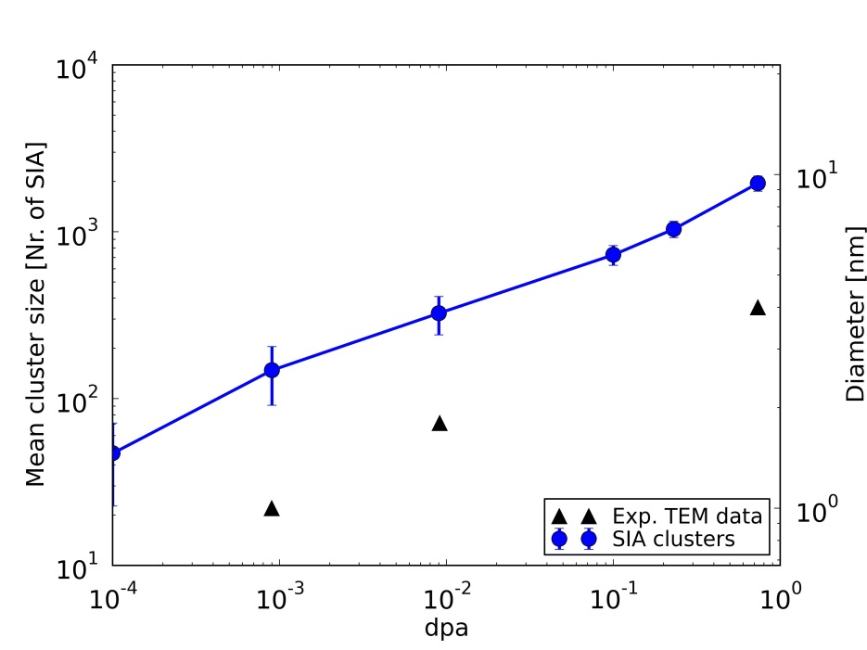
Fe ~100 appm C
Irradiation in HFIR @ 70°C & ~10⁻⁸ dpa/s up to ~0.8 dpa
Zinkle & Singh, J. Nucl. Mater. 351 (2006) 269
Visible SIA cluster density vs dpa
Threshold for loop/CV₂ interaction with centre is ~30 SIA (< 1 nm ∅)
Reasonable reproduction of density vs dose (except very low dose, because in reality traps are not there yet!), with slight overestimation of size
Notes:
7

Slide 8
T_{irr} ~ 300°C

Slide 9
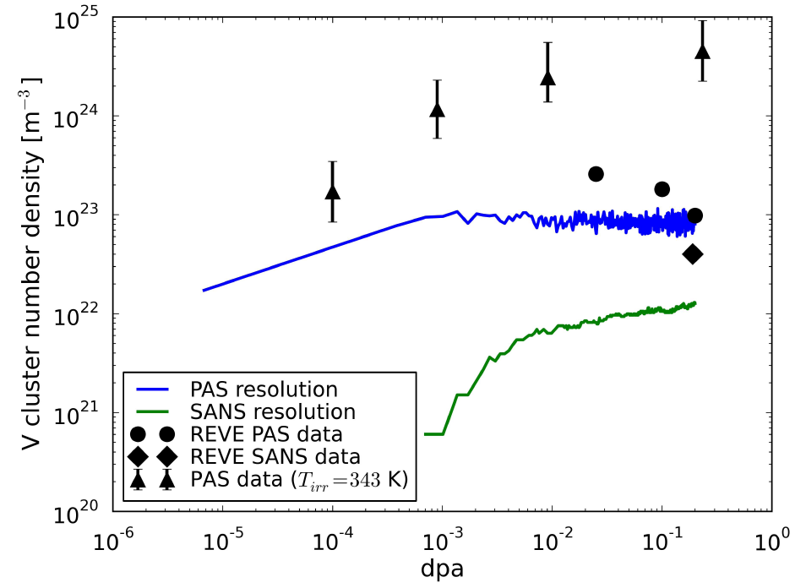
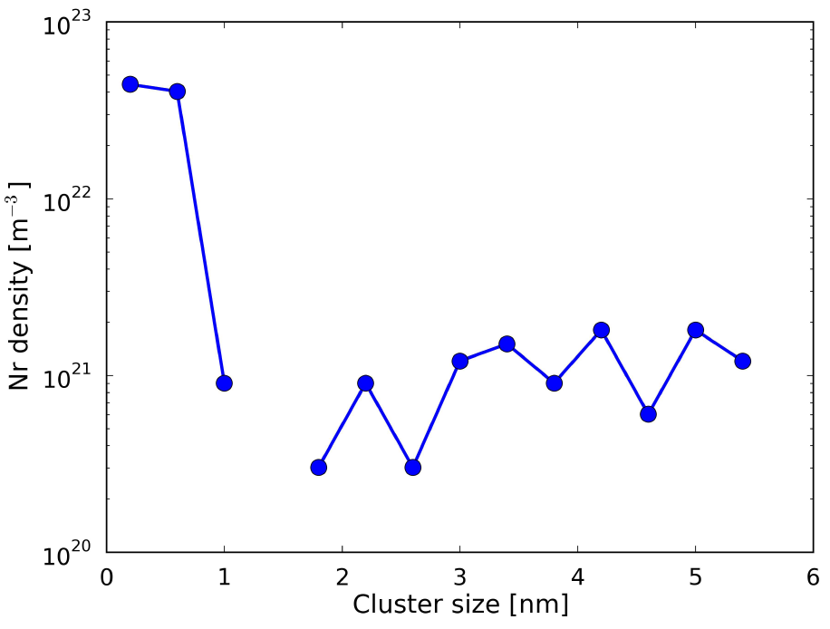
Fe ~100 appm C
Irradiation in BR2 @ 290°C & ~10⁻⁷ dpa/s up to ~0.2 dpa
REVE Experiment
Vacancy cluster density/size vs dpa
PAS ←
~12 vacs
~10²³ m⁻³
SANS
~2 nm
4⋅10²² m⁻³
Low T data for comparison
Good results for density and size of vacancy clusters vs experimental data
(slight overstimation of size, underestimation of density)
Notes:
9

Slide 10
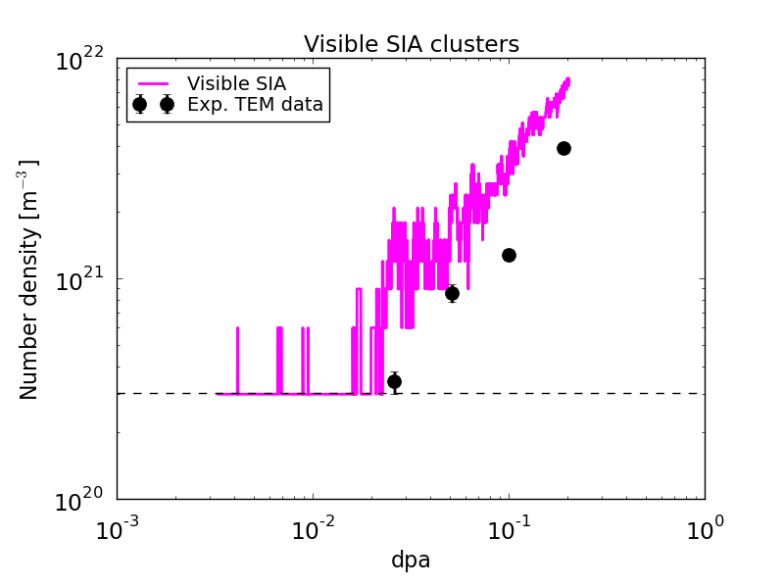
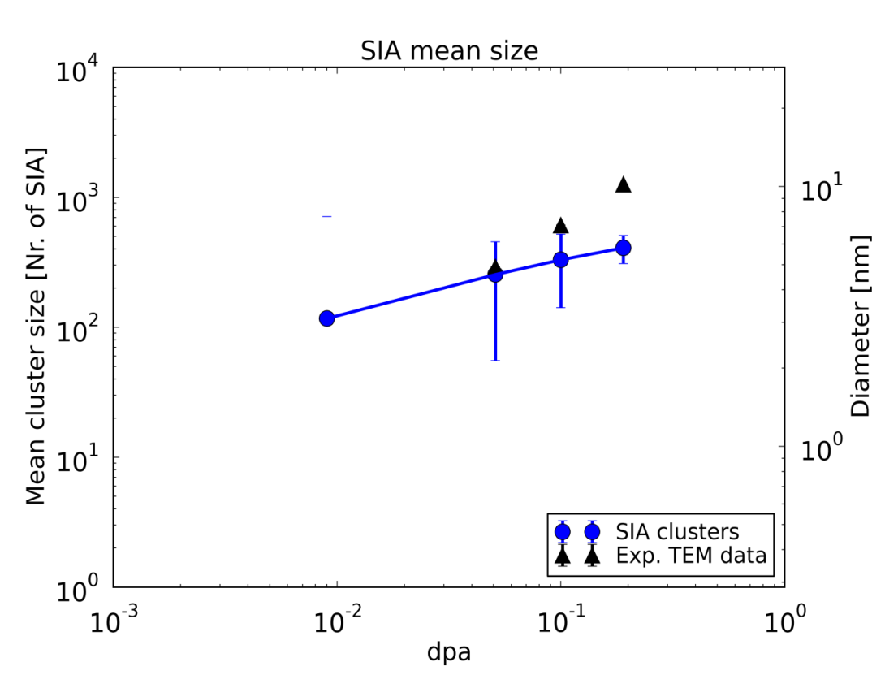
Fe ~100 appm C
Irradiation in BR2 @ 290°C & ~10⁻⁷ dpa/s up to ~0.2 dpa
REVE Experiment
SIA cluster density/size vs dpa
Reasonable reproduction of density and size of SIA
clusters vs experimental data.
Slight overestimation of density and underestimation of size
Notes:
10

Slide 11
Limitations and Perspectives
Limitations
Difficulty of unknown details of the process of formation of <100> vs <111> loops
Assumption of immobile traps instead of C atoms forming complexes
Perspectives
Introduce explicit treatment of mobile C atoms
Explore assumptions about <100> vs <111>

Slide 12
Model for Fe(-C)-”Cr”

Slide 13
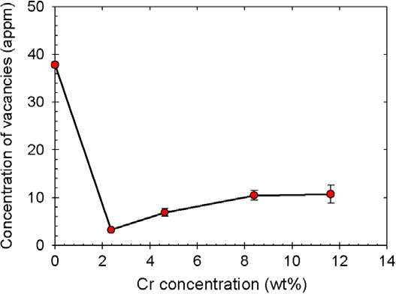
Fe-Cr: Irradiation in BR2 @ 290°C & ~10⁻⁷ dpa/s up to ~0.06 dpa
MIRE-Cr Experiment
%Cr | Grain size | Dislocation density (10¹³m⁻²) | wt%C
2.5 | 50 | 1.2 | 0.01
5 | 35 | 5.8 | 0.02
9 | 20 | 6.3 | 0.02
12 | 15 | 5.5 | 0.03
%Cr | SIA cluster mean size (nm) | SIA cluster density (10²¹ m⁻³)
2.5 | 8/4* | 1.2 /0.5*
5 | 7 | 1.4
9 | 6/4* | 1.3 /0.08*
12 | - | -
PAS
*M. Mayoral

Slide 14
Assumptions to simulate Cr effects
Self-interstitial clusters are slowed down by Cr atoms non-monotonically with Cr content / the effect disappears with increasing size

Slide 15
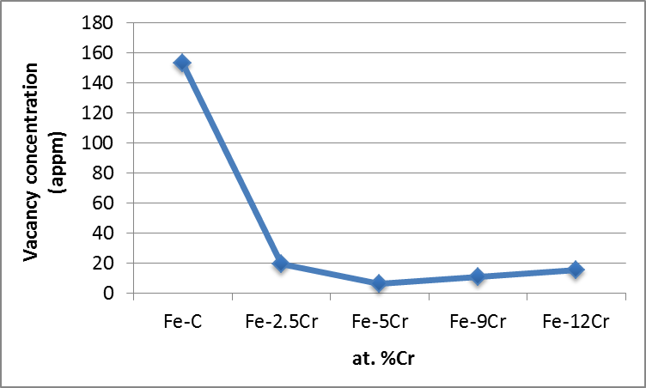
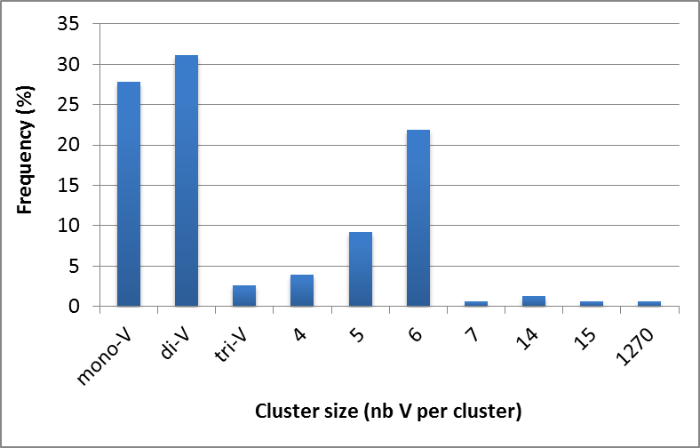
Assumptions to simulate Cr effects
Visible loops are mainly of <111> type in Fe-Cr >2.5%Cr
C segregated to grain boundaries (lath boundaries) in alloys with martensitic structure (>2.5%Cr)
  50 appm in the matrix
  20 appm in the matrix
Vacancy size distribution for 5 %Cr (C = 50 appm) at 0.06 dpa

Slide 16
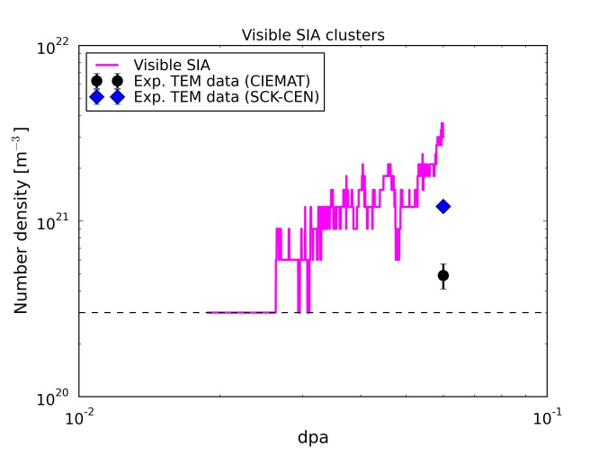
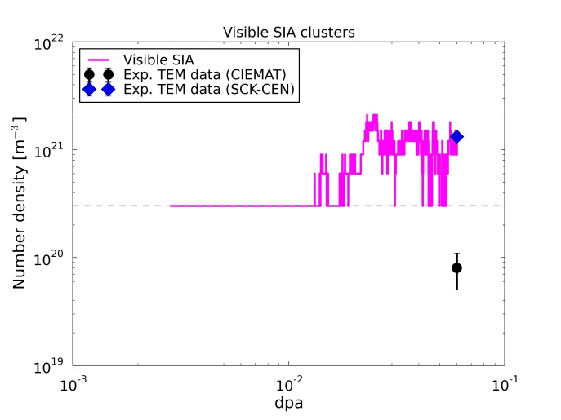
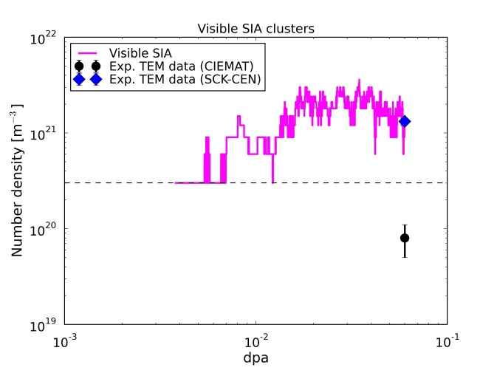
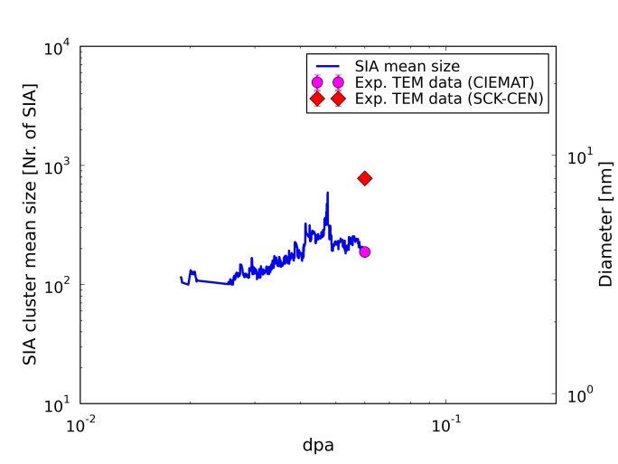
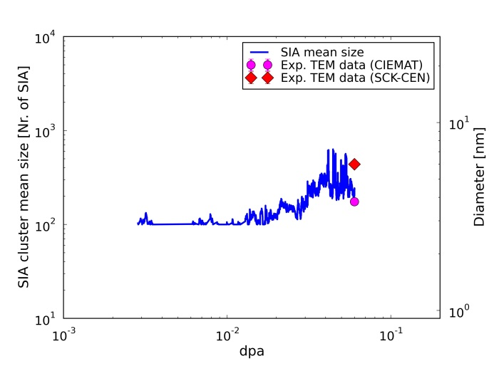
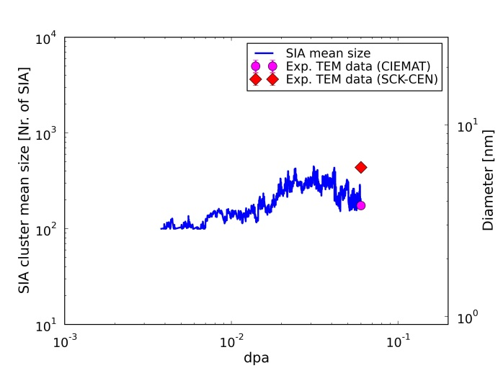
SIA clusters
2.5%Cr (100 appm C) | 9%Cr (50 appm C) | 9%Cr (20 appm C)

Slide 17
Limitations and Perspectives
Limitations
Difficulty of introducing full microchemical details: first approximation models
Smallness of the box to get statistics on visible loops
Perspectives
Take into account in more explicit way, possibly with the help of neural networks, the effect of Cr on defects and defect clusters
Explore assumptions about <100> vs <111>

Slide 18
Model for Fe(-C)-”MnNi”

Slide 19
Assumptions to simulate Mn & Ni effects in OKMC model
Vacancies are slowed down significantly by Mn (and Ni), effective migration energy on the order of ~1 eV
Self-interstitial clusters interact so strongly with Mn (and Ni) that they become virtually immobile above a relatively small size (~6-7 SIA)
(These are limiting cases: extreme assumptions!
But are “educated guesses” from DFT studies)

Slide 20
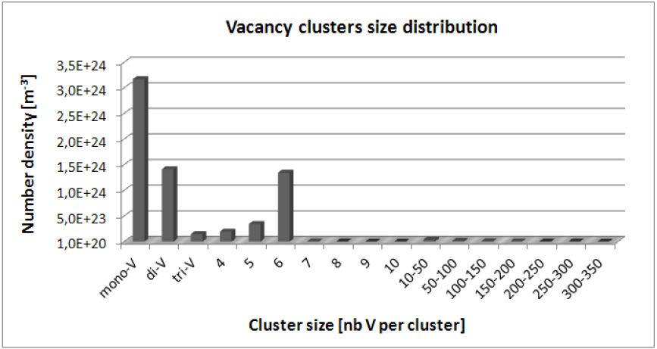
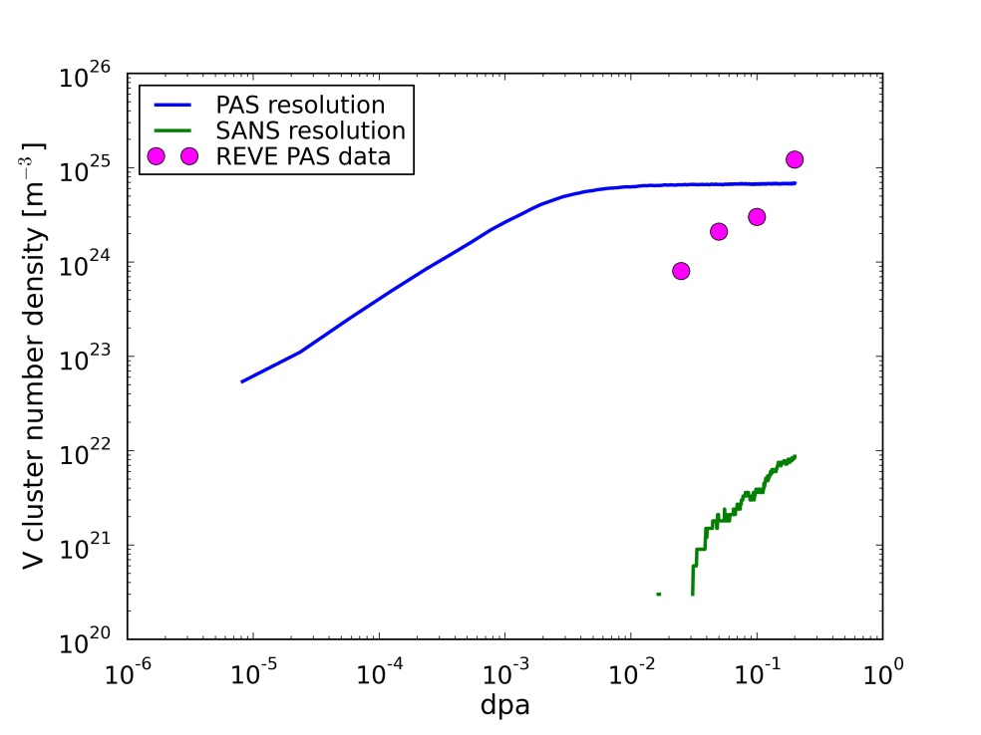

Results of adding the “effect of Mn (Ni)”
Reduced mobility of vacancy clusters leads spontaneously to absence of voids (no coalescence)
Only single & di-vacancies
Vacancy clusters
Fe”MnNi”
FeC

Slide 21
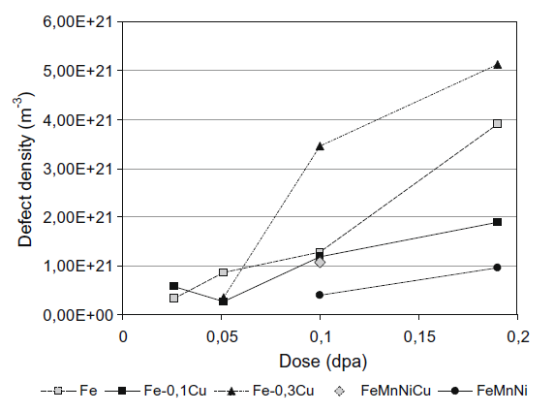
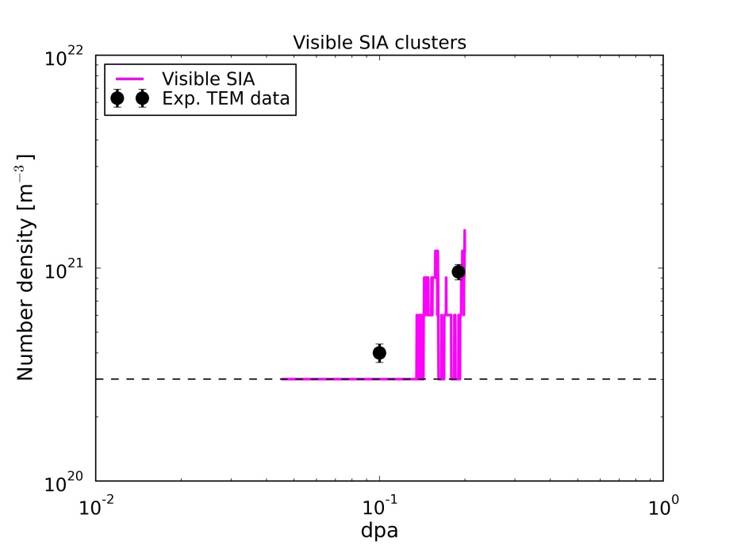
Results of adding the “effect of Mn (Ni)”
Visible interstitial dislocation loops
Fe-C
Fe-C
FeNiMn
FeNiMn
M. Hernandez-Mayoral, D. Gomez-Briceno, J. Nucl. Mater. 399 (2010) 146.

Slide 22
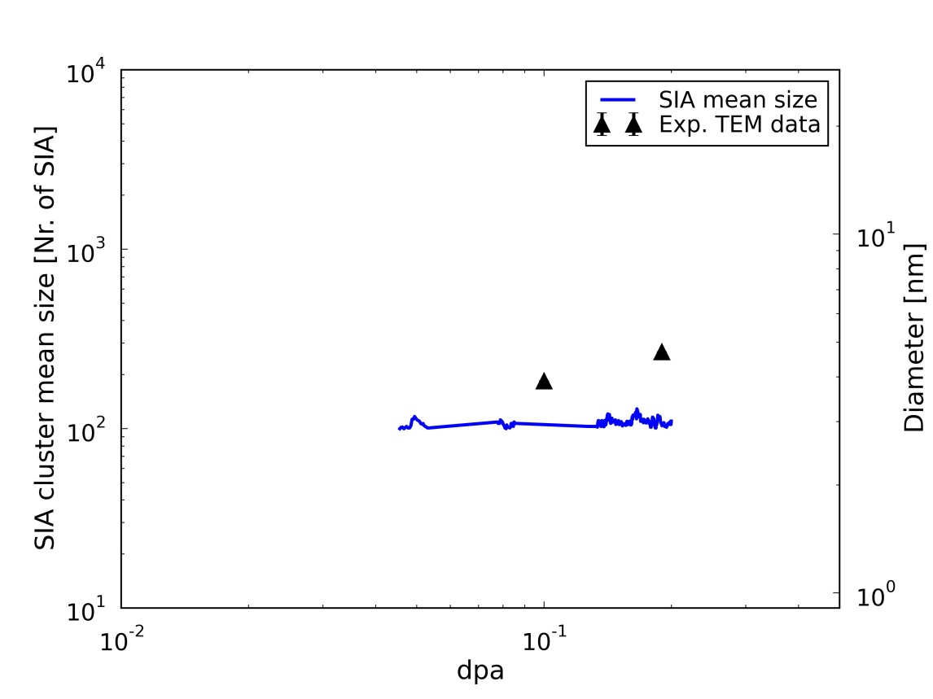
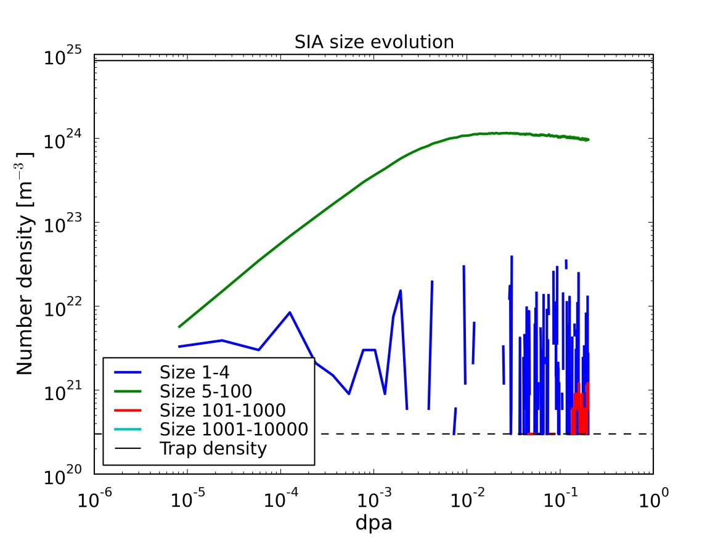
Results of adding the “effect of Mn (Ni)”
INvisible interstitial dislocation loops
Mean size of TEM visible ones
M. Hernandez-Mayoral, D. Gomez-Briceno, J. Nucl. Mater. 399 (2010) 146.
Mean size of all from OKMC
~3 nm ∅
Density of invisible loops vs dpa
Density of ~1.5 nm ∅ MnNi clusters according to APT
LBPs might be SDLs, solute decorated loops!
E. Meslin, B. Radiguet, P. Pareige, A. Barbu, Journal of Nuclear Materials 399 (2010) 137

Slide 23
Limitations and Perspectives
Limitations
Difficulty of introducing full microchemical details: first approximation models
Smallness of the box to get statistics on visible loops
Perspectives
Develop simple model including explicitly Mn & Ni (at least), including their transport by single point-defects

Slide 24
Summary
Main effect of C in the matrix is that it forms highly stable small complexes with vacancies
These complexes in turn trap mobile loops
Simple assumptions on the effect of Cr on mobility and types of SIA clusters + absence of C in the matrix provide correct trend of swelling vs Cr content
Two simple, though drastic, assumptions on Mn&Ni effect on SIA and V clusters devolve experimental nanostructure for FeMnNi alloys
Main conclusion: mobility of defects matters!

Slide 25
Thank you for your attention!

