Slide 1
Modeling of diffusion, segregation and decomposition of alloys using OKMC: Applications to FeCr
Ignacio Martin-Bragado¹, Ignacio Dopico¹ and Pedro Castrillo²
¹ IMDEA Materials Institute, Getafe, Spain
² Department of Electronics, University of Valladolid, Spain

Slide 2
Why FeCr alloys?
Motivation
FeCr steels are the materials of choice for high temperature applications under irradiation.
An approximation to such steels is having a modeling framework for the FeCr alloy
Swelling in FeCr alloys under irradiation is around one order of magnitude lower than in pure Fe for the same dose.

Slide 3
Why atomistic simulations?
Motivation
Requirements for FeCr alloy simulation:
Large periods of time (where MD is too short!)
Relatively big systems (where Lattice KMC is too memory consuming).
Including damage irradiation (from BCA or MD)
Predictive (useful: link to ab-initio).
Possible solution: off-lattice OKMC with quasi-atomistic FeCr spinodal decomposition model.

Slide 4
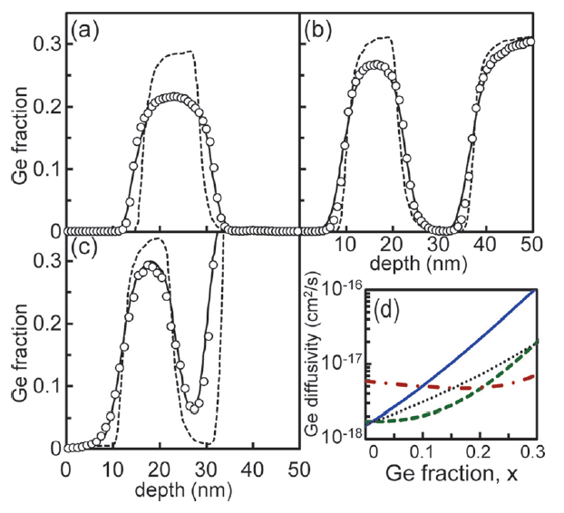
Previous work: SiGe alloys
Motivation
Recent experience: Atomistic modeling and OKMC simulation of diffusion in SiGe alloys
Castrillo et al, J. Appl. Phys. (2011)
Powerful approach, suitable for FeCr

Slide 5
Goals
This work
The goal it to develop a non-lattice, object KMC model for FeCr alloys able to:
Simulate realistic times and sizes.
Be integrated in a comprehensive OKMC simulator including other radiation effects.
Reproduce and explain interdiffusion and separation.
Include the effects of excess point defects.

Slide 6
Outline
This work
Modeling of diffusion, segregation and decomposition of alloys using OKMC: Applications to FeCr
Atomistic model
Code implementation
Simulation results
Conclusions

Slide 7
Diffusion in binary alloys
Atomistic Model
Defect diffusion
Atom diffusion
Inter-diffusion
Fe
Fe
I
I
I
Fe
Cr
Cr
Cr
V
V
V
Mobile point defects ⇒ defect diffusion → $D_{K}$(K = V, I)
Atom diffusion driven by V or I → $D_{A}^{K}$ (A = Fe, Cr)
Interdiffusion driven by V or I → ${\tilde{D}}^{K}$ ⇒ concentration modification
DEFECTS
→
ATOMS
→
ENERGIES
→
INTERDIFF.
→
THERMODYN.
→
DECOMPOSITION

Slide 8
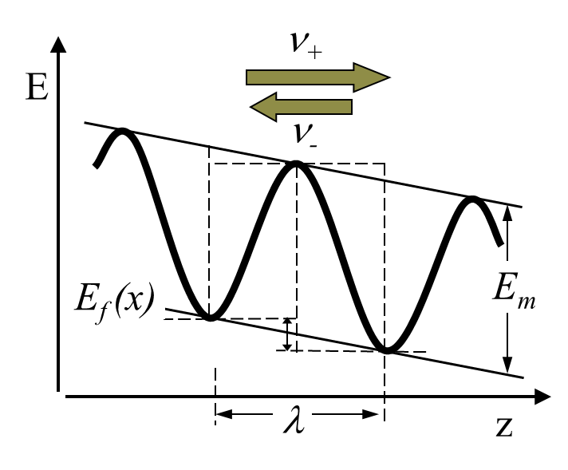
Point defect diffusion
Atomistic Model
I
I
V
V
Defect diffusivity $D_{K}$
Point defect fluxes depend on D_{K}C_{K}.
In metals in equilibrium, C_{I} << C_{V} ⇒ D_{I}C_{I} << D_{V}C_{V}
Both C_{I} and C_{V} enhanced with radiation damage (so, I’s could also play a role)
DEFECTS
→
ATOMS
→
ENERGIES
→
INTERDIFF.
→
THERMODYN.
→
DECOMPOSITION

Slide 9
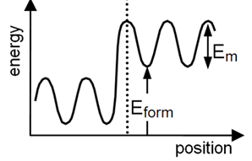
Point defect jumps
Atomistic model
Defect generation: thermal (→ $E_{form}$ ) and radiation damage
Random walks with $_{K}=\frac{6}{{ λ}^{2}}D_{K}$ (migration →$E_{m}$)
$E_{form}$ and $E_{m}$depend on alloy composition
Energy jump barriers → ${∆E}_{form}+∆E_{m}$
DEFECTS
→
ATOMS
→
ENERGIES
→
INTERDIFF.
→
THERMODYN.
→
DECOMPOSITION

Slide 10
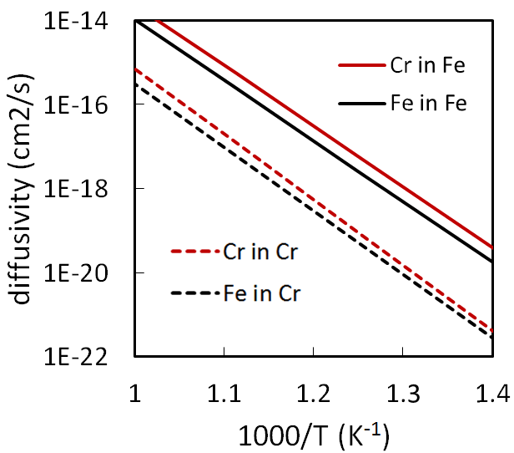
Atom diffusion
Atomistic model
In homogeneous alloys (no energy change): “tracer” diffusion
In general, $D_{Fe}^{K}≠D_{Cr}^{K}$.
Fitted to experiments.
Warning: “bulk” diffusivities, no dislocation-mediated ones, are relevant in the nanoscale.
Ab-initio calculations could be also a choice as an input for our model
Cfr. Martinez et al, PRB 2012
DEFECTS
→
ATOMS
→
ENERGIES
→
INTERDIFF.
→
THERMODYN.
→
DECOMPOSITION

Slide 11
Atom movements
Atomistic model
Defect movement ⇒ atom movement (I →, V ←)
The probability of moving Cr or Fe depends on:
The Cr and Fe content (configurational entropy)
The diffusivity ratio${D_{Cr}^{K}}/{D_{Fe}^{K}}$
The total energy modifications of the system: different final state after moving a Fe or a Cr
DEFECTS
→
ATOMS
→
ENERGIES
→
INTERDIFF.
→
THERMODYN.
→
DECOMPOSITION

Slide 12
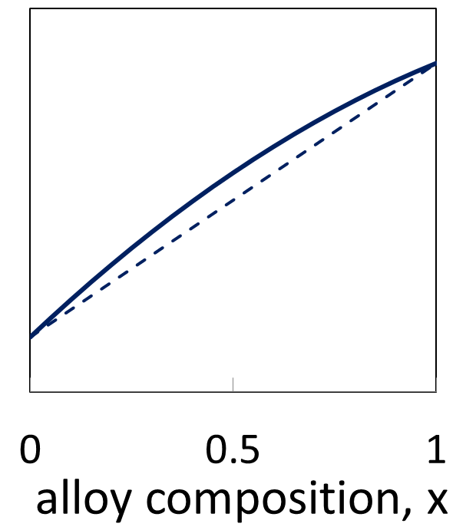
Energy modifications
Atomistic model
Energy changes: - mixing enthalpy
- elastic energy release.
$E_{bulk}\left(x\right)=\left(1−x\right)E_{bulk}\left(0\right)+xE_{bulk}\left(1\right)+E_{mix}\left(x\right)$
$E_{elast}=\frac{\overset{̿}{σ}\overset{̿}{ε}}{C_{at}}∝ ε^{2}$
Minimized for homogenous alloy
ε is low in FeCr , ≤ 0.45% ( but up to 4.2% in SiGe)
DEFECTS
→
ATOMS
→
ENERGIES
→
INTERDIFF.
→
THERMODYN.
→
DECOMPOSITION

Slide 13
Energy modifications (II)
Atomistic model
Different energy modification when an atom moves from a region 1 to a region 2 in Fe_{1-x}Cr_{x}:
$$δ{E_{Fe}^{K}}_{1→2}−δ{E_{Cr}^{K}}_{1→2}≈\frac{dE_{mix}}{dx}(x_{1})−\frac{dE_{mix}}{dx}(x_{2})+\left(x_{1}−x_{2}\right)\frac{4Yε_{{Fe}/{Cr}}^{2}}{C_{tot}}$$
This affects the relative rates of Cr and Fe atoms moving from 1 to 2 :
$\frac{{ν_{Cr}^{K}}_{1→2}}{{ν_{Fe}^{K}}_{1→2}}∝$ $exp\left(\frac{δ{E_{Fe}^{K}}_{1→2}−δ{E_{Cr}^{K}}_{1→2}}{kT}\right)$
DEFECTS
→
ATOMS
→
ENERGIES
→
INTERDIFF.
→
THERMODYN.
→
DECOMPOSITION

Slide 14
Interdiffusion
Atomistic model
Composition modification in inhomogeneous alloy.
For no net atom flux ($J_{Fe}+J_{Cr}=0$):
$J_{Fe}=−\tilde{D}\frac{∂C_{Fe}}{∂z}=\tilde{D}\frac{∂C_{Cr}}{∂z}=−J_{Cr}$
Interdiffusion coefficient ($\tilde{D}$):
$\tilde{D}>0$ ⇒ homogenization (as usual).
$\tilde{D}<0$ ⇒ separation (notably for Fe_{1-x}Cr_{x} at low T)
Fe_{1-x}Cr_{x}
Fe_{1-y}Cr_{y}
DEFECTS
→
ATOMS
→
ENERGIES
→
INTERDIFF.
→
THERMODYN.
→
DECOMPOSITION

Slide 15
Interdiffusion coefficient
Analytic results
${\tilde{D}}^{K}$for Fe_{1-x}Cr_{x} is analytically derived to be:
$\frac{Φ}{{\tilde{D}}^{K}}=\frac{x }{{ D}_{Fe}^{K}}+\frac{ 1−x }{D_{Cr}^{K}}$
Nernst-Planck equation.
Φ is the “thermodynamic factor” (see later).
For x~0.5, ${\tilde{D}}^{K}$ is limited by the slowest diffuser.
Valid in the nanoscale: $\sqrt{\tilde{D}t}≪$ defect mean free path.
Total interdiffusion coefficient: $\tilde{D}={\tilde{D}}^{V}+{\tilde{D}}^{I}$
$\left|\tilde{D}\right|$ is enhanced with radiation-induced defects:
$\tilde{D}=\frac{C_{V}}{C_{V}^{eq}}{{\tilde{D}}^{V}}^{eq}+\frac{C_{I}}{C_{I}^{eq}}{{\tilde{D}}^{I}}^{eq}$
DEFECTS
→
ATOMS
→
ENERGIES
→
INTERDIFF.
→
THERMODYN.
→
DECOMPOSITION

Slide 16
Thermodynamic factor
Analytic results
${\tilde{D}}^{K}=Φ·{\left(\frac{x }{{ D}_{Fe}^{K}}+\frac{ 1−x }{D_{Cr}^{K}}\right)}^{−1}$
The “thermodynamic factor” Φ is found to be:
$$Φ=1+x\left(1−x\right)\frac{2}{kT}\left(\frac{d^{2}E_{mix}}{{dx}^{2}} +\frac{4Y{ε^{2}}_{{Fe}/{Cr}}}{C_{tot}}\right)$$
In FeCr, the strain term can be neglected. (In contrast, in SiGe the two terms had opposite sign and almost compensate)
mixing
strain
DEFECTS
→
ATOMS
→
ENERGIES
→
INTERDIFF.
→
THERMODYN.
→
DECOMPOSITION

Slide 17
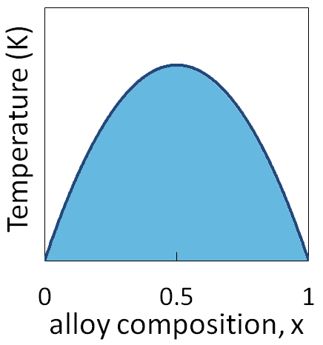
Spinodal decomposition
Analytic results
${\tilde{D}}^{K}=Φ·{\left(\frac{x }{{ D}_{Fe}^{K}}+\frac{ 1−x }{D_{Cr}^{K}}\right)}^{−1}$
If $Φ<0 ⇒\tilde{ D}<0 $spinodal decomposition
This happens if $\frac{d^{2}E_{mix}}{{dx}^{2}}<0$ for ${T<T}_{sp}\left(x\right)$ with:
$T_{sp}\left(x\right)=−x\left(1−x\right)\frac{2}{k}\frac{d^{2}E_{mix}}{{dx}^{2}}$
Also found from $\frac{d^{2}G}{{dx}^{2}}=0$
T_{sp}(x)
Spinodal decomposition
DEFECTS
→
ATOMS
→
ENERGIES
→
INTERDIFF.
→
THERMODYN.
→
DECOMPOSITION

Slide 18
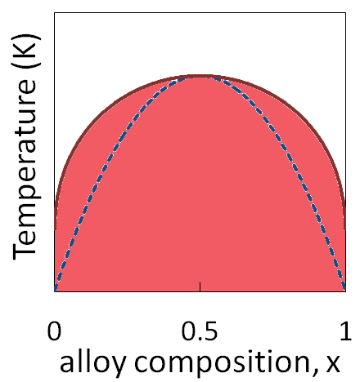
Miscibility gap
Analytic results
Regions 1 and 2 have null interdiffusion flux if:
$\frac{d{∆E}_{mix}}{dx}\left(x_{1}\right)+\frac{kT}{2} ln\frac{x_{1}}{1−x_{1}}=\frac{d{∆E}_{mix}}{dx}\left(x_{2}\right)+\frac{kT}{2}ln\frac{x_{2}}{1−x_{2}}$
Miscibility gap edge for:
$\frac{d{∆E}_{mix}}{dx}\left(x\right)+\frac{kT}{2}ln\frac{x}{1−x}=0$
$ T_{mg}(x)=\frac{2}{k}\frac{\frac{dE_{mix}}{dx}}{ ln\frac{1−x}{x}}$
Also found from $\frac{dG}{dx}=0$
Phase diagram
T_{mg}(x)
T_{sp}(x)
Miscibility gap
DEFECTS
→
ATOMS
→
ENERGIES
→
INTERDIFF.
→
THERMODYN.
→
DECOMPOSITION
Notes:
In our model, two neighboring regions 1 and 2 have interdiffusion flux if:

Slide 19
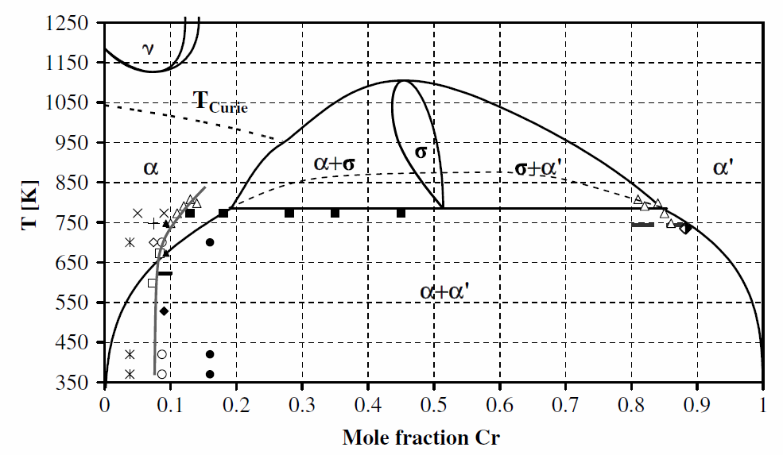
The FeCr phase diagram
Miscibility gap
Malerba at al, JNM 2008
DEFECTS
→
ATOMS
→
ENERGIES
→
INTERDIFF.
→
THERMODYN.
→
DECOMPOSITION

Slide 20
Object Kinetic Monte Carlo
Code implementation
Implemented in MMonCa code.
using the Object Kinetic Monte Carlo (non-lattice) approach.
Simulation sizes up to ~500 nm.
Simulation driven by events: times from μs to years, depending on event rates.
Very suitable for damage evolution simulation.

Slide 21
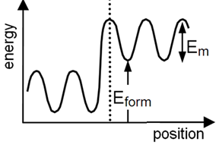
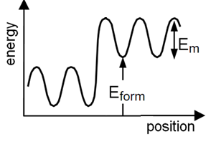
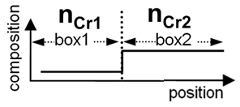
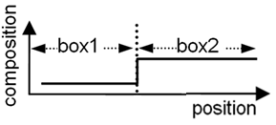
Quasi-atomistic approach
Code implementation
1
2
Atomistic handling of defects: particles
Continuum handling of the crystal: boxes
Quasi-atomistic handling of alloy composition: Cr atom counters
Particle properties depend on alloy composition in the box
Jump probability rejection as a function of Δ(E_{form}+E_{m})

Slide 22
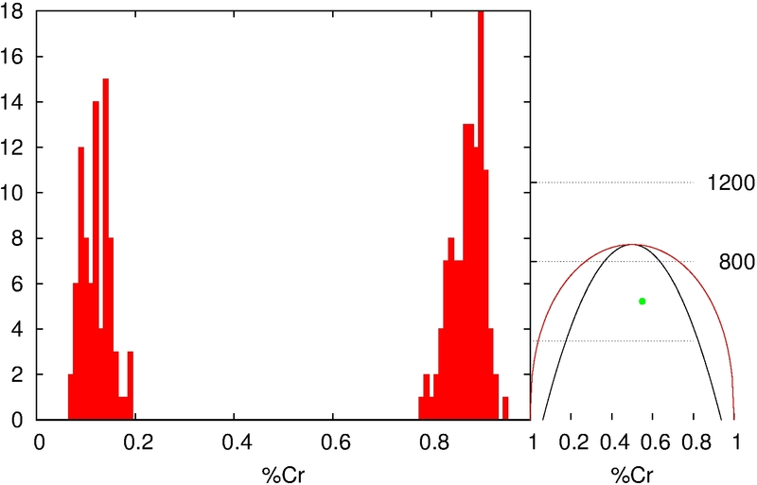
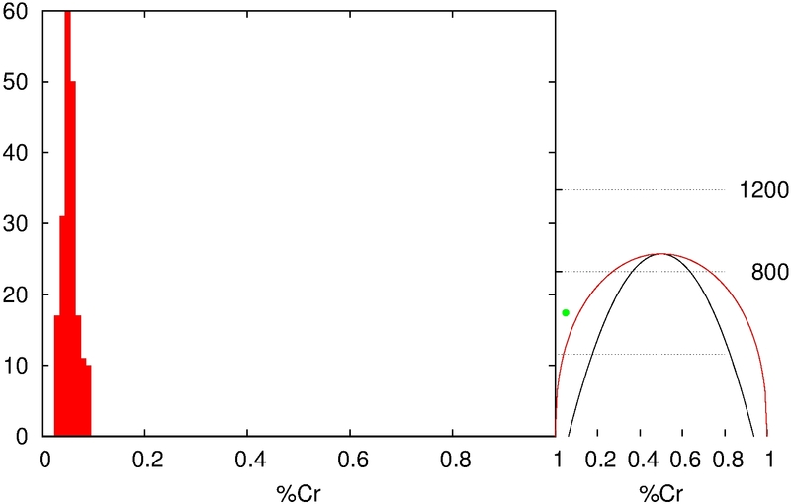
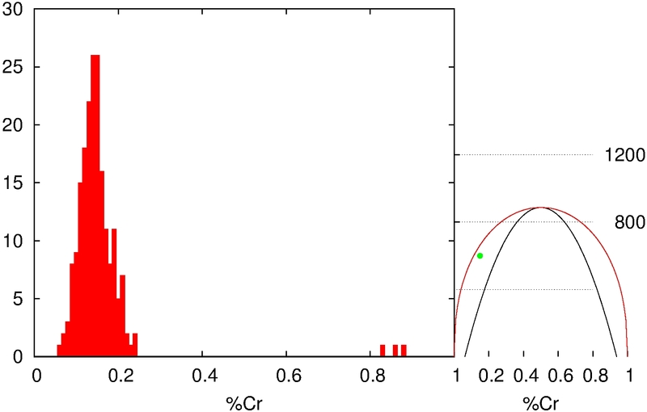
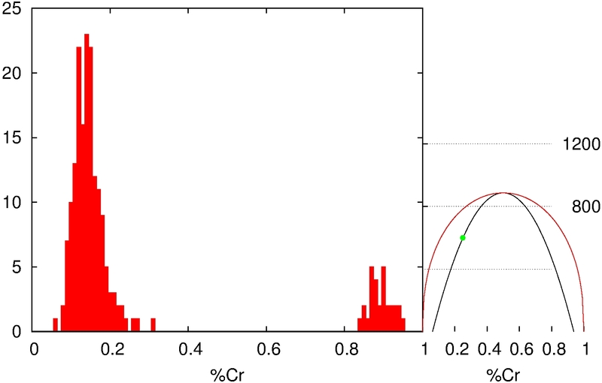
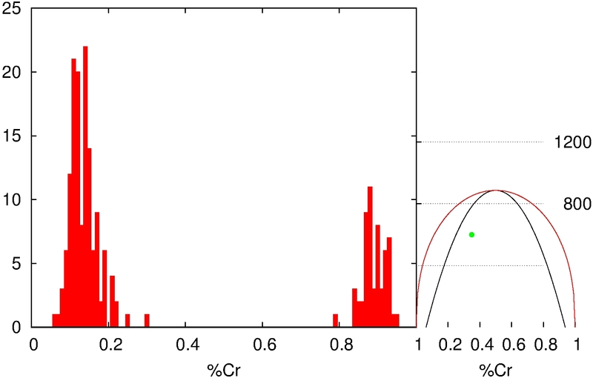
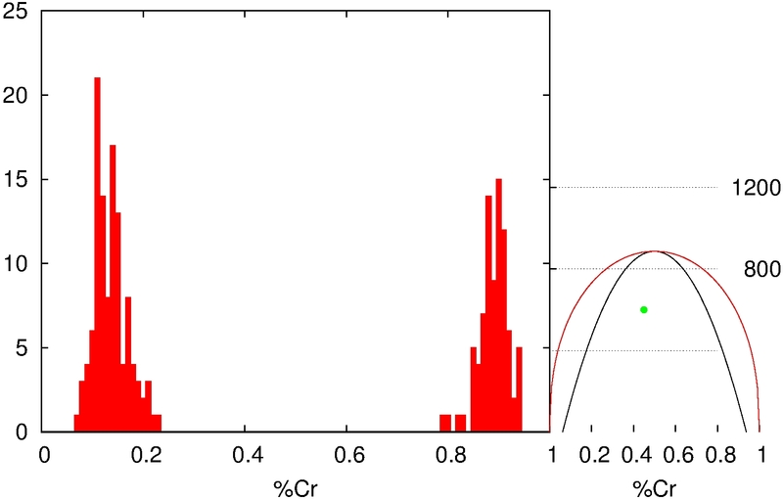
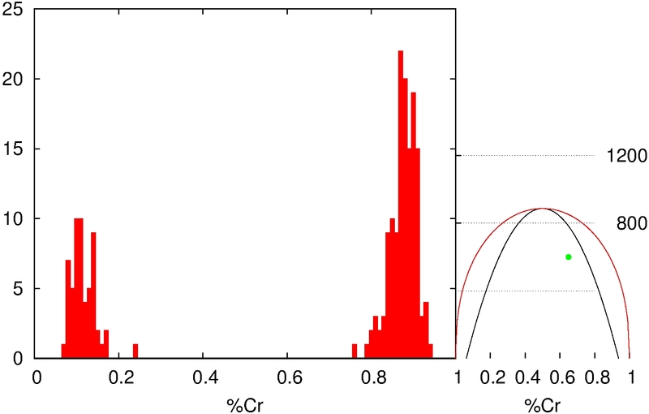
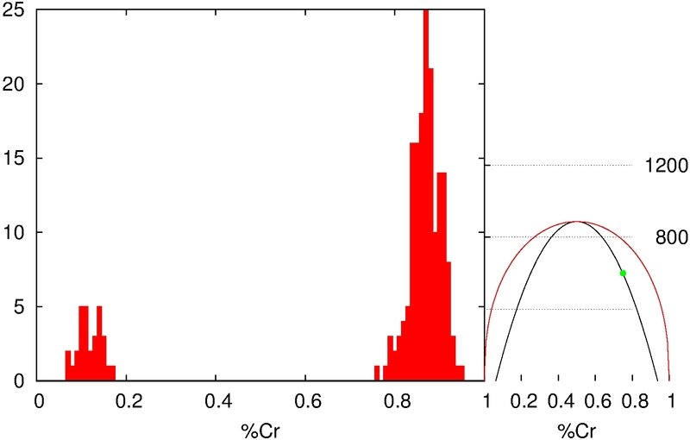
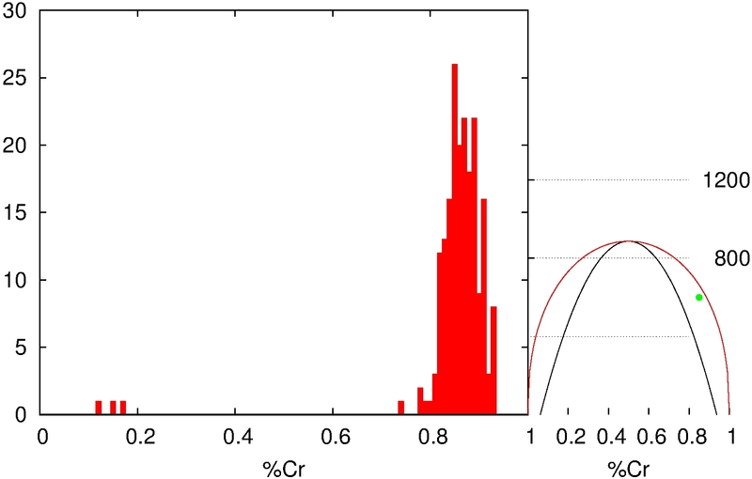
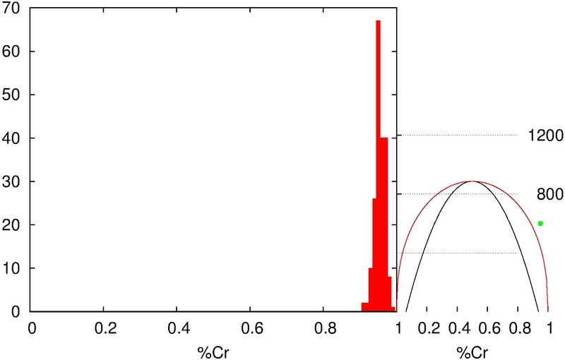
Composition evolution
Simulation results
Simulated composition histograms after annealing at 600K, starting at •
occurrence
no separation
nucleation
nucleation-spinodal decomposition
spinodal decomposition
nucleation-spinodal decomposition
nucleation
no separation

Slide 23
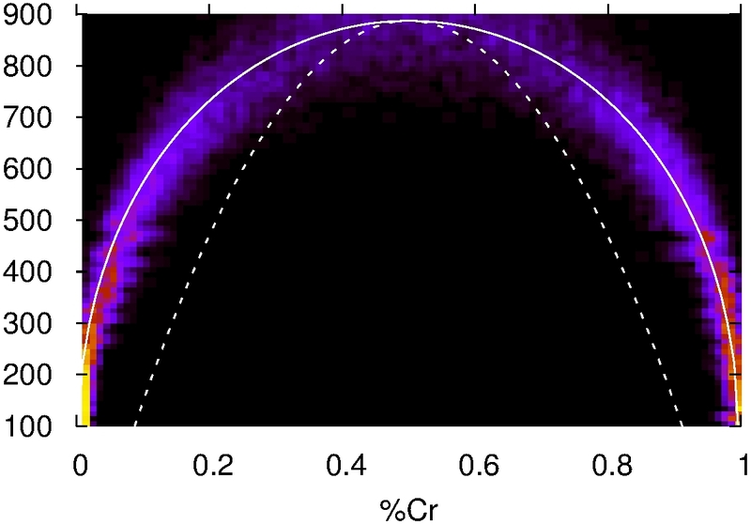
Miscibility gap
Simulation results
Final composition at different temperatures
Color histograms. Initial composition: x = 0.5.
miscibility
Temperature (K)
alloy composition, x
G minima (miscibility curve) populated at each T

Slide 24
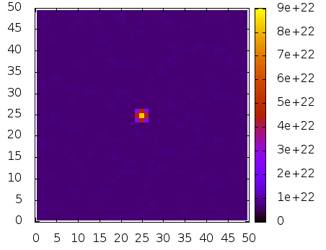
Nucleation and growth
Simulation results
Simulated view of evolution for T_{sp}(x) < T < T_{mg}(x) (x = 0.05, 100ºC, 50 nm x 50 nm x 8 nm)
Nucleation and growth

Slide 25
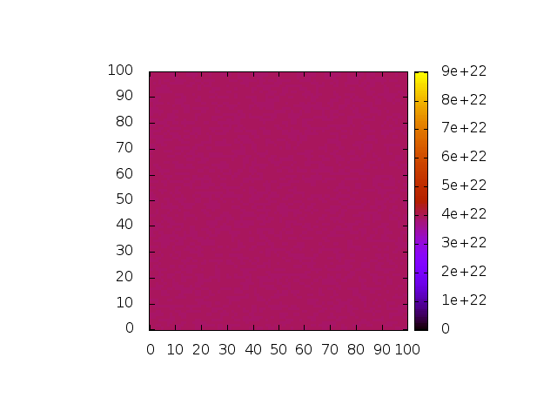
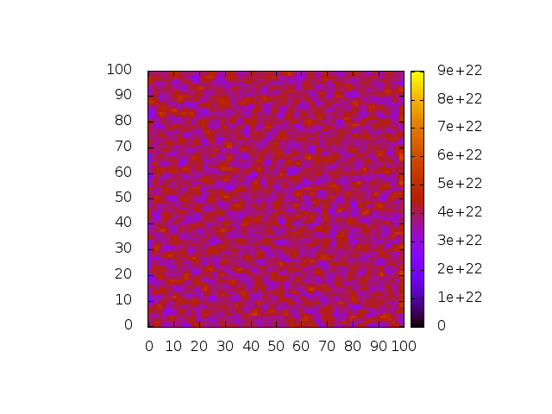
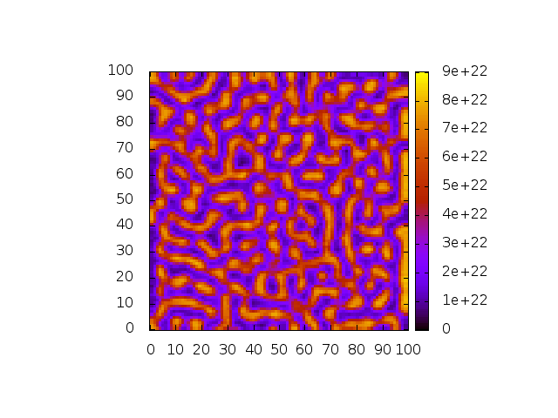
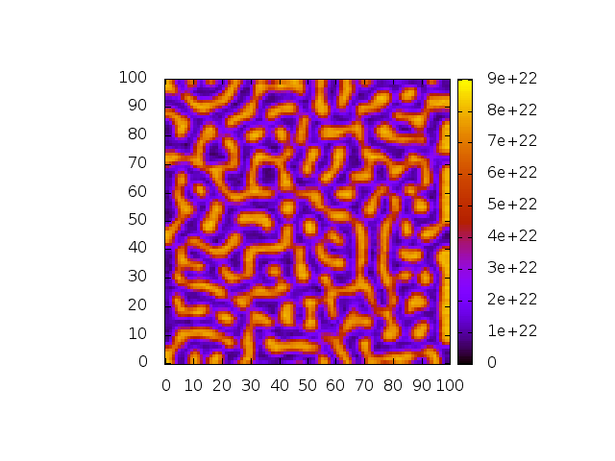
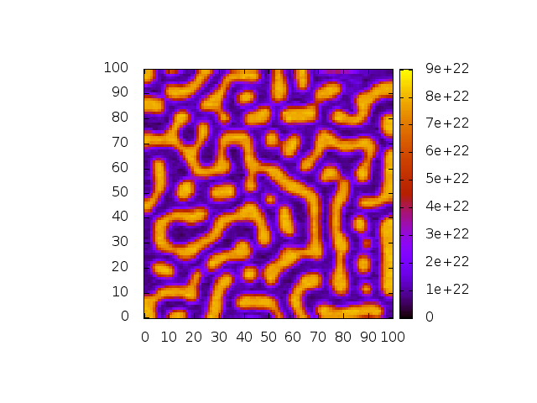
Spinodal decomposition
Simulation results
Simulated view of evolution within the spinodal decomposition range (x = 0.5, 350ºC, 100nm x 100nm x 8 nm)
Homogeneous, spinodal decomposition
Computation time: 2h, 1 core.

Slide 26
Summary
Conclusions
An efficient off-lattice OKMC model for phase separation in FeCr has been presented.
Analytical expressions to assist in understanding the results have been shown.
Part of the FeCr phase diagram is reproduced.
Results showing nucleation and growth and spinodal decomposition and have been presented.
The model is integrated in a full OKMC simulator of damage irradiation evolution.

Slide 27
Future work
Conclusions
Adjust the mixing enthalpy to better reproduce the experimental phase diagram.
Diffusivities and time-scale validation.
Study and calibrate the effects produced by excess of point defects generated by irradiation.
Finish the full integration into the simulator by including dependencies on Cr concentration to all the simulated defects (clusters, bubbles, …)

Slide 28
THANK YOU VERY MUCH FOR YOUR ATTENTION

