Slide 1


Characterization of He implanted Eurofer97
Inês Carvalho, Henk Schut, Alexander Fedorov,
Natalia Luzginova, Pierre Desgardin, Jilt Sietsma
Edinburgh, 4-5 June 2013

Slide 2
Outline
Project overview
Techniques
    Positron annihilation
    Thermal desorption spectroscopy
Experimental details
Results
    Helium implantations - 500 keV and 2 MeV
    Helium release mechanisms
      Example: 500 keV, 10¹⁶ He/cm²
      Overall picture
Final remarks & Future Work

Slide 3
Project Overview
      Eurofer97 (Fe - 9Cr - 1W - 0.2V - 0.1Ta - 0.1C wt.%)
      Correlation of microstructure and mechanical properties
          Understanding structural defects that affect the mechanical properties
          Evolution of defect structures formed due to clustering and coalescence of POINT DEFECTS
              Helium-vacancy clusters
              Helium-filled bubbles
              Interstitial loops
      Thermal desorption spectroscopy (TDS)
        defect populations
        thermal stabilities of defects
      Positron annihilation
        thermal evolution of free-volume related defects
      Electron Microscopy
        microstructure of ion implanted and (neutron) irradiated samples

Slide 4
Project Overview
      Use of thermal desorption spectroscopy (TDS) and electron microscopy on Eurofer97 neutron irradiated material
      First approach: reproduction of neutron irradiation conditions
          He implantation with 500 keV and 2 MeV energies
          Study of defect structures by positron annihilation and Thermal Desorption Spectroscopy (TDS)
        After: comparison of results – He implanted vs. neutron irradiated samples
Reference Material
Study of pre-existing defects
Ion Implantation (He)
Simulation of neutron irradiation defects
Neutron Irradiation
Real irradiation conditions
now

Slide 5
Techniques

Slide 6
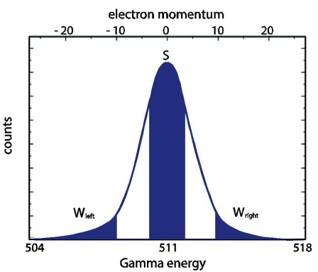
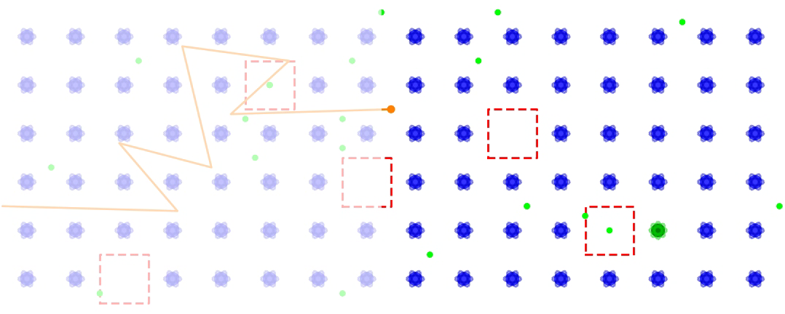
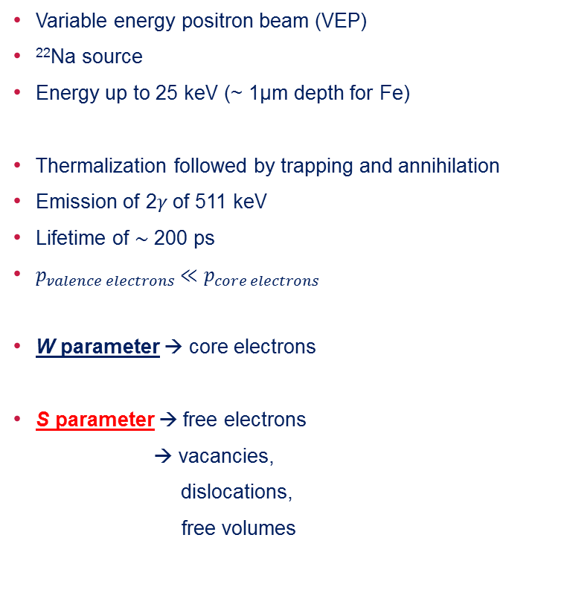
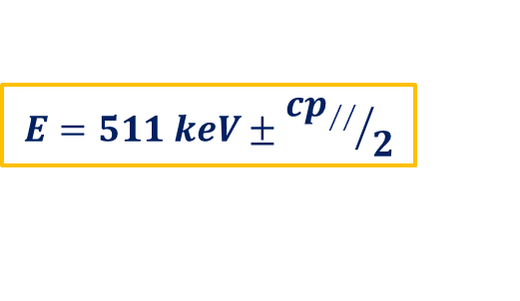
Techniques – VEP
Positron annihilation
Variable energy positron beam (VEP)
²²Na source
Energy up to 25 keV (~ 1µm depth for Fe)
Thermalization followed by trapping and annihilation
Emission of 2$γ$of 511 keV
Lifetime of $\sim$ 200 ps
$p_{valence electrons}≪p_{core electrons}$
W parameter → core electrons
S parameter → free electrons
→ vacancies,
dislocations,
free volumes
$$E=511 keV±{cp_{∕∕}}/2$$

Slide 7
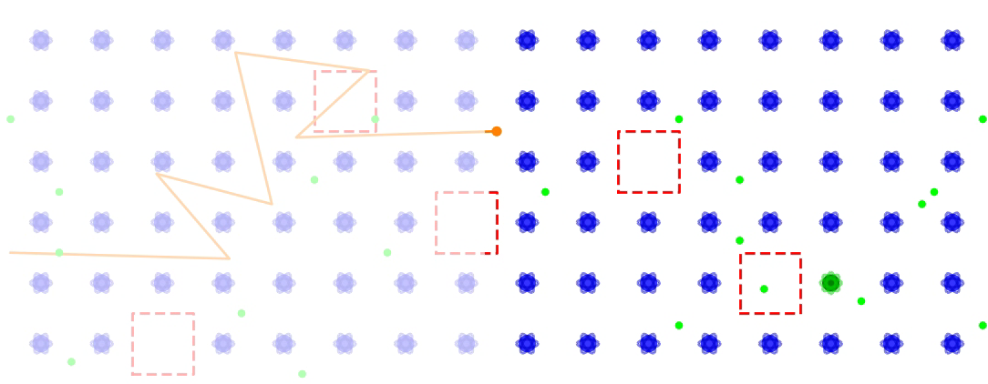
Techniques – VEP
Positron annihilation
Variable energy positron beam (VEP)
²²Na source
Energy up to 25 keV (~ 1µm depth for Fe)
Thermalization followed by trapping and annihilation
Emission of 2$γ$of 511 keV
Lifetime of $\sim$ 200 ps
$p_{valence electrons}≪p_{core electrons}$
W parameter → core electrons
S parameter → free electrons
→ vacancies,
dislocations,
free volumes
$$E=511 keV±{cp_{∕∕}}/2$$

Slide 8
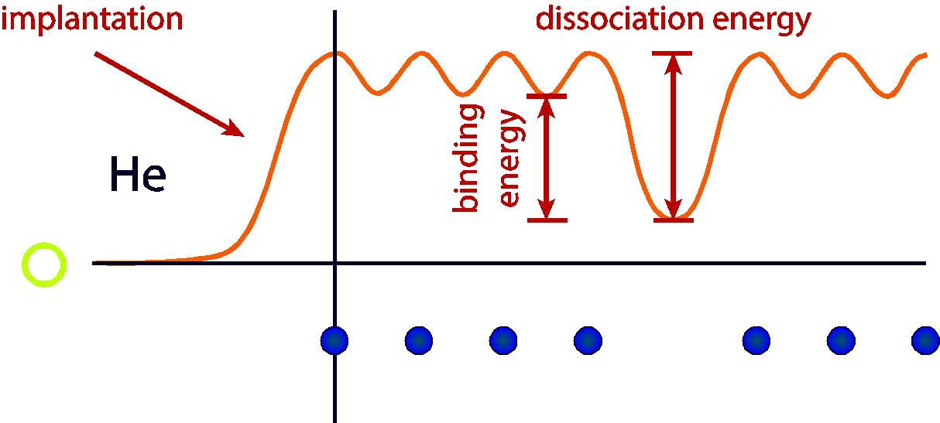
Techniques - TDS
Thermal desorption spectroscopy
Heating rate of 0,33 K/sec
Ramp anneal from 300 K up to 1500 K
Ultra high vaccum
Temperature of released helium related to the type of trap and thermal stability (He-defect binding energy)
Amount of He released associated with defect concentration

Slide 9
Experimental details

Slide 10
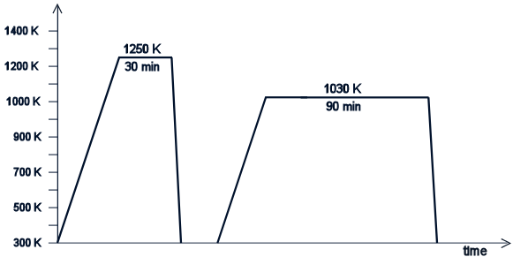
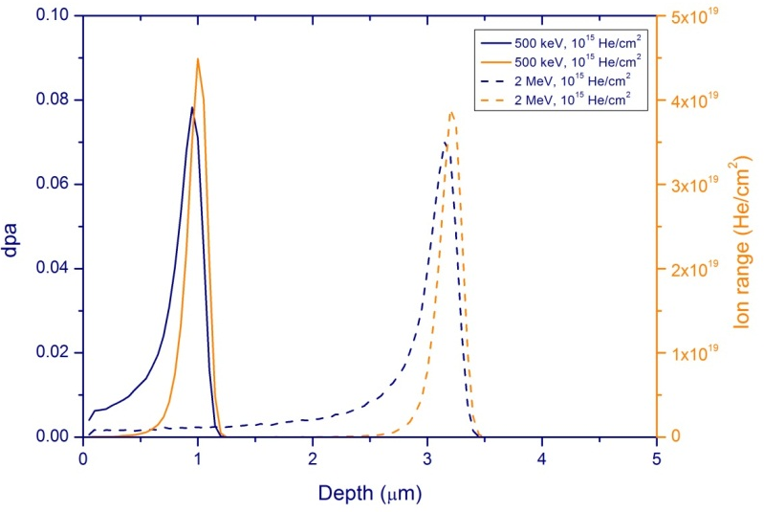
Experimental
Eurofer97 - Fe-9Cr-1W-0.2V-0.1Ta-0.1C (wt.%)
Tempered martensitic structure
Ion beam Helium implantation (RT)
    Sample size: 1.2 x 1.2 x 0.05 cm²
Measurements
    Positron annihilation DB
    TDS + in situ DB annealing
Energy | 500 keV | 2 MeV
Doses (He/cm2) | 1 x 10¹⁴-10¹⁷
Current (nA) | 270 – 280 | 120 - 212
Time (h) | 1 - 15
Dpa | 0.08 – 0.8 | 0.07 – 0.7
Ion range (µm) | ~ 1 | ~ 3
Positron range
TDS
PA
Schematics of implanted sample
TRIM calculation for 1 x 10¹⁵ He/cm²

Slide 11
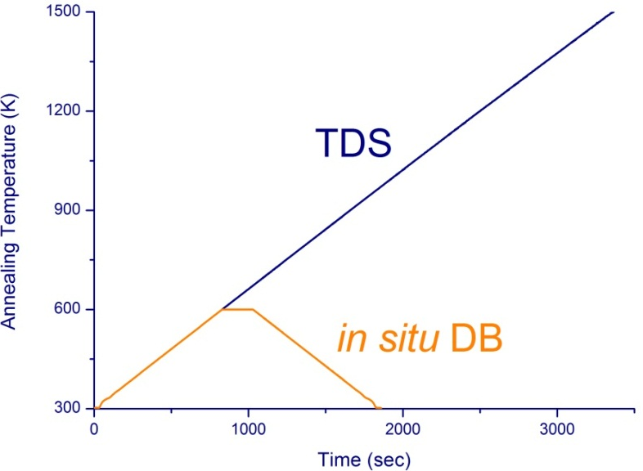
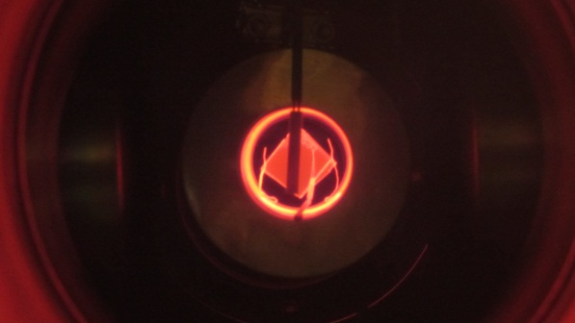
Experimental
Techniques
Thermal desorption spectroscopy
    Annealing from 300 K to 1500 K
    Heating rate of 0.33 K/sec
    Vacuum of 10⁻⁸ Torr
Positron Beam Doppler Broadening
    In situ annealing with similar annealing rate to TDS
    Annealing duration of 5 min
    Oven cooling
    Measurement at room temperature

Slide 12
Results
He implantations
500 keV & 2 MeV
RT, 10¹⁴-10¹⁷ He/cm²

Slide 13
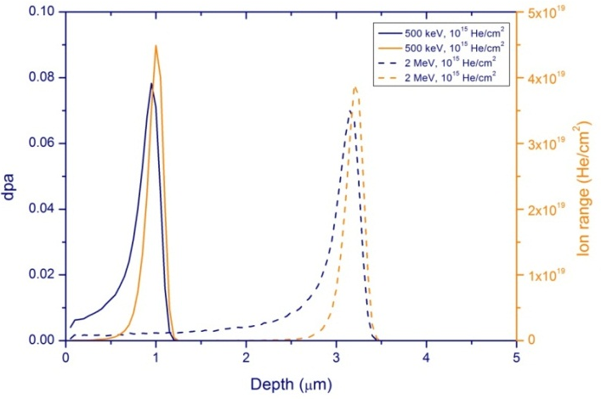
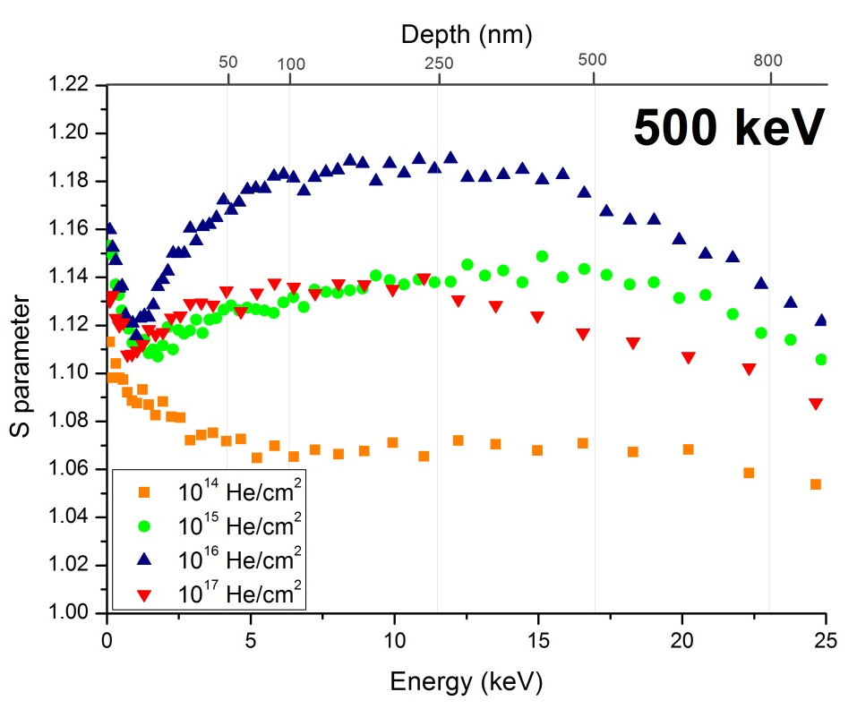
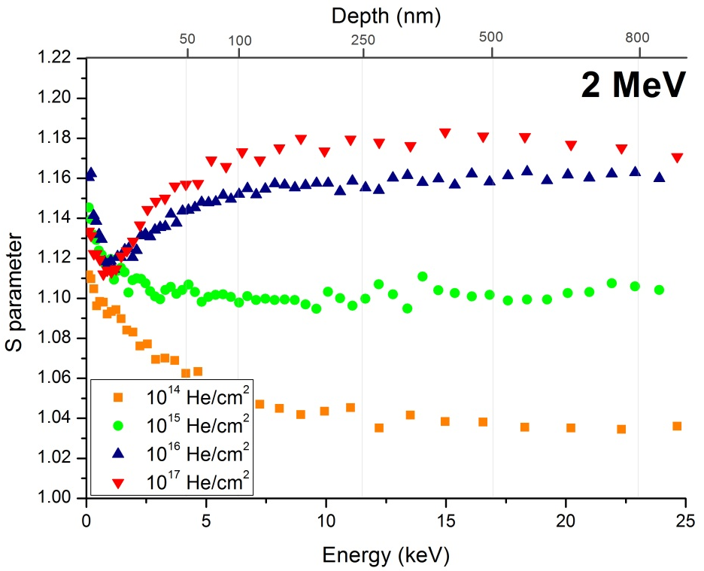
VEP
500 keV and 2 MeV, 10¹⁴⁻¹⁷ He/cm²
Positron range
 | Implantation Current (µA)
Dose (He/cm²) | 500 keV | 2 MeV
10¹⁴ | 0.12 | 0.31
10¹⁵ | 0.28 | 0.12
10¹⁶ | 0.27 | 0.21
10¹⁷ | 1.63 | 2.56

Slide 14


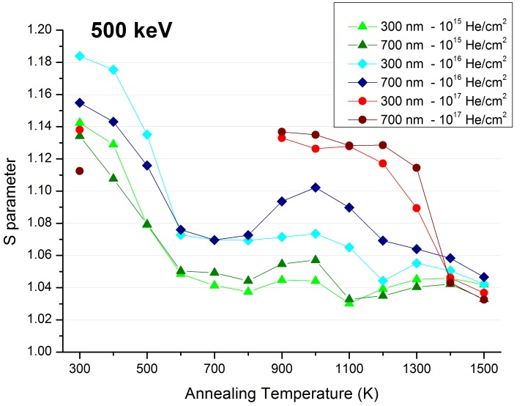
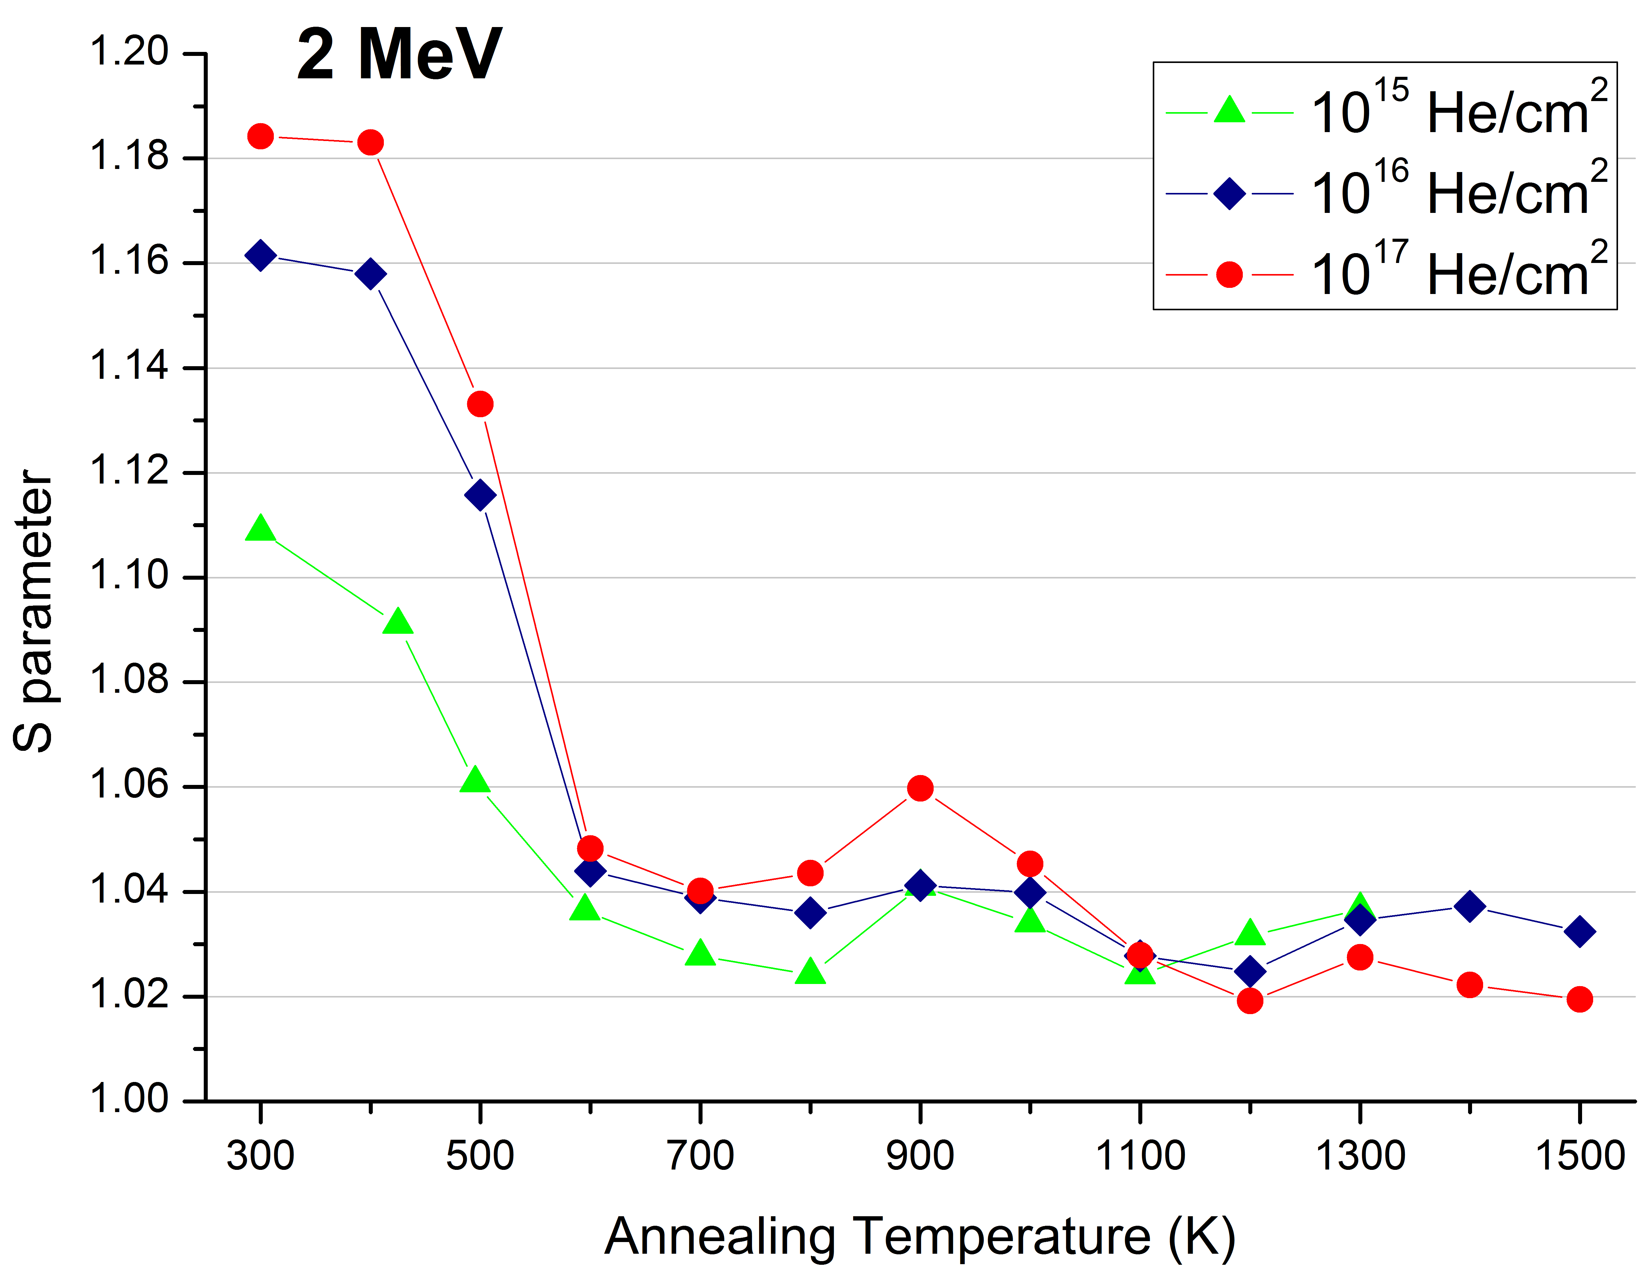
VEP - 500 keV and 2 MeV, 10¹⁴⁻¹⁷ He/cm²
Annealing study
  Increase of S parameter with increasing dose → Dose effect !!!
  Similar behaviour not only within same implantation energy but also comparing both energies
500 keV
  VEP – decrease of S for 10¹⁷ He/cm²
    Not observed in annealing study

Slide 15
TDS – 500 keV & 2 MeV
Helium release

Slide 16
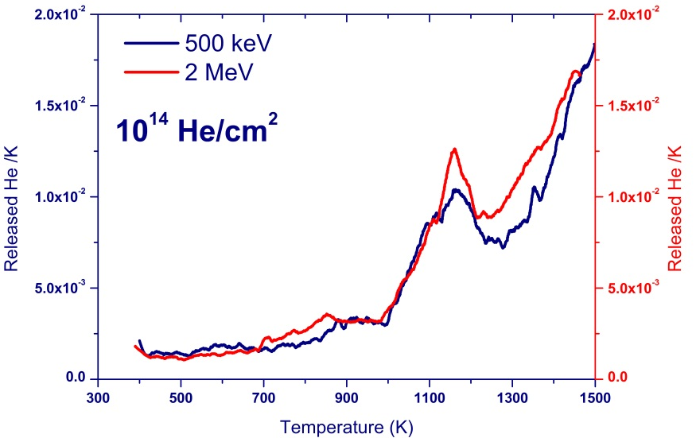
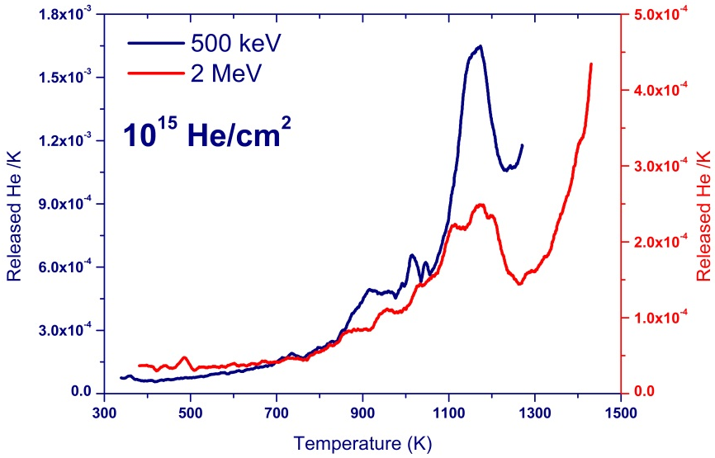
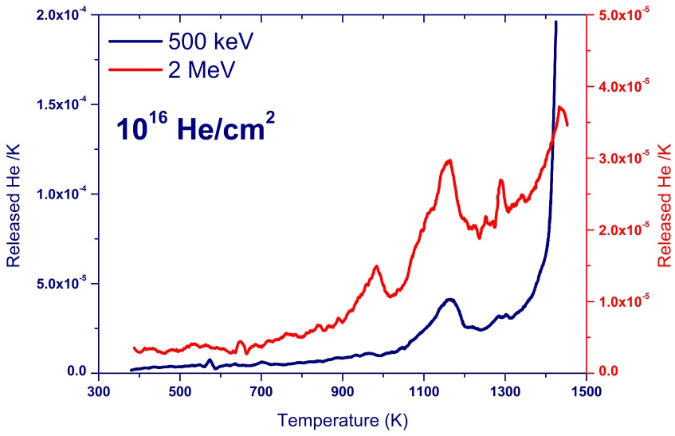
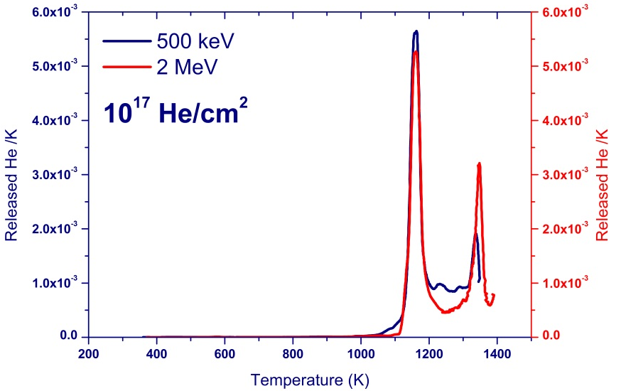
TDS – 500 keV & 2 MeV
retention: 75-110%
retention: 25-80%
retention: 2%
retention: 35%

Slide 17
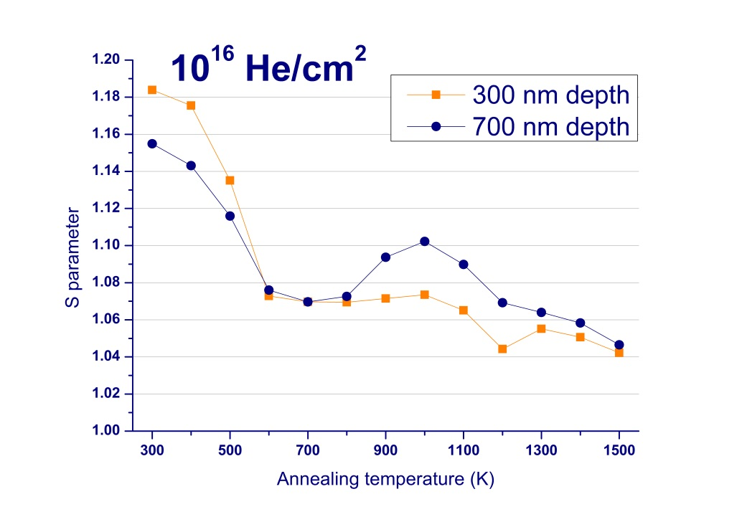
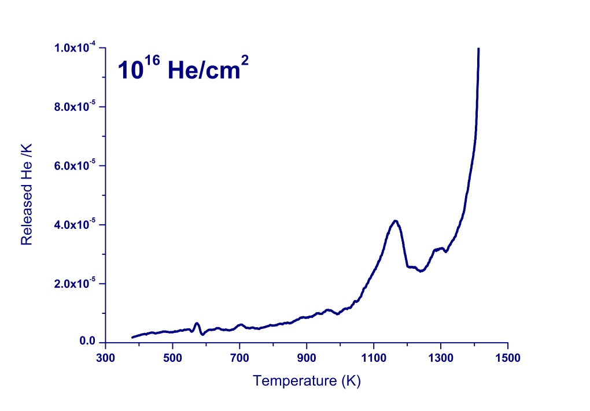
Interpretation of results
Example: 500 KeV, 10¹⁶ He/cm²
Overnight
bake out
Below 300 K
  Interstitial He is mobile below RT
300 K
  HELIUM IMPLANTATION

Slide 18
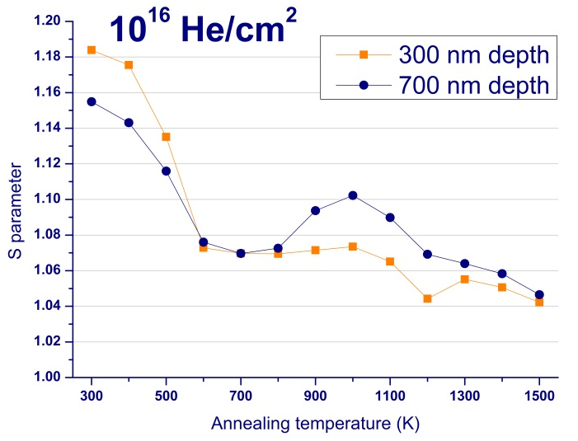
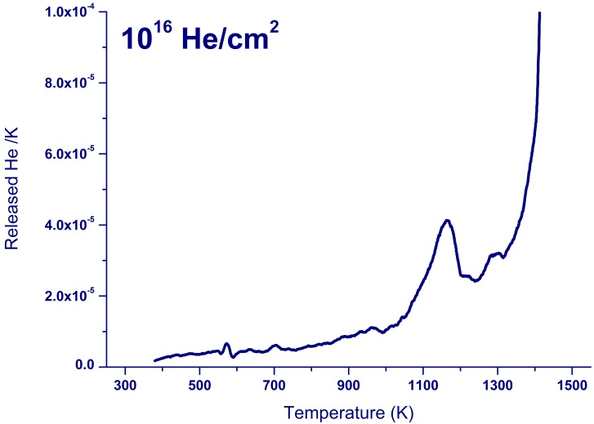
Interpretation of results
500 KeV, 10¹⁶ He/cm²
300 – 600 K
  He in substitutional position
  Vacancy assisted diffusion of He
  Annealing of vacancies and vacancies clusters
1 µm

Slide 19
Interpretation of results
500 KeV, 10¹⁶ He/cm²
600 – 800 K
  Dissociation of overpressured He_{n}V_{m} (n < m) clusters
  Possible re-trapping of He
  Formation of bigger clusters
  Stability of S level mainly due to HeV and stable He_{n}V_{m} pairs
1 µm

Slide 20
Interpretation of results
500 KeV, 10¹⁶ He/cm²
800 – 1200 K
  Ostwald ripening – formation of bubbles
  Increase of S for deeper implantation region
    Smaller diffusion length of He before retraping
  Dissociation of HeV pairs
  Phase transition of Eurofer97 (1160 K)
1 µm

Slide 21
Interpretation of results
500 KeV, 10¹⁶ He/cm²
1200 – 1500 K
  Release of He from bubbles
  Dissociation vs. Migration mechanism
1 µm

Slide 22
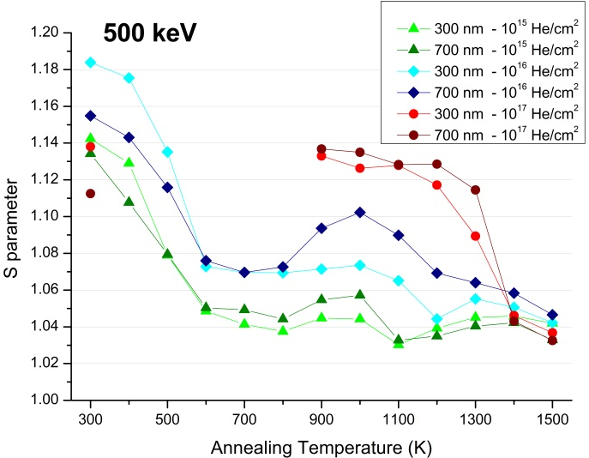
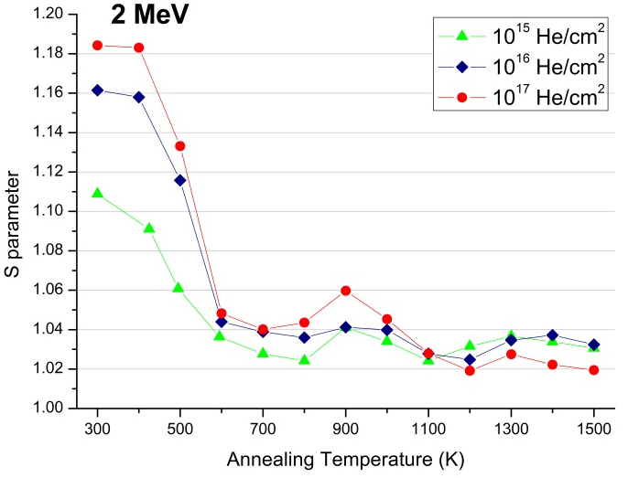


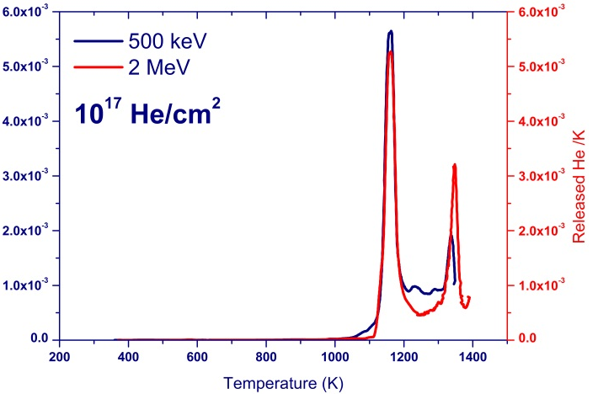
Interpretation of results
Overall picture

Slide 23
Final remarks
Higher implantation dose leads to an increase in the S parameter
    Also observed in the positron annealing study
    Repetition of implantation 500 keV, 10¹⁷ He/cm² necessary
Similar TDS spectra shape for all doses
    Increasing He release up to 1500 K
    Phase transition/HeV dissociation in the range 1100 – 1200 K
    Peak on the left of the phase transition peak
Helium release mechanisms are identified

Slide 24
Future work
Continuation of He implantations
Desorption experiments
    He implanted samples
    Neutron irradiated samples
TEM
    Neutron irradiated samples
Correlation of microstructure and mechanical properties

