Slide 1

Atomistic KMC for Fe-Cr alloys
α – α’ decomposition during thermal ageing
Radiation Induced Segregation
F. Soisson
(CEA Saclay, SRMP)
O. Senninger, E. Martinez (LANL), C.-C. Fu, M. Nastar,
Y. Bréchet (SIMAP)

Slide 2
Interaction and diffusion model for Fe-Cr alloys
magnetic properties of Fe-Cr alloys :
→ special thermodynamic properties (ordering/unmixing tendencies, asymmetrical phase diagram)
→ special diffusion properties (non-arrhenian behavior, acceleration of diffusion near T_{c})
effects on the kinetics of segregation and decomposition ?
Interaction and diffusion model :
Magnetic Cluster Expansion (M. Lavrentiev et al.)
Clear physical basis, efficient at 0K, but no diffusion of defects for the time being and difficult to handle by AKMC simulations
Alternative approach : concentration and temperature dependent pair interactions
fitted on
  - DFT calculations at 0K (ΔH_{mix} , vacancy formation and migration energies)
  - Experimental data at high temperature: T_{c} (α-α’) and diffusion coefficients
  - takes into account the magnetic transition and vibrational entropic contributions

Slide 3
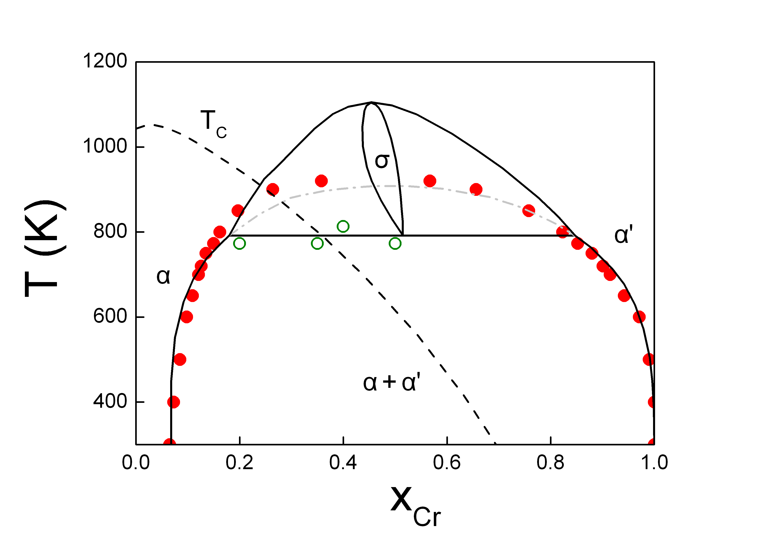
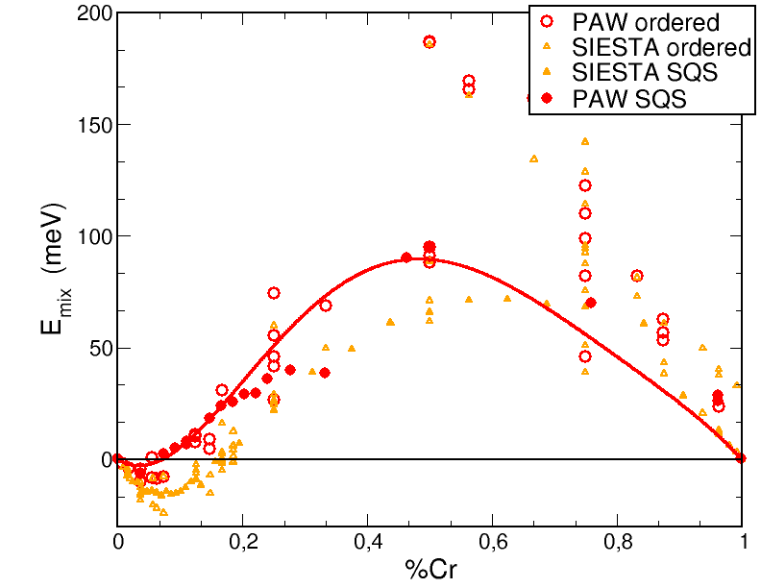
Thermodynamics properties
(Levesque et al. PRB 2011)
pair interactions on a rigid BCC lattice
- Composition dependence fitted on DFT calculations of ∆H_{mix} (SQS, PWSCF, GGA-PAW)
- A linear temperature dependence fitted on the experimental α-α’ critical temperature
Phase diagram : good agreement with the modified CALPHAD diagram (Bonny et al, 2010)
-> asymmetrical miscibility gap, non-vanishing Cr solubility at low T

Slide 4
Diffusion properties : dilute alloys
(Senninger et al. 2012)
at 0K : DFT calculations of vacancy migration barriers in ferromagnetic iron and non-magnetic chromium -> saddle-point interactions
acceleration at the ferro-paramagnetic transition in the α phase -> corrections of the migration barriers, fitted on experimental tracer and interdiffusion coefficients
tracer diffusion coefficients
in iron in chromium
strong acceleration of the diffusion at T_{c}
T_{c} decreases with the Cr concentration

Slide 5
Diffusion properties: concentrated alloys
The interdiffusion coefficients strongly decrease with the Cr content: may explain the small effect of the composition on the decomposition kinetics
Its important to take into account the real vacancy concentration
[1] Braun & Feller-Kniepmeier, 1985
[2] Jönsson 1995
~

Slide 6
Diffusion properties: concentrated alloys
The interdiffusion coefficients strongly decrease with the Cr content: may explain the small effect of the composition on the decomposition kinetics
Its important to take into account the real vacancy concentration
[1] Braun & Feller-Kniepmeier, 1985
[2] Jönsson 1995

Slide 7
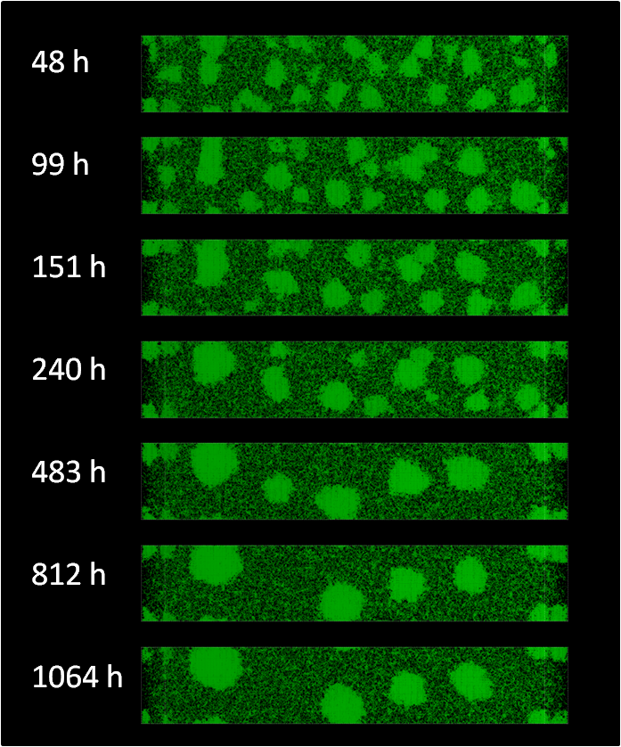
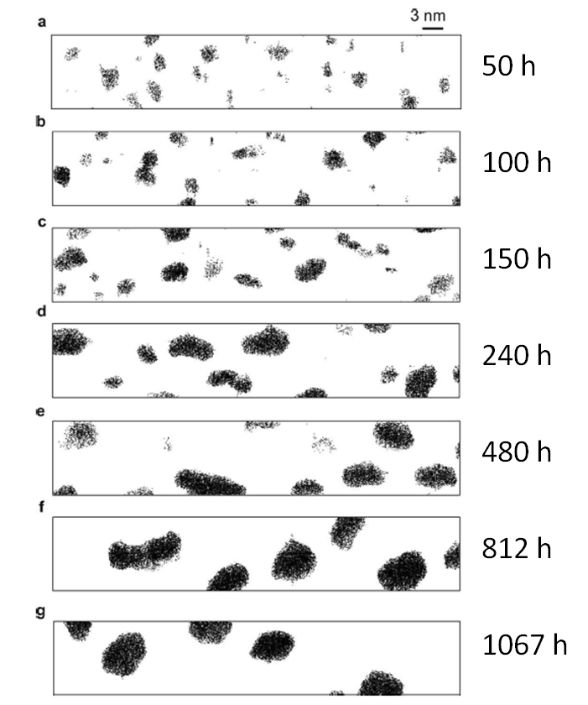
AKMC: α-α’ decomposition during thermal ageing
Fe-20%Cr T = 500°C
AKMC (E. Martinez, O. Senninger, CEA) 3D atom probe (Novy et al, GPM Rouen, 2009)

Slide 8
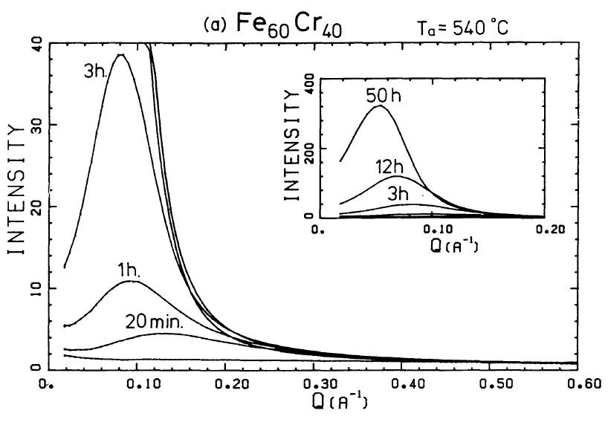
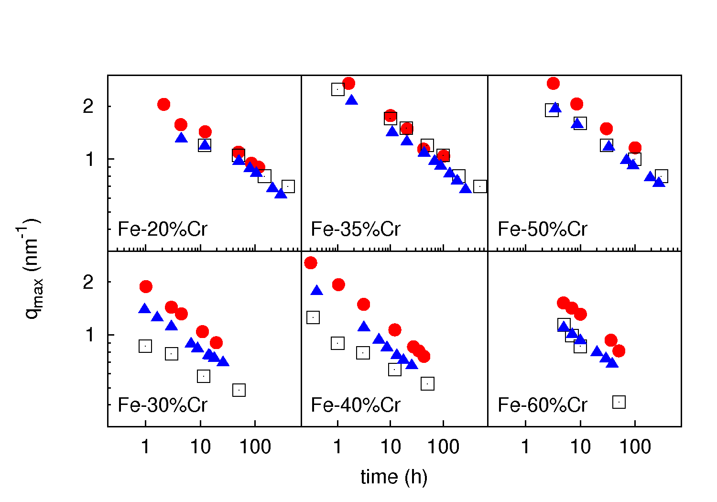
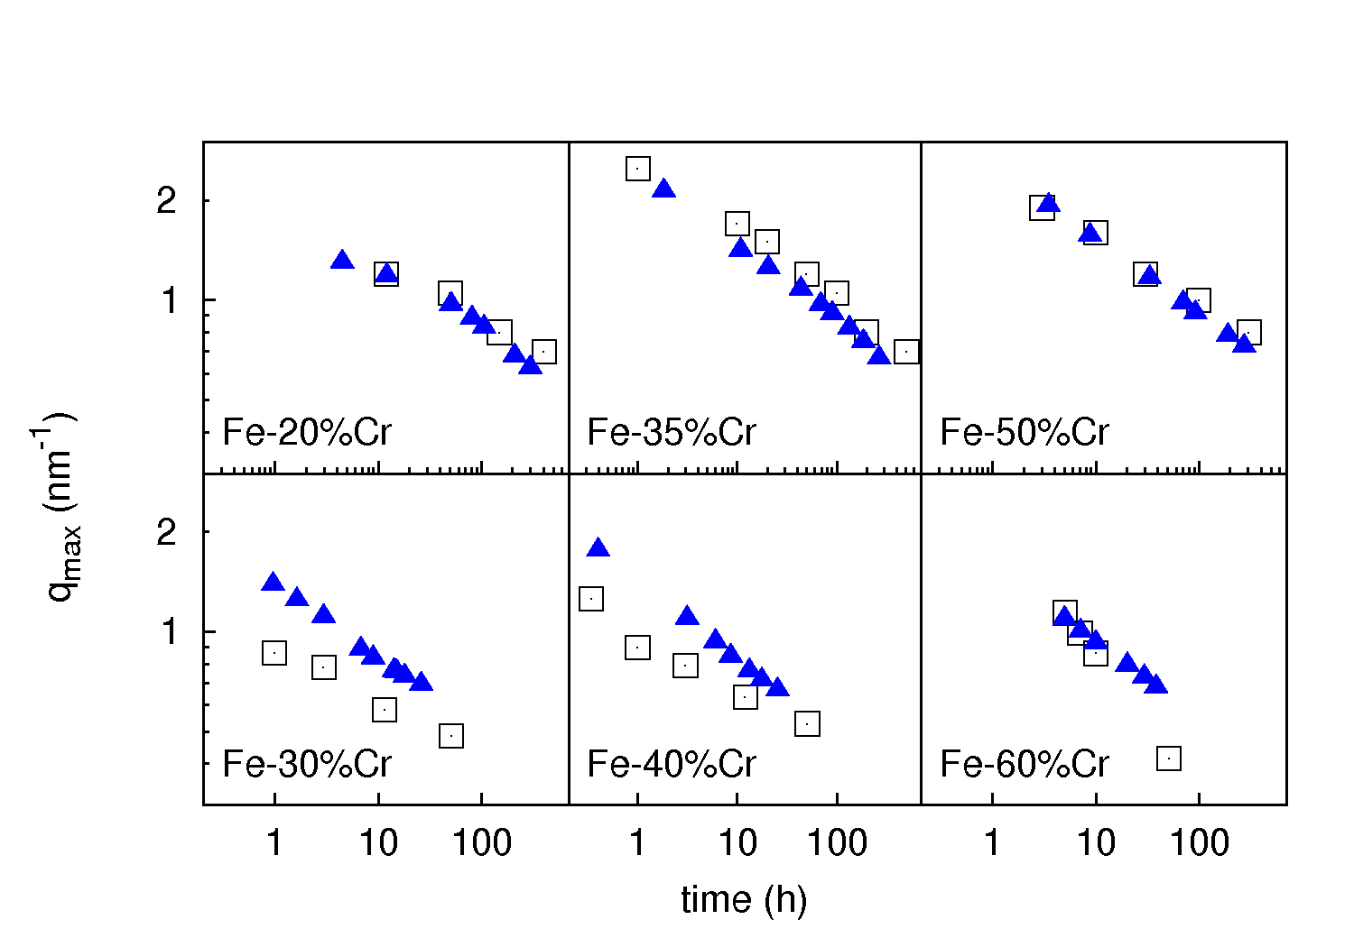
Kinetics of α-α’ decomposition: AKMC vs SANS
Small Angle Neutron Scattering experiments :
500°C: Bley (1992)
540°C: Furusaka et al. (1986)
- F/P transition : strong acceleration of the decomposition between above 35% Cr (lower T_{C})
- better agreement with experimental kinetics
500°C
540°C
□ SANS experiments
❐ AKMC simulations
 AKMC simulations without magnetic correction

Slide 9
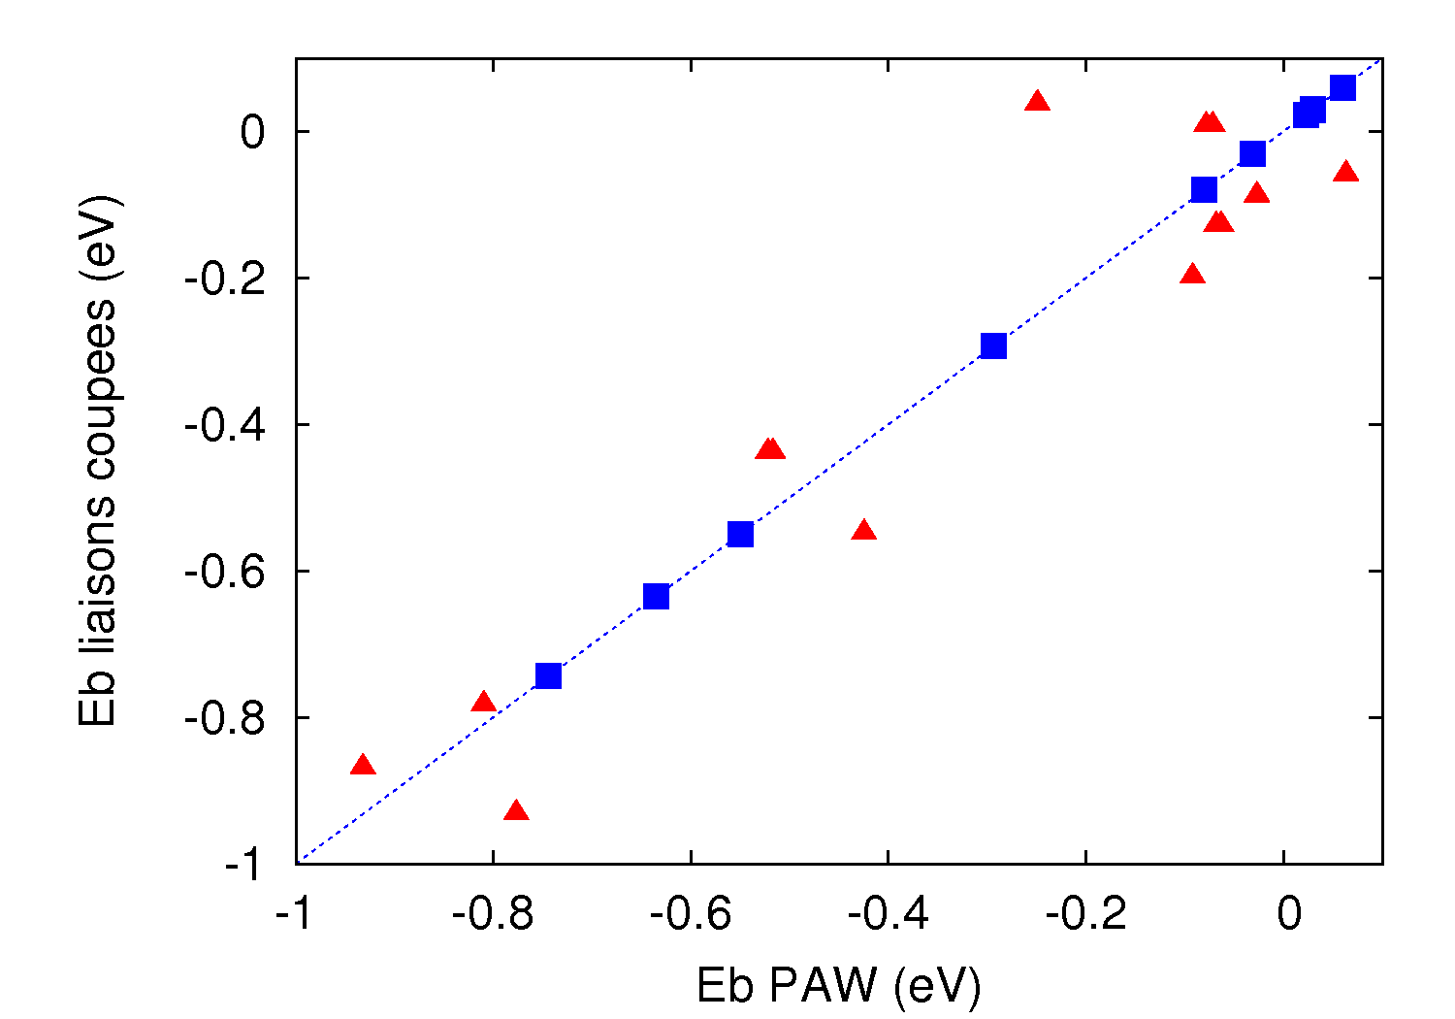
Under irradiation: self-interstitial properties
DFT calculations (PWSCF-GGA-PAW)
- in Fe-rich ferromagnetic configurations
Fe-Fe dumbbell 110 more stable than 111 (ΔE_{for} ≈ 0.7 eV)
weak Cr-dumbbell interactions
- in Cr-rich AFM configurations:
Cr-Cr dumbbell 110 slightly more stable than 111
very strong Fe-dumbbell attraction (ΔE_{for} ≈ 0.1 eV)
- SIA migration barriers
Integration in AKMC:
<110> dumbbells
Dilute Fe-Cr configurations
Measurements of L_{ij}  Radiation Induced Segregation
E_{bin} AKMC (eV)
E_{bin} DFT (eV)

Slide 10
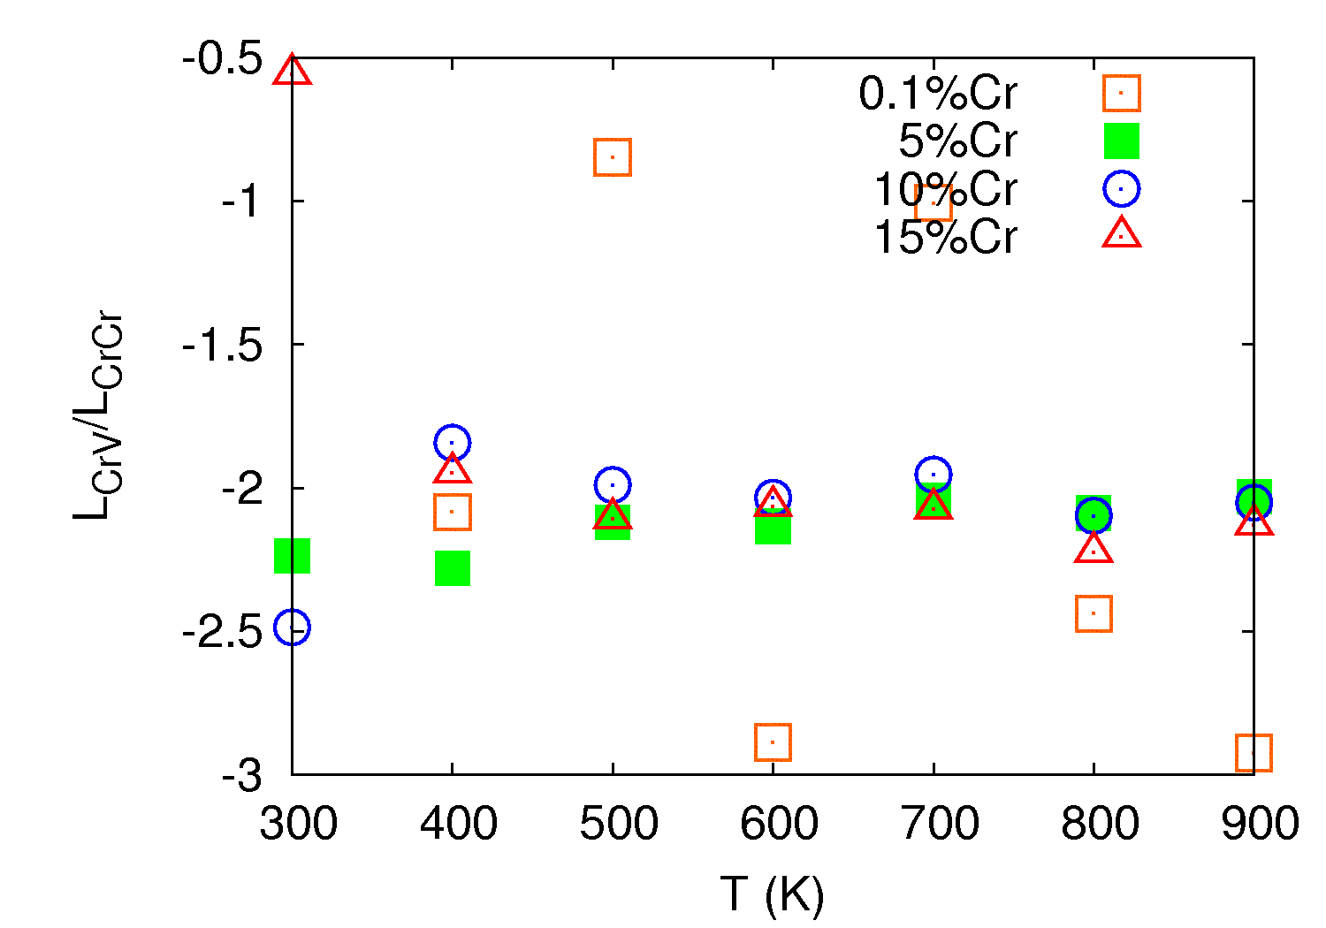
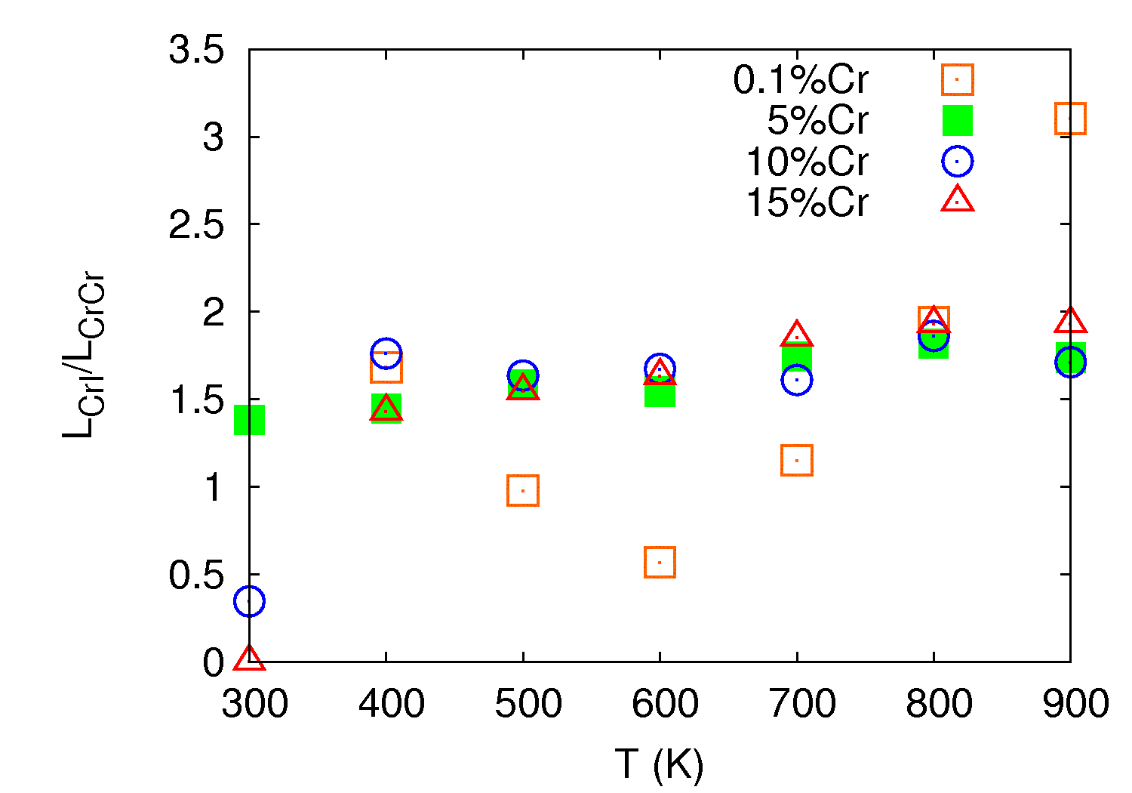
AKMC : measurements of Onsager coefficients
The coupling between fluxes of point defects and the flux of solute is controlled by the Onsager coefficients :
L_{Cr-V} < 0 L_{Cr-SIA} > 0
-> Cr depletion at sinks -> Cr enrichment at sinks
No significant effect of the Cr content

Slide 11
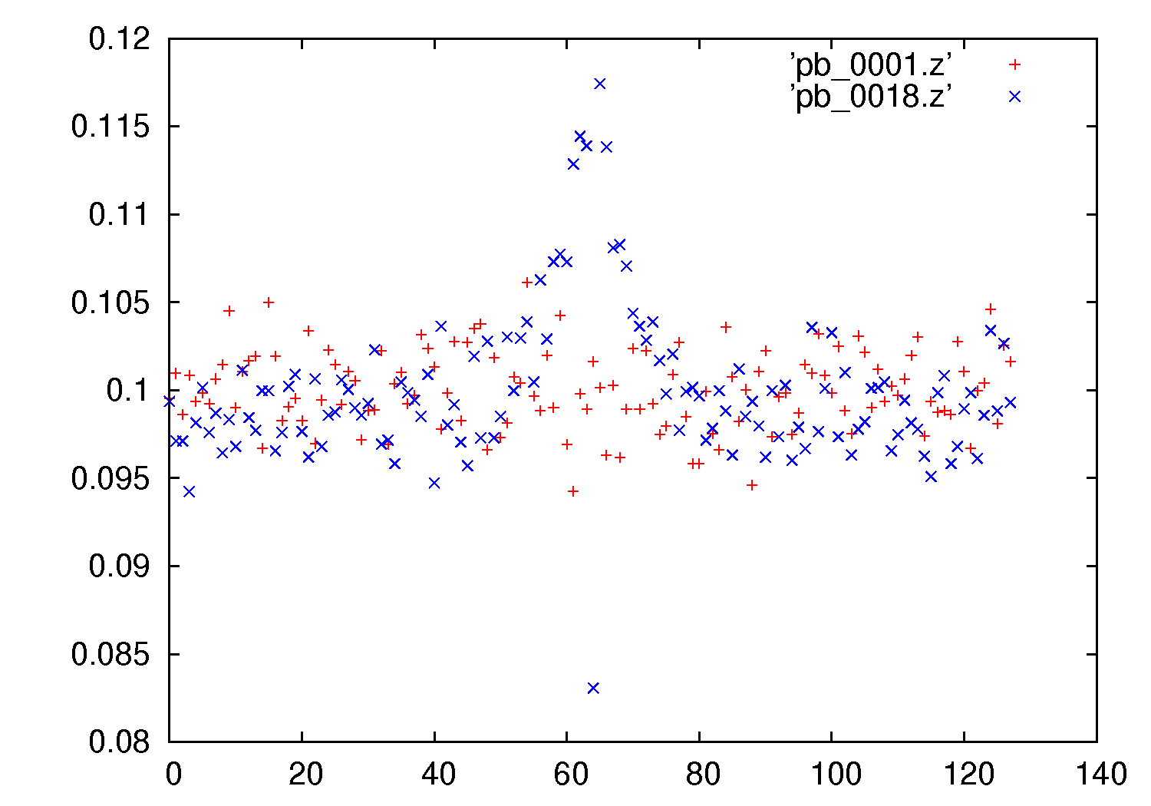
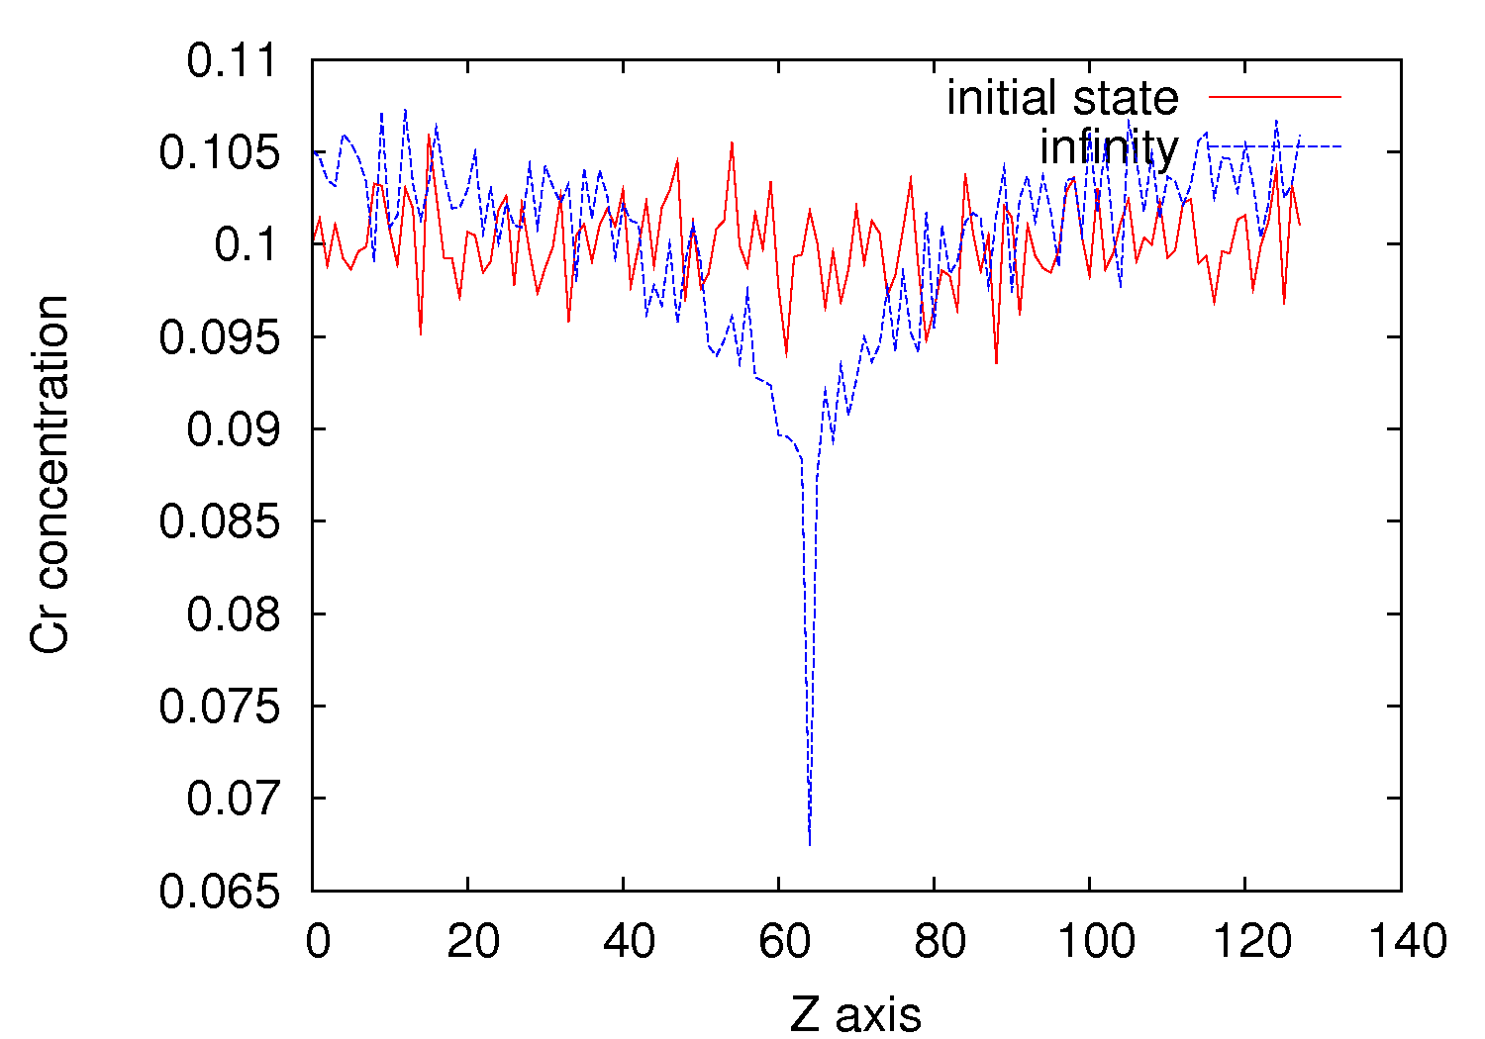
AKMC : simulations of radiation induced segregation
Evolution of the Cr concentration profiles at a grain boundary
Fe-10at%Cr
2 x 10⁻³ dpa/s
T = 650 K T = 850 K
different behaviors, depending on the temperature and the dose/rate, but…
initial state
steady-state
%Cr
%Cr
Atomic plane
Atomic plane

Slide 12
SIA migrations barriers
AKMC vs DFT migration (110 dumbbells):
The diffusion model must be improved, especially for SIA migration barriers in non-dilute configurations

Slide 13
Conclusions
A model with composition and temperature dependant pair interactions on rigid lattice:
gives reasonable thermodynamic and diffusion properties
kinetics of decomposition in good agreement with experimental results
take into account the effect of the F/P magnetic transition
Alloys under irradiation – the description of SIAs must be improved
A phenomenological model :
- lack experimental data at low T and in the Cr rich phase
- ad hoc corrections of the migration barriers only
- probably an effect of the F/P transition on the formation energies too
… A more physical model (with interactions between magnetic moments) would provide more information

Slide 14
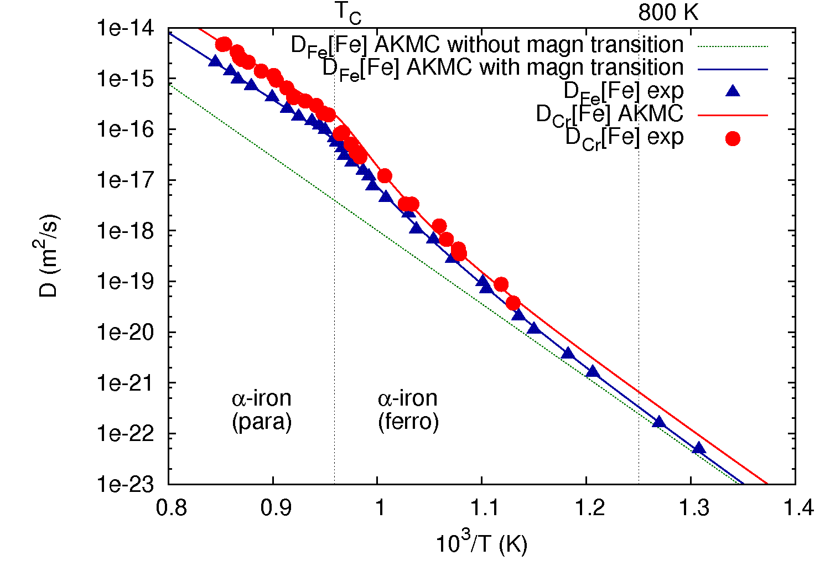
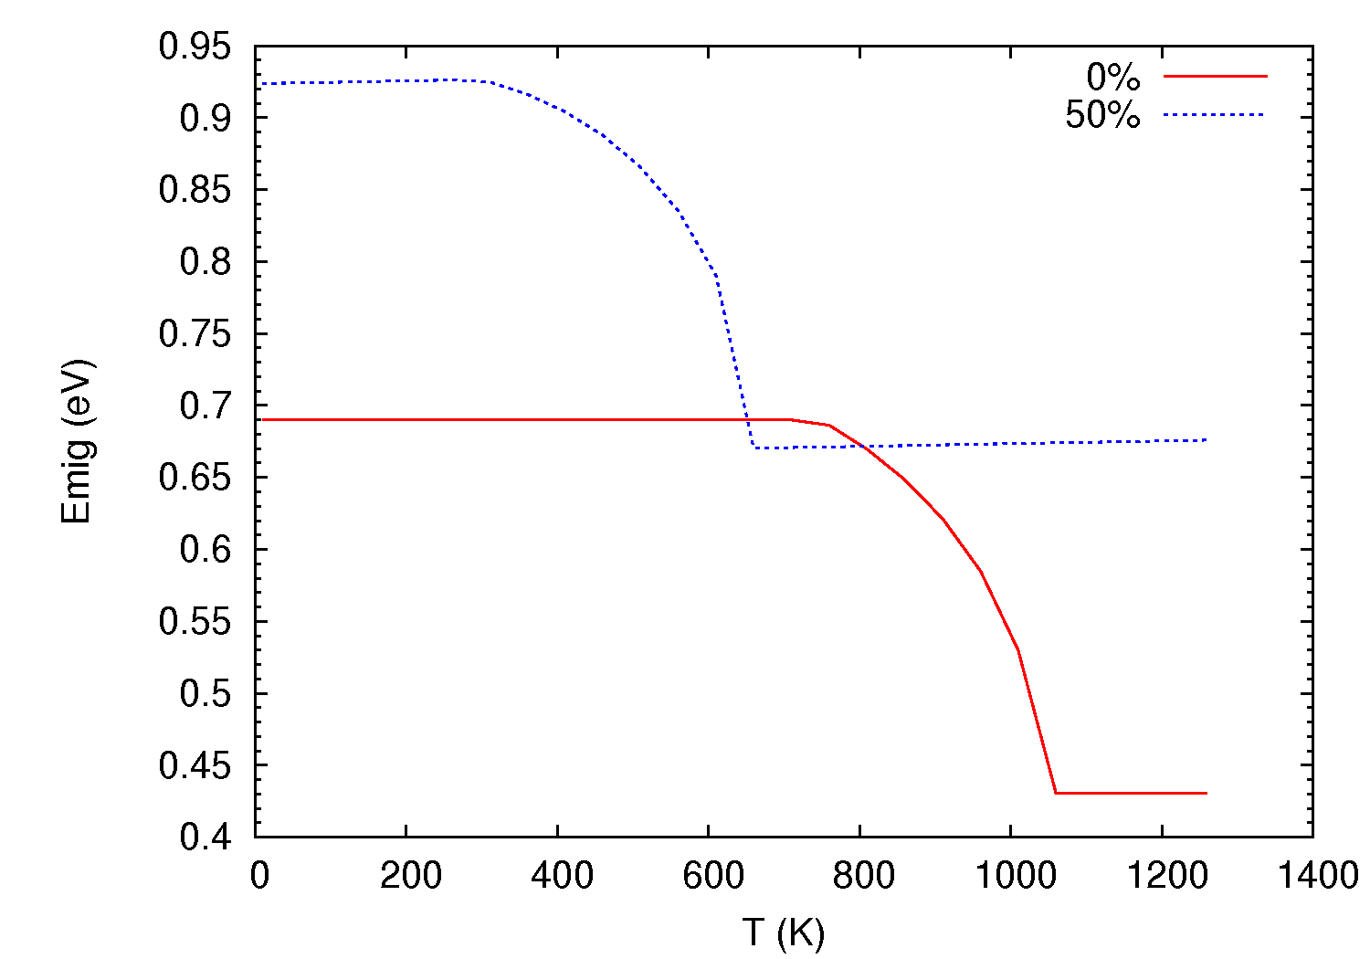
  Acceleration of the diffusion at the ferro-to-paramagnetic transition
  T c = 1043 K in pure Fe, decreases with %Cr
  → introduction of an empirical correction on the migration barriers
  fitted on:
  - tracer diffusion coefficients in pure iron
  - concentration dependence of T_{c}
  - tracer diffusion coefficients at 50%wt Cr

