Slide 1
Liquid metal corrosion
Massimo Angiolini, Alessandro Gessi, Massimo Celino
4th Workshop on Nuclear Fe Alloys: Modeling and Experiment
University of Edinburgh, Scotland
4th and 5th June 2013
ENEA
Lungotevere Thaon di Revel, 76
00196 ROMA Italia

Slide 2
Introduction
Lead and Lead–Bismuth Eutectic (LBE) have been proposed as candidate coolant materials for one class of the next generation nuclear reactors. They can also be used as both coolants and neutron spallation sources in the Accelerator Driven Systems
low reactivity
Lead is inert with respect to water, concrete etc.
low vapor pressure
Boiling temperature above melting point of the structural materials
low viscosity
good gamma shielding
and high neutron yield
Large density change with temperature
decay heat removal by natural circulation

Slide 3
Introduction
Lead and LBE at high temperature are very corrosive towards steels
Compatibility of material with liquid lead is a key problem and represents the main issue in the development of lead and LBE-cooled systems.
Corrosion in liquid lead follows two main processes depending on the concentration of oxygen dissolved in the melt:
dissolution of the steel constitutive elements (preferential dissolution of some elements)
reaction of the steel constitutive elements with the dissolved oxygen with the formation of an outer oxide scale not stable/internal oxidation
Surface oxidation can be used to protect the steel from dissolution (Active Oxygen Control): maintaining a low level of oxygen in the liquid lead allow the formation of a protective oxide layer on the steel surface thus eliminating the direct contact between the steel and liquid lead
Active Oxygen Control was found to work at relatively low temperatures but for temperatures above 500°severe corrosion attack are observed both in austenitic and F/M steels with the formation of thick oxide layers, which may spall off periodically leaving the steel surface exposed to the coolant
Additional protection methods must be adopted to protect the parts of the reactor that operate at high temperature (cladding, spacers etc.)
A better understanding of the corrosion mechanisms could lead to improve control of corrosion and the steel performance

Slide 4
Introduction
In this context we propose the development of a model for the corrosion damage evolution for steels exposed to liquid lead
Development of reliable models of the system by using atomic-scale simulations, via classical or first-principle molecular dynamics techniques
Use of transmission Electron Microscopy and Scanning Helium Ion Microscopy to gain microstructural information's at atomic level

Slide 5
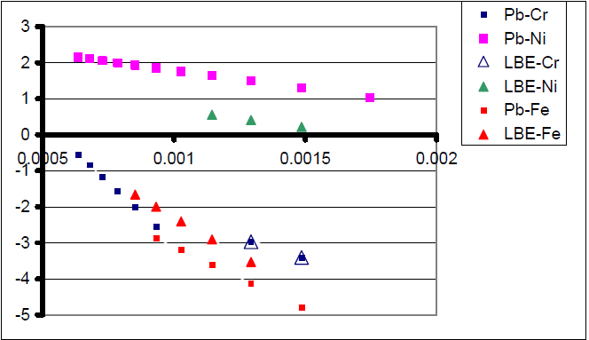
Solubility and diffusivity data in liquid Pb and LBE
Solubility data of iron in liquid Pb, Bi and LBE
Solubility data of Fe, Cr, Ni in liquid Pb and LBE
https://www.oecd-nea.org/science/reports/2007/nea6195-handbook.html

Slide 6
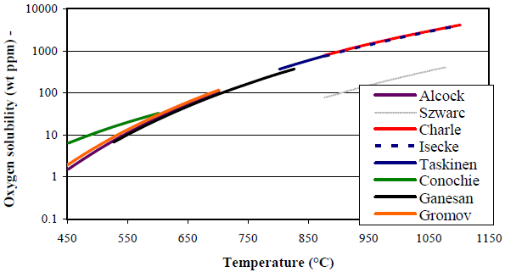
Solubility and diffusivity data in liquid Pb and LBE
Data of oxygen solubility in lead [1982]
Oxygen solubility in liquid lead
obtained by electrochemical techniques at high temperature (2006)
https://www.oecd-nea.org/science/reports/2007/nea6195-handbook.html

Slide 7
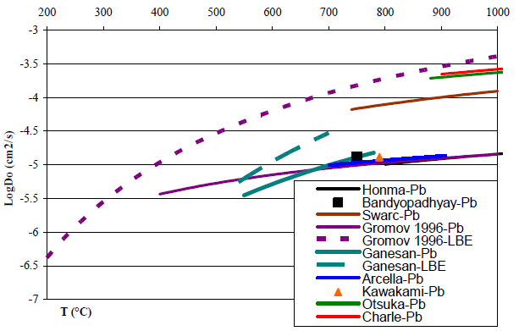
Solubility and diffusivity data in liquid Pb and LBE
Iron diffusion coefficient in pure Pb and eutectic Pb-Bi (best fit 3 experimental points)
Oxygen diffusion coefficient in liquid lead and lead-bismuth
https://www.oecd-nea.org/science/reports/2007/nea6195-handbook.html

Slide 8
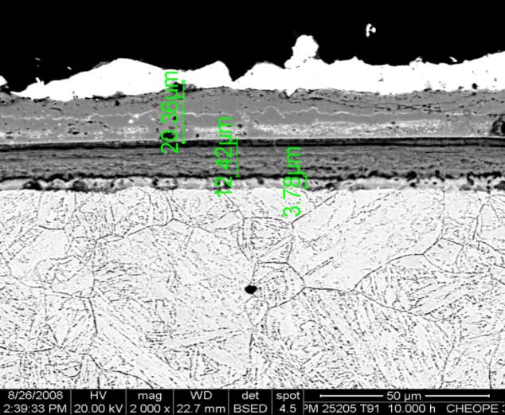
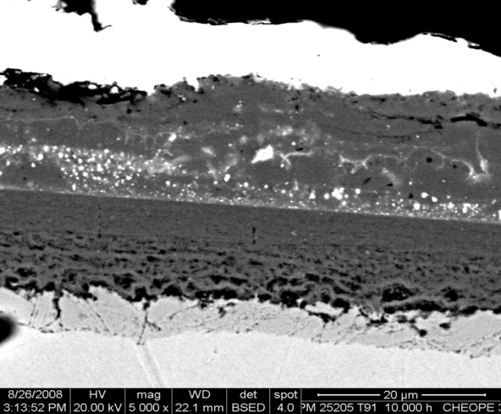
SEM Microstructural characterization
T91 exposed to Pb, 10.000 hours of experiments, 500°C, Oxygen 10⁻⁶wt%. Weak, thick, quickly formed oxide scales, easily eroded by HLM flux.
Alessandro Gessi, Mariano Tarantino, Pietro Agostini Matgen IV School, Santa Teresa, 21/9/2011

Slide 9
SEM Microstructural characterization
AISI 316L specimens exposed for 2000 h in pure Pb, CHEOPE III
Alessandro Gessi, Gianluca Benamati Journal of Nuclear Materials 376 (2008) 269–273

Slide 10
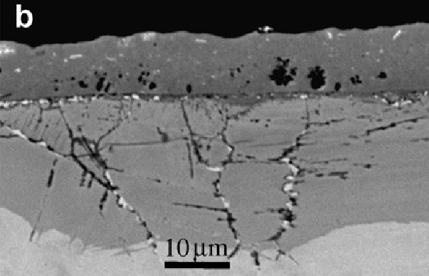
SEM Microstructural characterization
SEM image of the D9 after (a) 1000 h and (b) 3000 h exposure to LBE
P. Hosemann et al. Journal of Nuclear Materials 375 (2008) 323–330

Slide 11
Solubility and diffusivity values in liquid Pb and LBE
Discrepancies regarding the solubility data for oxygen and to a lesser extent for iron
Only a few data for the diffusion coefficients of metallic elements in liquid lead and lead bismuth are available
The iron diffusion coefficient in Pb and Pb-Bi is known at only three temperatures
There is a significant scatter of the different values of oxygen diffusion coefficient except in the 600-700°C temperature range
No information's about compounds among the atomic species involved and/or contaminants
Few information's about the microstructure: thickness of the oxidized regions and EDX concentrations profiles

Slide 12
Molecular modeling
www.afs.enea.it/project/cmast
Molecular dynamics simulation will be used to:
Develop reliable models of liquid atomic scale structure of Pb and its alloys with low percentage of O, Cr, Ni, Fe etc.
Characterize the liquid phase by computing:
coordination number
radial distribution function
diffusion coefficient
activation energy
structure factor
specific heat coefficient
formation energy of aggregates and clusters
etc
Characterize the interface between liquid and selected surfaces (adhesion energy, defect energy, atomic structures near the surface, chemical bonding, etc.).
Fit parameters from ab-initio modeling to develop classical interatomic potential for multiscale modeling
Molecular dynamics codes
Classical:
Home-made code (second-moment empirical tight-binding)
LAMMPS
DL_POLY
Ab-initio:
CPMD (Car-Parrinello Molecular Dynamics)
QE (Quantum Expresso)
PCGamess
Computational infrastructure
ENEA-GRID infrastructure based on distributed computational environment. The GRID contains: the high performance parallel computing CRESCO platform, grid services for collaborative work, databases, etc.
www.cresco.enea.it
Critical evaluation of the available experimental data

Slide 13
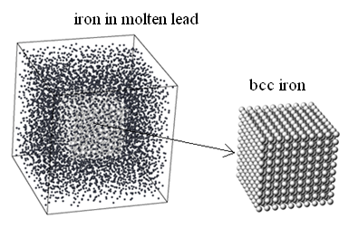
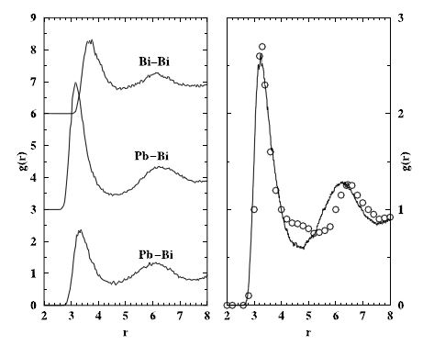
Molecular modeling
www.afs.enea.it/project/cmast
Atomic scale modeling of materials via classical or ab-initio molecular dynamics approaches
Liquid Lead and Lead–Bismuth Eutectic (LBE) characterization
Iron corrosion in liquid Lead
Pb-Pb
M.Celino, R.Conversano, V.Rosato, “Atomistic simulation of liquid lead and lead-bismuth eutectic”, J. Nuclear Materials 301 (2002) 64-69
A.Arkundato, Z.Suud, M.Abdullah, W.Sutrisno, M.Celino, “Numerical study: iron corrosion-resistance in lead-bismuth eutectic coolant by molecular dynamics method”, Int. Conf. on Advances in Nuclear Science and Engineering ICANSE2011, AIP Conference Proceedings 1448 (2012) 155-163
A.Arkundato, Z.Suud, M.Abdullah, W.Sutrisno, M.Celino, “Molecular dynamics simulation of iron corrosion-reduction in high temperature molten lead using oxygen injection”, submitted

Slide 14
Microstructural investigations in support of modeling
To this date, high resolution investigations of the microstructural details of lead corrosion are scarce
TEM investigations provide a better description and understanding of the observed microstructure which will help in modeling the oxidation/erosion mechanism
Diffraction contrast, EDX, EELS, Microdiffraction, HRTEM
Phase changes due to dissolution of alloy components: for example formation of ferritic regions on austenitic steel due to dissolution of Ni
Small voids/pores at the interface metal oxide layer or between the layers of the duplex oxide scale (inner Fe_{2.3}Cr_{0.7}O₄ spinel layer and an upper magnetite layer)
Small voids/pores in the steel due to dissolution of alloy components
Microstructural details of the oxide scales
Structure of the internal oxidation zone

Slide 15
Microstructural investigations in support of modeling
Scanning He-Ions Microscopy will be used to provide images with a resolution of few angstroms on a larger scale and on bulk samples
We will consider in our study 15-15 Ti and 316 austenitic steels that are at present the candidate materials for the realization of liquid lead fast reactors
Investigations will be carried out on cross sectional samples of steel exposed to liquid lead varying:
Temperature
Oxygen content of the melt
Time

Slide 16
Thank you for your
kind attention

