Slide 1

ENEA GRID &
JPNM WEB PORTAL
Italian National Agency for New Technologies,
Energy and Sustainable Economic Development
to create a collaborative development environment
Dr. Simonetta Pagnutti
JPNM – SP4 Meeting
Edinburgh – June 3rd, 2013

Slide 2
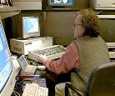
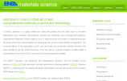
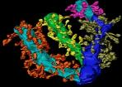
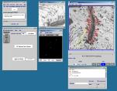
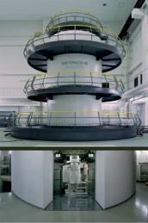
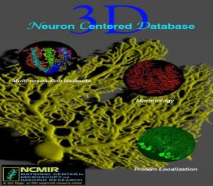
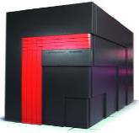
ENEA GRID INFRASTRUCTURE
DATA ACQUISITION AND REMOTE CONTROL
ADVANCED
COMPUTER
GRAPHICS
THEMATIC
WEB PORTALS
DATA ANALYSIS
AND SIMULATION
NETWORK
Cell Centered Data Base
“CCDB”
REMOTE
INSTRUMENTS
COMPUTATIONAL
RESOURCES
MULTI-SCALE
DATABASES

Slide 3
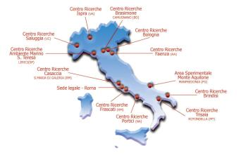





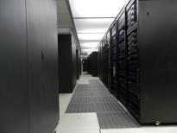

ENEA-GRID/CRESCO HPC infrastructure
ENEA-GRID is the infrastructure integrating all the scientific computing resources of ENEA, distributed over 6 research sites.
The most relevant systems are the CRESCO clusters
in Portici (~5000 cores, 400 TB storage, Linux) recently updated (CRESCO3, 2000 cores, 20 TFlops)
ENE
More than100 users, for applications in various domains: fluid-dynamics, combustion, climatology, nuclear science and technology (fission, fusion), bio-informatics, computational chemistry and more!
Second half of 2013 a new cluster CRESCO4 will provide a performances increase of a factor 5 up to ~100 TFlops.
The infrastructure is managed and developed by ENEA/UTICT department.
www.cresco.enea.it

Slide 4
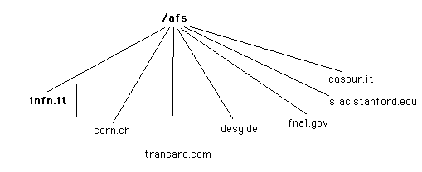
AFS Andrew File System
AFS ==> a distributed, networked file system that enables efficient
file sharing between clients and servers.
Features and benefits
  File sharing — easily and securely share documents and files over the network
  with colleagues, workgroups, and other institutions.
  File access — easily and securely access your files from other computers.
File security — files are protected by an efficient authentication system.

Slide 5
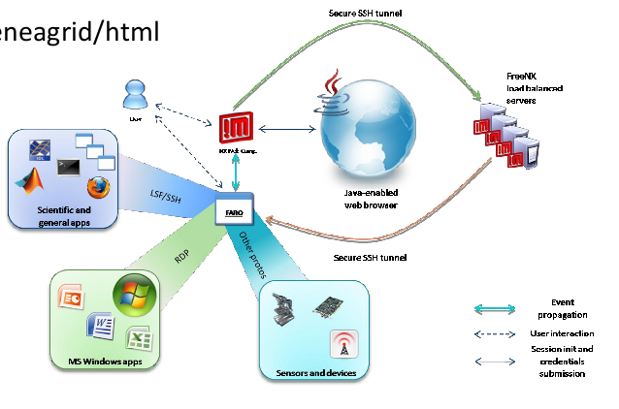
FARO – Fast Access to Remote Objects
FARO allows web access to ENEA-GRID resources in a fast, secure and reliable way.
researchers need only
a web browser
every remote
resource
(from Xterm
to remote Windows
desktops) will be
reachable

Slide 6
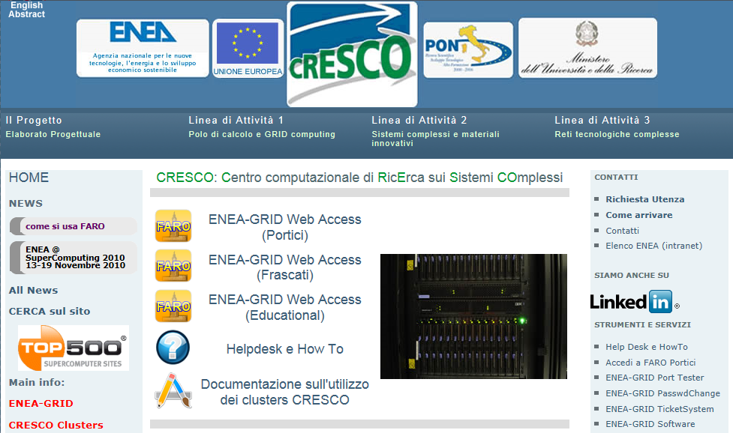
Web link http://www.cresco.enea.it/

Slide 7
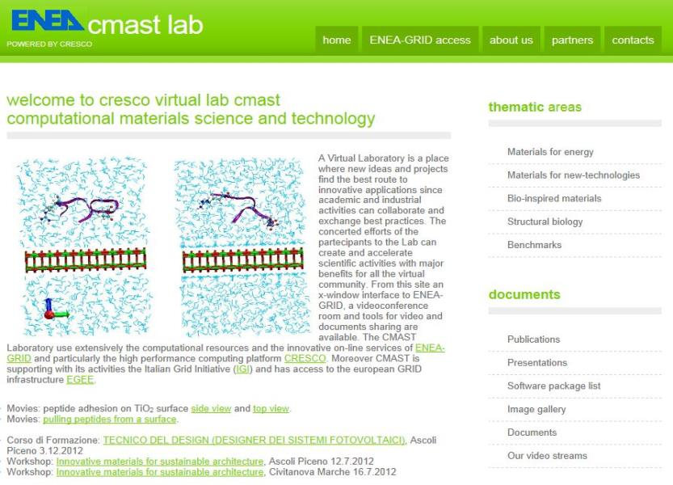
CMAST Virtual Lab home page
www.afs.enea.it/project/cmast

Slide 8
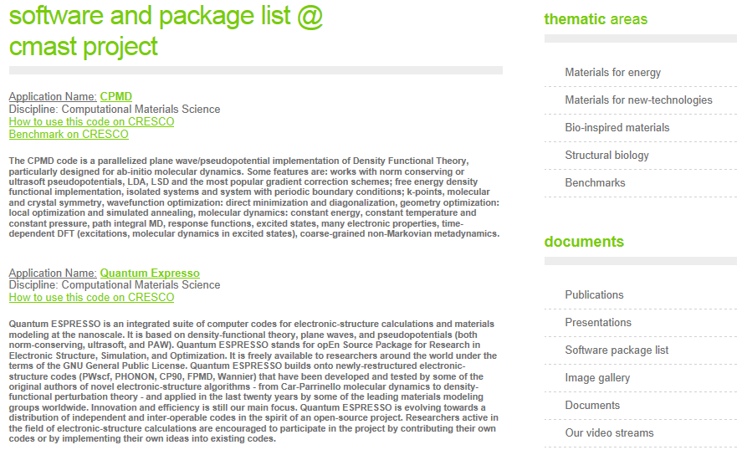

ENEA GRID & JPNM WEB PORTAL
JPNM – SP4 Meeting :: Edinburgh – June 3rd, 2013

Slide 9
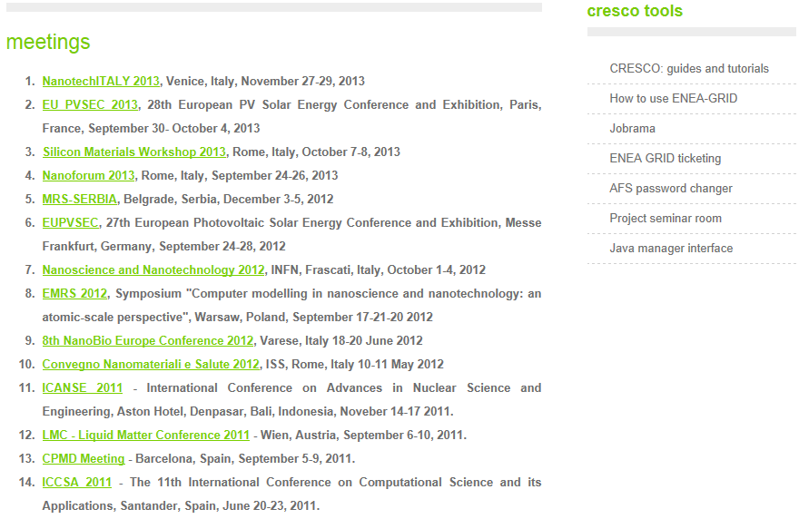
Links to :
View docs about CRESCO
View most used commands on CRESCO
View the status of the GRID
Report problems to system admin
Access to the conference room
Exchange data between local and
remote systems
ENEA GRID & JPNM WEB PORTAL
JPNM – SP4 Meeting :: Edinburgh – June 3rd, 2013

Slide 10
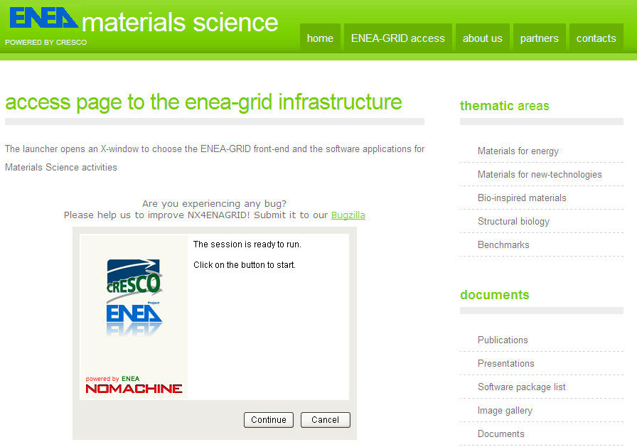
ENEA GRID & JPNM WEB PORTAL
JPNM – SP4 Meeting :: Edinburgh – June 3rd, 2013

Slide 11
Web based tool for remote real-time experiment sharing
Main features
visualization of the local machine desktop and laboratory webcams carried out by the use of streamers based on Flash technology
instrumentation remote control commands transferred through USB pads, which execute commands by communicating via the TCP-IP protocol with the remote control system.
chat based session (with video and audio interface) to interact with local technical personnel.
instrumentation and systems “remotized” through a local-bridge machine added to the laboratory LAN.
ENEA GRID & JPNM WEB PORTAL
JPNM – SP4 Meeting :: Edinburgh – June 3rd, 2013

Slide 12
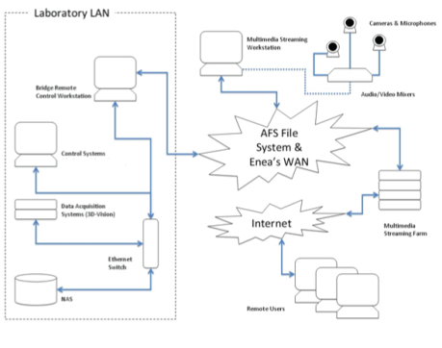
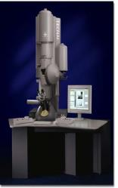
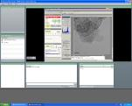
Web based tool for remote real-time experimentation sharing
Example Tele - microscopy:
CR ENEA Brindisi Transmission Electron Microscope remotization
Remote Controlled
Web-cam
Remote User able to operate
ENEA GRID & JPNM WEB PORTAL
JPNM – SP4 Meeting :: Edinburgh – June 3rd, 2013

Slide 13
JPNM Web portal
Main features
      set up of an environment for
        HPC computing, sharing codes, storage of data
      document storage & sharing
        indexing, searching, tagging, cloud sharing, OAI (Open Archive Initiative)
tools for meeting organization & planning
  shared calendar, event notifications, RSS, social network links
blog & FAQ about JPNM issues
  share “operating experience”, tips & tricks
wiki for sharing community scientific knowledge
  share specific scientific knowledge, create a sectorial open-access encyclopaedia
      dissemination of project’s objectives and results
        events, email, social networks, SEO
ENEA GRID & JPNM WEB PORTAL
JPNM – SP4 Meeting :: Edinburgh – June 3rd, 2013

Slide 14
Web portal for MATISSE WP1.4.3
Work breakdown structure
FASE I
USER REQUIREMENTS - restricted group of users
ANALYSIS
SYSTEM DESIGN - taking into account integration with LGI task & technology
IMPLEMENTATION - using AGILE approach: involving selected users and reiterating design-implementation cycles
PROTOTYPE DEPLOYMENT – using production platform
USERS TESTS involving selected users
FASE II
USERS FEEDBACK - all users by dedicated web portal tools
SYSTEM REVISION
RELEASE
DISSEMINATION & TRAINING
ENEA GRID & JPNM WEB PORTAL
JPNM – SP4 Meeting :: Edinburgh – June 3rd, 2013

Slide 15
Web portal WP1.43
Macro gantt
ENEA GRID & JPNM WEB PORTAL
JPNM – SP4 Meeting :: Edinburgh – June 3rd, 2013

