Slide 1

SANS-TEM results correlation on irradiated steels *
4th Workshop on Nuclear Fe Alloys
University of Edinburgh, 4th – 5th June 2013
R. Coppola¹, M. Klimenkov², R. Lindau², L. Porcar³, M. Sepielli¹, M. Valli⁴
¹ ENEA-Casaccia, Via Anguillarese 301, 00123 Roma, Italy
² KIT-IAM, PO Box 3640, D- 76021 Karlsruhe, Germany
³ILL, 6, rue Jules Horowitz, 38042 Grenoble, France
⁴ENEA- Faenza, Via Ravegnana 186, 48018 Faenza (RA), Italy
* based on oral contribution to sas2012 conference, Sydney, November 2012

Slide 2
Current activities
EFDA:
SANS study of neutron irradiated Eurofer97, SANS and high resolution neutron diffraction study of ODS steels for fusion applications (in collaboration with KIT)
IAEA:
CRP on Development, Characterization and Testing of Materials of Relevance to Nuclear Energy Sector Using Neutron Beams (microstructural studies of ODS steels)
CRP on Benchmarking of Structural Materials Pre-selected for Advanced Nuclear Reactors (neutron diffraction and PAS study of model ODS welds)
NeT : Neutron Techniques Standardization for Structural Integrity (JRC Petten)
National Programs:
Preliminary SANS studies of fission steels (EERA JPNM proposal)

Slide 3
Cold neutron beams for fission and fusion irradiated materials studies
Collimated beams of cold (25 meV) neutrons provide a unique experimental tool for microstructural investigation of irradiated materials:
- They interact via the neutron scattering length parameter b varying randomly with Z and allowing to detect light elements like H (b < 0), He or Li and to distinguish for instance Fe and Cr
- Their absorption coefficient is much lower than for X-rays, allowing to investigate samples as thick as 1 mm or more, which is particularly suited for non-destructive stress investigation of TMB’s and divertor prototypes
Their magnetic moment allows to investigate magnetic materials
No special metallurgical preparation is generally required and sample manipulation is considerably reduced with respect to other techniques, therefore neutron scattering techniques are quite suitable for highly irradiated samples

Slide 4
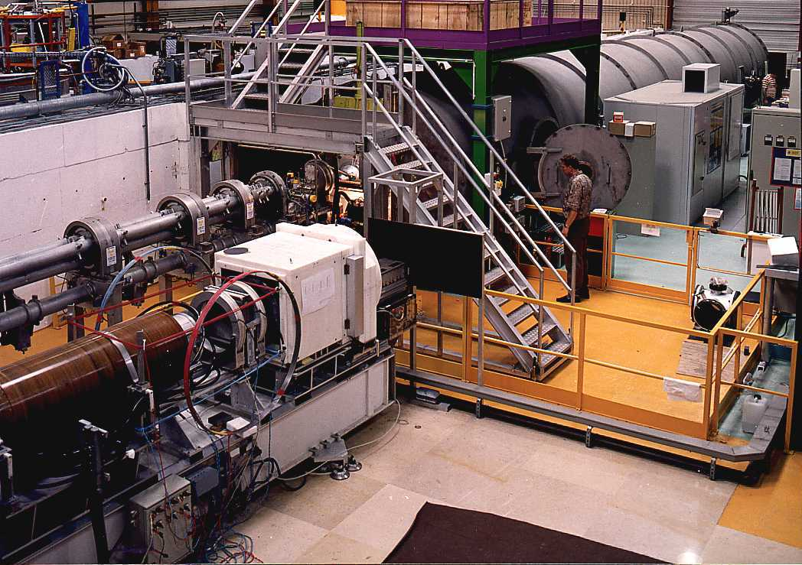
SANS instrument D22 at the ILL-Grenoble

Slide 5
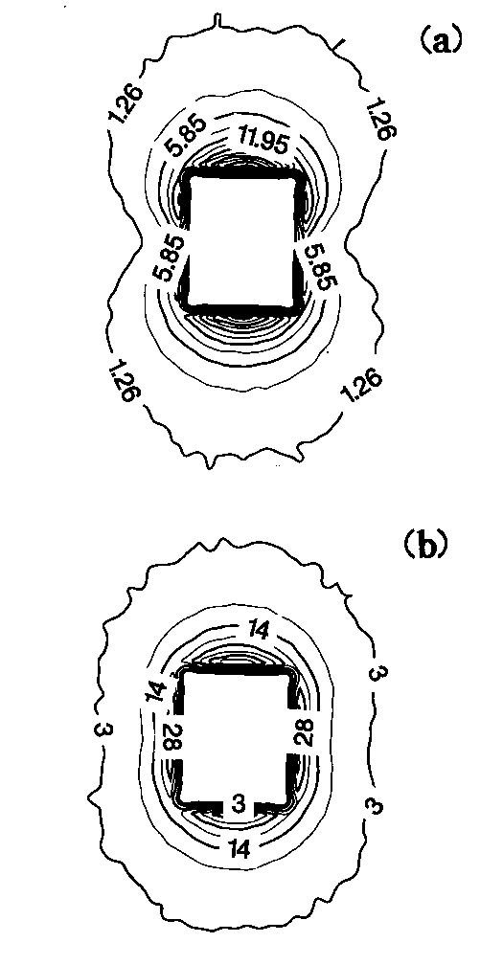
Nuclear and Magnetic SANS
IM + IN
Nuclear and magnetic SANS cross-section
IN
H = 1.4 T
Polarised SANS
a) reference sample, b) irradiated sample

Slide 6
B-spline transformation procedure
N (R) is written as linear combination of N cubic B-splines:
where B_{3,N} (x) is n-th of N bell-shaped functions defined in a grid of N+3 knots equally distributed in the range R_{min} – R_{max}, c_{n}> 0 (with the normalisation condition ) and N(R) >0.
No a-priori assumption on N(R), logR representation useful for highly polydispersed systems
Ref.s:
M. Magnani, P. Puliti, M. Stefanon, Nucl. Inst. Meth. A271 (1988) 611
R. Coppola, R. Kampmann, M. Magnani, P. Staron, Acta Mat. 46 (1998) 5447

Slide 7
Previous work:
  SANS study of fusion martensitic steel implanted with high energy α− particles (just helium bubbles to detect…)
This work:
  SANS study of european fusion reference martensitic steel Eurofer97 (0.12 C, 9 Cr, 0.2 V, 1.08 W wt%); original composition modified by alloying natural B contents variable between 10 and 1000 ppm to produce, under neutron irradiation and consequent B activation, corresponding helium bubble distributions.
  B-alloyed Eurofer97 has been neutron irradiated at the HFR of the JRC-Petten for T = 250 °C - 450 °C up do a dose level of 16 dpa (displacement per atom): in this case helium bubbles are produced together with dpa, originating microvoids and changes in precipitate composition.

Slide 8
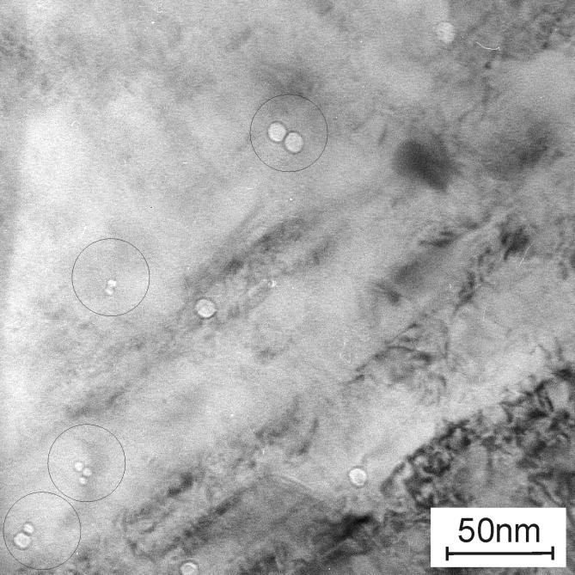
He bubbles in F82H-mod. martensitic steel implanted with α-particles at 250°C (400 appm), then annealed 2 h at temperatures between 550° C and 975 °C
Coalescence of helium bubbles after annealing at 975 °C
Ref.:
R. Coppola, M. Klimenkov, R. Lindau, A. Möslang, M. Valli, A. Wiedenmann, J. N. M. 409 (2011) 100

Slide 9
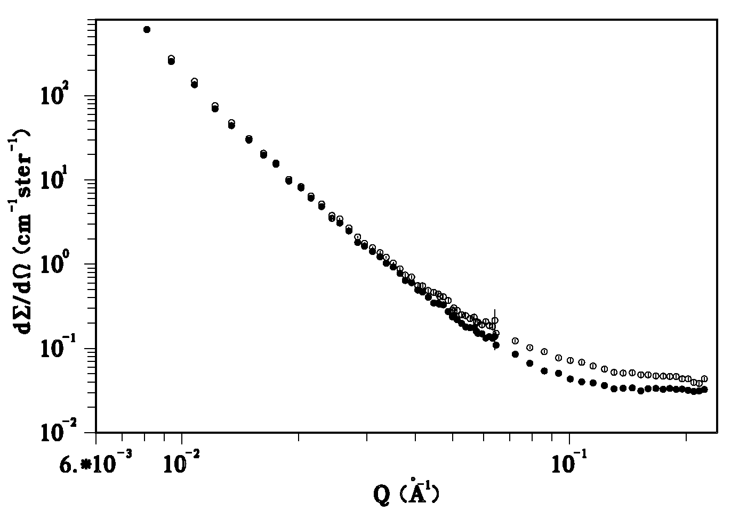
F82H-mod. steel as-implanted at 250°C then tempered at 825° C:
Left - SANS cross-sections of implanted and reference samples
Right - best-fit He bubble volume distributions D(R) (N (R) x V (R)) in Å⁻¹ in compared with the corresponding TEM histogram
Ref:
R. Coppola, M. Klimenkov, M. Magnani, A. Möslang, M. Valli, J. N. M. 329-333 (2004) 1057

Slide 10
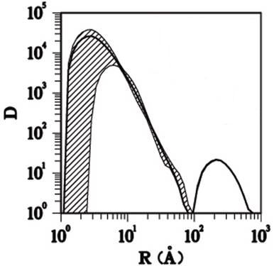
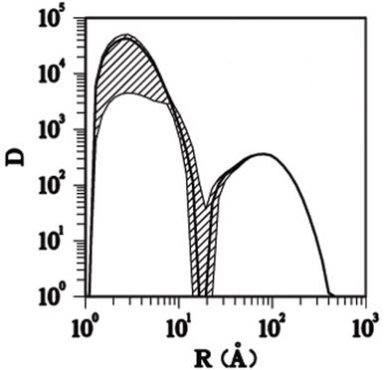
HELIUM BUBBLES VOLUME DISTRIBUTION IN F82H-mod.
IMPLANTED WITH α-PARTICLES AT 250 °C
250 °C as–impl.
2 h 825 °C
2 h 975 °C
The dashed area represents the 80% confidence band
Ref.:
R. Coppola, M. Klimenkov, R. Lindau, A. Möslang, M. Valli, A. Wiedenmann, J. N. M. 409 (2011) 100

Slide 11
Best-fit helium bubble volume fraction, ΔV, helium concentration, C_{He}, and radii obtained from SANS data. The R and ΔV values in parentheses are those obtained from TEM.
Temperature | ΔV | C_{He}(appm) | R_{V}(Å)
250 °C as-impl. | 0.0012 (0.0039) | 209.0 | 11.1 (7)
825 °C | 0.0053 (0.0036) | 375.9 | 3.8 14.6 (17)
975 °C | 0.0085 (0.0054) | 558.9 | 4.1 45.9 (46)
Ref.:
R. Coppola, M. Klimenkov, R. Lindau, A. Möslang, M. Valli, A. Wiedenmann, J. N. M. 409 (2011) 100

Slide 12
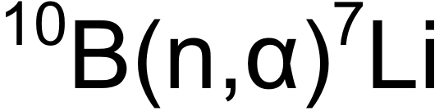
Irradiated Structural Material
Chemical compositions of the test alloys in wt.%
Heat | C | Si | Mn | Cr | Mo | Ni | B | V | W | N | Ta | Fe
EUROFER97 | 0.12 | 0.04 | 0.48 | 8.91 | <0.001 | 0.02 | < 0.001 ^{nat}B | 0.2 | 1.08 | 0.02 | 0.14 | Rest
806 ADS2 | 0.109 | 0.020 | 0.602 | 9.31 | 0.002 | 0.005 | 0.0082 ^{nat}B | 0.190 | 1.27 | 0.021 | 0.055 | Rest
826 ADS3 | 0.095 | 0.031 | 0.395 | 8.80 | 0.046 | 0.008 | 0.0083 ¹⁰B | 0.193 | 1.125 | 0.028 | 0.088 | Rest
825 ADS4 | 0.10 | 0.03 | 0.38 | 9.00 | 0.028 | 0.006 | 0.1160 ¹⁰B | 0.197 | 1.06 | 0.025 | 0.08 | Rest
Heat Treatment: 1040 °C 30 min + 760 °C 90 min
He Concentration
Irradiation HFR-Petten up to 16.3 dpa at T = 250°C, 350°C, 450°C
Neutron fluence rate:
1.42x10¹⁸ m⁻²s⁻¹ (thermal);
3.99 x10¹⁸ m⁻²s⁻¹ (fast, >0.1 MeV)
< 10 ppm ^{nat}B
82 ppm ^{nat}B
83 ppm ¹⁰B
1160 ppm ¹⁰B
<10 appm He
~80 appm He
~415 appm He
~5800 appm He

Slide 13
Investigation of B doped alloys
He bubbles in ADS3 (450°C), 415 appm He, 16 dpa
Cuboidal helium bubbles decoration of grains boundaries and dislocations lines

Slide 14
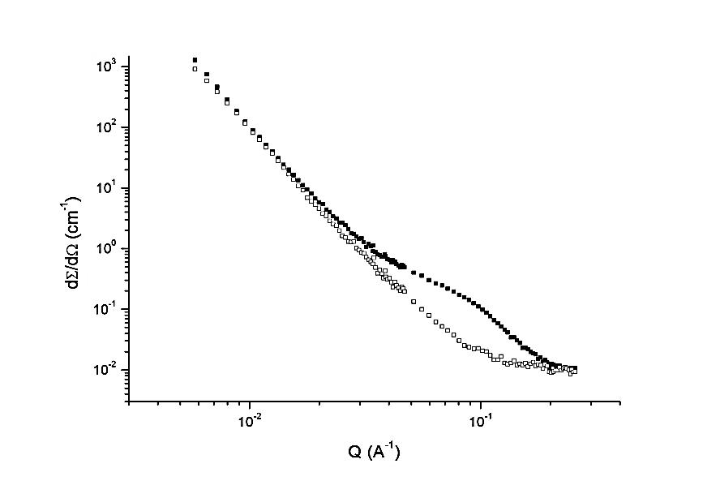
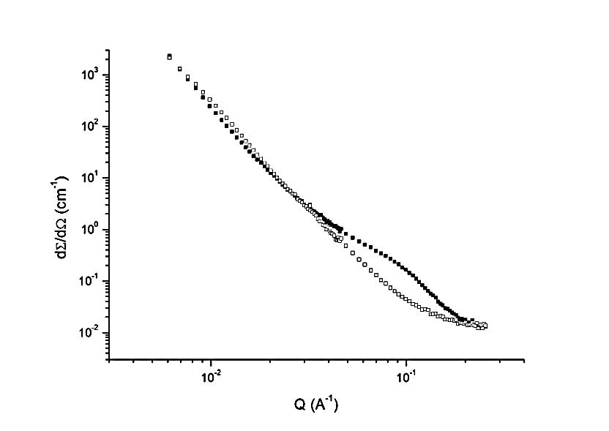
B-alloyed Eurofer97: 400appm He, 16 dpa, 450°C (full dots),
reference (empty dots)
D22, 2 m and 11 m, 6 Å
Nuclear SANS cross-section
Nuclear plus magnetic SANS cross-section

Slide 15
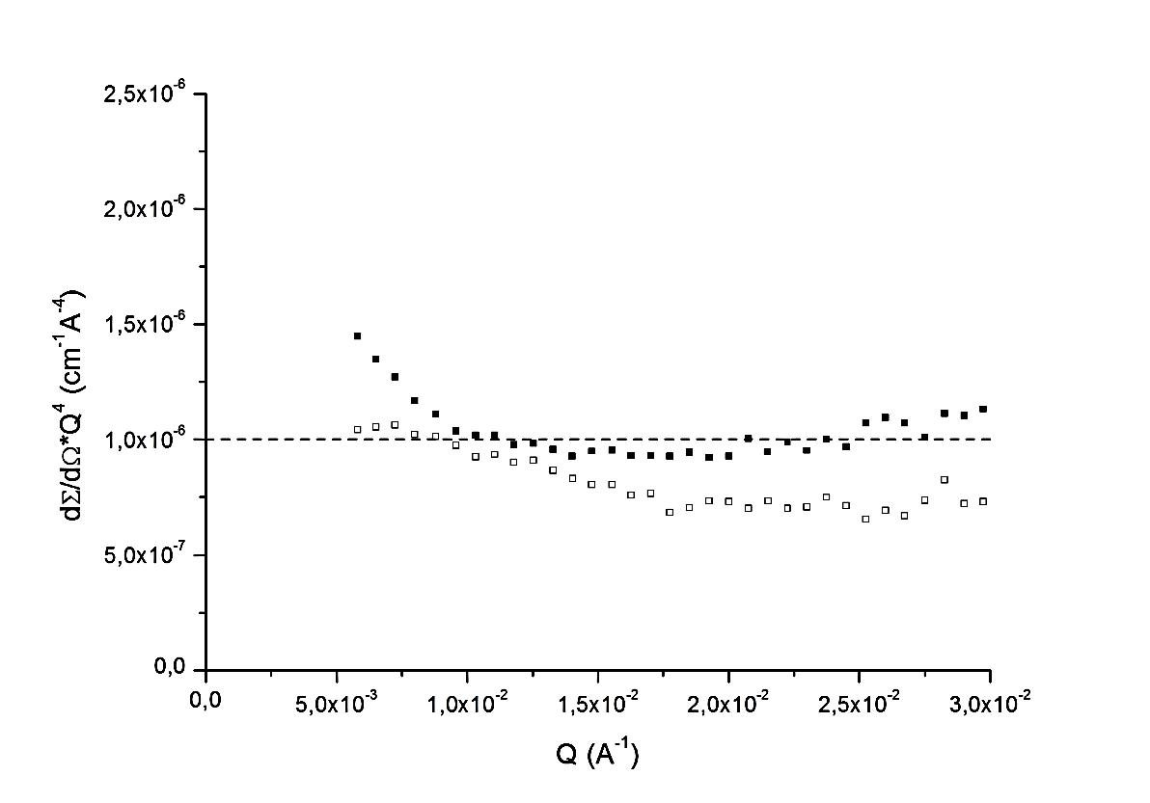
B-alloyed Eurofer97: 400appm He 16 dpa 450°C (full dots),
reference (empty dots)
Porod check (nuclear component) for 11 m 6 Å: Porod length of ~ 600 Å for M₂₃ C₆ precipitates and of ~ 1000 Å for microvoids

Slide 16
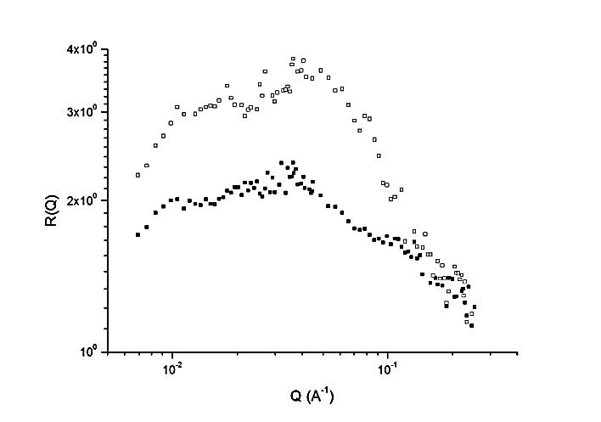
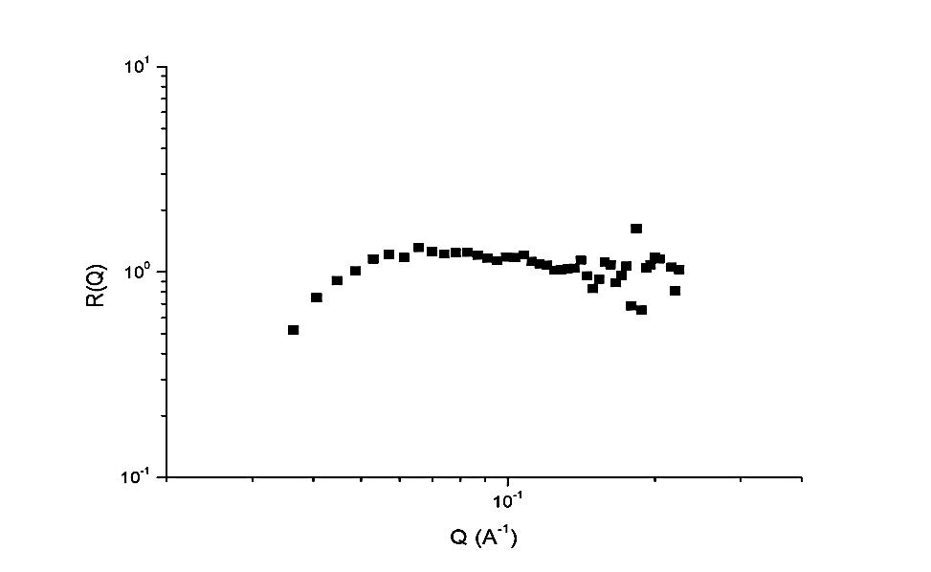
R(Q) behaviour
Eurofer97 400appm He 16 dpa 450°C (full dots), reference (empty dots) – Cr-rich carbides in the ref. disappear after irradiation
Eurofer97 400appm, He 16 dpa, 450°C after subtraction of reference – no magnetic contrast, only one type of scatterers

Slide 17
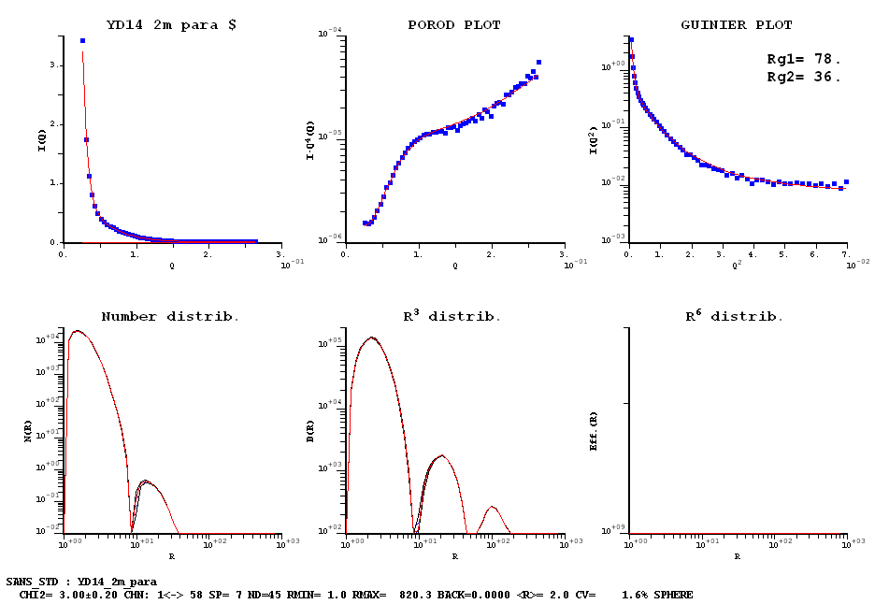
B-alloyed Eurofer97 400 appm He 16 dpa 450°C
contrast 0.484 10¹⁰ cm ⁻² for helium bubbles, 7 splines, volume fraction 1.6 %

Slide 18
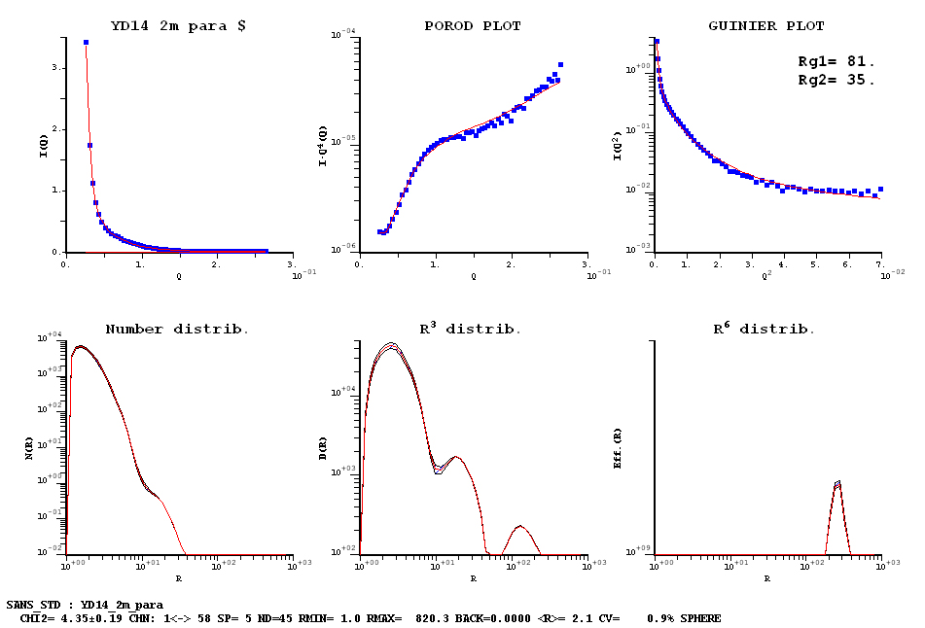
B-alloyed Eurofer97 400 appm He 16 dpa 450°C
contrast 0.484 10¹⁰ cm ⁻² for helium bubbles, 5 splines, volume fraction 0.9 %

Slide 19
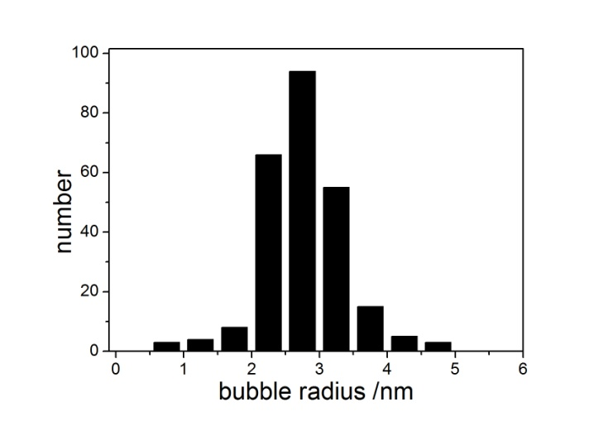
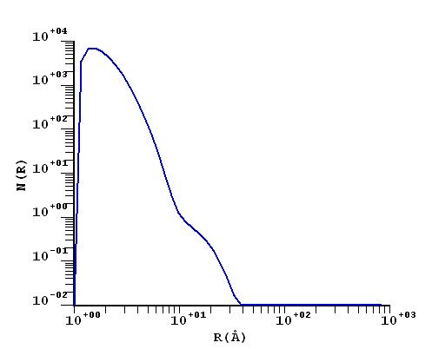
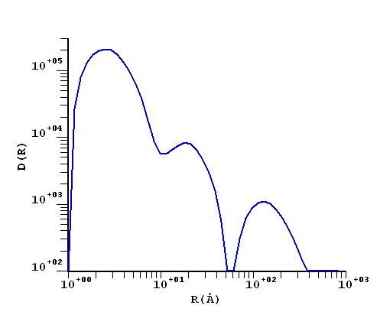
TEM – SANS (5 spline) comparison for B-alloyed Eurofer97 400appm He, 16 dpa, 450°C
Histogram – truncation effects for R < 1 nm
Size distribution
Volume distribution

Slide 20
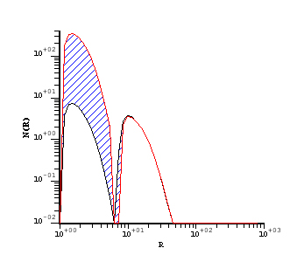
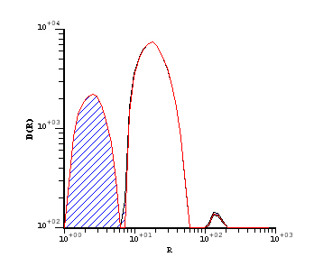
Distributions obtained from the difference irradiated – reference
(dashed area 80% confidence band)
Size distribution
Volume distribution
B-alloyed Eurofer97 400appm He 16 dpa 450°C
contrast 0.484 10¹⁰ cm ⁻² for helium bubbles, 5 splines, volume fraction 0.8 %
The contribution from bubbles with R < 10 Å is almost suppressed

Slide 21
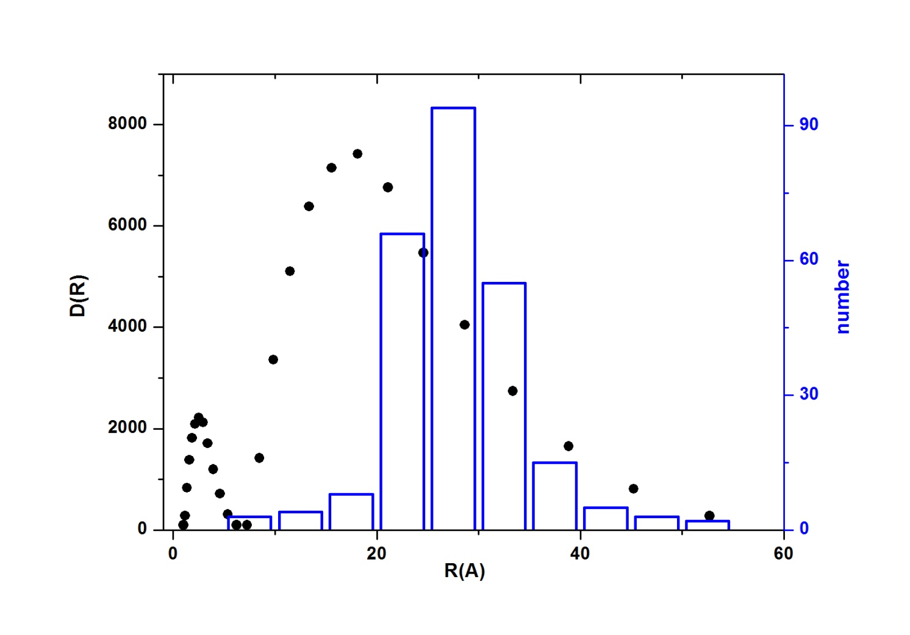
B-alloyed Eurofer97 400appm He 16 dpa 450°C
TEM histogram and best-fit SANS volume distribution

Slide 22
CONCLUSIONS – WORK IN PROGRESS
Appropriate background evaluation gives SANS helium bubble distributions consistent with TEM results, to be further checked by:
- TEM volume fraction determination
- comparison with other SANS transformation methods (eg SASfit)
Q < 10⁻³ Å⁻¹ and polarized SANS measurements useful to unambiguously identify the large scatters and improve the reliability of the obtained distributions

Slide 23
ADDITIONAL SLIDES

Slide 24
REFERENCES
R. Coppola, R. Kampmann, M. Magnani, P. Staron, Microstrucural investigation, using polarized neutron scattering, of a martensitic steel for fusion reactors, Acta mat. 46 (1998) 5447
R. Coppola, C. D. Dewhurst, R. Lindau, R. P. May, A. Möslang, M. Valli, Polarised SANS study of microstructural evolution under neutron irradiation in a martensitic steel for fusion reactors, Physica B 345 (2004) 225
R. Coppola, M. Klimiankou, R. Lindau, A. Möslang, M. Valli, Helium-bubble evolution in F82H mod – Correlation between SANS and TEM, J. N. M. 329-333 (2004) 1057
R. Coppola, R. Lindau, M. Magnani, r. P. May, A. Möslang, J. W. Rensman, B. van der Schaaf, M. Valli, Microstructural investigation, using SANS, of neutron irradiated Eurofer97 steel, F. Eng. & Des. 75-79 (2005) 985
R. Coppola, R. Lindau, R. P. May, A. Möslang, M. Valli, Investigation of microstructural evolution under neutron irradiation in Eurofer97 steel by means of small-angle neutron scattering, J. Nucl. Mat. 386-388 (2009) 195-198
R. Coppola, R. Lindau, A. Möslang, M. Valli, A. Wiedenmann, Recent applications of small-angle neutron scattering in the characterisation of irradiated steels for nuclear technology, pres. at EC-IAEA Workshop, Barcelona October 2009 J. Nucl. Mat. 409 (2011) 100

Slide 25
SANS contrast depends on bubble radius R
Δ ρ (R) = ρ_{F82H} – b_{He}ρ_{He}(R)
The dependence of the contrast on the bubble radius is taken into account in the fitting procedure but given the small value of r_{He} very large changes of the He mass density would be necessary to lead to significantly different distributions. Assuming that the He concentration is equal to the nominal value (400 appm), the obtained variations on range typically from –10% at 2 Å to +12% at 100 Å. The resulting variations in N(R) are generally of a few per cent, therefore well inside the statistical uncertainty band

Slide 26
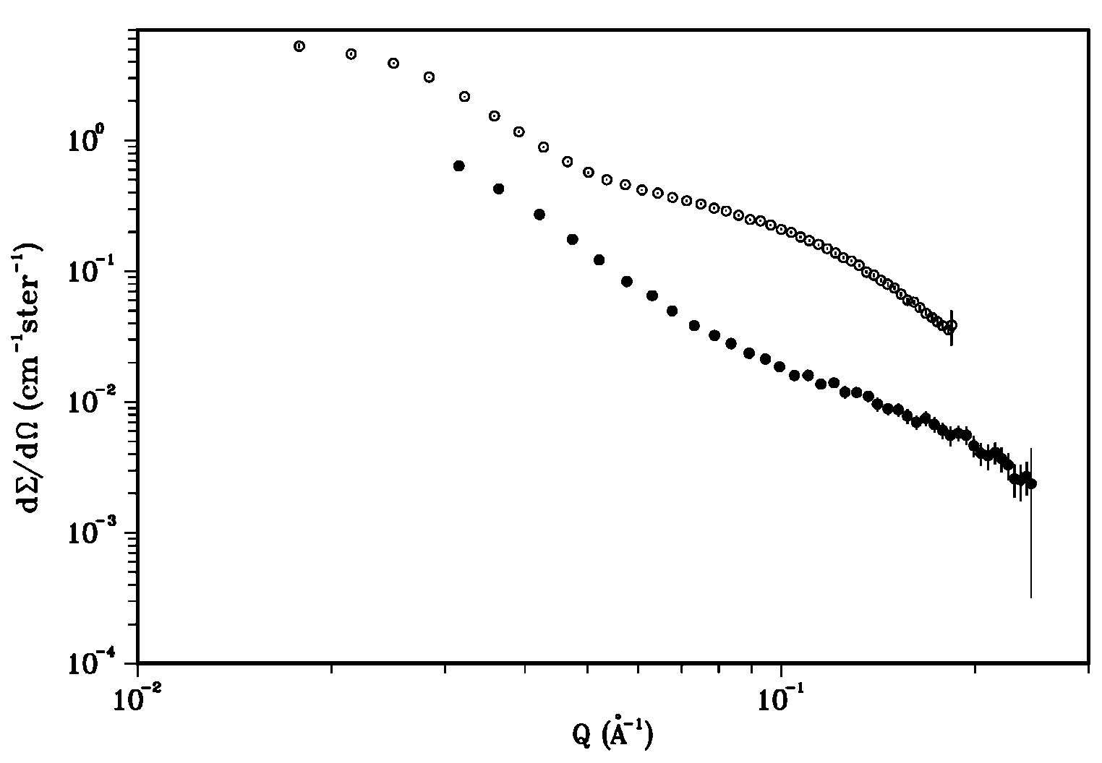
RESULTS ON 2.5 AND 8.4 dpa IRRADIATED EUROFER
_{8.4 dpa}
_{2.5 dpa}
Nuclear SANS cross-sections of the difference between Eurofer97 neutron irradiated at 250°C at 2.5 dpa and at 300°C at 8.4 dpa and their respective reference samples

Slide 27
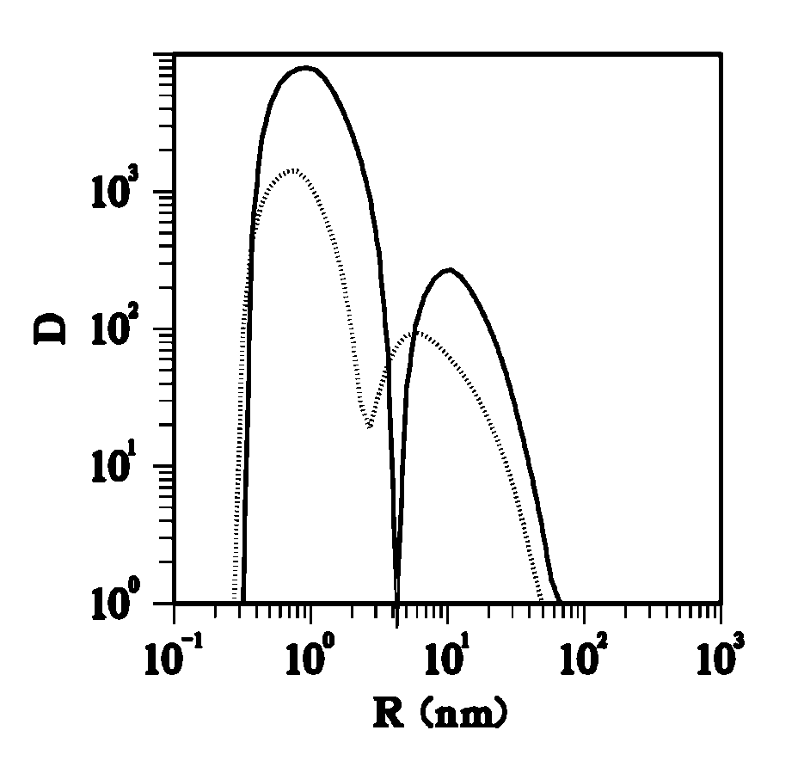
MICROVOIDS EVOLUTION WITH IRRADIATION DOSE
8.4 dpa
2.5 dpa
Volume distribution functions D(R) (nm⁻¹) obtained from the nuclear SANS difference between Eurofer97 neutron irradiated at 300°C and their respective reference samples (R. Coppola et al. J. Nuc. Mat. 386-388 (2009) 195)
Increasing the dose the average radius remains nearly unchanged but a consistent increase is observed in the volume fraction of the observed defects, from 0.005 at 2.5 dpa to 0.011 at 8.4 dpa

Slide 28
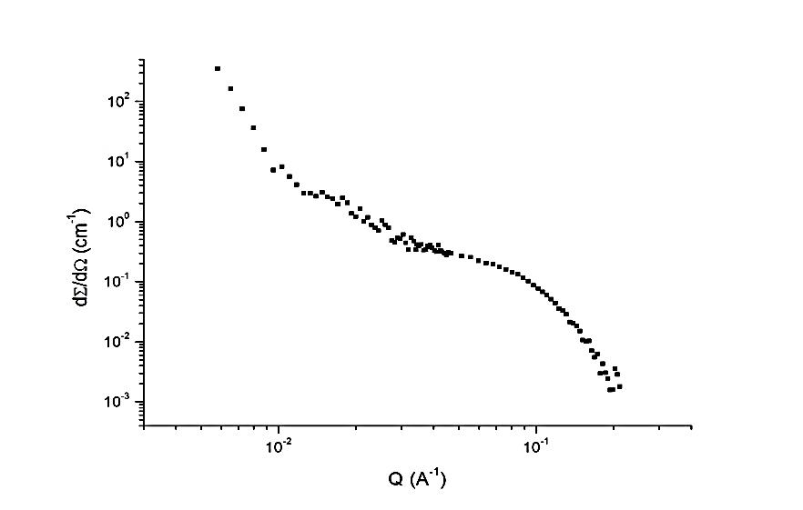
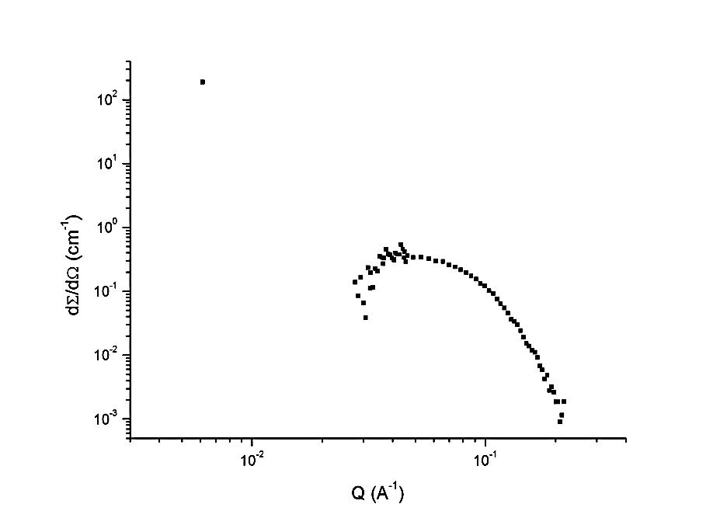
B-alloyed Eurofer97 400appm He, 16 dpa, 450°C
(after subtraction of reference, un-irradiated sample)
Nuclear
Nuclear plus magnetic

