Slide 1
Diffusion of point defects and SIA clusters in dilute Fe-Ni alloys
(EU Project PERFORM60)
A.Serra¹, N.Anento¹, D.Terentyev² & Y.N.Osetsky³
1.Universitat Politècnica de Catalunya (UPC), Spain
2. Institute of Nuclear Materials Science (SCK-CEN), Belgium
3. Oak Ridge National Laboratory, TN, USA

Slide 2
Motivation
Experimental evidence *: Addition of Ni promotes nucleation and/or immobilization of SIA clusters and small dislocation loops.
%Ni↑: Size ↓, density↑, relative fraction of a/2<111> loops↑
‘Loop stabilization' effect leads to reduction of the void growth since homogenously distributed small (TEM invisible) loops act as efficient sinks for vacancies
*(Mat.Res.Soc. Symp. Proc., 373 (1995) 57; PERFECT_Report:D1-3.8)
How Ni solid solution affects the mobility of in-cascade generated SIA clusters in dilute Fe-Ni alloys

Slide 3
Outline
Point defects (PD)
PD - Ni Interaction energy
PD diffusion in Fe and Fe-Ni
SIA clusters (7, 19 & 37) (Radius < 1nm)
Cluster – Ni Interaction energy
Cluster diffusion in Fe-0.8%Ni

Slide 4
Vacancy migration energy barrier and Vac-Ni Binding energy
Vacancy migration energy barrier (eV) *
Fe diffusion coefficients (m²/s)
E_{m}(Fe) | 0.63
E_{m}(Ni) | 0.61
E_{m}(Fe, Ni 2nn) | 0.52
E_{m}(Fe, Ni 3nn) | 0.71
E_{m}(Fe, Ni 5nn) | 0.68
Ni-Vacancy binding energy (eV) *
Eª =0.56eV
E_{b}(1nn) | -0.02
E_{b}(2nn) | 0.10
*Interatomic potential Fe-Ni: G. Bonny et al. MSMS Eng. 17 (2009) 025010

Slide 5
Vacancy diffusion in Fe-0.8%Ni
T (K)
1400 1000 800 600

Slide 6
SIA migration and SIA-Ni E
Single SIA migration energy barrier (eV)
Ni-SIA binding energy (eV)*
E_{m}^{Fe-Fe} (bulk) | 0.31
E_{m}^{Fe-Fe} Ni(1nn) tens. | 0.35
E_{m}^{Fe-Fe} Ni(1nn) comp. | 0.23
E_{b}^{Fe-Fe} Ni(1nn) tens. | -0.14
E_{b}^{Fe-Fe} Ni(1nn) comp. | -0.12
E_{b}^{Fe-Ni} Ni(1nn) comp. | -0.35
Fe-Fe <110> Ni (1nn) tension
Fe-Fe <110> Ni (1nn) compression
Fe-Ni <110> Ni (1nn) compression
Matrix atom
Solute atom
*G. Bonny et al. MSMS Eng. 17 (2009) 025010

Slide 7
1 SIA (0.5 to 1.6%Ni)
E^{a (Fe)}= 0.27eV
E^{a (Ni)}= 0.32eV

Slide 8
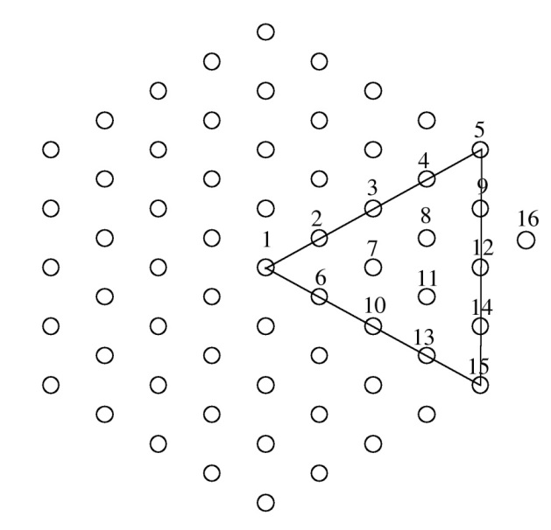
Ni-Cluster binding energy
17
7SIAs
E_{b} (centre)= 0.15 eV
E_{b} (edge) = 0.22eV
61SIAs
E_{b} (centre)= 0.07 eV
E_{b} (edge) = 0.26eV

Slide 9
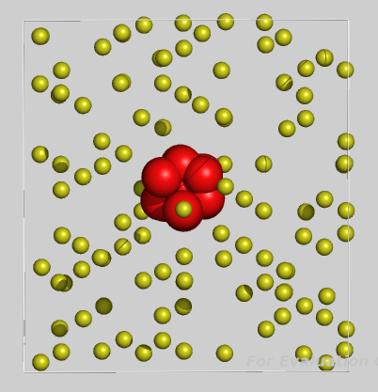
7SIAs
[111]
900K 600K 450K
[1-10]

Slide 10
19SIA cluster
900K 600K 450K 300K

Slide 11
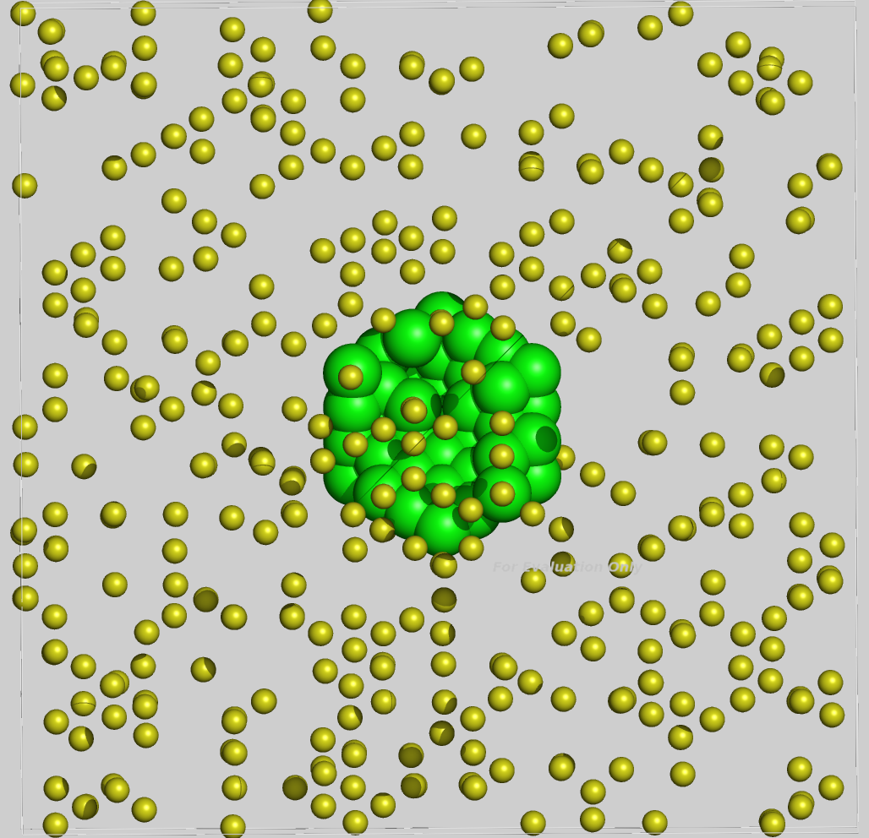
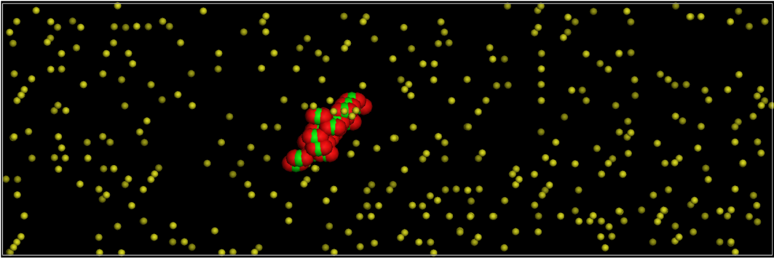
37SIAs
T (K)
900 600 500 450 300
500K

Slide 12
Cluster diffusion @ Fe-0.8%Ni
T (K)
900 600 500 450 400 300

Slide 13
Summary
We studied diffusion of point defects and SIA clusters in dilute Fe-Ni alloys (0.5, 0.8, 1.6 wt%Ni)
Diffusion of point defects is almost not affected by Ni solid solutions from 0.5 to 1.6%
The mobility of SIA clusters is strongly affected by Ni and decreases with size of cluster and concentration of Ni
Ni in low concentrations provides the necessary friction to slow down clusters decreasing the diffusion coefficient and increasing the activation energy

Slide 15
Defect diffusivity vs. temperature
Defect diffusion coefficient calculation:
$$D_{}^{d}=\frac{1}{N_{sd}}\sum_{i=1}^{N_{sd}}{\frac{R_{i}}{2nt_{sd}}}$$
n: dimensionality of diffusion
N_{sd}: number of isochronal segments of t_{sd.}
E_{m:} migration energy
TTD: Time trajectory decomposition
${Dd}_{ν}^{}=f_{d}\frac{νΔ^{2}}{2n}$
JFA: Jump Frequency Analysis
D=D₀ exp(-E_{m}/KT)
$$D^{∗}=\lim_{t → ∞}{\frac{<R^{2}\left(t\right)>}{2nt}}$$
SD: Self diffusion coefficient

