Slide 1
Particle production beyond eikonal accuracy in the dilute-dense CGC framework
Pedro Agostini
Universidade de Santiago de Compostela and IGFAE
pedro.agostini@usc.es
with Néstor Armesto (IGFAE) and Tolga Altinoluk (NCBJ)
09/12/2020

Slide 2
The eikonal approximation
Boosting the target
Eikonal approximation
Our approach
Dense and left moving: Strong classical field
Infinity Lorentz factor: $γ→∞$
We still neglect the transverse
component of the field
$$x^{⊥}$$
$$𝒜^{μ}\left(x\right)→\left\{\begin{aligned}0 \\ { δ(x^{+})𝒜}^{−}\left(x\right) \\ 0\end{aligned}\right.$$
$$𝒜^{μ}\left(x\right)→\left\{\begin{aligned}{\frac{1}{γ}𝒜}^{+}\left(γx^{+},\frac{x^{−}}{γ},x\right) \\ {γ𝒜}^{−}\left(γx^{+},\frac{x^{−}}{γ},x\right) \\ 𝒜^{⊥}\left(γx^{+},\frac{x^{−}}{γ},x\right)\end{aligned}\right.$$
$$𝒜^{μ}\left(x\right)→\left\{\begin{aligned}0 \\ { 𝒜}^{−}\left(x^{+},x\right) \\ 0\end{aligned}\right.$$
$$(𝒜^{−},𝒜^{⊥})$$
$$x^{⊥}$$
$$x^{⊥}$$
$$𝒜^{−}$$
Shockwave
Finite length
$$L^{+}$$
$$𝒜^{−}$$
$$x^{+}$$
$$x^{+}$$
$$x^{+}$$
¡
The projectile is eikonal and dilute
See the talk by Alina Czajka.
$j^{μ}\left(x\right)=$ $δ^{μ+}δ\left(x^{−}\right)ρ^{b}(x)$

Slide 3
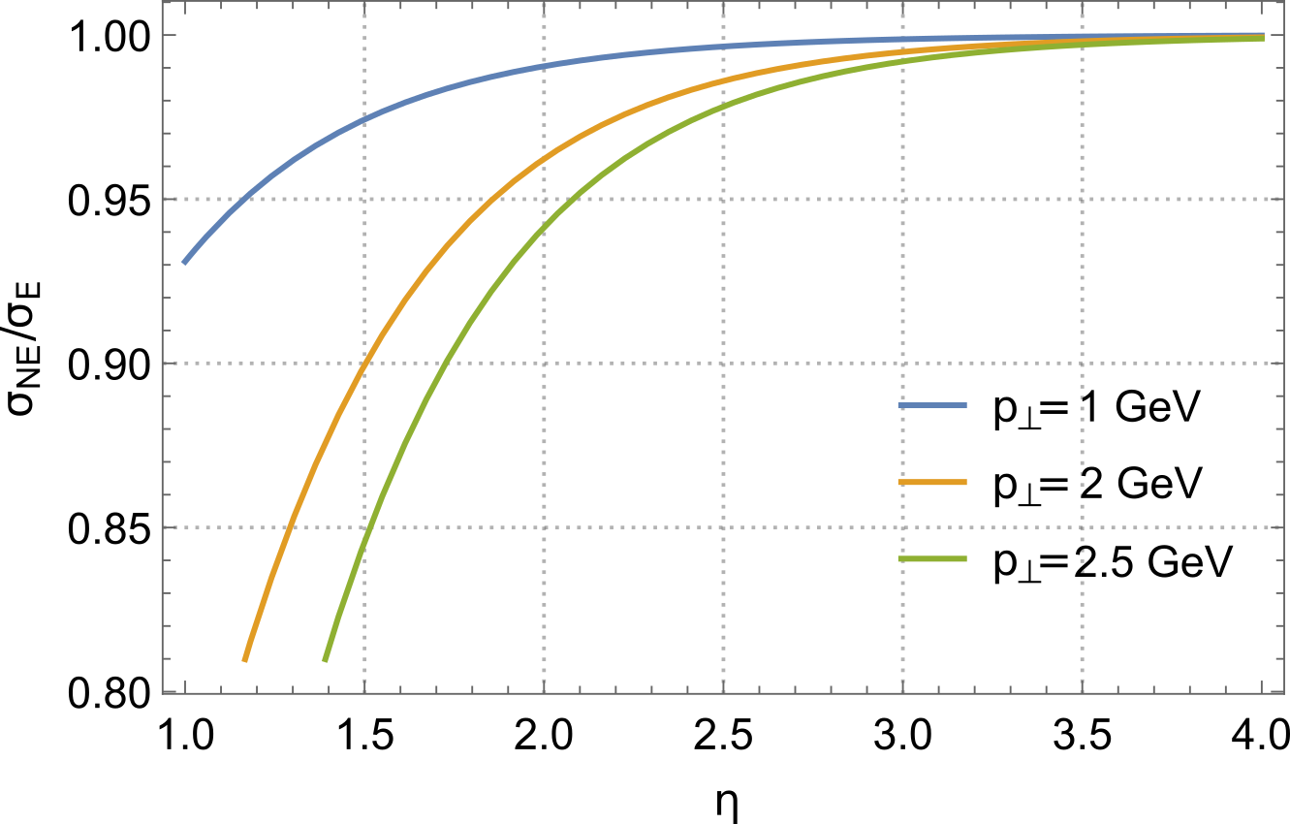
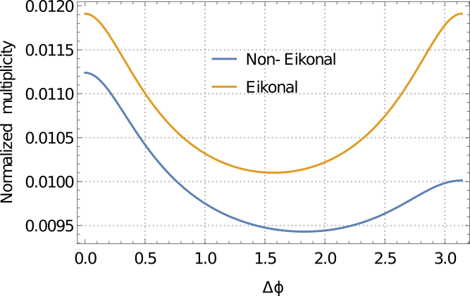
Non-eikonal pp scattering
Gluon production in dilute-dilute (pp) collisions:
Double gluon production in the CGC is symmetric in transverse momentum:
Non-eikonal corrections are sizeable at mid-rapidity
$$σ\left(k_{1},k_{2}\right)=σ\left(k_{1},−k_{2}\right)$$
Non-eikonal corrections break the symmetry:
$$σ\left(k_{1},k_{2}\right)≠σ\left(k_{1},−k_{2}\right)$$
Odd azimuthal harmonics
[ P. A. ,T. Altinoluk, N. Armesto, arXiv:1902.04483]
[ P. A. ,T. Altinoluk, N. Armesto, arXiv:1907.03668]

Slide 4
Dilute-dense scattering (pA) in the CGC
Single gluon spectrum
LSZ reduction formula
$${\left(2π\right)}^{3}\left(2k^{+}\right)\frac{dN}{dk^{+}d^{2}k}= {\left\langle {\left|ℳ_{λ}^{a}\left(k\right)\right|}^{2}\right\rangle }_{p,T}$$
$$ℳ_{λ}^{a}\left(k\right)=ε_{λ}^{μ∗}∫d^{4}x e^{ik⋅x} ⊡_{x}A_{μ}^{a}(x)$$
Looking for the retarted gluon field
Target: dense and left moving
$$𝒜^{μ}\left(x\right)=δ^{μ−}𝒜^{−}\left(x^{+},x\right)$$
Projectile: dilute and right moving
$j^{μ}\left(x\right)=δ^{μ+}j^{+}\left(x^{−},x\right)$= $δ^{μ+}δ\left(x^{−}\right)ρ^{b}(x)$
Linear response: $A_{a}^{μ}=𝒜_{a}^{μ}+a_{a}^{μ}+𝒪(g^{3})$
$$a_{a}^{μ}(x)=−i∫d^{4}y G_{R}^{μν}{\left(x,y\right)}_{ab} j_{νb}(x)$$
LC Gauge: $A^{+}=0 ; ε_{λ}^{+}=0$
$$ℳ_{λ}^{a}\left(k\right)=ε_{λ}^{i∗}∫d^{4}x e^{ik⋅x} ⊡_{x}a_{a}^{i}(x)$$
We are only interested in the transverse part of $a^{μ}(x)$

Slide 5
Gluon propagator through a dense medium
Scalar retarded propagator
Solve the 2+1 dimensional Schrödinger equation
$$\left[δ^{ab}\left(i ∂_{x^{+}}+\frac{∂_{x}^{2}}{2k^{+}}\right)+g𝒜^{−}{\left(x^{+},x\right)}^{ab}\right]𝒢_{k^{+}}^{bc}\left(x^{+},x;y^{+},y\right)=iδ^{ac}δ^{\left(2\right)}\left(x−y\right)δ(x^{+}−y^{+})$$
The solution is a Brownian motion around the path $z(z^{+})$
$$𝒢_{k^{+}}^{ab}\left(x^{+},x;y^{+},y\right)=Θ\left(x^{+}−y^{+}\right)\int_{y}^{x}{𝒟z\left(z^{+}\right)\exp\left[\frac{ik^{+}}{2}\int_{y^{+}}^{x^{+}}{dz^{+}}{\dot{z}}^{2}\left(z^{+}\right)\right]𝒰^{ab}\left(x^{+},y^{+};z\left(z^{+}\right)\right)}$$
Propagator of a gluon moving through a dense medium (extensively used in jet quenching)
Wilson Line
$$𝒰^{ab}\left(x^{+},y^{+};z\left(z^{+}\right)\right)=𝒫^{+}{\exp\left\{ig \int_{y^{+}}^{x^{+}}{dz^{+}}𝒜^{−}\left(z^{+},z\left(z^{+}\right)\right)\right\}}^{ab}$$

Slide 6
Gluon production matrix
Single gluon production amplitude
After contribution
$$ℳ_{λ}^{a}\left(k\right)∝$$
$$2\frac{k^{i}}{k^{2}}\int_{y}{e^{i\left(k−q\right)⋅y}}𝒰_{y}{\left(L^{+},0\right)}^{ab}$$
$$−2\frac{q^{i}}{q^{2}}\int_{y,x}{e^{iq⋅y−i k⋅x}}𝒢_{k^{+}}^{ab}\left(L^{+},x;0,y\right)+\frac{1}{k^{+}}\int_{x,y}{e^{iq⋅y−i k⋅x }\int_{0}^{L^{+}}{dy^{+}}\left[∂_{y^{i}}𝒢_{k^{+}}^{ac}\left(L^{+},x;y^{+},y\right)\right]𝒰_{y}{\left(y^{+},0\right)}^{cb}}$$
$$0$$
$$L^{+}$$
Before contribution
(doesn’t appear in jet quenching)
$$0$$
$$L^{+}$$
Inside contribution
(completely non eikonal, $L^{+}≠0$)
$$0$$
$$y^{+}$$
$$L^{+}$$

Slide 7
Generalizing the dipole operator
3 ingredients
$${d_{0}=\frac{1}{N_{c}^{2}−1}\left\langle Tr\left[𝒰_{y}\left(x^{+},y^{+}\right)𝒰_{\overline{y}}^{†}\left(x^{+},y^{+}\right)\right]\right\rangle }_{T}$$
Single gluon spectrum
$${d_{1}=\frac{1}{N_{c}^{2}−1}\left\langle Tr\left[𝒢_{k^{+}}\left(x^{+},x;y^{+},y\right)𝒰_{\overline{y}}^{†}\left(x^{+},y^{+}\right)\right]\right\rangle }_{T}$$
$$\frac{dN}{dk^{+}d^{2}k}∝ {\left\langle ℳ_{λ}^{a}\left(k\right)ℳ_{λ}^{a}{\left(k\right)}^{†}\right\rangle }_{p,T}$$
$${d_{2}=\frac{1}{N_{c}^{2}−1}\left\langle Tr\left[{𝒢_{k^{+}}\left(x^{+},x;y^{+},y\right)𝒢}_{k^{+}}^{†}\left(x^{+},\overline{x};y^{+},\overline{y}\right)\right]\right\rangle }_{T}$$
… and also a fourth one
${\left\langle ρ^{a}\left(x\right)ρ^{b∗}\left(y\right)\right\rangle }_{p}∝δ^{ab}δ^{\left(2\right)}(x−y)$ (MV model)
GBW model
Localized GBW model
$${\frac{1}{N_{c}^{2}−1}\left\langle Tr\left[𝒰_{y}𝒰_{\overline{y}}^{†}\right]\right\rangle }_{T}=\exp\left\{−\frac{Q_{S}^{2}}{4}{\left(y−\overline{y}\right)}^{2}\right\}$$
$${\frac{1}{N_{c}^{2}−1}\left\langle Tr\left[𝒰_{y}\left(x^{+},y^{+}\right)𝒰_{\overline{y}}^{†}\left(x^{+},y^{+}\right)\right]\right\rangle }_{T}=\exp\left\{−\frac{Q_{S}^{2}}{4}{\left(y−\overline{y}\right)}^{2}\frac{x^{+}−y^{+}}{L^{+}}\right\}$$

Slide 8
Discretizing the longitudinal space
generalized dipole operator
$$z_{N−1}$$
$$x$$
$${\frac{1}{N_{c}^{2}−1}\left\langle Tr\left[{𝒢_{k^{+}}\left(x^{+},x;y^{+},y\right)𝒢}_{k^{+}}{\left(x^{+},\overline{x};y^{+},\overline{y}\right)}^{†}\right]\right\rangle }_{T}$$
$$y$$
$$z_{1}$$
$$z_{2}$$
Discretizing the longitudinal space
$$y^{+}$$
$$z_{1}^{+}$$
$$z_{2}^{+}$$
$$⋯$$
$$⋯$$
$$z_{N−1}^{+}$$
$$x^{+}$$
$$𝒢_{k^{+}}^{ab}\left(x^{+},x;y^{+},y\right)=Θ\left(x^{+}−y^{+}\right)\int_{y}^{x}{𝒟z\left(z^{+}\right)\exp\left[\frac{ik^{+}}{2}\int_{y^{+}}^{x^{+}}{dz^{+}}{\dot{z}}^{2}\left(z^{+}\right)\right]𝒰^{ab}\left(x^{+},y^{+};z\left(z^{+}\right)\right)}$$
$$𝒢_{k^{+}}^{ab}\left(x^{+},x;y^{+},y\right)=\lim_{N→∞}Θ\left(x^{+}−y^{+}\right) \int{\left(\prod_{n=1}^{N−1}{d^{2}z_{n}}\right){\left(\frac{−ik^{+}N}{2\left(x^{+}−y^{+}\right)}\right)}^{N}\exp\left[\frac{i k^{+}N}{2\left(x^{+}−y^{+}\right)}\sum_{n=0}^{N−1}{{\left(z_{n+1}−z_{n}\right)}^{2}}\right]}𝒫^{+}{\left\{\prod_{n=1}^{N−1}{\exp\left[ig\frac{x^{+}−y^{+}}{N}𝒜^{−}\left(z_{n}^{+},z_{n}\right)\right]}\right\}}^{ab}$$
$$z_{0}=y$$
$$z_{N}=x$$

Slide 9
Discretizing the space
Non-eikonal dipole operator
$$z_{N−1}$$
$$x$$
$${\frac{1}{N_{c}^{2}−1}\left\langle Tr\left[{𝒢_{k^{+}}\left(x^{+},x;y^{+},y\right)𝒢}_{k^{+}}{\left(x^{+},\overline{x};y^{+},\overline{y}\right)}^{†}\right]\right\rangle }_{T}$$
$$y$$
$$z_{1}$$
$$z_{2}$$
$$y^{+}$$
$$z_{1}^{+}$$
$$z_{2}^{+}$$
$$⋯$$
$$⋯$$
$$z_{N−1}^{+}$$
$$x^{+}$$
Discretizing the longitudinal space
$${\frac{1}{N_{c}^{2}−1}\left\langle Tr\left[{𝒢_{k^{+}}\left(x^{+},x;y^{+},y\right)𝒢}_{k^{+}}{\left(x^{+},\overline{x};y^{+},\overline{y}\right)}^{†}\right]\right\rangle }_{T}=\lim_{N→∞}Θ\left(x^{+}−y^{+}\right) \int{\left(\prod_{n=1}^{N−1}{d^{2}z_{n}d^{2}{\overline{z}}_{n}}\right){\left(\frac{−ik^{+}N}{2\left(x^{+}−y^{+}\right)}\right)}^{2N}\exp\left[\frac{i k^{+}N}{2\left(x^{+}−y^{+}\right)}\sum_{n=0}^{N−1}{\left\{{\left(z_{n+1}−z_{n}\right)}^{2}−{\left({\overline{z}}_{n+1}−{\overline{z}}_{n}\right)}^{2}\right\}}\right]}$$
$$×\frac{1}{N_{c}^{2}−1}{\left\langle Tr\left[𝒰_{z_{0}}\left(z_{0}^{+},z_{1}^{+}\right)𝒰_{z_{1}}\left(z_{1}^{+},z_{2}^{+}\right)⋯𝒰_{z_{N−1}}\left(z_{N−1}^{+},z_{N}^{+}\right)𝒰_{{\overline{z}}_{N−1}}{\left(z_{N−1}^{+},z_{N}^{+}\right)}^{†}⋯𝒰_{{\overline{z}}_{1}}{\left(z_{1}^{+},z_{2}^{+}\right)}^{†}𝒰_{{\overline{z}}_{0}}{\left(z_{0}^{+},z_{1}^{+}\right)}^{†}\right]\right\rangle }_{T}$$

Slide 10
Localization argument
The MV model is local
The target ensemble is color neutral
For a generic functional $F[ρ_{T}]$ of the target charge density:
$${\left\langle 𝒰^{ab}𝒰^{bc†}\right\rangle }_{T}=\frac{δ^{ac}}{N_{c}^{2}−1}{\left\langle Tr[𝒰𝒰^{†}]\right\rangle }_{T}$$
${\left\langle F\left(x^{+},z^{+}\right)F\left(z^{+},x^{+}\right)\right\rangle }_{T}={\left\langle F\left(x^{+},z^{+}\right)\right\rangle }_{T}{\left\langle F\left(z^{+},x^{+}\right)\right\rangle }_{T}$ $; y^{+}<z^{+}<x^{+}$
Localized GBW model
$$\frac{1}{N_{c}^{2}−1}{\left\langle Tr\left[𝒰_{z_{n}}\left(z_{n}^{+},z_{n+1}^{+}\right)𝒰_{{\overline{z}}_{n}}{\left(z_{n}^{+},z_{n+1}^{+}\right)}^{†}\right]\right\rangle }_{T}=\exp\left\{−\frac{Q_{s}^{2}}{4}{\left(z_{n}−{\overline{z}}_{n}\right)}^{2}\frac{z_{n+1}^{+}−z_{n}^{+}}{L^{+}}\right\}=\exp\left\{−\frac{Q_{s}^{2}}{4N}{\left(z_{n}−{\overline{z}}_{n}\right)}^{2}\right\}$$
Therefore
$${ \frac{1}{N_{c}^{2}−1}\left\langle Tr\left[𝒰_{z_{0}}\left(z_{0}^{+},z_{1}^{+}\right)𝒰_{z_{1}}\left(z_{1}^{+},z_{2}^{+}\right)⋯𝒰_{z_{N−1}}\left(z_{N−1}^{+},z_{N}^{+}\right)𝒰_{{\overline{z}}_{N−1}}{\left(z_{N−1}^{+},z_{N}^{+}\right)}^{†}⋯𝒰_{{\overline{z}}_{1}}{\left(z_{1}^{+},z_{2}^{+}\right)}^{†}𝒰_{{\overline{z}}_{0}}{\left(z_{0}^{+},z_{1}^{+}\right)}^{†}\right]\right\rangle }_{T}$$
$$=\frac{1}{{\left(N_{c}^{2}−1\right)}^{N}}{\left\langle Tr\left[𝒰_{z_{0}}\left(z_{0}^{+},z_{1}^{+}\right)𝒰_{{\overline{z}}_{0}}{\left(z_{0}^{+},z_{1}^{+}\right)}^{†}\right]\right\rangle }_{T}⋯{\left\langle Tr\left[𝒰_{z_{N−1}}\left(z_{N−1}^{+},z_{N}^{+}\right)𝒰_{{\overline{z}}_{N−1}}{\left(z_{N−1}^{+},z_{N}^{+}\right)}^{†}\right]\right\rangle }_{T}$$
$$=\exp\left\{−\frac{Q_{s}^{2}}{4N}\sum_{n=0}^{N−1}{{\left(z_{n}−{\overline{z}}_{n}\right)}^{2}}\right\}$$

Slide 11
Discretizing the space
Gaussians are doable
Performing the integral
$${\frac{1}{N_{c}^{2}−1}\left\langle Tr\left[{𝒢_{k^{+}}\left(x^{+},x;y^{+},y\right)𝒢}_{k^{+}}^{†}\left(x^{+},\overline{x};y^{+},\overline{y}\right)\right]\right\rangle }_{T}=\lim_{N→∞}Θ\left(x^{+}−y^{+}\right) \int{\left(\prod_{n=1}^{N−1}{d^{2}z_{n}d^{2}{\overline{z}}_{n}}\right){\left(\frac{−ik^{+}N}{2\left(x^{+}−y^{+}\right)}\right)}^{2N}\exp\left[\frac{i k^{+}N}{2\left(x^{+}−y^{+}\right)}\sum_{n=0}^{N−1}{\left\{{\left(z_{n+1}−z_{n}\right)}^{2}−{\left({\overline{z}}_{n+1}−{\overline{z}}_{n}\right)}^{2}\right\}}\right]}\exp\left\{−\frac{Q_{s}^{2}}{4N}\sum_{n=0}^{N−1}{{\left(z_{n}−{\overline{z}}_{n}\right)}^{2}}\right\}$$
The solution
$${\frac{1}{N_{c}^{2}−1}\left\langle Tr\left[{𝒢_{k^{+}}\left(x^{+},x;y^{+},y\right)𝒢}_{k^{+}}^{†}\left(x^{+},\overline{x};y^{+},\overline{y}\right)\right]\right\rangle }_{T}={\left(\frac{k^{+}}{2π\left(x^{+}−y^{+}\right)}\right)}^{2}exp\left\{i\frac{k^{+}}{2\left(x^{+}−y^{+}\right)}\left[{\left(x−y\right)}^{2}−{\left(\overline{x}−\overline{y}\right)}^{2}\right]\right\}\exp\left\{−\frac{Q_{s}^{2}}{12}\left[{\left(y−\overline{y}\right)}^{2}+\left(x−\overline{x}\right)\left(y−\overline{y}\right)+{\left(x−\overline{x}\right)}^{2}\right]\right\}$$

Slide 12
Dipole operators beyond eikonal accuracy
$𝒢$ $𝒢^{†}$ operator
$$\frac{1}{N_{c}^{2}−1}\int_{x,\overline{x}}{e^{−i k⋅(x−\overline{x})}}{\left\langle Tr\left[{𝒢_{k^{+}}\left(x^{+},x;y^{+},y\right)𝒢}_{k^{+}}^{†}\left(x^{+},\overline{x};y^{+},\overline{y}\right)\right]\right\rangle }_{T}=exp\left\{−\frac{{αQ}_{s}^{2}}{4}{\left(y−\overline{y}\right)}^{2}−i k⋅\left(y−\overline{y}\right)\right\}$$
It is the same as the eikonal dipole operator! (only for single gluon production, not for double inclusive)
$𝒢$ $𝒰^{†}$ operator
$$\frac{1}{N_{c}^{2}−1}\int_{x}{e^{−i k⋅x}}{\left\langle Tr\left[𝒢_{k^{+}}\left(x^{+},x;y^{+},y\right)𝒰_{\overline{y}}^{†}\left(x^{+},y^{+}\right)\right]\right\rangle }_{T} =N\left(α^{2}ε\right)\exp\left\{−iN\left(α^{2}ε\right)k^{−}L^{+}−i k⋅\left[\frac{y+\overline{y}}{2}+\frac{\left(y−\overline{y}\right)}{2}B\left(α^{2}ε\right)\right]−\frac{αA\left(α^{2}ε\right)Q_{s}^{2}}{4}{\left(y−\overline{y}\right)}^{2}\right\}$$
Harmonic oscillator at small $ε$:
$$B\left(x\right)≈\cosh^{−1}\left(\frac{1+i}{2}\sqrt{x}\right)$$
$A(x),B(x) and N(x)$ are rational functions with $A\left(0\right)=B\left(0\right)=N\left(0\right)=1$
$α=\frac{x^{+}−y^{+}}{L^{+}}$ (fraction of the medium)
$$A\left(x\right)≈N\left(x\right)≈\frac{\tan{\sqrt{−\frac{ix}{2}}}}{\sqrt{−\frac{ix}{2}}}$$
Non-eikonal parameter: $ε=\frac{Q_{s}^{2}L^{+}}{k^{+}}$ (Eikonal approximation $↔ε=0$)

Slide 13
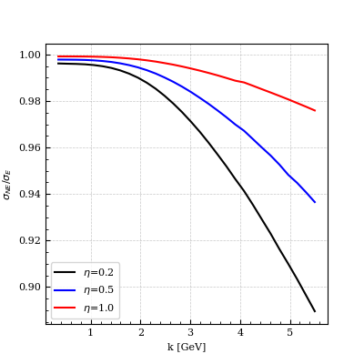
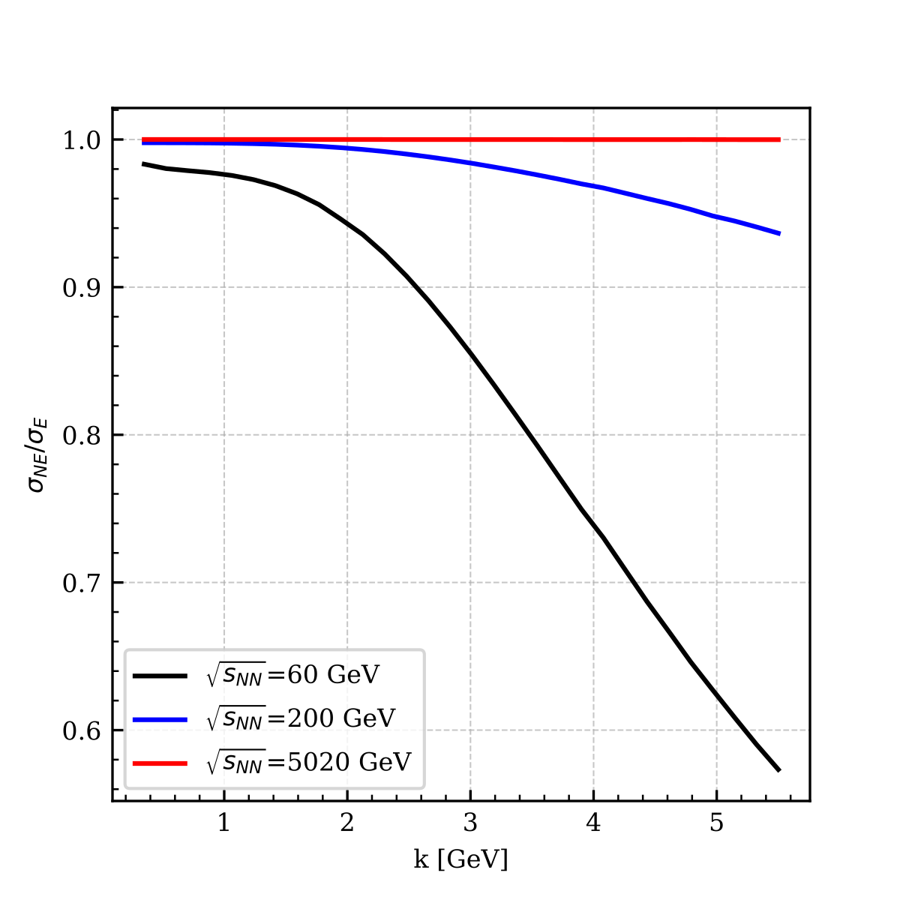
Results
Sizeable at mid-rapidty and large p_{T}
Sizeable at RHIC energies
$\sqrt{s_{NN}}=200 G\text{eV}\text{,}$ $Q_{s}=1 GeV and L_{0}=6 fm$
$η=0.5\text{,}$ $Q_{s}=1 GeV and L_{0}=6 fm$

Slide 14
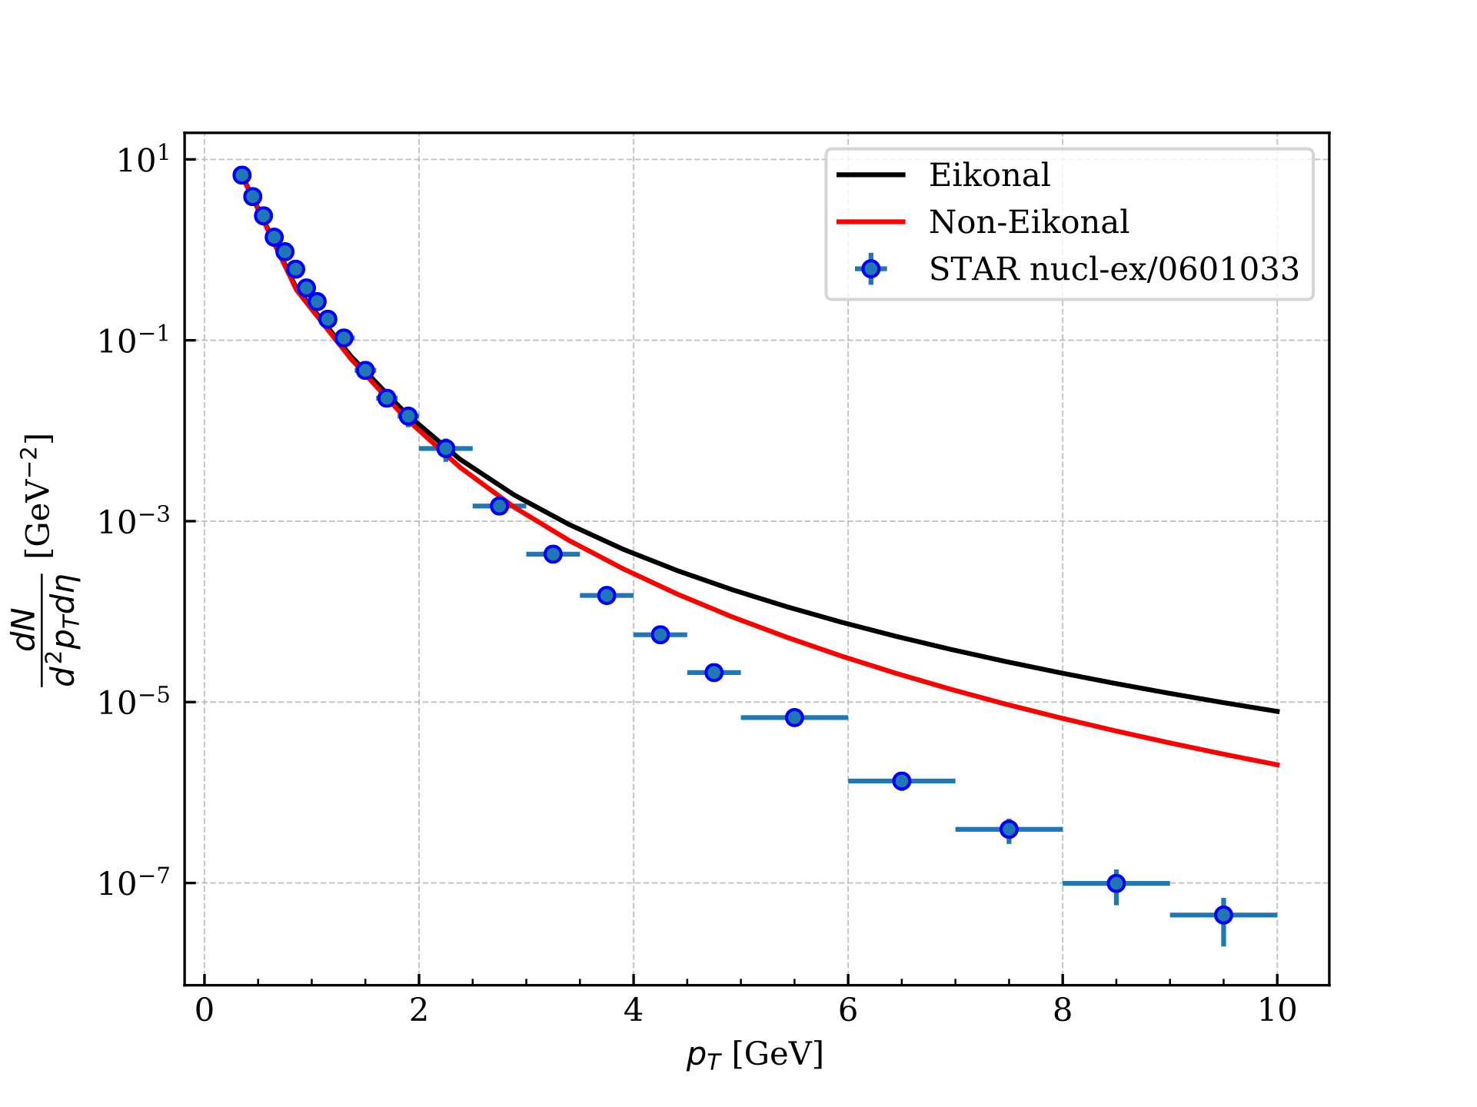
Results
Comparing with data
We convolute our result with a FF:
$$\frac{{dN}^{{p+A → π}^{+}+X}}{dηd^{2}k}=\int_{z_{min}}^{1}{\frac{dz}{z^{2}}D_{g}^{π^{+}}\left(z,Q=\left|k\right|\right)\frac{{dN}^{g}}{dηd^{2}k}}$$
[NLO NNFF1.0 arXiv:1706.07049]
STAR $d+Au→π^{+}+X$ at $\sqrt{s_{NN}}=200$ GeV
$\left|y\right|<0.5$ and centrality 0-20%
Our parameters:
$η=0.2$,$Q_{s}=1 GeV$
$L_{0}^{+}=7$ fm
The improvement with respect to the eikonal approximation is a factor 2 at large $p_{⊥}$!
!
Not attempting to fit data (ordinary NLO corrections are needed)

Slide 15
Conclusions
We have computed the dipole operators and single particle production beyond eikonal accuracy in dilute-dense scattering (pA)
Non-eikonal corrections are sizeable when $\sqrt{s_{NN}}<200 G\text{eV}$, $η<1$ and $p_{⊥}>2 GeV$ relevant for RHIC and EIC
We are working on computing double inclusive gluon production beyond eikonal accuracy in dilute-dense scattering and studying its azimuthal harmonics

Slide 16
Thank you!

