Slide 1
Itk Pixel Module work 2020
Chloe Stanton

Slide 2
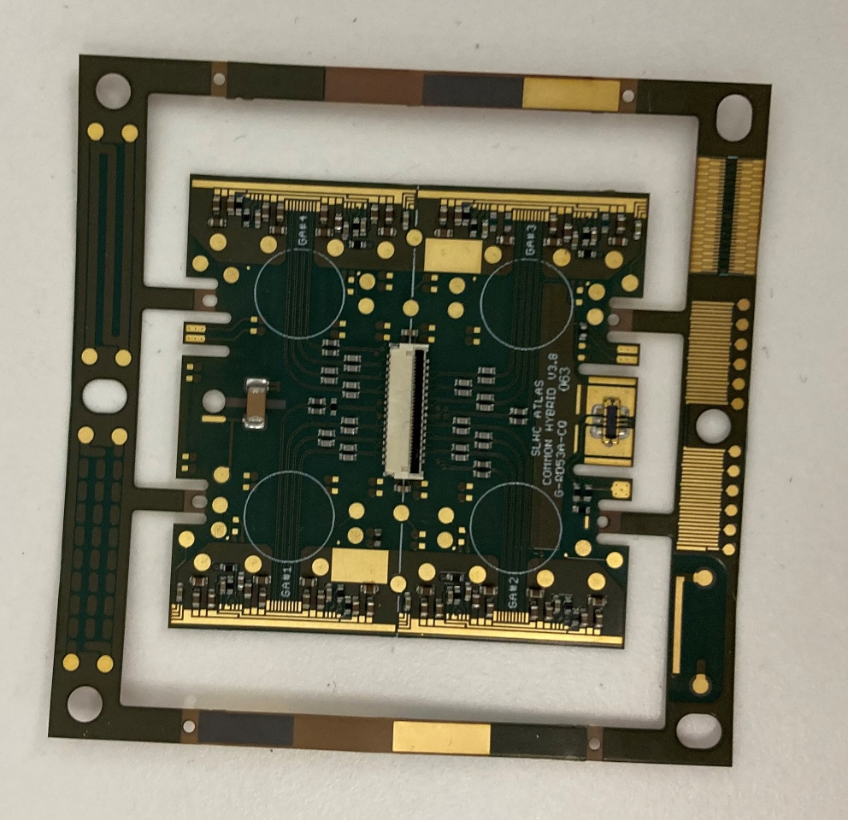
RD53A background
RD53A is the current iteration of a design that will eventually become the pixel modules that make up Itk.
As the name suggests, it is an R&D design and this current iteration will never make it into the Itk itself. We will learn all we can from it before iterating the design based on what we learn(already in progress)
Made up of a sensor bump bonded to an ASIC, and then glued to a flexible PCB (known as a hybrid).

Slide 3
Testing & Quality Control
Due to the nature of the module design and our requirements pushing the boundaries of what is technically possible to manufacture, we have a high rate of variability in many of the module characteristics.
Variability leads to defects, and the cost of failure in the detector due to a defect is massive, so variability must be reduced (six sigma methodology).
To reduce variability, we have to understand everything we can about the product design, our processes, and our people at this R&D stage so that we can control everything during mass manufacture. In such a large, geographically distributed team, this is very challenging.
I was a lead in doing this for the hybrid.

Slide 4
Failure Modes and Effects Analysis (FMEA) Methodology (a crash course)
Identify issues in the design and process
On a scale of 1 to 10, Rate the probability of it occurring, the severity of it occurring, and the likelihood of detecting it. (theres industry standards of how to assign the numbers)
The product of these three numbers is a Risk Priority Index (RPI)and lets you quantify problems and prioritise what needs to be fixed. Lower RPI the better, but youll never get 0 unless you design the problem out entirely. RPIs are relative and contextual to a given project.
If you cant do that (too late/expensive to go through another iteration, or just inherent to what youre designing) then you need to increase the likelihood of detection, and make your processes such that you detect it as early as possible > reducing the cost of failure.
You can never change the severity of the failure mode. Eg. if a given failure mode can kill someone, it can always kill them if it happens. All you can do is reduce its chance of happening, and increase the chance of catching a unit that will do it before it ever gets out into the field.

Slide 5
Test plan
I prepared a quality control plan for the hybrids to catch potential failures before they are assembled into modules (a costly process)
This involved taking detailed scans, validating copper thicknesses used in the stackup, probing for component misplacements, testing the voltage drop across power planes, leakage currents in high voltage nets, mass measurements and more.
Some of these tests will be redundant on all but a small sample per batch once we control the variability.
All data is recorded in a dedicated Itk production database, for people to cross check test results of full modules comprising these hybrids, and retrospectively identify what could be early indicators of failures in the hybrid stage, to increase future yields
The test plan has evolved over the year, and will continue to do so when the next revision of the design arrives.

Slide 6
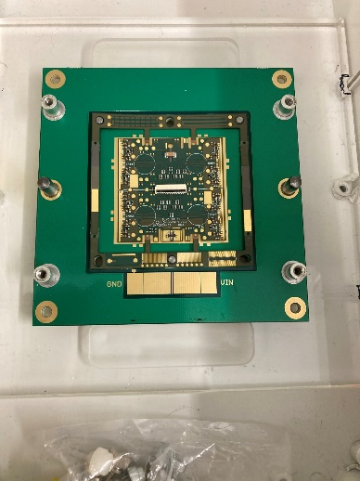
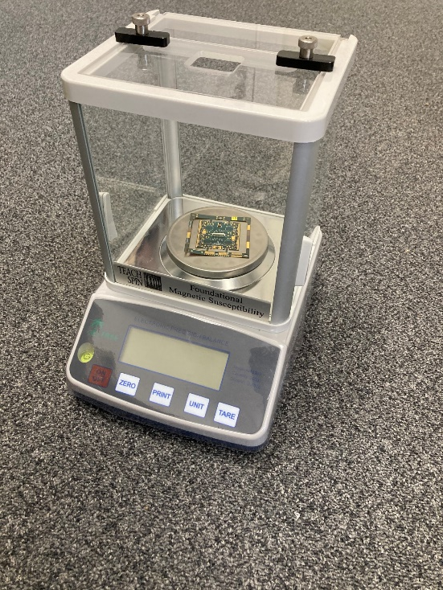
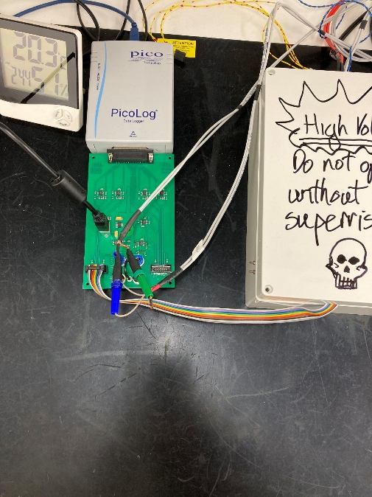
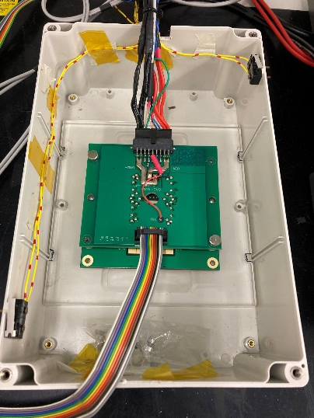
Testing the hybrids – some examples
Electrical
Testing
Mass measurements
Copper thickness measurement

Slide 7
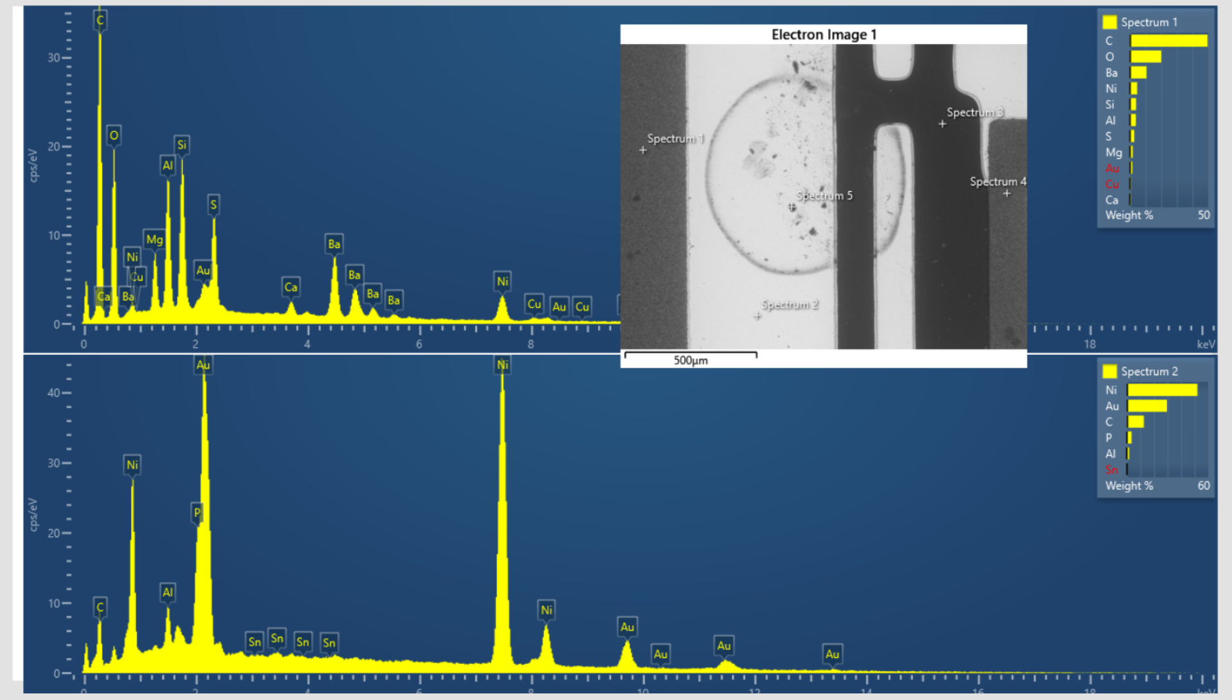
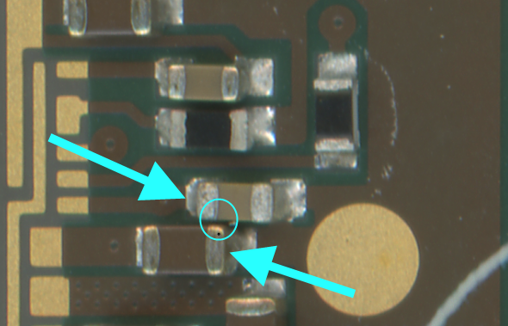
Examples of manufacturing issues identified
Organic contamination of wirebond pads leading to pad lifts rather than heel breaks when pull tested – investigations ongoing, controls in place to detect.
Short Circuits between capacitors arising from “best practice” layout rules being ignored by designer– designed out of next iteration.
Copper thicknesses trending downwards over the course of a batch – controls in place, but root cause still under investigation.
Inadequate traceability by manufacturer – take our business elsewhere in future and tell them to have a long hard look at themselves…

Slide 8
Future Procurement
Mass production will involve a request to tender, and the collaboration auditing any firms who respond. Through the testing that I have done, I took a lead role in developing an audit process that will be used to qualify potential manufacturers for the full production (>10k hybrids).
If we cant find suitable commercial grade manufacturers, then we would have to explore those who specialise in military/aerospace applications. They are far more expensive however, and you would still need to audit them.

Slide 9
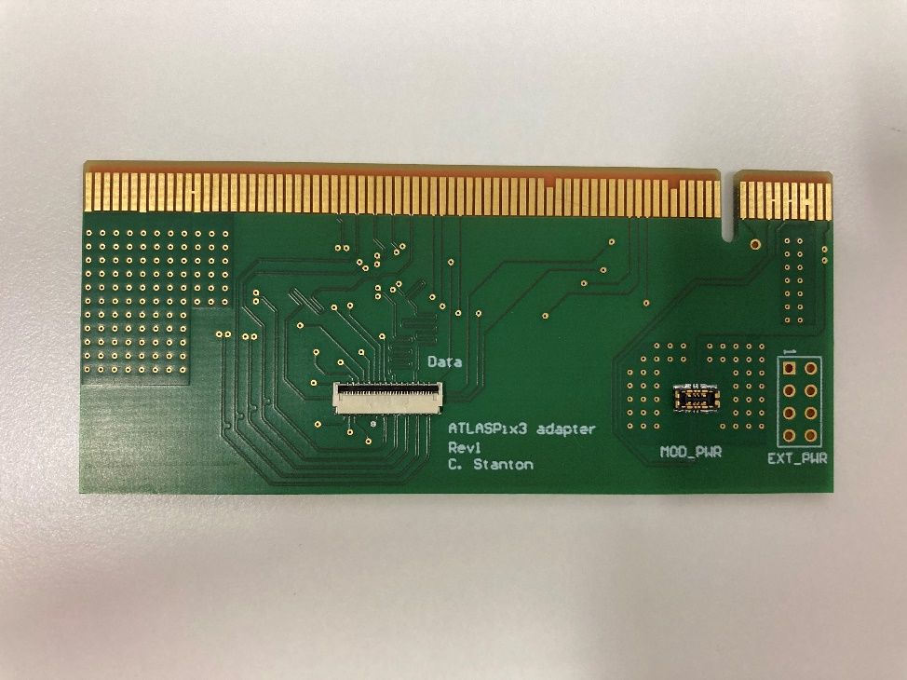
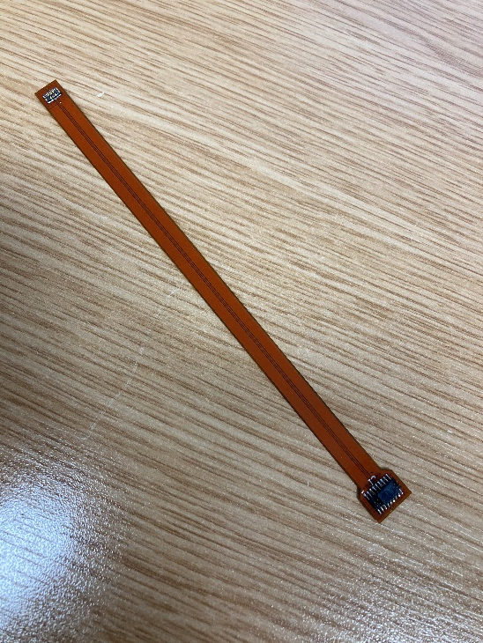
Other miscellaneous Itk related work
Designing pcbs used in testing for RD53A/ItkPixV1/ATLASPix3
Market survey, selection and testing of connectors used in the services – not very exciting so I wont spend time on it!

Slide 10
All that’s left to say is Goodbye!
Its been a pleasure ☺

