Slide 1
The IGM thermal history down to z ~ 1.5: a new curvature measurement
Elisa Boera
Collaborators:
Supervisor:
G. Becker
Michael Murphy
J. Bolton

Slide 2
Outline
The post- He II reionization IGM : the “footprint” of photo-heating
Previous results: uncertainties and new hypothesis
Applying the curvature method at low redshifts: what we need
Results: Temperature and heating models

Slide 3
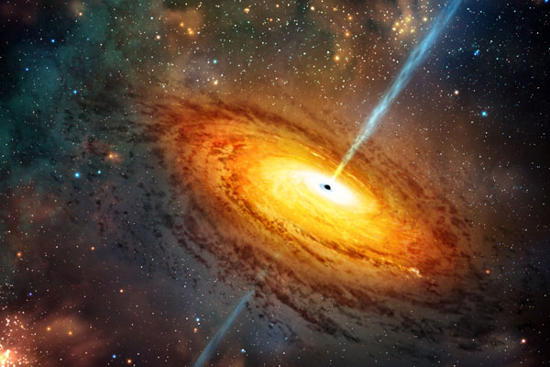
The He II reionization impact on the IGM
γ
HeII
I = 54.4 eV
HeIII
E_{γ}> 54.4eV
e⁻
E_{e-}=E_{γ} - I
Photo - heating
The electron will share its energy with the baryons

Slide 4
What do we expect to see?

Slide 5
He II reionization “footprint”: the temperature evolution
No reionizazion model
T₀/10³ K
He II reionizazion “model”
T at the mean density
15
10
5
0
1
2
3
4
5
z
He II reionization mark: a peak at redshift z~3 followed by rapid cooling due to adiabatic expansion

Slide 6
He II reionization “footprint”: the T-ρ relation
Δ= ρ / ρ
Gas overdensities
Slope power- law
T(Δ) = T₀ Δ^{γ-1}
Temperature at the mean density
He II reionizazion flattening
^{γ}
1.6
1
0
0
1
2
3
4
5
z

Slide 7
Why it is important to constrain the thermal history of the low redshift IGM ?
To test predictions
To constrain the He II reionization
To study ionising sources
To study the chemical & thermodynamic conditions for structures formation
Notes:
Test prediction / detect/constrain/ionizing sources t & c for galaxy and structure formation ?

Slide 8
What was found?

Slide 9
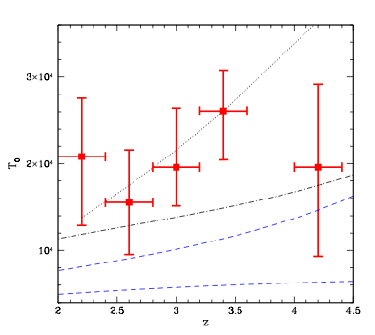
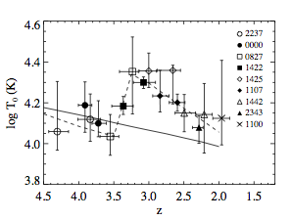
Previous Results
T₀
Schaye et al. 2000:
Line fitting
Lidz et al. 2009: wavelet analysis
Garzilli et al. 2012: wavelet + PDF
Notes:
… large uncertainties and not clear evidence for the He II reionization peak

Slide 10
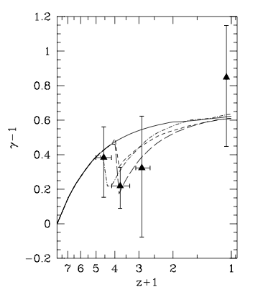
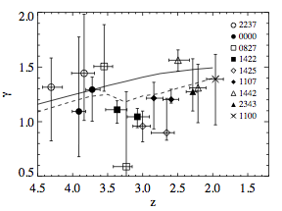
Previous Results
γ
line fitting
Ricotti et al. 2000
Schaye et al. 2000
PDF
Becker et al. 2007
(γ< 1) at z < 3
Bolton et al 2008, Viel et al. 2009, Calura et al. 2012, Garzilli et al. 2012
Notes:
In terms of a flattening of the T-ρ relation…
Inverted T-rho reation at z<3 Becker et al. first suggestion, after him further evidences from…

Slide 11
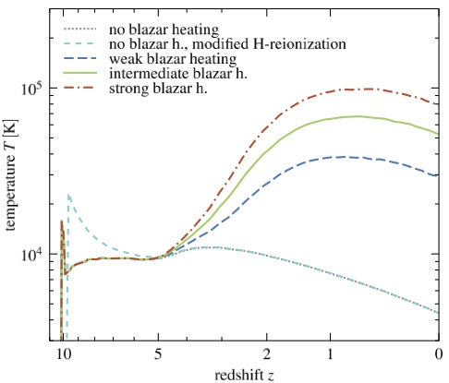
Lower density regions show higher temperature
γ < 1
T(Δ) = T₀ Δ^{γ-1<0}
Chang et al. 2011: NEW VOLUMETRIC HEATING FROM BLAZAR TeV EMISSION
Low-redshift region
Blazar heating models
photo-heating model
Puchwein et al. 2012
Notes:
… large uncertainties and possible evidence for an inverted (γ<1) T-ρ relation

Slide 12
?
What is the thermal state of the IGM at low redshift (z< 3) and which are the possible heating processes that could explain it

Slide 13
The curvature statistic
✔
Simple to compute
F
κ =
Derivatives of the flux
κ =
[1+( F )² ]^{3/2}
Becker et al. 2011
✔
Systematic uncertainties minimized

Slide 14
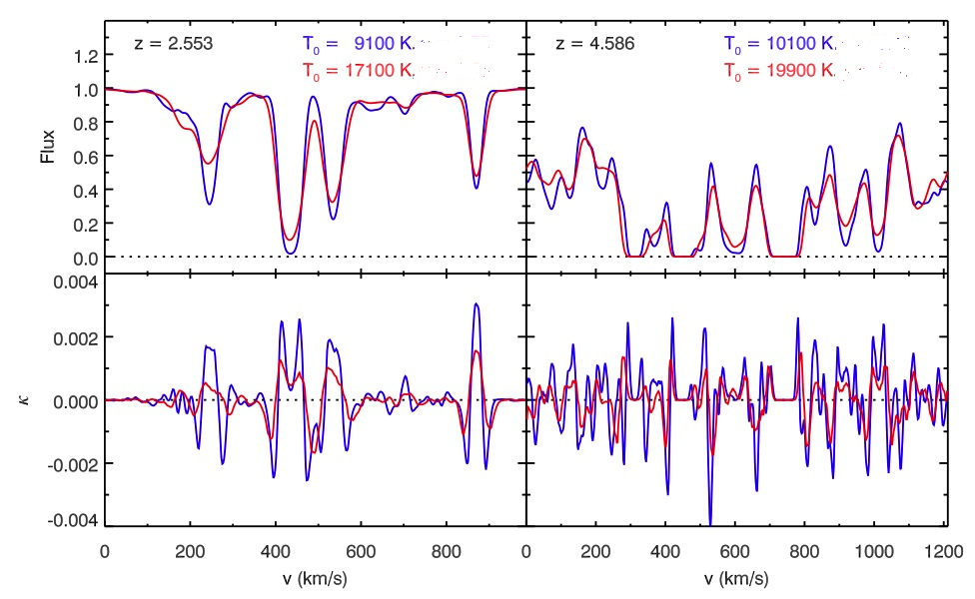
✔
The overall amplitude of the curvature is greater at the lower temperature
Sensitive to the IGM temperature
Becker et al. 2011

Slide 15
Maintains degeneracy between T₀ & γ
< lκl>
Overdensities traced by the Ly-α forest
Hydrodynamical simulation
ρ
T(Δ)
Δ > >
BUT…
The Ly-α forest not always traces the gas at the mean density (ρ)
Δ= 1
Becker et al. 2011
Notes:
The gas shows overdensities much higher than the mean

Slide 16
The curvature statistic
T(Δ)
T₀
We need to constrain γ !
T(Δ) = T₀ Δ^{γ-1}
Degeneracy

Slide 17
Previous curvature results with the curvature statistic
Gradual reheating
Evidence for the peak of He II reionization very tenuous
T(Δ)
New measurements needed at lower redshift z < 2.0
Becker et al. 2011
Notes:
At high redshifts the forest tend to be sensitive at overdensities near the mean
Extend with new data the previous results of the curvature method to the region at low redshift (z < 2.0).
New estimation at lower redshift of the IGM temperature evolution history
Why it is important?
… for the first time we are able to push the measurements down to z~1.5
Thanks to a new archive of high S/N and high resolution UVES spectra
… the redshift range is crucial for constraining the He II reionization
… a direct comparison among different models of thermal histories is possible right in the regime where they mostly diverge

Slide 18
General plan of the project
Data preparation
< lκl>
Simulation by J. Bolton
T(Δ)
T₀

Slide 19
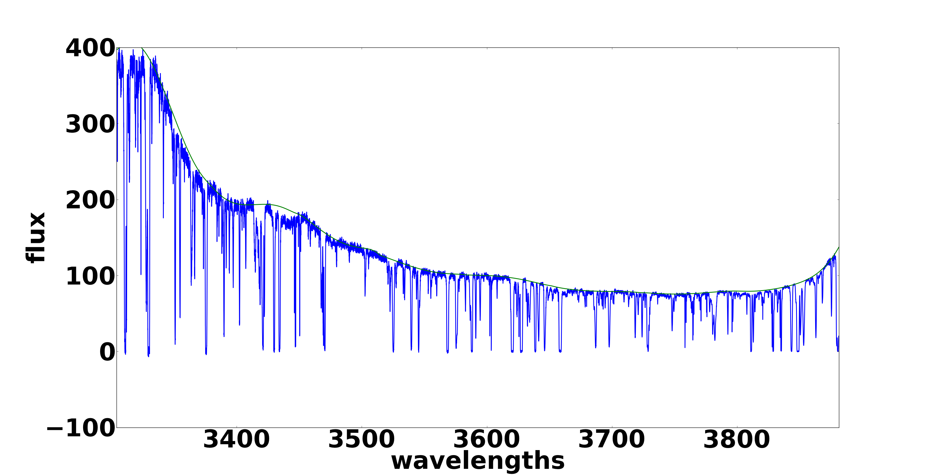
Data analysis: preparation of the data
60 spectra
high S/N
1.5 < Ζ_{Lα} < 3
UVES archive selection
C/N>24

Slide 20
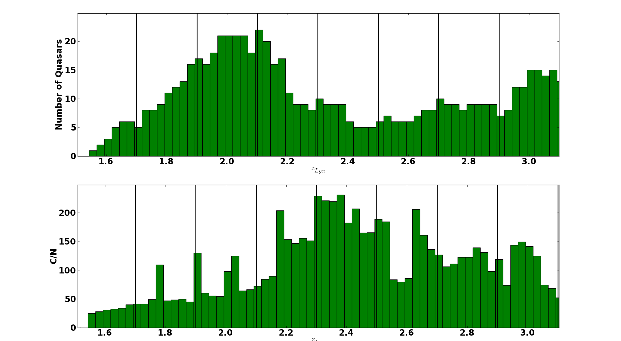
Data sample
C/N>24

Slide 21
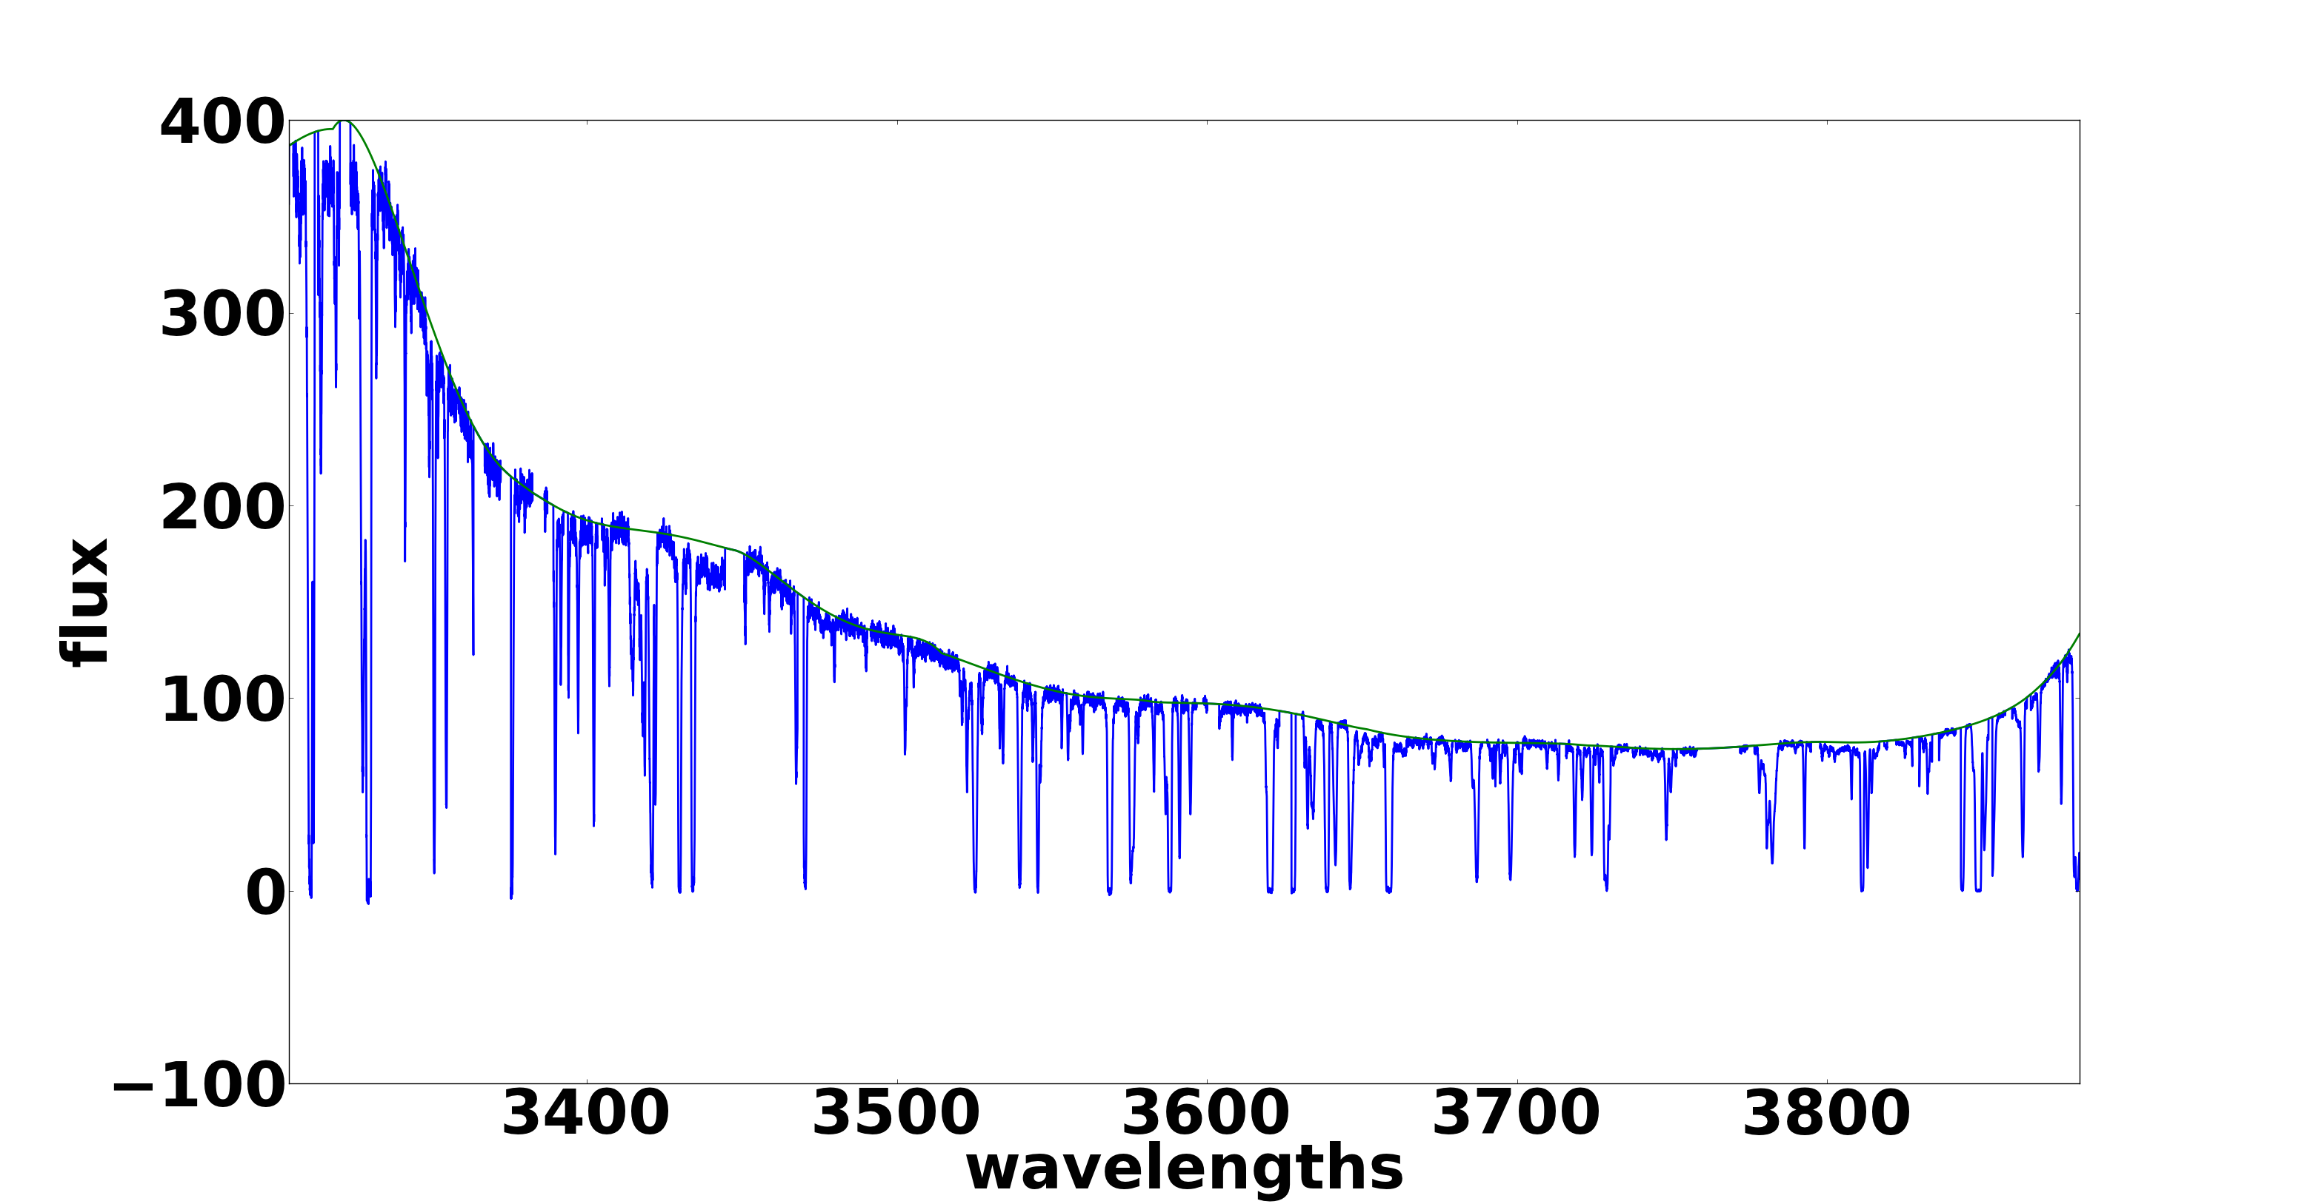
Data analysis
10h⁻¹Mpc

Slide 22
Data analysis: curvature measurements
b – spline fit
Mean absolute curvature < lκl>
Mean flux

Slide 23
Data analysis: curvature results

Slide 24
General plan of the project
Data preparation
< lκl>
Simulation by J. Bolton
T(Δ)
T₀

Slide 25
Simulation analysis
Different thermal histories
Different T₀ & γ
Hydrodynamical simulations
(GADGET 3)
2*512³ particles
Box size: 10 h⁻¹ Mpc
Instrumental resolution
Optical depth
Synthetic spectra in the same z range of the data
noise

Slide 26
Simulation analysis: curvature results

Slide 27
General plan of the project
Data preparation
< lκl>
Simulation by J. Bolton
T(Δ)
T₀

Slide 28
Final analysis
< lκl>
T(Δ)
Simulations
Empirical search for T(Δ) at each z
Interpolation of the T(Δ)-log< lκl> with the data values

Slide 29
Results: IGM temperature at the characteristic overdensities
The results overlap
Possible dip

Slide 30
General plan of the project
Data preparation
< lκl>
Simulation by J. Bolton
T(Δ)
T(Δ) = T₀ Δ^{γ-1}
T₀

Slide 31
Results: IGM temperature at the mean density

Slide 32
Summary
We obtained measurements of the temperature at the lowest possible optical redshifts
Not strong statistical evidence for a structure at low redshift for T(Δ)
No clear evidence for a peak due to He II reionization
The results do not seem favor strongly any blazar heating model but there is still degeneracy between T₀ and γ

Slide 33
THANKS !

Slide 34
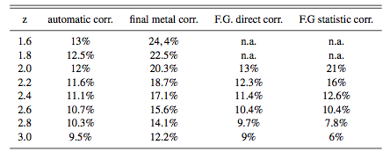
Metal correction

Slide 35
Metal correction: curvature

