Slide 1
Towards a Universal Decomposition of Phase-Space Integrands
David A. Kosower Institut de Physique Théorique, CEA–Saclay and CERN
work with Ben Page (CERN), [2211.14156]
RADCOR 2023 May 29–June 2, 2023

Slide 2
Taming Jets’ Hair
LO — each jet modeled by a lone parton
NLO — virtual: same; IR divergences in loop integrals — real-emission, some jets modeled by pair, IR divergences in phase-space integrals
NNLO — double-virtual: lone parton, IR divs in loop integrals — mixed: mixed divergences — double-real: IR divergences in phase-space integrals
Need to cancel divergences
Ideally point-by-point in jet phase space

Slide 3
Approaches at NLO
Cancel in physical observables (not point by point in jet phase space)
Slicing — integrate analytically in singular regions, numerically in hard regions
Giele & Glover; Giele, Glover, & DAK
— modern revival with n-jettiness & $q_{T}$ slicing
Stewart, Tackmann, & Waalewijn; Catani & Grazzini
Subtraction — subtract singular behavior, resulting integral finite — integrate singular functions analytically, subtracted numerically
Catani & Seymour; Frixione, Kunszt, & Signer; Nagy & Soper; Bevilacqua, Czakon, Kubocz, & Worek
NNLO
Generalizations of NLO subtraction schemes
Gehrmann-De Ridder, Gehrmann, & Glover; Weinzierl; Braun-White, Glover, Preuss Del Duca, Duhr, Kardos, Somogyi, Szőr, Trócsányi, & Tulipánt; Czakon; Magnea, Maina, Pelliccioli, Signorile-Signorile, Torrielli, Uccirati; Bertolotti, Torrielli, Uccirati, Zaro;
Caola, Devoto, Melnikov, Röntsch, Signorile-Signorile, Tagliabue, …
Hybrid schemes: combine Catani–Seymour subtraction with slicing
Stewart, Tackmann, & Waalewijn; Catani & Grazzini
Hard problem: complicated and general algorithm emerging slowly
Talks here: Bertolotti; Marcoli; Signorile-Signorile; Braun-White

Slide 4
Framework
Virtual @ NLO: $n$ partons → $n$ (proto)jets
Same mapping as LO (tree-level)
${\left\{k_{j}\right\}}^{n}$ ${\left\{{\hat{k}}_{j}\right\}}^{n}$
Real Emission @ NLO: $n+1$ partons → $n$ (proto)jets
${\left\{k_{j}\right\}}^{n+1}$ ${\left\{{\hat{k}}_{j}\right\}}^{n}⊕k_{r}$
integrate over $k_{r}$
Do phase-space integral exactly in $D=4−2ε$
Mixture of analytic and numerical
Want to align phase spaces, expose analogy between virtual and real-emission

Slide 5
Framework
Initial view: express protojets in terms of partons
“clustering”
$${\hat{k}}_{i}={\hat{k}}_{i}({\left\{k_{j}\right\}}^{n+1})$$
$$k_{r}=k_{r}({\left\{k_{j}\right\}}^{n+1})$$
Factorize phase space (exact)
Inverse view: express partons in terms of protojets and “singular” emission
“declustering”
$$k_{j}=k_{j}({\left\{{\hat{k}}_{i}\right\}}^{n},k_{r})$$
Work with variables that are invariants of protojet momenta

Slide 6
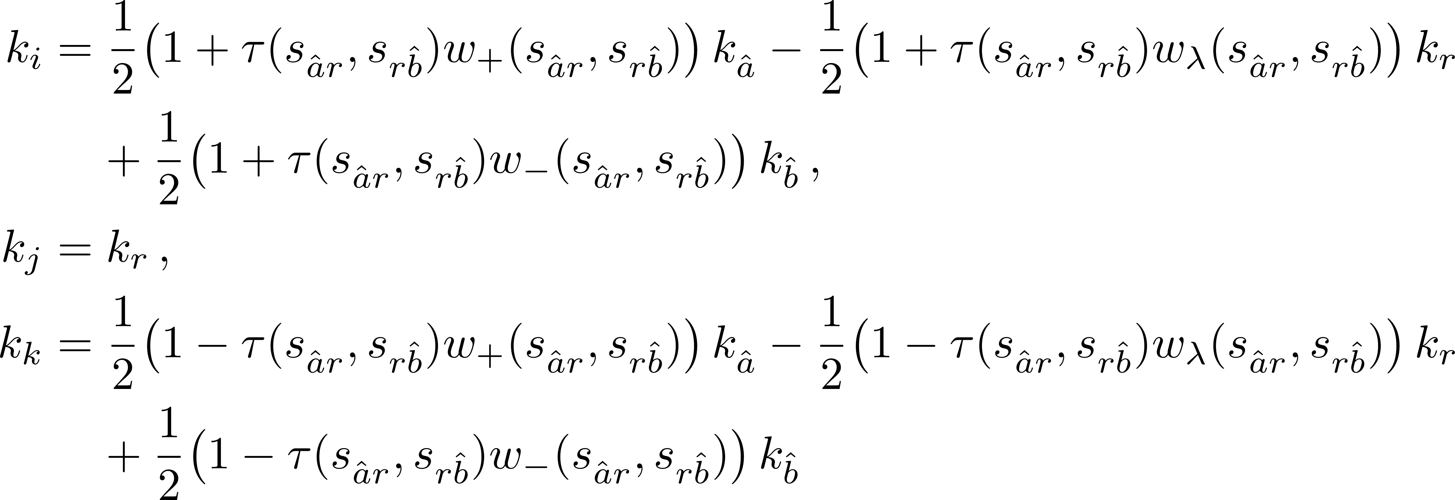
Inverse Antenna Mapping
Maps protojets → partons, so that we can write
original partons as f(protojets, real emission $k_{r}$)
Ultimately, all invariants are functions of $τ, \hat{λ}, s_{\hat{a}r},s_{r\hat{b}},s_{r1}, s_{r2}$, and external invariants (treated as inert)

Slide 7
Vision of the Destination
If you don't know where you're going, you'll end up someplace else. —Yogi Berra
Master-integral decomposition of multi-emission phase-space integrals
⇑
Master-integral decomposition of single-emission phase-space integrals
⇑
Decomposition of single-emission phase-space integrands: squares of tree amplitudes
⇑

Slide 8
A thousand-mile journey begins with a single step
Paraphrase of Laozi (between 2300 – 2500 yrs ago)
Decomposition of tree amplitudes with one emission
Suitable mapping to isolate emission ~ “theoretical” jet algorithm
Classification of amplitudes
Computational algebraic geometry

Slide 9
Decomposition of One-Loop Integrands
First: integrands with trivial numerators
Integrand of hexagon
External momenta strictly in $D=4$
Use Gram determinants

Slide 10
Scalar Hexagon Decomposition
Six denominators $D_{j}={\left(ℓ−K_{1,j}\right)}^{2}$
Write a Gram identity
Vanishing is nontrivial
And put it over the denominator

Slide 11
New Lyrics to an Old Melody
like the Lichtenstein National Anthem
Look at singularities on both sides of the decomposition
Both are singular when any $D_{j}$ vanishes
What happens when all $D_{j}$ vanish simultaneously?
Left-hand side (6 powers) appears more singular than right-hand side (5 powers)
Consistent only if all $D_{j}$ cannot vanish simultaneously
Obstruction must be dependent on external momenta in $D=4$

Slide 12
Inconsistency of Equations
Need to show that simultaneous equations
have no solution
Use computational algebraic geometry

Slide 13
A Foreign-Language Lesson
Study systems of polynomial equations in variables $x_{i}$
We start with some basis polynomials $P_{j}(x_{i})$, or generators
coefficients are numbers, or rational functions of other variables
Consider all polynomials built out of them
$$Q\left(x_{i}\right)=f_{j}\left(x_{i}\right) P_{j}\left(x_{i}\right)$$
This is the ideal generated by the $P_{j}(x_{i})$: $⟨P_{j}⟩$

Slide 14
A Foreign-Language Lesson
Questions we want to ask:
What is the “simplest” set of polynomials $P_{j}$ that generate the ideal?
Can a polynomial $Q_{2}(x_{i})$ be written in terms of the $P_{j}$?
Can we recover the coefficients $f_{j}$?
Are the equations $P_{j}\left(x_{i}\right)=0$ consistent?
To answer them
We need to choose an ordering of monomials $x_{1}^{i_{1}}x_{2}^{i_{2}}⋯x_{n}^{i_{n}}$
Build a Gröbner basis, a special set of generators that allows us to answer these questions
A Gröbner basis and ordering
Makes the result of polynomial division independent of ordering
Makes the membership question equivalent to zero remainder
Gives us an equivalent set of equations to $P_{j}=0$
In particular, the equations have no solution iff the GB is $\{1\}$

Slide 15
Back to the Hexagon Reduction
Show the ideal generated by the $D_{j}$ and $G_{1}$ is the unit ideal $\left\langle 1\right\rangle$
Compute the Gröbner basis
In that case, cofactor matrix would give coefficients
$$c_{j}D_{j}+c_{0}G=1$$
Which gives us the explicit partial fractioning

Slide 16
Tree Amplitudes
Apply this to tree amplitudes
Express partons $k_{i}, k_{j}, k_{k}$ in terms of protojets $k_{\hat{a}}, k_{\hat{b}}$ and singular emission $k_{r}$: inverse antenna mapping
$k_{r}$ plays the role of $ℓ$
Analog of hexagon are tree amplitudes with five denominators: eight-point amplitudes

Slide 17
Simple Example
Contribution $\frac{1}{s_{j3}s_{j34}s_{j345}s_{j1345}s_{j12345}}$
$S_{1}=s_{j3}, S_{2}=s_{j34}, S_{3}=s_{j345}, S_{4}=s_{j1345}, S_{5}=s_{j12345}$
Build a Gram
It gives a similar decomposition

Slide 18
Harder Case
No simple identity as for the simple example
Need to add functions imposing mapping constraints
$T_{1}=s_{i4}, T_{2}=s_{j1}, T_{3}=s_{i45}, T_{4}=s_{j12}, T_{5}=s_{j123}$
$Z_{j}$ vanish on physical configurations
Too computationally difficult in standard variables
Use finite-field values for protojet momenta, invariants of protojets & emitted parton

Slide 19
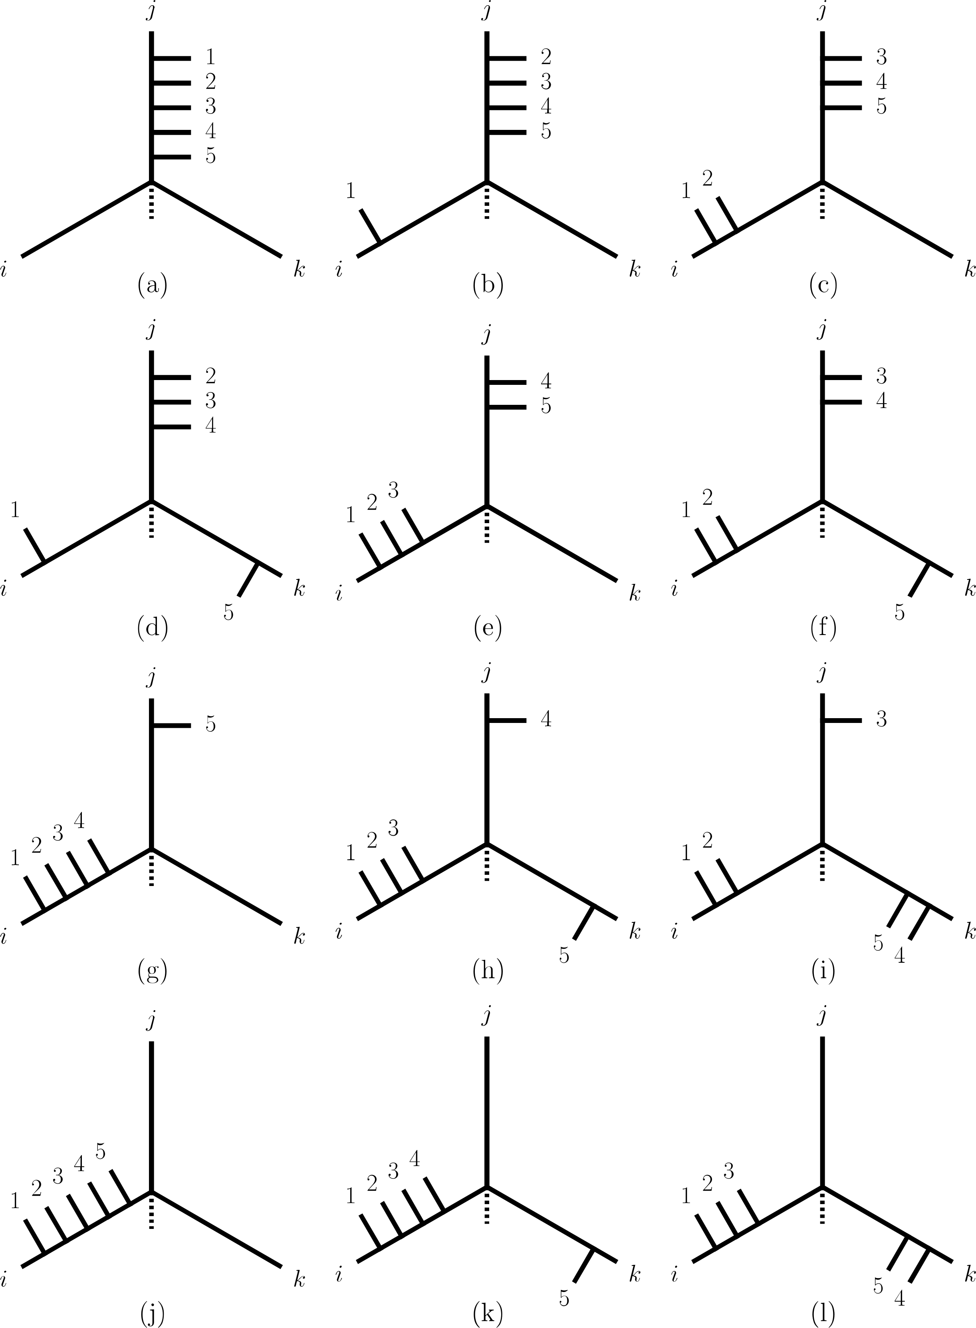
Triskelia
a well-known triskelion
Classify all possible contributions: focus on all possible arrangements of the three recombining partons
Lines from each inwards will ultimately meet at a center
Number and types of legs attached give different triskelia
Twelve major classes, subclasses depending on masses

Slide 20
Survey
Consider 1152 triskelia (after symmetries)
All yield unit Gröbner basis
In all cases, coefficients can be made independent of $k_{r}$
Results independent of external masses
Simplify numerators using similar ideas

Slide 21
Summary
First step towards decomposing phase-space integrals into master integrals
Recast one-loop integral reduction into language of computational algebraic geometry
Generalizes to allow partial-fractioning of any cubic contribution to a tree-level scattering amplitude
Finite basis of master integrals

