Slide 1




CPV & LFV/LFU @ Belle II
Boštjan Golob
University of Ljubljana/Jožef Stefan Institute
& Belle/Belle II Collaboration
Introduction
(Examples of...)
LFU
LFV
CPV
Summary
University
of Ljubljana
“Jožef Stefan”
Institute
Heavy Flavor 2016
Quo Vadis?

Slide 2
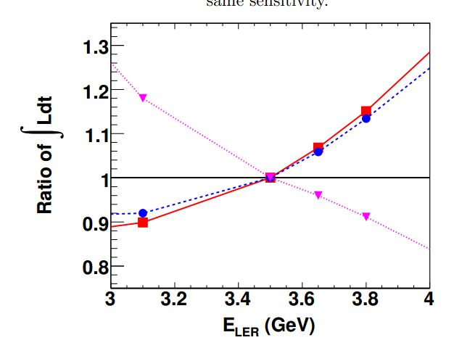
Introduction
“SuperKEKB” Accelerator
Lumi ratio for same sensitivity
e⁻ (HER): 7.0 GeV
e⁺ (LER): 4.0 GeV
E_{CMS}=M(Υ(4S))c²
dN_{f}/dt = σ(e⁺e⁻→f) L
L =8x10³⁵ cm⁻² s⁻¹
B → φK_{s}
B → J/ψK_{s}
B → τν
Belle
Belle 2
E^{e+}_{beam}
5 ab⁻¹
20 ab⁻¹
Phase 1:
w/o QCS, Belle 2
Phase 2:
w/ QCS, Belle 2
(no VXD)
Phase 3:
full Belle 2
2016 2017 2018 2019 2020 2021
Phase 1
Phase 2
Phase 3
QCS, Belle 2
VXD
35 ab⁻¹
50 ab⁻¹
2022 2023 2024 2025 2026 2027 2028

Slide 3

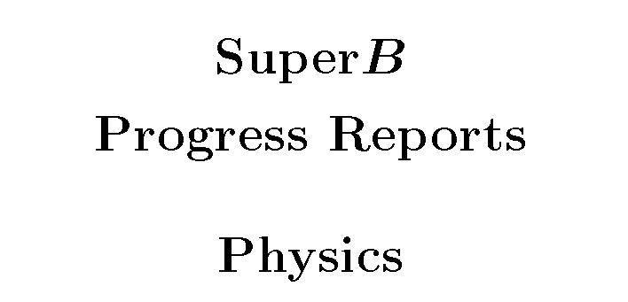
Subjects
Methods and processes where Belle 2 can provide
important insight into NP complementary to other experiments:
E_{miss}:
B(B→ τν), B(B → X_{c}τν), B(B → hνν),...
(Semi)Inclusive:
B(B → sγ), A_{CP}(B → sγ), B(B → sll ), ...
Neutrals:
S(B → K_{S}π⁰γ), S(B → η’ K_{S}), S(B → K_{S}K_{S}K_{S}), B(τ → μγ), B(B_{s} → γγ), ...
Detailed description of physics program at Belle 2 in:
The Physics of the B Factories
A.G. Akeroyd et al., arXiv: 1002.5012
B.G.,, K, Trabelsi, P. Urquijo, BE LLE2-NOTE- PH-2015-002
Impact of Belle II on Flavor Physics
Ed. A.J. Bevan, B. Golob, Th. Mannel, S. Prell, and B.D. Yabsley,
Eur. Phys. J. C74 (2014) 3026
P. Urquijo, BE LLE2-NOTE- PH-2015-002
Belle I I - LHCb measurement
extrapolation comparisons
B. O’Leary et al., arXiv: 1008.1541

Slide 4
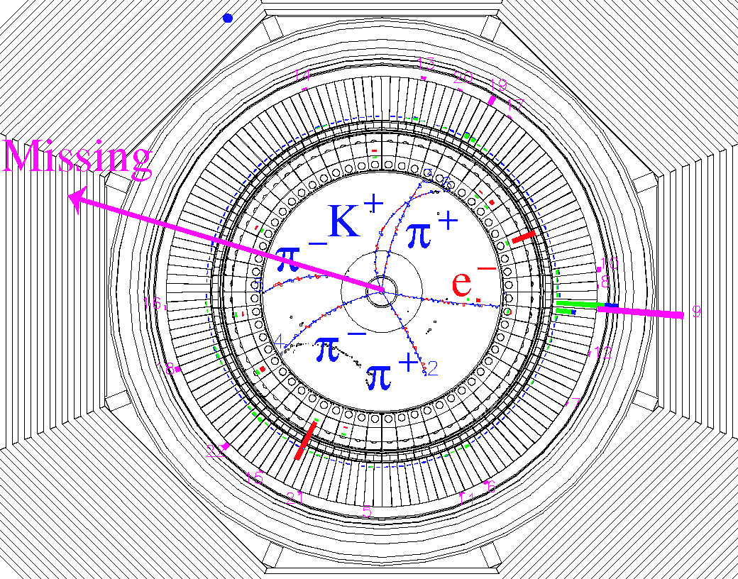

LFU/Missing energy
B → τν, hνν, X_{c}τν,...
possible to reconstruct
events with ν‘s;
fully (partially) reconstruct
B_{tag};
reconstruct h± from B_{sig};
no additional energy in
EM calorim.;
signal at E_{ECL}~0;
Partial reconstruction (semileptonic tagging):
ε_{tag}~1%
Missing E
(ν)
B_{tag}
B_{sig}
B_{sig} → τν
candidate
event
D*±
B_{sig}
l○
B_{tag}
ν

Slide 5
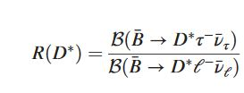

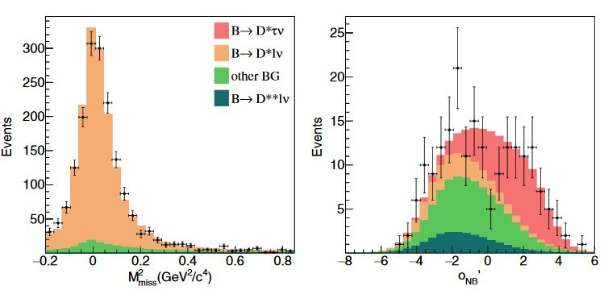
LFU/Missing energy
B → D*τν
R(D⁽*⁾)
R(D)_{SM}=0.300 ±0.008
R(D*)_{SM} =0.252 ±0.003
use NN with M²_{miss},
E_{vis}, cosθ_{B-D* l} ^{sig}.
data sample with
low M²_{miss} used to
fit the background
contribution
l =e,μ
Belle, arXiv:1603.06711, 700 fb⁻¹
H. Na et al., Phys.Rev.D 92, 054410 (2015)
S.Fajfer et al., Phys.Rev.D85(2012) 094025
signal is to the
right →
NN output for data
with M²_{miss} >
0.85 GeV²

Slide 6
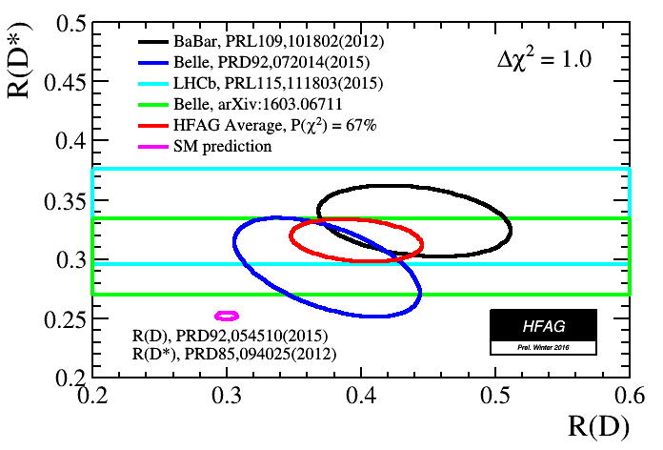
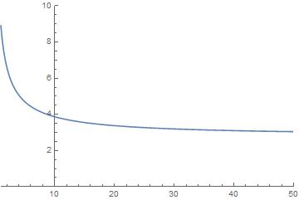
LFU/Missing energy
B → D*τν
R(D*)=0.302±0.030±0.011
Belle, arXiv:1603.06711, 700 fb⁻¹
σ(R(D*))/R(D⁽*⁾)[%]
HFAG,
http://www.slac.stanford.edu/xorg/hfag/
4σ discrepancy with SM
3.5 σ from SM @ 5 ab⁻¹
5 σ from SM @ 20 ab⁻¹
L [ab⁻¹]

Slide 7
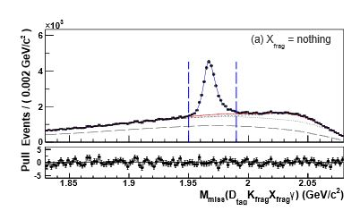
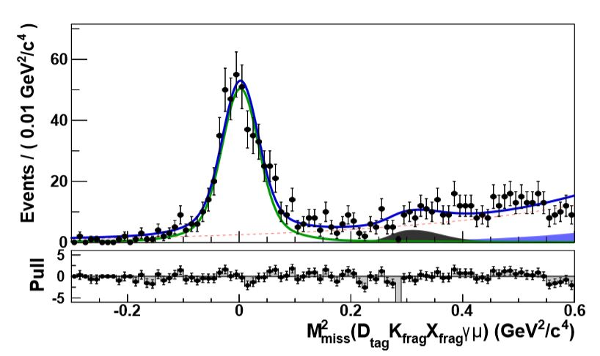
LFU/Missing energy
D_{s} → l ν
inclusive D meson reconstr.
cc → D_{tag} D_{s}* (→ D_{s} γ) K_{frag} X_{frag}
M_{miss}(D_{tag} γK_{frag}X_{frag}) = M_{Ds}
D_{s} → μν
M_{miss}(D_{tag} γK_{frag}X_{frag} μ) = M_{ν}
inclusive reconstruction of D_{s}
Belle, JHEP09, 139 (2013), 900 fb⁻¹
reconstruction of D_{s}→μν

Slide 8

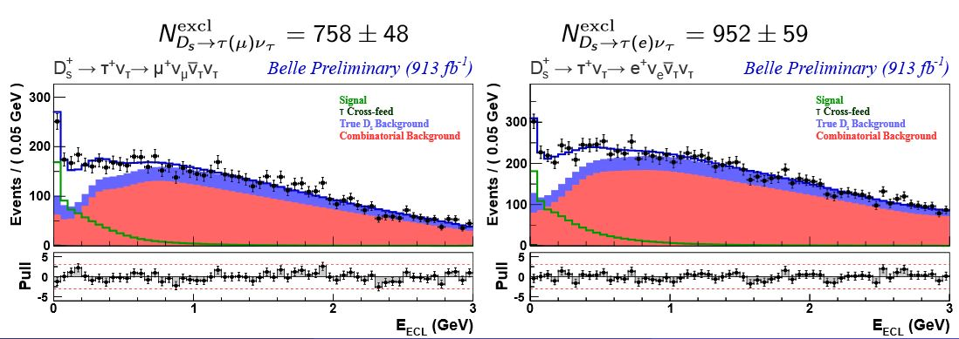
LFU/Missing energy
D_{s} → l ν
D_{s} → τν
E_{ECL}
Belle, JHEP09, 139 (2013), 900 fb⁻¹

Slide 9
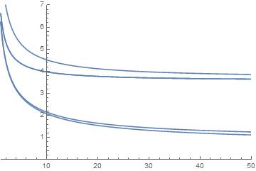
LFU/Missing energy
σ(X)/X[%]
D_{s} → l ν
B.G.,, K, Trabelsi, P. Urquijo, BE LLE2-NOTE- PH-2015-002
R^{Ds}_{τ/μ}
Br(D_{s} → μν)
Br(D_{s} → τν)
R^{Ds}_{τ/μ}= Br(D_{s} → τν) / Br(D_{s} → μν)
R^{Ds}_{τ/μ}=10.73 ± 0.69 ± 0.55
(R^{Ds}_{τ/μ})_{SM}= 9.762 ± 0.031
Belle, JHEP09, 139 (2013), 900 fb⁻¹
L [ab⁻¹]
n.b.: σ(R(D*))/R(D⁽*⁾) ~4% @20 ab⁻¹

Slide 10
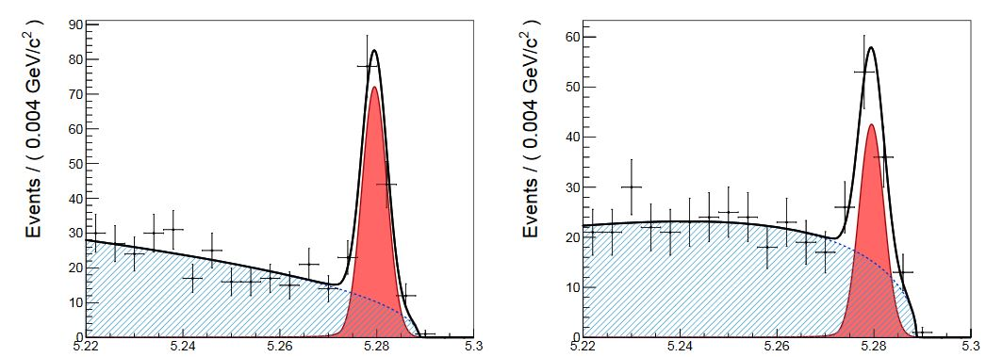
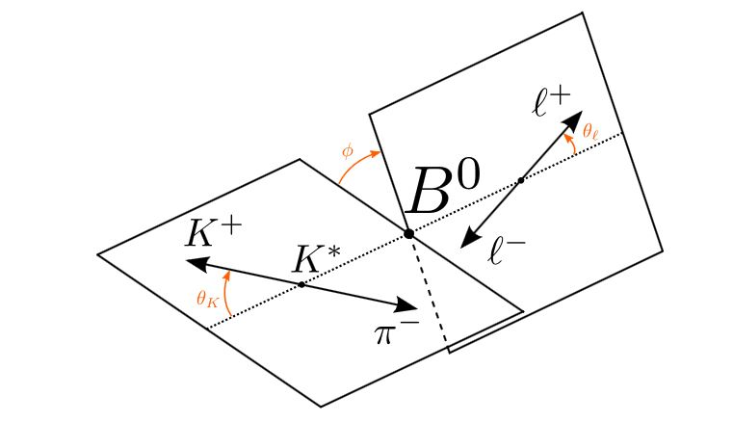
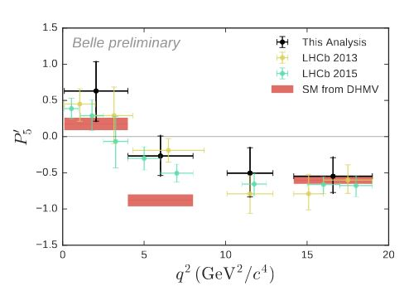
LFU/B →K* l l
B → K*l l
angular analysis
B → K*μμ
B → K*ee
N_{sig}=118±12
N_{sig}=69±12
Belle, arXiv:1604.04042, 700 fb⁻¹
P₅‘
LHCb, JHEP 1308 (2013) 131

Slide 11
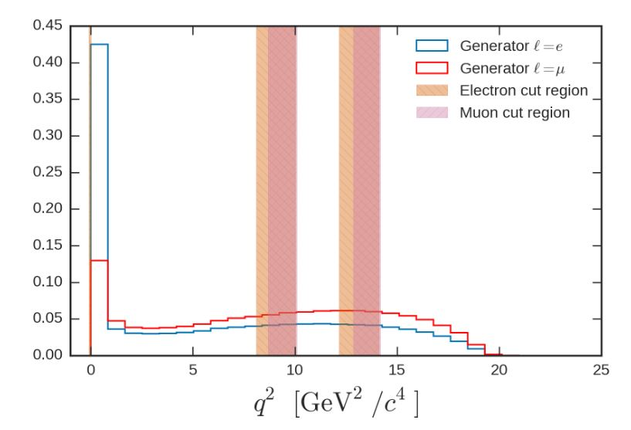
LFU/B →K* l l
B → K*l l
R(K*)=
N(B → K*ee)
N(B → K*μμ)
approximate stat.
uncertainty on
R(K*)
Belle, arXiv:1604.04042, 700 fb⁻¹
L [ab⁻¹] 0.7 5.0 20.0

Slide 12
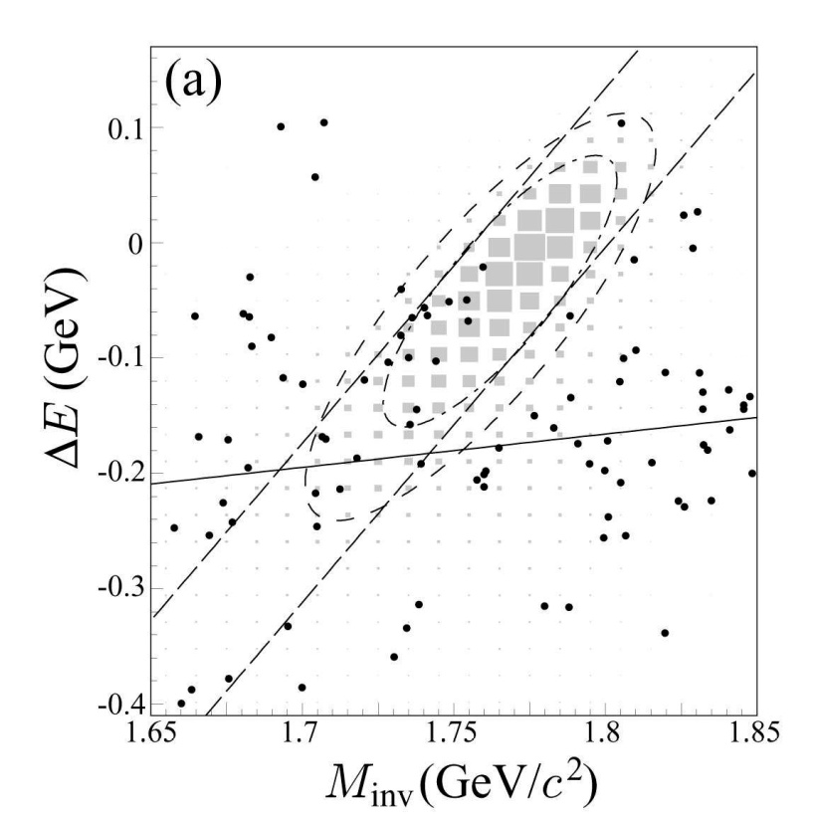
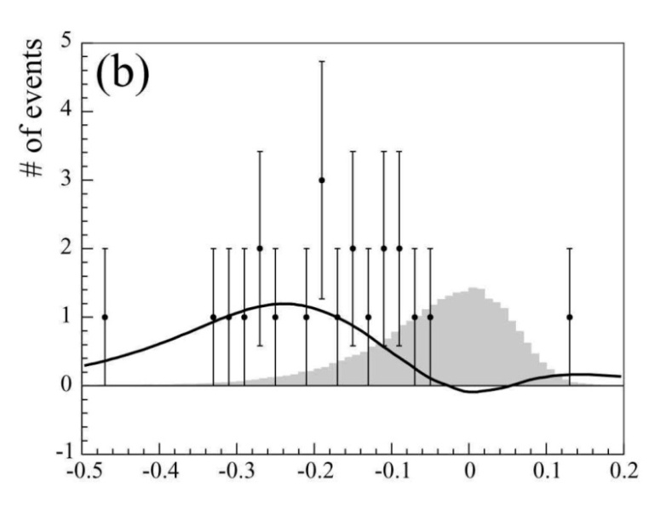
LFV/τ → μ γ
ε
τ → μ γ
γ
Belle, PLB66, 16 (2008), 535 fb⁻¹
μ
τ
kinematic variables
for signal isolation:
ΔE=E^{CM}(μγ)-E^{CM}(beam)
M_{inv}=m(μγ)
main background from
ee→ τ(μνν) τ(πν) γ_{ISR}
Br^{UL} ∝ 1/ √L
e
e
τ
π
signal
ν
ν
ν
γ
μ
expected sig.
B ∼5x10⁻⁷
τ
e
e
τ
π
background
ν
ε

Slide 13
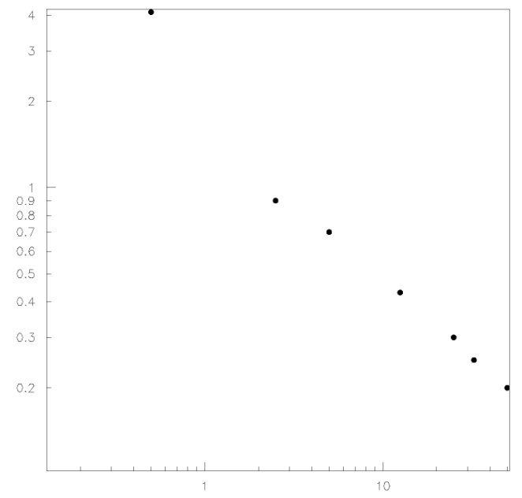
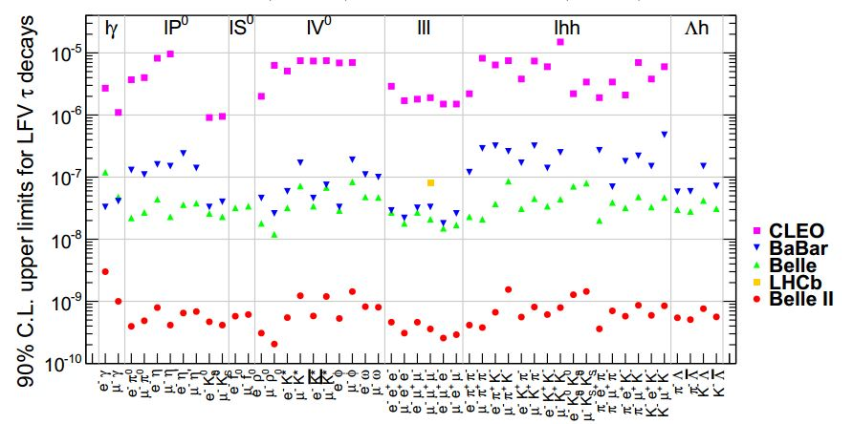
LFV/τ → μ γ
UL_{90%}
B(τ → μ γ)
[10⁻⁸]
simplified (1D) toy MC
τ → μ γ
4
2
1
0.4
0.2
Belle, PLB66, 16 (2008), 535 fb⁻¹
∼ ∝1/L
B(τ → μ γ) < 4.4 ·10⁻⁸
decays τ → 3l, l h⁰ background free
∼ ∝1/√L
0.2 1 10 L[ab⁻¹]
B.G.,, K, Trabelsi, P. Urquijo,
BE LLE2-NOTE- PH-2015-002

Slide 14
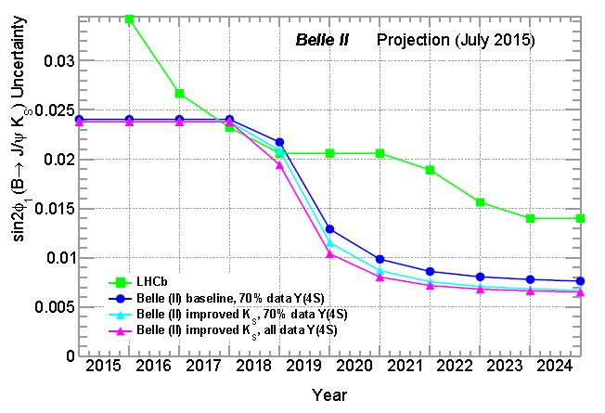
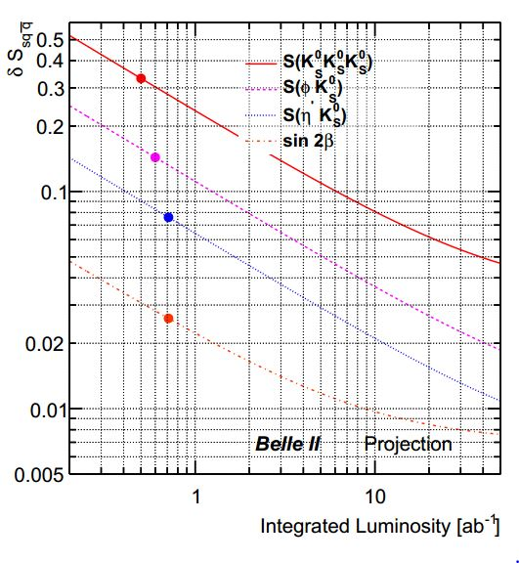
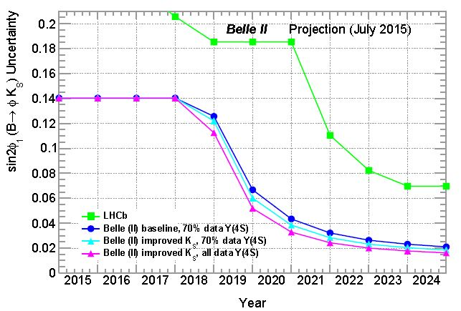
CPV/B → sqq
b → sqq t-dependent CPV
- some uncertainties cancel in ΔS
(vtx reconstr., flavor tag, likelihood fit) ;
- better K_{S} eff. with vtx hits - larger vtx radius,
30%);
- vtx reconstr. improved with better tracking;
41 new phases in MSSM
ΔS=sin2φ₁^{eff} -sin2φ₁
σ(sin2φ₁(J/ψK_{s}))
σ(s)
0.007
3K_{s}
φK_{s}
P. Urquijo,
Belle2-note-ph-2015-004
0.045
η‘K_{s}
σ(sin2φ₁(φK_{s}))
0.020
J/ψK_{s}
0.02
B. Golob, K. Trabelsi, P. Urquijo,
Belle2-note-ph-2015-002

Slide 15
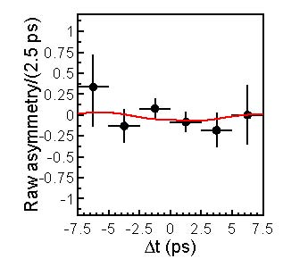
CPV/B → sγ
B → K* (→K_{S}π⁰)γ
t-dependent CPV
SM:
S_{CP}^{K*γ} ∼ -(2m_{s}/m_{b})sin2φ₁ ∼ -0.04
Left-Right Symmetric Models:
S_{CP}^{K*γ} ∼ 0.67 cos2φ₁ ∼ 0.5
S_{CP}(K_{s}π⁰γ) = -0.10 ±0.31 ±0.07
A_{CP}(K_{s}π⁰γ) = -0.20 ±0.20 ±0.06
for m(K_{s}π⁰) < 1.8 GeV (mainly K*γ)
t-dependent decays rate of B → f_{CP};
S and A: CP violating parameters
D. Atwood et al., PRL79, 185 (1997)
B. Grinstein et al., PRD71, 011504 (2005)
Belle, PRD74, 111104 (2006), 500 ab⁻¹

Slide 16
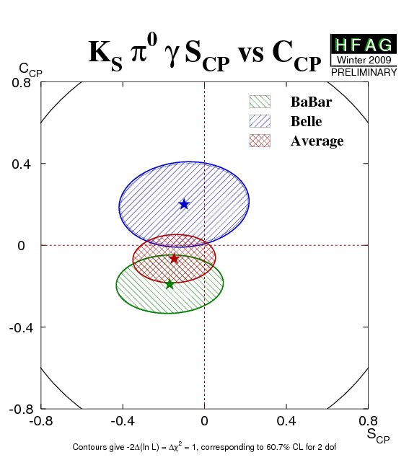
CPV/B → sγ
B → K* (→K_{S}π⁰)γ
t-dependent CPV
S_{CP}^{Ksπ0γ} = -0.15 ±0.20
A_{CP}^{Ksπ0γ} = -0.07 ±0.12
HFAG
Summer 2012
HFAG, Summer’12
5 ab⁻¹
σ(S_{CP}^{Ksπ0γ})= 0.11 @ 5 ab⁻¹
0.04 @ 50 ab⁻¹
(~SM prediction)
B.G.,, K, Trabelsi, P. Urquijo, BE LLE2-NOTE- PH-2015-002
50 ab⁻¹
for B→ ρ⁰γ ~2x larger uncertainty

Slide 17
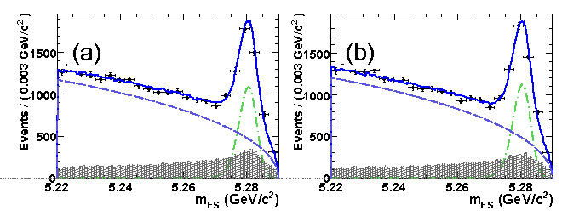
DCPV/B → sγ
B → s(+d)γ
direct CPV
Semi-inclusive, sum of many exclusive
states: all flavor specific final
states;
<D>: average dilution due to
flavour mistag, ∼1
ΔD: difference between
flavour mistag for
b and b, << 1
A_{det}: detector induced
asymmetry
BaBar, PRL101, 171804(2008),350 fb⁻¹
b → sγ
b → sγ
A_{det}: careful study of K/π asymmetries in (p,θ_{lab})
using D decays or inclusive tracks from
fragmentation;
lots of work on system., → few 10⁻³ exp. sensitivity

Slide 18
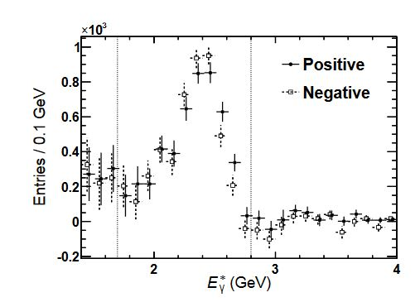
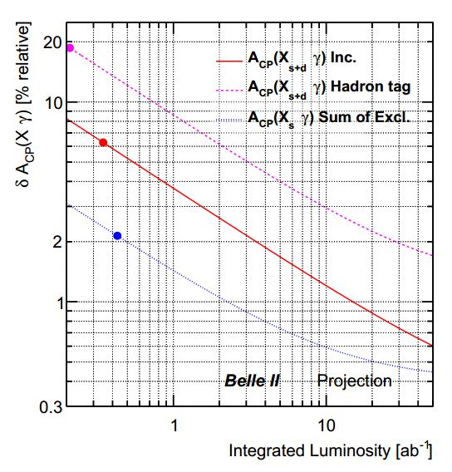
DCPV/B → sγ
B → sγ
direct CPV
Inclusive, γ recontruction only;
bkg. suppression (kinematic event shape
variables);
semileptonic tagging;
Similar sensitivity expected for semi-inclusive
& fully inclusive
Belle, PRL114, 151601 (2015), 700 fb⁻¹
HFAG, 2014(?)
SM: A_{CP} ~ (0.0044±^{0.0024}_{0.0014})%
T. Hurth et al., Nucl.Phys. B704, 56 (2005)
sum of excl.
incl.
5x10⁻³

Slide 19
Summary
LFU:
important measurements to be performed already
with 5 – 10 ab⁻¹ (2019-2020)
LFV:
50 ab⁻¹ (2023) needed to reduce existing limits by > 10
CPV:
in rare modes 20-50 ab⁻¹ (2021-2023) needed to reach
SM expectations

Slide 20
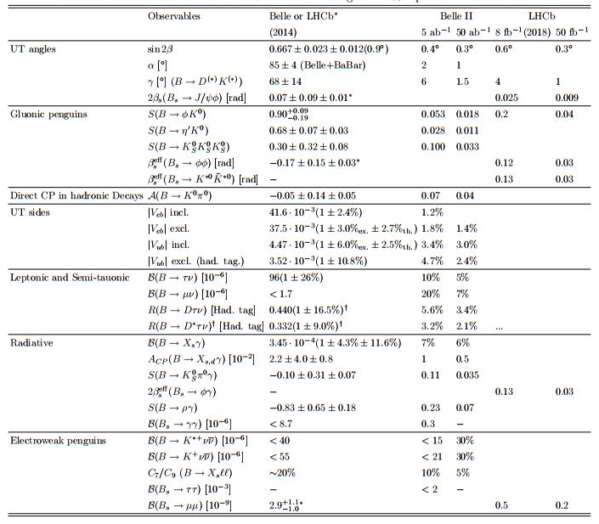
Summary

Slide 21
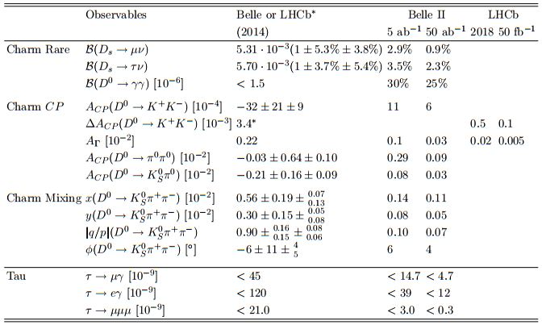
Summary

