Slide 1
Joint Programme on Nuclear Materials Sub-programme 4 – Modelling: Correlations, Simulation and Experimental Validation
SP Coordinator : L. Malerba
Structural Materials Modelling and Microstructure
Institute of Nuclear Materials Science
SCK•CEN (Belgium)
lmalerba@sckcen.be
SP4 Meeting - Edinburgh, 3 June, 2013

Slide 2
EERA

Slide 3
What is EERA?
European Energy Research Alliance of leading public organizations
Goals
Contribute to achieving the SET-Plan objectives
Strengthen, expand and optimize EU energy research capabilities by
Pooling and integrating activities and use of resources
Sharing national facilities & expertise, overcoming fragmentation
Realizing pan-European research Joint Programmes
Combining national and Community sources of funding
Accelerate the development of energy technologies, by
Streamlining and coordinating national and European energy R&D programmes
Develop links and sustained partnerships with industry

Slide 4
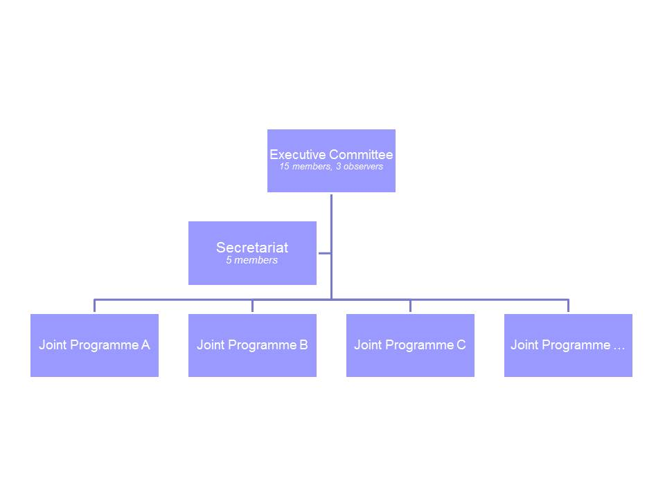
What is EERA?
The Joint Programme on Nuclear Materials is only one of a long list …

Slide 5
JPNM

Slide 6
Joint Programme on Nuclear Materials
To be set up
Notes:
6

Slide 7
SPs and management board composition
Joint Program on Nuclear Materials (JPNM) - Concetta Fazio, KIT
SP2
Oxide Dispersed Strengthened (ODS) Steels Yann de Carlan, CEA
SP3
Refractory materials: ceramic composites and metal-based alloys - Marie-Francoise Maday, ENEA
SP4
Support to the European Sustainable Nuclear Industrial Initiative (ESNII) - Karl Fredrik Nilsson, JRC IET
SP1
Modelling: Correlation, Simulation and Experimental Validation - Lorenzo Malerba, SCK-CEN
SP5
SP6
Manufacturing, irradiation and qualification of advanced fuels - Joe Somers, JRC ITU
Modelling and separate effect experiments on fuels Marjorie Bertolus, CEA

Slide 8
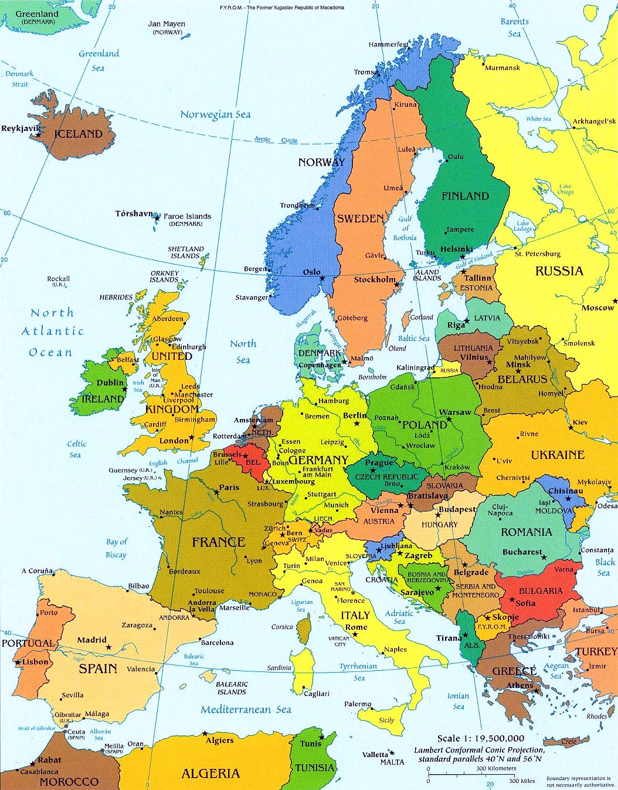
Participants in the JPNM
CEA | France
CIEMAT | Spain
CNR | Italy
CNRS | France
CV Rez (RC Rez) | Czech Republic
ENEA | Italy
HZDR | Germany
INR | Rumania
JRC-IE | EU
KIT | Germany
KTH | Sweden
NRG | The Netherland
PSI | Switzerland
SCKCEN | Belgium
UKERC | UK
VTT | Finland














Slide 9
Associated members
CSM | Italy
EDF | France
IFE | Norway
IMDEA Materials | Spain
MPA | Germany
NNL | UK
POLITO | Italy
UA | Spain
ULB | Belgium
UPC | Spain
Aalto University, University of Helsinki (FIN) and University of Genoa (I) applied for association
C. University of Leuven (B) should be in the process of joining

Slide 10
Instruments for Implementation
Pilot Projects (PP)
Joint Technical Teams (JTT)
Task Forces (TF)
Training and Mobility Schemes (T&M)
The JPMB has recognized that by defining the instruments above the following activities might not be clearly included :
Platform to share codes (though present in WP4 of SP4)
Materials database (MATTER DM2 Test Case)
Monographic contributions ←

Slide 11
Identification of instruments for implementation: guidelines
Pilot Projects (PP)
R&D activities with focus on specific topics within a more general theme of the DoW. The results of the PP are integral part of one or more than one SP (if the PP is cross-cutting) and are reported through deliverables.
PP are based on the principles of coordination of use of resources and complementarity
Number of participants should be at least 3; Duration of at least 1 year; Effort of at least 1 PY/Y.
Associated can participate. However, PP are coordinated only by participants
IPR: the EERA IPR rules should be followed. However, there might be the need for some PPs to have specific agreements. These items will be always analyzed by the JPMB and proposed for decision to the SC.
For PP proposal the template should be used

Slide 12
Identification of instruments for implementation: guidelines
Joint technical teams
The Joint Technical Team works on a specific overall theme within one or more than one Sub-Program
The objective is to compare results and put together ideas (no specific deliverables are asked for: these are produced in projects)
There is no need for official appointments, anyone from any of the partners can participate in committee meetings, but contact persons per partner in each committee should be appointed
Meet regularly in workshops to monitor what is being done within the research theme
Revise and propose modifications to the official SP description
Identify and elaborate jointly pilot project proposals

Slide 13
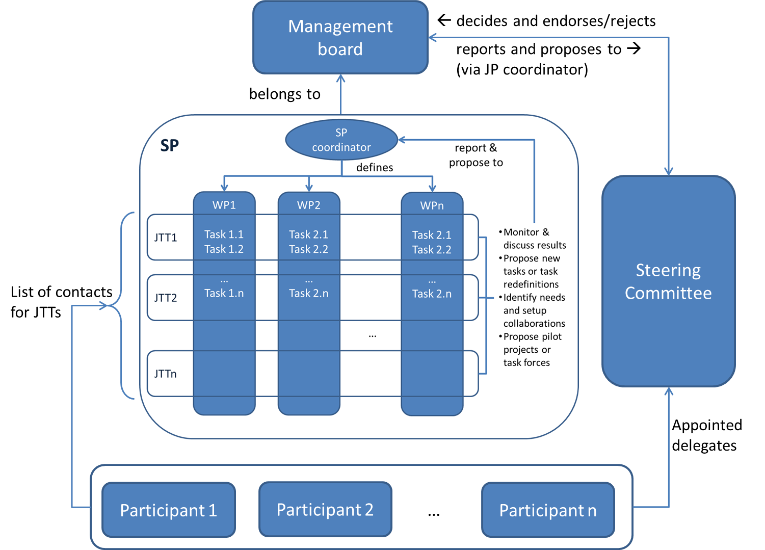
Joint Technical Teams
The cooperation within the SP should be made effective through the instrument of the JTTs

Slide 14
Identification of instruments for implementation: guidelines
Task forces
The task forces address specific tasks (e.g. “burning R&D questions” from industrial initiatives) to be handled within a short period of time and on which no well-defined activity exists or no clear plan has been elaborated yet
The task forces are groups of experts (members appointed by partners) and are formed on request of the JPMB and JPSC
The task force produces a report which remains within the JP
The task force can identify and elaborate jointly pilot project proposals

Slide 15
Identification of instruments for implementation: guidelines
Mobility scheme
PhD / Post Doc / student programs: Mobility program funding opportunities
KIC-Innoenergy
COST
Marie Curie
Evaluate the setting up of a training network e.g. Universities, Research Centre etc. needs to be set-up).
The mobility scheme needs further elaboration and especially funding

Slide 16
SP4

Slide 17
Structure of SP4
SP1
F/M steels
Austenitic Stainless Steels
(Ni-base alloys)
SP4
WP4.1
F/M & austenitic steels → FeCrX
SP2
Oxide dispersion strengthened F/M steels
WP4.2
ODS steels → FeCrX + hard particles/oxides
Transversal
SP3
Ceramic composites (SiC_{f}/SiC)
Refractory alloys
WP4.3
Ceramic composites (SiC)
Refractory alloys (V?)
WP4.4
Coordination & consolidation
+ How to share facilities

Slide 18
Participants in SP4
Participants Name |  | Short Name | Country | Role | Human Resource committed (person year per year) | Contact
Commissariat à l'Energie Atomique et aux Energies Alternatives |  | CEA | France | Participant | 4 | francois.willaime@cea.fr; frederic.soisson@cea.fr
 | Electricité de France Recherche & Developpment | EDF R&D | France | Associate | 0.3 | martine.blat@edf.fr; christophe.domain@edf.fr
Conseil National de la Recherche Scientifique |  | CNRS | France | Participant | 3.1 | cristelle.pareige@univ-rouen.fr
Centro de Investigaciones Energéticas, Medioambientales y Tecnológicas |  | CIEMAT | Spain | Participant | 1 | m.mayoral@ciemat.es
 | IMDEA Materiales | IMDEA | Spain | Associate | 1 | ignacio.martin@imdea.org
 | Universidad de Alicante / Universitat d'Alacant | UA | Spain | Associate | 0.4 | mj.caturla@ua.es
 | Universitat Politècnica de Catalunya | UPC | Spain | Associate | 0.12 | a.serra@upc.edu
Consiglio Nazionale delle Ricerche |  | CNR | Italy | Participant | 0 | r.novakovic@ge.ieni.cnr.it
Ente Nazionale per l'Energia e l'Ambiente |  | ENEA | Italy | Participant | 1 | antonio.rinaldi@enea.it; simonetta.pagnutti@enea.it
Helmholtz-Zentrum Dresden-Rossendorf |  | HZDR | Germany | Participant | 3 | m.posselt@hzdr.de; f.bergner@hzdr.de
Joint Research Centre – Institute of Energy and Transport |  | JRC-IET | EU | Participant | 2.5 | igor.Simonovski@ec.europa.eu
Karlsruhe Institute of Technology |  | KIT | Germany | Participant | 2 | pavel.vladimirov@kit.edu
 | Materialprüfungsanstalt Universität Stuttgart | MPA | Germany | Associate | 0.25 | andreas.klenk@mpa.uni-stuttgart.de‘ ewa.soppa@mpa.uni-stuttgart.de
Royal Institute of Technology |  | KTH | Sweden | Participant | 2.5 | olsson.par@gmail.com
Nuclear Research and consultancy Group |  | NRG | The Netherlands | Participant | 2 | fedorov@nrg.eu; blagoeva@nrg.nl
Paul Scherrer Institute |  | PSI | Switzerland | Participant | 1 | Jiachao.chen@psi.ch
Studiecentrum voor Kernenergie • Centre d'Etudes de l'Energie Nucléaire |  | SCK•CEN | Belgium | Sub Program Coordinator | 3 | lmalerba@sckcen.be
 | Université libre de Bruxelles | ULB | Belgium | Associate | 0.16 | thmassar@batir.ulb.ac.be
UK Engineering and Physical Sciences Research Council |  | UKERC | United Kingdom | Participant | 1 | james.marrow@materials.ox.ac.uk; b.j.connolly@bham.ac.uk
Technical Research Centre of Finland |  | VTT | Finland | Participant | 1 | wade.karlsen@vtt.fi; sami.penttila@vtt.fi
 | Aalto University | AU | FInland | Associate | 2 | mikko.alava@aalto.fi
 | University of Helsinki | UH | Finland | Associate | 4 | knordlun@acclab.helsinki.fi
 |  |  |  | Total | 35,33

Slide 19
About the DoW of SP4
Was put together based exclusively on what the different organisations involved in the JPNM communicated as activities to contribute to SP4
No obligation to strictly follow what is written there for new (or old) members: activities can be freely added (or removed)
It is NOT a roadmap (though the roadmap will take this DoW as starting point)
Activities are organised in the most consistent way possible that I could find (but suggestions for modification are welcome)
Task forces are foreseen to elaborate workplans (i.e. consensually propose new activities) when none exists
JTTs should be integrating part of it

Slide 20
End general part

Slide 21
What should a JTT be? Should this be a JTT?

Slide 22
SCK•CEN’s monographic activities
4.1.1g | Development of phase field models describing microstructure evolution in Fe alloys | SCK•CEN, CNRS | Mo48 | Contact persons: M. Vankeerberghen (SCK·CEN), A. Legris (CNRS/UMET), H. Zapolski (CNRS/GPM)
At the moment it is just a proposal for a PhD project:
Objective: to explore the possibility of developing phase field models describing the nanostructural changes experienced by structural materials subjected to irradiation.
The development of phase field models of the type targeted has been demonstrated in work performed e.g. at Idaho National Lab and published over the last few years.
This published work will be the starting point to develop models that should, in the expectations, be almost as reliable as the available kMC models, but allowing a step forward in terms of scales that can be addressed.

Slide 23
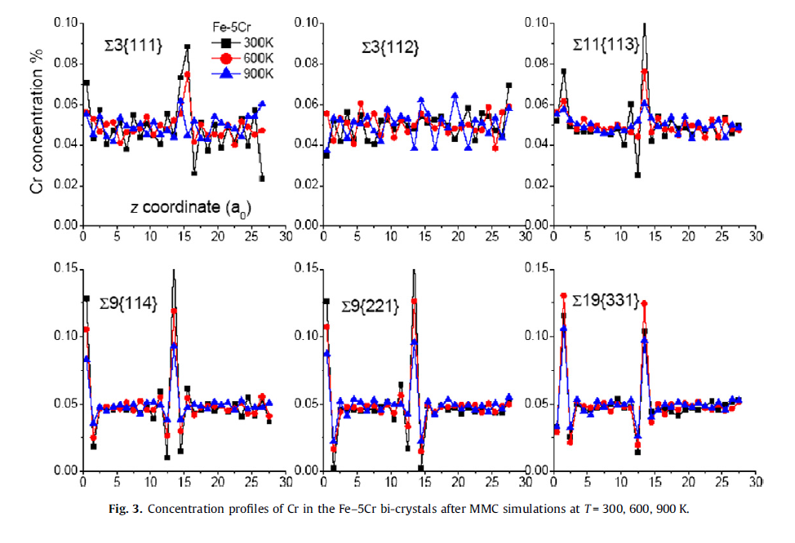
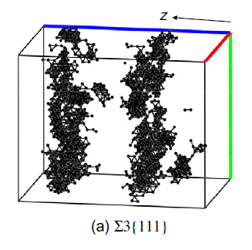
SCK•CEN’s monographic activities
4.1.3a | Atomic-level study of cohesion properties of grain boundaries in Fe alloys | SCK•CEN, (MPA) | Mo48 | Contact person: D. Terentyev (SCK·CEN), (MPA?)

Slide 24
Pilot projects

Slide 25
Pilot Projects – WP4.1
DOMOPLEX
Title: Design-Oriented MOdelling of Plastic Localisation effects in irradiated austenitic and ferritic steels and supporting Experiments
Participants: CEA, CIEMAT, HZDR, JRC-IE, SCK•CEN, ULB, UMAN, UOXF, VTT , (KTH), (MPA?)
Objective: Develop tools needed to build a crystal gradient plasticity model at the polycrystalline aggregate scale, by drawing information from both experiments and molecular dynamics and dislocation dynamics simulations. Finally, the grain scale descriptions will be upscaled within a multi-level scheme, thereby allowing for plastic localisation and instability up to macroscopic and component level
Work-Packages (+ DOMOn JTT launch, UOXF)
WP1 - Fundamental studies of processes leading to clear band formation
Leader: L. Dupuy, CEA-Saclay
WP2 - Development of crystal gradient plasticity models
Leader: Th. Massart, ULB
WP3 - Ion & neutron irradiation experiments and subsequent materials characterization
Leader: F. Bergner, HZDR

Slide 26
Pilot Projects – WP4.1
DOMOPLEX
Approved by SC in May 2012
Kick-off meeting was held on 6-7 September
Minutes available, have been distributed
Almost fully feasible without funding from outside consortium
To be used as example of JPNM “own” activity
Situation in short:
WP1 & WP2: missing PhD student for main objective, other activities are starting but objective is ambitious
WP3: need to define materials matrix based on availability and suitability, then work can actually start

Slide 27
Challenges of a self-funded pilot project
Cons
Absence of stable funding specific for the project implies higher risk of discontinuities in the work
Some activities that could easily be performed in terms of expertise & infrastructure cannot be considered
Some activities might have to be dropped
Difficult to guarantee that all objectives (milestones, deliverables, …) are reached
Pros
The workplan is not fixed by any contractual agreement
can be flexibly changed depending on circunstances, new opportunities, failures of approaches and subsequent new ideas …
Contributors may withdraw or join without major impediments
High level of genuine involvement, as well as mutual trust, are required in order to reach the objectives

Slide 28
Management of a self-funded pilot project
Management should not be too cumbersome
Yet some coordination is needed → tasks related to coordination & function of WPL should be formalised
Coordinator:
Initially centralises preparation of proposal
Takes care for communication with MB & SC
Collects deliverables from WPLs
Presents short periodic report on advancement, with help of WPL (e.g. intermediate and final)
Presents account of PP results at JTT meetings or wherever of relevance
…

Slide 29
Management of a self-funded pilot project
Management should not be too cumbersome
Yet some coordination is needed → tasks related to coordination & function of WPL should be formalised
WPL:
Help in proposal preparation for the part concerning their WP
Collects deliverables from participants
Provides coordinator with input for intermediate and final short periodic report
Presents account of WP results at JTT meetings or wherever of relevance)
…

Slide 30
Management of a self-funded pilot project
Deliverables & Milestones
Form of deliverables:
Draft paper?
Presentation?
Report?
Strong preference for papers and reports
Emphasis on the fact that reports distributed to other participants justify the participation in a joint project without additional funding
Outcome of the project (final technical report) could be an EERA deliverable
Form of milestones: → target
Do we need them? Yes but only as references or decision points
Abstract ?

Slide 31
Pilot Projects – WP4.1
MOIRA
Coordinator | Emmanuel Clouet, CEA Emmanuel.clouet@cea.fr
Name of the project | Modelling of irradiation creep in F/M alloys (MOIRA)
Expected duration (yrs) | 4 years
List of partners
Name | Country | Person-months: total ~94 (~8 PPY, ~2 PPY/Y)
CEA | France | 7.6
CNRS | France | 2
HZDR | Germany | 16.6
KIT | Germany | 3.7
PSI | Switzerland | 3.5
SCK•CEN | Belgium | 13.5
UKERC (U. Birmingham) | UK | 29
Partially funded by EC in FP7/MatISSE/WP2
PMs above include both in-kind effort & effort partially covered by EC (almost 50% in-kind → EC pays back ~>25%)
Full description circulated

Slide 32
Pilot Projects – WP4.1
MEFISTO
Coordinator | Cristelle Pareige, CNRS/GMP cristelle.pareige@univ-rouen.fr
Name of the project | Modelling of embrittling features in irradiated F/M steels and alloys (MEFISTO)
Expected duration (yrs) | 4 years
List of partners
Name | Country | Person-months: total ~103 PM (~8.5 PYY, > 2 PYY/Y)
CEA | France | 3.5
CIEMAT | Spain | 12
CNRS | France | 24.9
EDF R&D | France | 2.8
ENEA | Italy | 3
HZDR | Germany | 16.6
KTH | Sweden | 3.7
NRG | The Netherlands | 7
PSI | Switzerland | 2
SCK·CEN | Belgium | 15.9
U. Alicante | Spain | 7.9
UKERC (Open U.) | UK | 3.3
Same situation as MOIRA (~1/3 in-kind → ~1/3 paid back by EC)

Slide 33
Task force ODS modelling
Pär Olsson, KTH (Chair)
Bertrand Radiguet, GMP/CNRS
Chuchun Fu / Maylise Nastar, CEA
Marta Serrano, CIEMAT
JiaChao Chen, PSI
Frank Bergner / Matthias Posselt, HZDR
Graeme Ackland, U. Edinburgh

Slide 34
“Task force” SiC/SiC modelling
M. Françoise Maday, ENEA (Chair)
James Marrow, UKERC
Philippe Chapelot, CEA

