Slide 1
MULTISCALE MODELLING OF CERAMIC COMPOSITES (SIC/SIC) SUPPORTED BY MICRO/NANOMECHANICAL CHARACTERIZATION EXPERIMENTS
SUB-PROGRAMME 4: Modelling: correlations, simulation and experimental validation
Francoise Maday Antonio Rinaldi

Slide 2
STATUS ABOUT CERAMIC COMPOSITE PROPERTY MODELING IN THE EU
Advanced models for C-or SiC-based composite properties are mainly developed at a European level by French laboratories:
C/C and C/SiC for aerospace applications:
Unité Mixte-Laboratoire des Composites Thermo-Stucturaux de Pessac (LCTS)
Office National de Recherche et d’études Aerospatiales - ONERA
Ecole Normale Supérieure de Cachan (ENS)
SiC/SiC for nuclear applications (i.e.fuel cladding)
CEA
Multiscale approach based on microstructures more and more representative of the real ones (at each length scale) and using numerical resolution tools have significantly progressed. Studies include modelling of:
Linear elastic behaviour
Non linear behaviour due to damage
Thermal properties
Oxidation
Complementary experimental data might be needed in order to validate these models

Slide 3
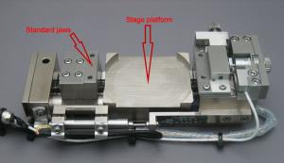
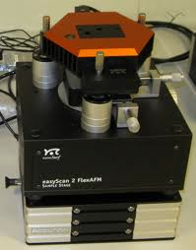
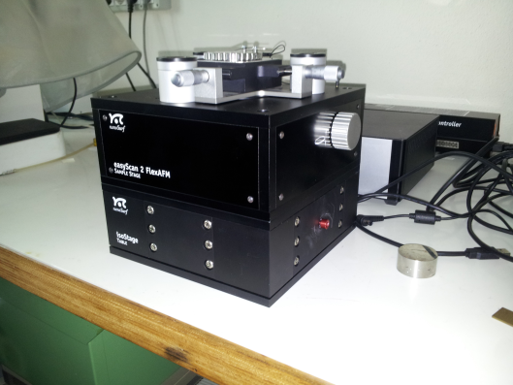
TESTING PLATFORMS AVAILABLE AT ENEA
SET OF MACRO TENSILE AND CREEP STATIONS FOR MACRO TESTING (Differential Interference Contrast used to capture microfields during testing)
2. MICROTESTING SYSTEM WITH LOAD CELLS OF 2N and 200 N TO BE OPERATED UNDER AN OPTICAL MICROSCOPE OR IN SEM + VIDEO MONITORING CAPABILITY
3. AFM WITH NANOMECHANICAL MODEL TO DO ELASTIC MAPPING OF MATRICES UP TO 64x64 OVER 100x100 um² (SUPPORTING SPECIAL SAPPHIRE CANTILEVER FOR CERAMICS)
To pull on microcomposite , single yarns, and single fibers
In-situ push-in on fibers or map strain field with nanometer resolution during an external test (if coupled with the microtensile stage)

Slide 4
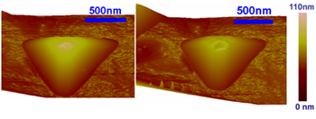
TESTING PLATFORMS AVAILABLE AT ENEA
4. NANOINDENTER FOR QUANTITATIVE MEASUREMENT OF MECHANICAL PROPERTIES (RESIDUAL STRESS) AT THE NANOSCALE – (THIS WILL BECOME AVAILABLE OVER SUMMER)
Ultra precise positioning and high stiffeness testing on fibers and nanophases by a diamond tip
5. FULL ACCESS TO A FOCUSED ION BEAM (FIB) TO SUPPORT NEEDS FOR SECTIONING SiC/SiC and DIAMOND TIPS AS NEEDED , AS WELL AS TO PREPARE MICROMETER SCALE NOTCHED SAMPLED FOR FRACTURE TESTING

Slide 5
POTENTIAL CONTRIBUTION FROM ENEA
PROVIDING EXPERIMENTAL DATA IN SUPPORT TO THE MULTI-SCALE APPROACH OF THE MECHANICAL BEHAVIOUR OF SIC/SIC COMPOSITES AT THE SCALE OF THE TOW:
NANOINDENTATION TESTS TO EVALUATE THE INTERFACE PROPERTIES (SHEAR STRESS, DEBOND ENERGY AND RESIDUAL STRESSES ) FROM THE NANOSCALE OF SIC/SIC
IN-SITU MICROSCOPIC OBSERVATIONS (OPTICAL, SEM) DURING TENSILE TESTS TO CHARACTERIZE THE ELASTIC AND DAMAGE BEHAVIOUR OF SIC/SIC MINICOMPOSITES

