Slide 1


Hexaquarks in hadro- and photo- induced reactions
Mikhail Bashkanov

Slide 2

Quark systems
Meson
Baryon
Tetraquark
Pentaquark
Hexaquark
Octaquark?
Meson-Meson
molecule
Meson-Baryon
molecule
Baryon-Baryon
molecule
$$Λ\left(1405\right)+N$$

Slide 3






Possible particles
Tetraquark
Meson-Meson molecule
Hexaquark
Baryon-Baryon molecule
Pentaquark
Meson-Baryon molecule
$$f_{0}/a_{0}(980)$$
$$Z^{+}(4430)$$
$$deuteron$$
$$Λ(1405)$$
$$d^{∗}(2380)$$
$$P_{c}^{+}(4450)$$

Slide 4
Deuteron to Deltaron
I(J^{p}) = 0(1⁺)
I(J^{p}) = 0(3⁺)
u
u
u
d
d
d
u
u
u
d
d
d
Threshold
2.2 MeV
p
n
80 MeV
Δ
Δ
deuteron
d*

Slide 5
d*(2380)
The Discovery

Slide 6
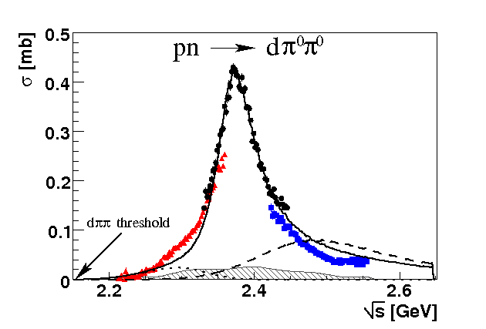
Total cross section pn → dπ⁰π⁰
“d* resonance”
Γ∼70 MeV
ΔΔ
NN*(1440)
P. Adlarson et. al Phys. Rev. Lett. 106:242302, 2011

Slide 7
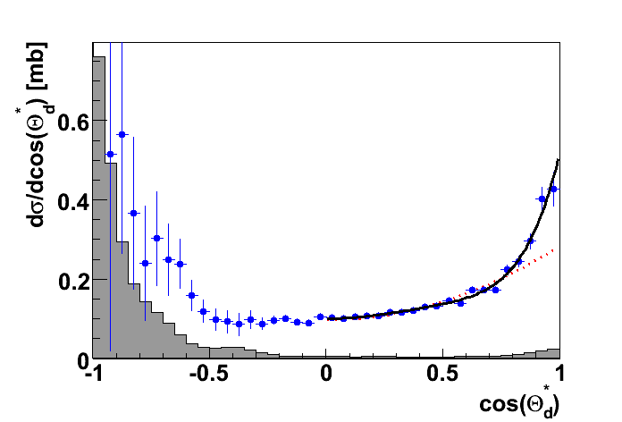
Angular distribution in the peak
J=3
J=1
P. Adlarson et. al Phys. Rev. Lett. 106:242302, 2011

Slide 8
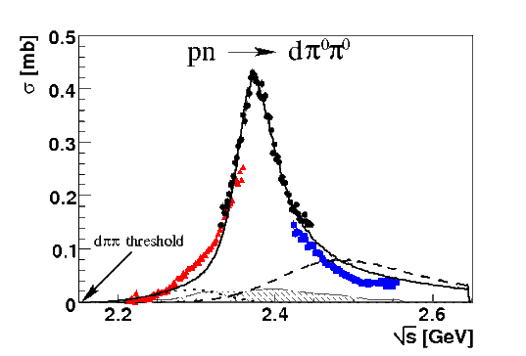

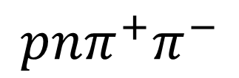

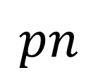
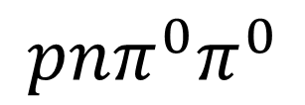
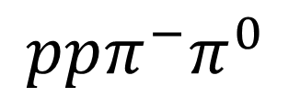
Dibaryon hadronic decays
PRL 106 (2011) 242302
PLB 721 (2013) 229
WASA data
$$dπ^{0}π^{0}$$
$$dπ^{+}π^{−}$$
pn → d*(2380)
$$pn$$
$$ppπ^{−}π^{0}$$
$$pnπ^{0}π^{0}$$
$$pnπ^{+}π^{−}$$
PRL 112 (2014) 202301
PRC 90, (2014) 035204
d*
d*
PRC 88 (2013) 055208
PLB 743 (2015) 325
d*

Slide 9
Argand plot
P. Adlarson et al. Phys. Rev. Lett. 112, 202301, (2014)
P. Adlarson et al. Phys. Rev. C 90, 035204 , (2014)

Slide 10
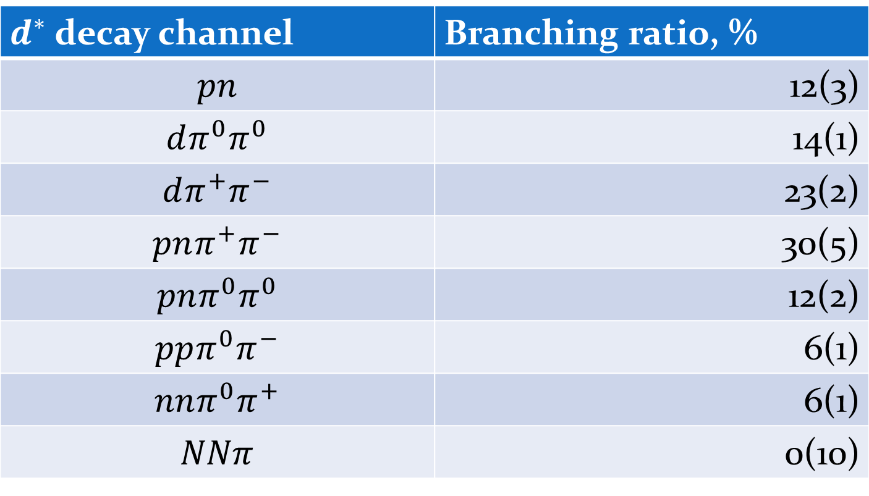
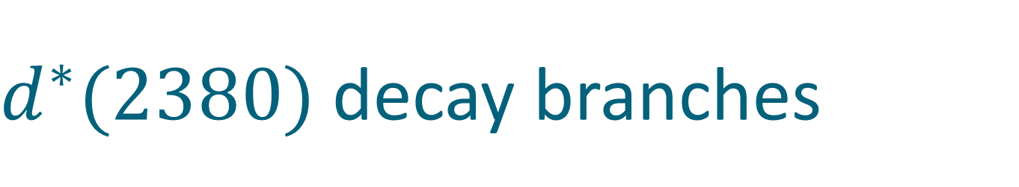
$d^{∗}(2380)$ decay branches
$d^{∗}$ decay channel | Branching ratio, %
$$pn$$ | 12(3)
$$dπ^{0}π^{0}$$ | 14(1)
$$dπ^{+}π^{−}$$ | 23(2)
$$pnπ^{+}π^{−}$$ | 30(5)
$$pnπ^{0}π^{0}$$ | 12(2)
$$ppπ^{0}π^{−}$$ | 6(1)
$$nnπ^{0}π^{+}$$ | 6(1)
$$NNπ$$ | 0(10)
Eur.Phys.J. A51 (2015) 7, 87

Slide 11

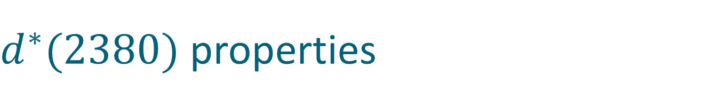

$d^{∗}(2380)$ properties
I(J^{p}) = 0(3⁺)
$$M_{d^{∗}}=2.38 GeV≈2M_{Δ}−80 MeV$$
$$Γ_{d^{∗}}=70 MeV≪Γ_{ΔΔ}=240 MeV$$
$$d^{∗}$$
Δ
90 %
Δ
$$d^{∗}$$
p
10 %
n

Slide 12

$d^{∗}(2380)$ properties
I(J^{p}) = 0(3⁺)
$$M_{d^{∗}}=2.38 GeV≈2M_{Δ}−80 MeV$$
$$Γ_{d^{∗}}=70 MeV≪Γ_{ΔΔ}=240 MeV$$
$$d^{∗}$$
Δ
90 %
Δ
p
Δ
$$d^{∗}$$
? %
$$d^{∗}$$
p
10 %
Δ
n
n

Slide 13
Molecule vs Hexaquark

Slide 14
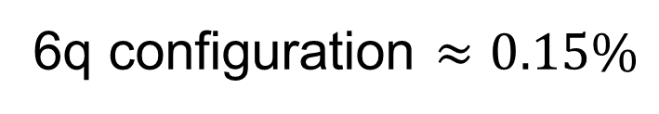

Deuteron
L=0
n
p
n
p
L=2
0.9 fm
4 fm
$$≈5\%$$
6q configuration $≈0.15\%$

Slide 15
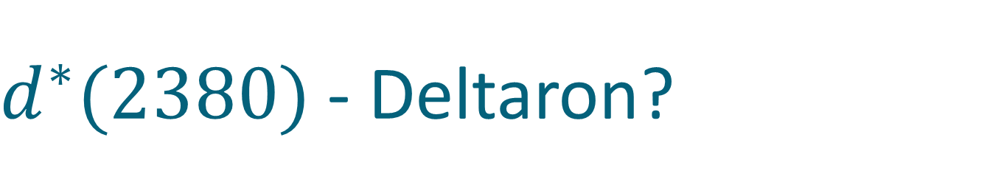
$d^{∗}(2380)$ - Deltaron?
L=0
Δ
Δ

Slide 16
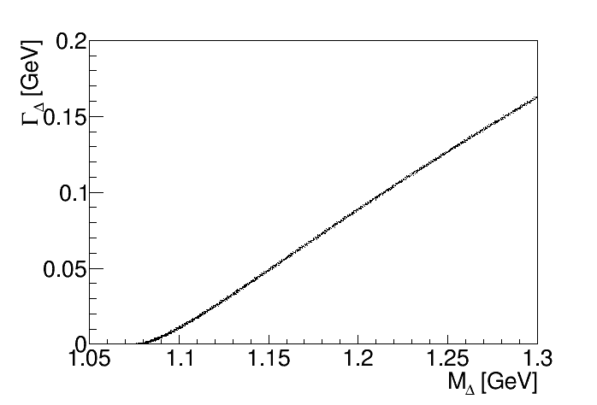
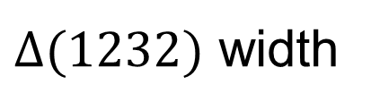
Deltaron: the width quest
$Δ(1232)$ width

Slide 17
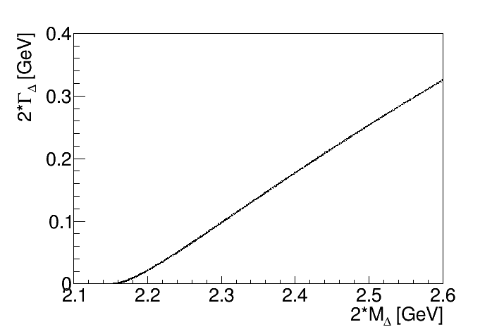
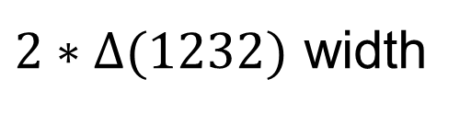
Deltaron: the width quest
$2∗Δ(1232)$ width

Slide 18
Deltaron: the with quest
$2∗Δ(1232)$ width

Slide 19
Hidden color concept
Hexaquark
Deltaron
M. Bashkanov, Stanley J. Brodsky, H. Clement Phys.Lett. B727 (2013) 438-442
F. Huang et al, Chin.Phys. C39 (2015) 7, 071001

Slide 20

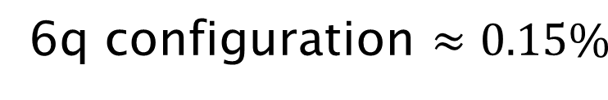
Deltaron vs Hexaquark
$$≈33\%$$
L=0
Δ
Δ
0.7 fm
$$≈66\%$$
0.9 fm
0.9 fm
F. Huang et al, Chin.Phys. C39 (2015) 7, 071001

Slide 21
d* internal structure
Experimental verification

Slide 22
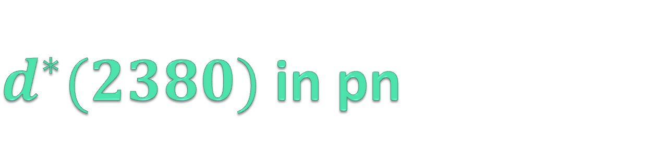
$d^{∗}(2380)$ best decay channels
Isospin filter
pn → dibaryon → dπ⁰π⁰
3-body reaction
pn → dibaryon → pn
PWA
polarization observables
2-body reaction

Slide 23
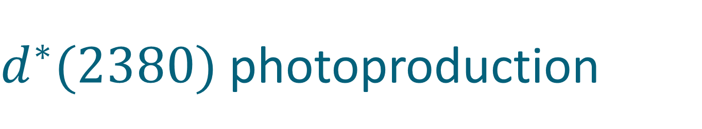
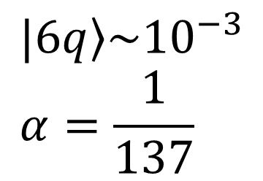

$d^{∗}(2380)$ photoproduction
$$γd→d^{∗}\left(2380\right) ⟹E_{γ}=550 MeV$$
γ
Δ
π
d
d
Δ
π
$$|\left.6q\right\rangle →|\left.6q\right\rangle$$
$$σ(γd→d^{∗}\left(2380\right)→dπ^{0}π^{0})\sim 10nb$$
$$|\left.6q\right\rangle \sim {10}^{−3} \\ α=\frac{1}{137}$$

Slide 24
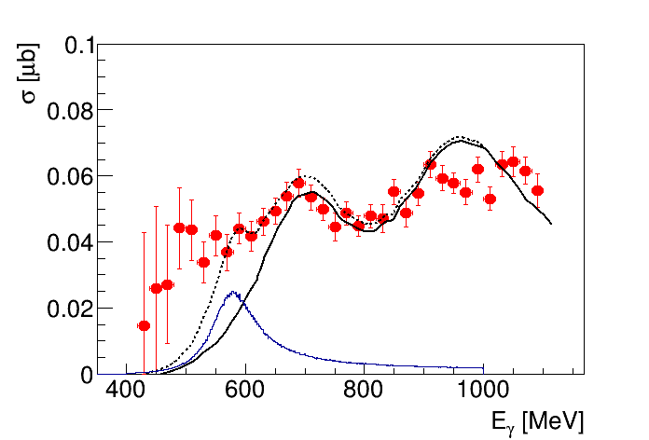


$$γd →d^{∗}→dπ^{0}π^{0}$$
M. Guenther Master Thesis, Basel 2015
Conventional Background
M. Egorov, A. Fix,
Nucl.Phys. A933 (2015) 104-113
$$d^{∗}$$

Slide 25
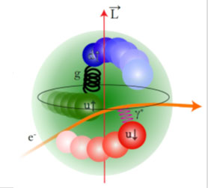
Hexaquark vs molecule
e⁻
e⁻
γ*
d*(2380)
d
Transition form factor
Charge distribution
Internal structure

Slide 26

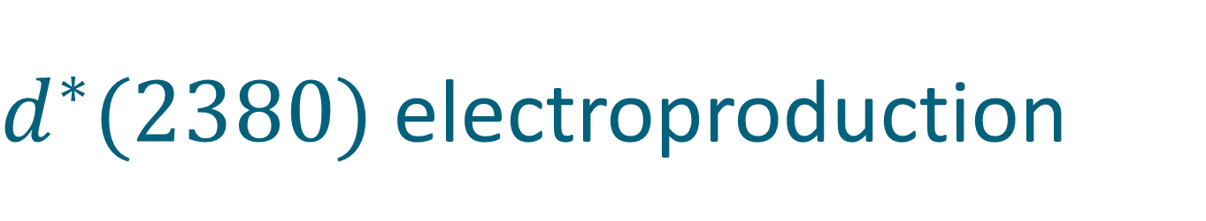

$d^{∗}(2380)$ electroproduction
γ
$$Γ(d^{∗}→γd)\sim 1keV$$
d
γ
Δ
d
$$Γ(d^{∗}→γγd)\sim 1keV$$
Δ
γ

Slide 27
$d^{∗}(2380)$ electroproduction
e⁻
e⁻
γ*
e⁻
γ*
d*(2380)
e⁻
d*(2380)
γ*

Slide 28
Dibaryons
a paradigm shift

Slide 29
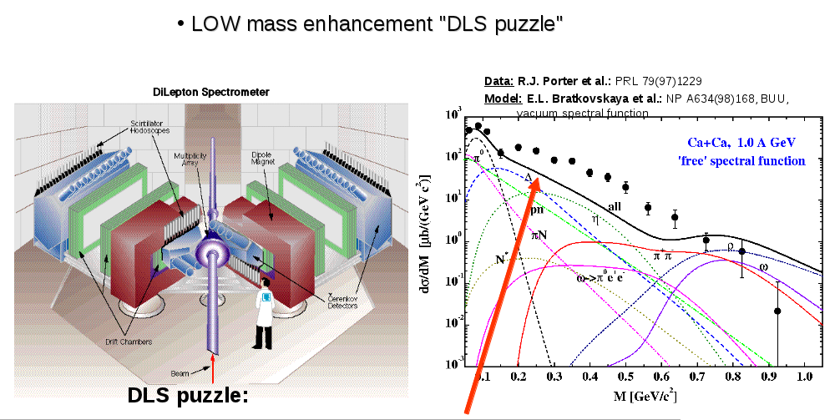
DLS puzzle
Strong dilepton enhancement over hadronic coctails

Slide 30
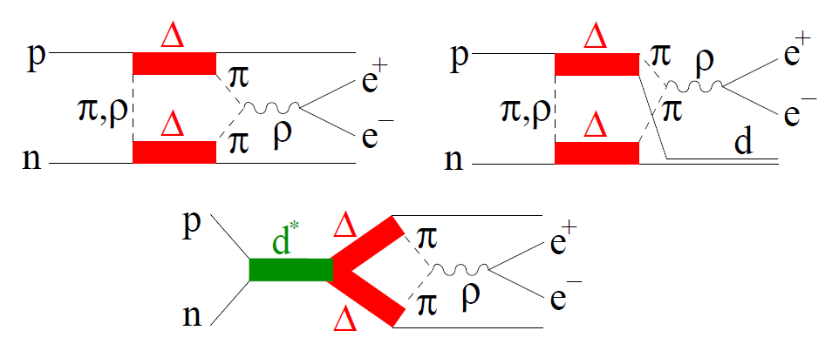
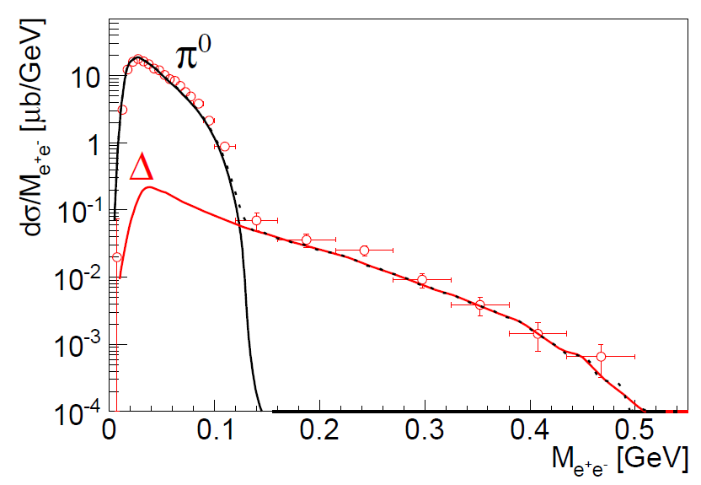
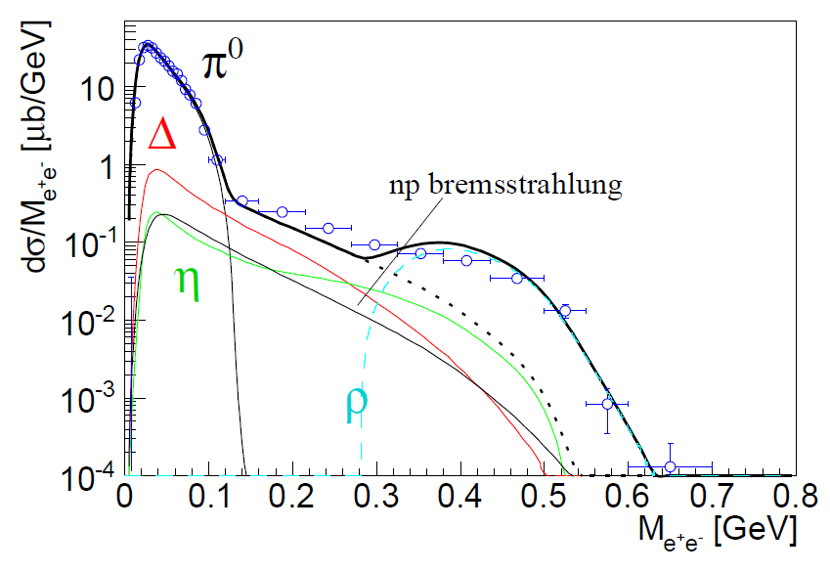



DLS puzzle @ $T_{N}=1.25 GeV$
$$pp→e^{+}e^{−} X$$
$$pn→e^{+}e^{−} X$$
pp
pn
M. Bashkanov, H. Clement Eur.Phys.J. A50 (2014) 107
Data from G. Agakichiev et al. (HADES Collaboration), Phys. Lett. B 690 (2010) 118

Slide 31
The family of dibaryons

Slide 32
Mirror dibaryon
d*
I(J^{p}) = 0(3⁺)
I(J^{p}) = 3(0⁺)
Δ
Δ
Δ
Δ
u
u
u
d
d
d
u
u
u
u
u
u
Freeman J. Dyson, Nguyen-Hue Xuong Phys. Rev. Lett. 13(1964) 815
Avraham Gal, Humberto Garcilazo Nucl. Phys. A928, (2014), 73

Slide 33
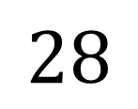
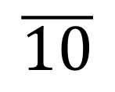


How many ways can you combine 6q?
Isospin
$$J^{P}=3^{+}$$
$$J^{P}=0^{+}$$
Strangeness
$$\overline{10}$$
$$28$$
Δ⁻Δ⁻
Δ⁺⁺Δ⁺⁺
d*
ΔΔ
ΔΣ*
Σ*Σ*+ΔΞ*
Ξ*Σ*+ΔΩ
Ξ*Ξ*+Σ*Ω
Ξ*Ω
ΩΩ

Slide 34
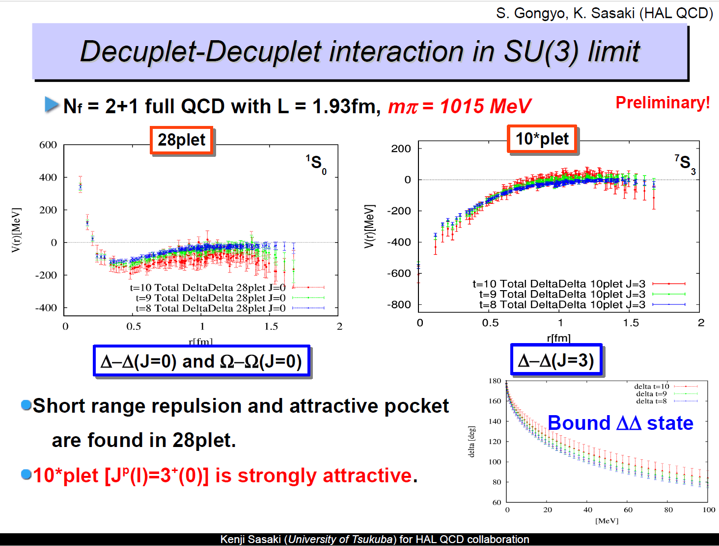
d* in Lattice

Slide 35

NN vs ΔΔ
$${}_{}^{1}{S_{0}}$$
Z=+4
p
n
Δ
Δ
66 keV
Threshold
?
2.2 MeV
p
n
80 MeV
Δ
Δ
deuteron
d*
”Search for an Isospin I =3 Dibaryon”arXiv:1606.02964

Slide 36
How many ways can you combine 6q?
Isospin
$$J^{P}=3^{+}$$
$$J^{P}=0^{+}$$
Strangeness
$$\overline{10}$$
$$28$$
Δ⁻Δ⁻
Δ⁺⁺Δ⁺⁺
d*
ΔΔ
ΔΣ*
Σ*Σ*+ΔΞ*
Ξ*Σ*+ΔΩ
Ξ*Ξ*+Σ*Ω
Ξ*Ω
ΩΩ

Slide 37
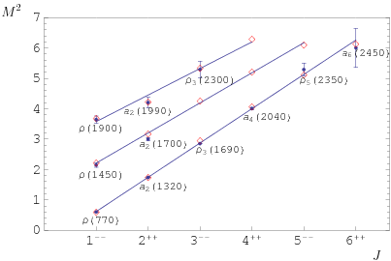
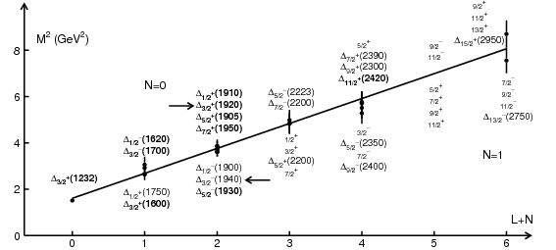
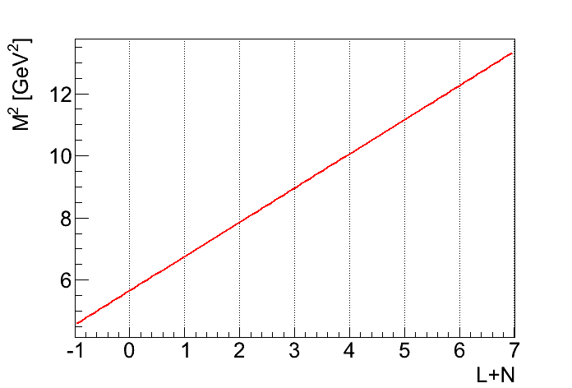



Dibaryon Spectroscopy
$$d^{?}(2800)$$
$$d^{?}(2600)$$
$$d^{∗}(2380)$$

Slide 38
Strange dibaryon

Slide 39




d*(2380) SU(3) multiplet
J^{p} = 3⁺
ΔΔ
$$d^{∗}(2380)$$
$$M_{d^{∗}}−M_{Δ}+M_{Σ^{∗}}<M_{d_{s}^{∗}}≤M_{Δ}+M_{Σ^{∗}}$$
ΔΣ*
$$d_{s}^{∗}(2.53−2.60)$$
ΔΞ*
$$d_{ss}^{∗}(2.68−2.76)$$
ΔΩ
$$d_{sss}^{∗}(2.82−2.90)$$

Slide 40
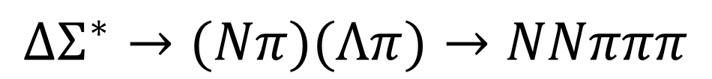
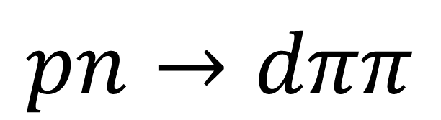
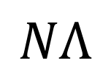

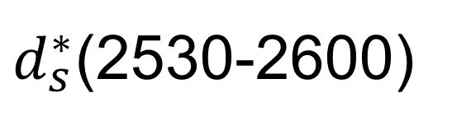
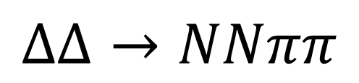
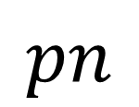
Strange Dibaryon
Isospin
$$pn$$
$$\overline{10}$$
$d^{∗}$(2380)
Strangeness
d*
ΔΔ
ΔΣ*
$$ΔΔ→NNππ$$
Σ*Σ*+ΔΞ*
Ξ*Σ*+ΔΩ
$$NΛ$$
$d_{s}^{∗}$(2530-2600)
$$ΔΣ^{∗}→(Nπ)(Λπ)→NNπππ$$

Slide 41





Reaction
γ
$$π^{+}$$
p
$$Δ^{++}$$
p
d
$$π^{−}$$
p
n
$$Σ^{∗−}$$
$$Λ$$
$$K^{0}$$
$$π^{−}$$
$$π^{−}$$
$$π^{−}$$
$$π^{+}$$

Slide 42





Reaction
$$π^{+}π^{−}$$
$$γd→\left(K^{0}\right)+d_{s}^{∗}→pp2π^{+}3π^{−}$$
$$Δ^{++}Σ^{∗−}$$
$$Λπ^{−}$$
$$pπ^{+}$$
$$pπ^{−}$$

Slide 43
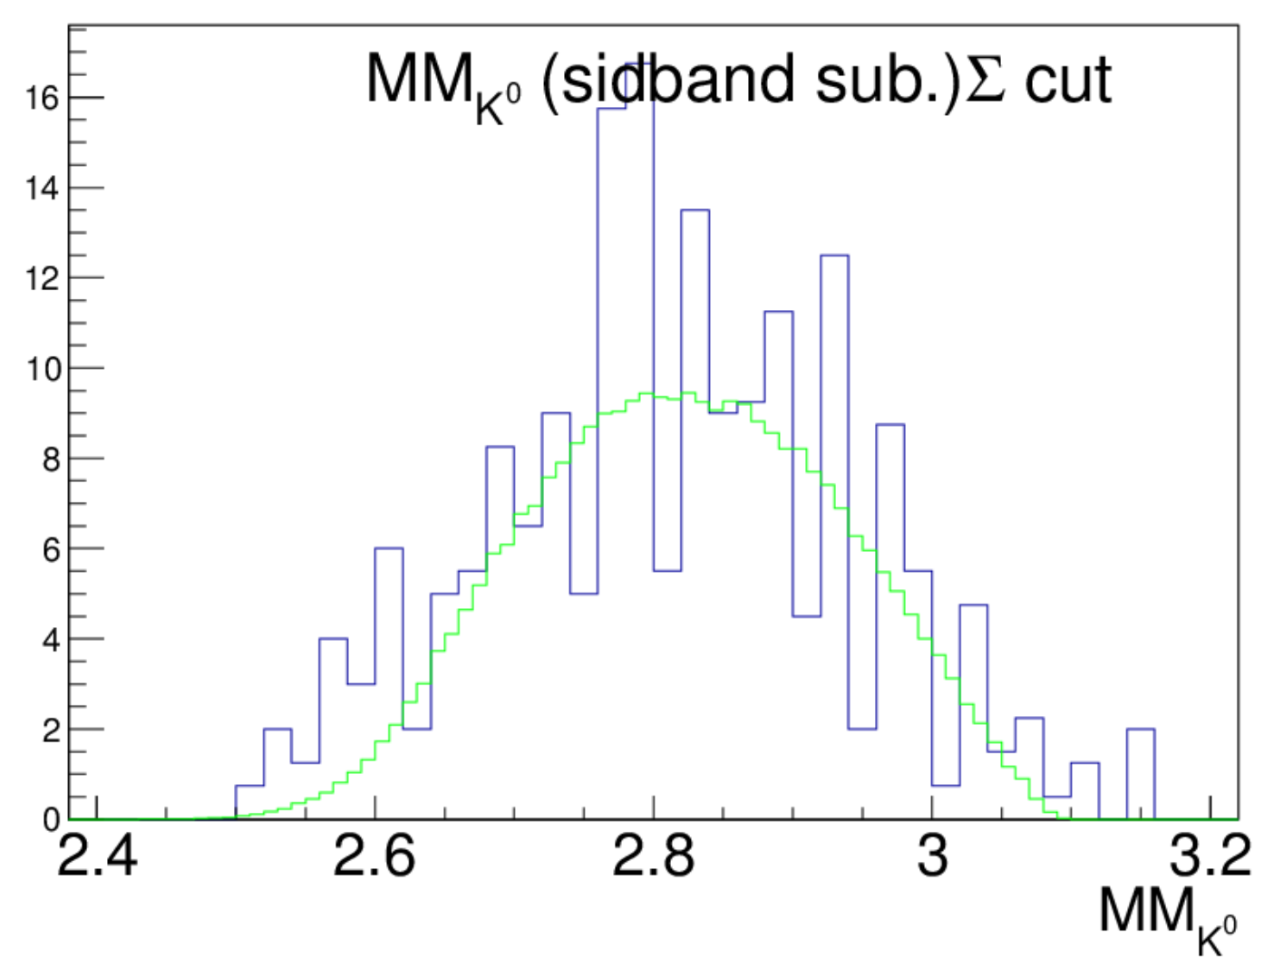

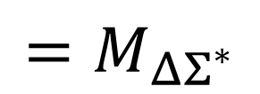
Search for the strange dibaryon
counts
MonteCarlo $Δ^{++}Σ^{∗−}$
$$=M_{ΔΣ^{∗}}$$

Slide 44
Search for d* in high-energy experiments

Slide 45
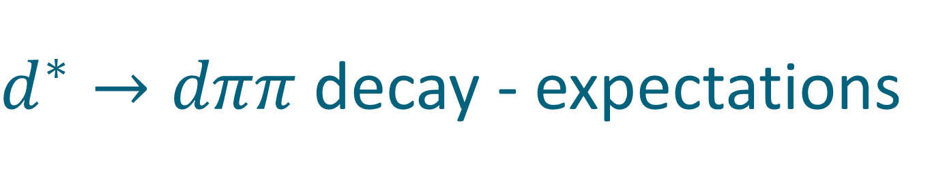
$d^{∗}→dππ$ decay - expectations
π
n
p
π

Slide 46
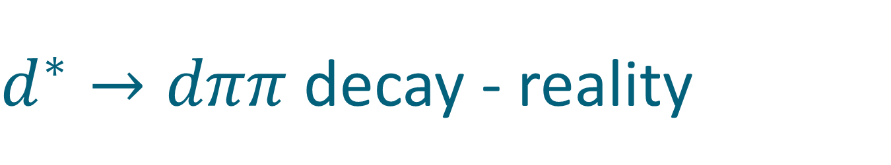
$d^{∗}→dππ$ decay - reality
π
n
p
π

Slide 47
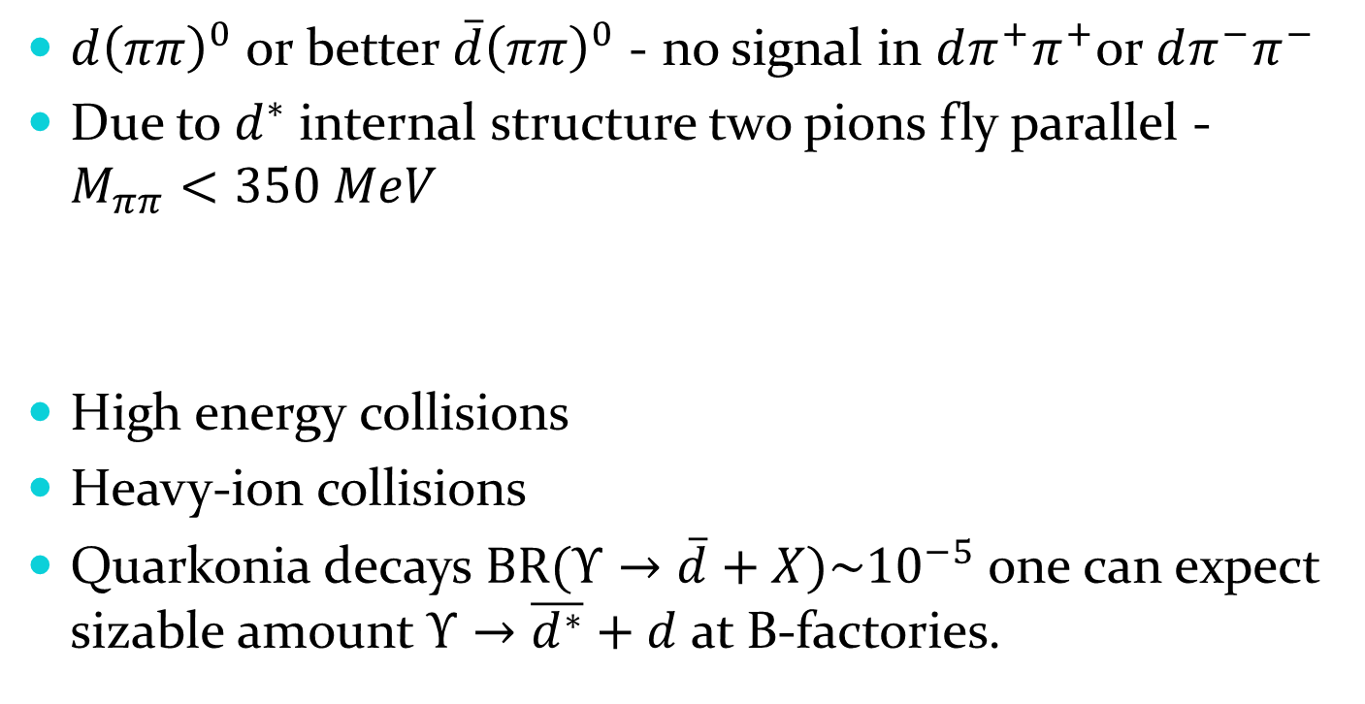

Search for $d^{∗}\left(2380\right)$
$d{\left(ππ\right)}^{0}$or better $\overline{d}{\left(ππ\right)}^{0}$ - no signal in $dπ^{+}π^{+}$or $dπ^{−}π^{−}$
Due to $d^{∗}$ internal structure two pions fly parallel - $M_{ππ}<350 MeV$
High energy collisions
Heavy-ion collisions
Quarkonia decays $BR(Υ→\overline{d}+X)\sim {10}^{−5}$ one can expect sizable amount $Υ→\overline{d^{∗}}+d$ at B-factories.

Slide 48
Conclusion
The very first dibaryon d*(2380) is established
  Mass, Width, Quantum numbers, Main decay branches
Photo-induced reactions
  Structure: Hexaquark vs Molecule?
  Strange dibaryon
Support from theory
Further conformation from Particle Physics experiments?

Slide 49
Points for discussion:
Multiquarks vs molecules
  Two-body decay vs many-body decays?
  Branching ratios?
  Fragmentation?
Internal structure
  Diquarks?
  Meson clouds?
  Dynamical resonances?

Slide 50

ΔΔ
$$d^{∗}(2380)$$
Thank you
ΔΣ*
ΔΞ*
ΔΩ

Slide 51
d*(2380) internal structure

Slide 52

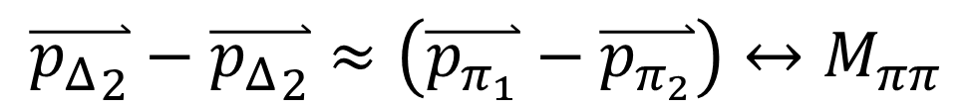

d*(2380) internal structure
pn → d* → ΔΔ → dππ
π
p
Δ
$$N_{1}$$
d
n
$$N_{2}$$
Δ
π
$$\overset{⃑}{{p_{Δ}}_{2}}−\overset{⃑}{{p_{Δ}}_{2}}=\left(\overset{⃑}{p_{N_{1}}}+\overset{⃑}{p_{π_{1}}}\right)−\left(\overset{⃑}{p_{N_{2}}}+\overset{⃑}{p_{π_{2}}}\right)=\left(\overset{⃑}{p_{N_{1}}}−\overset{⃑}{p_{N_{2}}}\right)+\left(\overset{⃑}{p_{π_{1}}}−\overset{⃑}{p_{π_{2}}}\right)≈\left(\overset{⃑}{p_{π_{1}}}−\overset{⃑}{p_{π_{2}}}\right)$$
$$\overset{⃑}{p_{N_{1}}}≈\overset{⃑}{p_{N_{1}}}$$
$$\overset{⃑}{{p_{Δ}}_{2}}−\overset{⃑}{{p_{Δ}}_{2}}≈\left(\overset{⃑}{p_{π_{1}}}−\overset{⃑}{p_{π_{2}}}\right)↔M_{ππ}$$

Slide 53
d*(2380) internal structure and the ABC effect
L=0
Δ
Δ
Δ
Δ
L=2
M. Bashkanov et al, arXiv:1502.07500

Slide 54




Deltaron vs Hexaquark
0.7 fm
$$≈66\%$$
$$≈33\%$$
$$?$$
Narrow width
L=0
Branching ratios
Dalitz plots
Δ
Δ
Δ
Δ
L=2
$$≈90\%$$
$$≈10\%$$
$M_{ππ}$, PWA
F. Huang et al, Chin.Phys. C39 (2015) 7, 071001

Slide 55
Theory

Slide 56
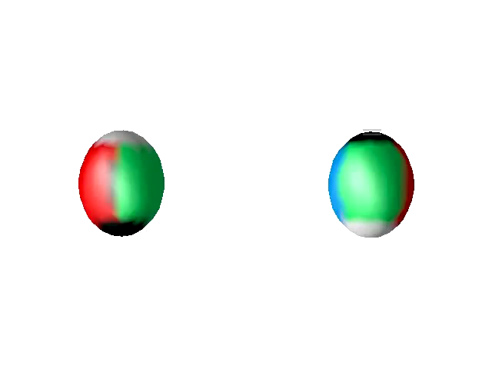
Dibaryon in Skyrme model
David Foster, Nicholas S. Manton, Nucl.Phys. B899 (2015) 513

Slide 57
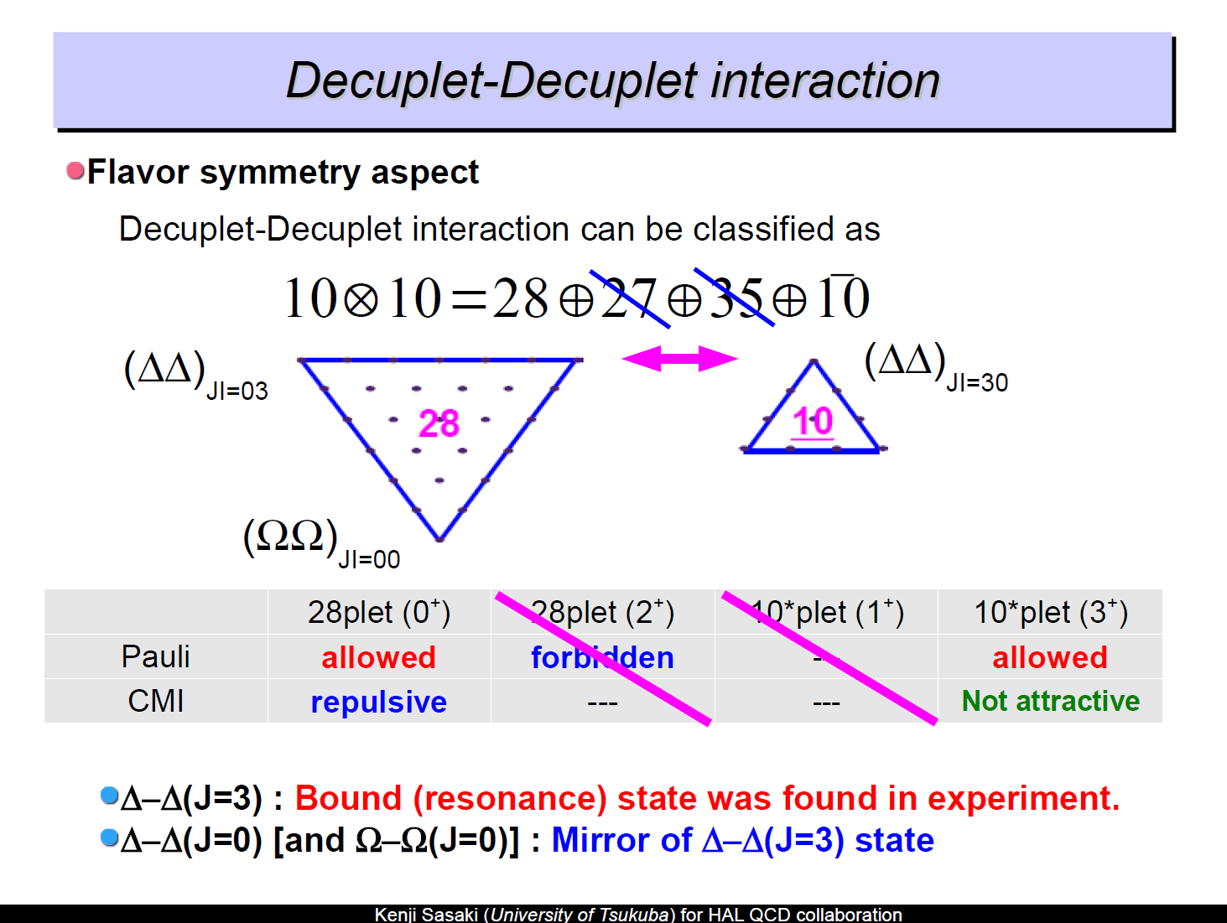
d* in Lattice

Slide 58
d* in Lattice

Slide 59
$d^{∗}(2380)$ in pn

Slide 60
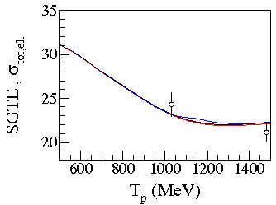
Expectations
p
p
n
n
SAID with resonance
SAID
A. Pricking, M. Bashkanov, H. Clement: arXiv:1310.5532

Slide 61
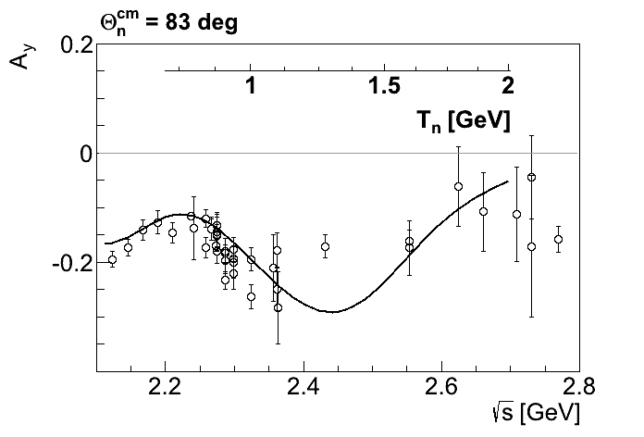

$A_{y}$ energy dependence at $83°$
p
p
n
n
SAID
A. Pricking, M. Bashkanov, H. Clement: arXiv:1310.5532

Slide 62

$A_{y}$ energy dependence at $83°$
p
p
n
n
SAID
New SAID
solutions
P. Adlarson et al. Phys. Rev. Lett. 112, 202301, (2014)

Slide 63




Dimensionless partial wave amplitudes
Pole at $(2380±10)−i(40±5) MeV$
Dimensionless partial wave amplitudes
Im
SP14
SP07
Re
$${}_{}^{3}{D_{3}}$$
$$ε_{3}$$
$${}_{}^{3}{G_{3}}$$
Resonance in the pn system
P. Adlarson et al. Phys. Rev. Lett. 112, 202301, (2014)

Slide 64
Total pn cross-section
Devlin et al, PRD8, 136 (73)
LisowskI et al, PRL49, 255(82)
SAID SP07
SAID new solution
P. Adlarson et al. Phys. Rev. Lett. 112, 202301, (2014)
P. Adlarson et al. Phys. Rev. C 90, 035204 , (2014)

Slide 65

Effect of d* on other pn observables
with d*
without d*
SP07
R.L. Workman, W.J. Briscoe, I.I. Strakovsky Phys.Rev. C93 (2016), 045201

Slide 66




Conventional background $(π^{0}π^{0})$
$$γd→NN^{∗}\left(1520\right)→dπ^{0}π^{0}$$
$$σ(γd→dπ^{0}π^{0})\sim 10nb$$
Conventional background:
Known
Small
$$\frac{σ\left(γd→dπ^{0}π^{0}\right)}{σ\left(γd→d^{∗}→dπ^{0}π^{0}\right)}\sim 2$$
Fix, H. Arenhoevel. Eur. Phys. J. A 25, 115, (2005).
M. Egorov, A. Fix, Nucl.Phys. A933 (2015) 104-113

Slide 67




Conventional background – other $ππ$ channels
$$σ(γd→pnπ^{0}π^{0})\sim 8μb$$
$$σ(γd→dπ^{+}π^{−})\sim 8μb$$
$$\frac{σ\left(γd→pnπ^{0}π^{0}\right)}{σ\left(γd→d^{∗}→pnπ^{0}π^{0}\right)}\sim 100$$
$$\frac{σ\left(γd→dπ^{+}π^{−}\right)}{σ\left(γd→d^{∗}→dπ^{+}π^{−}\right)}\sim 100$$
Fix, H. Arenhoevel. Eur. Phys. J. A 25, 115, (2005).
M. Egorov, A. Fix, Nucl.Phys. A933 (2015) 104-113

Slide 68




$$γd→d^{∗}→pn$$
Conventional background
$$σ(γd→pn)\sim 8μb$$
$$σ(γd→d^{∗}\left(2380\right)→pn)\sim 10nb$$
$$\frac{σ\left(γd→pn\right)}{σ\left(γd→d^{∗}\left(2380\right)→pn\right)}\sim 1000$$
BUT
Polarization observables
Federico Ronchetti arXiv 1301.5886

Slide 69


d*(2380) in photoproduction?
R. Gilman and F. Gross nucl-th/0111015 (2001)
d*
γ
p
T. Kamae, T. Fujita Phys. Rev. Lett. 38, Feb 1977, 471
d
n
H. Ikeda et al., Phys. Rev. Lett. 42, May 1979, 1321
I(J^{p}) = 0(3⁺)
$$M=2.38 GeV$$

Slide 70


Very Preliminary Results

Slide 71




Very Preliminary Results, sideband subtracted
$$M_{pπ^{−}}$$
$$M_{Λπ^{−}}$$

Slide 72

The benchmark measurement
γ
p
Measure polarization of both
proton and neutron !
d*
d
n

Slide 73

New Particle identification detector

Slide 74

New Particle identification detector

Slide 75


Polarimeter

Slide 76




Experiment
$$γ$$
n
$$p$$
$$Θ,φ,E$$
Target
$$Θ^{′},φ′$$
$$γd→\vec{p}n$$
Polarimeter

Slide 77


Experiment
$$γ$$
p
$$n$$
$$Θ,φ,E$$
p
Target
$$Θ^{′},φ′$$
$$γd→p\vec{n}$$
Polarimeter

Slide 78










Structure of the resonance. Transition form factor
$$e^{+}$$
$$γ^{∗}$$
$$e^{−}$$
$$N^{∗}$$
$$N$$
$$e^{−}$$
JLab
$$γ^{∗}$$
$$e^{−}$$
$$N$$
$$N^{∗}$$

Slide 79


The Roper resonance = $Nσ$ molecule

Slide 80
Mirror dibaryon
d*
I(J^{p}) = 0(3⁺)
I(J^{p}) = 3(0⁺)
Δ
Δ
Δ
Δ
u
u
u
d
d
d
u
u
u
u
u
u
Freeman J. Dyson, Nguyen-Hue Xuong Phys. Rev. Lett. 13(1964) 815
Avraham Gal, Humberto Garcilazo Nucl. Phys. A928, (2014), 73

Slide 81
NN vs ΔΔ
$${}_{}^{1}{S_{0}}$$
Z=+4
p
n
Δ
Δ
66 keV
Threshold
?
2.2 MeV
p
n
80 MeV
Δ
Δ
deuteron
d*

Slide 82
How many ways can you combine 6q?
Isospin
$$J^{P}=3^{+}$$
$$J^{P}=0^{+}$$
Strangeness
$$\overline{10}$$
$$28$$
Δ⁻Δ⁻
Δ⁺⁺Δ⁺⁺
d*
ΔΔ
ΔΣ*
Σ*Σ*+ΔΞ*
Ξ*Σ*+ΔΩ
Ξ*Ξ*+Σ*Ω
Ξ*Ω
ΩΩ

Slide 83



Argand plots
P. Adlarson et al. Phys. Rev. Lett. 112, 202301, (2014)
P. Adlarson et al. Phys. Rev. C 90, 035204 , (2014)
$$\frac{Γ_{d^{∗}→pn}}{Γ_{tot}}≈0.12$$
$$Γ_{d^{∗}→pn({}_{}^{3}{D_{3}})}≈10 MeV$$
$$Γ_{d^{∗}→pn({}_{}^{3}{G_{3}})}≈1 MeV$$

Slide 84

S-wave $Δ−Δ$ only?
Δ
N
L=0
L=0,2
Δ
N
Δ
N
L=2
L=0,2,4
Δ
N

Slide 85


S-wave $Δ−Δ$ only?
d* (2380)→ pn
Δ
N
$d^{∗}(2380)$
p
L=0
L=0,2
90%
L=2
Δ
n
N
$d^{∗}(2380)$
p
Δ
N
10%
L=4
n
L=2
L=0,2,4
Δ
N

Slide 86

S-wave $Δ−Δ$ only?
d* (2380)→ pn
Δ
N
$d^{∗}(2380)$
p
L=0
L=0,2
90%
L=2
Δ
n
N
$d^{∗}(2380)$
p
Δ
N
10%
L=4
n
L=2
L=0,2,4
Δ
N
$d^{∗}(2380)$
Δ
Δ

Slide 87


Total cross section pN → dππ
$$dπ^{+}π^{−}$$
$$\frac{1}{2}∙dπ^{+}π^{0}$$
$$2∙dπ^{0}π^{0}$$
P. Adlarson et. al Phys. Lett. B721 (2013) 229

Slide 88
pn → pnπ⁰π⁰
Conventional process +d*
d*
d*
Conventional process
$$\sqrt{s} [GeV]$$
$$\sqrt{s} [GeV]$$
P. Adlarson et al., Phys.Lett. B743 (2015) 325-332

Slide 89




Dibaryon non-fusion decays
$$ppπ^{−}π^{0}$$
$$pnπ^{0}π^{0}$$
$$pnπ^{+}π^{−}$$
d*
d*
PRC 88 (2013) 055208
PLB 743 (2015) 325
HADES
PLB 750 (2015) 184

Slide 90
The decay modes of the dibaryon
Channel | Publications
d π⁰π⁰ | M. Bashkanov et. al Phys.Rev.Lett. 102 (2009) 052301 P. Adlarson et. al Phys. Rev. Lett. 106:242302, 2011 P. Adlarson et. al Phys.Lett. B721 (2013) 229-236
d π⁺π⁻ | P. Adlarson et. al Phys.Lett. B721 (2013) 229-236
ppπ⁰π⁻ | P. Adlarson et. al Phys. Rev. C 88, 055208
npπ⁰π⁰ | P. Adlarson et. al Phys.Lett. B743 (2015) 325
np | A. Pricking, M. Bashkanov, H. Clement. arXiv:1310.5532 P. Adlarson et al. Phys. Rev. Lett. 112, 202301, (2014) P. Adlarson et al. Phys. Rev. C 90, 035204 , (2014)
pn e⁺e⁻ | M. Bashkanov, H. Clement, Eur.Phys.J. A50 (2014) 107
³He ππ | M. Bashkanov et. al Phys.Lett. B637 (2006) 223-228 P. Adlarson et. al Phys. Rev. C 91 (2015) 1, 015201
⁴He ππ | P. Adlarson et. al Phys.Rev. C86 (2012) 032201
+ activities from other groups
M. Bashkanov, Stanley J. Brodsky, H. Clement Phys.Lett. B727 (2013) 438-442

Slide 91
$d^{∗}(2380)$ decay branches
$d^{∗}$ decay channel | Branching ratio, %
$$pn$$ | 12(3)
$$dπ^{0}π^{0}$$ | 14(1)
$$dπ^{+}π^{−}$$ | 23(2)
$$pnπ^{+}π^{−}$$ | 30(5)
$$pnπ^{0}π^{0}$$ | 12(2)
$$ppπ^{0}π^{−}$$ | 6(1)
$$nnπ^{0}π^{+}$$ | 6(1)
$$NNπ$$ | 0(10)
Eur.Phys.J. A51 (2015) 7, 87

Slide 92
Conventional background $(π^{0}π^{0})$
$$γd→NN^{∗}\left(1520\right)→dπ^{0}π^{0}$$
$$σ(γd→dπ^{0}π^{0})\sim 10nb$$
Conventional background:
Known
Small
$$\frac{σ\left(γd→dπ^{0}π^{0}\right)}{σ\left(γd→d^{∗}→dπ^{0}π^{0}\right)}\sim 2$$
Fix, H. Arenhoevel. Eur. Phys. J. A 25, 115, (2005).
M. Egorov, A. Fix, Nucl.Phys. A933 (2015) 104-113

Slide 93
Conventional background – other $ππ$ channels
$$σ(γd→pnπ^{0}π^{0})\sim 8μb$$
$$σ(γd→dπ^{+}π^{−})\sim 8μb$$
$$\frac{σ\left(γd→pnπ^{0}π^{0}\right)}{σ\left(γd→d^{∗}→pnπ^{0}π^{0}\right)}\sim 100$$
$$\frac{σ\left(γd→dπ^{+}π^{−}\right)}{σ\left(γd→d^{∗}→dπ^{+}π^{−}\right)}\sim 100$$
Fix, H. Arenhoevel. Eur. Phys. J. A 25, 115, (2005).
M. Egorov, A. Fix, Nucl.Phys. A933 (2015) 104-113

Slide 94
$$γd→d^{∗}→pn$$
Conventional background
$$σ(γd→pn)\sim 8μb$$
$$σ(γd→d^{∗}\left(2380\right)→pn)\sim 10nb$$
$$\frac{σ\left(γd→pn\right)}{σ\left(γd→d^{∗}\left(2380\right)→pn\right)}\sim 1000$$
BUT
Polarization observables
Federico Ronchetti arXiv 1301.5886

Slide 95

Kinematics
dp→np + p_{sp}
neutron
Proton spectator
proton

