Slide 1


Paths into Multi-Regge Regions
April 13, 2017
Volker Schomerus
Based on work with Till Bargheer, Vsevolod Chestnov [in progress] and with J. Bartels, J. Kotanski, M. Sprenger.

Slide 2
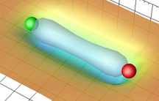
Epilogue: Gauge/String Correspondence
Recall: Planar N=4 SYM is a classical string theory
genus zero
Solution in terms of its flux tube = integrable GKP string
[Beisert, Eden, Staudacher] [B. Basso]
Wilson-loop OPE: Efficient formulas in some kinematic regimes, e.g. collinear limit at weak coupling
[Basso,Sever,Vieira]

Slide 3
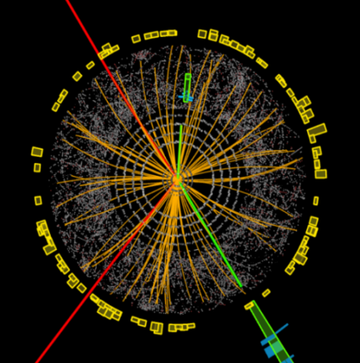
Intro: Multi-Regge Limit…
… typical kinematics
at colliders
n can be large
Strong coupling: Infrared limit of integrable quantum system → MRL of finite remainder can be obtained by solving Bethe Ansatz equations [Bartels,VS,Sprenger]
If we knew which solution was relevant
MRL would be solved at strong coupling!

Slide 4

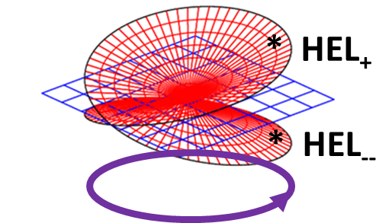

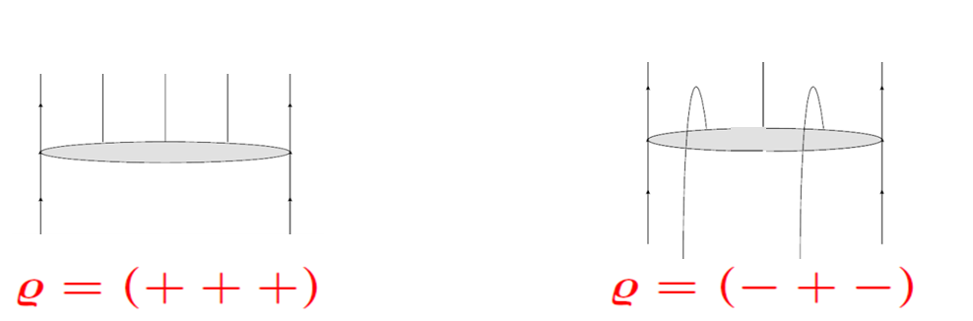



Intro: Analytical Structure
MRL_{ρ} is MRL
in Mandelstam region
MRL_{ρ}
MRL
BDS on main sheet in MR exact, i.e.
= 0
NLL
[Goncharov et al.]
[Bartels et al.]

Slide 5
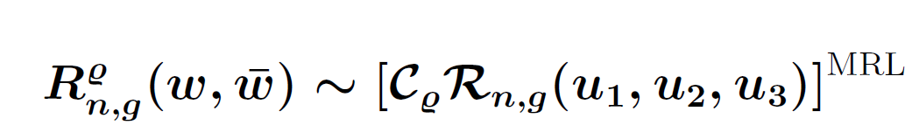
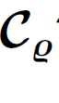
Intro: Paths & Plan
MRL captures monodromies of finite remainder
What is ?
need homotopy not just homology
I MRL at strong coupling & Bethe Ansatz
II Continuation paths at weak coupling

Slide 6
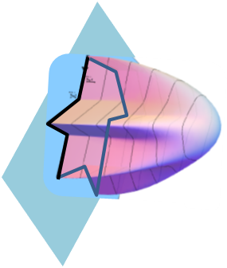
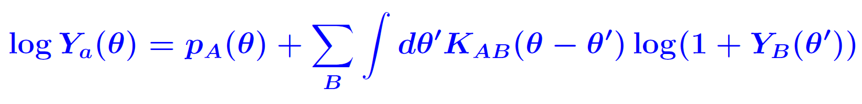
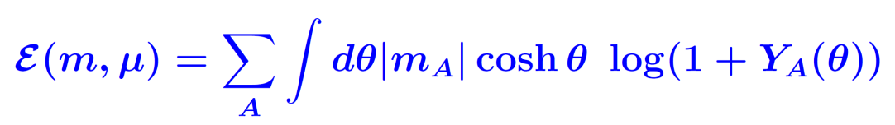
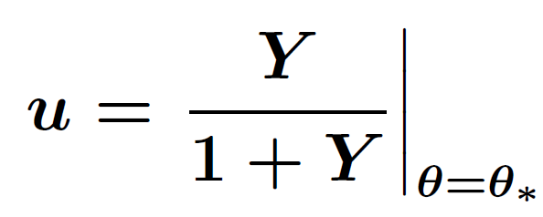
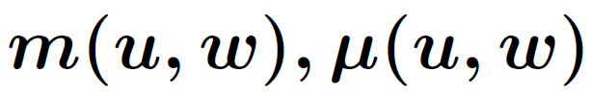
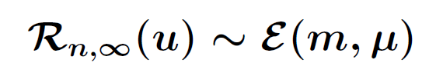
I.1 Minimal Area & TBA
[Alday,Gaiotto,Maldacena,Sever,Vieira]
amplitude = area of minimal surface in AdS₅
R = energy of 1D multiparticle quantum system with
3n-15 parameters (m,μ) & integrable interaction S^{2→2}
Energy:
Solve … for to obtain
Theorem

Slide 7
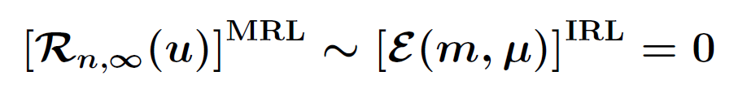
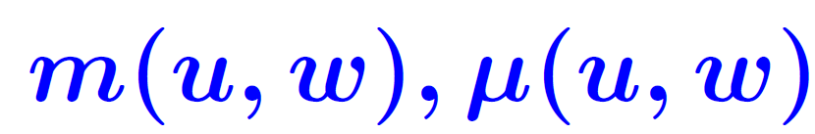
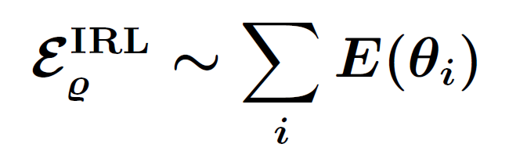
I.2 MRL is 1D Infrared Limit
[Bartels,Kotanski,Sprenger,VS]
MRL corresponds to limit of large masses m→ ∞
→
To reach MRL_{ρ} we must continue m(u,w),(u,v)
During this process, excitations are produced in
the 1D system by mechanism of
[Dorey,Tateo]
θ_{i} Bethe roots
of excitations
→

Slide 8


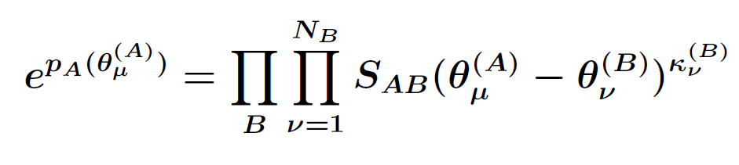
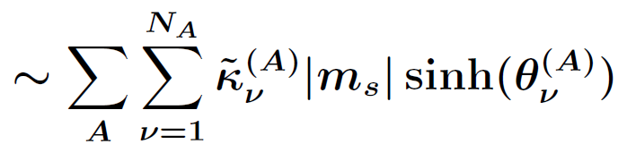

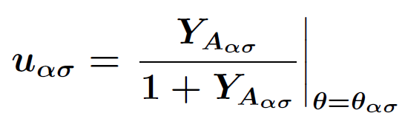

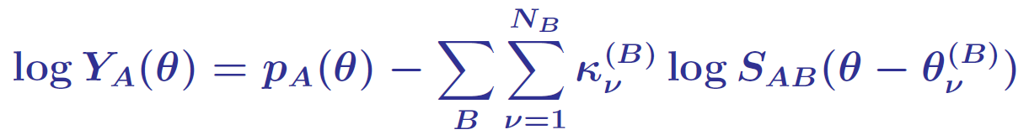
I.3 Multi-Regge Bethe Ansatz
In MRL: TBA → BA for rapidities θ of bare excitations
1
From solution of BA equations compute the energy
2
3
Solve for & compute R
with

Slide 9
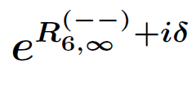
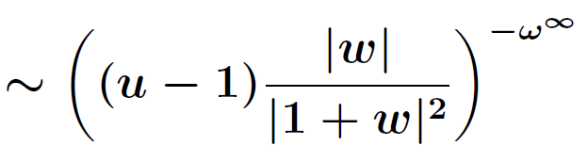
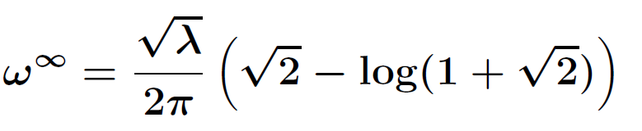

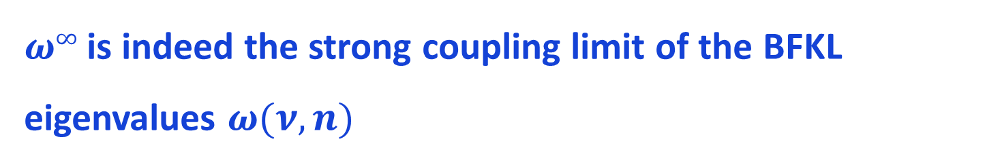
I.4 Strong Coupling Results
For n=6 gluons: Pair of 1D excitations gives in IRL
[Bartels,
Sprenger, VS]
where
Same curve as in 2-loop analysis
$ω∞$is indeed the strong coupling limit of the BFKL eigenvalues $ω(ν,n)$
[Basso,Caron-Huot,Sever]

Slide 10
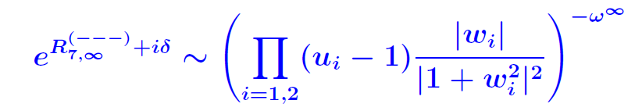
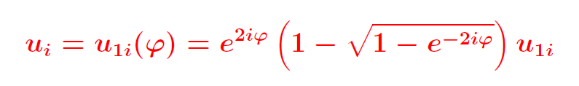



I.5 Beyond the Hexagon
$$ρ=(− −−)$$
?
$$ρ=(− + −)$$

Slide 11
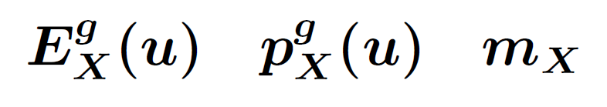
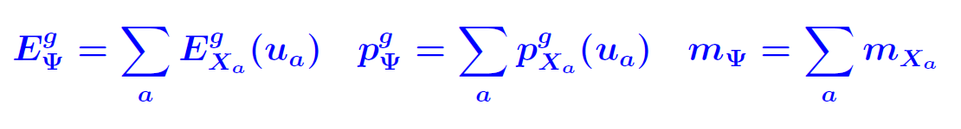
II.1 The GKP String
Known 1-particle excitations X
Dispersion
u = rapidity
Helicity
U(1) charge
Determined by BES equation
[B. Basso]
Interact through factorizable scattering ← S^{2→2}

Slide 12
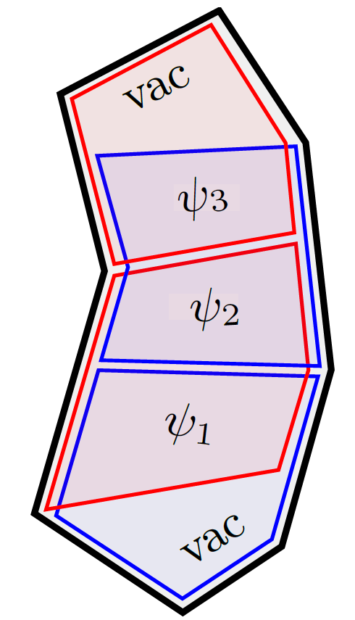
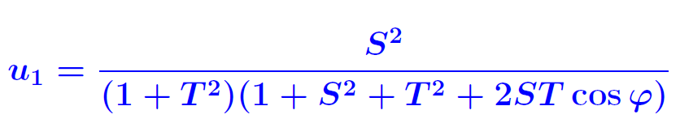
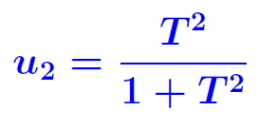
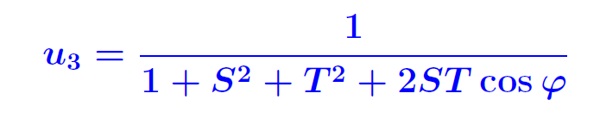

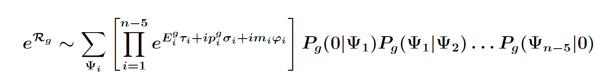
II.2 Wilson loop OPE
Introduce new variables, e.g. for n=6
Remainder can be computed from GKP string through
from S^{2→2}
[Basso,Sever,Vieira]
Sum over single particle content, integral over rapidities

Slide 13
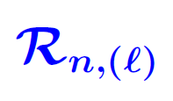
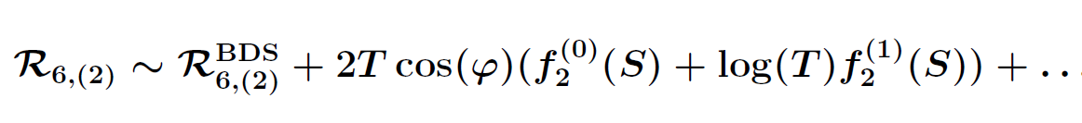


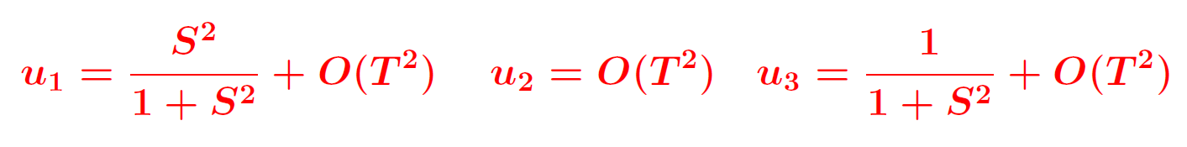
II.3 Collinear limit
In collinear limit only single particle excitations
w. X = F± contribute → simple to evaluate
CL
Possesses branch points where S², 1+S² vanish
Fundamental group of complex S² plane\{0,-1}
generated by

Slide 14
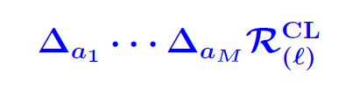
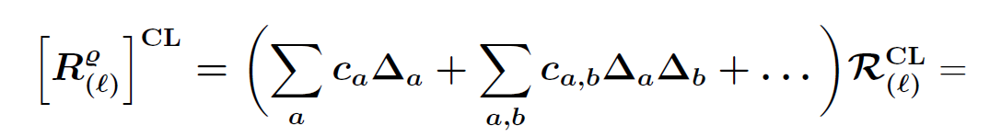
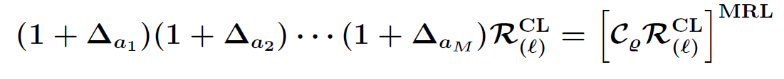
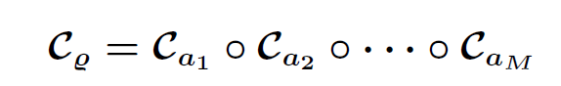

II.4 Finding the Path
List all multiple discontinuities
MRL
?
?
=
➔
unique in semigroup
Hexagon: Equality holds for

Slide 15

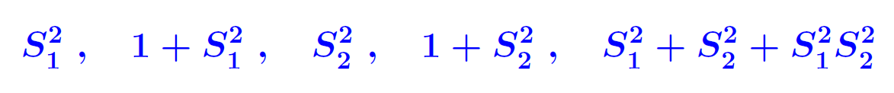





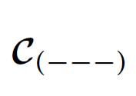





II.5 Beyond the Hexagon
possesses branch points where following functions vanish
CL
Fundamental group generated by five elements
$$U_{25} U_{36} U_{15} { U}_{37} U_{26}$$
Analysis of R₇₍₂₎ gives following continuation paths
LLA
LLA → the curve cannot be built out of
alone, but needs either nnn or
+

Slide 16
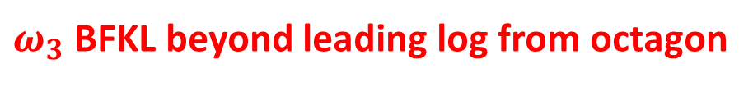
Conclusions / Open problems
Push analysis of paths at weak coupling to higher
orders in loops and legs and higher orders in T.
Identify the relevant solution of the Regge Bethe Ansatz at strong coupling.
$ω_{3}$BFKL beyond leading log from octagon
Repeat the analysis of [Basso, Caron-Huot, Sever] beyond hexagon.

