Slide 1
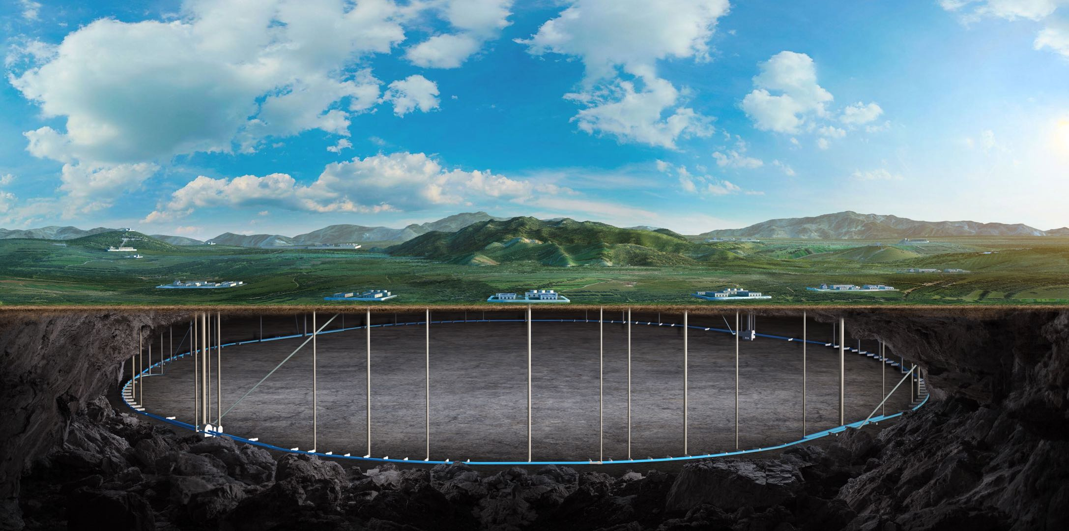
Beam optics design for the CEPC collider ring
Yiwei Wang, Bin Wang, Yuan Zhang, Sha Bai, Jiyuan Zhai, Yuanyuan Wei
for the CEPC Accelerator Physics Group
3-6 July 2023, University of Edinburgh, The 2023 international workshop on the CEPC

Slide 2
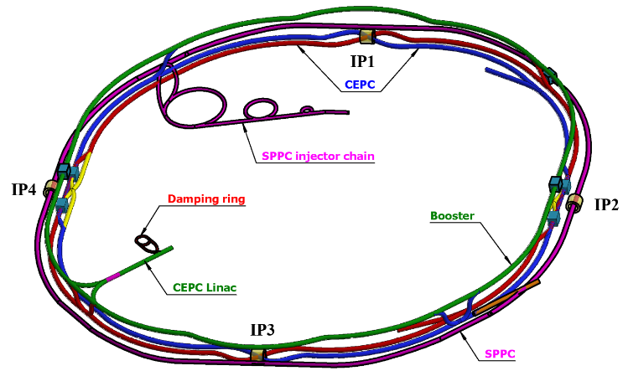
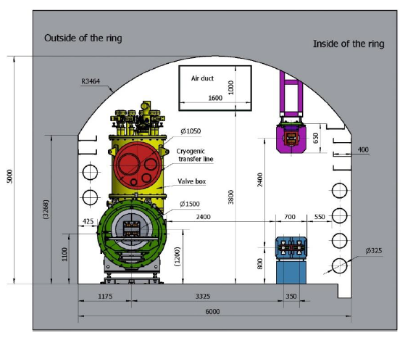
Overall design requirement of the CEPC collider ring
SR power per beam 30 MW (50 MW upgradable), 100 km, 2 interaction points
Higgs mode hold the 1st priority and compatible with the ttbar/W/Z modes.
Compatible with SPPC: circumference, section length, two machines share the most tunnels
CEPC+SPPC complex
Tunnel in the arc regions
CEPC detectors

Slide 3
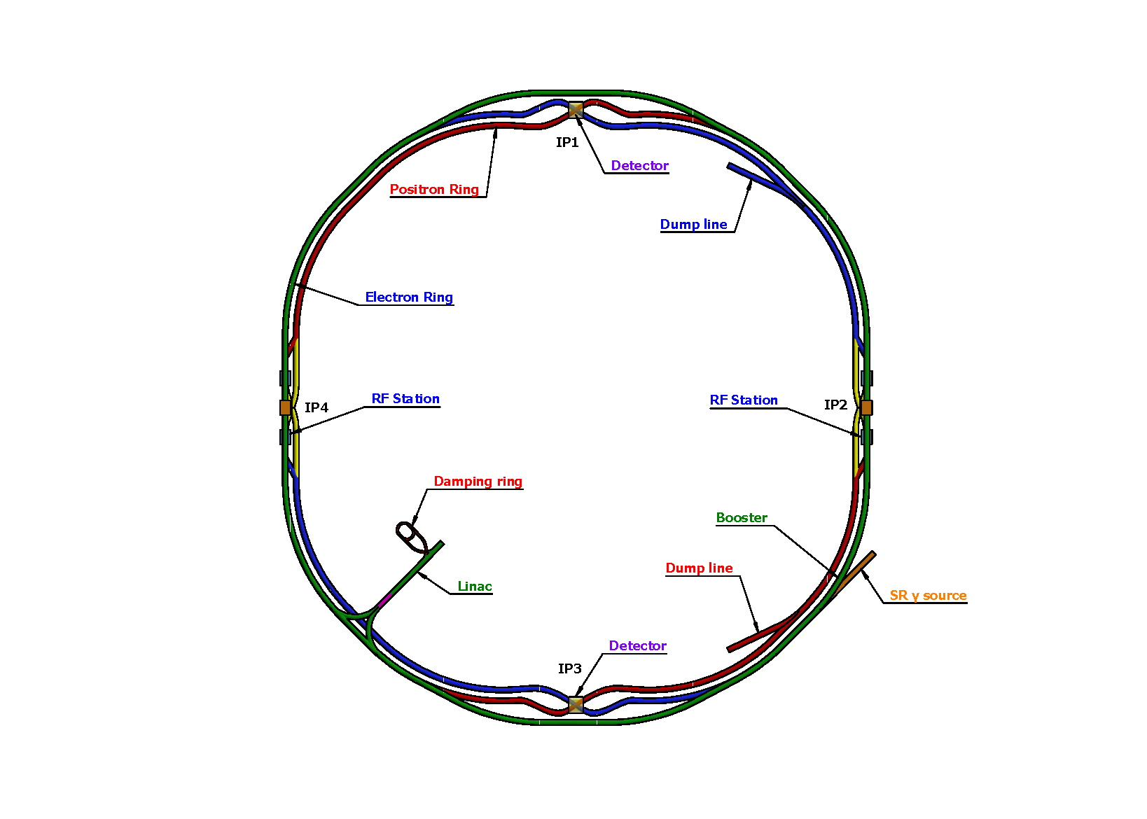
Lattice design requirement of the CEPC collider ring
Basically 2 folded symmetry
2 interaction regions @ IP1 and IP3
crab waist collision
local chromaticity correction for the interaction region
2 RF acceleration regions @ IP2 and IP4
shared cavities for two beam @ ttbar, Higgs
flexible switching between compatible modes
8 arc sections
dual aperture dipole and quadrupole magnets
4 short straight section
on/off axis injection regions for different modes
beam dumping, gamma source
Providing polarized beam*
SS4
SS1
SS3
SS2
*Progress of CEPC Polarization studies, Zhe DUAN,4 July, this workshop
Ref: CEPC CDR, arXiv:1809.00285, 2018; K. Oide, arXiv:1610.07170; M. Zobov et al, Phys. Rev. Lett. 104, 174801(2010);
SS: short straight section

Slide 4
CEPC Design Parameters
 | Higgs | Z | W | $$t\overline{t}$$
Number of IPs | 2
Circumference (km) | 100.0
SR power per beam (MW) | 30
Half crossing angle at IP (mrad) | 16.5
Bending radius (km) | 10.7
Energy (GeV) | 120 | 45.5 | 80 | 180
Energy loss per turn (GeV) | 1.8 | 0.037 | 0.357 | 9.1
Damping time τ_{x}/τ_{y}/τ_{z} (ms) | 44.6/44.6/22.3 | 816/816/408 | 150/150/75 | 13.2/13.2/6.6
Piwinski angle | 4.88 | 24.23 | 5.98 | 1.23
Bunch number | 268 | 11934 | 1297 | 35
Bunch spacing (ns) | 591 (53% gap) | 23 (18% gap) | 257 | 4524 (53% gap)
Bunch population (10¹¹) | 1.3 | 1.4 | 1.35 | 2.0
Beam current (mA) | 16.7 | 803.5 | 84.1 | 3.3
Phase advance of arc FODO (°) | 90 | 60 | 60 | 90
Momentum compaction (10⁻⁵) | 0.71 | 1.43 | 1.43 | 0.71
Beta functions at IP β _{x}*/β _{y}* (m/mm) | 0.3/1 | 0.13/0.9 | 0.21/1 | 1.04/2.7
Emittance ε_{x}/ε_{y} (nm/pm) | 0.64/1.3 | 0.27/1.4 | 0.87/1.7 | 1.4/4.7
Betatron tune ν_{x}/ν_{y} | 445/445 | 317/317 | 317/317 | 445/445
Beam size at IP σ_{x} /σ_{y} (um/nm) | 14/36 | 6/35 | 13/42 | 39/113
Bunch length (natural/total) (mm) | 2.3/4.1 | 2.5/8.7 | 2.5/4.9 | 2.2/2.9
Energy spread (natural/total) (%) | 0.10/0.17 | 0.04/0.13 | 0.07/0.14 | 0.15/0.20
Energy acceptance (DA/RF) (%) | 1.6/2.2 | 1.0/1.7 | 1.2/2.5 | 2.0/2.6
Beam-beam parameters ξ_{x} /ξ_{y} | 0.015/0.11 | 0.004/0.127 | 0.012/0.113 | 0.071/0.1
RF voltage (GV) | 2.2 | 0.12 | 0.7 | 10
RF frequency (MHz) | 650
Longitudinal tune ν_{s} | 0.049 | 0.035 | 0.062 | 0.078
Beam lifetime (Bhabha/beamstrahlung) (min) | 39/40 | 82/2800 | 60/700 | 81/23
Beam lifetime (min) | 20 | 80 | 55 | 18
Hourglass Factor | 0.9 | 0.97 | 0.9 | 0.89
Luminosity per IP (10³⁴ cm^{–2} s^{–1}) | 5.0 | 115 | 16 | 0.5
-𝛽y∗ and emittance chosen for luminosity
-adequate Ne for the luminosity and achievable energy acceptance for lattice design

Slide 5
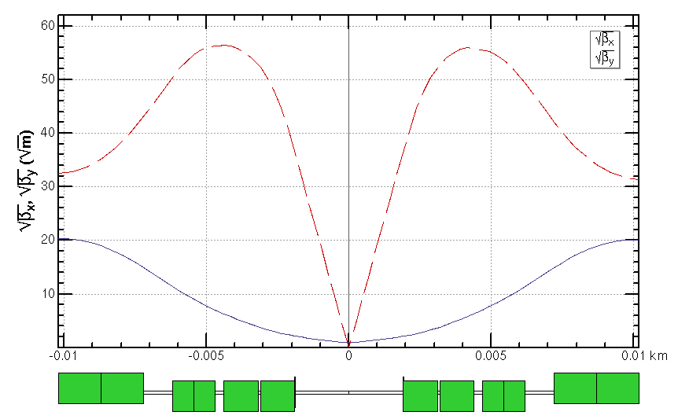
Final quadrupoles for all modes
Higgs running keep the 1st priority
Strength of other modes doesn’t exceeded the one of Higgs mode.
The parameters near the IP are chosen based on a trade-off between the beam dynamics and the machine detector interface.
Quadrupole | L [m] | Distance from IP [m] | Strength [T/m]
 |  |  | $$t\overline{t}$$ | Higgs | W | Z
Q1AIRU | 1.21 | 1.9 | -141 | -141 | -94 | -110
Q1BIRU | 1.21 | 3.19 | -59 | -85 | -56 | +65
Q2IRU | 1.5 | 4.7 | -51 | +95 | +63 | 0
Q3IRU | 3 | 7.2 | +40 | 0 | 0 | +2
Q1AIRD | 1.21 | -1.9 | -142 | -142 | -95 | -110
Q1BIRD | 1.21 | -3.19 | -64 | -85 | -57 | +65
Q2IRD | 1.5 | -4.7 | -47 | +96 | +64 | 0
Q3IRD | 3 | -7.2 | +40 | 0 | 0 | +2
Q3BIRU
Q3AIRU
Q2IRU
Q1BIRU
Q1AIRU
Q1AIRD
Q1BIRD
Q2IRD
Q3AIRD
Q3BIRD
 | QD | QF
Z | Q1A | Q1B
W/H | Q1A+Q1B | Q2
ttbar | Q1A+Q1B+Q2 | add quad Q3A and Q3B
 | L* [m] | LQ1 [m] | LQ2 [m] | GQ1 [T/m] | GQ2 [T/m] | d [m]
CDR | 2.2 | 2.0 | 1.5 | -136 | 111 | 0.3
TDR | 1.9 | 1.22/1.22 | 1.5 | -141/-85 | +95 | 0.3

Slide 6
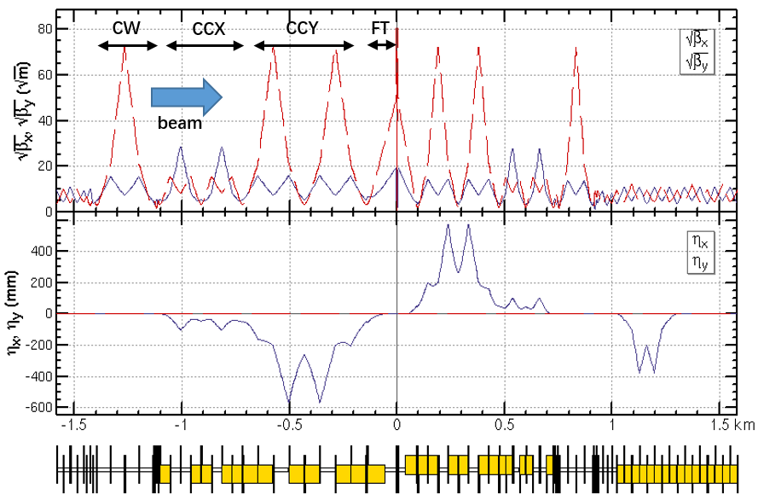
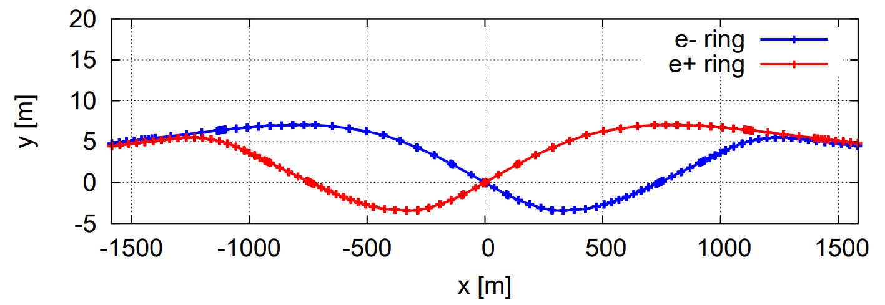
Lattice design of the interaction region
Crab waist collision, local chromaticity correction, asymmetric interaction region
Up to 3rd order chromaticity is corrected with pairs of main sextupoles, phase tuning and additional sextupoles respectively.
Main resonance driving terms (RDT) due to sextupoles in 3rd and 4th order Lie operators are cancelled.
The tune shift due to the finite length of the main sextupoles is corrected with additional weak sextupoles.

Slide 7
RF region Layout*
*CEPC SRF system designs for collider, boosters and upgrade plan, Jiyuan ZHAI,
4 July, this workshop
1st priority of the Higgs running and switching between different modes
Shared cavities for two beam @ Higgs, ttbar; Bunches filled in each half rings
Independent cavities; bunches filled in each whole rings for the W and Z
Maximize the performance and flexibility of future circular electron positron collider
Stage 1
H/W/LL
-
Z (and HL
-
：
H/W upgrade)
Outer Ring
H
H
Inner Ring
Stage 2
HL
-
H/W/Z (HL
-
：
Z upgrade)
Outer Ring
Z
H
H
Z
Inner Ring
Stage 3
HL
-
H/W/Z/ttbar (ttbar
-
：
upgrade)
Peak luminosity at different stages with SR power for 30/50MW per beam
Outer Ring
Z
H
ttbar
H
Z
Luminosity/IP [10^34/cm^2/s] | Higgs | Z | W | ttbar
Stage 1 | 5/8.3 | 38 (10MW limit) | 16/26.7 | -
Stage 2 | 5/8.3 | 115/192 | 16/26.7 | -
Stage 3 | 5/8.3 | 115/192 | 16/26.7 | 0.5/0.83
Inner Ring
H
Z
ttbar
650 MHz 2
-
cell cavity
650 MHz 5
-
650 MHz 1
cell cavity
-
6 cavities in 1 CM
cell cavity
4 cavities in 1 CM
1 cavity in 1 CM

Slide 8
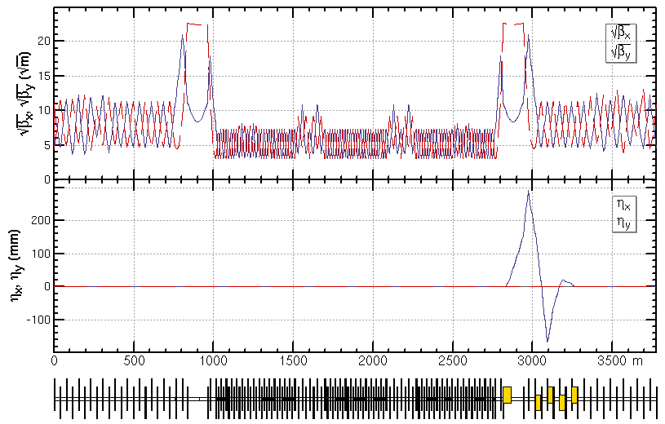
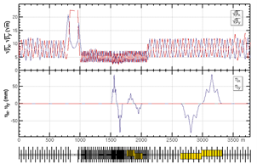
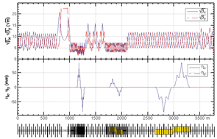
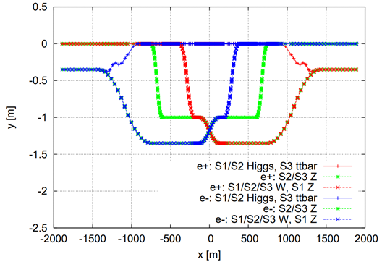
Lattice design of the RF region
The lattice was designed to satisfy the RF system design for different energies.
bypass and section length for different RF stages, small average beta functions to reduce the multi-bunch instability
Higgs at stage 1/2
ttbar at stage 3
W at stage 1/2/3
Z at stage 1
Esep= 2.0 MV/m
Lsep= 4 m×10
Δx= 10 cm at entrance of quad
Z at stage 2/3

Slide 9
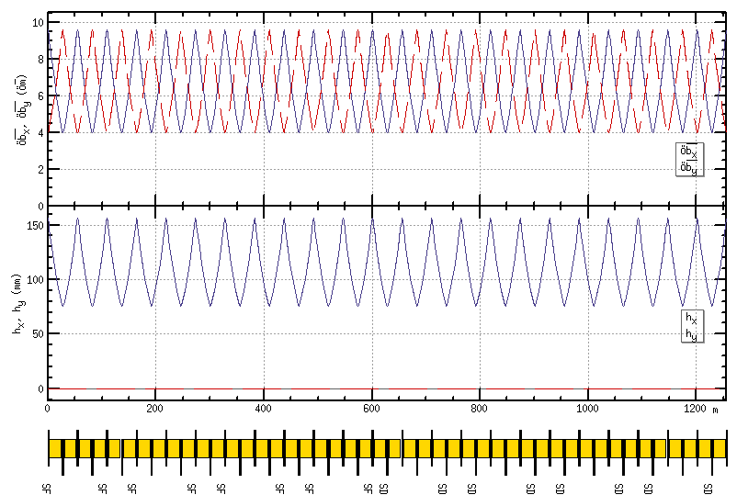
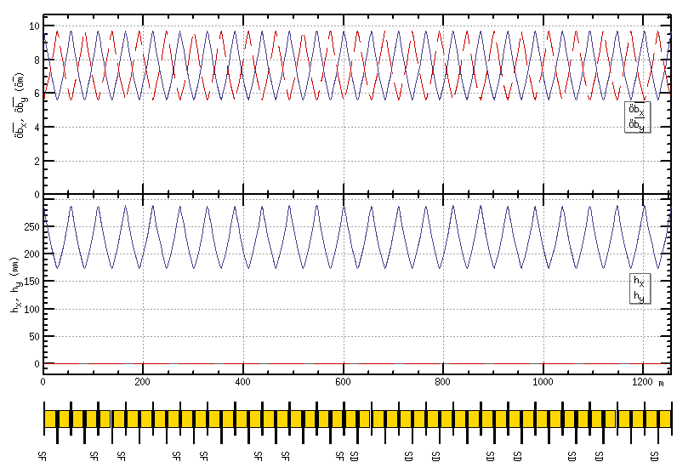
Lattice design of the ARC region
FODO cell to provide a large filling factor.
90/90 degrees’ phase advances for the Higgs and ttbar modes due to the emittance and nonlinearity cancelation.
60/60 degrees’ phase advances for the W and Z modes to fulfil the collective instability requirement.
suppress the impedance induced instability at Z mode
increase stable tune area if considering beam-beam effect and impedance consistently at W and Z modes
The distance 0.35m and opposite polarity between two beams fulfill the requirement technical design of the twin-aperture of dipoles and quadrupoles.
0.35m
Higgs/ttbar
90/90 degree
W/Z
60/60 degree
Dual aperture quadrupole and bend with opposite polarity in two ring

Slide 10
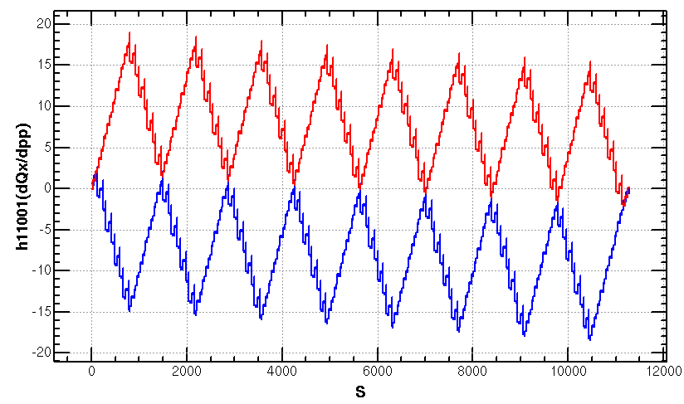
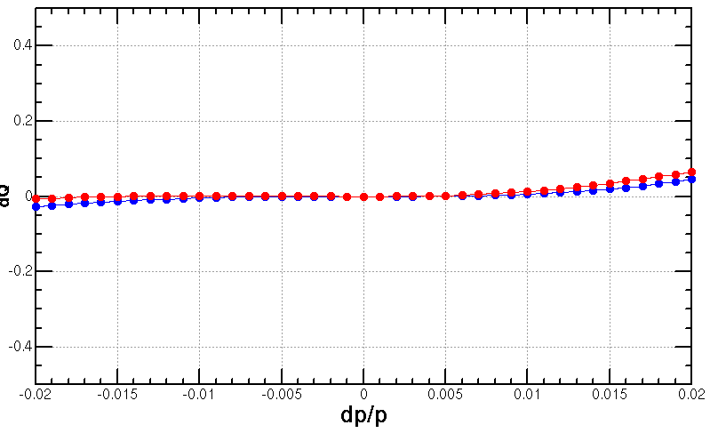
Optimization of ARC aberration for Higgs/ttbar modes
Four –I sextupole pairs scheme for Higgs & ttbar modes
With small 2nd order chromaticity esp. for the horizontal plane
2nd order chromaticity for the vertical plane generated in the ARC region are further corrected with IR knobs.
SF
1A
SF
1B
SF
2A
SF
2B
SF3A
SF
3B
SF
4A
SF
4B
SD
1A
SD
1B
SD
2A
SD
2B
SD3A
SD
3B
SD
4A
SD
4B
Scheme with four –I sextupole pairs, T. Bian, PhD thesis 2018, IHEP
Q’’=9, 145

Slide 11
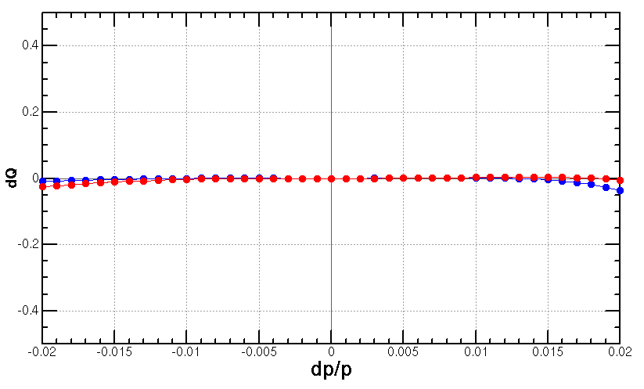
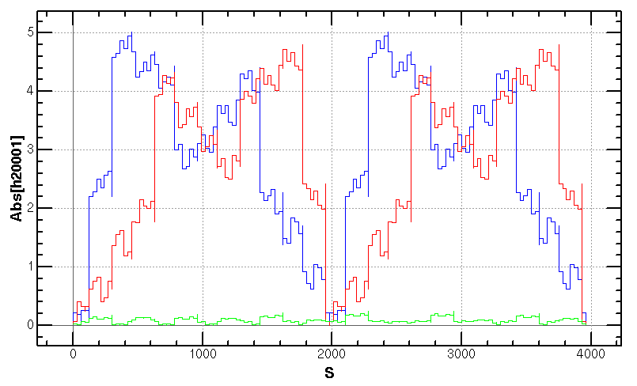
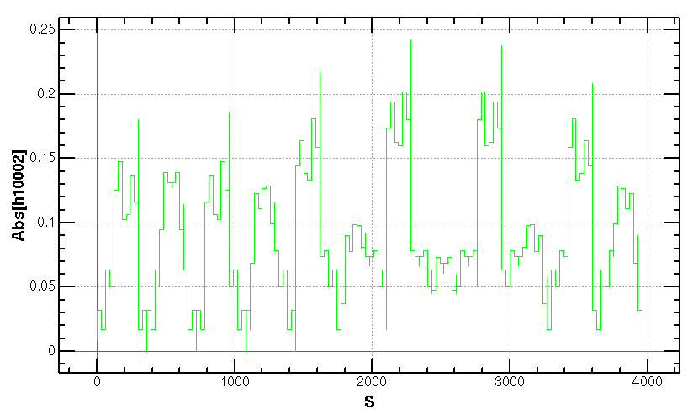
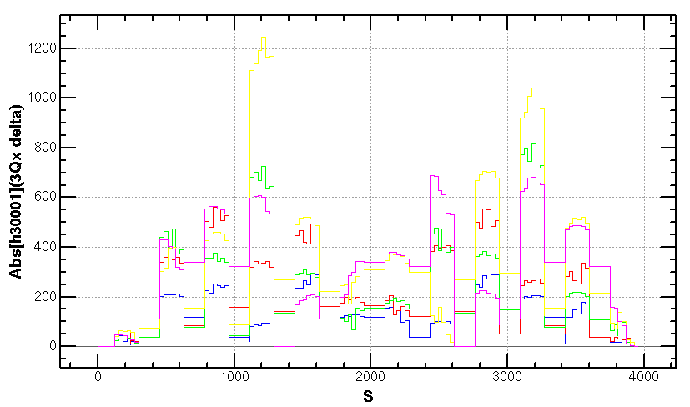
Optimization of ARC aberration for W/Z
The distribution of sextupoles for Higgs & ttbar mode allowed to select –I sextupole pairs for W &Z modes.
Cancellation of main aberration has period of 23*3 cells. Give a good start point for the dynamic aperture optimization.
SF
1A
SF
1B
SF
2A
SF
2B
SF3A
SF
3B
SF
4A
SF
4B
SD
1A
SD
1B
SD
2A
SD
2B
SD3A
SD
3B
SD
4A
SD
4B
-I
-I
-I
-I
dQ vs. dp/p
Cancellation of
beta distortion due to energy deviation
Cancellation of
dispersion distortion due to energy deviation
Cancellation of
3rd RDT due to energy deviation
case {4,3}+{3,4}

Slide 12
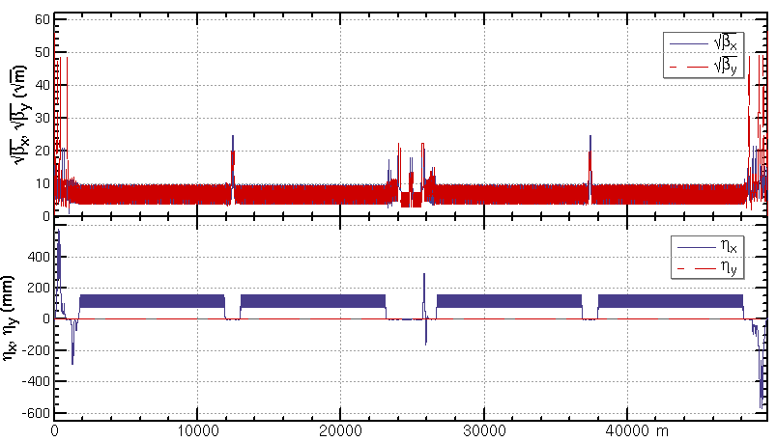
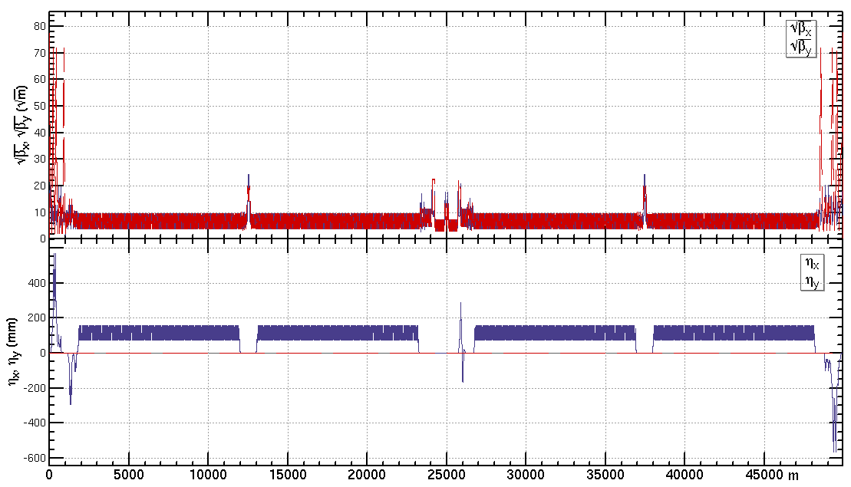
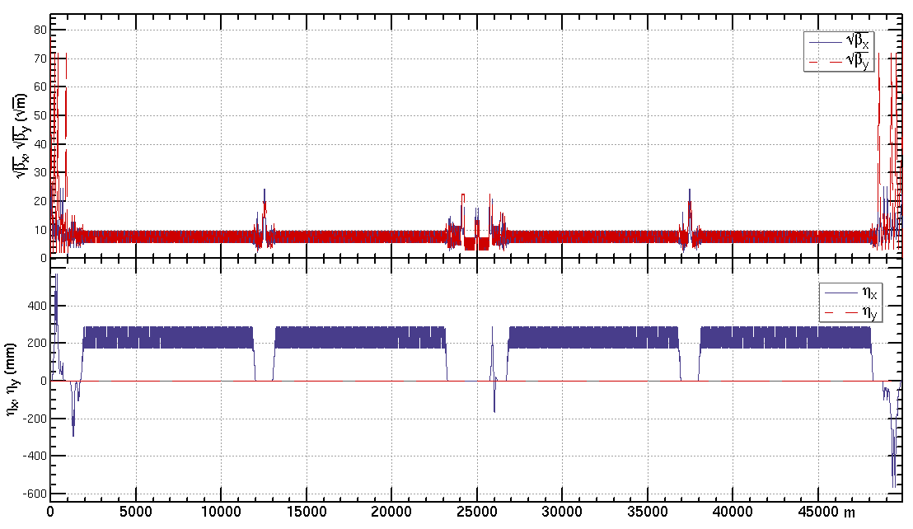
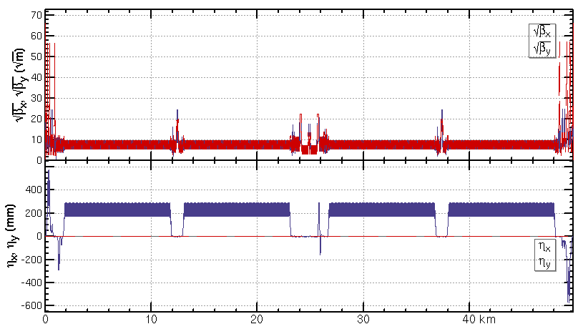
Lattice design of the CEPC half ring
ttbar: εx=1.4nm, β=1.04m/2.7mm
Higgs: εx=0.64nm, β=0.30m/1mm
W: εx=0.87nm, β=0.21m/1mm
Z: εx=0.27nm, β=0.13m/0.9mm

Slide 13
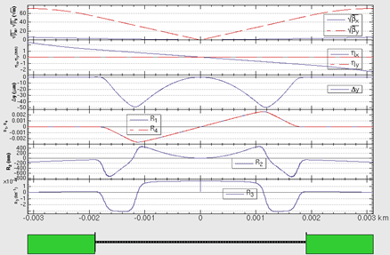
Vertical emittance generated by solenoid field
The detector solenoid are compensated locally with anti-solenoids
3T for 𝑡𝑡 ̅/Higgs/W, 2T for the Z
cancel the ∫Bzdz between the IP and the faces of the final quadrupole
exists a transverse fringe field esp. at the fringe of anti-solenoid
The vertical emittance increases due to the fringe field of the anti-solenoid combined with the horizontal crossing angle.
The solenoid field induced vertical emittance fulfill the parameter list.
IR optics with solenoid for Higgs energy
Vertical emittance due to the solenoid field
 | ttbar 3T | Higgs 3T | W 3T | Z 2T
EmitY nominal (pm) | 4.7 | 1.3 | 1.7 | 1.4
EmitY (pm) | 0.04 | 0.41 | 1.35 | 1.07

Slide 14
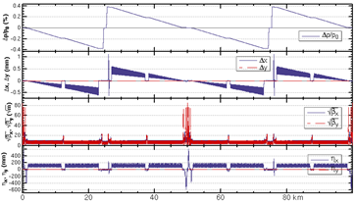
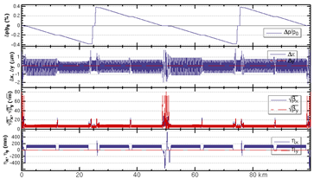
Energy sawtooth effects and correction
With only two RF stations, the energy sawtooth is around ±0.4 % @ H and 1.3 % @ ttbar
The closed orbit distortion in CEPC collider ring is around 1 mm and becomes 1um after tapering* the magnet strength with beam energy.
require adjusting range of magnets strength ±2.5% with the trim coil
Higgs
Higgs
*Ref: CEPC CDR, arXiv:1809.00285, 2018

Slide 15
Dynamic aperture requirement
by Y. Zhang, X. H. Cui, Y. W. Wang
The dynamic aperture requirement comes from the horizontal injection parameters, beam lifetime for the top-up injection.
 | ttbar | Higgs | W | Z
Horizontal Emittance in collider/booster [nm] | $1.4$ / 2.83 | $0.64$/ 1.26 | $0.87$/ 0.56 | $0.27$ / 0.19
DA requirement from injection | $${\text{1}\text{1} σ}_{x}×7 σ_{y}$$ off axis | $$13.5{ σ}_{x}×7{ σ}_{y}$$ off axis $$7{ σ}_{x}×7 σ_{y}$$ on axis | $${\text{8}\text{.}\text{5 }σ}_{x}×5 σ_{y}$$ off axis | $${\text{11} σ}_{x}×5{ σ}_{y}$$ off axis
Energy acceptance requirement [%] | 2.0 | 1.6 | 1.2 | 1.0
Beam lifetime (mainly bhabha and beamstrahlung) [min] | 18 | 18 | 21 | 72

Slide 16
Dynamic aperture requirement (cont.)
The dynamic aperture requirement comes from the horizontal injection parameters, beam lifetime for the top-up injection.
DA requirement | ttbar | Higgs | W | Z
with on-axis injection | - | ${\text{8}σ}_{x}×20σ_{y}×$1.6% | - | -
with off-axis injection | ${\text{1}\text{1}σ}_{x}×{16σ}_{y}×$2.0% | ${\text{13.}5σ}_{x}×20σ_{y}×$1.6% | ${\text{8.}5σ}_{x}×20σ_{y}×$1.2% | ${\text{1}\text{1}σ}_{x}×23σ_{y}×$1.0%

Slide 17
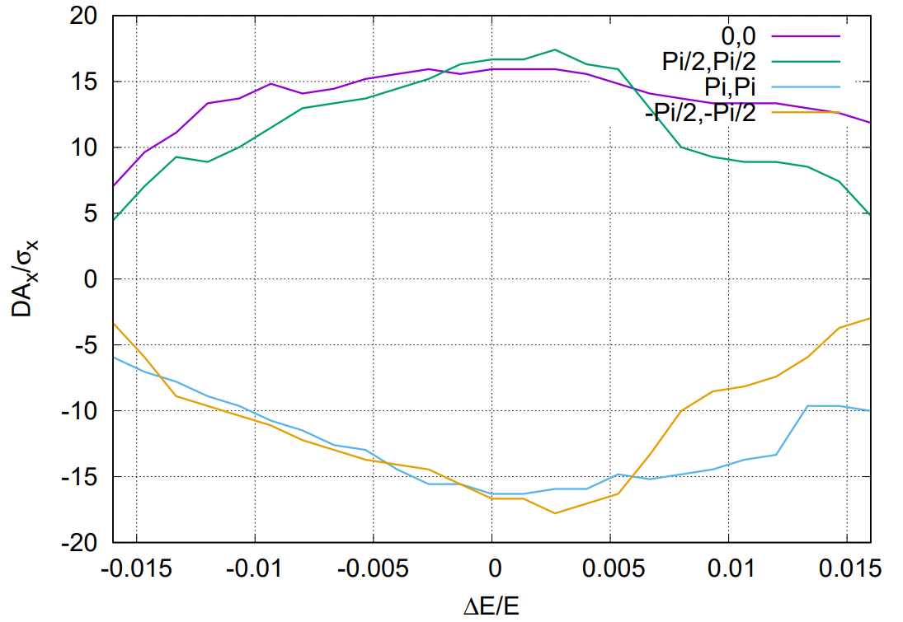
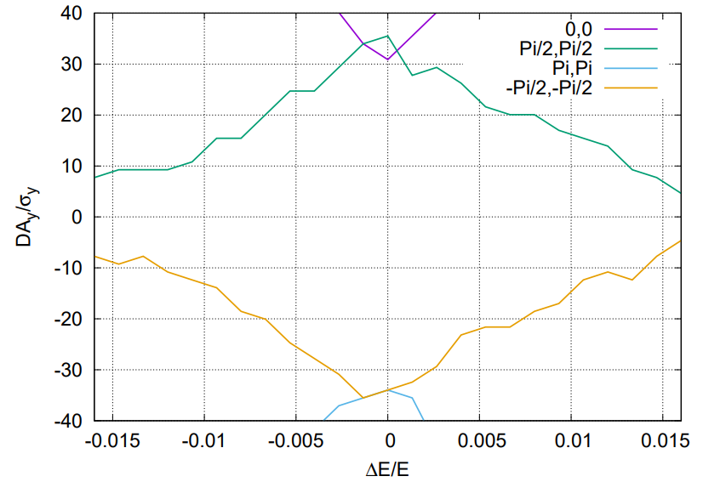
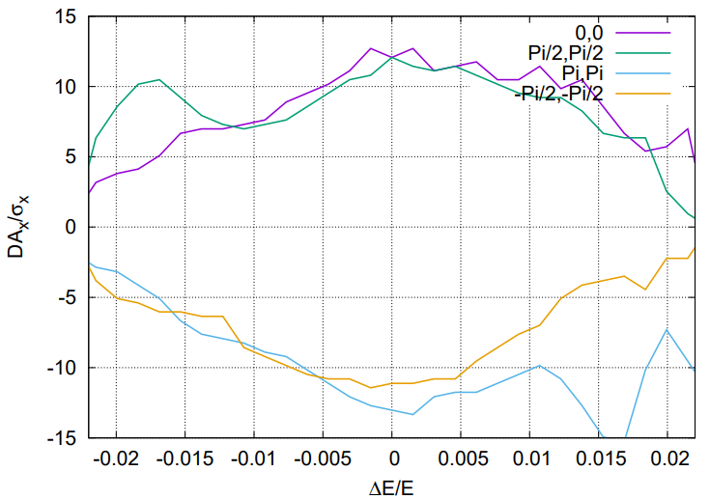
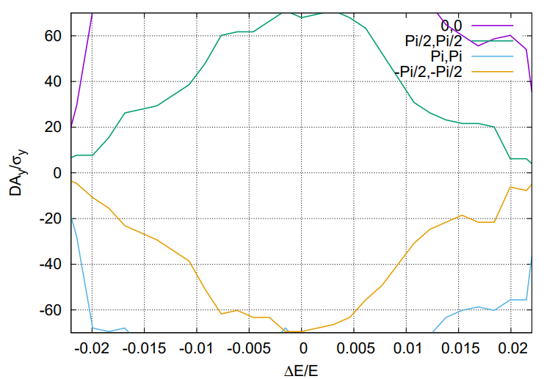
Dynamic aperture @ Higgs and ttbar
Tracking to get DA without errors, with turns for one transvers damping time, with 4 initial phases
Higgs case optimized with 256 arc sextupoles + 8 IR sextupoles + 4 multipoles + 8 phase advances
ttbar case optimized with 64 arc sextupoles + 8 IR sextupoles + 4 multipoles + 8 phase advances
Effects included in tracking
Synchrotron motion
Radiation loss in all magnets
Tapering
Crab waist sextupole
Maxwellian fringes
Kinematic terms
Finite length of sextupole
Higgs
ttbar

Slide 18
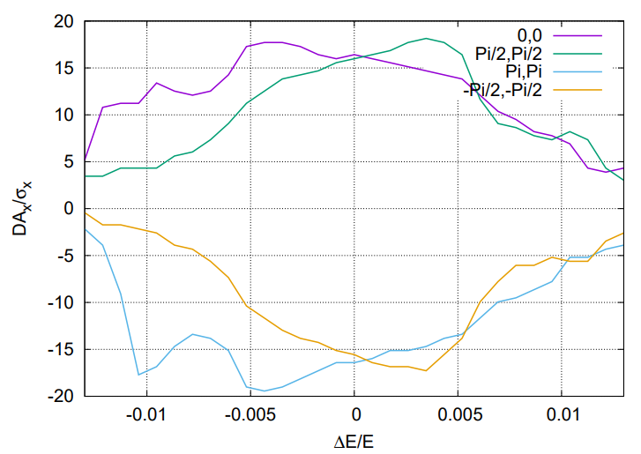
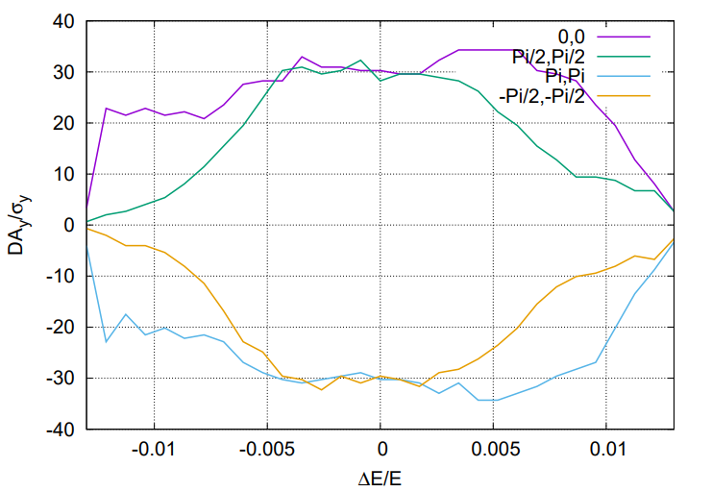
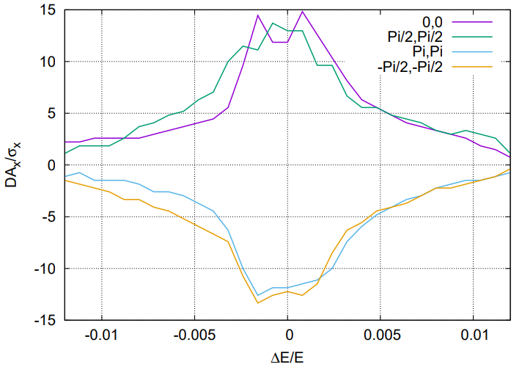
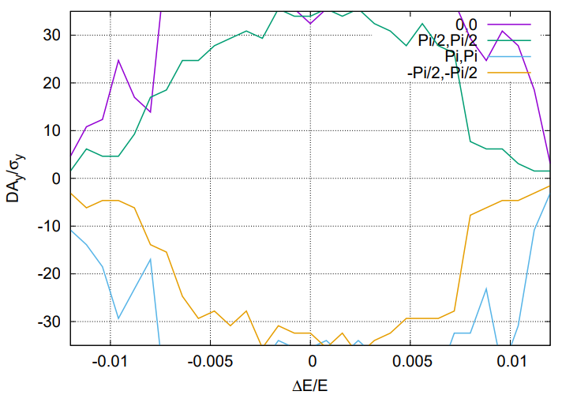
Dynamic aperture @ Z and W
Tracking to get DA without errors, with turns for one transvers damping time, with 4 initial phases
Higgs case optimized with 128 arc sextupoles + 8 IR sextupoles + 4 multipoles + 8 phase advances
ttbar case optimized with 128 arc sextupoles + 8 IR sextupoles + 4 multipoles + 8 phase advances
Effects included in tracking
Synchrotron motion
Radiation loss in all magnets
Tapering
Crab waist sextupole
Maxwellian fringes
Kinematic terms
Finite length of sextupole
Z
W

Slide 19
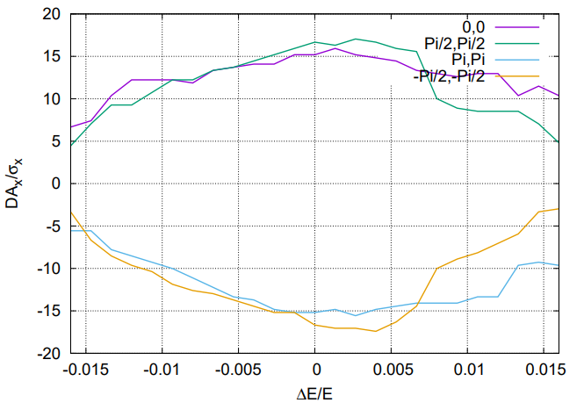
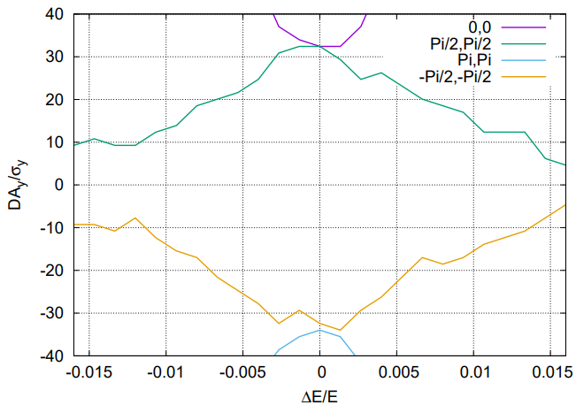
Solenoid effect on Dynamic aperture
Ander Ma, Yingshun Zhu et al
The anti-solenoid cancel the ∫Bzdz between the IP and the faces of the final quadrupole.
The Twiss function distortion due to solenoid field was corrected with final quadrupoles.
The solenoid effect on the dynamic aperture is small.
Effects included in tracking
Synchrotron motion
Radiation loss in all magnets
Tapering
Crab waist sextupole
Maxwellian fringes
Kinematic terms
Finite length of sextupole
Solenoid
Higgs without solenoid
Higgs with
solenoid

Slide 20
Beam lifetime of lattice + beam beam+Beamstrahlung
Y. Zhang, Y. Wang, D. Wang, H. Geng, Z. Duan
The beam lifetime including both beam-beam and lattice are optimized with large number of nonlinear knobs with algorithm of multi-objective differential evolution (MODE)#
Further check of beam lifetime with bare lattice + beam beam (weak-strong) + beamstrahlung fulfill the requirements of the H/W/$t\overline{t}$ modes. Beam lifetime study of Z mode is on the way.
 | ttbar | Higgs | W
Beam lifetime requirement for top-up injection [min] | 18 | 18 | 21
Bhabha lifetime [min] | 81 | 39 | 60
Required lattice + beambeam + beamstrahlung beam lifetime [min] | 24 | 34 | 32
Simulated lattice + beambeam + beamstrahlung beam lifetime [min] | 278 | 139 | 139
Crab sextupole strength [%] | 49 | 80 | 80
#J. Wu, Y. Zhang, Q. Qin, Y. Wang, C. Yu, D. Zhou, NIMA 959 (2020) 163517.
J. Wu, Y. Zhang, Q. Qin, doi:10.18429/JACoW-IPAC2019-MOPGW051, IPAC19.
Y. Zhang et al, doi:10.18429/JACoW-eeFACT2018-TUYBA04, eeFACT2018.

Slide 21
Correction scheme for magnets errors
Correction of the closed orbit distortion
Correction of the closed orbit distortion (COD) with sextupoles off is made firstly.
Turn on the sextupoles and perform COD correction again.
Orbit correction is applied using orbit response matrix and SVD method.
Dispersion correction
With dispersion free steering (DFS): orbit manipulation by knob correctors.
Beta-beating correction
Correct the beta functions with sextupoles turned on based on AT LOCO
Coupling correction
Both coupling and vertical dispersion are controlled.
Using the trim coils of the sextupoles, which providing skew-quadrupole field, to perform emittance tuning for CEPC.

Slide 22
Error assumption
With assumption of 100 um transverse misalignments
BPMs placed at each quadrupoles
H/V correctors placed beside focusing/defocusing quadrupoles
Component | Δx (mm) | Δy (mm) | Δθ_{z} (mrad) | Field error
Dipole | 0.10 | 0.10 | 0.10 | 0.01%
Arc Quadrupole | 0.10 | 0.10 | 0.10 | 0.02%
IR Quadrupole | 0.10 | 0.10 | 0.10 | 0.02%
Sextupole | 0.10* | 0.10* | 0.10 | 0.02%
*assume beam-based alignment techniques to reach rms offsets in the order of 10 um with respect to the beam
with a large beta* lattice
with quadrupole coils in the sextupoles
10um is possible as O(BPM resolution)=1um

Slide 23
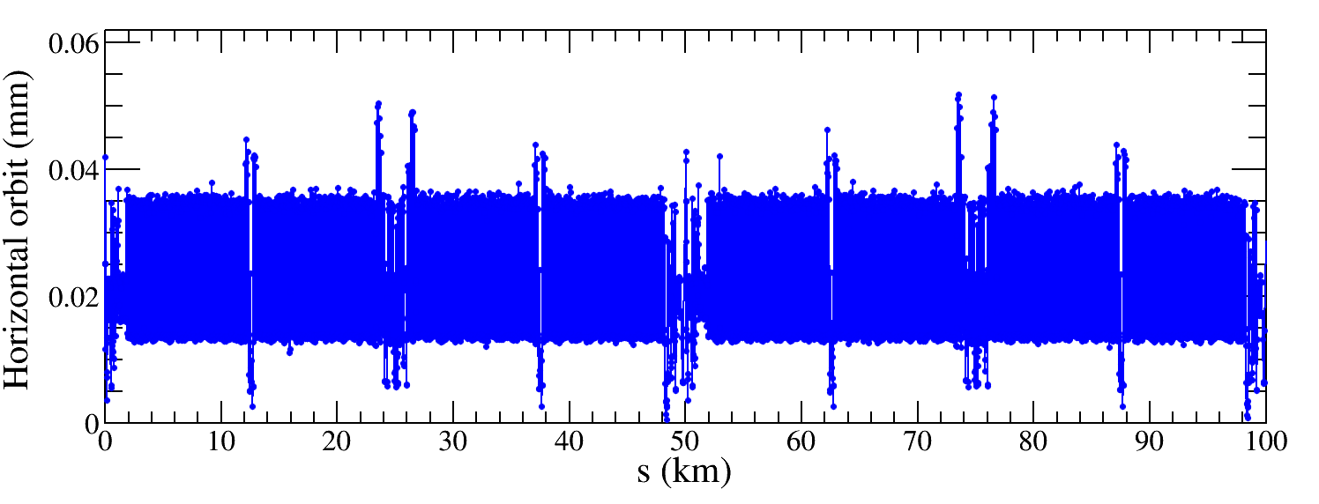
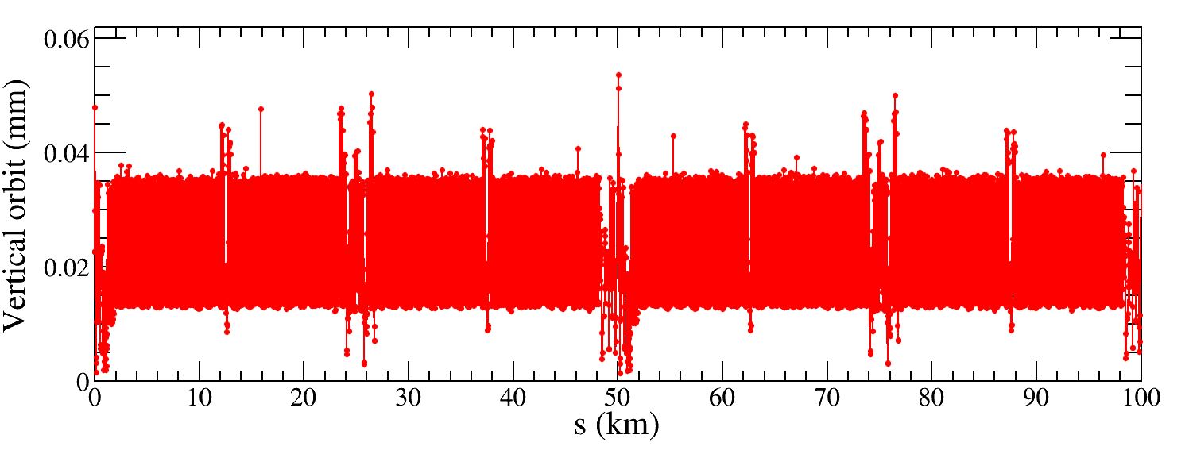
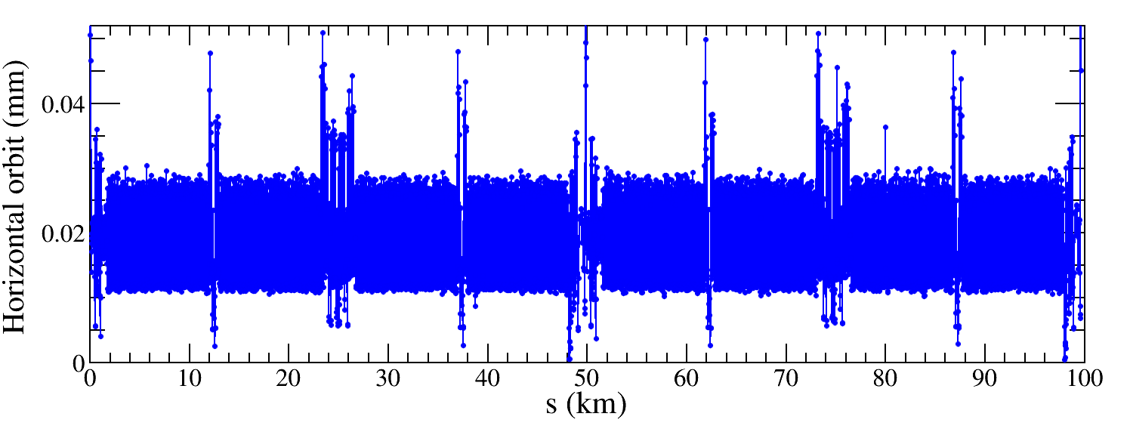
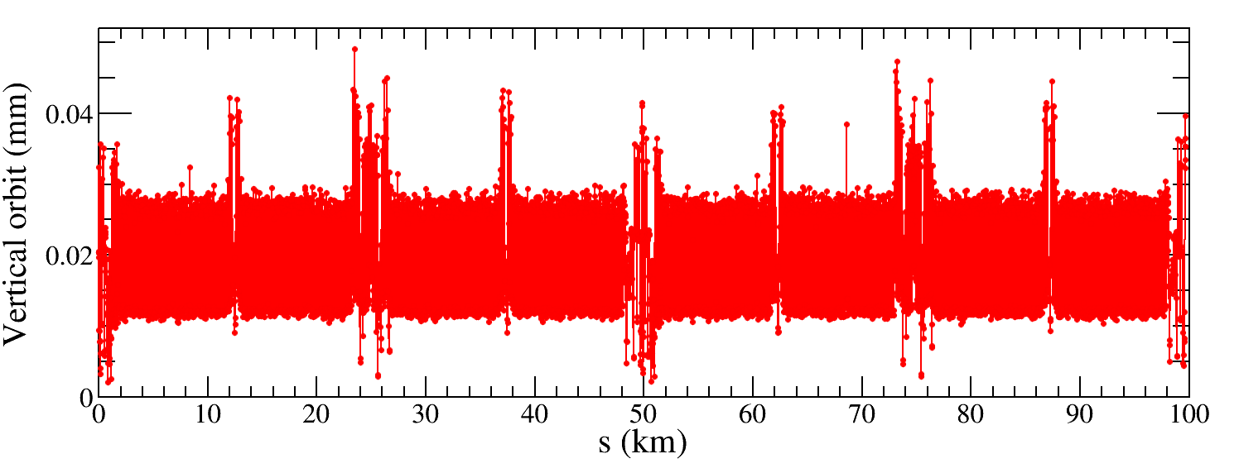
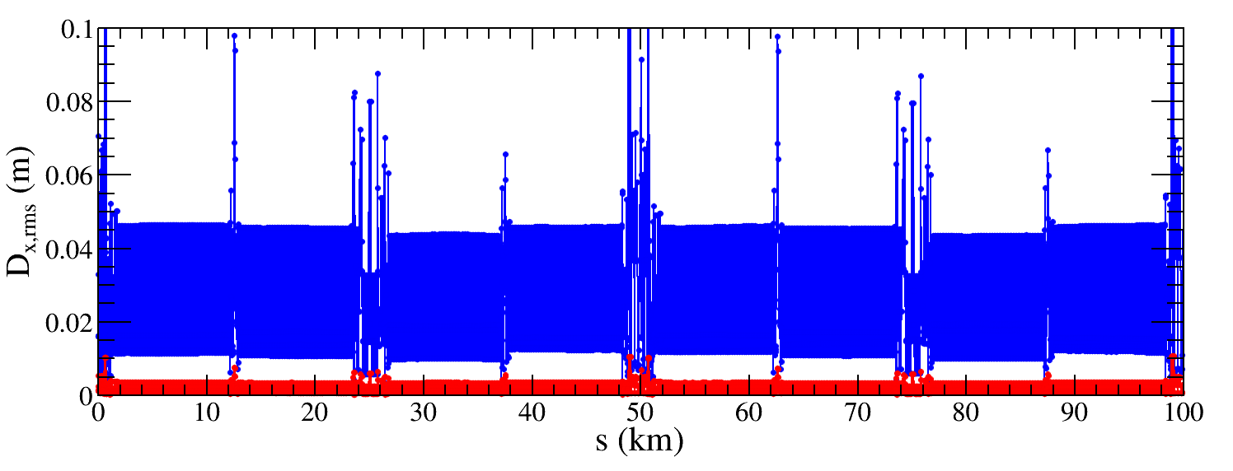
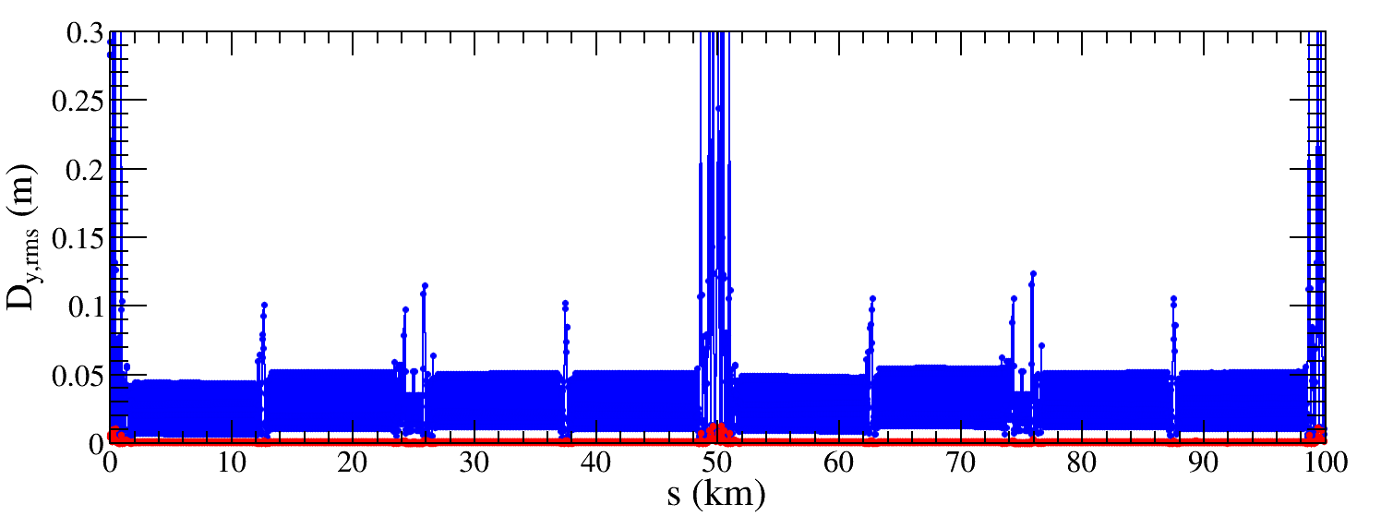
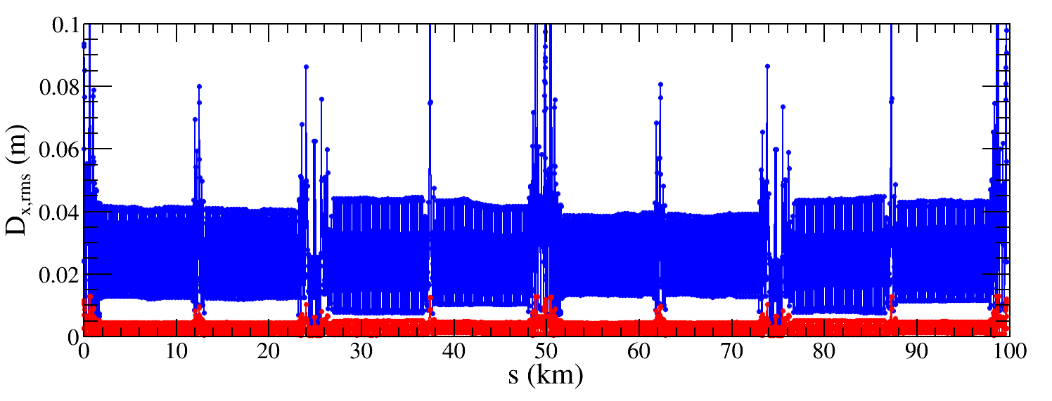
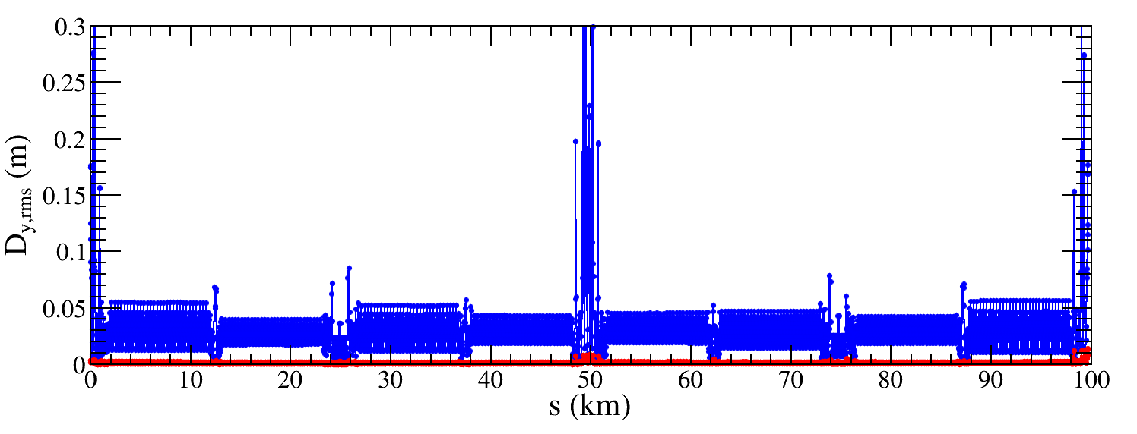
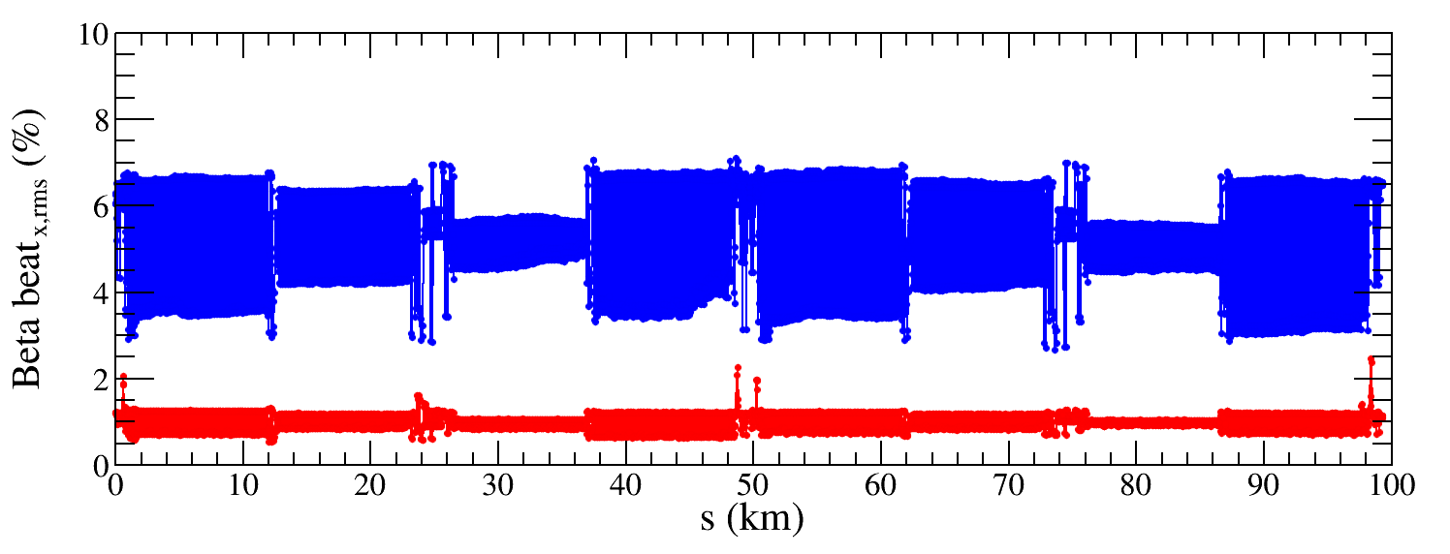
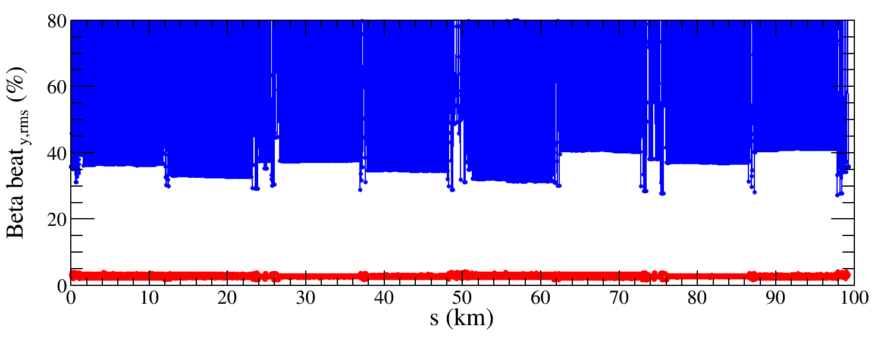
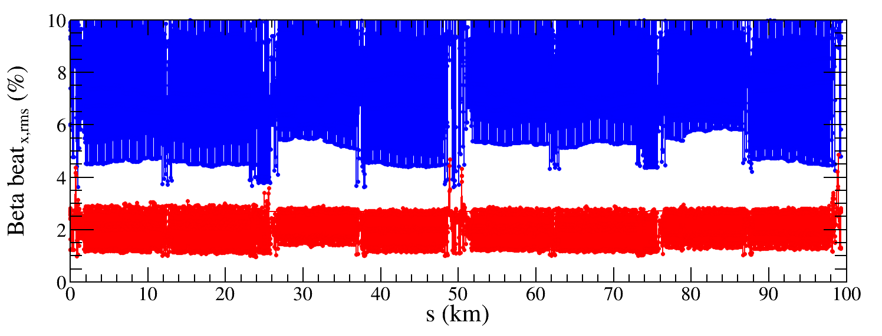
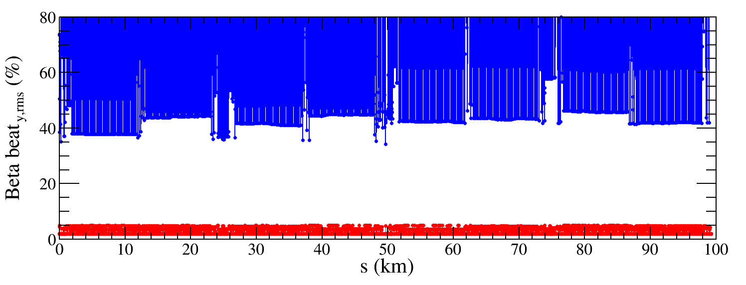
Result of Higgs and Z lattice functions
The RMS orbit, dispersion and beta-beating of the whole ring are controlled after the global corrections.
$∆X$ decreased to max 50um
$∆Y$ decreased to max 50um
$∆X$ decreased to max 50um
$∆Y$ decreased to max 50um
${∆D}_{x,rms}$ decreased from 23.1 mm to 1.8 mm
${∆D}_{y,rms}$ decreased from 31.9 mm to 0.9 mm
${∆D}_{x,rms}$ decreased from 23.1 mm to 1.8 mm
${∆D}_{y,rms}$ decreased from 31.9 mm to 0.9 mm
${∆β/β}_{x,rms}$ decreased from 5.2% to 1.0%
Higgs
${∆β/β}_{y,rms}$ decreased from 83.2% to 2.8%
${∆β/β}_{x,rms}$ decreased from 7.5% to 2.0%
Z
${∆β/β}_{y,rms}$ decreased from 148.8% to 3.0%

Slide 24
Orbit and optics after corrections
The RMS orbit, dispersion and beta-beating of the whole ring for the Higgs/Z/W/ttbar modes are controlled after the global corrections.
RMS | Higgs | Z | W | $$t\overline{t}$$
Orbit ($μm$) | < 50 | < 50 | < 50 | < 50
Dispersion (mm) | 1.8/0.9 | 2.8/1.4 | 2.7/1.8 | 0.6/0.3
Beta-beating (%) | 1.0/2.8 | 2.0/3.0 | 0.5/2.5 | 1.1/1.2

Slide 25
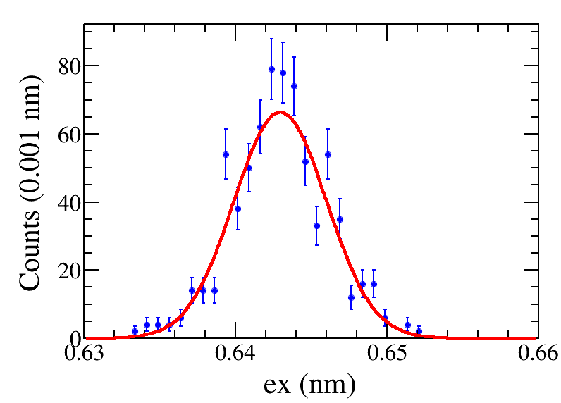
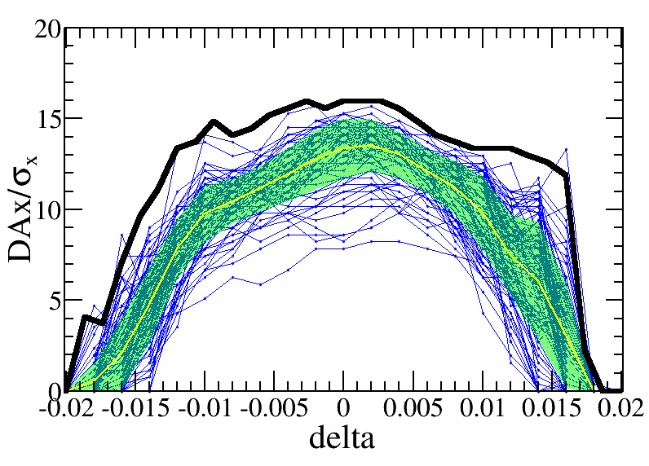
Emittance and dynamic aperture with error @ Higgs
—w/o error
—mean value
—statistic errors
—seeds
—requirement
Effects included in tracking
Synchrotron motion
Radiation loss in all magnets
Tapering
Crab waist sextupole
Maxwellian fringes
Kinematic terms
Finite length of sextupole
Component | Δx (mm) | Δy (mm) | Δθ_{z} (mrad) | Field error
Dipole | 0.10 | 0.10 | 0.10 | 0.01%
Arc Quadrupole | 0.10 | 0.10 | 0.10 | 0.02%
IR Quadrupole | 0.10 | 0.10 | 0.10 | 0.02%
Sextupole | 0.10* | 0.10* | 0.10 | 0.02%
The emittance coupling fulfill the requirement (<0.2%)
All of 100 lattice seeds with errors are corrected.
90% lattice seeds with error correction fulfill the requirement of on axis top-up injection ${\text{8}σ}_{x}×20σ_{y}×$1.6%.
Correction with more errors and the IP tuning are undergoing.

Slide 26
Emittance and dynamic aperture with error @ Z
—w/o error
—mean value
—statistic errors
—seeds
—requirement
Effects included in tracking
Synchrotron motion
Radiation loss in all magnets
Tapering
Crab waist sextupole
Maxwellian fringes
Kinematic terms
Finite length of sextupole
Component | Δx (mm) | Δy (mm) | Δθ_{z} (mrad) | Field error
Dipole | 0.10 | 0.10 | 0.10 | 0.01%
Arc Quadrupole | 0.10 | 0.10 | 0.10 | 0.02%
IR Quadrupole | 0.10 | 0.10 | 0.10 | 0.02%
Sextupole | 0.10* | 0.10* | 0.10
The emittance coupling fulfill the requirement (<0.5%)
All of 100 lattice seeds with errors are corrected.
94% lattice seeds with error correction fulfill the requirement of off axis top-up injection${\text{ 11}σ}_{x}×23σ_{y}×$1.0%.
Correction with more errors and the IP tuning are undergoing.

Slide 27
Emittance and dynamic aperture with error @ ttbar
—w/o error
—mean value
—statistic errors
—seeds
—requirement
Effects included in tracking
Synchrotron motion
Radiation loss in all magnets
Tapering
Crab waist sextupole
Maxwellian fringes
Kinematic terms
Finite length of sextupole
Component | Δx (mm) | Δy (mm) | Δθ_{z} (mrad) | Field error
Dipole | 0.10 | 0.10 | 0.10 | 0.01%
Arc Quadrupole | 0.10 | 0.10 | 0.10 | 0.02%
IR Quadrupole | 0.10 | 0.10 | 0.10 | 0.02%
Sextupole | 0.10* | 0.10* | 0.10
The emittance coupling fulfill the requirement (<0.34%)
All of 100 lattice seeds with errors are corrected.
90% lattice seeds with error correction fulfill the requirement of off-axis top-up injection ${\text{11}σ}_{x}×16σ_{y}×2$.0%.
Correction with more errors and the IP tuning are undergoing.

Slide 28
Preliminary EDR plans
Further tradeoff between the collider lattice, MDI, booster to get a more adequate machine design and further improve the dynamic aperture for the bare machine.
Establish the more realistic lattice with polarization systems, energy measurement systems, the complex interaction region components, realistic finite length fringe field and so on.
Face to the engineering design, trade off the accelerator physics requirements and the technology to establish parameters for future engineering.
(including short term plans)

Slide 29
Preliminary EDR plans (cont.)
Improve the global corrections and emittance tuning with errors.
Investigate more static errors including effect of BPM errors and multi-field errors, the long range alignment errors and the beam-based alignment for the main magnets et al.
Investigate on the dynamic error effects and possible feedback, including the injection jitter, the power source jitter, the ground motion with realistic data from the candidate sites.
(including short term plans)

Slide 30
Preliminary EDR plans (cont.)
Perform tracking simulations with a realistic lattice and strong-strong beam-beam interaction, to study the effects of machine errors on the beam-beam performance and the interplay with the luminosity-tuning knobs.
Establish the detailed procedures for the first turn injection, tuning, operation, different modes switching et al. Establish the tools and soft wares for tuning and operation.
(including short term plans)

Slide 31
Summary
Lattice of the CEPC collider ring design fulfill the requirements of the parameters list, geometry and key hardware.
Dynamic aperture w/ main errors for H/Z/$t\overline{t}$ modes achieve the requirements from the top-up injection. DA study of W mode is on the way.
Correction with more errors and the IR tuning are undergoing.
Further check of beam lifetime with bare lattice + beam beam + beamstrahlung fulfill the requirements for the H/W/$t\overline{t}$ modes. Beam lifetime study of Z mode is on the way.
Preliminary EDR plans are proposed.

Slide 32
Backup

