Slide 1
FCC local chromatic compensation lattice
CEPC workshop
Edinburgh, July 3rd, 2023
Pantaleo Raimondi
SLAC National Accelerator Laboratory

Slide 2
Outline
HFD ARC lattice
Local chromatic compensation Final Focus
Performances

Slide 3
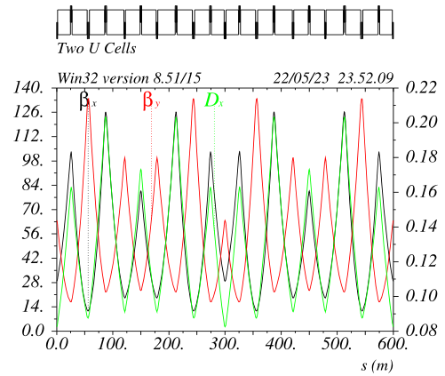
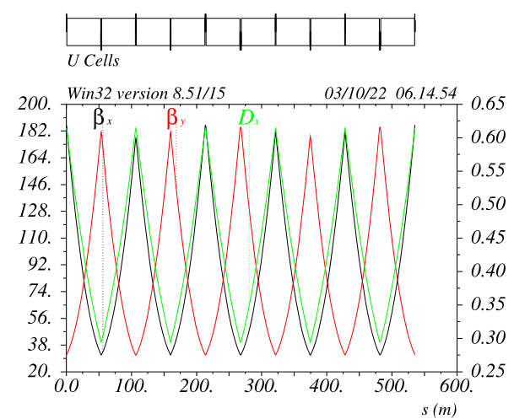
Hybrid FoDo lattice: the evolution of the FODO9090 (ttbar case)
Two cells are displayed
One cell is built with the following matching constraints:
Mux => minimize emittance
Muy => minimize Y chromaticity
Dmux between SFs => zero X-detuning
Dmuy between SFs => zero XY-detuning
Dmuy between SDs => zero Y-detuning
Betay @ SD => zero second order y chromaticity
Betax @ SF => zero second order x chromaticity
One “cell” consists of 10 dipoles and 10 quadrupoles
6 quadrupoles (remaining 4 quads are paired) are
varied to match the constraints
plus the relative length of the dipoles in between the
sextupoles pairs
~-Ix
~-Iy
Fodo9090

Slide 4
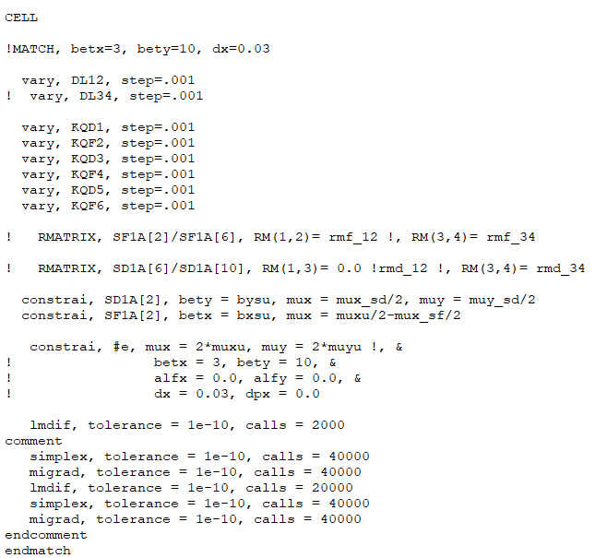
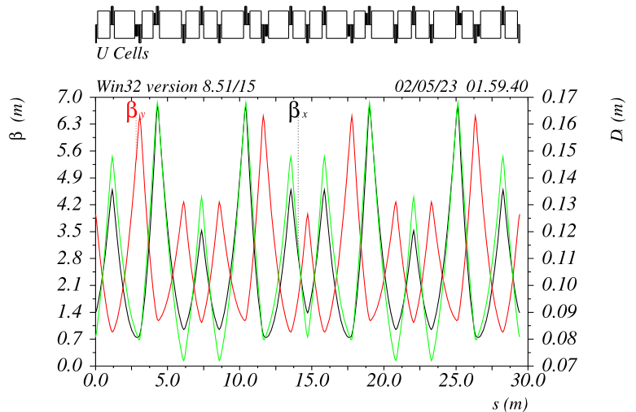
HFD lattice matching routine
~-Ix
~-Iy
This routine generates a linear and
second order achromatic lattice

Slide 5
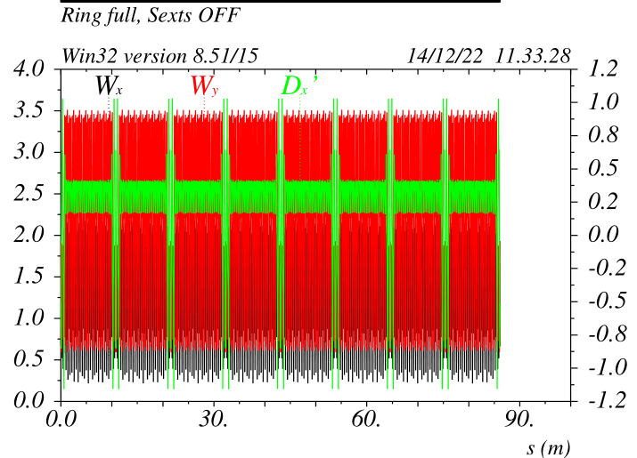
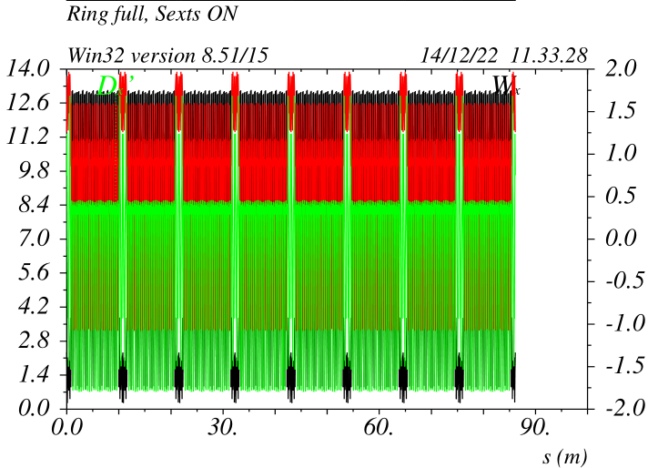
HFD + Straight Section
Matching with Transpareny Conditions guarantees the periodicity of the chromatic functions.
They remain periodic with sextupoles OFF and ON
No sextupole families are needed to restore chromatic properties up to the third order

Slide 6
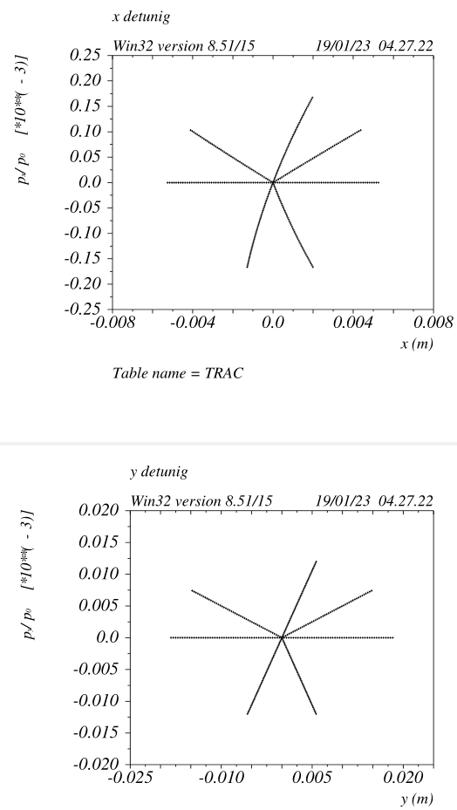
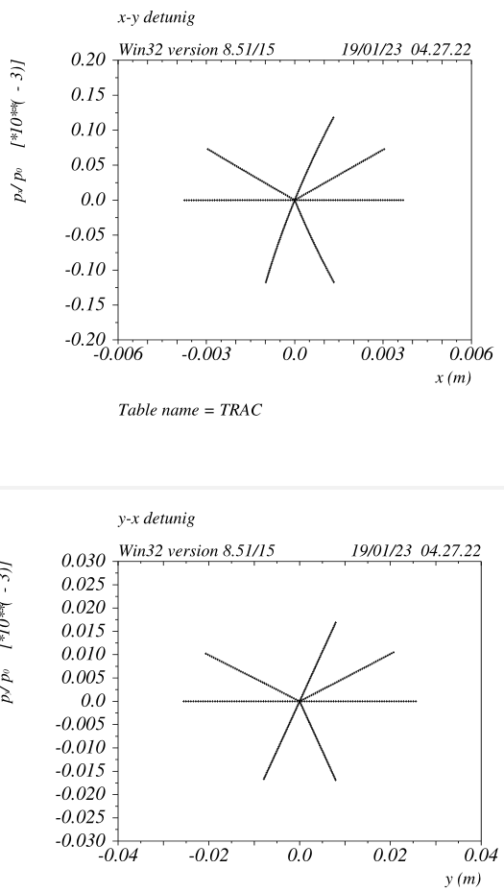
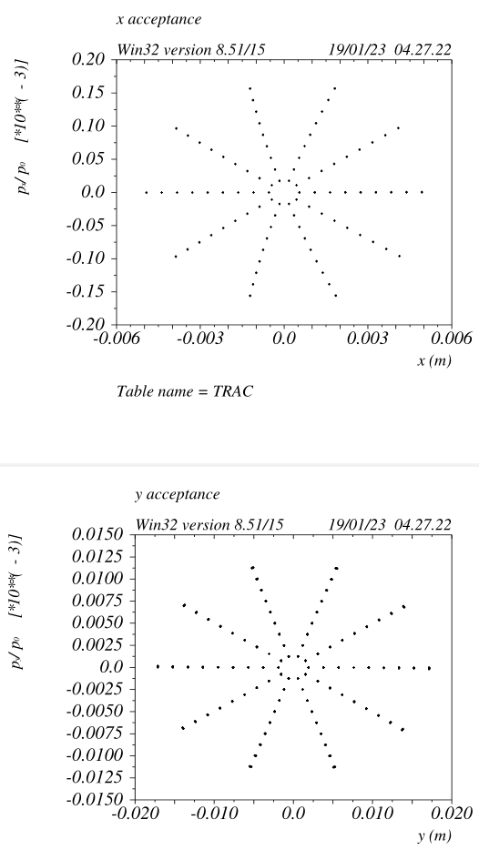
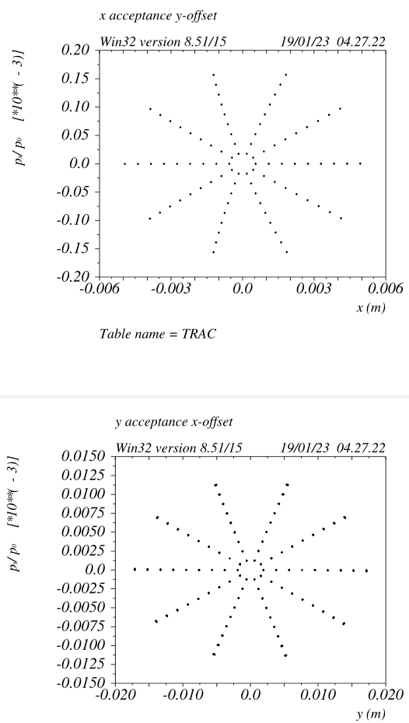
ARCs+LSs+FFDS (no Final focus) dynamic properties
betax= 30m betay = 1450m (FF entrance, crab sext location)

Slide 7
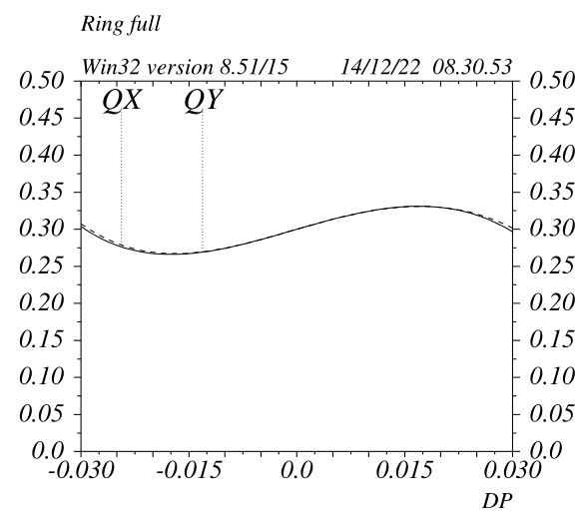
HFD Energy Acceptance
The ARC+LSS has zero second order chromaticity in both planes, only third and higher orders remain.
In principle paired-decapoles placed at the sextupole locations can remove the third order chromaticity (not needed for FCC) as well
These properties can be maintained for a very large number of cells.

Slide 8
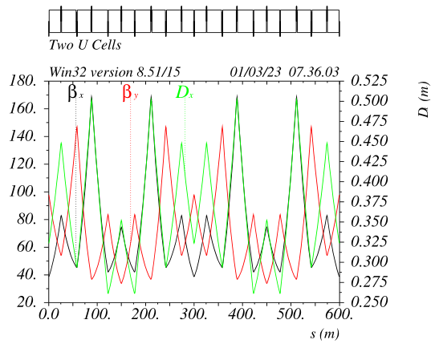
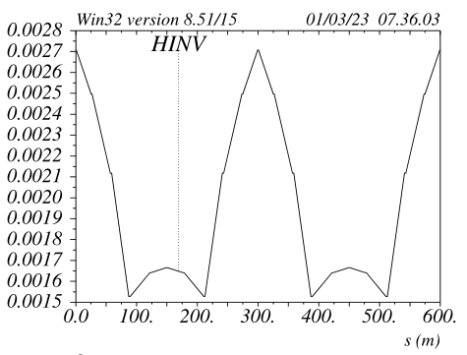
HFD lattice optimization: (short) HFD4545 for Z (Long FODO9090 Baseline)
The trick of canceling the linear detuning by adjusting the phase between
the sextupole pairs can be applied for any given Cell phase advance.
It works better (less linear detuning as starting with and residual non-linear
detuning ) if the fractional X-cell phase advances is around pi/2
The cell has been optimized around:
mux_C = 1.235 muy_C = 1.251 (~45deg/plane between consecutive QFs)
The matching routine is the one shown on the previous slide.
The sextupoles become very weak, Ks about 5 times weaker wrt to ttbar
optics, no detuning is visible up to 100sigmas
The DA/MA is extremely large, possibly larger wrt to HFD9090
A small second order chromaticity remains to keep betax below 170m.
Natural chromaticity is much lower wrt LONG FODO9090
quasi -Ix
quasi -Iy

Slide 9
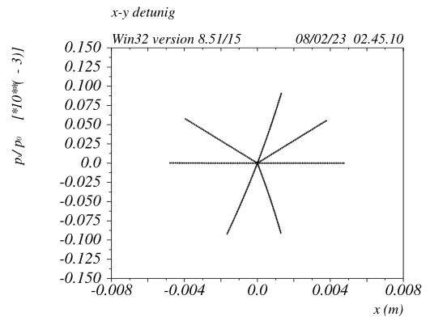
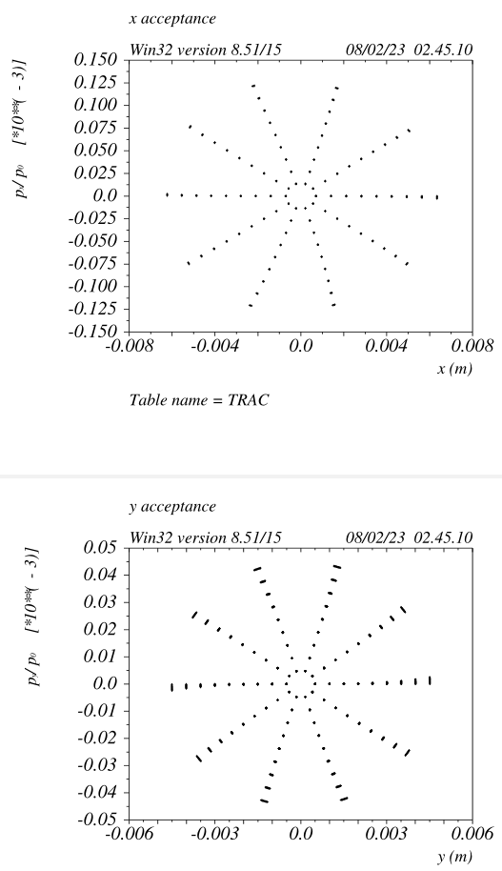
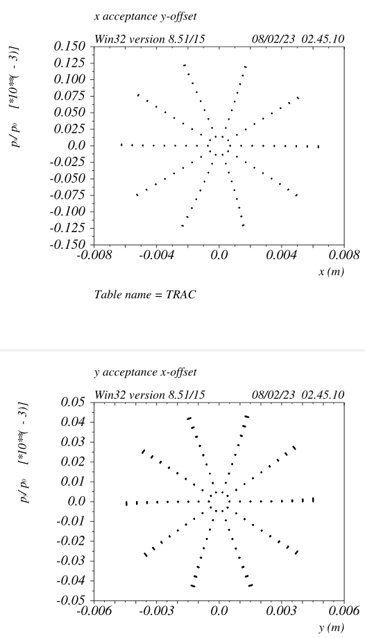
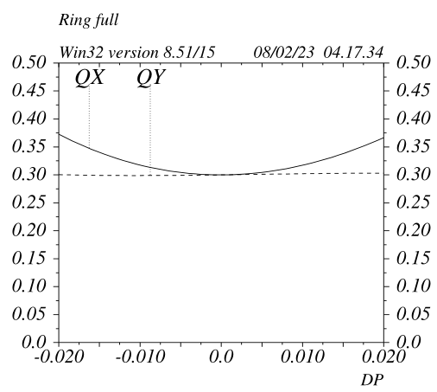
Z ARCs dynamic properties v_51a1
betax= 45m betay = 100m
HFD4545 dynamic properties are comaparble to HFD9090

Slide 10
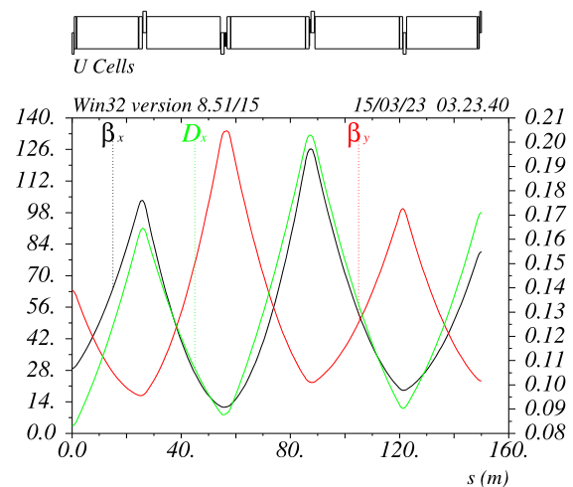
ARC half cell layout
ARC quads are pairs ~1.2m long with gradients around 12T/m @ttbar
Quads are not paired between the two rings
Total number of ARC quads ~250*20=5000 per ring, ~10000 total
It would be interesting to see if it is possible to conceive a quad that needs 1-2Kw@ttbar
(ESRF HG-quad, 0.49m long, G=90T/m, bore radius~12.5mm, needs~1.5Kw, APS HG-quads are even more efficient)
If a power efficient design is found, the QDs can be twice shorter => twice less => 7500 quads total
ARC sextupoles (at the moment) have all the same strength, apart the “matching section” ones
Sextupoles sit in between two quads
SFs are 0.38m long Ks~0.146 @Z Ks~0.685 @ttbar
SDs are 0.77m long Ks~-0.125 Ks~-0.70
Total number of ARC sextupoles ~250*4=1000 per ring ~2000 total
Sextupoles total power consumption is a very small fraction wrt to quads
In order to minimize synchrotron radiation, one of
the two quads could be offset by ~2-4mm =>~3% less U0
Half Cell
Optimal complement of corrector and bpms
might be smaller wrt baseline
With HTS, the quads dipole field can be superimposed to all the ARC quads.
In this case the ARC dipole filling ratio will be > 0.99 for all modes

Slide 11
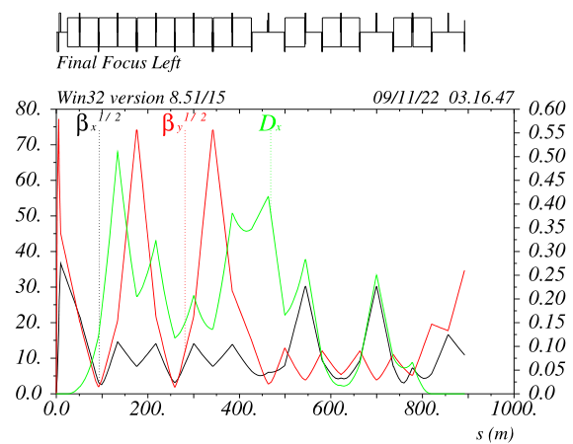
Final Focus: NLC FF => LCC FF for Circular colliders
The FF system has built 5 tuning knobs that
make it a quasi-fifth order achromat and
produce very little detuning
1) Main Sextupoles SDy and SFx
2) SDy&SDx phase advance wrt IP
3) IP-phase sextupoles SDM and SFM
4) Etaxp@ CCSY and CCSX
5) Decapole y (&x) (fifth order chromaticity)
6) Phase advance between –I sextupole pairs
(for detuning)
CCY -I
Dmuy~0.25
Crab
sextupole
Dmux~0.25
CCX -I
IP-phase
SDM sext
IP-phase
SFM sext
IP-phase
DECy
IP nearly image points

Slide 12
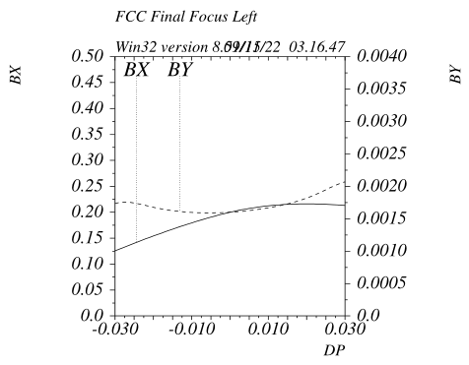
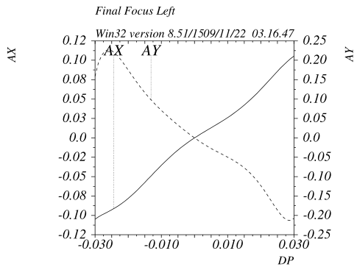
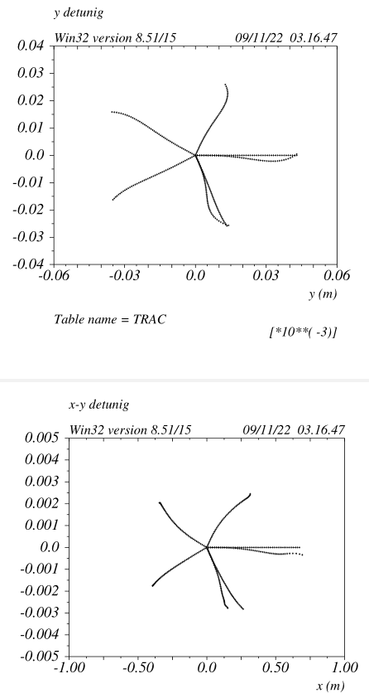
Final Focus with up to Fifth Order Chromatic Correction v_23c
The Final Focus can be made linear very effectively, by local compensating or not creating high order aberrations.
~95% of the job is done with optimized linear matching and 3 sextupoles/plane

Slide 13
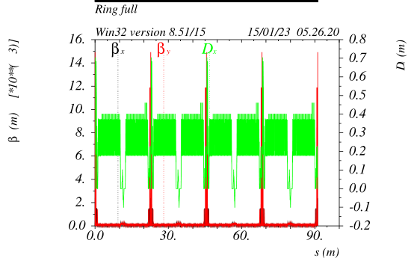
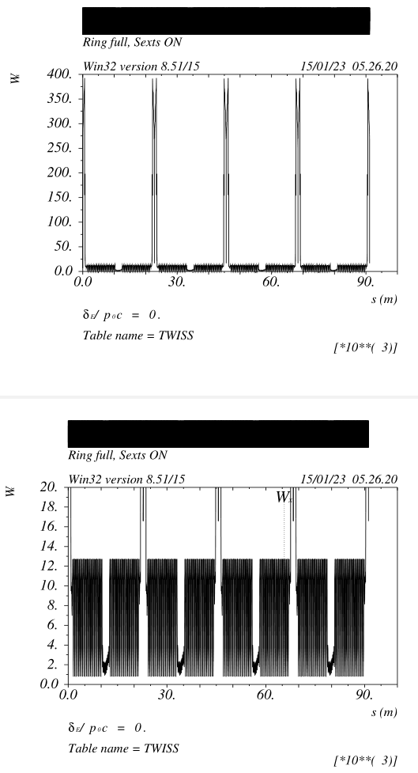
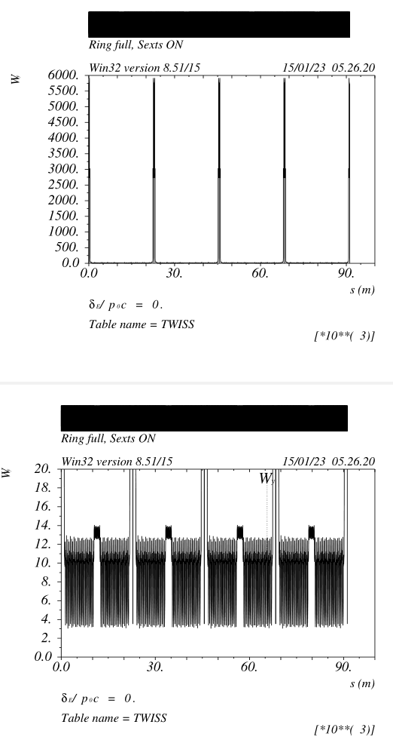
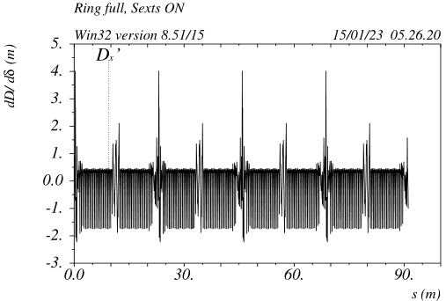
Final Focus and Long Straight section are “transparently” inserted

Slide 14
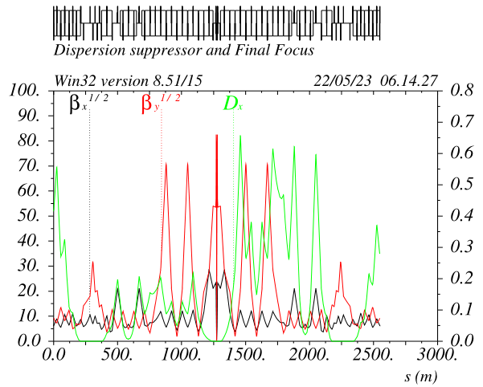
FF layout v_61a (Z mode)
V_61a layout is Left-Right symmetric
Dipoles have all the same (ARC) sign, on the left are ~ 3 times weaker wrt right to make up for the X-angle.
FF has a net bend angle of about 85mrad, this
value is optimzed based on the overall layout constraints
Last two arc dipole bending angles (~+/-10%) are used to match the layout and two rings separation.
Last two arcs sextupoles are also used (~20% max modulation) to compensate for the
resulting high order dispersion asymmetry and the residual aberrations leaking outside the FF (mostly high order dispersion due to the dipole asymmetry)
Dipoles complement is optimized based on SR requirement

Slide 15
FF sextupoles effect on DA&MA and mismatch
FF sextupoles strength driven by the low-beta chromaticity (given)
Bigger betas at sextupoles do reduce the sextupole strength but have little effect on error sensitivity
Larger dispersion at sextupoles reduces their strength as well and consequentely:
- inversely decreases the waist shift (betatron mismatch) due to horizontal orbit error
- inversely decreases the coupling due to vertical orbit error
- inversely^2 (or more) decreases the residual non-linear geometric (and some chromatic) aberrations
- the dispersion mismatch due to orbit errors is not affected
Larger dispersion is in general beneficial (if can be created without generating dispersion-related aberrations and keeping the SR in check)
Given the left-right dispersion ratio~3, the Left-FF SDs sensitivities dominate

Slide 16
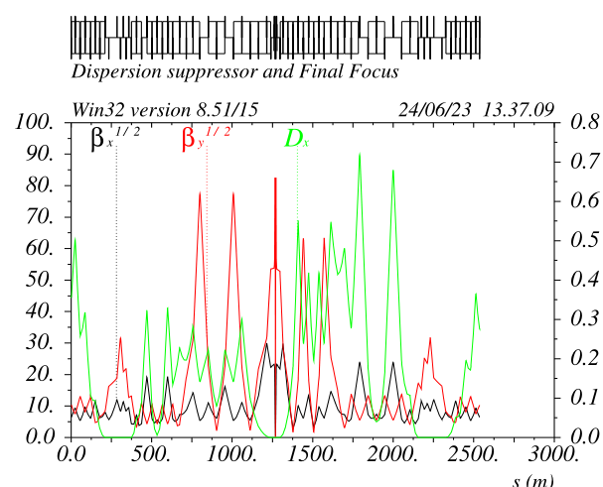
FF asymmetric layout
Asymmetric layout (a-la-CEPC/FCC_baseline)
Left: CCSx shorter, and stronger dipoles
CCSy longer, dipole field unchanged
Right: CCSy shorter, stronger dipoles
CCSx longer, weaker dipoles
It is possible to make the whole AsymmFF entrance-exit optically symmetric up to the:
- fifth order (chromatically)
- fourth order (geometrically)
The layout shown has a +-25% CCS length modulation.

Slide 17
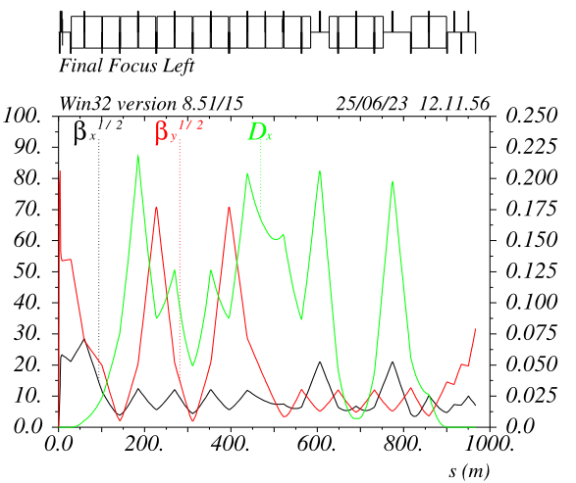
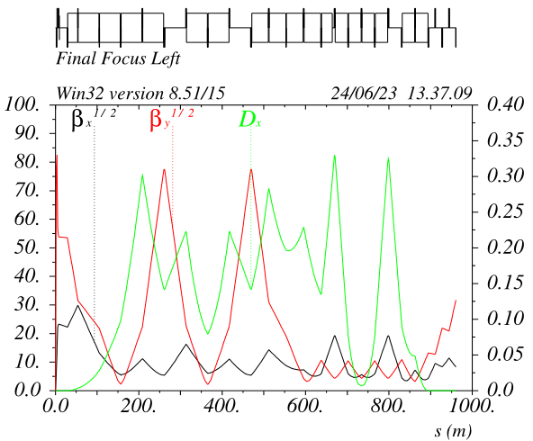
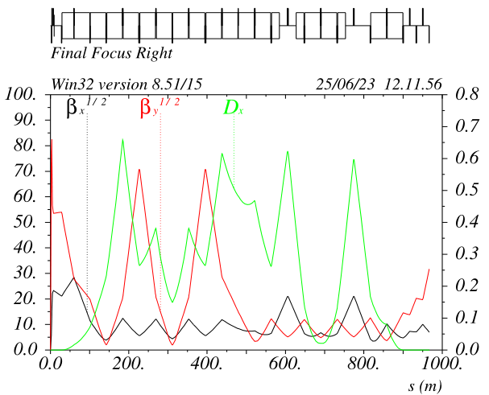
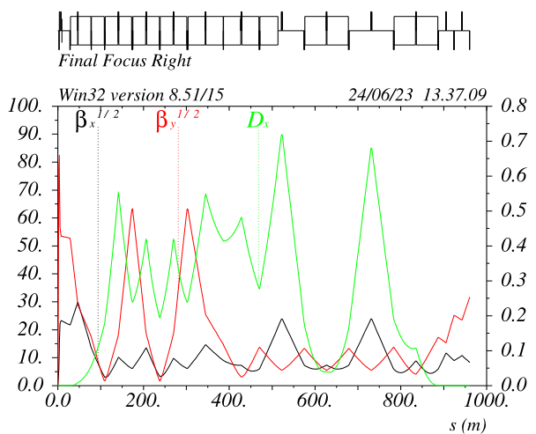
FF asymmetric layout v_65a
FFL Y-sextupoles are 2 times weaker
(K2Ls very similar on both FF sides)
because 65% larger dispersion and 25%
larger betay
Tolerances should be relaxed accordingly
FFL decapole is 3 times weaker as well
In general all sextupoles are weaker and
more left-right symmetric
DA/MA larger wrt symmetric case
Symmetric (v_61a)
Asymmetric (v_65a)

Slide 18
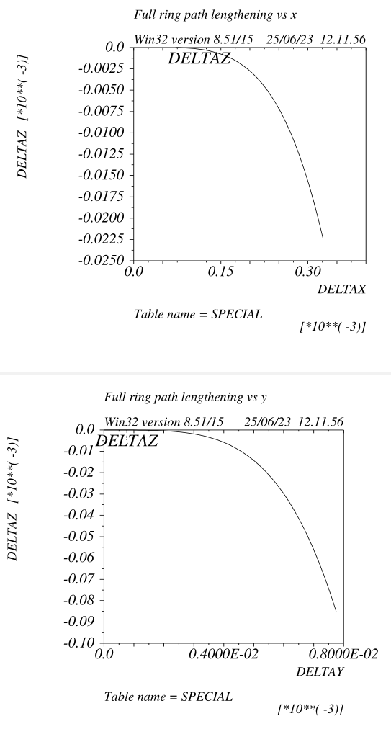
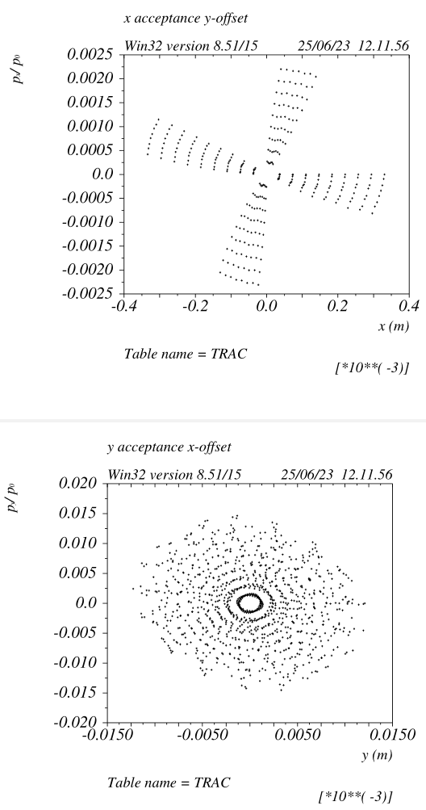
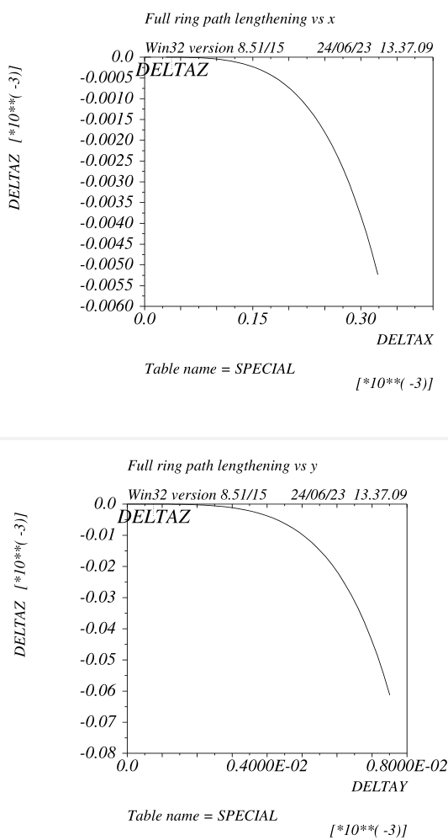
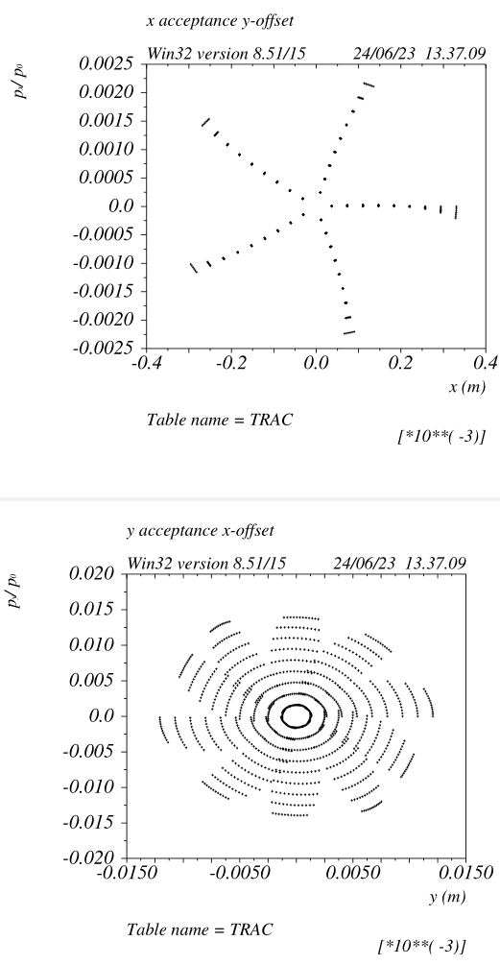
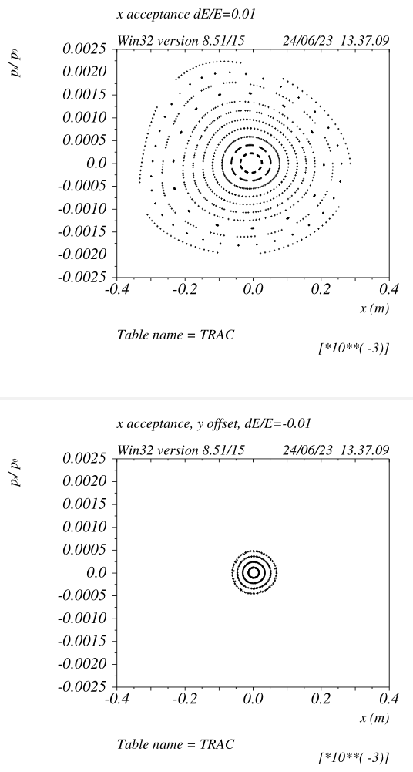
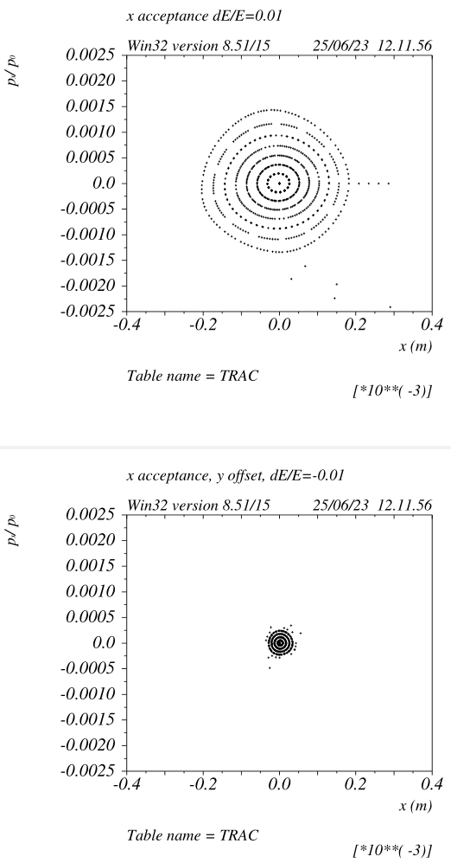
Beam dynamics
Symmetric (v_61a)
Asymmetric (v_65a)
Lower path lengthening vs amplitude reduces the DA shrinking from 4D to 6D
Transverse linearity is improved, now tracking is completely linear for offset beam as well
Off momentum transverse DA almost doubled, this also should reduce the 4D to 6D DA shrinkage
*Off momentum tracking shown is done with mad8, not accurate for high chromaticity rings

Slide 19
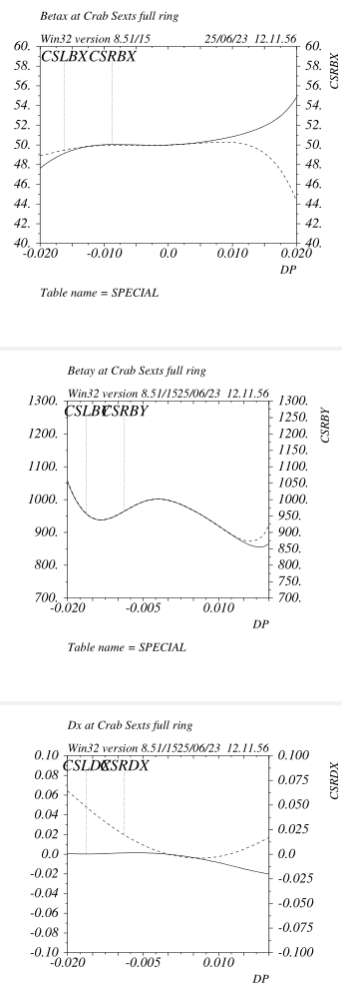
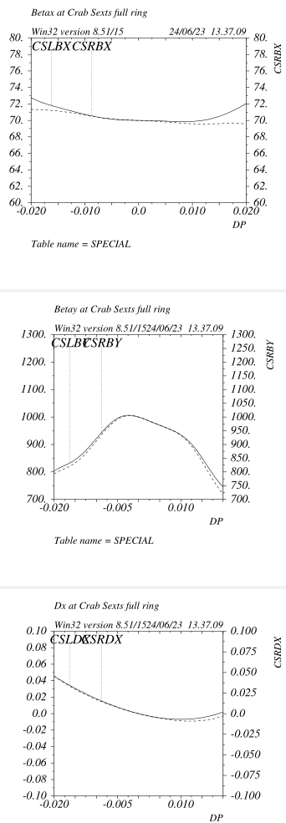
Crab sextupoles
In order to reduce the impact of CS on BW, betas have to be as constant as possible.
High order dispersion should be small and equal on the two CSs.
For v_65a there is no change in the BW for CS on/off
(v_61a dynamic betay is flatter because the last two arc sextupoles optimization)
Higher betax@CS might be beneficial to reduce sensitivities
Symmetric (v_61a)
Asymmetric (v_65a)

Slide 20
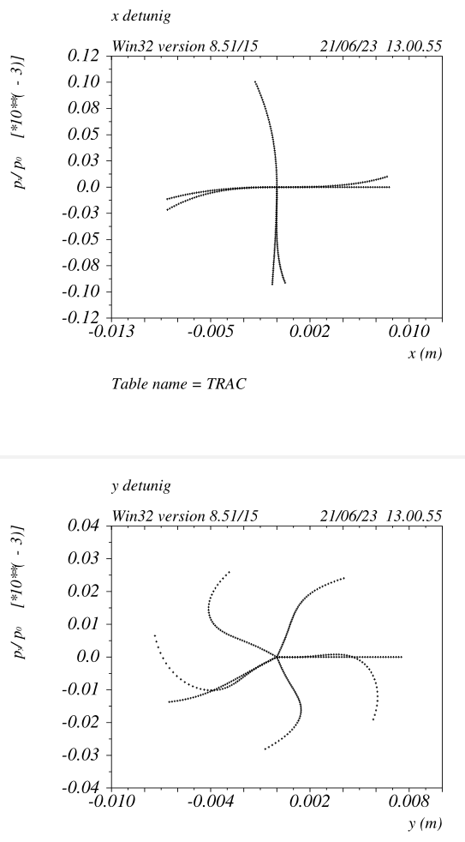
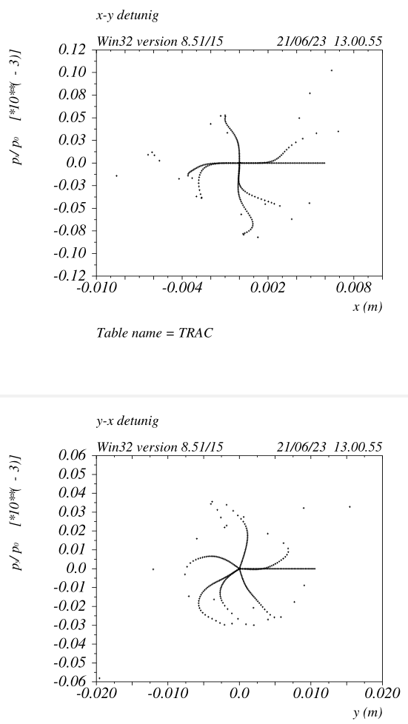
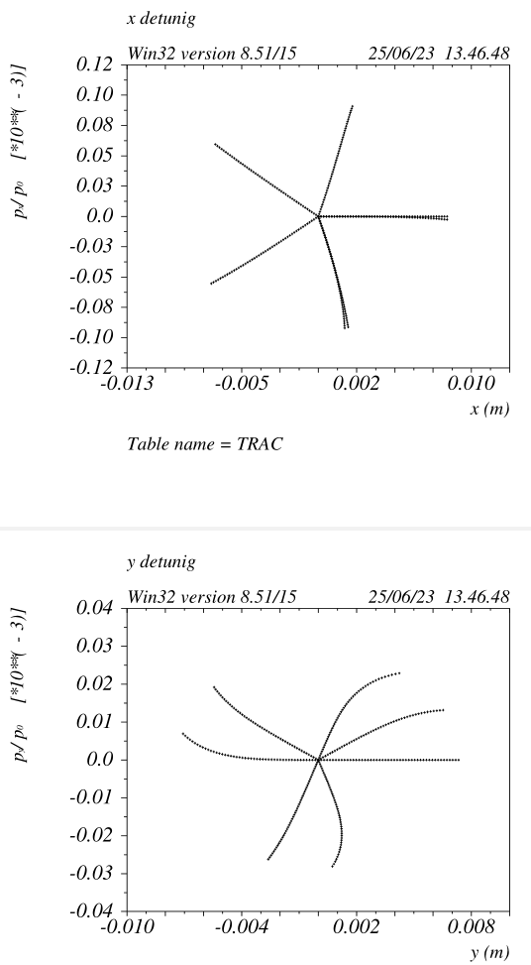
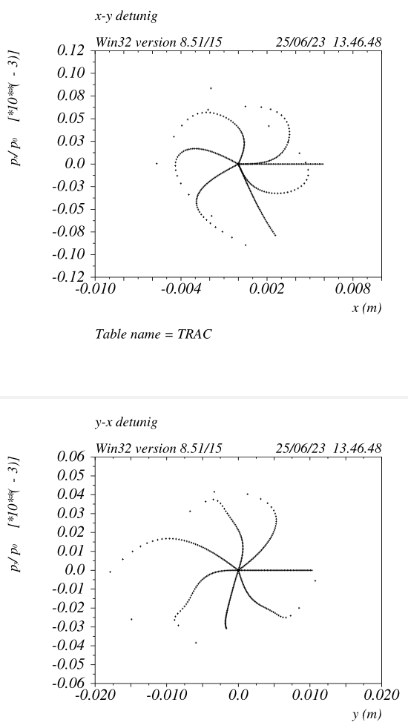
Detuning from Crab sextupoles
Symmetric (v_61a)
Asymmetric (v_65a)
Detuning from crab sextupoles further reduced.
X-Y detuning (v_65a) almost entirely due to IP_phase_SFs, it might be further improved
DA shrinkage due to CS is reduced as well

Slide 21
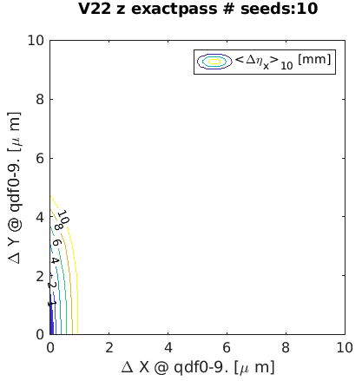
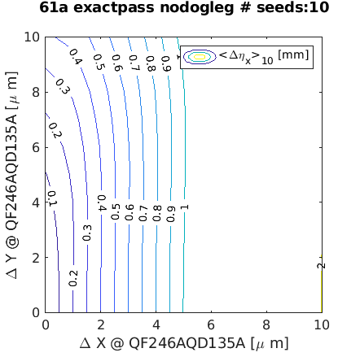
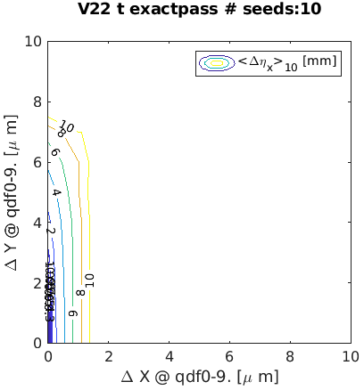
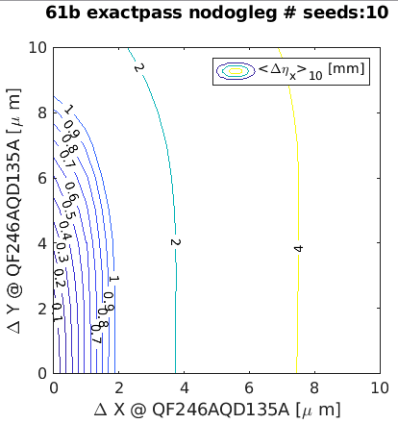
Comparison of dispersion sensitivity for baseline, HFD @ Z, Ttbar
V22
@ Z
HFD61
V22
@ ttbar
HFD61

Slide 22
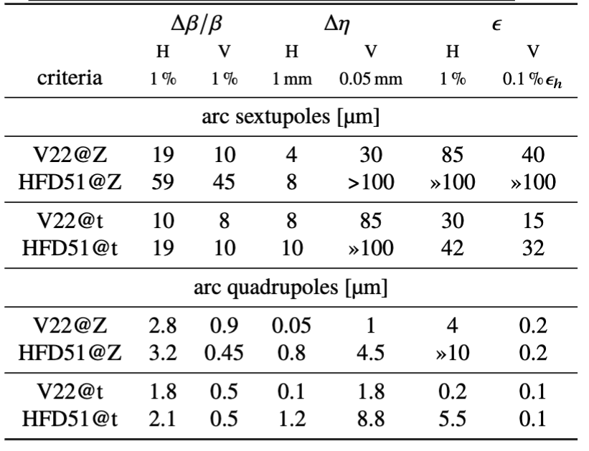
Summary table of error sensitivity
ARCS
V22
ARC’s quadrupoles: q[df][0-9]*
ARC’s sextupoles: s[fd]*
HFD-51 (or 61)
ARC’s quadrupoles: QF[246]A*, QD[135]A*
ARC’s sextupoles: S[FD]1*
R.Tomas et al., Progress of the FCC-ee tuning working group WEPLO23, IPAC2023

Slide 23
Summary sensitivity to ARC errors
HFD61 is less sensitive to errors in the ARCS than the baseline lattice for for all parameters studied.

Slide 24
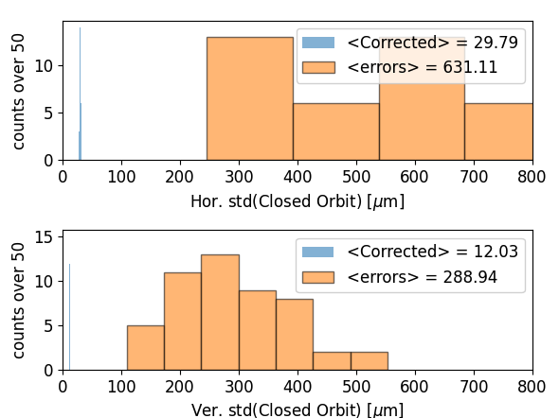
DA and lattice properties after commissioning-like correction : V22@Z
# BPMS: 1856 # normal quad: 1496
# correctors: 1856 # skew quad: 632
pyAT
@ IP
~36σ_{v}
~19σ_{h}
S.Liuzzo et al., Commissioning simulations tools based on python Accelerator Toolbox, MOPA142, IPAC2023, IOP
R.Tomas et al., Progress of the FCC-ee tuning working group WEPLO23, IPAC2023

Slide 25
Commissioning simulations for HFD-61@Z : location of BPM and correctors
ASSUMPTION (as for EBS): SEXTUPOLES ARE THE MAIN SOURCE OF OPTICS ERRORS
~ 2 BPMs per sextupole : @ sextupole and 1 between 2 consecutive sextupoles: 1732 BPM
1 H/V corrector at every sextupole : 1064 correctors
(1 corrector per BPM will also be analyzed (1732 BPM / 1732 cor) and 1 BPM/COR per sextupole (1064 BPM / 1064 COR)
Normal and skew quad at every sextupole : 1064 Norm/Skew quad
ARC
Final Focus
= BPM
Straight

Slide 26
DA and lattice properties after commissioning-like correction: HFD61@Z
RF ON, Radiation ON, Tapering ON, Sext ON, Oct ON, …
CrabSext OFF, Fringe fields OFF, Solenoid OFF, Spin OFF
10 μm alignment errors in ARCS’s quad. and sext.
All parameters are well corrected and correctors strengths are small.
It seems possible to increase the errors set in the lattice ARCS.

Slide 27
DA and lattice properties after commissioning-like correction: HFD61@Z
RF ON, Radiation ON, Tapering ON, Sext ON, Oct ON, …
CrabSext OFF, Fringe fields OFF, Solenoid OFF, Spin OFF
30 μm alignment errors in ARCS’s quad. and sext.

Slide 28
DA and lattice properties after commissioning-like correction: HFD61@Z
RF ON, Radiation ON, Tapering ON, Sext ON, Oct ON, …
CrabSext OFF, Fringe fields OFF, Solenoid OFF, Spin OFF
70 μm alignment errors in ARCS’s quad. and sext.
8 failed seeds over 50
Beam is stored with > 500um closed orbit.
300um BPM offsets are probably tolerable to store the beam. (To be checked)
As for Synchrotron light sources, beam can be stored with BPM offsets (c.o.d. ~ (300² + 500²) and as a second stage standard BBA (based on closed orbit) takes place.

Slide 29
Commissioning simulations comparison table
Summary of above plots:
Only errors in ARCS
Gaussian errors, no truncation.
NO ERRORS in Final Focus.
RF ON
Radiation ON
Tapering
Identical correction procedure
Identical correction parameters (eigenvectors, weights, etc…)
Average over 50 seeds of standard deviations of parameters along the ring.
8 failed seeds

Slide 30
Dynamic aperture with errors: 6D tracking, tapering, ARC errors and corrections
DA for the 50 error seeds of previous slide
RADIATION has a severe effect on Dynamic Aperture
V22-Z-10μm
Errors further reduce Dynamic Aperture
errors
With radiation HFD~=V22
600σ_{v}
~150σ_{v}
errors
~50σ_{v}
HFD61-Z-70μm
~50σ_{h}
~50σ_{h}

Slide 31
Conclusions
HFD lattice has a very large DA&MA and very high filling ratio
Transparency conditions allow the insertion of any kind of Straight Section with negligible impact on DA&MA
LCCFF is a very powerful telescope with very efficient built-in compensation of high order aberrations
Dipole filling ratio can be made asymptotically close to 1!
HFD&LCCFF could ameliorate/alleviate many of the requirements on hardware and power consumption.
Machine tuning and ramp-up time could benefit as well
Please refer to S. Liuzzo, M.Hofer, D.Shatilov for detailed machine performances studies

