Slide 1
CEPC High efficiency klystron development
Zusheng Zhou
On behalf of CEPC klystron R&D team
The 2023 International Workshop on Circular Electron Positron Collider (European Edition)

Slide 2
Content
Design consideration
R&D Status
CEPC Collider/650MHz/800kW klystron fabrication
1st prototype
2nd (HE klystron) conditioning
3rd (MBK) design and fabrication progress
CEPC Linac/5720MHz/80MW & 2860MHz/80MW klystron design

Slide 3
Design consideration for Collider RF sources
Considering klystron lifetime, power redundancy and cost, the 2 cavities will be powered with one CW klystron capable to deliver more than 800 kW.
130kV/16A klystron power supply has multi-operation modes for different klystron type(Single beam and multi-beam klystron).
Distribution of RF power to the cavities, including waveguide, power divider, phase shifter, circulator and load.
Other Auxiliary PS, interlock and controls, LLRF, Pre-amplifier are also included in RF power source system.

Slide 4
Design consideration for Collider RF sources
Requirement list:
Klystron | 120 | 650MHz/700kW
PSM Power Supply | 120 | 130kV/16A or 55kV/22A
Circulator | 120 | 650MHz/700kW
Load | 120 | 650MHz/700kW
Phase shift | 120 | 650MHz/700kW
Waveguide | 120 | Power divider/directional coupler
LLRF | 120 | Phase stabilization <0.1 degree, Amplitude stabilization <0.1%
Pre-amplifier | 120 | 650MHz/200W

Slide 5
Design consideration for Collider RF sources
Requirement list:
Klystron | 120 | 650MHz/700kW | Higher efficiency
PSM Power Supply | 120 | 130kV/16A or 55kV/22A | Mature product
Circulator | 120 | 650MHz/700kW | Mature product
Load | 120 | 650MHz/700kW | Mature product
Phase shift | 120 | 650MHz/700kW | Mature product
Waveguide | 120 | Power divider/directional coupler | Mature product
LLRF | 120 | Phase stabilization <0.1 degree, Amplitude stabilization <0.1% | Mature product
Pre-amplifier | 120 | 650MHz/200W | Mature product

Slide 6
Design consideration for Collider RF sources
Cost consumption
CEPC at 800 RMB/MWh and 6000 hours/year
Efficiency impact on operation cost (Only considering operation efficiency of klystrons)
Save Money
84M RMB
1 year
65 M RMB
Excessive electricity bill, M RMB
NOW
1st tube
62%
COMING
2nd tube
75%
Efficiency, %
FUTURE
3rd
80%

Slide 7
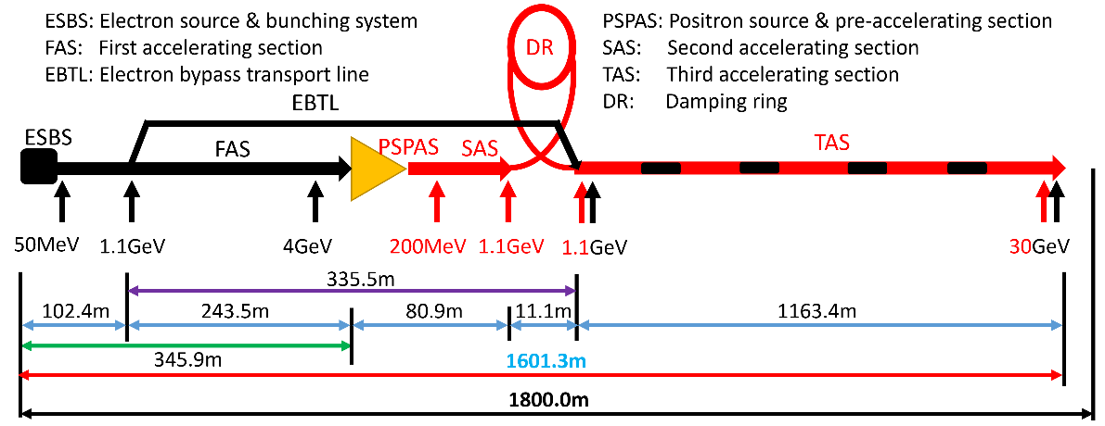
Design consideration for Linac RF sources
The main high power RF sources components are 33 units of 80 MW S-band klystrons, 236 units of 50MW C-band klystrons and related solid state modulators.
Type | QTY | Freq.(MHz) | Structure type
S-band klystron | 33 | 2860 | 1 1-to-1，standard-bunch 3 1-to-2，standard acc. structure. 8 1-to-2，large aperture acc. structure 21 1-to-4, standard acc. structure.
C-band klystron | 236 | 5720 | 1-to-2，standard acc. structure.

Slide 8
Design consideration for Linac RF sources
Requirement list:
S band klystron | 33 | 2860MHz/80MW
Modulator of S band klystron | 33 | 400kV/500A
C band klystron | 236 | 5720MHz/50MW/3us
Modulator of C band klystron | 236 | 350kV/400A

Slide 9
Design consideration for Linac RF sources
Requirement list:
S band klystron | 33 | 2860MHz/80MW | Higher Efficiency
Modulator of S band klystron | 33 | 400kV/500A | Mature product
C band klystron | 236 | 5720MHz/50MW | Mature product
Modulator of C band klystron | 236 | 350kV/400A | Mature product

Slide 10
Design consideration for Linac RF sources
Why we do C band 80MW klystron?
Only C band of 50MW klystron is mature product in the world.
1 klystron power to 2 accelerator structure (CEPC Linac baseline).
QTY of C band klystron is very large (236 set).
IF output power of C band klystron is up to 80MW, the number of klystron and accelerator structure will be decreased a lot.

Slide 11
R&D Strategies
650MHz/800kW klystron with much higher efficiency design for CEPC Collider.
5720MHz klystron with high power level for CEPC Linac cost decreased.
2860MHz/80MW klystron with much higher efficiency design for CEPC Linac.

Slide 12
R&D Status

Slide 13
650MHz klystron R&D strategy and plan
3 or more klystron prototypes
2016 | 2017 | 2018 | 2019 | 2020 | 2021
2022
2023
Prototypes
Step1
1st
Step2
2nd
Step3
3rd
more
Efficiency: 60%
70%
80%

Slide 14
Design scheme
Scheme 1: Traditional way for >60% efficiency
Scheme 2: With high voltage gun (110 kV/9.1 A), low perveance (HE, >75%)
Scheme 3: MBK, 54 kV/20A electron gun (8 beams) (HE, >80%)
Parameter | Scheme1(1st prototype) | Scheme2(2nd) | Scheme3(3rd)
Freq. (MHz) | 650 | 650 | 650
Voltage (kV) | 82 | 110 | 54
Current (A) | 16 | 9.1 | 20(2.5×8)
Beam No. | 1 | 1 | 8
Perveance (µP) | 0.65 | 0.25 | 1.6(0.2×8)
Efficiency (%) | 65 | ~80 | >80
Power(kW) | 800 | 800 | 800(100×8)

Slide 15
1st prototype milestone
Oct. 2017 Design report
May 2018 Mechanical design review
Mar. 2019 Window fabrication
Apr. 2019 Collector brazing
Sep. 2019 Prepressing of electron gun
Oct. 2019 Klystron bake out
Dec. 2019 Delivered to IHEP
Mar. 2020 High power test at IHEP

Slide 16
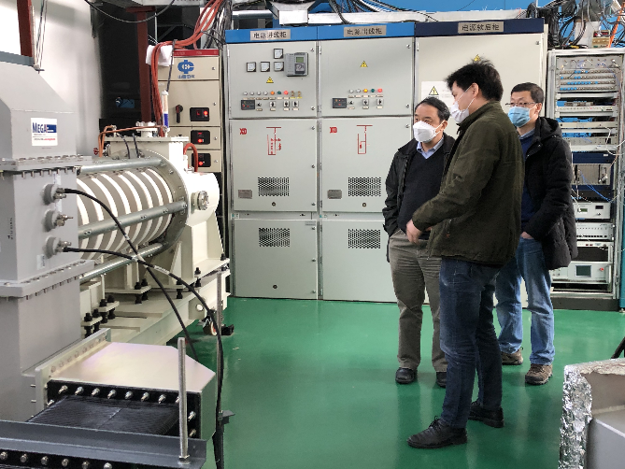
Test results
700kW CW and 800kW pulsed power with 62% efficiency
Parameters | Design | Test
Operating frequency (MHz) | 650 | 650
Beam Voltage (kV) | 81.5 | 80
Beam Perveance (μA/V^{3/2}) | 0.65 | 0.7
Efficiency(%) | 65 | 62
Saturation Gain(dB) | ≥45 | 47
Output power(kW) | 800 | 800
1 dB Bandwidth(MHz) | ≥1 | 1.8

Slide 17
2nd prototype (HE design) milestone
Jan., 2021: Klystron manufacture started
Jul., 2021: Parts fabrication completed
Nov., 2021: Gun processing and klystron baking out
Dec., 2021: Klystron delivered to IHEP
Mar., 2022: Klystron conditioning started
Jul., 2022: CW 630kW with Eff. 70.5% (1st stage high power test)

Slide 18
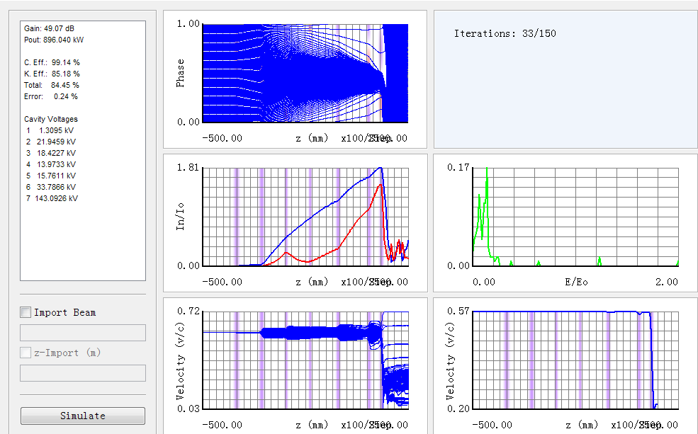
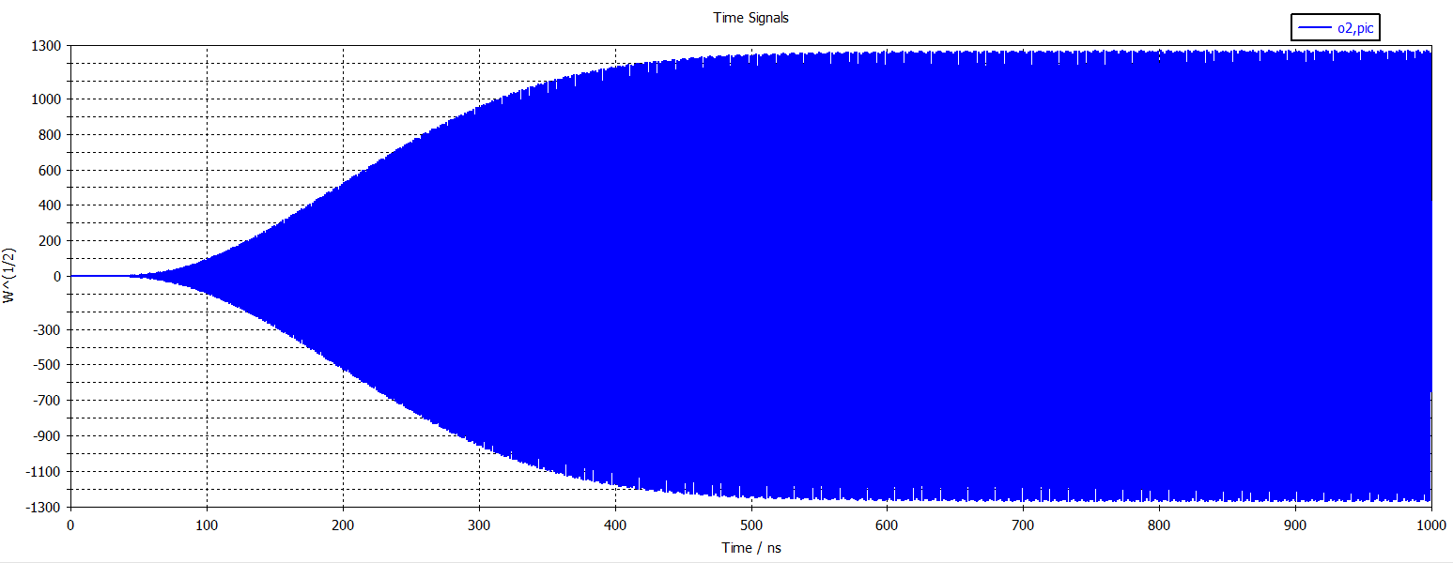
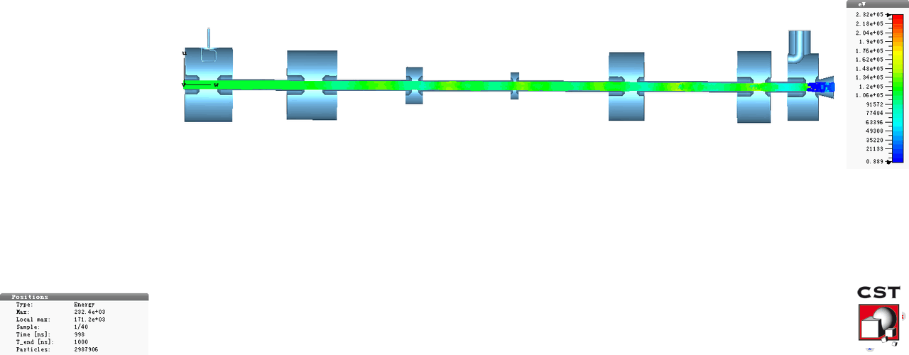
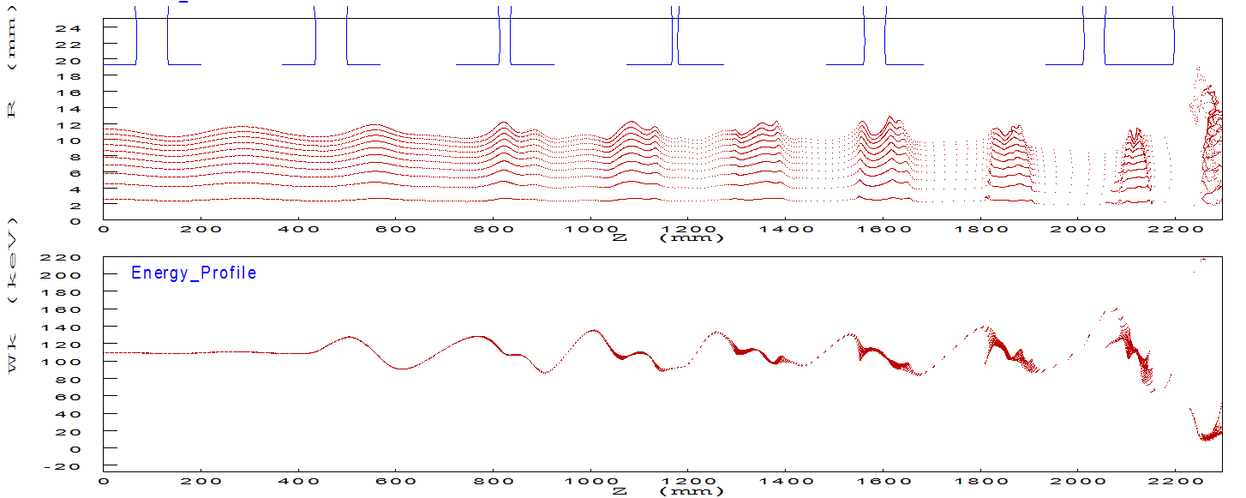
Beam dynamic simulation
AJDISK 1D efficiency: 84.5%
CST 3D efficiency: 77%
EMSYS 2.5D efficiency: 79.3%

Slide 19
1st stage test results
Jul.5, 2022
CW power: 630kW
Eff. : 70.5%

Slide 20
3rd prototype (Muti-beam design) milestone
Dec., 2021: Klystron manufacture started
Sep., 2022: MBK waveguide window fabrication completed
Nov., 2022: Experiment cavity cold test
Mar., 2023: Klystron beam tester delivered to IHEP
May., 2023: Klystron beam tester conditioning started

Slide 21
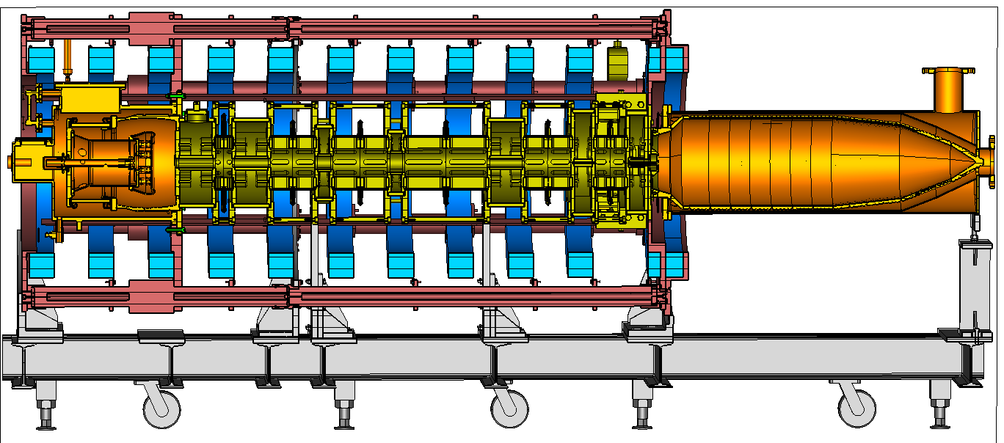
MBK design and fabrication status
Parameters | Value
Frequency | 650 MHz
Output Power | 800 kW
Efficiency | 80.5%
$1dB$ bandwith | ±0.75 MHz
Beam voltage | 54 kV
Beam current | 2.51*8 A
Beam number | 8

Slide 22
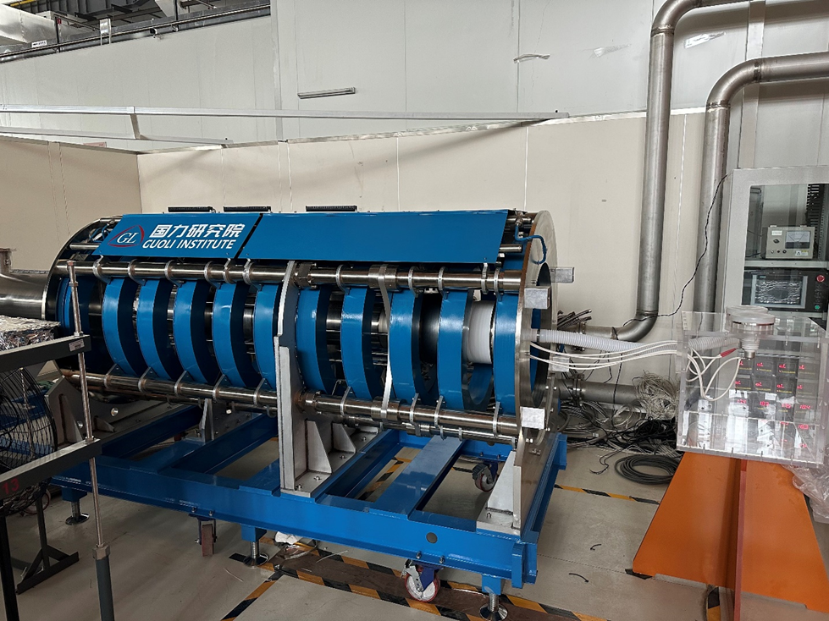
MBK beam tester conditioning
Fabrication of MBK beam tester is completed(including electron gun, collector, focusing coil) and has been delivered to IHEP March of 2023. It is being tested in Platform of Advanced Proton Source(PAPS).

Slide 23
5720MHz klystron design

Slide 24
Main parameters
Parameters | Value
Frequency | 5720 MHz
Output Power | 80MW
Pulsed width | 3us
Repetition rate | 100Hz
Gain | 54 dB
Efficiency | 47%
$3dB$ bandwith | ±5MHz
Beam voltage | 420 kV
Beam current | 403 A
Focusing field | 0.28 T

Slide 25
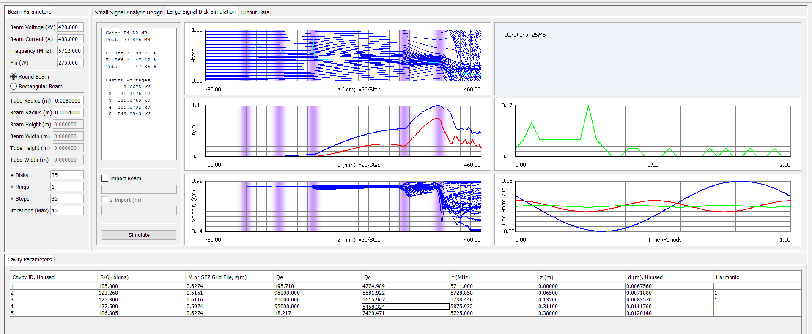
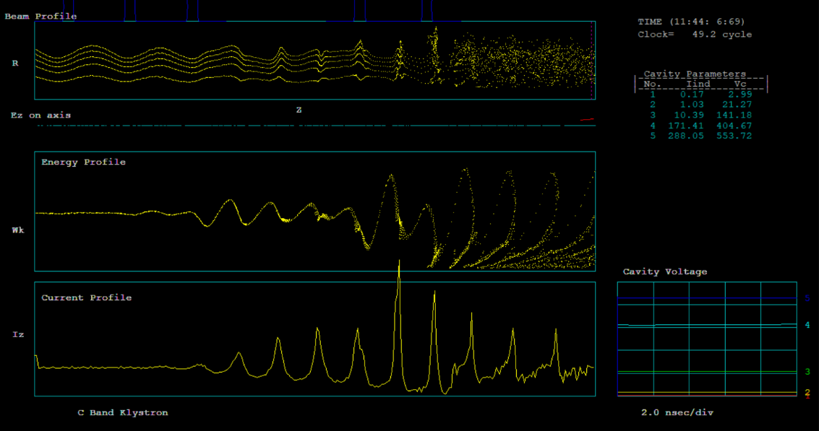
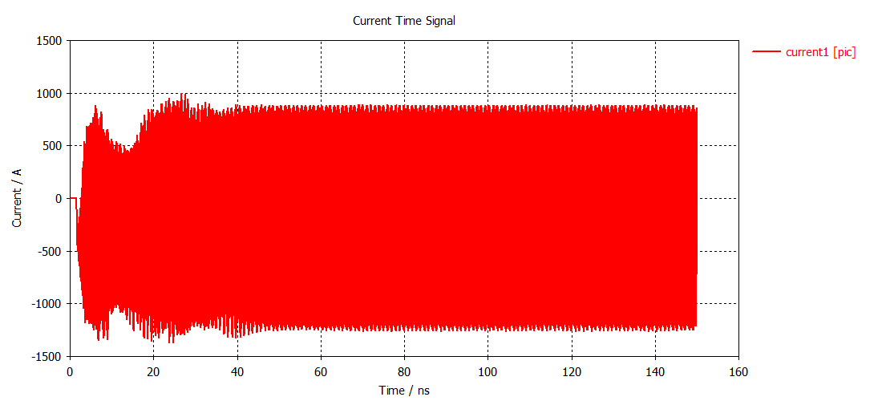
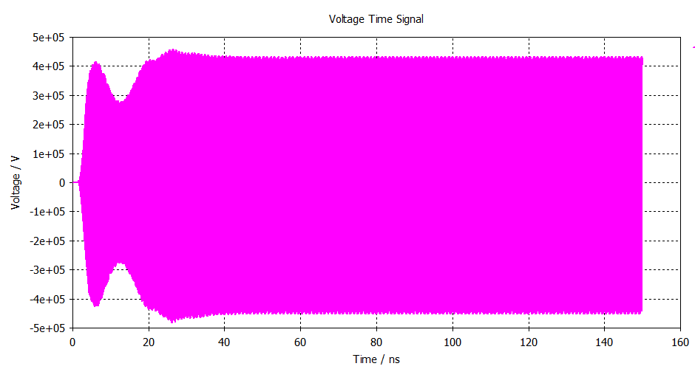
Beam dynamics

Slide 26
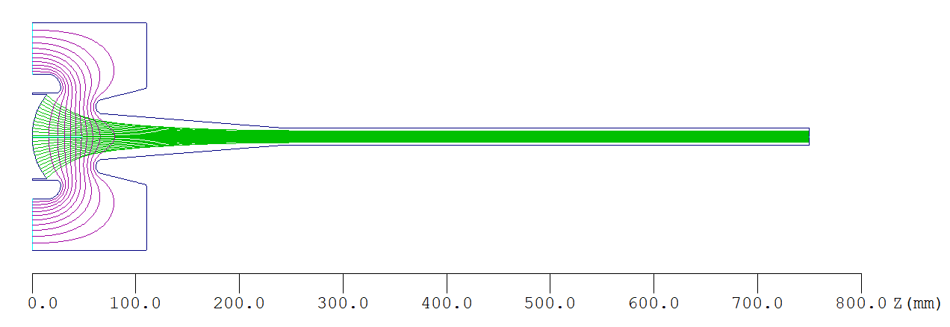
Beam optics simulation
Emax@ FE = 0.186E+05 V/mm
Emax @Anode = 0.155E+05 V/mm
Beam Current = 390 A
Beam Voltage = 410 kV
Perveance = 1.49 µP
% Ripple rate < 4.2%

Slide 27
Summary
RF power source system is ready for CEPC construction.
Much higher efficiency and much less power consumption and cost.
High efficiency klystron will be tested this year and there is a great possibility of more than 75%.
C band and S band klystron are also developed with higher power level and higher efficiency.

Slide 28
Higher efficiency Less energy consumption Lower cost
This is my and our team’s ultimate goal.

Slide 29
Thanks for your attention!

