Slide 1



R & D of full-scale prototype magnets for CEPC Booster and collider
Wen Kang
12-16. June. 2023, Hongkong, CEPC Accelerator TDR International Review

Slide 2
Content
Requirement lists of the dipole magnets
Test results of the subscale prototype dipole magnets
Development of the full-scale prototype dipole magnets
  CT coil dipole magnet for the Booster
  Iron core dipole magnet for the Booster
  DAD magnet for the Collider
Summary

Slide 3
Requirement lists of the dipole magnets for booster and collider
 | BST-63B | MR-70B
Number | 14866 | 3008
Minimum field (Gs) | 28@10GeV/CDR 95@30GeV/TDR | 151@45.5GeV
Maximum field (Gs) | 564@180GeV | 597@180GeV
Gap (mm) | 63 | 66
Magnetic length (m) | 4.7 | 22.7
Length of magnet unit(m) | 4.7 | 5.67
Good field region (mm) | 45 | 11.6
Field uniformity | 1.0E-3 | 5.0E-4

Slide 4
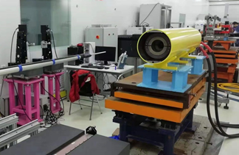
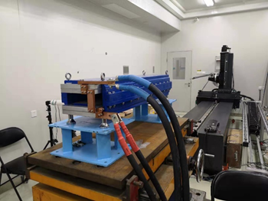
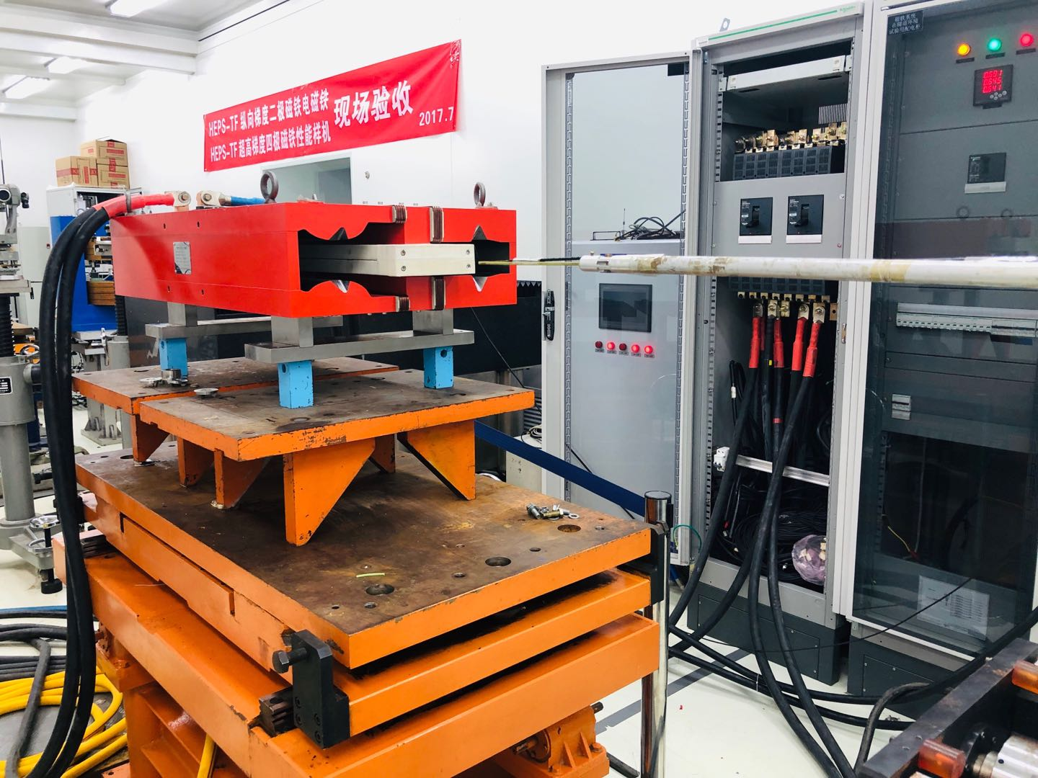
Subscale prototype dipole magnets
In the past years, several subscale prototype dipole magnets were developed and tested for the CEPC Booster and Collider.
The CT coil dipole magnet for the Booster could reach the precision requirement at 28Gs@10GeV, the iron-core dipole magnet made by grain-oriented steel laminations could reach at 60Gs@20GeV and that made by non-oriented steel laminations could reach at 90 Gs@30GeV.
The harmonic errors of the dual aperture dipole (DAD) magnet for Collider were less than the required value of 5×10^{–4} in the range of 151Gs-597Gs.
Three full-scale prototype dipole magnets have been developed to study the procedures of magnet production.

Slide 5
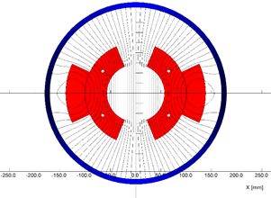
The full-scale CT coil dipole magnet for the Booster
The total length of the magnet is 5.1m, it consists of the coil and shielding tube.
The coil has two half coils, each half coil has two layers and three turns, which are formed by the pure aluminum conductors.
The shielding tube is made by a long steel tube. In order to install the coils, it can be split into upper and lower halves.
The water cooling tubes are inserted between two conductors in the inner layer of half coil.

Slide 6
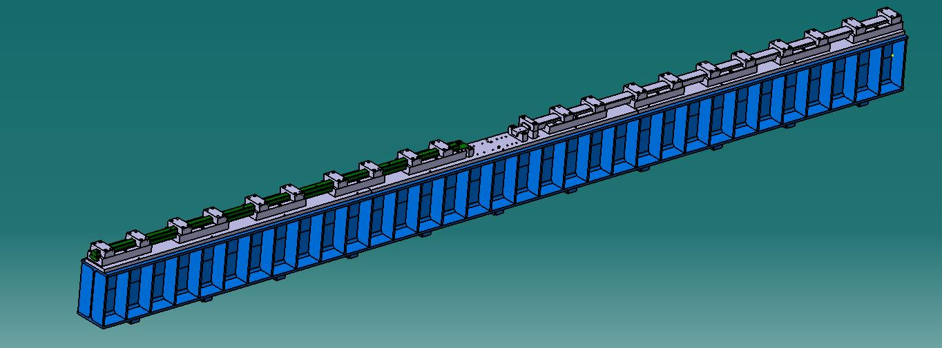
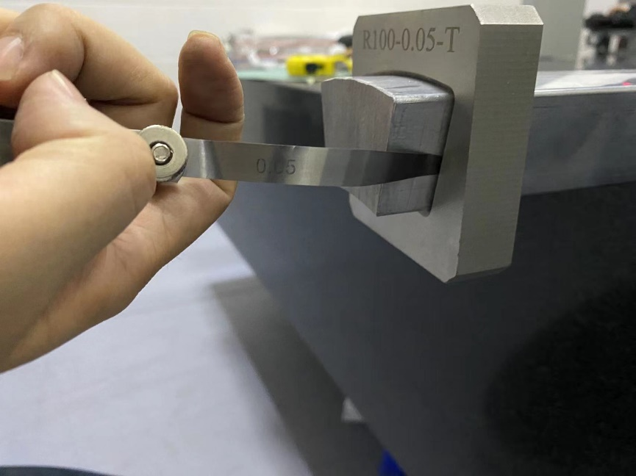
The full-scale CT coil dipole magnet for the Booster
To reduce the production cost, the 5m long conductors are pieced by two 2.5m short ones which are made by extrusion instead of by direct fabrication. The touch surfaces are coated with the silver film to reduce the contact resistance.

Slide 7
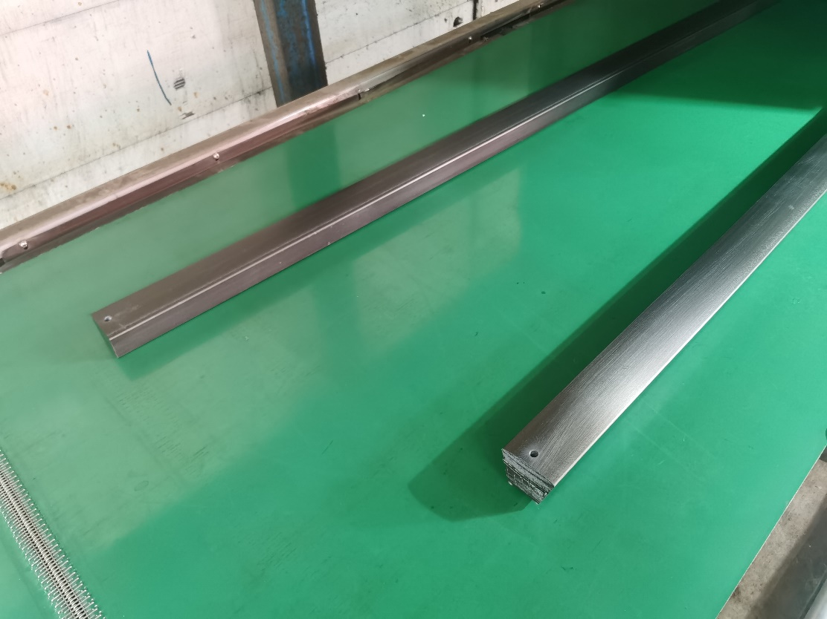
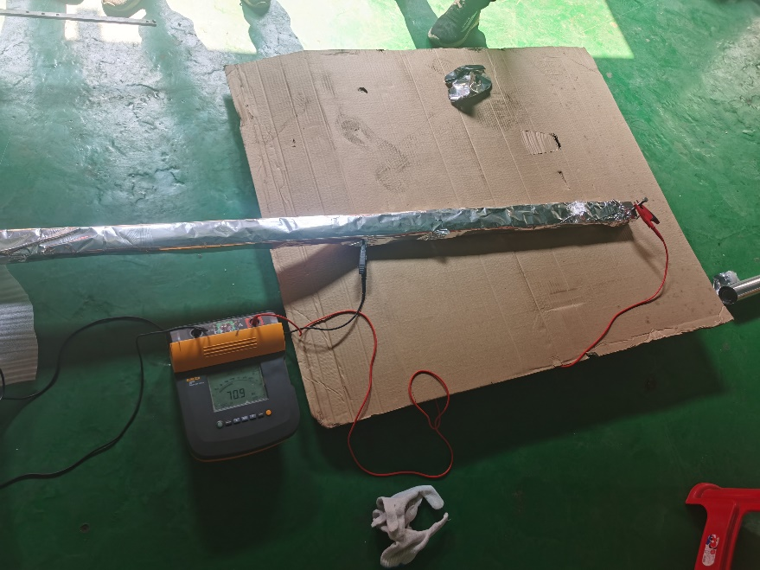
The full-scale CT coil dipole magnet for the Booster
The insulation from turn to turn of the coils could be made by the technology of surface anodization. The insulation resistance of the anodized film is larger than 50 MΩ@500V. The film on the touch surfaces is gotten rid of before coated with silver film.

Slide 8
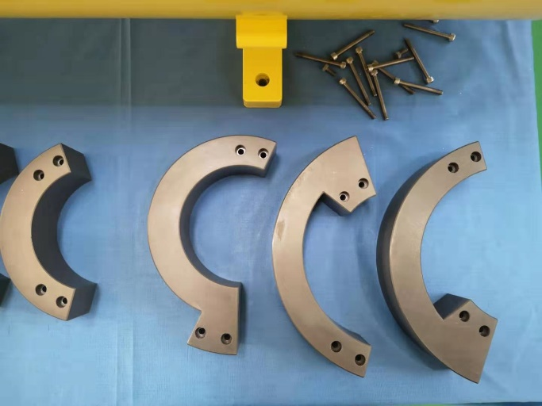
The full-scale CT coil dipole magnet for the Booster
The conductors of the coils from turn to turn are connected by the by-pass circular conductors at the ends of the magnet. The water cooling tubes are inserted between two inner turns and led out at one end of the magnet.

Slide 9
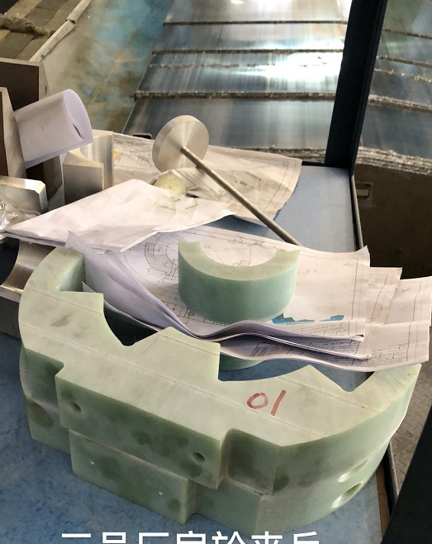
The full-scale CT coil dipole magnet for the Booster
To insure the conductors of the coils at their right position, the supporters every 415mm in longitudinal direction are assembled. The positions of the shielding tube that support the supporters of the coils are machined carefully and precisely.

Slide 10
The full-scale CT coil dipole magnet for the Booster
In the assembly process, the lower coil is directly installed in the lower half shielding tube, the upper half coil should be firstly assembled in an assembling tooling and then rotated 180 degree. After it is put together with the lower coil, the upper shielding tube is assembled with the lower one by the same assembling tooling.

Slide 11
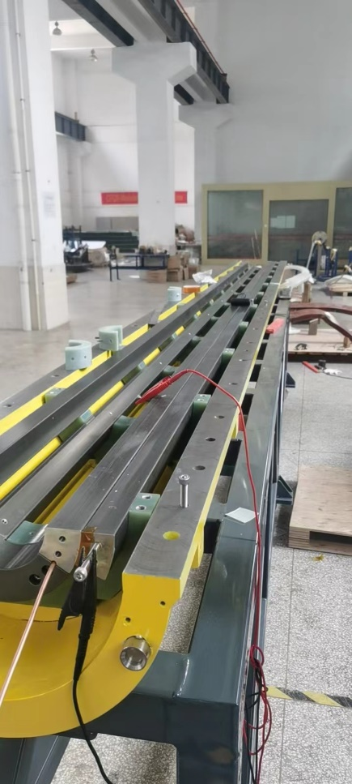
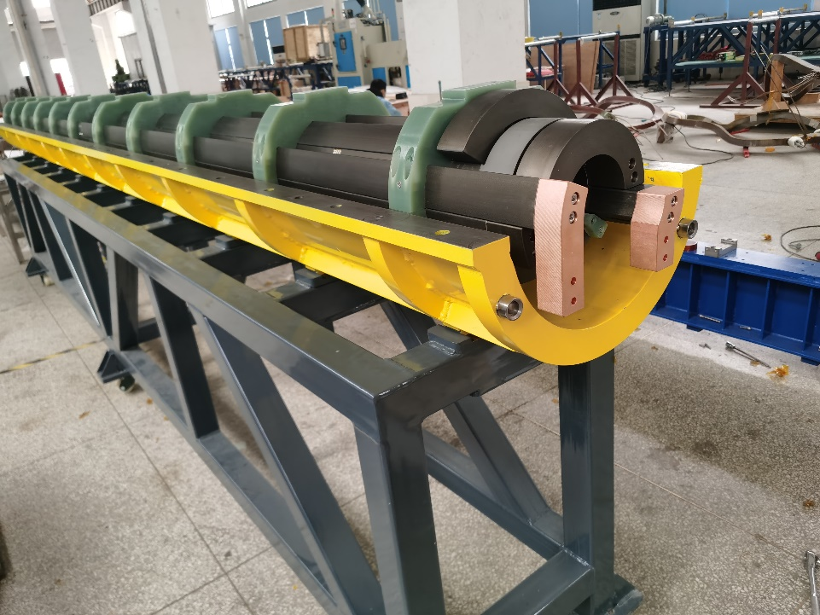
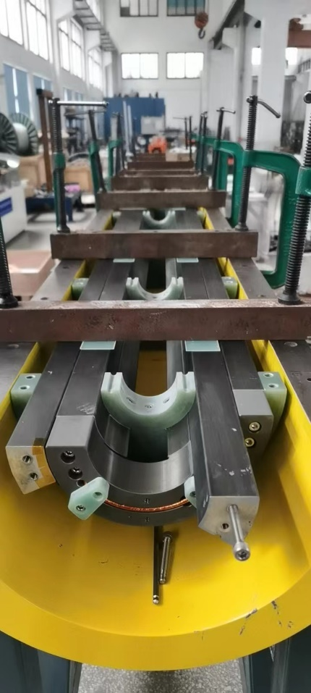
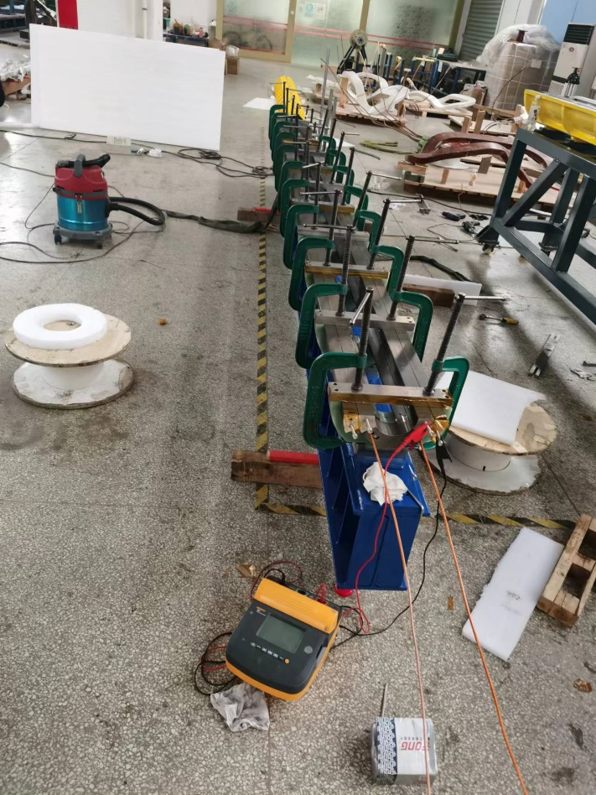
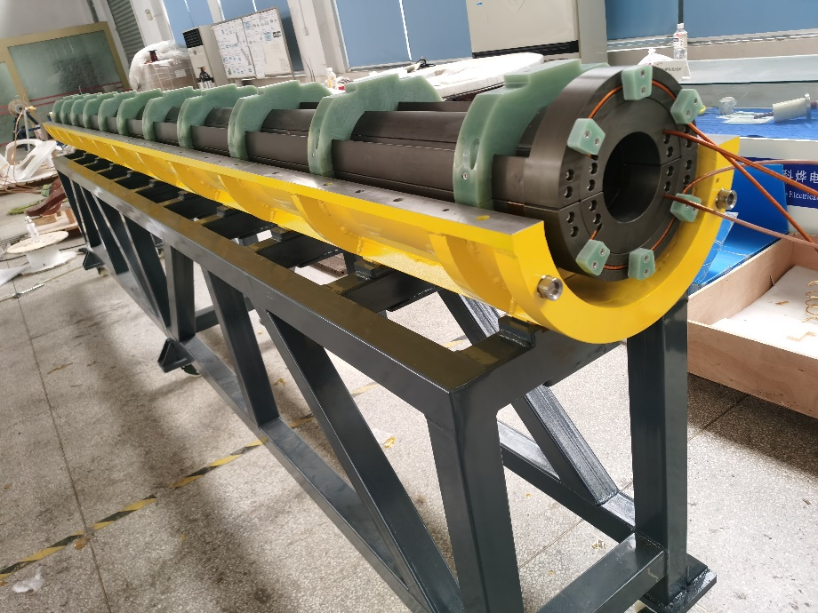
The full-scale CT coil dipole magnet for the Booster
The pictures in the process the magnet assembly.

Slide 12
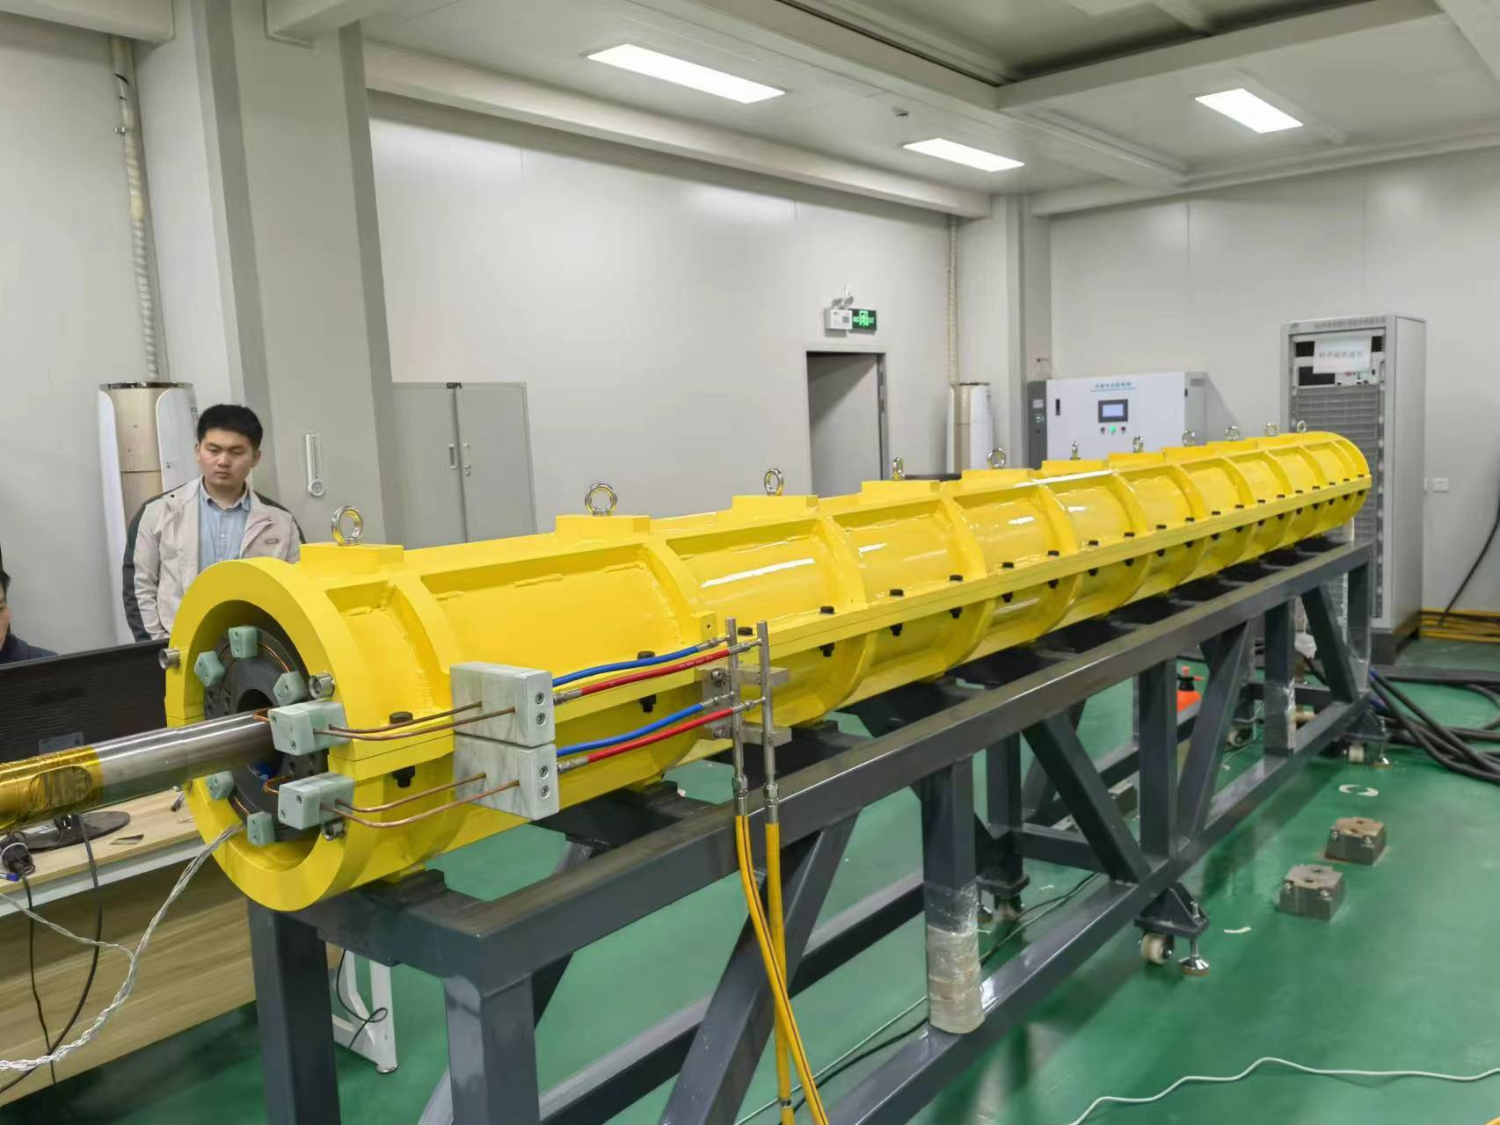
The full-scale CT coil dipole magnet for the Booster
The dipole magnet was measured in the lab constructed for the HEPS booster.

Slide 13
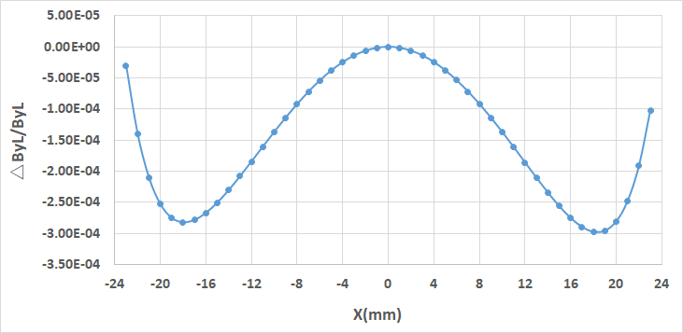
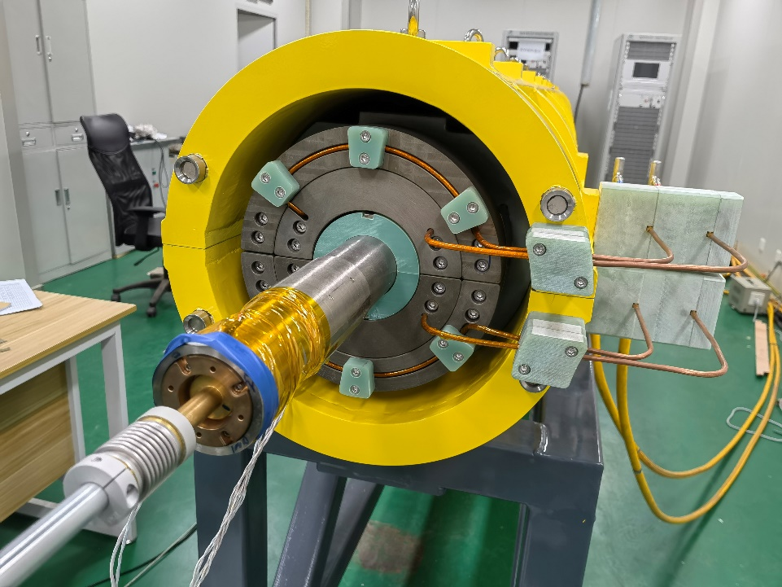
The full-scale CT coil dipole magnet for the Booster
The measured field uniformity @31 Gs reaches 3×10^{–4} (@GFR=+-22.5mm), which meets the requirement of 5×10^{–4}(@GFR=+-22.5mm).

Slide 14
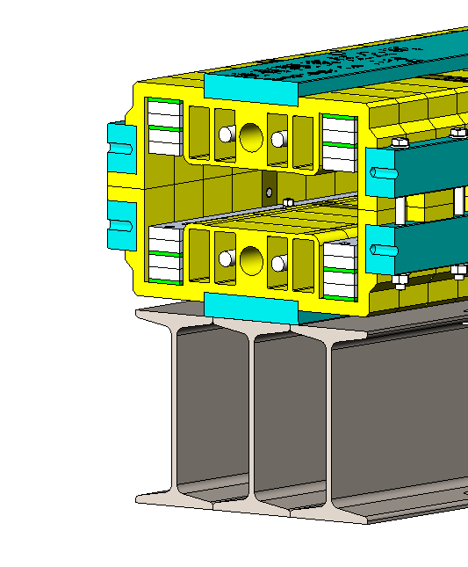
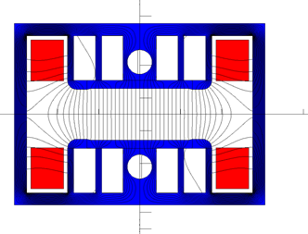
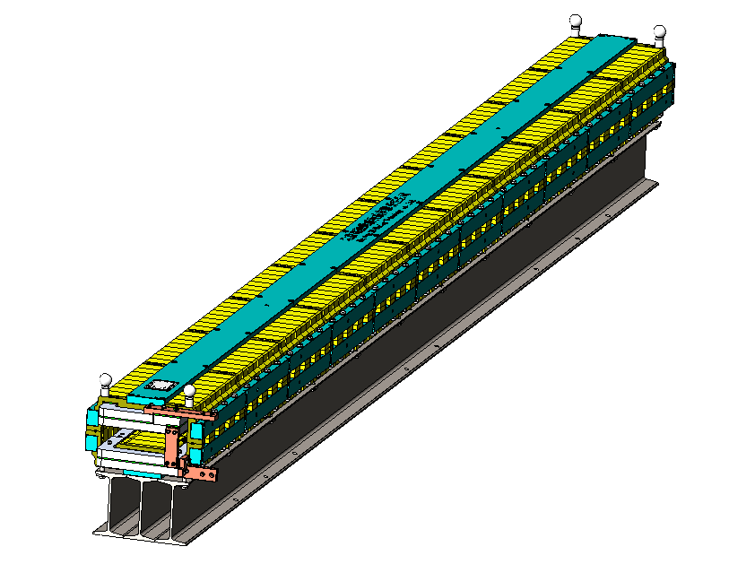
The full-scale iron core dipole magnet for the Booster
The length of the full-scale iron-core dipole magnet is 4.7m, which can be spit into upper and lower halves for the coil and vacuum chamber installation.
To achieve better shielding effectiveness from the earth's field, a closed H-type core was chosen.
To increase the field and decrease the weight of the core, the return yoke of the core is made as thin as possible and some holes are punched in the pole areas of the laminations.
To reduce the deformation in longitudinal direction, the magnet is put on a long I-steel beam which has a precisely machined surface.

Slide 15
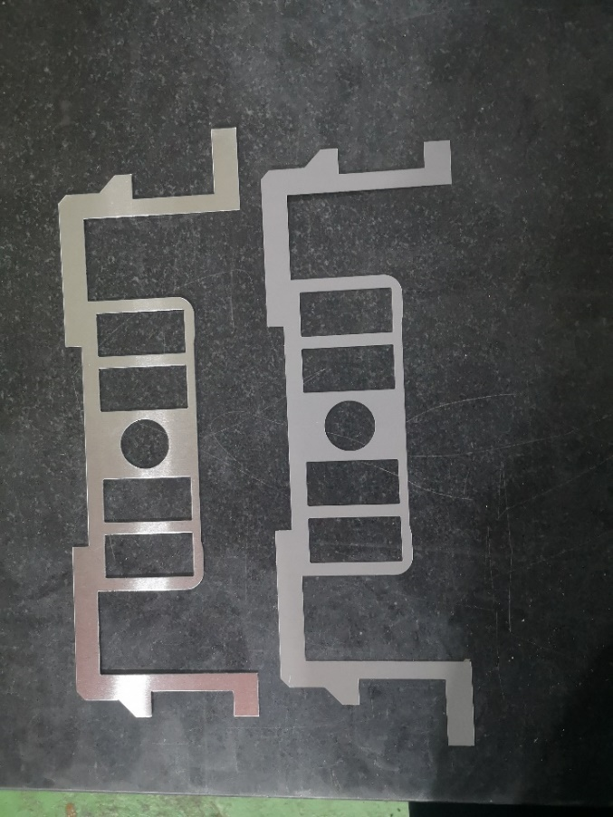
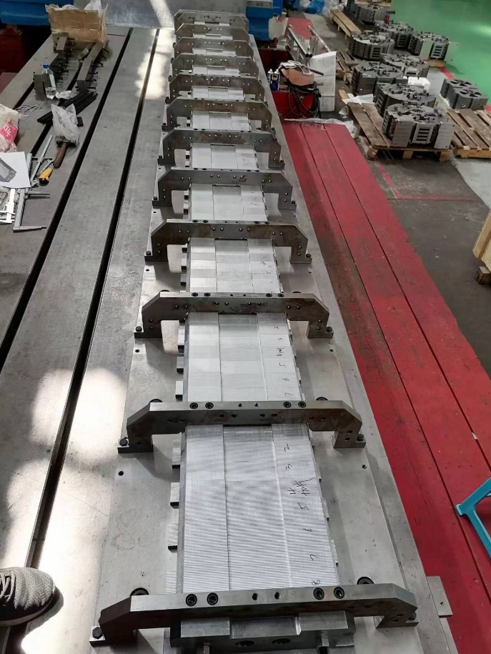
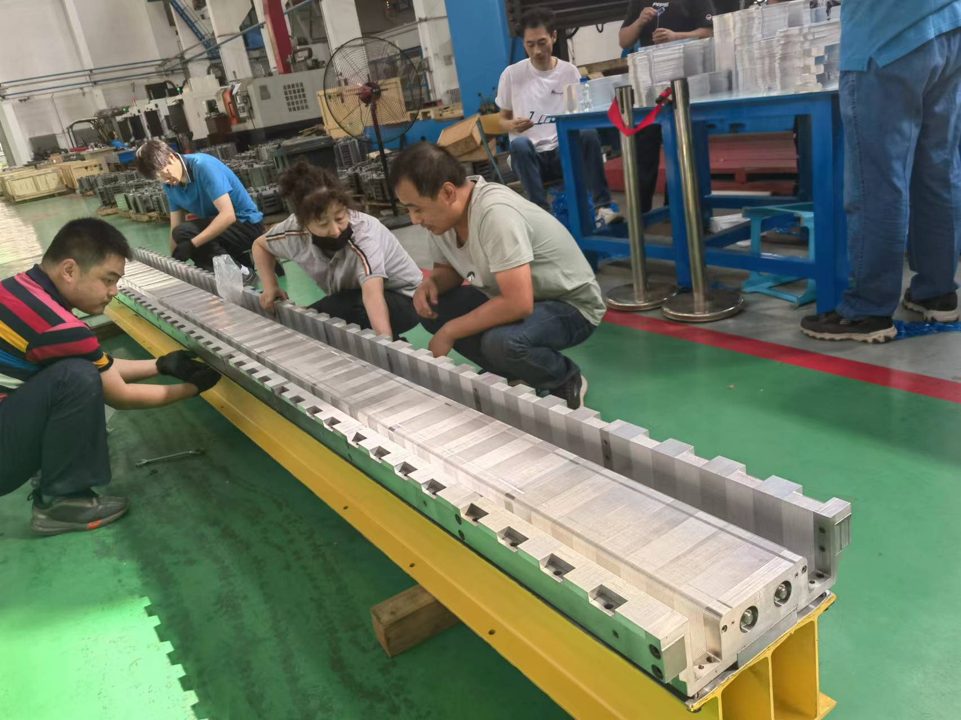
The full-scale iron core dipole magnet for the Booster
The half cores are stacked by the silicon steel laminations and aluminum laminations with the ratio of 1:1, which are pulled together by the surrounding metal bars.

Slide 16
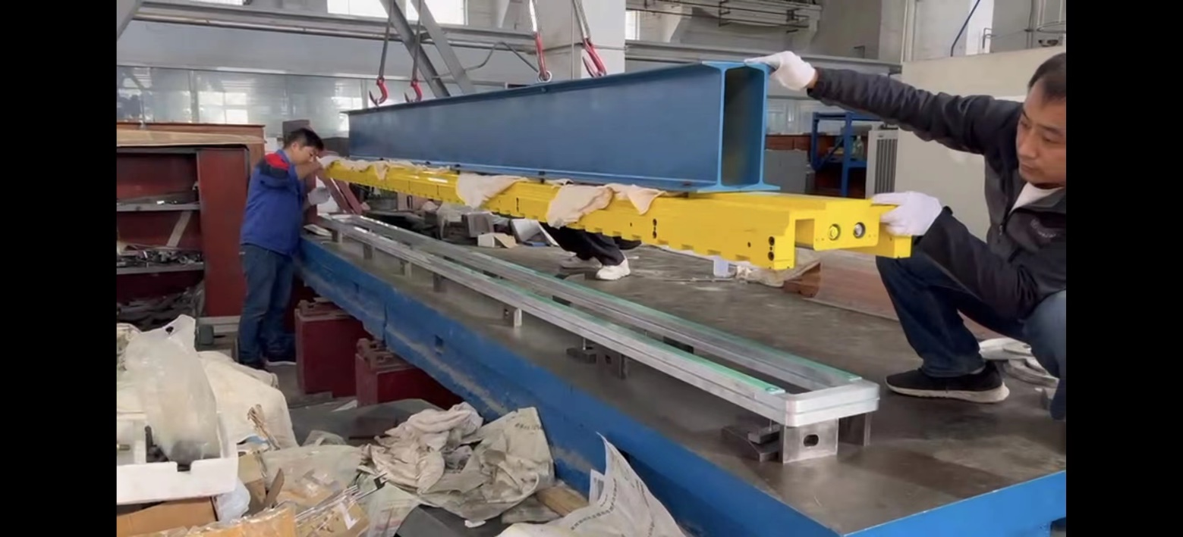
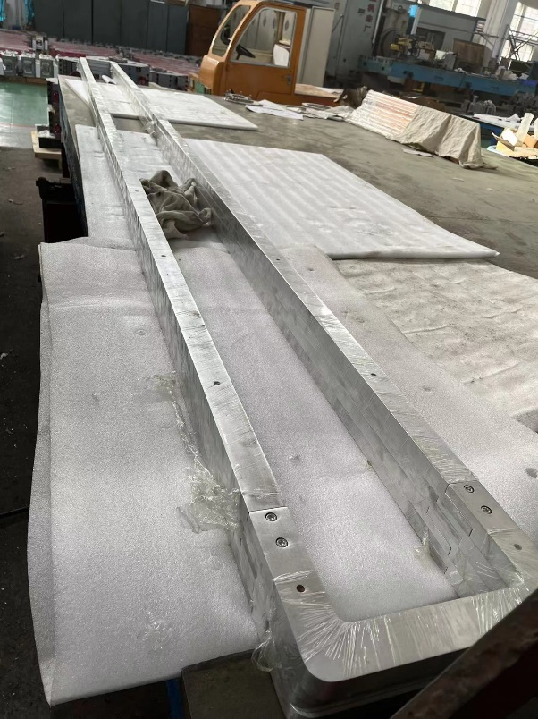
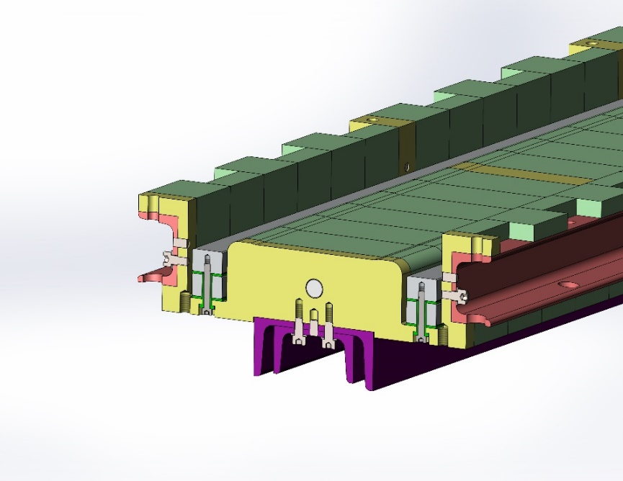
The full-scale iron core dipole magnet for the Booster
The magnet has two coils, each coil has two turns, which are formed with several pieces of the aluminum bars
Unlike the conventional vacuum epoxy casting, the insulation either between the turns or between coil and iron-core are simply made by G10 plates.
By using some kind of special structure, the coils can be simply fixed on the iron cores.

Slide 17
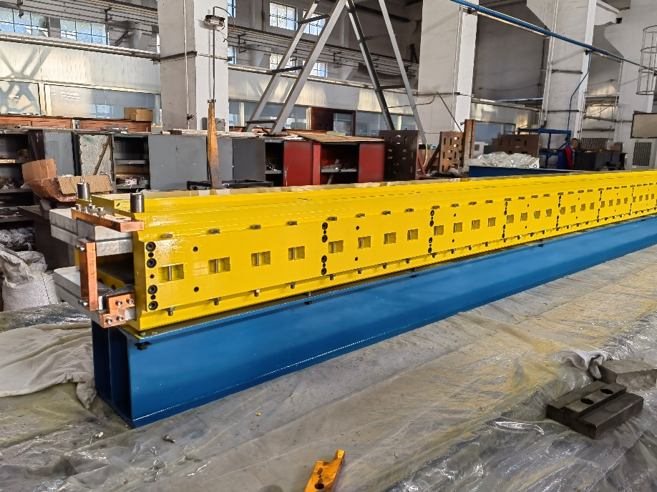
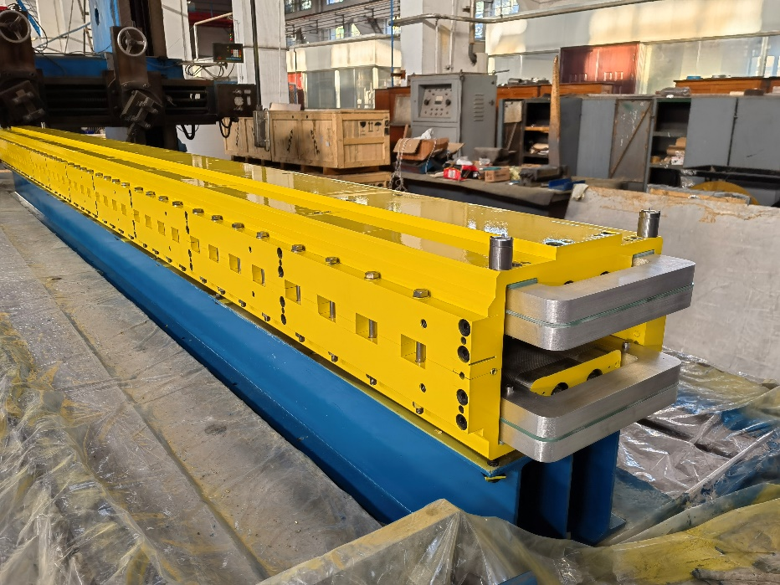
The full-scale iron core dipole magnet for the Booster
After two coils are installed in the two half cores, they are assembled together and then the production of the magnet is completed.

Slide 18
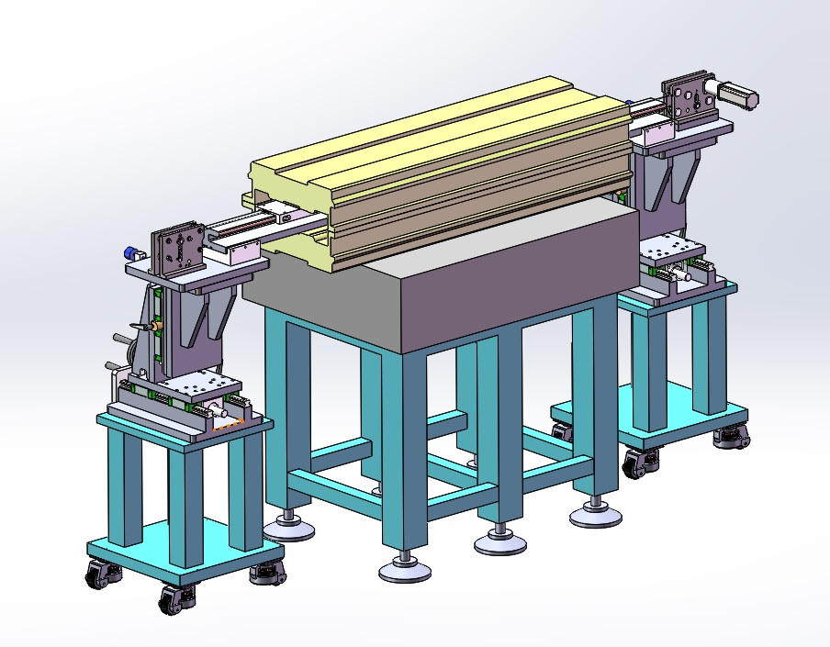
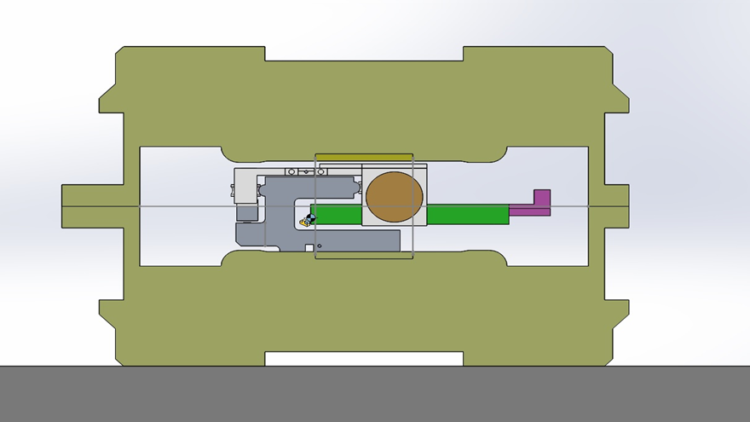
The full-scale iron core dipole magnet for the Booster
A hall probe field measurement system is used to measure the magnetic field of the dipole magnet.
It is composed of a 6m long slide rail, a trolley, a gauss meter and a computer. The slide rail is supported on the pole surface of the magnet, the gauss meter is carried by the trolley to move along the slide rail.

Slide 19
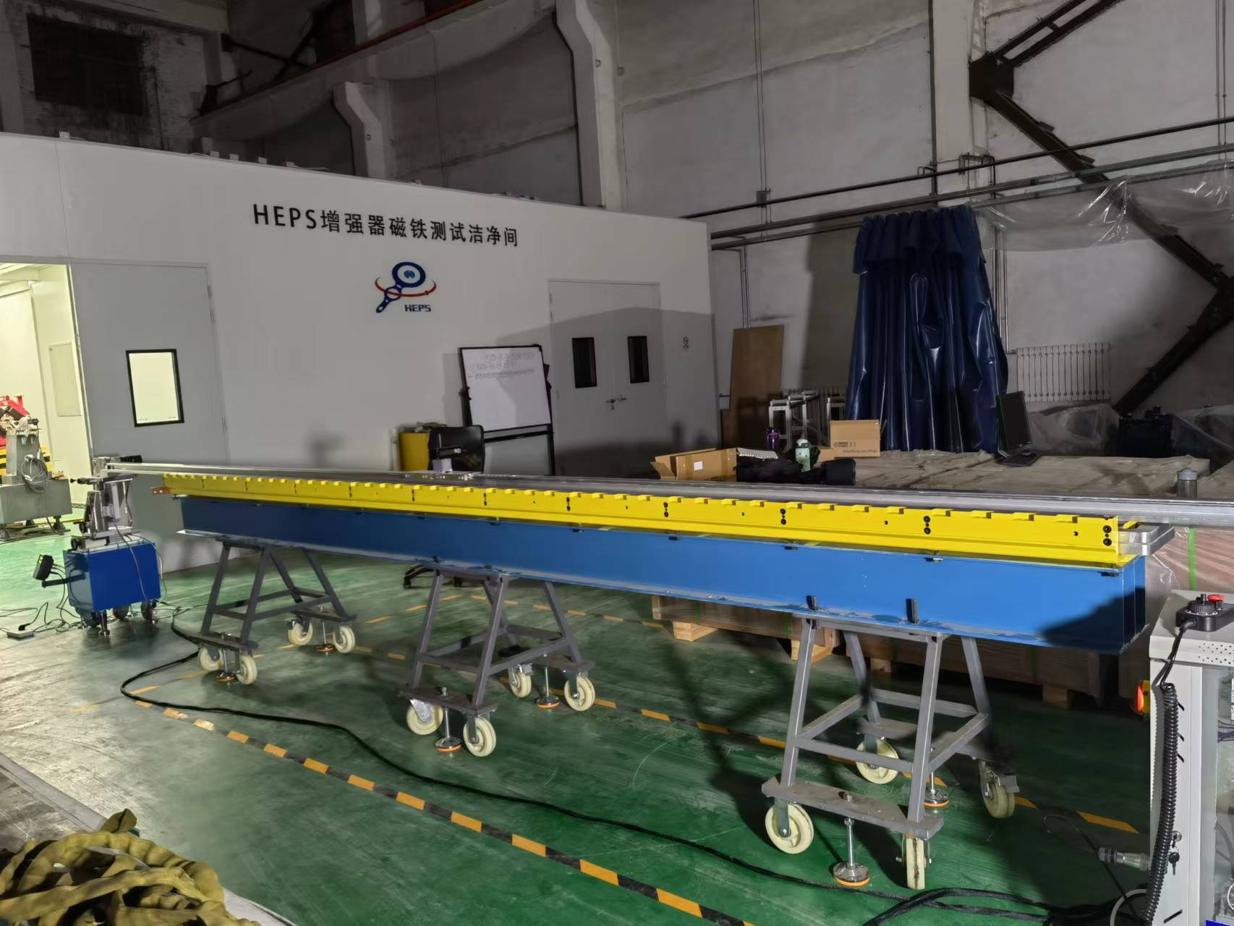
The full-scale iron core dipole magnet for the Booster
In order to put the 6m long slide rail on the lower pole surface of the magnet, the upper half of the magnet should be moved away.

Slide 20
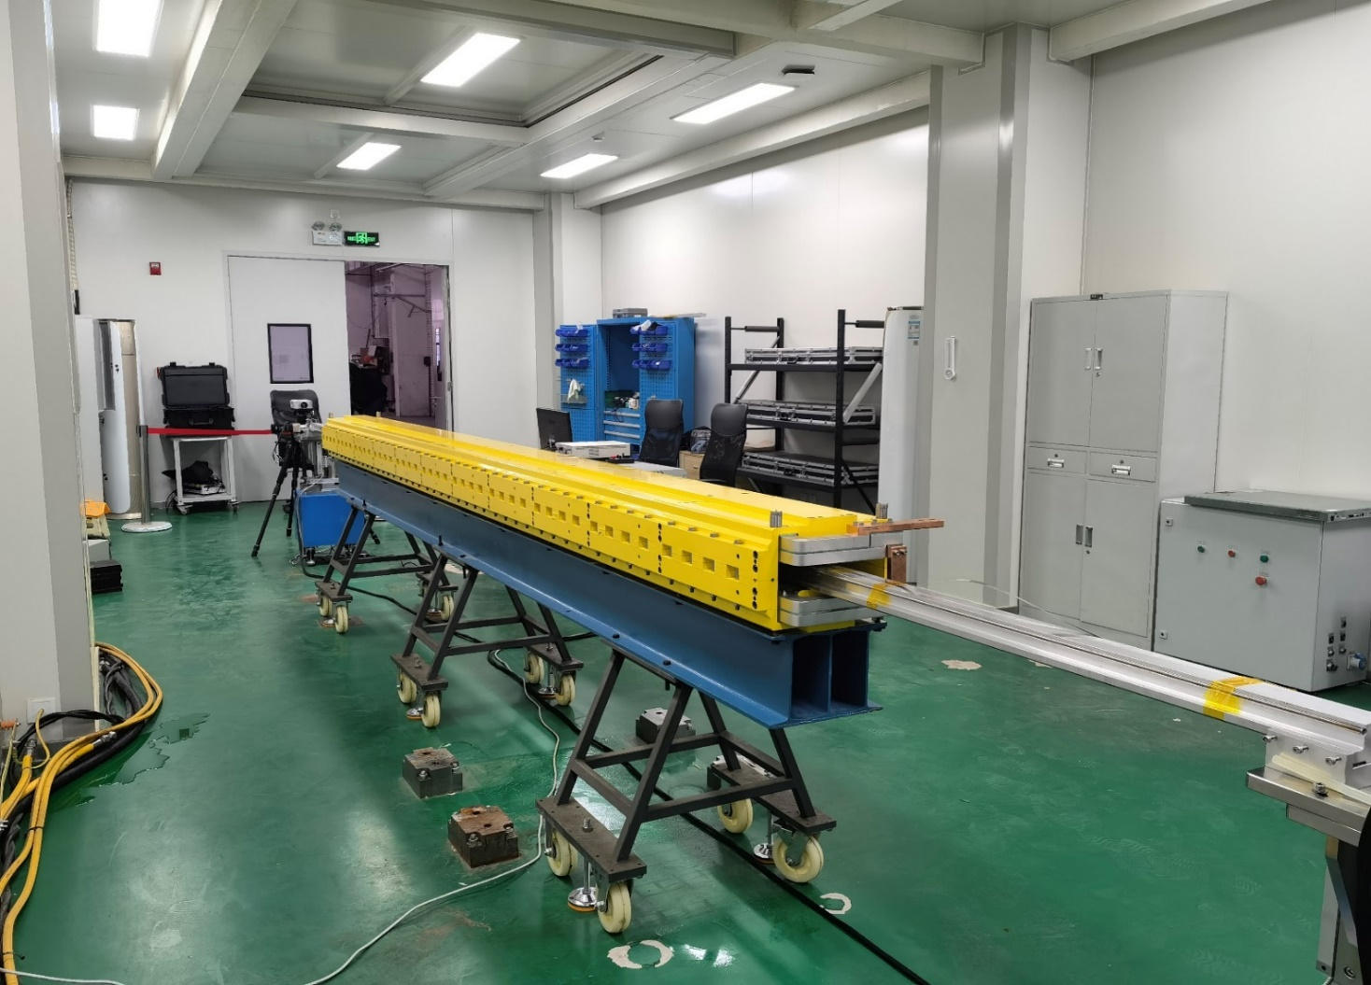
The full-scale iron core dipole magnet for the Booster
After the dipole magnet is assembled with the field measurement system, it is delivered into the lab and tested.

Slide 21
The full-scale iron core dipole magnet for the Booster
The magnetic field measurement results
The field reproducibility of four excited cycles is better than ±2.5×10^{–4}
The integral field uniformity at all field levels is better than ±1×10^{–3}

Slide 22
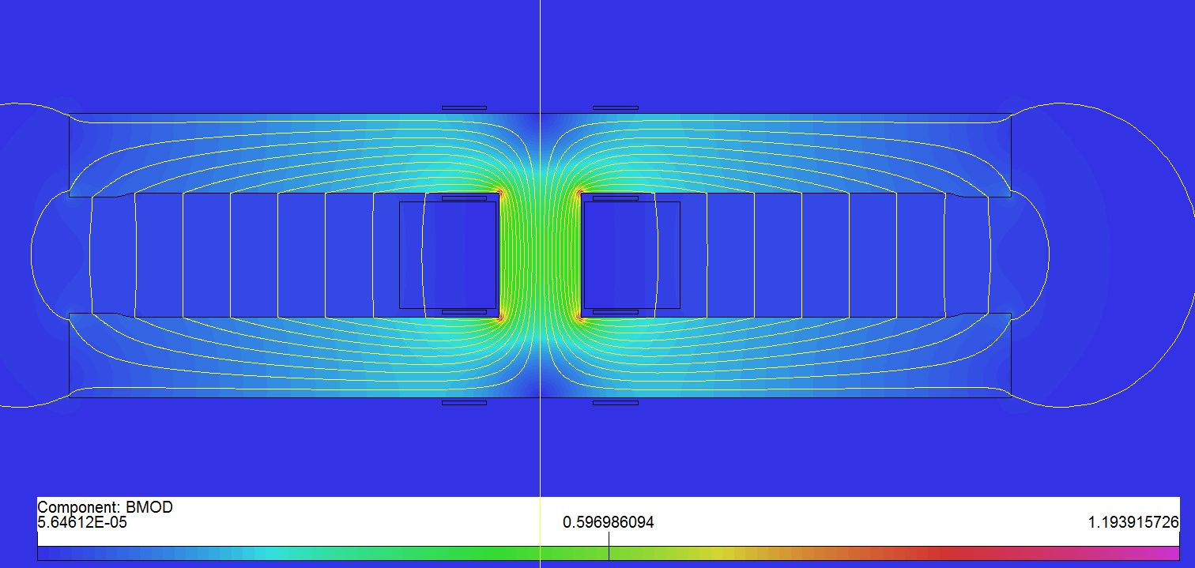
The full-scale dual aperture dipole magnet for the Collider
The CEPC Collider has two rings, so the dual aperture dipole (DAD) magnets are used for the two rings.
The full-scale DAD magnet unit is 5.67m long.
To reduce the cost and power loss, the core of the DAD magnet has a simple “I” type structure, which is formed by three long iron plates.
In order to decrease the deformation in longitudinal direction, four supporters on the bottom of the magnets are used.
To keep the precision of the gap height, several precisely machined blocks are inserted in the two open mouths of the core.

Slide 23
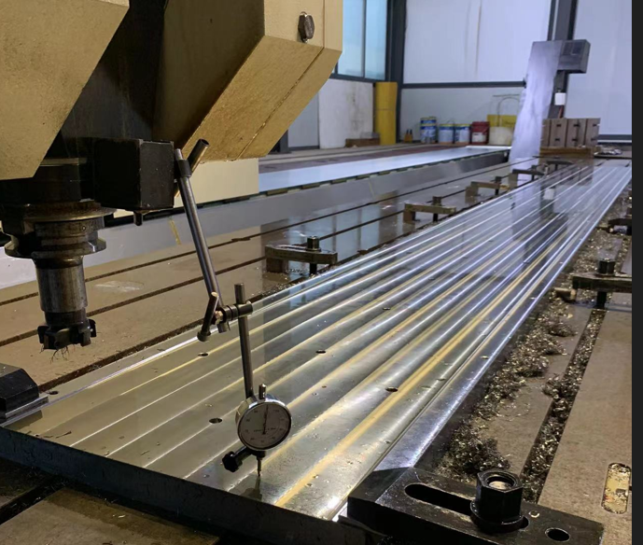
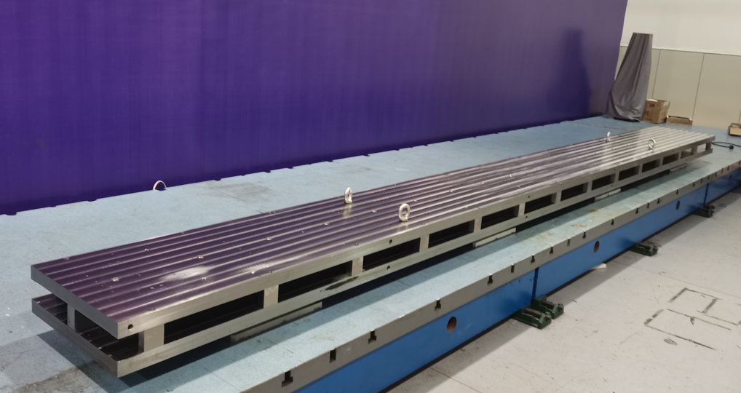
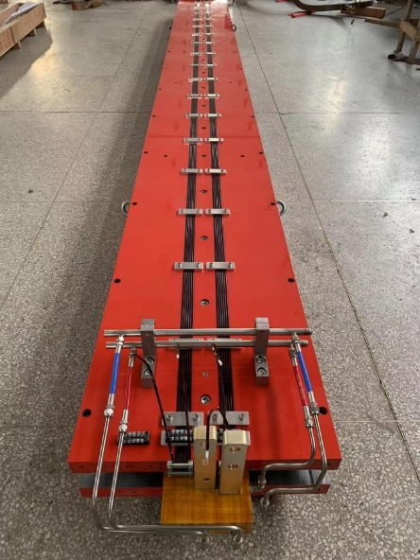
The full-scale dual aperture dipole magnet for the Collider
The DAD magnet has only one coil, which is formed by long aluminum busbars.
The coil has two turns, the insulation from turn to turn as well as from coil to core are made by the technology of the ceramic plasma spraying.
The components of the core are manufactured on a CNC machine, the final gap tolerance of the core is within ±0.05mm.
At present, the production of the full-scale DAD magnet is finished. It will be measured in the lab of IHEP in this month.

Slide 24
Summary
The CT coil subscale prototype dipole magnet could meet the precision requirement at 28Gs@10GeV while the iron-core subscale prototype dipole magnet made by non-oriented steel laminations could reach at 90Gs@30GeV.
To reduce the cost of the dipole magnets, the injection energy of the Booster is increased to 30GeV so that the iron-core dipole magnet made by non-oriented silicon steel laminations is taken as the baseline design for the Booster in TDR stage.
Two full-scale prototype dipole magnets for the Booster are produced and tested, the field performances are good enough to meet the requirements.
The subscale prototype DAD magnet for Collider could meet the field quality requirements, so a full-scale DAD magnet has been produced.

Slide 25
Next work
To finish the field measurement of the full-scale DAD magnet for the Collider.
To develop a full scale dipole and sextupole combined magnet for the Booster.
To develop the full scale quadrupole magnets for the Booster and Collider.
To set up a long rotating coil field measurement system to measure harmonic errors of the magnets for the Collider and Booster.
To explore the feasibility of the automatic production and test lines for the future mass production of the magnets.

Slide 26
Thank you for your attention!
12-16. June. 2023, Hongkong, CEPC Accelerator TDR International Review

