Slide 1



Error and Correction Simulation of CEPC Booster and Damping Ring
Daheng Ji (IHEP)
on behalf of CEPC AP group
4. July. 2023, Edinburgh, The 2023 International Workshop on CEPC

Slide 2
Content
CEPC Booster
  Booster design
  Error set
  Correction
CEPC positron damping ring
  Damping ring design
  Error Set
  Correction
Summary

Slide 3
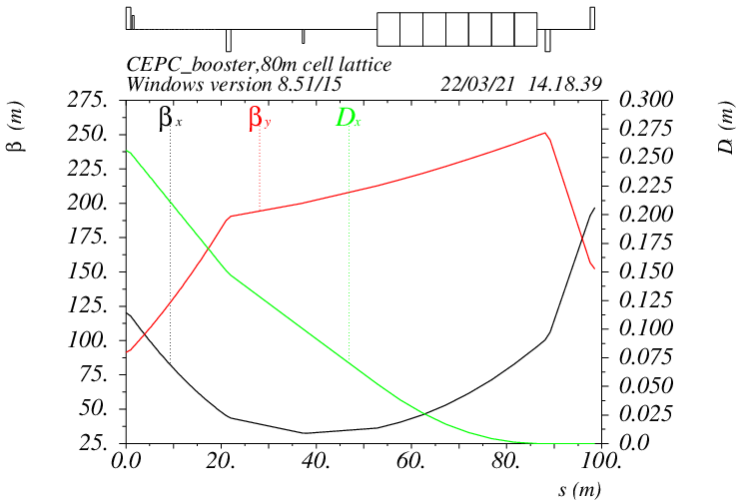
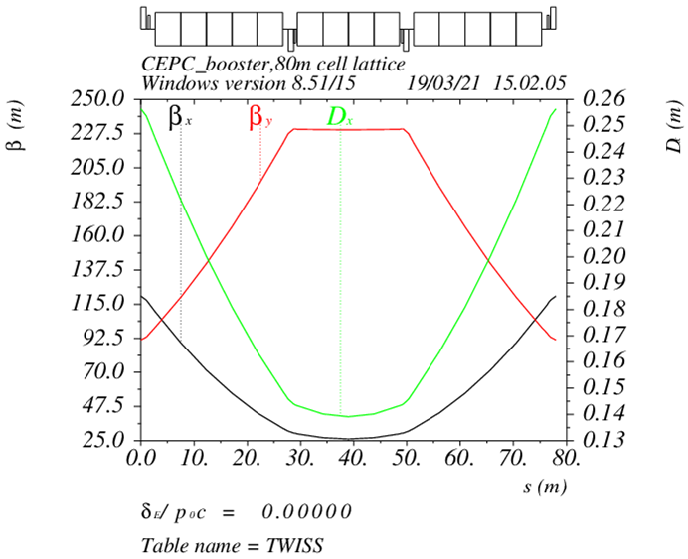
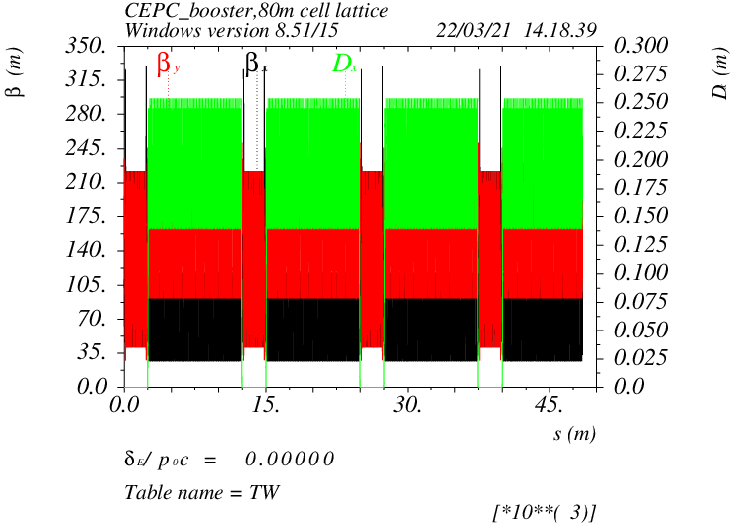
Booster optics
D. Wang, C. H. Yu, Y. M. Peng…
TME like structure (cell length=78m)
Interleave sextupole scheme
Emittance@120GeV=1.26nm
Overall idea: uniform distribution for the Q
Combined magnet (B+S) scheme possible
Phase advance/cell: 100° (H) / 28° (V)
Dispersion sup.
Arc cell
Half ring

Slide 4
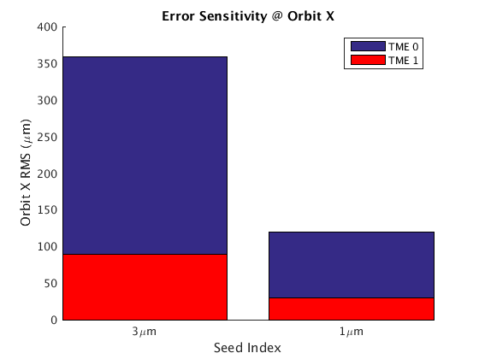
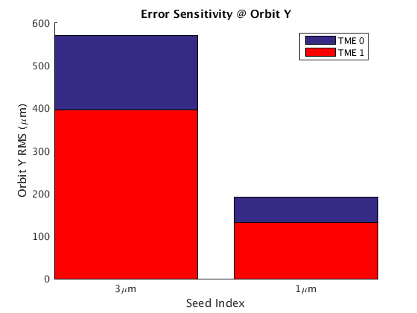
Error Set in Simulation
Simulation based on Accelerator Toolbox(AT).
3σ cutoff | Dipole | Quadrupole | Sextupole
Transverse shift X/Y (μm) | 100 | 100 | 100
Longitudinal shift Z (μm) | 100 | 150 | 150
Tilt about X/Y (mrad) | 0.2 | 0.2 | 0.2
Tilt about Z (mrad) | 0.1 | 0.2 | 0.2
Nominal field | 1e-3 | 2e-4 | 3e-4
 | Accuracy (m) | Tilt (mrad) | Gain | Offset w/ BBA (mm)
BPM(10Hz) | 1e-7 | 10 | 5% | 30e-3
  #BPM~2400
  #Corrector~1200
dipole | quadrupole
B1/B0 ≤ 2×10⁻⁴
B2/B0 ≤ 5×10⁻⁴ | B2/B1 ≤ 3×10⁻⁴
B3/B0 ≤ 2×10⁻⁵ | B3/B1 ≤ 2×10⁻⁴
B4/B0 ≤ 8×10⁻⁵ | B4/B1 ≤ 1×10⁻⁴
B5/B0 ≤ 2×10⁻⁵ | B5/B1 ≤ 1×10⁻⁴
B6/B0 ≤ 8×10⁻⁵ | B6/B1 ≤ 5×10⁻⁵
B7/B0 ≤ 2×10⁻⁵ | B7/B1 ≤ 5×10⁻⁵
B8/B0 ≤ 8×10⁻⁵ | B8/B1 ≤ 5×10⁻⁵
B9/B0 ≤ 2×10⁻⁵ | B9/B1 ≤ 5×10⁻⁵
B10/B0 ≤ 8×10⁻⁵ | B10/B1 ≤ 5×10⁻⁵

Slide 5
Correction Process
Orbit Correction + Horizontal dispersion
Optics correction
Coupling and vertical dispersion correction

Slide 6
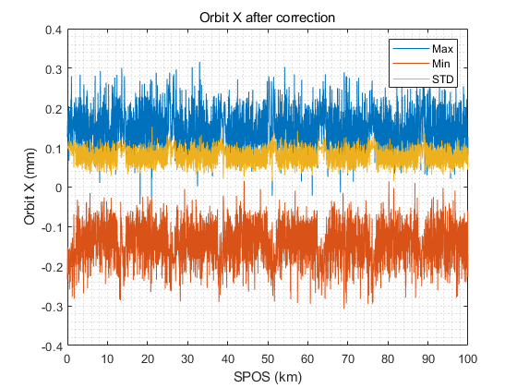
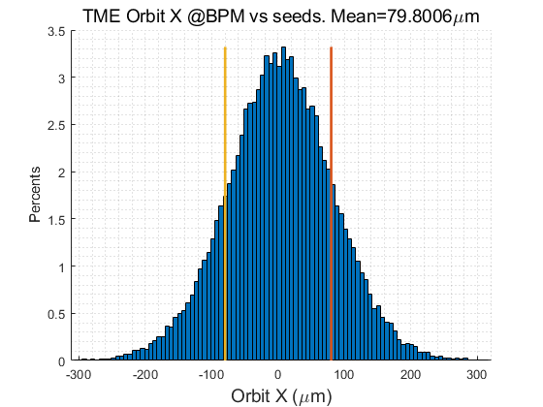
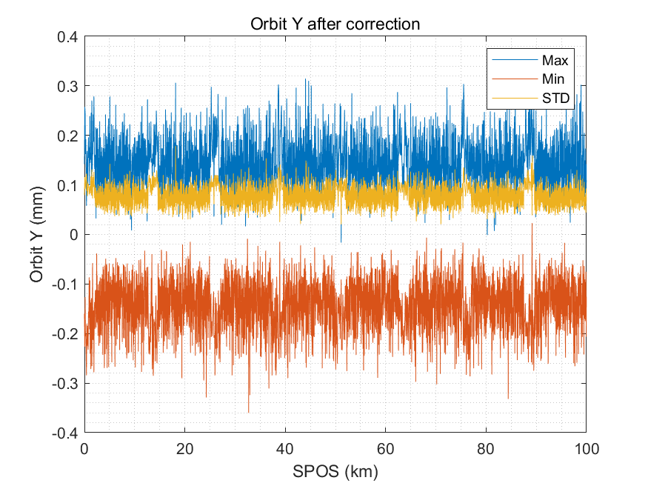
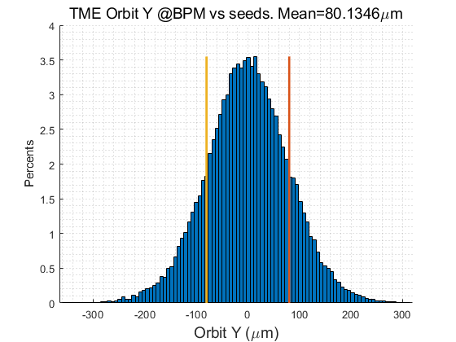
Correction Process
Orbit Correction + Horizontal dispersion
  Response Matrix
  2-level iteration：
    1st Loop: 20%~100% Corrector
    2nd Loop：30%~80% Singular Value
  Dispersion correction
  Energy adjustment by corrector
  80um RMS in both plan
Optics correction
Coupling and vertical dispersion correction
@30GeV

Slide 7
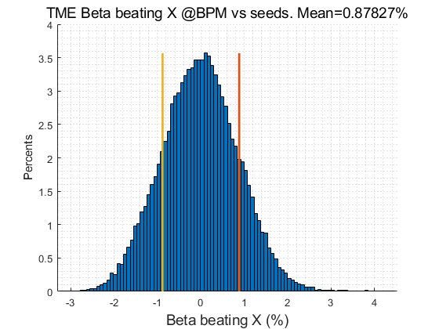
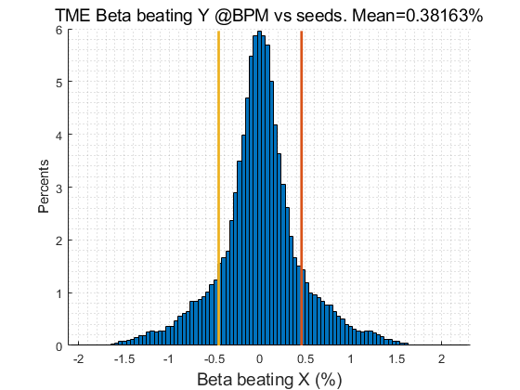
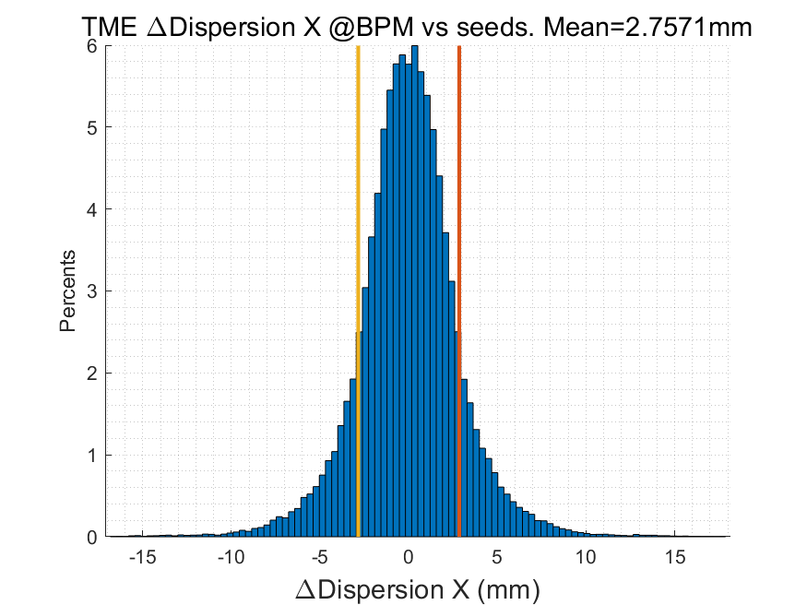
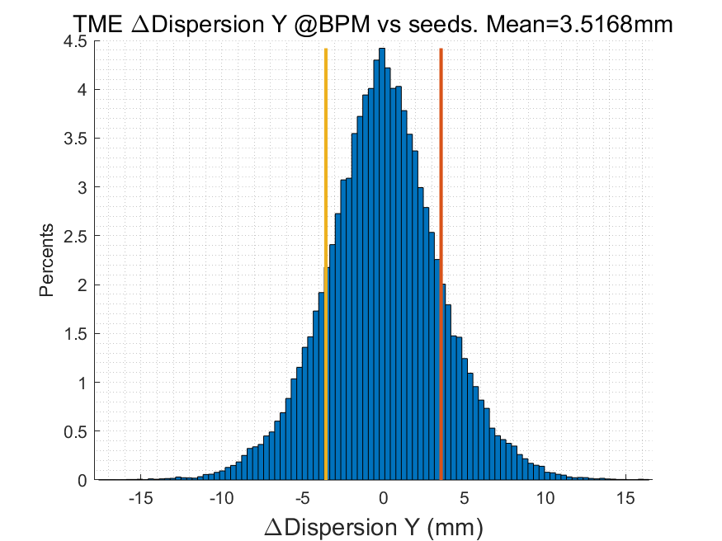
Correction Process
Orbit Correction + Horizontal dispersion
  Response Matrix
  2-level iteration：
    1st Loop: 20%~100% Corrector
    2nd Loop：30%~80% Singular Value
  Dispersion correction
  Energy adjustment by corrector
  80um RMS in both plan
Optics correction
  RM + LOCO
  Based on 30GeV simulation
  All quadrupole independent
  Dispersion correction included
Coupling and vertical dispersion correction
RMS@30GeV | X | Y
Orbit (mm) | 0.080 | 0.080
Beta Beating(%) | 0.8 | 0.38
Δ Dispersion(mm) | 2.7 | 3.5
@30GeV

Slide 8
Correction Process
Orbit Correction + Horizontal dispersion
  Response Matrix
  2-level iteration：
    1st Loop: 20%~100% Corrector
    2nd Loop：30%~80% Singular Value
  Dispersion correction
  Energy adjustment by corrector
  80um RMS in both plan
Optics correction
  RM + LOCO
  Based on 30GeV simulation
  All quadrupole independent
  Dispersion correction included
Coupling and vertical dispersion correction
  Mainly used for the simulation of beam polarization. (Z. Duan)
  Skew quadrupole magnets are arranged in both the dispersion free section and the arc section to correct coupling and vertical dispersion independently.
  the coupling control target being better than 0.5%

Slide 9
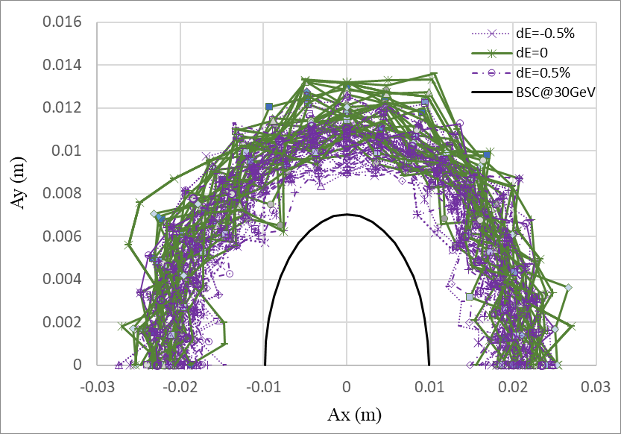
DA@30GeV
Dou Wang, Daheng Ji
On axis injection from Linac to booster
Tracking by SAD (1500 turns)
include errors (w. multipole errors)
Include SR sawtooth orbit (without taper)
Include SR damping & fluctuation
BSC definition (ε_{inj}=6.5nm):
Energy acceptance: 3*δ_{inj} =0.45%

Slide 10
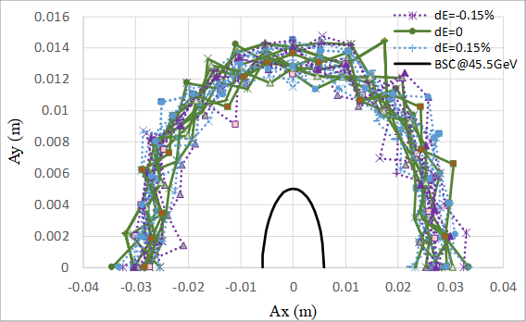
DA@45GeV
Dou Wang, Daheng Ji
Tracking by SAD (1200 turns)
include errors (w. multipole errors)
Include SR sawtooth orbit (without taper)
Include SR damping & fluctuation
Off axis injection from booster to collider
BSC definition (ε_{x}=0.18nm, ε_{y}=ε_{x} *1%):
Energy acceptance: 4*δ =0.15%

Slide 11
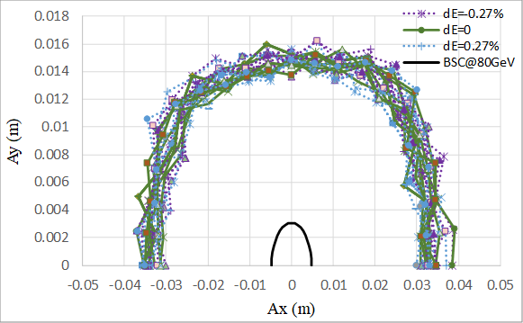
DA@80GeV
Dou Wang, Daheng Ji
Tracking by SAD (500 turns)
include errors (w. multipole errors)
Include SR sawtooth orbit (without taper)
Include SR damping & fluctuation
Off axis injection from booster to collider
BSC definition (ε_{x}=0.56nm, ε_{y}=ε_{x} *1%):
Energy acceptance: 4*δ =0.27%

Slide 12
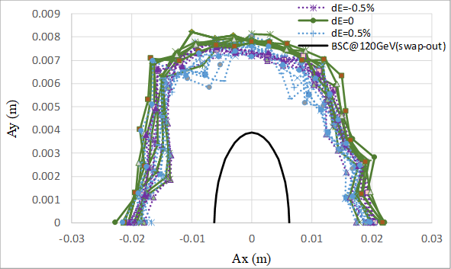
DA@120GeV
Dou Wang, Daheng Ji
Tracking by SAD (250 turns)
include errors (w. multipole errors)
Include SR sawtooth orbit (without taper)
Include SR damping & fluctuation
On axis injection from booster to collider
BSC definition (ε_{x}=1.26nm, ε_{y}=ε_{x} *1%):
Energy acceptance: 5*δ =0.5%

Slide 13
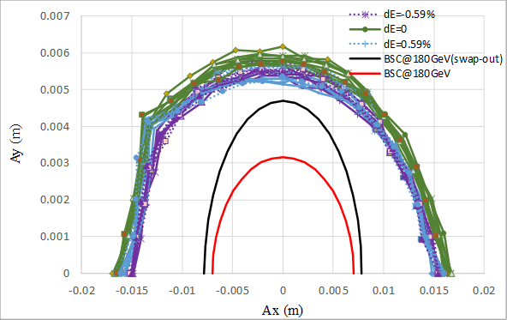
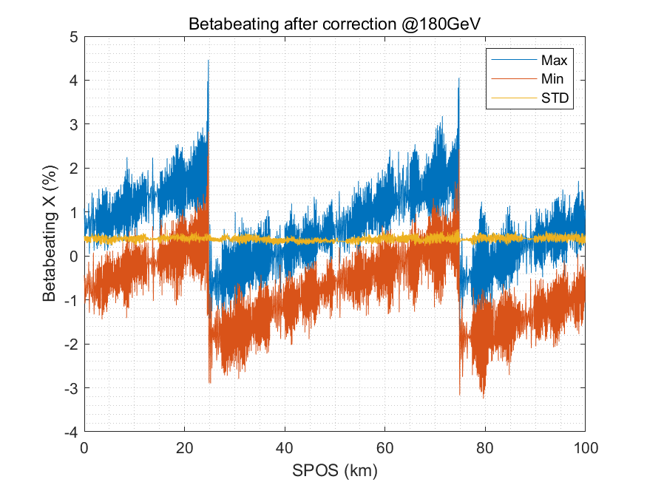
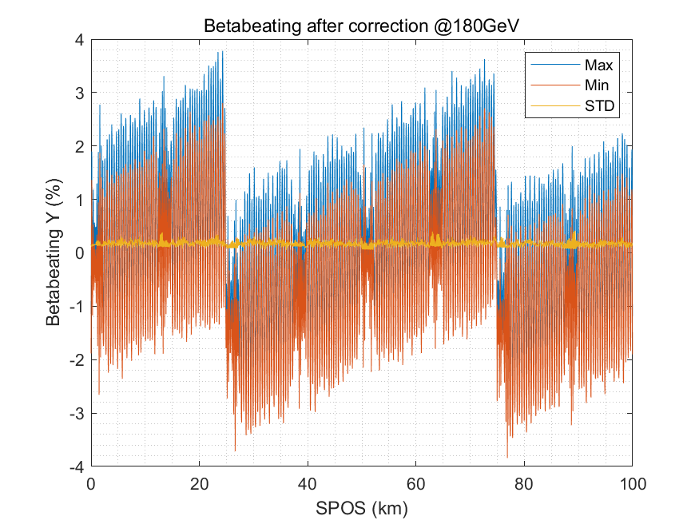
DA@180GeV
Dou Wang, Daheng Ji
Tracking by SAD (150 turns)
include errors (w. multipole errors)
Include SR sawtooth orbit (with taper)
Include SR damping & fluctuation
Keep possibility for on axis injection to collider
BSC definition (ε_{x}=2.84nm, ε_{y}=ε_{x} *1%):
--
--
(On-axis)
(Off-axis)
Energy acceptance: 4*δ =0.59%
Taper:
The DA deteriorated significantly when the beam energy exceeds 120GeV.
Taper the dipoles and quadrupoles can obviously improve the DA.
The approximate effect can be obtained by grouped dipoles which can significantly reduce the cost

Slide 14
Content
CEPC Booster
  Booster design
  Error set
  Correction
CEPC positron damping ring
  Damping ring design
  Error Set
  Correction
Summary

Slide 15
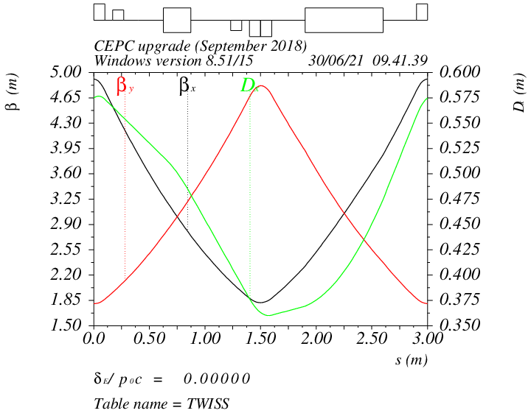
DR optics
Cell length: 3m
B=1.28T
θ_{r} /θ₀=0.355
Parameters | Dipole | Quadrupole | Sextupole
Transverse shift X/Y (μm) | 100 | 100 | 100
Longitudinal shift Z (μm) | 100 | 150 | 100
Tilt about X/Y (mrad) | 0.2 | 0.2 | 0.2
Tilt about Z (mrad) | 0.1 | 0.2 | 0.1
Nominal field | 1×10⁻³ | 2×10⁻⁴ | 3×10⁻⁴
Phase/cell: 60°/60°
Interleave sextupole scheme
2 sex. families
-θ_{r}
B=1.28T
θ₀
Parameters | BPM (10 Hz)
Accuracy (m) | 1×10⁻⁷
Tilt (mrad) | 10
Gain | 5%
Offset after beam based alignment (BBA) (mm) | 30×10⁻³
Arc
Dipole | Quadrupole | Sextupoles
B₁ ≤ 2
B₂ ≤ 3 | B₂ ≤ 3
B₃ ≤ 0.2 | B₃ ≤ 2 | B₃ ≤ 10
B₄ ≤ 0.8 | B₄ ≤ 1 | B₄ ≤ 3
B₅ ≤ 0.2 | B₅ ≤ 1 | B₅ ≤ 10
B₆ ≤ 0.8 | B₆ ≤ 0.5 | B₆ ≤ 3
B₇ ≤ 0.2 | B₇ ≤ 0.5 | B₇ ≤ 10
B₈ ≤ 0.8 | B₈ ≤ 0.5 | B₈ ≤ 3
B₉ ≤ 0.2 | B₉ ≤ 0.5 | B₉ ≤ 10
B₁₀ ≤ 0.8 | B₁₀ ≤ 0.5 | B₁₀ ≤ 3

Slide 16
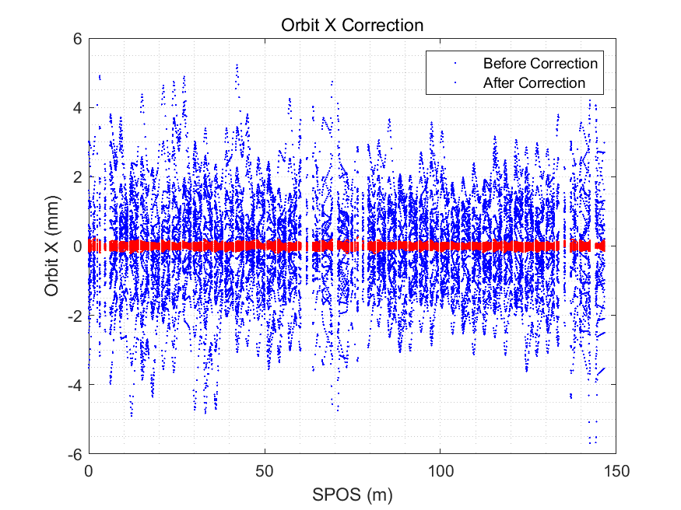
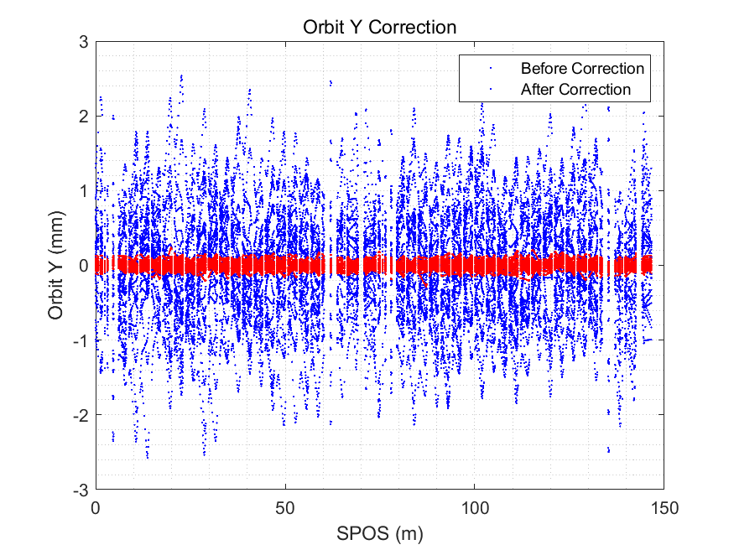
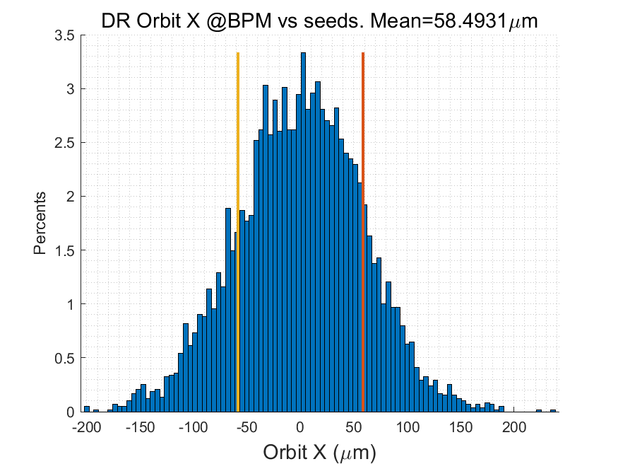

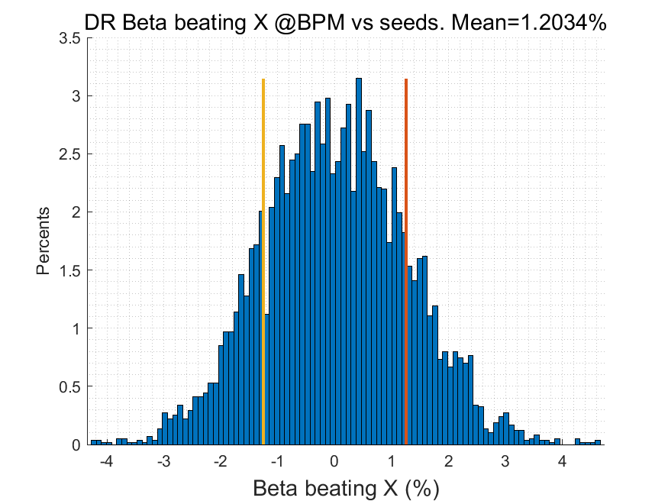
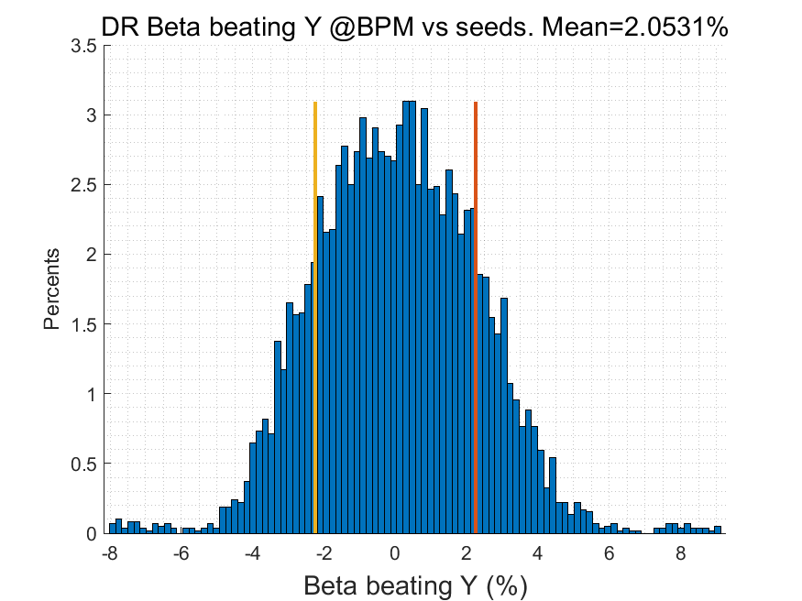
Error study for DR
Daheng Ji, Dou Wang
Orbit correction only
  # BPMs 40
  #Correctors 30+30
RMS@30GeV | X | Y
Orbit (mm) | 0.58 | 0.56
Beta Beating(%) | 1.1 | 2.0
Δ Dispersion(mm) | 6.4 | 2.4

Slide 17
Error study for DR
Daheng Ji, Dou Wang
Orbit correction only
  # BPMs 40
  #Correctors 30+30
RMS@30GeV | X | Y
Orbit (mm) | 0.58 | 0.56
Beta Beating(%) | 1.1 | 2.0
Δ Dispersion(mm) | 6.4 | 2.4
BSC_{x,y}=5σ_{inj_x,y}+5mm
Energy acceptance: 8.3δ_{inj}=1.5%

Slide 18
Further Plan in the EDR
Injection to storage: Filling the gap in the simulation of the entire process commissioning.
  First-turn, injection correction program, longitudinal parameter optimization program, etc.
Fast measurement and correction: The application and evaluation of these fast correction programs for the CEPC Booster will be based on the TBT BPM measurement and correction program.
Optimization of correction elements layout: Reducing costs while maintaining performance
Dynamic errors and drift: jitter/vibration/ground drift ↔ feedback
Abnormal situations: Identification and handling in commissioning process
Notes:
gaps in our research regarding the process from beam injection to beam storage.

Slide 19
Summary
The TME structure (TDR) has the following characteristics
  Use combined magnet to reduce magnet mounts
  Reduce beam emittance
  Error sensitivity is optimized
Error effect and correction simulation
  The error requirements for the hardware system are basically determined
  Error and correction simulation process is clear
  The simulation shows that the linear parameters and DA can meet the requirements
The next study will focus more on the actual commissioning requirements.

Slide 20
Thanks for your attention!

Slide 21
Back up

Slide 22
DR parameters in TDR
Damping with reversed bending magnet
4 (max. 8)-bunch storage, storage time:20 (40) ms
Emittance: 2500→ 166/75 (97/3) mm.mrad
Flexibility for extr. emittance
 | DR V3.0
Energy (Gev) | 1.1
Circumference (m) | 147
Number of trains | 2 (4)
Number of bunches/trian | 2
Total current (mA) | 12.4 (24.8)
Bending radius (m) | 2.87
Dipole strength B₀ (T) | 1.28
U₀ (kev/turn) | 94.6
Damping time x/y/z (ms) | 11.4/11.4/5.7
Phase/cell (degree) | 60/60
Momentum compaction | 0.013
Storage time (ms) | 20 (40)
δ₀ (%) | 0.056
ε₀ (mm.mrad) | 94.4
injection σ_{z} (mm) | 4.4
Extract σ_{z} (mm) | 4.4
ε_{inj} (mm.mrad) | 2500
ε_{ext x/y} (mm.mrad) | 166(97)/75(3)
δ_{inj} /δ_{ext} (%) | 0.18 /0.056
Energy acceptance by RF(%) | 1.8
f_{RF} (MHz) | 650
V_{RF} (MV) | 2.5
Longitudinal tune | 0.0387

Slide 23
Design Parameters of Booster
Extraction |  | tt | H |  | W | Z
 |  | Off axis injection | Off axis injection | On axis injection | Off axis injection | Off axis injection
Beam energy | GeV | 180 | 120 |  | 80 | 45.5
Bunch number |  | 35 | 268 | 261+7 | 1297 | 3978 | 5967
Maximum bunch charge | nC | 0.99 | 0.7 | 20.3 | 0.73 | 0.8 | 0.81
Maximum single bunch current | μA | 3.0 | 2.1 | 61.2 | 2.2 | 2.4 | 2.42
Beam current | mA | 0.11 | 0.56 | 0.98 | 2.85 | 9.5 | 14.4
Bunches per pulse of Linac |  | 1 | 1 |  | 1 | 2
Time for ramping up | s | 7.1 | 4.3 |  | 2.4 | 1.0
Injection duration for top-up (Both beams) | s | 29.2 | 23.1 | 31.8 | 38.1 | 132.4
Current decay in Collider |  | 3%
Energy spread | % | 0.15 | 0.099 |  | 0.066 | 0.037
Synchrotron radiation loss/turn | GeV | 8.45 | 1.69 |  | 0.33 | 0.034
Emittance | nm | 2.83 | 1.26 |  | 0.56 | 0.19
Betatron tune ν_{x}/ν_{y} |  | 321.27/117.19
RF voltage | GV | 9.7 | 2.17 |  | 0.87 | 0.46
Longitudinal tune |  | 0.14 | 0.0943 |  | 0.0879 | 0.0879
RF energy acceptance | % | 1.78 | 1.59 |  | 2.6 | 3.4
Damping time | ms | 14.2 | 47.6 |  | 160.8 | 879
Natural bunch length | mm | 1.8 | 1.85 |  | 1.3 | 0.75
Full injection from empty ring | h | 0.1 | 0.14 | 0.16 | 0.27 | 1.8 | 0.8
Injection |  | tt | H | W | Z
Beam energy | GeV | 30
Bunch number |  | 35 | 268 | 1297 | 3978 | 5967
Bunch charge | nC | 1.1 | 0.78 | 0.81 | 0.87 | 0.9
Single bunch current | μA | 3.4 | 2.3 | 2.4 | 2.65 | 2.69
Beam current | mA | 0.12 | 0.62 | 3.1 | 10.5 | 16.0
Energy spread | % | 0.025
Synchrotron radiation loss/turn | MeV | 6.5
Momentum compaction factor | 10⁻⁵ | 1.12
Emittance | nm | 0.076
Natural chromaticity | H/V | -372/-269
RF voltage | MV | 761.0 | 346.0 | 300.0
Betatron tune ν_{x}/ν_{y} |  | 321.23/117.18
Longitudinal tune |  | 0.14 | 0.0943 | 0.0879
RF energy acceptance | % | 5.7 | 3.8 | 3.6
Damping time | s | 3.1
Bunch length of linac beam | mm | 0.4
Energy spread of linac beam | % | 0.15
Emittance of linac beam | nm | 6.5

