Slide 1



Progress of CEPC Polarization Studies
Zhe Duan
Contributors:
S. H. Chen, T. Chen, D. H. Ji, X. P. Li, W. H. Xia, B. Wang, D. Wang, Y. W. Wang,
D. P. Barber (DESY&UNM),
S. Nikitin (BINP)
Acknowledgement:
E. Forest & D. Sagan on help with Bmad/PTC code.
2023 CEPC Workshop EU Edition, University of Edinburgh, 3-6 July 2023

Slide 2
Content
Introduction
Longitudinally polarized colliding beams at Z-pole
Resonant depolarization
Radiative depolarization at ultra-high energies
Summary

Slide 3
Introduction
This talk is about the design study of beam polarization aspects of CEPC, as a Chapter in the Appendix of CEPC TDR
The contents are based on the CEPC CDR lattices and parameters, and shall be considered as an exploratory study independent from the main trunk of the CEPC TDR at this stage, while the results can be implemented into the CEPC design later.

Slide 4
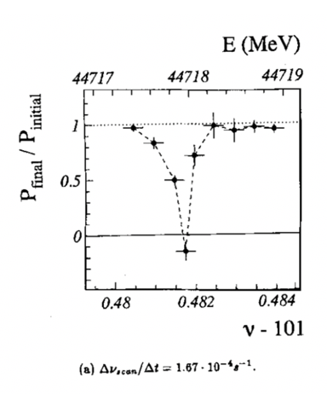
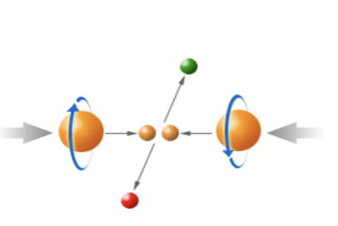
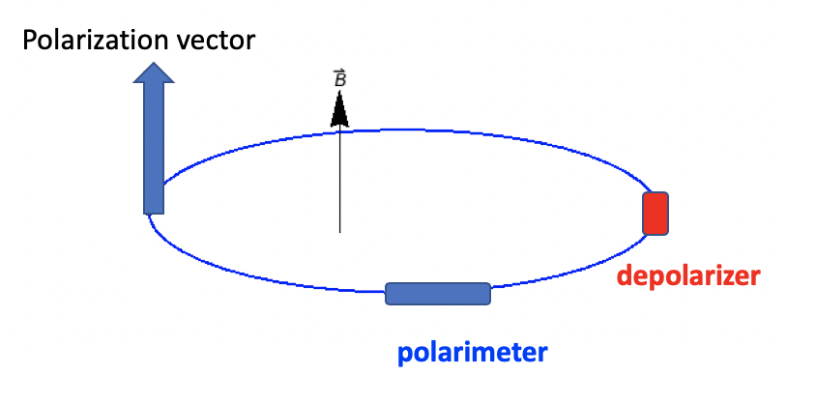
Motivation of CEPC polarized beam program
Vertically polarized beams in the arc
  Beam energy calibration via the resonant depolarization technique
  Essential for precision measurements of Z and W properties
  At least 5% ~ 10% vertical polarization, for both e+ and e- beams
Longitudinally polarized beams at IPs
  Beneficial to colliding beam physics programs at Z, W and Higgs
  Figure of merit: Luminosity * f( Pe+, Pe- )
  ~50% or more longitudinal polarization is desired, for one beam, or both beams
L. Arnaudon, et al., Z. Phys. C 66, 45-62 (1995).
Supported by National Key R&D Program 2018-2023 to design longitudinally polarized colliding beams at Z-pole.

Slide 5
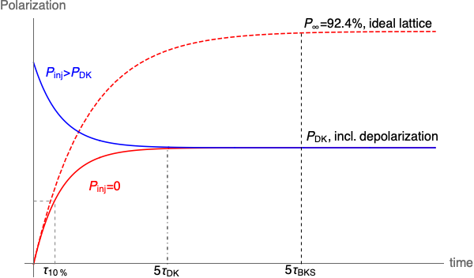


Beam polarization in the collider rings
Non-colliding “pilot” bunches: decay mode
Colliding bunches: top-up injection
Bunch charge
Polarization
$$\frac{1}{τ_{DK}}=\frac{1}{τ_{BKS}}+\frac{1}{τ_{dep}}$$
  If $τ_{DK}≫τ_{b}$, then $P_{avg}≈P_{inj}$
time
Self-polarization can be utilized for RD measurements using pilot bunches
  Employ asymmetric wigglers to reduce the polarization time @Z [1]
To achieve a high-level polarization for colliding bunches without significantly sacrificing luminosity [2]
  Injection of polarized beams is mandatory
CEPC CDR parameters | 45.6 GeV (Z, 2T) | 80 GeV (W) | 120 GeV (Higgs)
Polarization build-up time w/o radiative depolarization $τ_{BKS}$ (hour) | 253 | 15.2 | 2.0
Beam lifetime $τ_{b}$ (hour) | 2.5 | 1.4 | 0.43
[1] The FCC-ee Energy and Polarization Working Group, arXiv:1909.12245v1, 2019.
[2] Zhe Duan, talk on 2nd FCC EPOL Workshop, Sep 29, 2022

Slide 6
Content
Introduction
Longitudinally polarized colliding beams at Z-pole
Resonant depolarization
Radiative depolarization at ultra-high energies
Summary

Slide 7
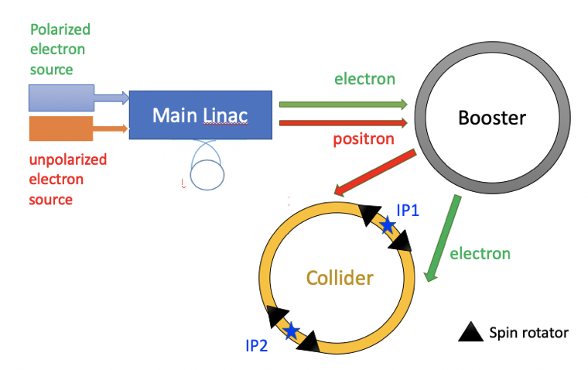

Preparation and injection of polarized electron beam
Compton polarimeter
Assumption: Polarized e- vs. unpolarized e+
State-of-the-art polarized e+ source cannot meet the requirements of top-up injection for CEPC [1]
The design is applicable to e+ when the polarized e+ source becomes technically ready.
Compton polarimeter
[1] P. Musumeci et al., Positron Sources for Future High Energy Physics Colliders, ArXiv:2204.13245 Phys. (2022).

Slide 8
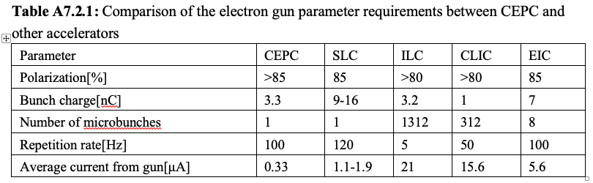
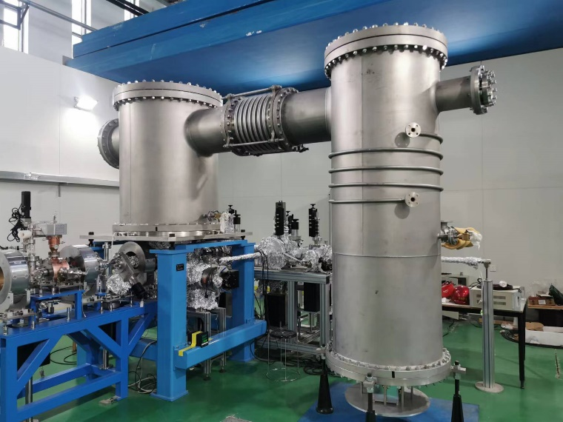
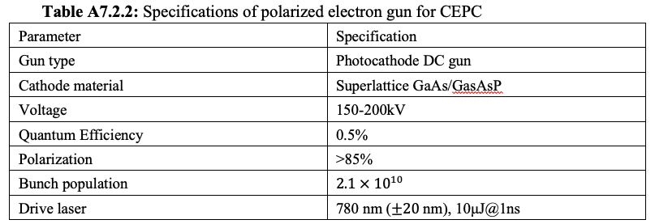
Polarized electron source
Using state-of-the-art technology, polarized electron gun can supply > 85% polarization and satisfy injection requirements of CEPC.
Photocathode DC gun @ PAPS can provide a basis for R&D of polarized electron beam generation.
Polarized electron gun
Wien filter
Mott polarimeter
bend
Main linac
Unpolarized electron gun
bend
Photocathode DC gun @ PAPS

Slide 9
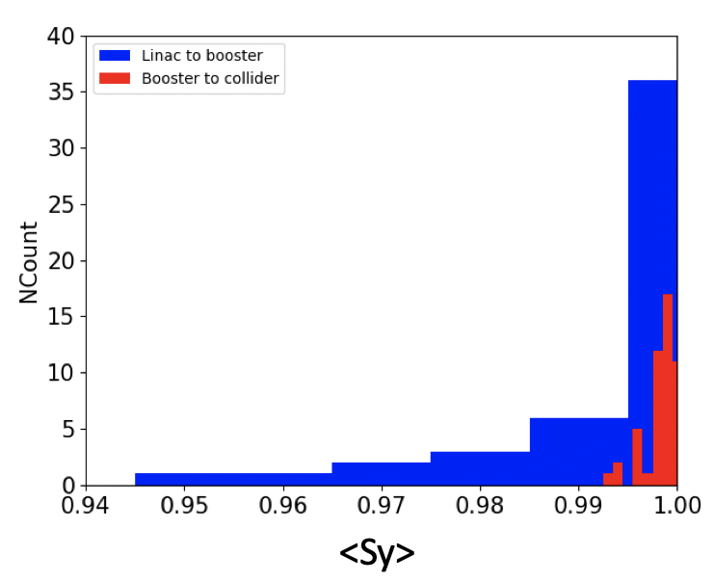
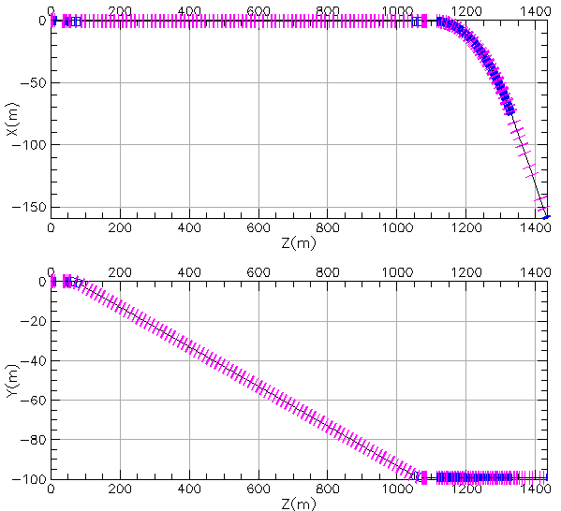
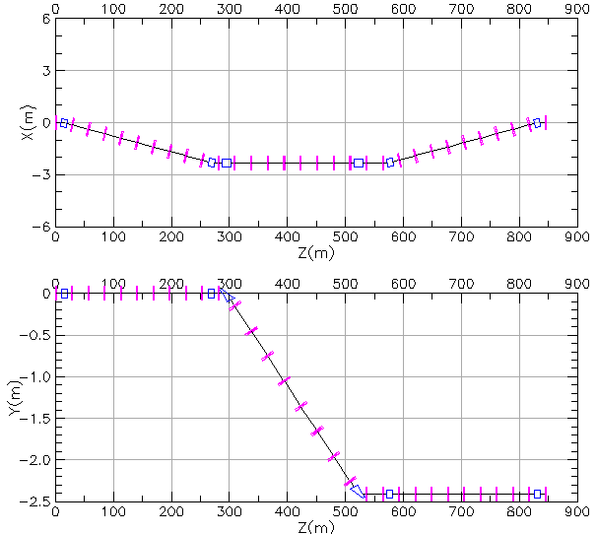


Polarization transmission in the linac & transport lines
  Depolarization in the linac is expected to be negligible[1,2].
  Transport lines (polarization loss < 10%)
    non-interleaved horizontal bending & vertical bending
    Typical errors without trajectory correction
$$\hat{n}$$
$$\vec{S}$$
Mismatch at injection
Linac to booster transport line
Booster to ring transport line
rms vertical trajectory set to 2mm
[1] G. Moortgat-Pick, et al., Polarized positrons and electrons at the linear collider, Physics Reports 460 (2008) 131-243.
[2] M. Woods, The polarized electron beam for the SLAC Linear Collider, arXiv:heps-ex/9611006v1, 1996

Slide 10
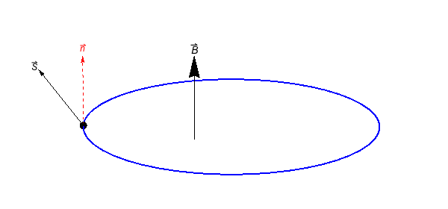
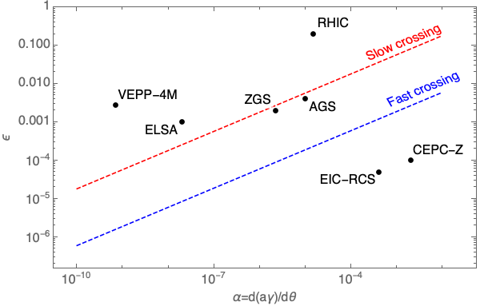
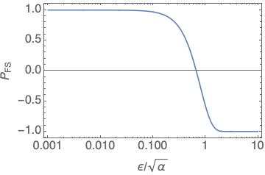
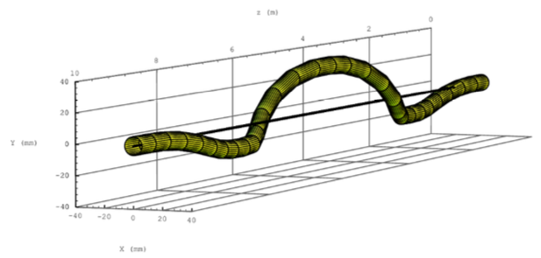
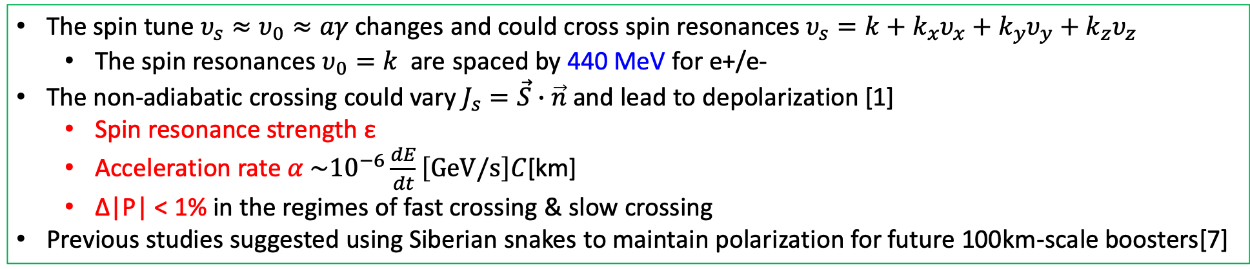
Depolarization in the booster
The spin tune $υ_{s}≈υ_{0}≈aγ$ changes and could cross spin resonances $υ_{s}=k+k_{x}υ_{x}+k_{y}υ_{y}+k_{z}υ_{z}$
  The spin resonances $υ_{0}=k$ are spaced by 440 MeV for e+/e-
The non-adiabatic crossing could vary $J_{s}=\vec{S}∙\vec{n}$ and lead to depolarization [1]
  Spin resonance strength ε
  Acceleration rate $α \sim {10}^{−6}\frac{dE}{dt}\left[GeV/s\right]C$[km]
  Δ|P| < 1% in the regimes of fast crossing & slow crossing
Previous studies suggested using Siberian snakes to maintain polarization for future 100km-scale boosters[7]
Fast crossing
Slow crossing
Spin precession
Orbit motion in a helical snake @ RHIC
[1] Froissart and Stora, NIM 7, 297 (1960) [2] A. K. Barladyan, et al., PRAB 22, 112804, (2019)
[3] S. Nakamura, et al., NIM A 411, 93 (1998) [4] T. Khoe et al., Part. Accel. 6, 213 (1975)
[5] Configuration Manual: Polarized Proton Collider at RHIC, 2006 [6] V. Ranjbar, et al., PRAB 21, 111003 (2018)
[7] I. Koop et al., Phys. Part. Nucl. Lett. 13. 7 (2016); S. Nikitin, IJMPA 34, 1940004(2019); IJMPA 35, 2041001 (2020).
Data from Ref [2-6]

Slide 11
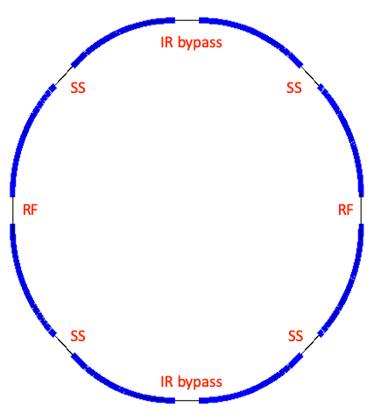
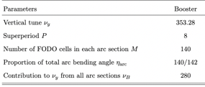
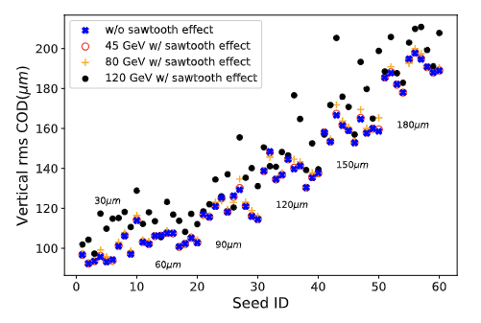
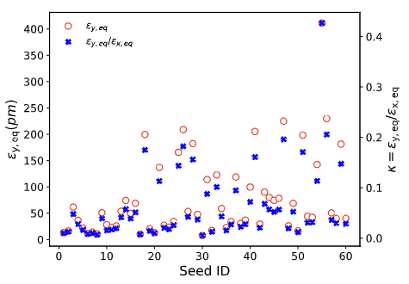
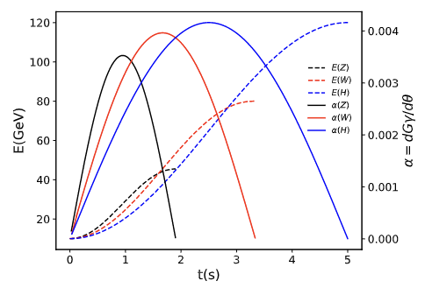
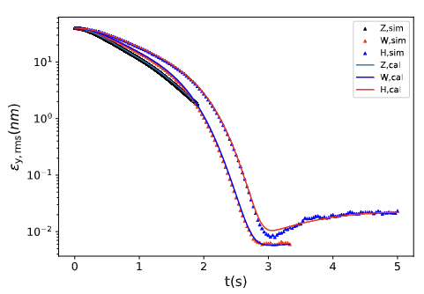
Setup of CEPC booster lattice
Arc region covers ~ 80% of circumference
General structure of the CEPC booster lattice (an alternative design)
  8 arcs each containing 140 FODO cells
  interleaved with 8 straight sections
60 imperfection lattice seeds
  Misalignment error & field error, scan BPM offset
  Closed orbit correction & tune correction
Multi-particle tracking in Bmad
  Energy and RF ramping in the whole process
  Element-by-element tracking with radiation damping & quantum excitation
[1] T. Chen, Z. Duan, D. H. Ji, D. Wang, Phys. Rev. Accel. Beams, 26, 051003 (2023).

Slide 12
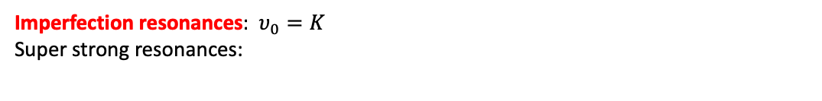
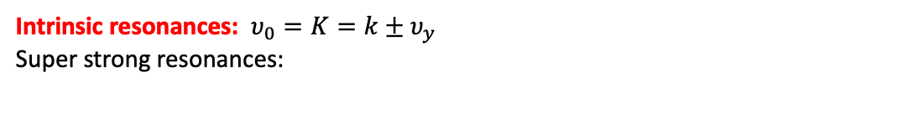
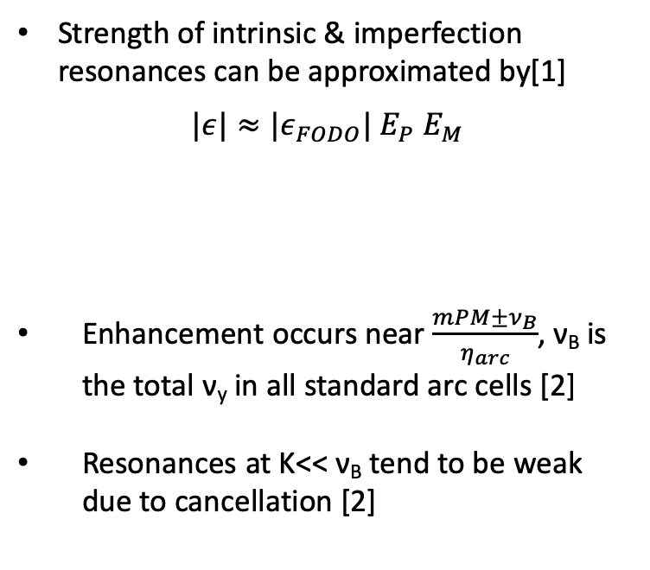
Spin resonance structure
Strength of intrinsic & imperfection resonances can be approximated by[1]
$$|ε|≈{|ε}_{FODO}| E_{P} E_{M}$$
Enhancement occurs near $\frac{mPM±ν_{B}}{η_{arc}}$, ν_{B} is the total ν_{y} in all standard arc cells [2]
Resonances at K<< ν_{B} tend to be weak due to cancellation [2]
Intrinsic resonances: $υ_{0}=K=k±υ_{y}$
Super strong resonances:
due to M identical FODOs in each arc
due to P superperiods
Imperfection resonances: $υ_{0}=K$
Super strong resonances:
[1] S. Y. Lee, Spin dynamics and snakes in synchrotrons (World Scientific, 1997).
[2] T. Chen, Z. Duan, D. H. Ji, D. Wang, Phys. Rev. Accel. Beams, 26, 051003 (2023).

Slide 13
Depolarization effects: simulation vs. estimation
In the acceleration to Z & W
  The spin resonances are generally weak
  Polarization is mostly maintained
  Estimations agree fairly well with simulations
In the acceleration to H
  The spin resonances become stronger at higher energies
  Severe depolarization occurs
  Mitigation methods to be explored
Z-mode
W-mode
H-mode
This study supports injecting highly polarized beams into the collider rings as a very attractive solution, for applications @ Z & W.
[1] T. Chen, Z. Duan, D. H. Ji, D. Wang, Phys. Rev. Accel. Beams, 26, 051003 (2023).

Slide 14
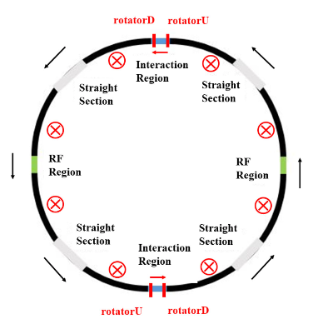
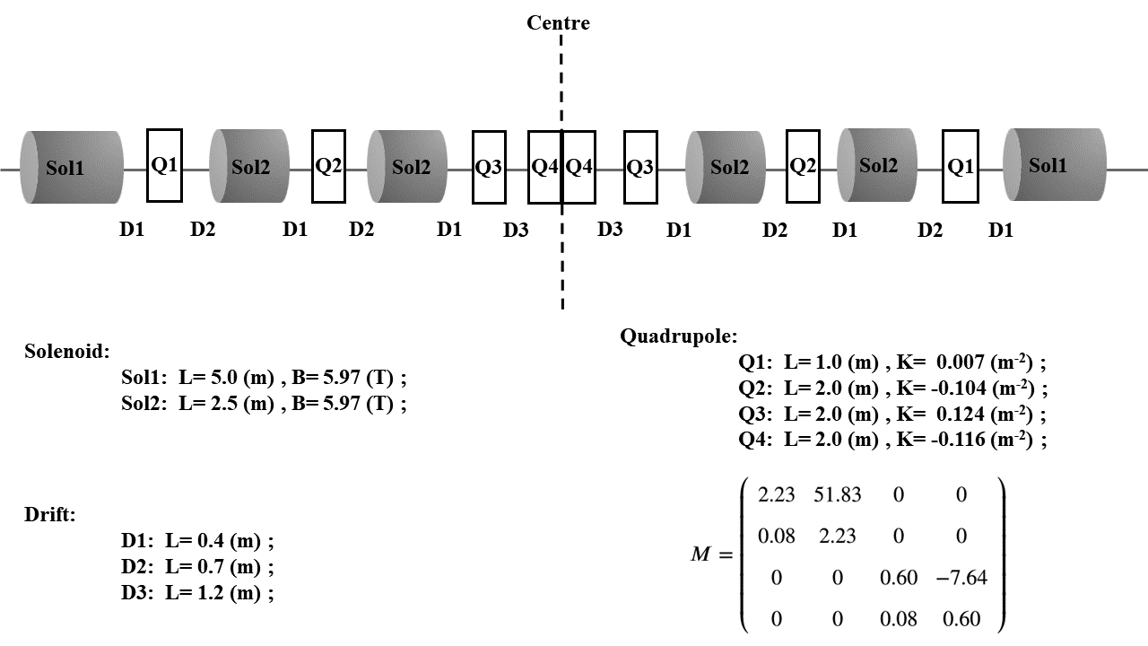
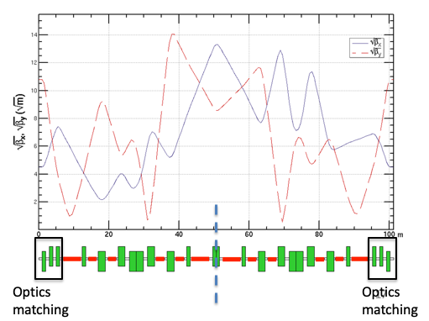
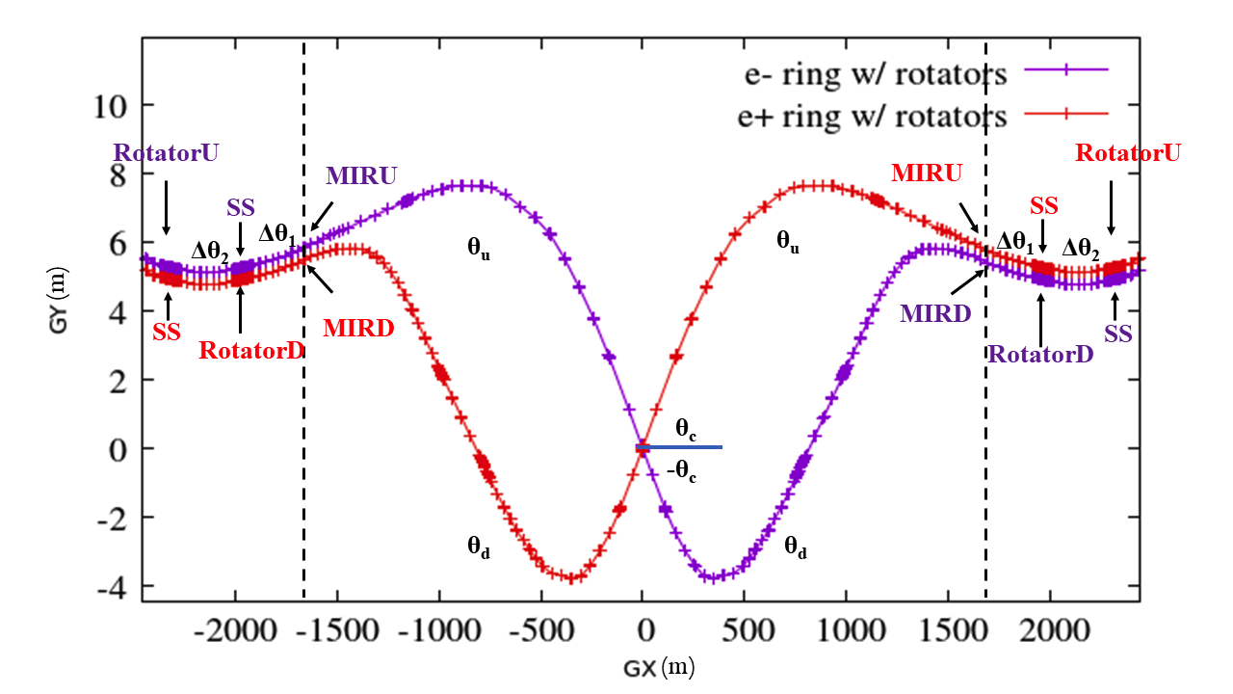
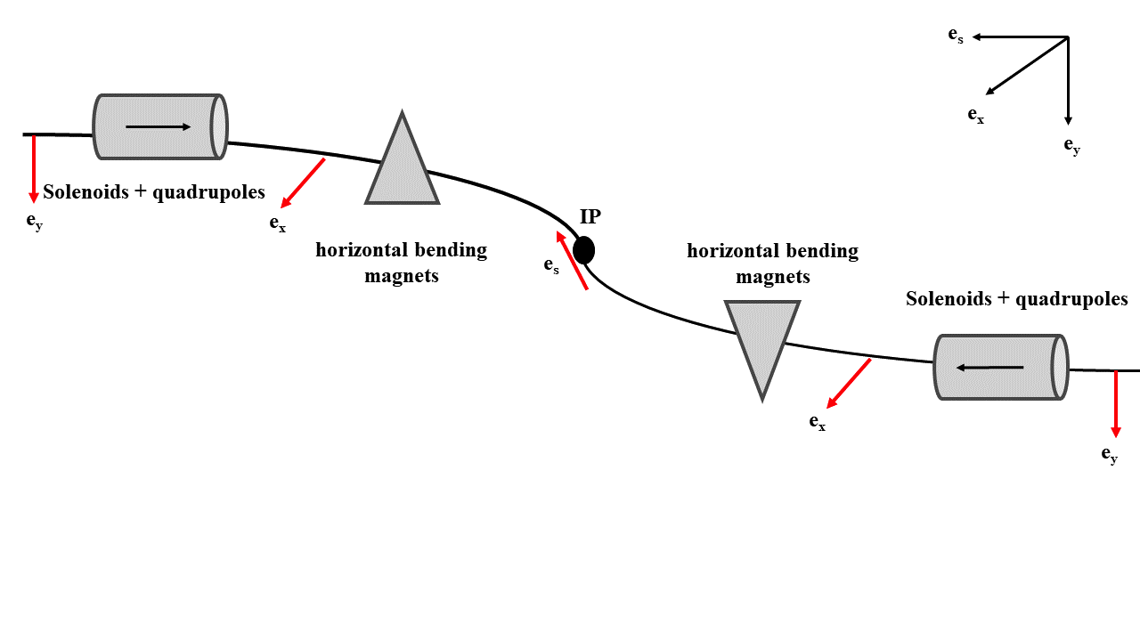
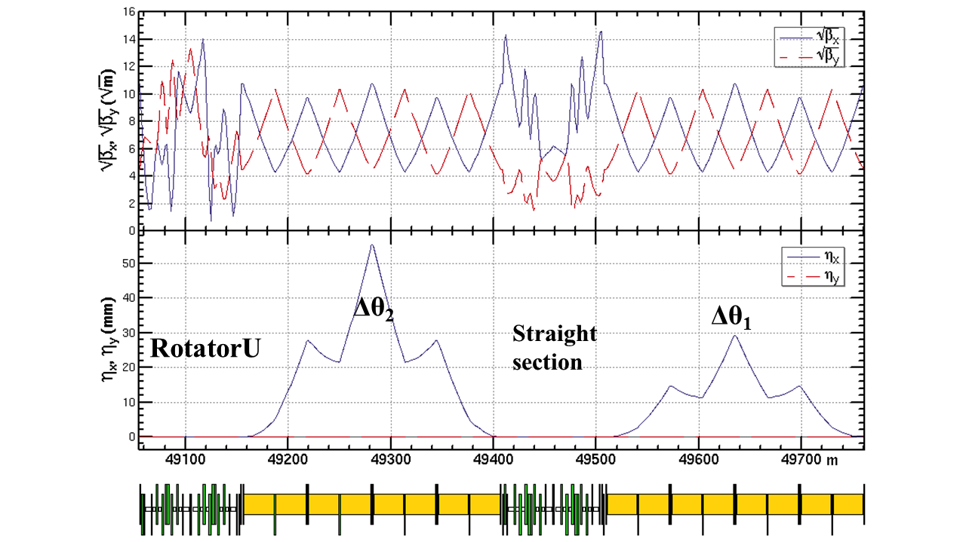
Spin rotators in the collider ring at Z-pole
Solenoid-based spin rotator + anti-symmetric arrangement [1,2,3,4]
solenoids: 240 T m, Lsol = 40m @ 6T
two modules: ~100 m
2.65 mrad
1.39mrad
[1] D. Barber, et al., A solenoid spin rotator for large electron storage rings. Part. Accel. 17 (1985) 243. [2] I. Koop, Longitudinally polarized electron in SuperB, eeFACT’08 [3] S. Nikitin, Opportunities to obtain polarization at CEPC, IJMPA, 34, 194004 (2019) [4] W. Xia et al., Radiat. Det. Tech. Meth. 6:490 (2022).

Slide 15
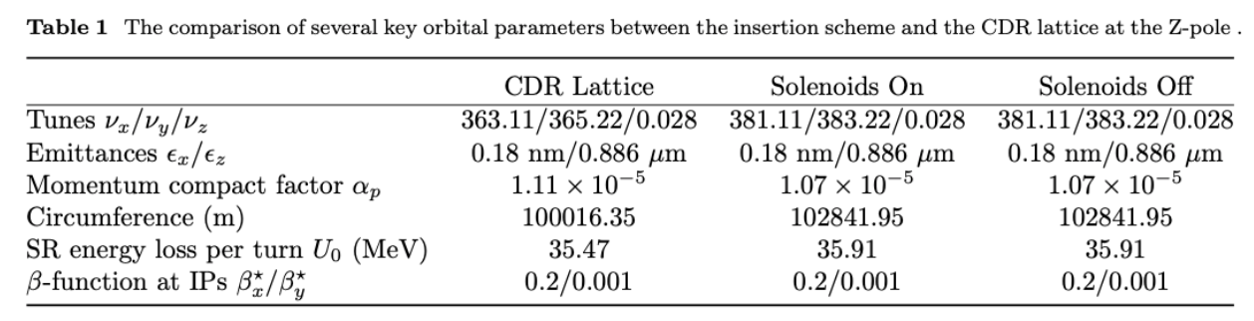
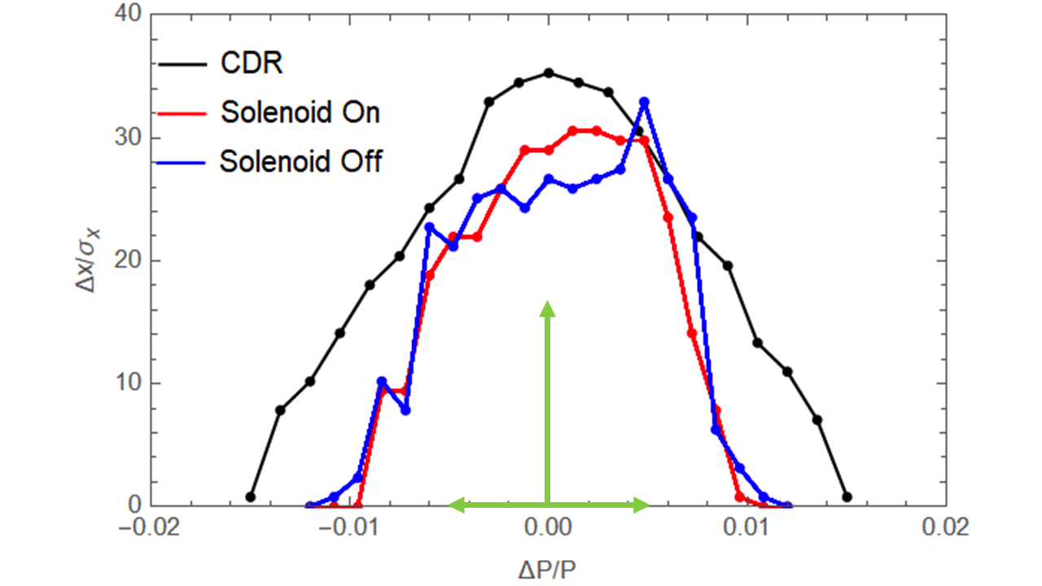
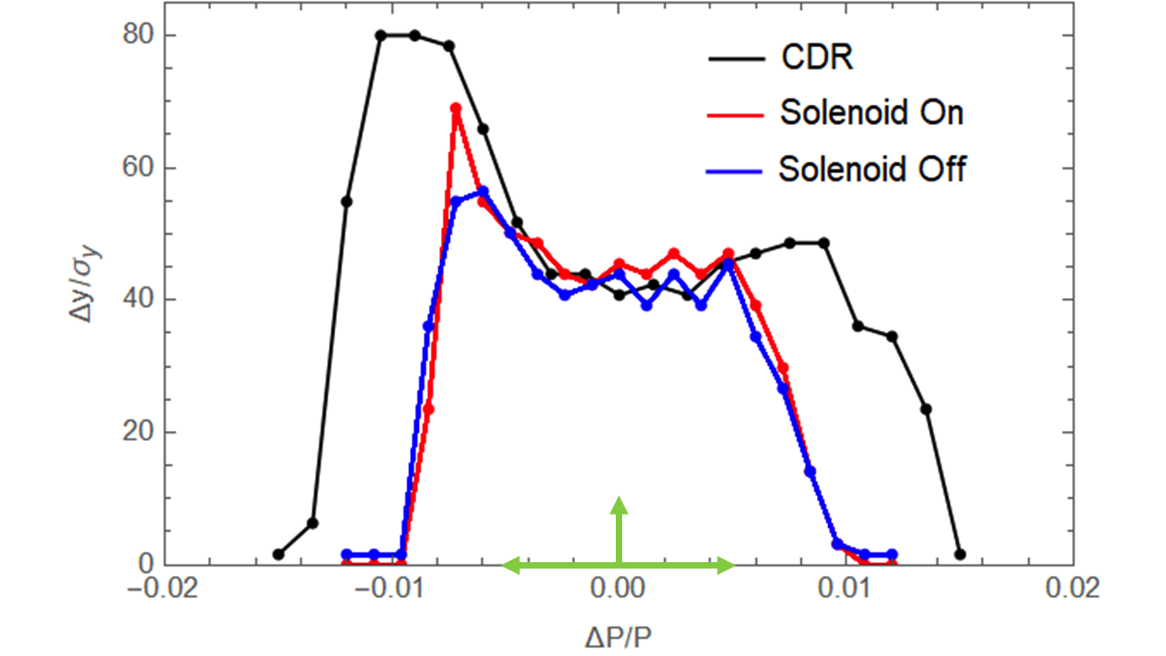
Performance evaluation: orbital motion
Changes in optics parameters
  Increase of circumference ~ 2.8 km, can be optimized.
  Increase of integer betatron tunes by 18 units
Moderate reduction in dynamic aperture and local momentum acceptance
Further optimization using more sextupole families could help recover
[1]W. Xia et al., Radiat. Det. Tech. Meth. 6:490 (2022).

Slide 16
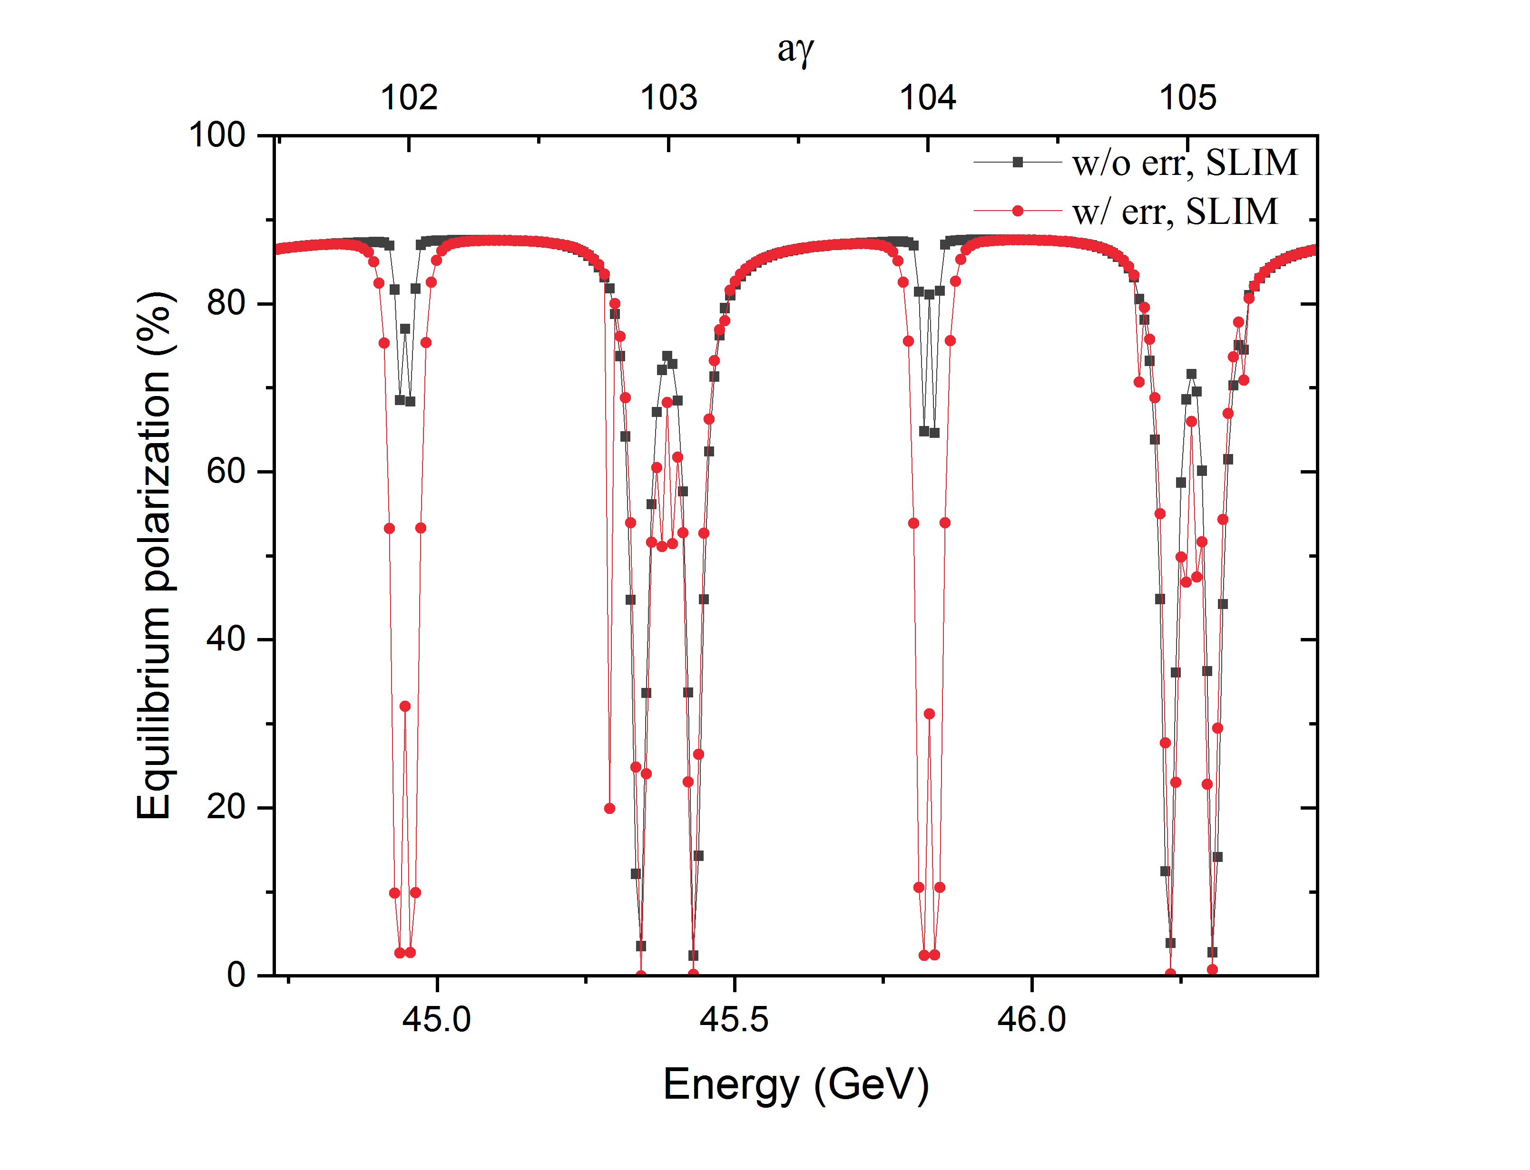
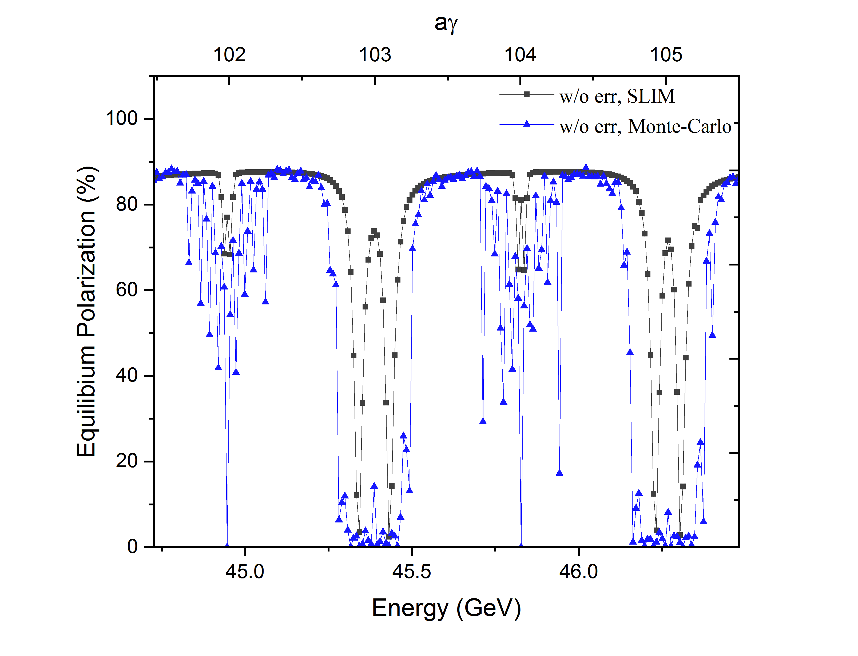
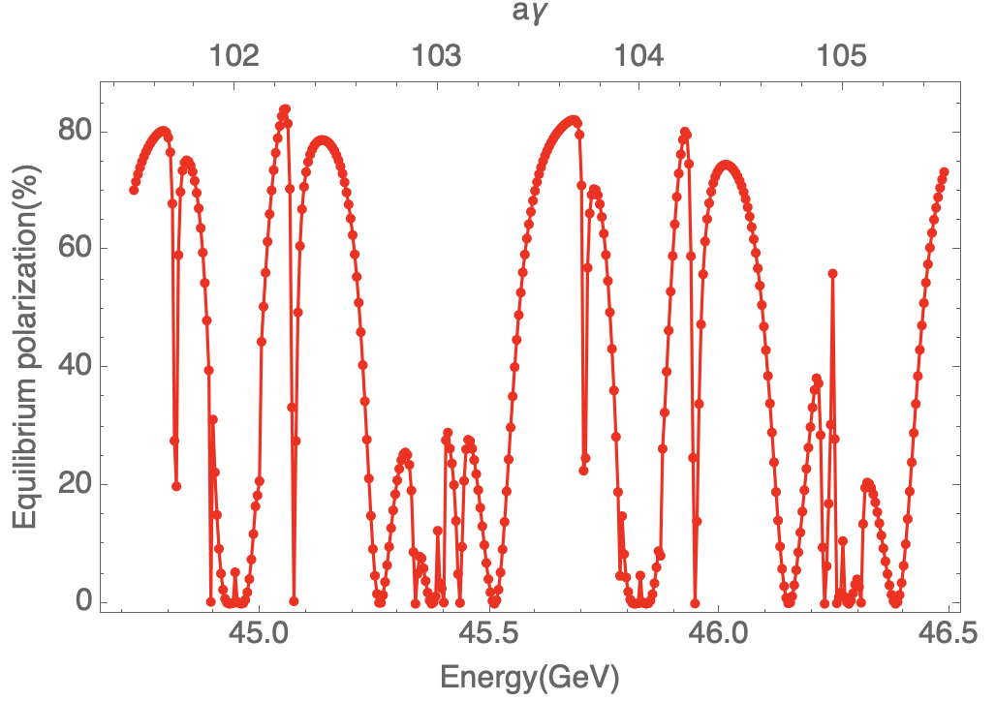
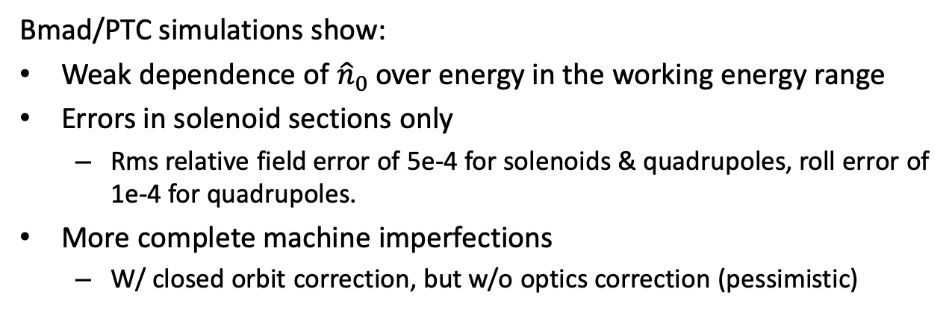
Performance evaluation: polarization
Bmad/PTC simulations show:
Weak dependence of ${\hat{n}}_{0}$ over energy in the working energy range
Errors in solenoid sections only
  Rms relative field error of 5e-4 for solenoids & quadrupoles, roll error of 1e-4 for quadrupoles.
More complete machine imperfections
  W/ closed orbit correction, but w/o optics correction (pessimistic)
w/ errors in solenoid sections
w/ more complete imperfections and closed orbit correction
[1]W. Xia et al., Radiat. Det. Tech. Meth. 6:490 (2022).

Slide 17
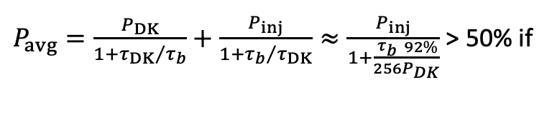
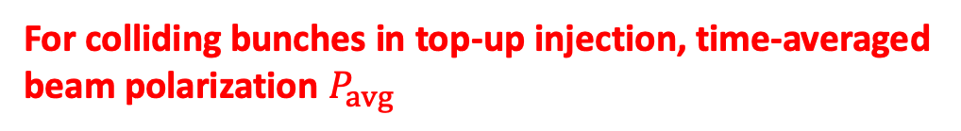
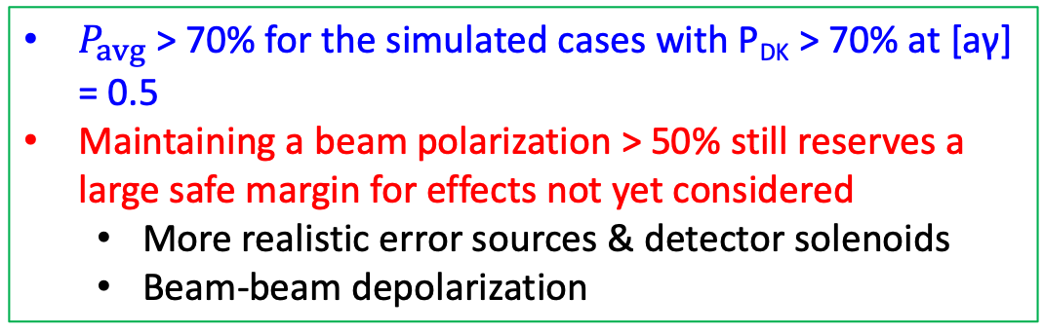
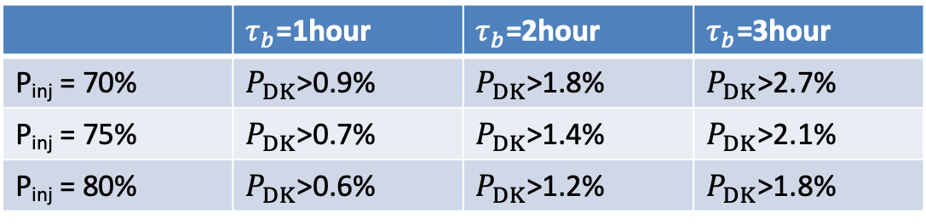
Time-averaged polarization for colliding bunches
Polarization transmission
For colliding bunches in top-up injection, time-averaged beam polarization $P_{avg}$
Polarized e- source
Polarization >85%
Ref: ILC, EIC
Linac and transport lines
Polarization loss < 10%
Ref: SLC, ILC
Booster
Polarization loss < 5%
Collider
P_{inj} > 70% after considering these factors
$P_{avg}=\frac{P_{DK}}{1+{τ_{DK}}/{τ_{b}}}+\frac{P_{inj}}{1+{τ_{b}}/{τ_{DK}}}≈\frac{P_{inj}}{1+\frac{τ_{b}}{256}\frac{92\%}{P_{DK}}}$ > 50% if
 | $τ_{b}$=1hour | $τ_{b}$=2hour | $τ_{b}$=3hour
P_{inj} = 70% | $P_{DK}$>0.9% | $P_{DK}$>1.8% | $P_{DK}$>2.7%
P_{inj} = 75% | $P_{DK}$>0.7% | $P_{DK}$>1.4% | $P_{DK}$>2.1%
P_{inj} = 80% | $P_{DK}$>0.6% | $P_{DK}$>1.2% | $P_{DK}$>1.8%
$P_{avg}$ > 70% for the simulated cases with P_{DK} > 70% at [aγ] = 0.5
Maintaining a beam polarization > 50% still reserves a large safe margin for effects not yet considered
  More realistic error sources & detector solenoids
  Beam-beam depolarization

Slide 18
Content
Introduction
Longitudinally polarized Colliding beams at Z-pole
Resonant depolarization
Radiative depolarization at ultra-high energies
Summary

Slide 19
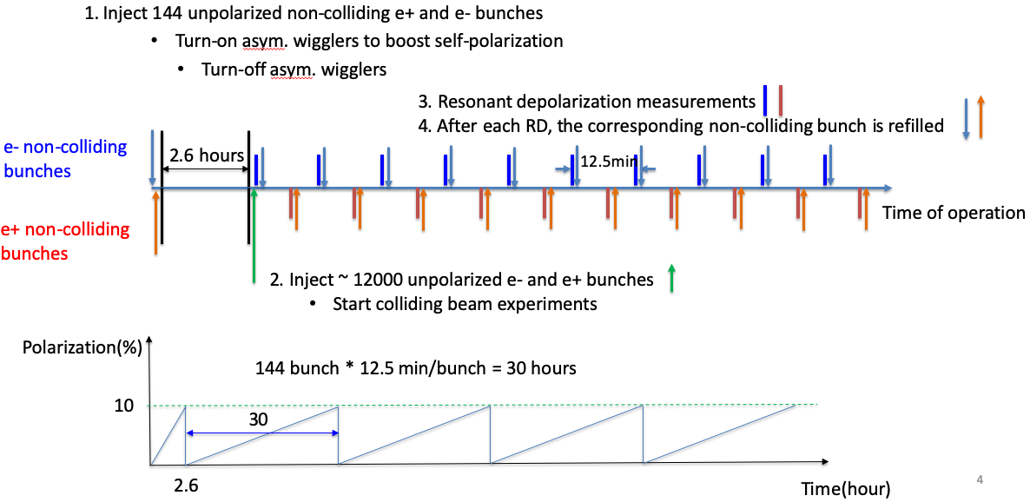
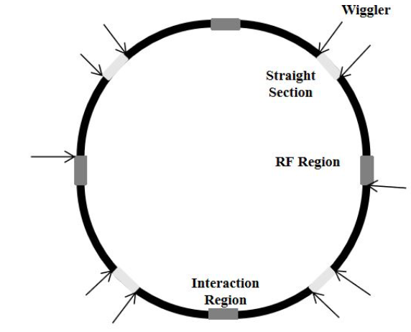
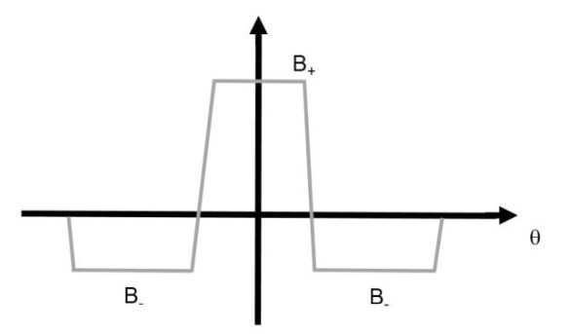
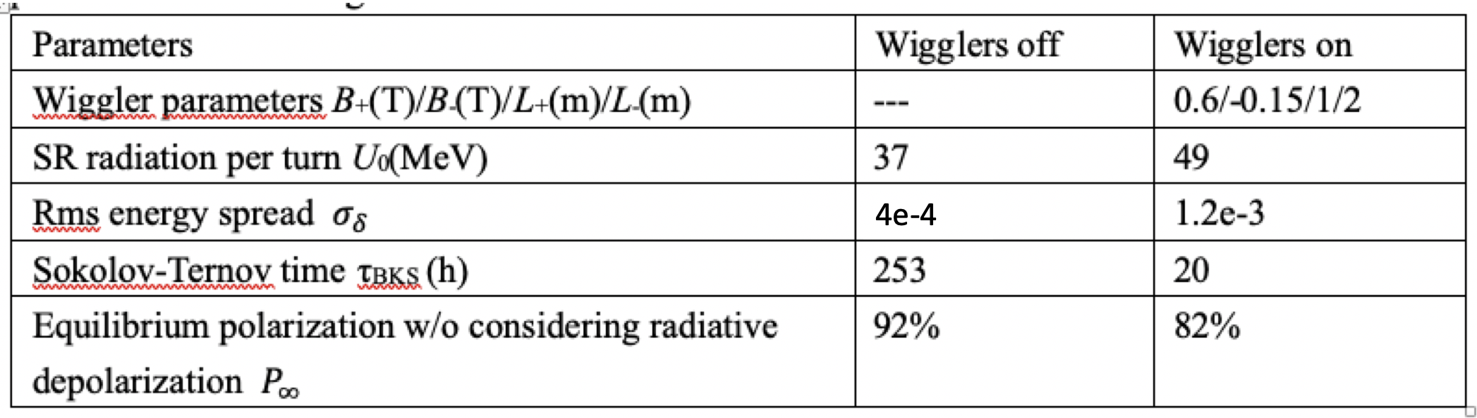
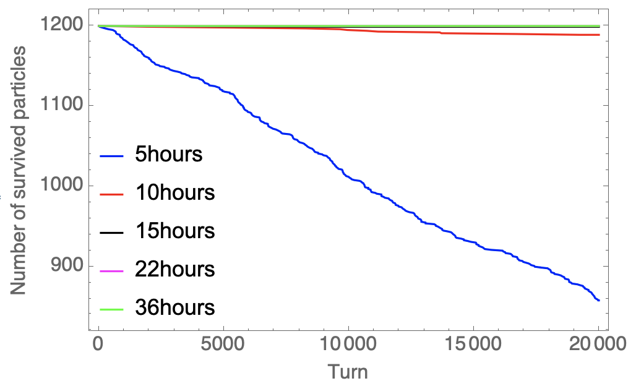
Polarized beams for Resonant Depolarization at Z-pole
Scenario 1: Self-polarization enhanced by asymmetric wigglers [1]
Implementation of the asymmetric wigglers into the CDR lattice w/ spin rotators
The lifetime limited by the dynamic aperture is not an issue for the above wiggler settings
[1] The FCC-ee Energy and Polarization Working Group, arXiv:1909.12245v1, 2019.

Slide 20
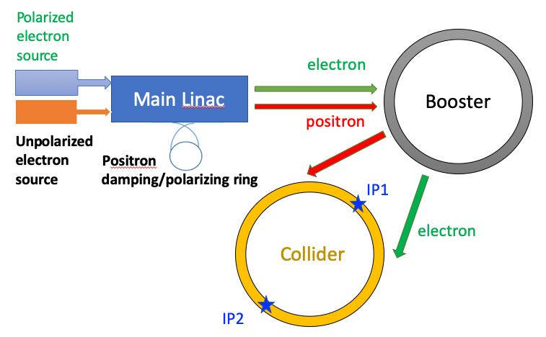
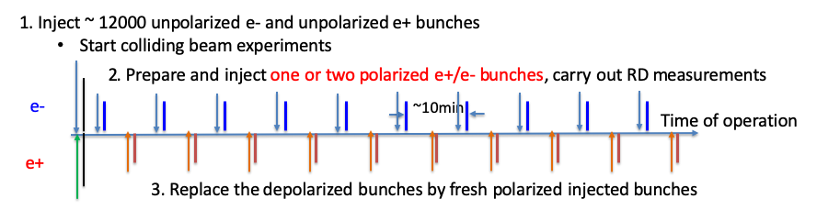
Polarized beams for Resonant Depolarization at Z-pole
Scenario 2: Injecting polarized e+/e- beams [2]
Scenarios |  | Self-polarization in the collider[1] | Injection of polarized beams[2]
Hardware | Polarized electron gun | None | Yes
 | Asymmetric wigglers | In the colliders | In the e+ damping ring
Polarization level |  | 5% ~ 10% | > 70% for e-, > 20% e+
Dead time for physics |  | Initial 1~2 hours in each fill | None
Frequency of RD measurements |  | Every ~10 min per beam | More frequent for e- beam
RD on colliding beams |  | None | Possible at lower bunch charge
[1] The FCC-ee Energy and Polarization Working Group, arXiv:1909.12245v1, 2019.
[2] Zhe Duan et al., Proc. eeFACT 2022, Proc. IPAC 23.

Slide 21






e+ damping/polarizing ring
DR V4.0 | unpolarized e+ | polarized e+
Energy (Gev) | 1.542
Circumference (m) | 144.2
Number of trains | 2(4)
Number of bunches/trian | 1(2)
Total current (mA) | 12.4
Bending radius (m) | 3.44
Dipole strength B₀ (T) | 1.07
Wiggler strength B₊ (T) | 1.8
Wiggler cell length (m) | 1.5
U₀ (kev/turn) | 190.9
Damping time x/y/z (ms) | 7.77/7.77/3.89
Momentum compaction | 0.015
Storage time | 20 ms | 10 min
δ₀ (%) | 0.072
ε₀ (mm.mrad) | 138
injection σ_{z} (mm) | 6
Extract σ_{z} (mm) | 5.7 | 5.6
ε_{inj} (mm.mrad) | 2500
ε_{ext x/y} (mm.mrad) | 151/15 | 138/14
δ_{inj} /δ_{ext} (%) | 0.18 /0.072
RF acceptance (%) | 1.8
f_{RF} (MHz) | 650
V_{RF} (MV) | 3.95
Longitudinal tune | 0.044
+1(2)
Asymmetric wigglers
B₊=1.8T=-5 B₋
cell length=1.5m
16 such cells
[1] Z. Duan et al., eeFACT 2022, IPAC 2023

Slide 22
Content
Introduction
Longitudinally polarized Colliding beams at Z-pole
Resonant depolarization
Radiative depolarization at ultra-high energies
Summary

Slide 23




Radiative depolarization in electron storage rings
Radiative depolarization characterized by $τ_{d}$ exhibits two phenomenon in previous measurements:
  Dips near spin resonances
  More difficult to achieve a high polarization at higher energies
    Stronger first-order spin resonances
    Enhanced higher-order synchrotron-sideband resonances
  $P_{DK}≈\frac{P_{∞}}{1+τ_{p}/τ_{d}}$, $\frac{1}{τ_{DK}}=\frac{1}{τ_{p}}+\frac{1}{τ_{d}}$
The SPEAR electron polarization for different beam energies[1]
Electron polarization measurements in different machines [2]
[1] J. R. Johnson, et al., Nucl. Instrum. Meth 204, 261 (1983).
[2] R. Assmann, et al., AIP Conference Proceeding, 570, 169 (2001).

Slide 24






Radiative depolarization in ultra-high-energy storage rings
Two distinct spin diffusion mechanisms were proposed in [1] in 1970s, regarding the regimes of spin resonance crossing, in the combined effects of synchrotron oscillation and synchrotron radiation
Regime | Correlated regime (consistent with existing measurements) | Uncorrelated regime (not yet confirmed by experiments)
Condition | $$κ=\frac{υ_{0}^{2}λ_{p}}{υ_{z}^{3}}≪1$$ | $κ=\frac{υ_{0}^{2}λ_{p}}{υ_{z}^{3}}≪1$ is violated and $\frac{υ_{0}σ_{δ}}{υ_{z}}≫1$
Theory | Non-resonant spin diffusion & perturbative treatment of $\frac{∂\hat{n}}{∂δ}$ | Resonant spin diffusion
Depolarization effect | Higher-order synchrotron sideband spin resonances | No dependence on $υ_{z}$, weaker depolarization
Monte-Carlo simulations were compared with these theories in the energy range of CEPC [2]
  showing a gradual evolution from the correlated regime to the uncorrelated regime in parameter scan
This study suggests existing theories are incomplete, requiring further development
Case A: dependence on beam energy
Case B: influence of harmonic RF cavity
Z
Higgs
optimal lengthening condition
Scan harmonic RF voltage
$$κ=\frac{{\text{ν}}_{0}^{2}λ_{p}}{{\text{ν}}_{z}^{3}}→∞$$
[1] Derbenev, Kondrantenko and Skrinsky, Part. Accel. 9, 247 (1979)
[2] W. H. Xia, Z. Duan, D. P. Barber, Y. W. Wang, B. Wang, J. Gao, accepted by Phys. Rev. Accel. Beams.

Slide 25



Uncorrelated regime of spin resonance crossing
Prediction of the theory of resonant spin diffusion [1]
  Assume the adjacent two integer resonances have the same strength
  Influence of first-order betatron spin resonances are not included
120
180
120
180
Is it possible to have a few percent polarization at Higgs or even ttbar energies?
In collaboration with Yi Wu (EPFL & CERN) on spin bumps for ultra-high energies.
[1] Derbenev, Kondrantenko and Skrinsky, Part. Accel. 9, 247 (1979)

Slide 26
Content
Introduction
Longitudinally polarized Colliding beams at Z-pole
Resonant depolarization
Radiative depolarization at ultra-high energies
Summary

Slide 27
Summary
We’ve studied the approach of preparation of polarized beam from the source, transmission in the injector and injection into the collider ring, which promises high-level injected beam polarization for applications.
Longitudinally polarized colliding beams at Z-pole have been designed for CEPC CDR lattice and parameters.
Two different scenarios of polarized beam generation for RD measurements have been investigated.
Some theoretical and simulation studies of depolarization effects in booster & collider rings.

Slide 28
Future work in the EDR stage
For the longitudinally polarized colliding beams:
  Identify the boundary conditions that spin rotators and polarimeters be implemented into a future version of the collider ring lattice, help the lattice designers devise a lattice version with the possibility to insert spin rotators at a later stage.
  Clarify the hardware specifications of polarized electron sources, asymmetric wigglers, solenoid spin rotators, and discuss with related hardware systems to establish a long-term plan for hardware design and R&D.
For the resonant depolarization measurements:
  Continue simulation studies of the RD process and the analysis of the errors in beam energy calibration.
  Carry out RD experiments at BEPCII & HEPS booster

Slide 29
Your comments and suggestions are highly appreciated!

