Slide 1
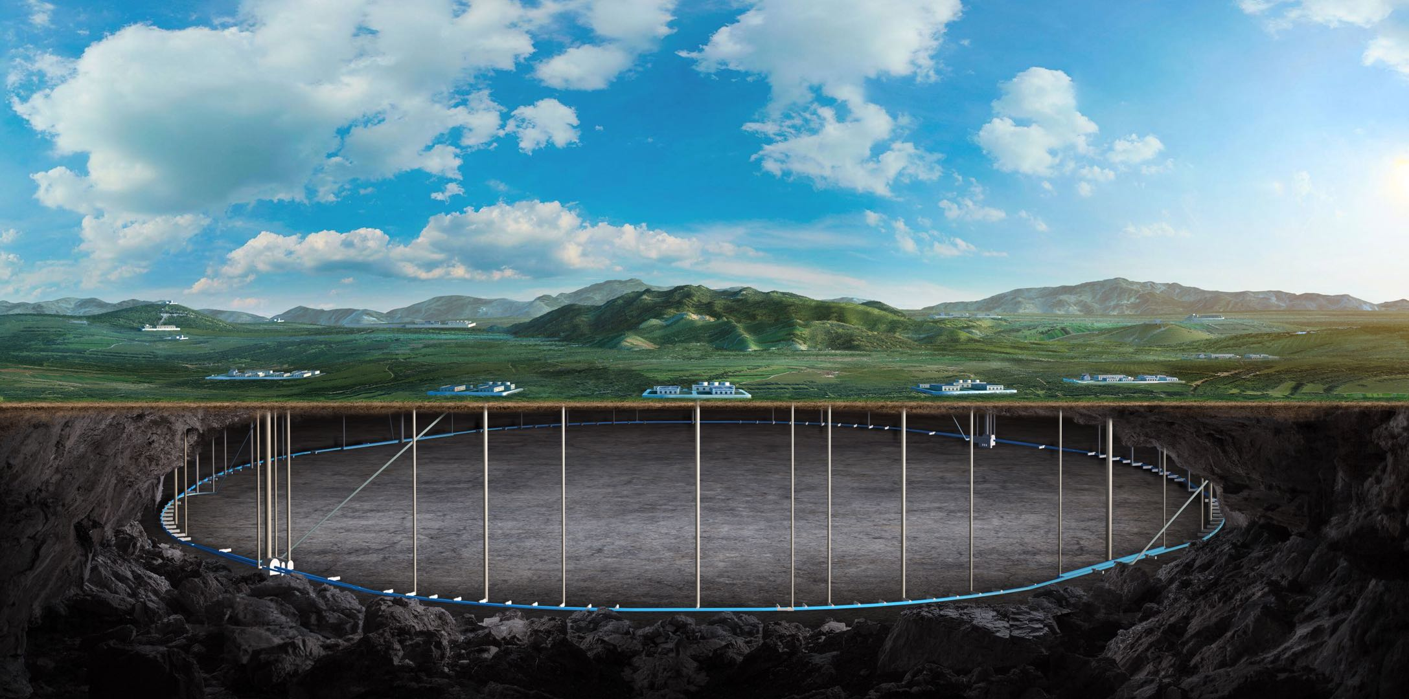
CEPC parameters and its possible applications to multidisciplinary science
Yuhui Li
03-06. July, Edinburgh, 2023 International Workshop on the Circular Electron Positron Collider

Slide 2
Content
CEPC serving as an ultra-high energy gamma source
Beam parameters
Radiation characters
Impact to the beam and mitigation measures
Conceptual design for the extraction system
Possible applications
CEPC potential as an ultra high energy FEL facility
Schematic plan and beam parameters
Start-to-end simulation results
FEL parameters optimization and selection
FEL simulations and indicators

Slide 3
CEPC as a gamma-ray SR facility

Slide 4
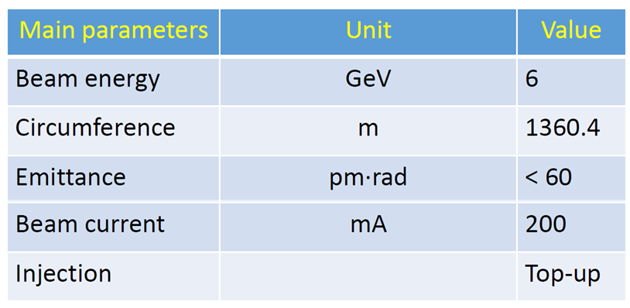
Beam parameters
Beam parameters of CEPC
Beam parameters of HEPS @ Beijing
CEPC parameter
Beam Energy (GeV) | 120
Circumference (km) | 100
Emittance (pm rad) | 640
Beam Current (mA) | 16.7
Injection | Top-up
Making CEPC a photon source for intensive ultra-high energy gamma-rays
Synchrotron Radiation (SR) critical frequency proportional to energy square and magnet field
In a conventional SR facility, the beam energy stays lower than 10 GeV level, resulting in a maximum photon energy in the level of 100 keV.
Due to the high beam energy, which is approximately 120 GeV, the photon energy reaches a level of 100 MeV
$$ω_{c}=\frac{3γ^{3}c}{2ρ} \underset{→}{ρ=\frac{m_{e}cγ}{eB}} ω_{c}=\frac{3γ^{2}eB}{2m_{e}}$$

Slide 5
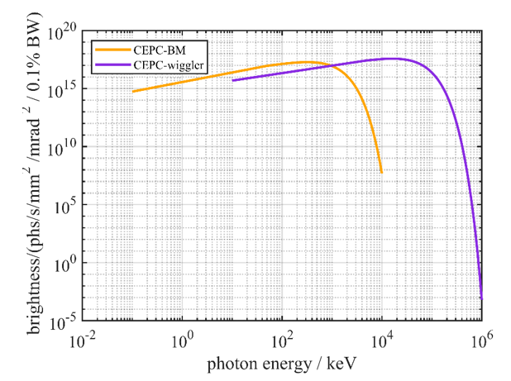
Radiation Spectrum
100 keV
100 MeV
SR sources:
Wiggler parameter
B (T) | 2
Total length (m) | 0.32
Magnetic period Length (m) | 0.32
Period number | 1
K value | 59.7
characteristic energy (MeV) | 19.2
Bending magnet
B (T) | 0.04
Length (m) | 20
Critical energy (keV) | 383
Angular Density of Spectral Flux: [Ph/s/mr/0.1%bandwidth]
Bending magnets generate intensive x-ray photon with energy around 100 keV
Wiggler with 2T generates gamma-ray in the level of 100 MeV
$$G_{1}(y)≈\left\{\begin{aligned}{(ω/ω_{c})}^{1/3}\text{,}ω≪ω_{c} \\ \exp\left(−\frac{ω}{ω_{c}}\right),ω≫ω_{c}\end{aligned}\right.$$

Slide 6
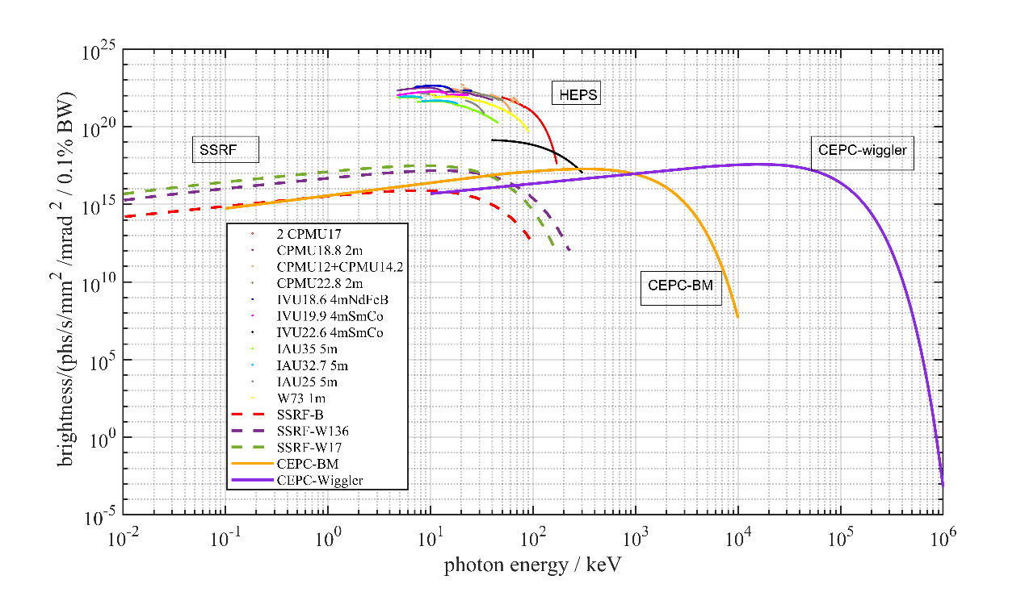
Comparison with other x/γ -ray source
Compare to the SSRF, HEPS, (China) and oversea gamma-ray sources, CEPC provides much wider energy range, higher intensity, and maximum photon energy
Source | CEPC BM | CEPC Wiggler | SSRF (China) | TUNL -HIGS (USA) | TERAS (Japan) | ALBL (Spain)
Gamma energy range(MeV) | 0.1~5 | 0.1~100 | 0.4-20 330-550 | 2-100 | 1-40 | 0.5-16 16-110 250-530
Enenergy resolution (Delta E/E) | continuous | continuous | 5% | 0.8~10%
Flux | >1e12@0.1% | >1e16@0.1% | 1e6 | 1e8 | 1e4-1e5 | 1e5 - 1e7

Slide 7
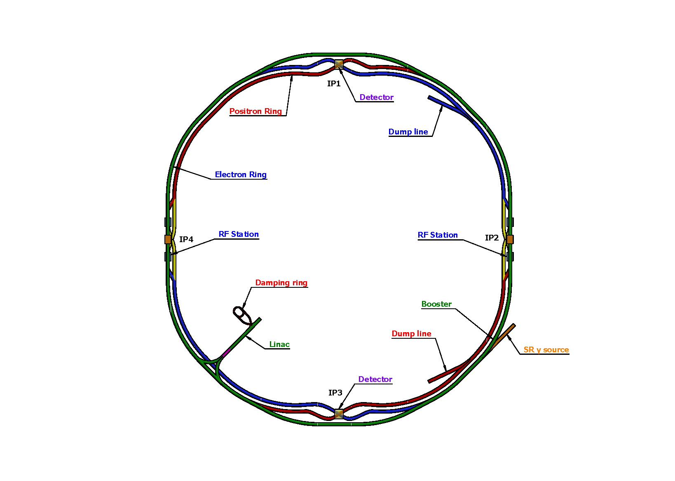
Beam line arrangement and impact to collider
SS4
SS1
SS3
SS2
Since the bending magnets are original ones used in CEPC, they introduce no additional impacts.
The short wiggler is installed in the lattice at the down stream of the on-axis injection region. Switching on the wiggler increases additional 1% beam energy loss, which is acceptable according to specific simulations.

Slide 8
Mitigation measures to the SR effect
The conventional measures to mitigate the beam energy loss due to SR is to taper the bending magnet field.
• The closed orbit distortion reduced to be 1um and 15um at wiggler by applying bending magnet tapering.
• The dynamic aperture w/ and w/o wiggler are almost the same.

Slide 9
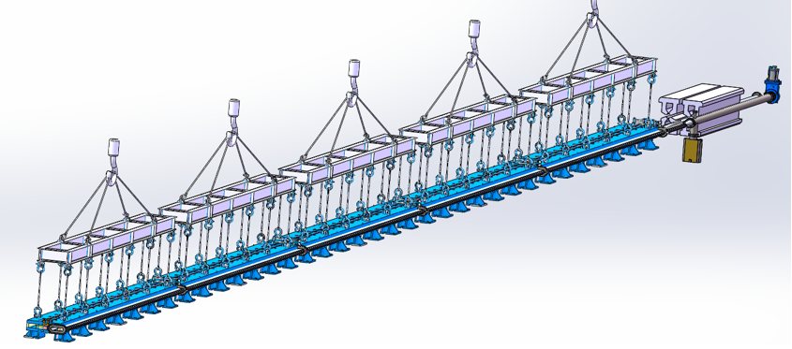
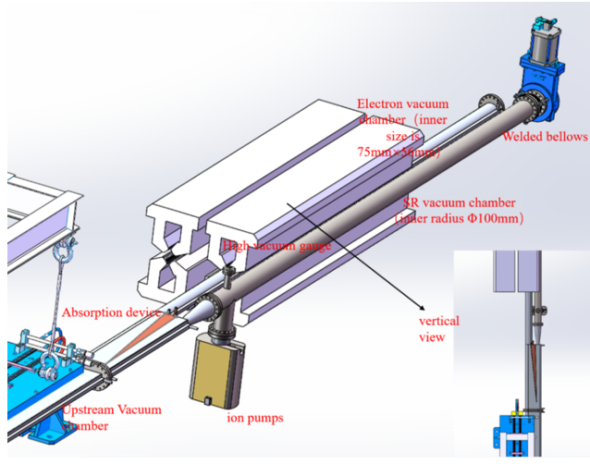
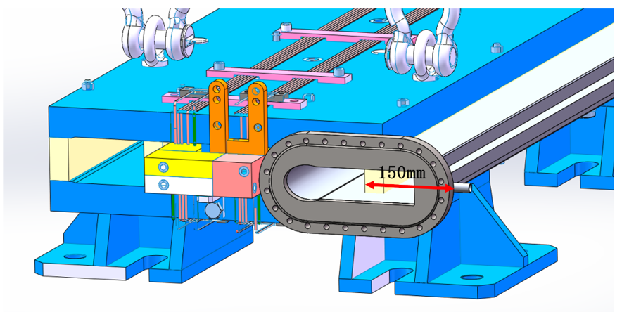
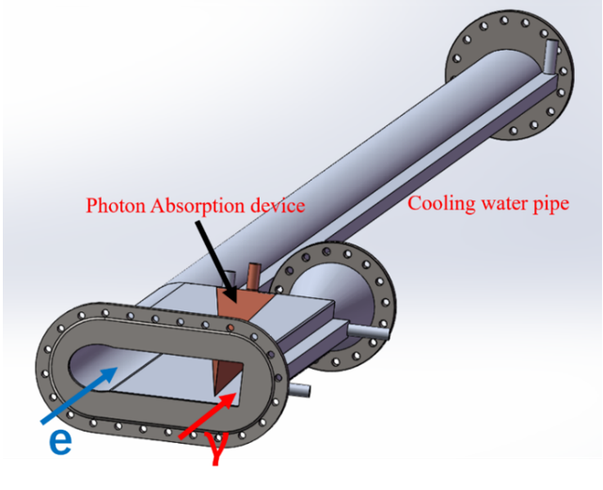
Conceptual Beam Line Design
Dual-aperture dipole and extraction beam pipes

Slide 10
Key Points to the Vacuum Chamber Design
Vacuum maintenance: getter films (NEG films) + ion pump.
(ii) The system consists of 8 sections, separated by all-metal ultra-high vacuum valves (9 valves). A roughing vacuum bump and gas filling port are installed in each section. Additionally, 5 to 10 ion pumps are uniformly distributed (used to pump out gases that are not easy to pump out of getter films such as CH4), and the inner walls of all vacuum boxes are plated with NEG films.
(iii) 304 stainless steel (the inner diameter is 100 mm, the thickness of wall is 3 mm) is used for the vacuum chamber.
(iv) 2 measurement points are allocated in each section, and a cold cathode vacuum gauge is used for the measurement.
(v) Temperature sensors are arranged to monitor the temperature changes of the vacuum box outer wall.

Slide 11
Gamma-Ray Detection

Slide 12
Possible Applications on Metals

Slide 13
Possible Applications on Nucleon
Gamma assistant transmutation:

Slide 14
Possible Applications on Medical

Slide 15
Conclusion to the application as gamma source
Due to the ultra-high beam energy of over 100 GeV, CEPC presents an unique opportunity to generate 100 MeV level intense gamma-rays using a 2 T wiggler
Compare to other photon sources, CEPC may provide much higher photon energy and intensity
Beam dynamic simulations indicate that the introduced beam energy loss is acceptable
The original bending magnet can generate 100 keV level x-rays, covering a wide range of photon energies
Conceptual design for the vacuum system and photon focalization were made
There are wide-ranging applications waiting to be explored

Slide 16
CEPC as a FEL facility

Slide 17
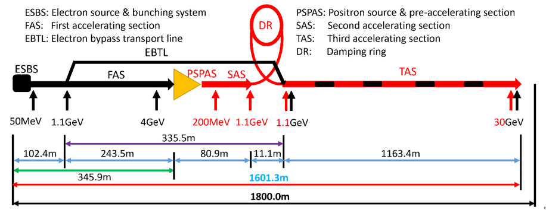
Linac Layout and Potential as a FEL Facility
The C-band accelerator increasing the beam energy from 1.1 GeV up to to 30 GeV
It along can generate beam energy over 20 GeV, which is a very good candidate to drive a ultra-high energy x-ray FEL

Slide 18
Survey of the hard x-ray FELs in the world
Hard XFEL Facilities | Beam Energy （GeV） | Photon Energy (keV)
European XFEL (Germany) | 17.5 | 0.26- 25
LCLS (USA) | 15 | 0.2-25
PAL-FEL (Korea) | 10 | 0.25-15
SACLA (Japan) | 8.5 | 4-20
SHINE (China, under construction) | 8 | 0.4-25
Swiss FEL (Swiss land) | 6 | 0.25-12
Existing hard x-ray FELs use beam energy less than 20 GeV
As the consequence, the maximum photon energy is smaller than 20 keV
Ultra-high energy FELs in the level of 100 keV requires beam energy higher than 20 GeV
$$λ_{r}=\frac{λ_{u}}{2γ^{2}}(1+\frac{K^{2}}{2})$$

Slide 19
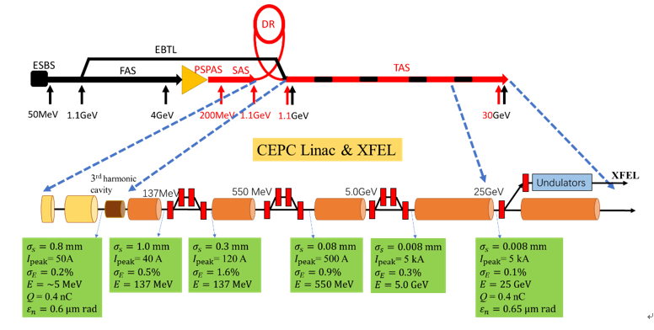
Schematic plan for the XFEL Facility
Additional photon-gun is needed, adjacent to the damping ring
3 chines are induced for bunch compression
Beam energy of 25 GeV is sufficient (as to see later)
An undulator line will be installed parallel to the linac

Slide 20
Start-to-end Simulations of Gun to Linac
Phase space at the accelerator end:
Various effects, including CSR, wakefield, ect., have been accounted;
5kA peak current is available
The global energy spreads in the range of 20MeV (slice energy spread 2MeV)

Slide 21
Beam Parameters
 | Value | Unit
Electron energy | 25 | GeV
Bunch charge | 0.4 | nC
Peak current | 5000 | A
Bunch length | 8 | µm
Normalized emittance(slice) | 0.65 | mm mrad
Energy spread (slice) | 2.0 | MeV
Max. Repetition rate | 100 | Hz

Slide 22
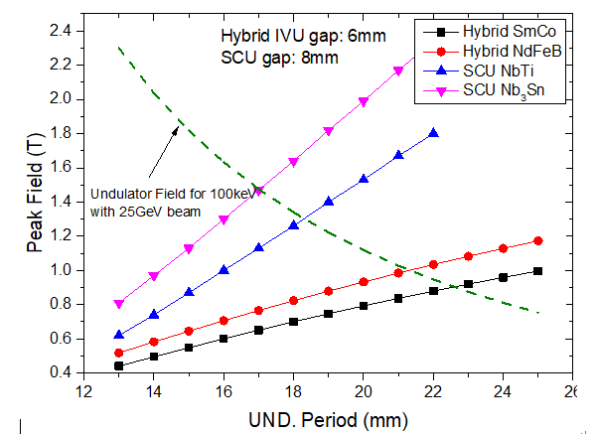
Undulator Parameter Selection
$$λ_{r}=\frac{λ_{u}}{2γ^{2}}(1+\frac{K^{2}}{2})$$
$$\left.K=0.934λ_{u}\left[cm\right]B[T\right]$$
 | Value | Unit
Undulator Period | 25 | mm
Minimum Gap | 6 | mm
Maximum Field | 1.2 | T
Undulator parameter, K | 2.8 | -
Undulator type | IVU, hybrid | -
Magnet material | NbFeB | -
Polarization | Linear
The goal is to generate 100 keV FELs
A certain tunability is need to the lower photon energy region
Performance of different undulators are inspected

Slide 23
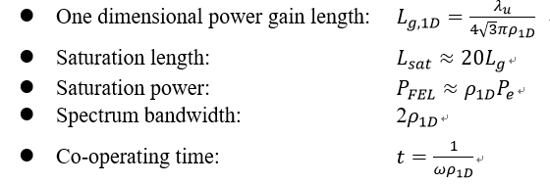
FEL Design Criteria
1-D Pierce Parameter:
$${\left(2ρ_{1D}\right)}^{3}=\frac{μ_{0}e^{2}n_{0}K^{2}{\left[JJ\right]}^{2}{λ_{u}}^{2}}{16π^{2}mγ^{3}}$$
3-D Gain Length:
$$\left.L_{g,3D}=L_{g,1D}(1+δ\right)$$
$$δ=a_{1}{η_{d}}^{a_{2}}+a_{3}{η_{ε}}^{a_{4}}+a_{5}{η_{γ}}^{a_{6}}+a_{7}{η_{ε}}^{a_{8}}{η_{γ}}^{a_{9}}+a_{10}{η_{d}}^{a_{11}}{η_{γ}}^{a_{12}}$$
$+a_{13}{η_{d}}^{a_{14}}{η_{ε}}^{a_{15}}+a_{16}{η_{d}}^{a_{17}}{η_{ε}}^{a_{18}}{η_{γ}}^{a_{19}}$
$η_{d}=\frac{L_{g,1D}}{2k_{r}{σ_{x}}^{2}}$, $η_{ε}=2L_{g}βk_{r}ε$, $η_{γ}=2L_{g}λ_{u}σ_{γ}$
Energy spread, beta-function and beam transverse size are accounted

Slide 24
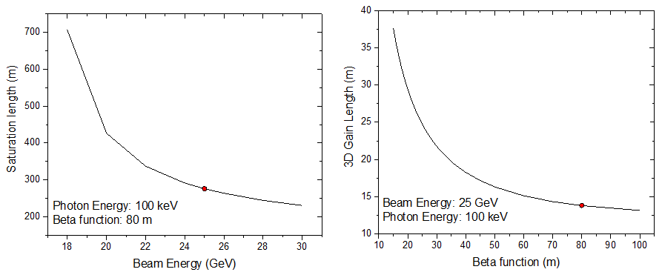
Beam Energy and β Function Investigation
25 GeV beam energy and 80 m beta function is the optimum selection for a reasonable saturation length

Slide 25
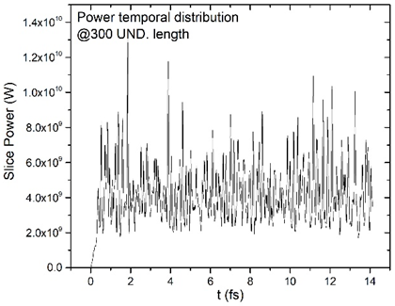
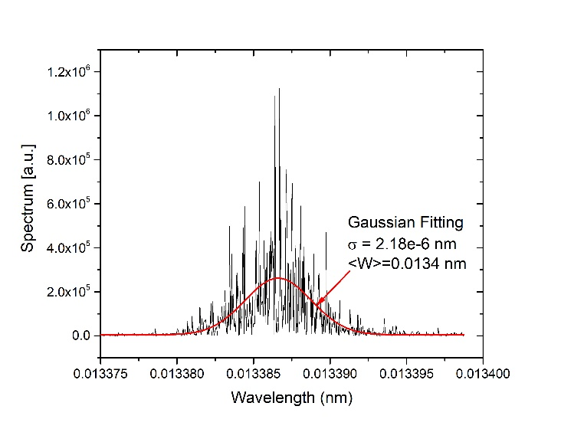
Saturation Spectrum in Time and Frequency Domain
Homogeneity current of 5kA is supposed in the simulation
The radiation wavelength is 0.0134 nm, corresponding to 93 keV
The fitted sigma is 2.18e-6 nm, ($∆ω/ω≈3.26×{10}^{−4}$), agree well with the band with evaluation using Pierce parameter

Slide 26
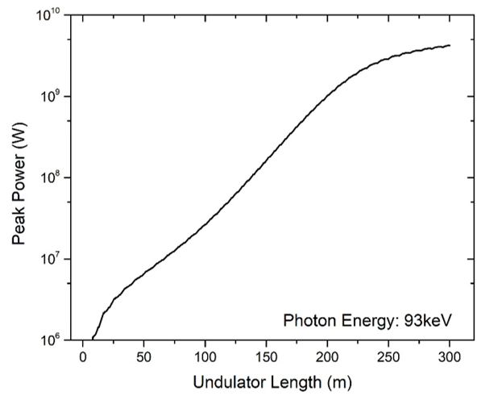
Radiation Gain Curve and FEL Characters
 | Value | Unit
Beta function | 80 | m
1 D Pierce Parameter | 1.6ⅹ10⁻⁴
3 D gain length | 13.8 | m
Saturation length | 250 | m
Bandwidth $∆ω/ω$ | 3.26ⅹ10⁻⁴
Photon energy | 93 | keV
Wavelength | 0.0134 | nm

Slide 27
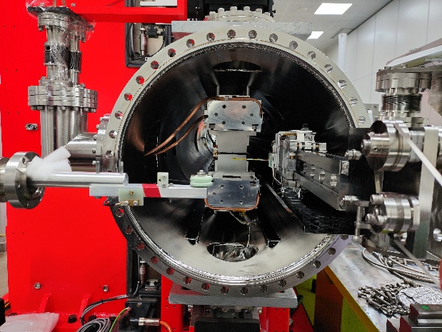
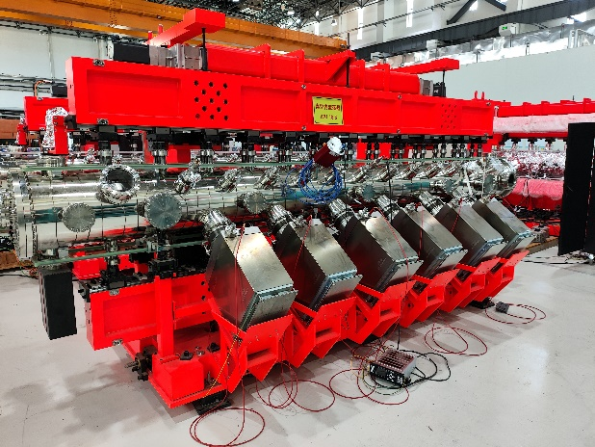
Undulator system R&D
Most of the technologies are conventional and mature
IHEP holds full in-house experiences to most of the related technologies
Undulator is the special technology, which is only used in photon sources
IHEP develop undulators for HEPS, including the required in-vacuum UND
Undulator Tyep | Length [m] | Period [mm] | Performance Gap [mm] | Max. Peak Field [T]
CPMU | 2 | 12.0 | 5.2-7.0 | 0.81
CPMU | 2 | 14.2 | 5.2-9.9 | 1.00
CPMU | 2 | 16.7 | 5.2-10.0 | 1.19
CPMU | 2 | 18.8 | 5.2-13.1 | 1.35
CPMU | 2 | 22.8 | 7.2-16.0 | 1.18
IVU (NdFeB) | 4 | 18.8 | 5.2-13.1 | 1.35
IVU (SmCo) | 4 | 19.9 | 5.2-14.0 | 0.97
IVU (SmCo) | 4 | 22.6 | 5.2-15.2 | 1.10

Slide 28
Conclusion to the application as a FEL facility
CEPC exploits a 30 GeV linac, which can drive an ultra-high x-ray FEL
Additional electron gun is need for small emittance
3 chicanes will be installed in Linac for the bunch compression, which results in 5kA peak current
In-vacuum undulator will used to generate 100keV, with a centain wavelength tunability
100 keV SASE-FEL is simulated, corresponding to the analytical evaluation

Slide 29
The End

