Slide 1



Status of CEPCSW
Wenxing Fang, Xingtao Huang, Teng Li, Weidong Li, Tao Lin, Shengyi Wang, Jiaheng Zou
July 5, 2023
The 2023 International Workshop on CEPC (EU Edition)

Slide 2
Contents
Introduction
Overview of CEPCSW
Status and new development of CEPCSW
Summary

Slide 3
Introduction
The CEPC software development first started with the iLCSoft
  Reused most software modules: Marlin, LCIO, MokkaC, Gear
  Developed CEPC’s software components for simulation and reconstruction
  Massive M.C. data produced for detector and physics potential studies
  CDR was released in Nov, 2018, based on results from the iLCSoft
New CEPC software (CEPCSW) prototype was proposed at the Oxford workshop in April 2019
The consensus among CEPC, CLIC, FCC, ILC and other future experiments was reached at the Bologna workshop in June 2019
  Develop a Common Turnkey Software Stack (Key4hep) for future collider experiments
  Maximize the sharing of software components among different experiments

Slide 4
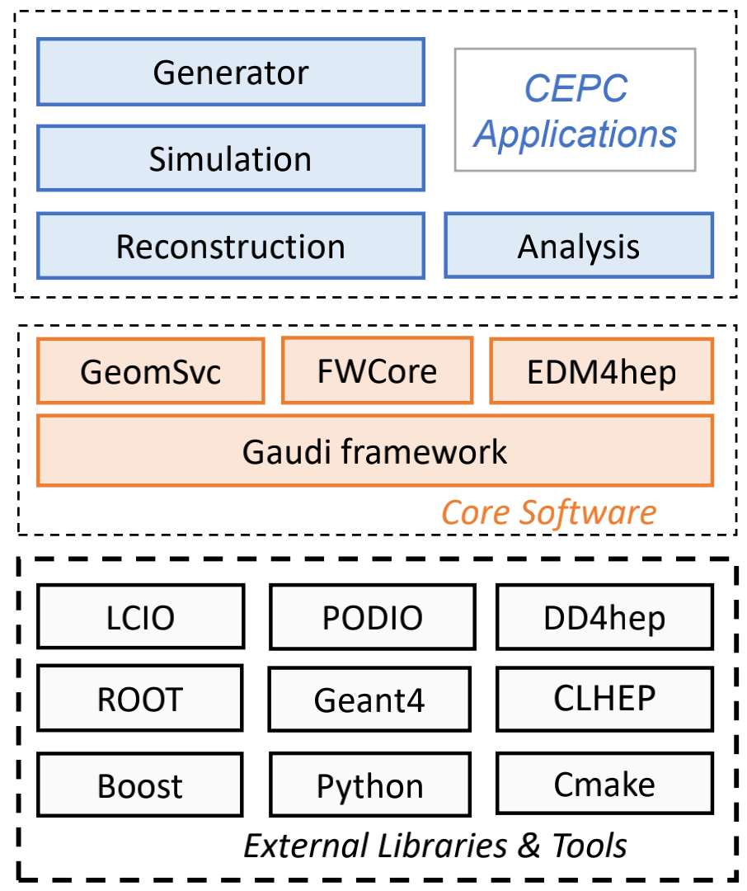
Overview of CEPCSW
CEPCSW software structure
  Core software
  Applications: simulation, reconstruction and analysis
  External libraries
Core software
  Gaudi/Gaudi Hive: defines interfaces to all software components and controls their execution
  EDM4hep: generic event data model
  K4FWCore: manages the event data
  DD4hep: geometry description
  CEPC-specific framework software: generator, Geant4 simulation, beam background mixing, fast simulation, machine learning interface, etc.
https://github.com/cepc/CEPCSW

Slide 5
Status of CEPCSW
CEPCSW is under rapid development, and its latest version is v0.2.6
  Well supported detector simulation and reconstruction studies on the 4th conceptual detector
Lots of progress has been made on core software of CEPCSW since last workshop
  Optimization on key components according to application requirements
    Event Data Model
    Detector Description
    Simulation Framework
  Developments on adopting new technologies to boost CEPCSW performance
    Multi-threaded Detector simulation
    Heterogeneous Computing
    Machine Learning Integration based on ONNX
    Analysis framework based on RDataframe
    Automated Validation System

Slide 6
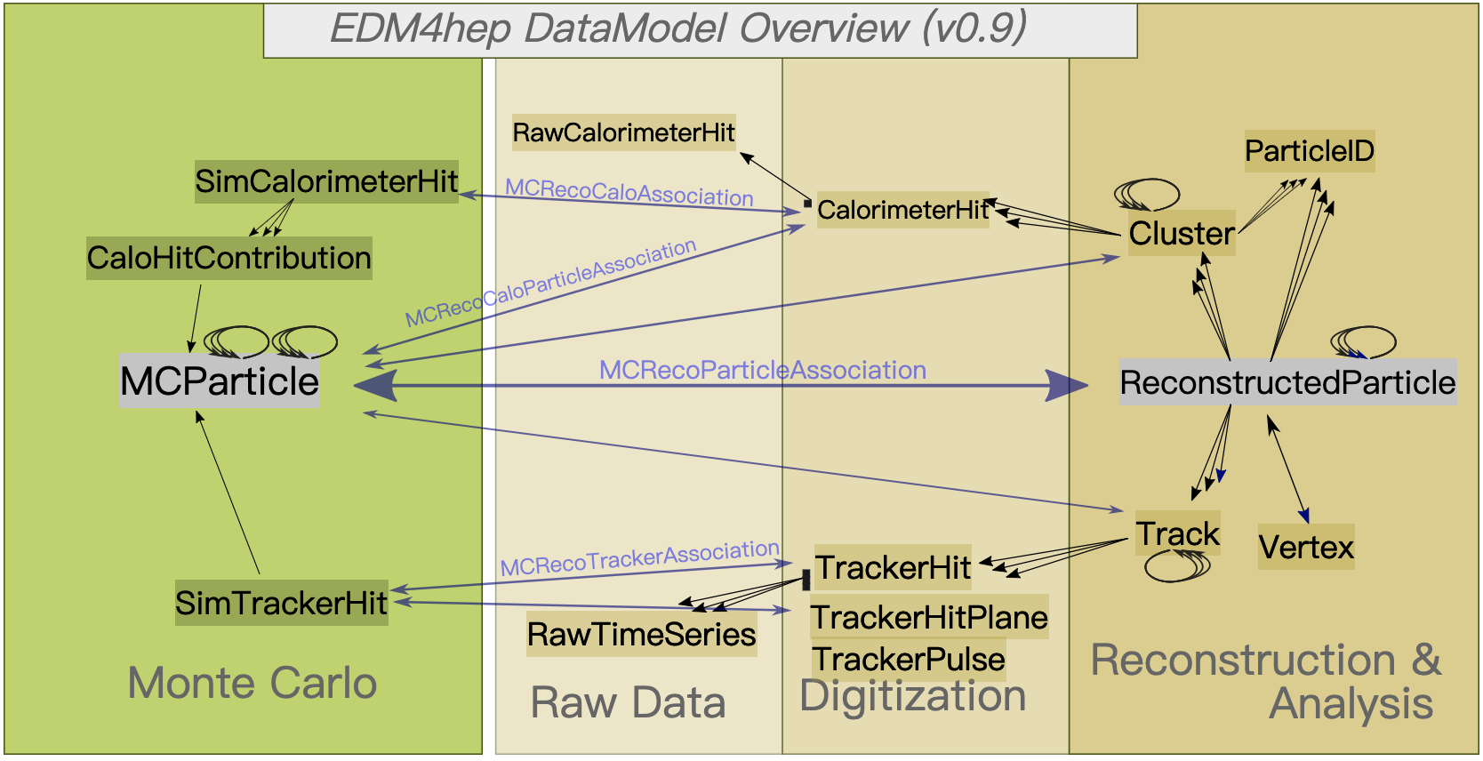
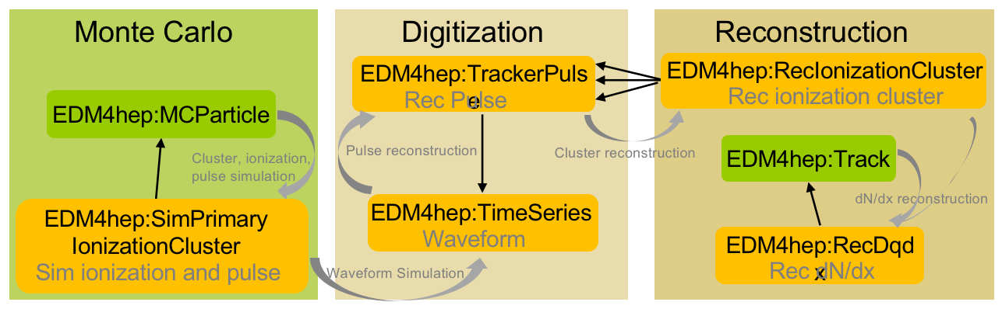
Event Data Model
EDM of CEPCSW is adopted from EDM4hep
  In different data processing stages and for different sub-detectors
Extension of EDM4hep is developed to accommodate the drift chamber dN/dx study
  Based on the upstream mechanism of podio
  Can also be used for TPC detector
  Adopted by EDM4hep (PR)

Slide 7
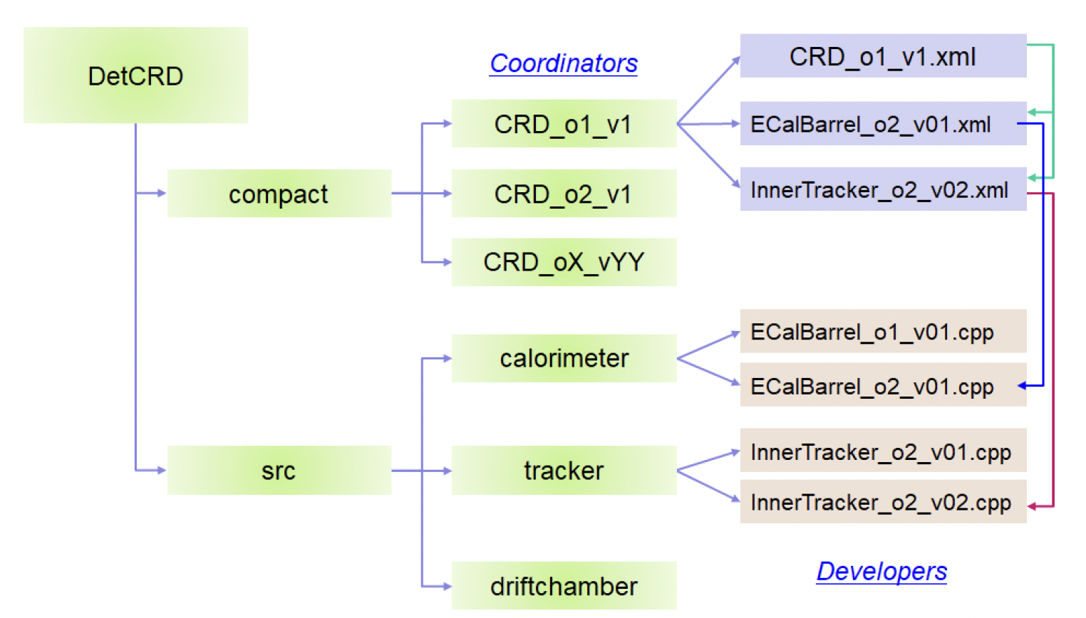
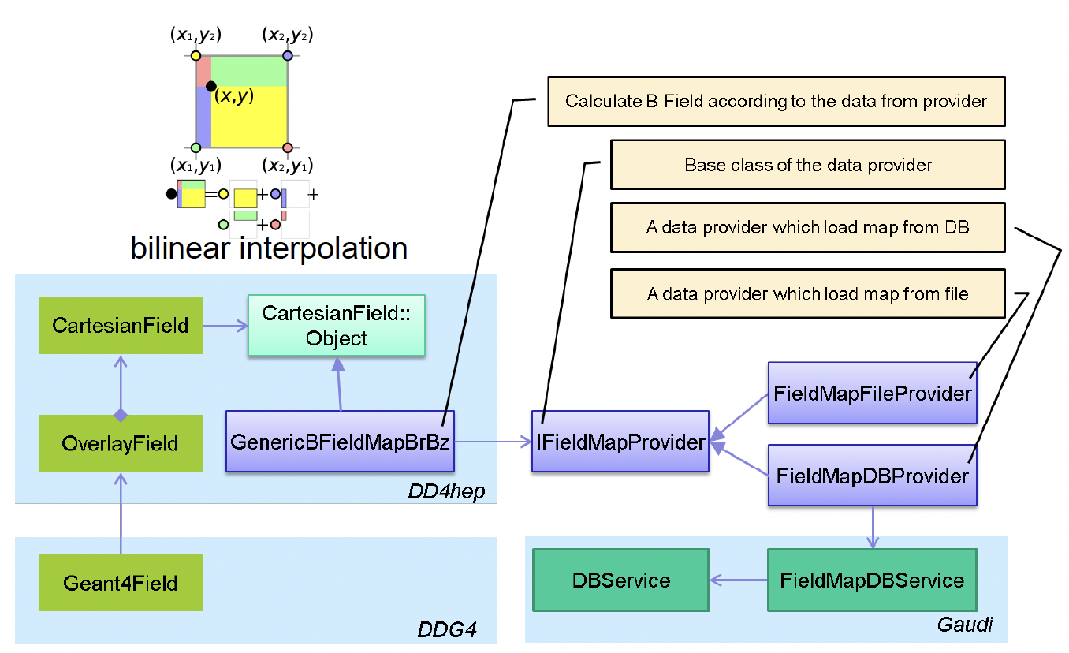
Detector Description
DD4hep is adopted to provide a full detector description with a single source of information
Different detector design options are managed in git repository and easily to be changed in CEPCSW
The non-uniform magnetic field has been implemented

Slide 8
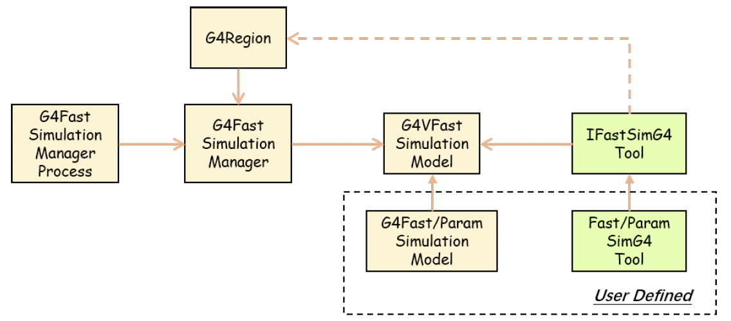
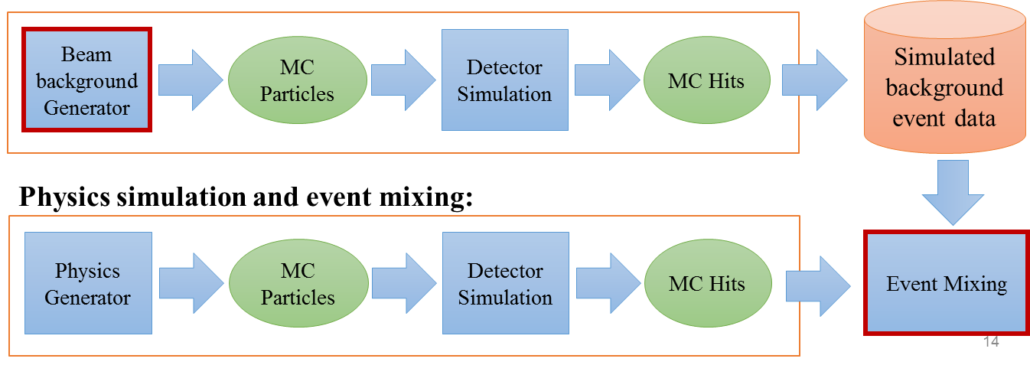
Detector Simulation (1)
The Geant4-based full detector simulation framework has been developed in CEPCSW and supported sub-detectors simulations and their performances study
  Silicon detector, time projection chamber, drift chamber and calorimeters
The region-based fast simulation interface is also developed to integrate different fast simulation models into Geant4
CEPCSW provides an unified solution for different backgrounds’ simulation and event mixing at the hit level

Slide 9
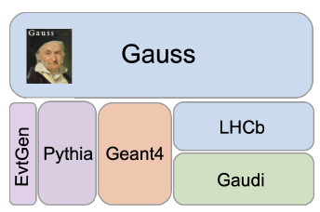
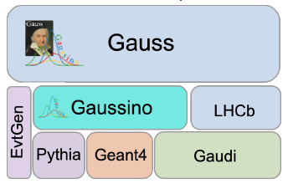
Detector Simulation (2)
CEPC is working with Key4hep project members re-implementing the detector simulation software based on Gaussino
Gauss->Gaussino: evolution of the simulation framework from LHCb
  Better support for multi-threading, machine learning and fast simulation models
  Gauss-on-Gaussino is a new version of LHCb simulation framework
Gaussino is being added to Key4hep by extracting experiment-independent parts from Gauss

Slide 10
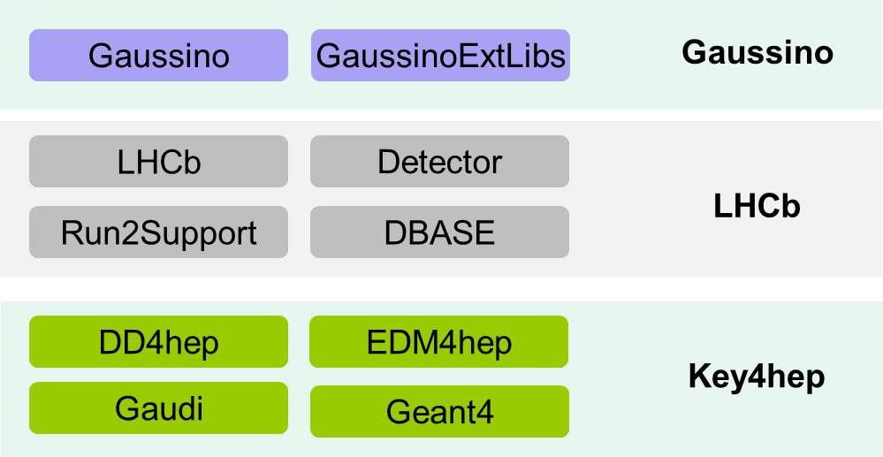
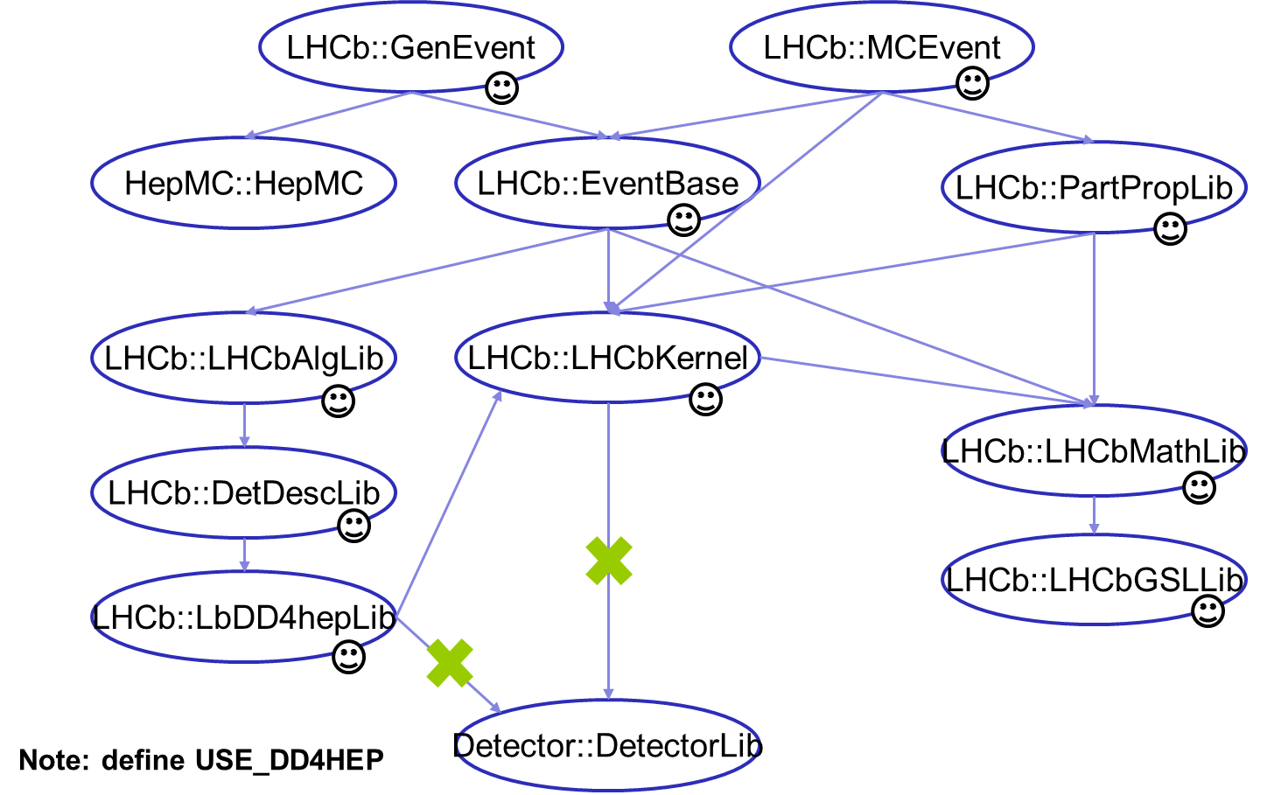
Detector Simulation (3)
Now Gaussino still depends on LHCb software and can not be used by other experiments directly
Development of CEPC-on-Gaussino was planned with the following three steps
  Using the original version having the dependency on the LHCb software
  Creating the modified version in which the LHCb dependency is removed
  Directly using the Key4hep version (not available at the moment)

Slide 11
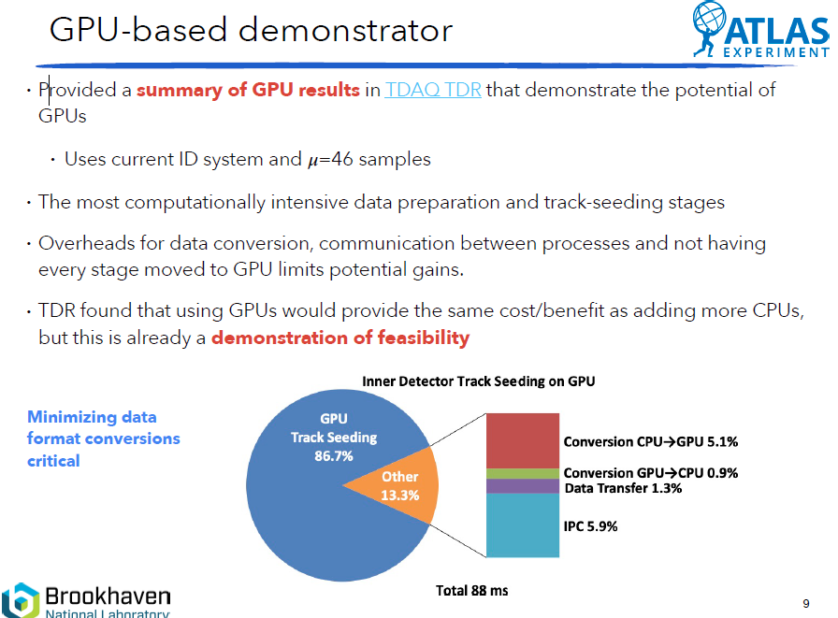
Heterogeneous Computing (1)
(Talk at ICHEP2022 )

Slide 12
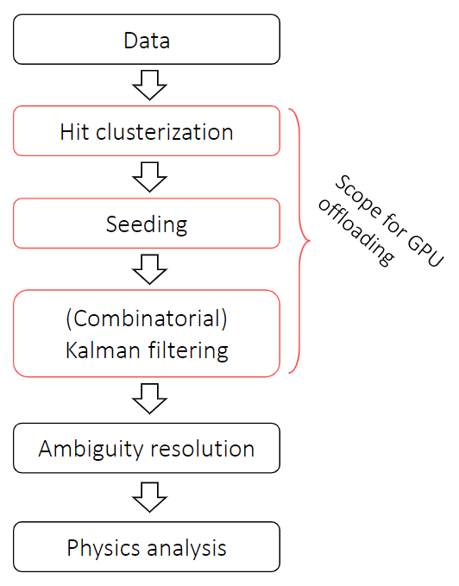
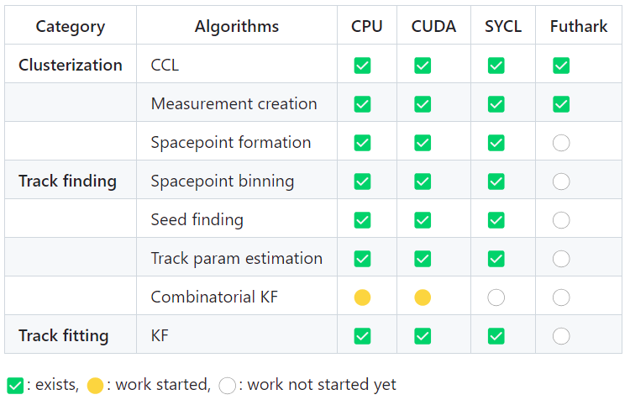
Heterogeneous Computing (2)
TRACCC: one of ACTS R&D projects
  Full chain demonstrator for track reconstruction on CPU/GPU
https://github.com/acts-project/traccc

Slide 13
Heterogeneous Computing (3)
Activities in CEPCSW
  We are able to run TRACCC in a standalone environment and managed to build/run TRACCC on both CPU/GPU.
  Now the TRACCC seeding algorithm has been integrated within CEPCSW by developing middleware between Gaudi algorithm and SYCL based algorithm
Config | Hardware | OS | Compiler | SYCL backend | Bulid traccc | Run traccc
1 | Intel CPU (IHEP login node) | CentOS 7.8 | LCG 101 (GCC 10.3 + clang 12) + oneAPI DPC++ | CPU | OK | OK
2 | Intel CPU + NVIDIA RTX 8000 (workstation) | CentOS 7.9 | LCG 101 (GCC 11.1) + intel/llvm (2021-12) | CUDA 11.2 | OK | OK
Gaudi
Algorithm
SYCL based
Algorithm
A component library
A shared library
CEPCSW + GCC
Intel oneAPI + DPC++

Slide 14
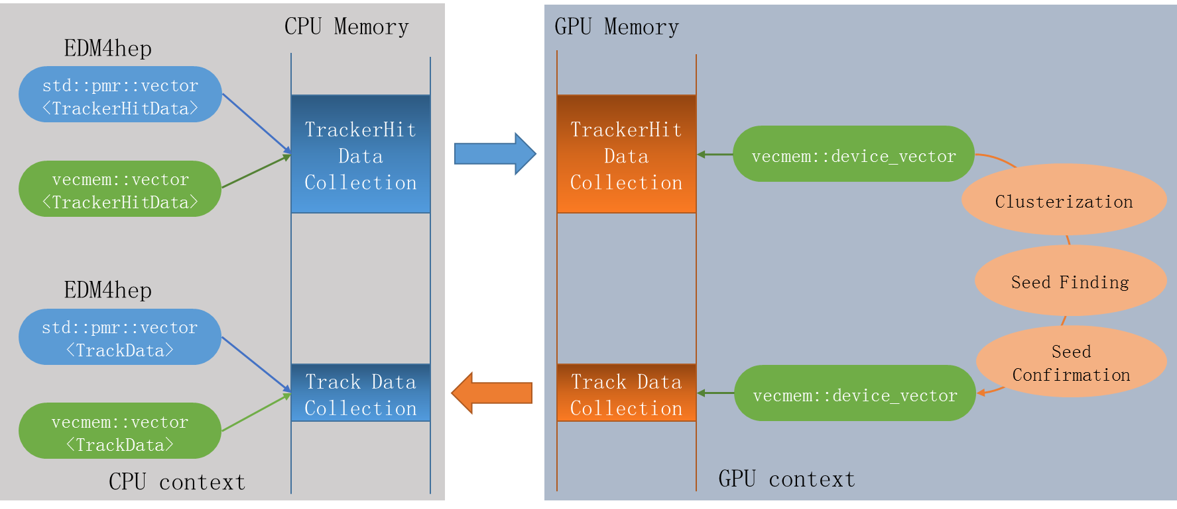
Heterogeneous Computing (4)
Building a bridge between EDM4hep and TRACCC
  Common memory for both EDM4hep and TRACCC
  No data conversion is needed between them

Slide 15
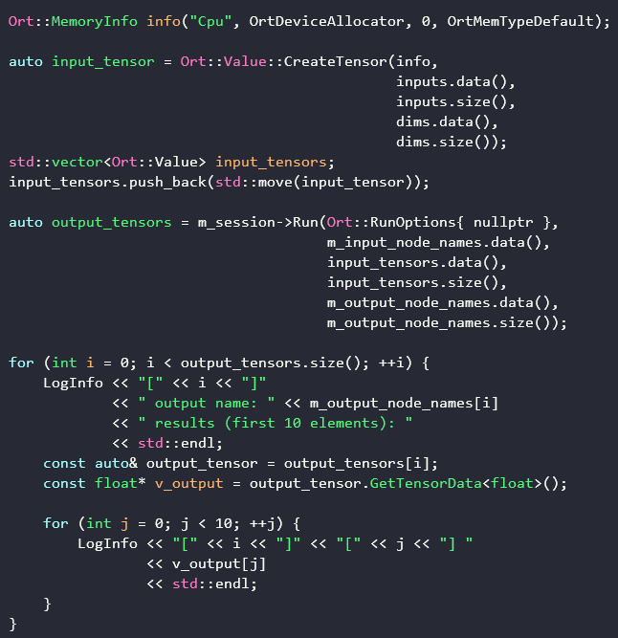
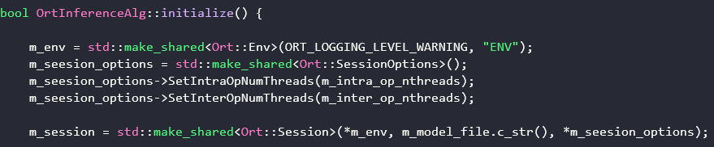
Machine Learning Integration
ONNX/ONNX Runtime have been integrated with CEPCSW
Provided an example, OrtInferenceAlg,
  During initialization
    Create a session object of ONNX runtime
    Load and run an ONNX model
  During execution
    Compute output for an input data
Fast pulse simulation in the drift chamber provided as an example (MLP)

Slide 16
Analysis toolkit based on RDataFrame
Developing a new toolkit based on new technologies of software and hardware is very crucial to rapidly analyze drastically increasing data
RDataFrame provides powerful and flexible way analyzing data
  Declarative programming and parallel workflow
  Analysis in both Python and C++
  Already support reading EDM4hep format
  Actively used by FCC-ee for flavour, higgs and top physics
Development and test of analysis tool for CEPCSW
  Develop and common components (functions) for analyzing EDM4hep data
    Analysis functions in C++: event selection, filtering, Jet clustering, vertex fitting ..
    Python for configuration: define analysis functions, input samples, output variables ..
  Test multithreading performance using analysis within CEPCSW

Slide 17
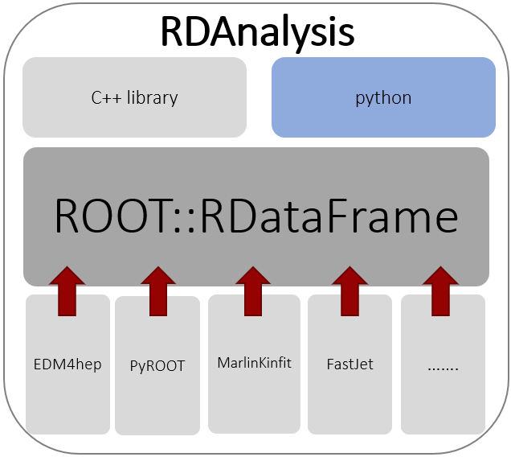
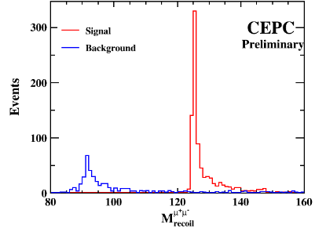
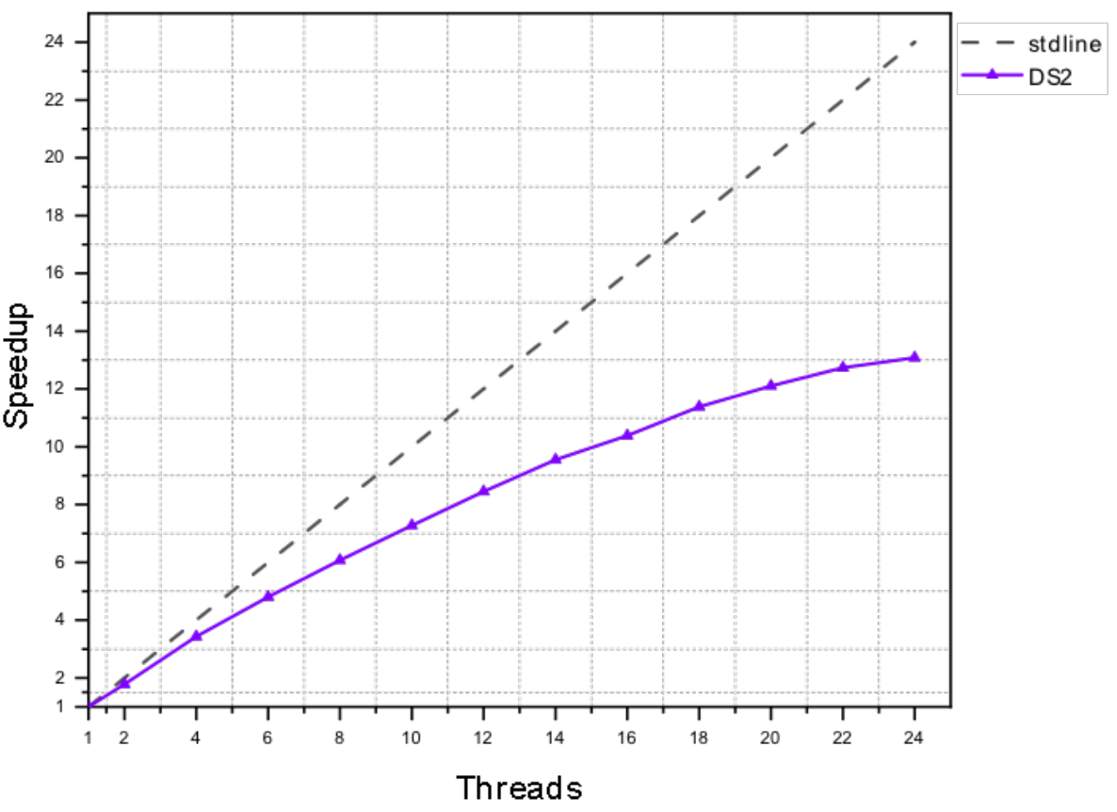
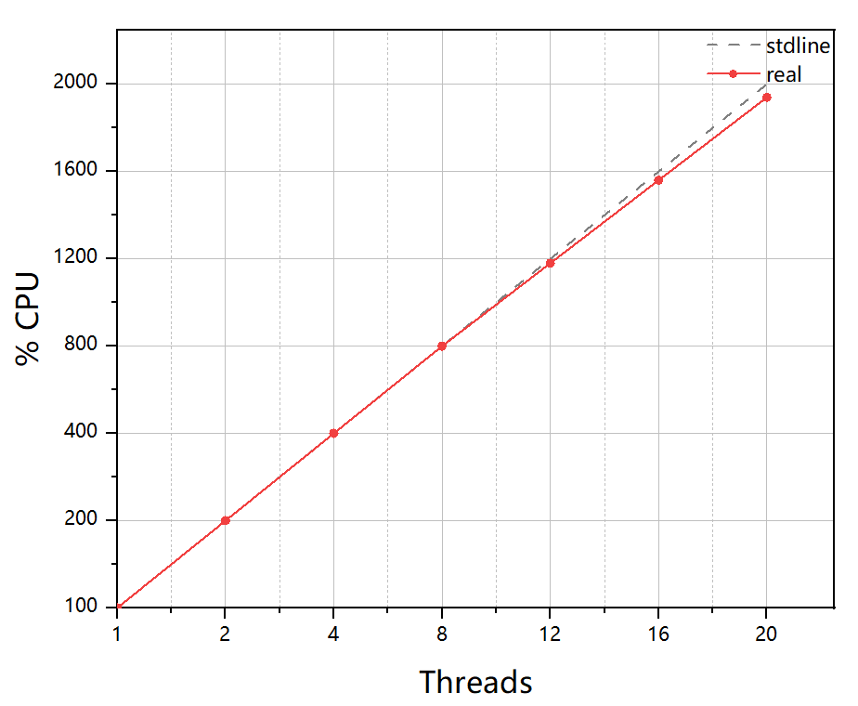
Analysis toolkit based on RDataFrame
Several packages are ported from FCC
analysis, more are being implemented
  FastJet, MarlinKinfit
  Vertex fit, jet tag, PID etc.
Functionalities and performance test
performed on two analysis channels
  e+e- -> Z(mumu)H
  e+e- ->H(2jet) mumu
Identical results with Marlin
performance test

Slide 18
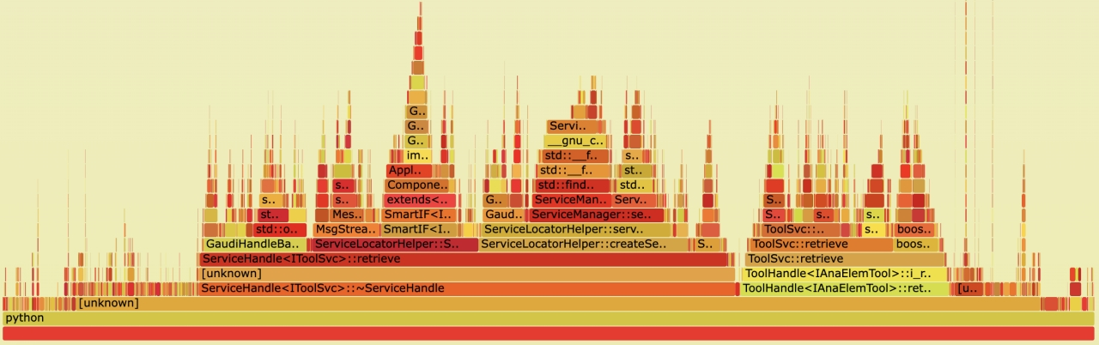
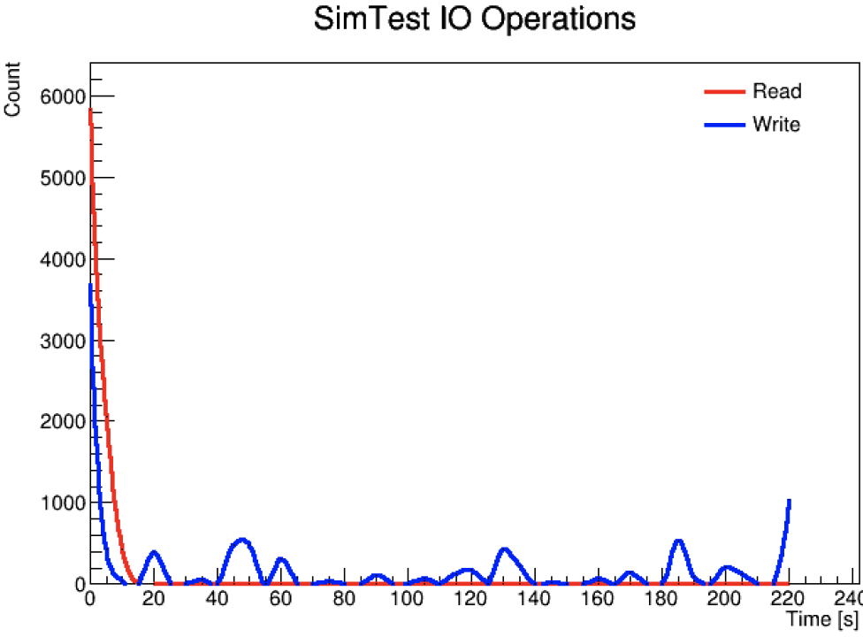
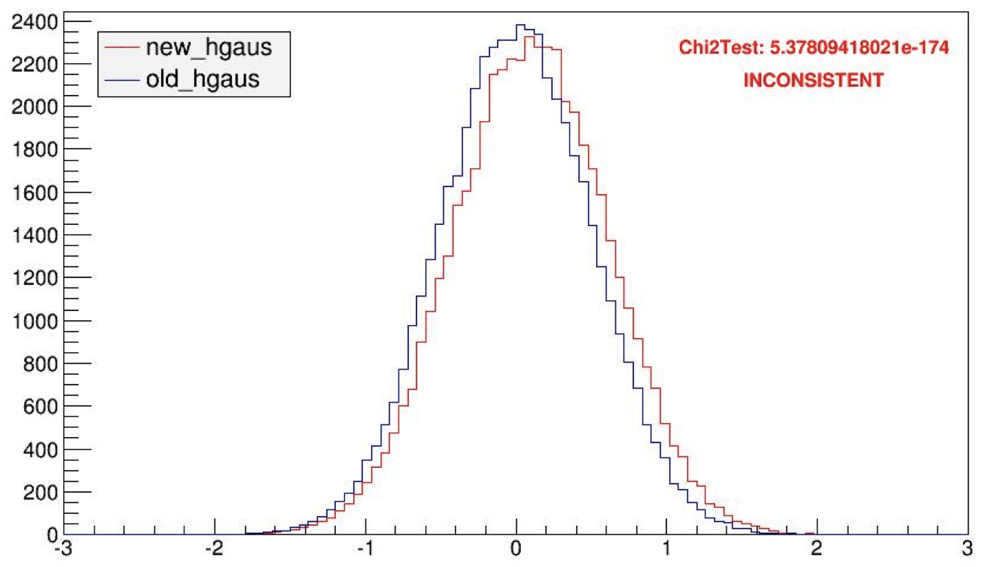
Automated Validation System
An automated validation system is developed for software validation at different levels
  Unit test, integrated test, performance profiling, physical validation etc.
A toolkit is developed for building software validation workflow
  Provide interfaces to define and run unit tests
  Provide toolkit for performance profiling
  Support results validation based on statistical methods
Automated physical validation system based on massive data production (run via DIRAC resource) is being developed

Slide 19
Automated Validation System
The validation system is integrated with the Github Action system
  Full validation workflow can be triggered by commit/merge-request
  Developing running validation jobs on the grid
~ O(200) cores are now available for running validation jobs
READY
Pull
Request
GitHub
Build
installation
CVMFS
TODO
Docker
Performance
Testing
Commit
Code
GitHub
Actions
Central
Database
Build
Servers
Test
Servers
Kubernetes
(dedicated)
DIRAC
(shared)
Web
Portal

Slide 20
Summary
CEPCSW is being developed in collaboration with the Key4hep project
Key components of the CEPCSW core software are in place and keeps optimized to well support detector simulation and reconstruction studies
Lots of efforts are devoted to adopt new technologies to boost CEPCSW performance
  Multi-threaded detector simulation based on Gaussino
  Track reconstruction using heterogeneous resources
  Integration of ML models
  Parallel analysis framework based RDataFrame
  Automated validation system

Slide 21
Thanks for your attention!
Welcomed to joining CEPCSW and working together!
https://github.com/cepc/cepcsw

Slide 22
Backup

Slide 23
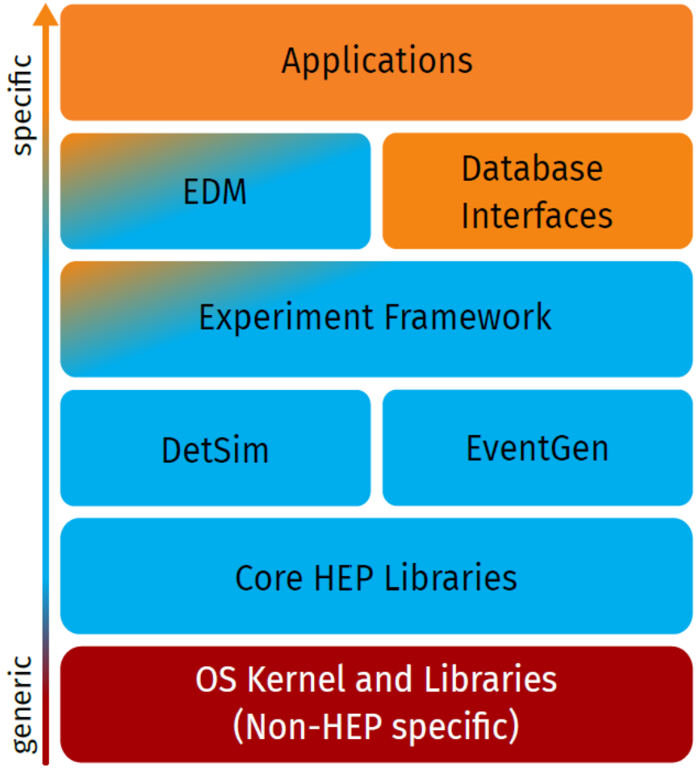
Key4hep
HEP software usually consist of lots of applications
  Application layer of modules/algorithms /processors
  performing physics task (PandoraPFA, FastJet, ACTS,...)
  Data access and representation layer including EDM
  Experiment core orchestration layer (Gaudi, Marlin, ...)
  Specific components reused by many experiments (DD4hep, Delphes, Pythia,...)
  Commonly used HEP core libraries (ROOT, Geant4, CLHEP, ...)
  Commonly used tools and libraries (Python, CMake, boost,…)
Thomas Madlener,
Epiphany Conference 2021
CEPCSW is being fully integrated with Key4hep to share software with other future experiments
IHEP and SDU are also involved in Key4hep development as non-EU members

Slide 24
ONNX Introduction
Machine Learning becomes more and more important in HEP data processing
  Different tasks may use different Machine learning libraries and produce different models
  We need an unified way to integrate different models in CEPCSW and run inference easily
ONNX is an open format built to represent machine learning models.
  Support to convert from other models to ONNX, such as Tensorflow, PyTorch etc.
  Easy to run inference on different platforms, such as ONNX Runtime, ONNX MLIR etc.
  Some applications of ONNX in HEP
    Fast simulation in Geant4 using ONNX inference interface [1]
    Fast Inference for Machine Learning in ROOT TMVA [2]
ONNX Runtime is a cross-platform inference and training accelerator
  Accelerate inference on different hardware platform (CPUs/GPU/FPGA)
[1] Anna Zaborowska et al., Fast Simulation : from Classical to Machine Learning Models
[2] Sitong An et al., Fast Inference for Machine Learning in ROOT/TMVA

Slide 25
Detector Simulation
Reusing GenEvent and MCEvent from the LHCb project
  Minimum number of packages are selected
  Non-required dependencies were removed
Source code of CEPC-on-Gaussino
  LHCb: https://gitlab.cern.ch/talin/LHCb/-/tree/cepc-on-gaussino
  gaussinoextlibs: https://gitlab.cern.ch/talin/gaussinoextlibs/-/tree/cepc-on-gaussino
  Gaussino: https://gitlab.cern.ch/talin/Gaussino/-/tree/cepc-on-gaussino
Building script: https://gitlab.cern.ch/talin/build-cepc-on-gaussino

