Slide 1
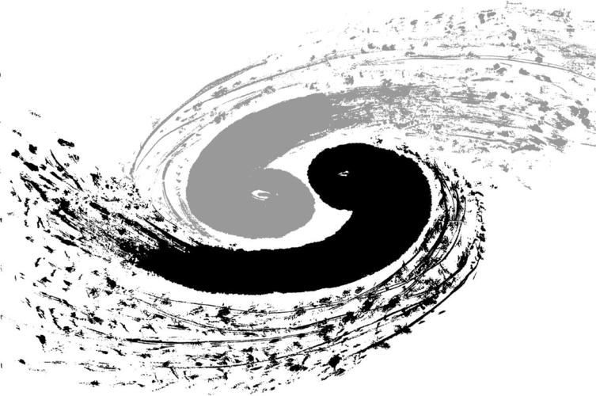
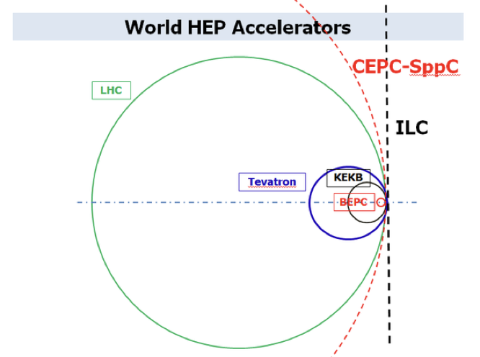
H→bb/cc/gg measurement in CEPC with modified PFN
Yu Bai^{（1）}, Gang Li^{（2）}, JianPeng Deng^{（1）}, JianYu Huang^{（1）}, WeiHan Tan^{（1）}, HeYu Meng^{（1）}, Ke Wang^{（1）}, NengXuan Xu^{（1）}
^{July 4, 2023}
（1）Southeast University
（2）Institute of high energy physics

Slide 2
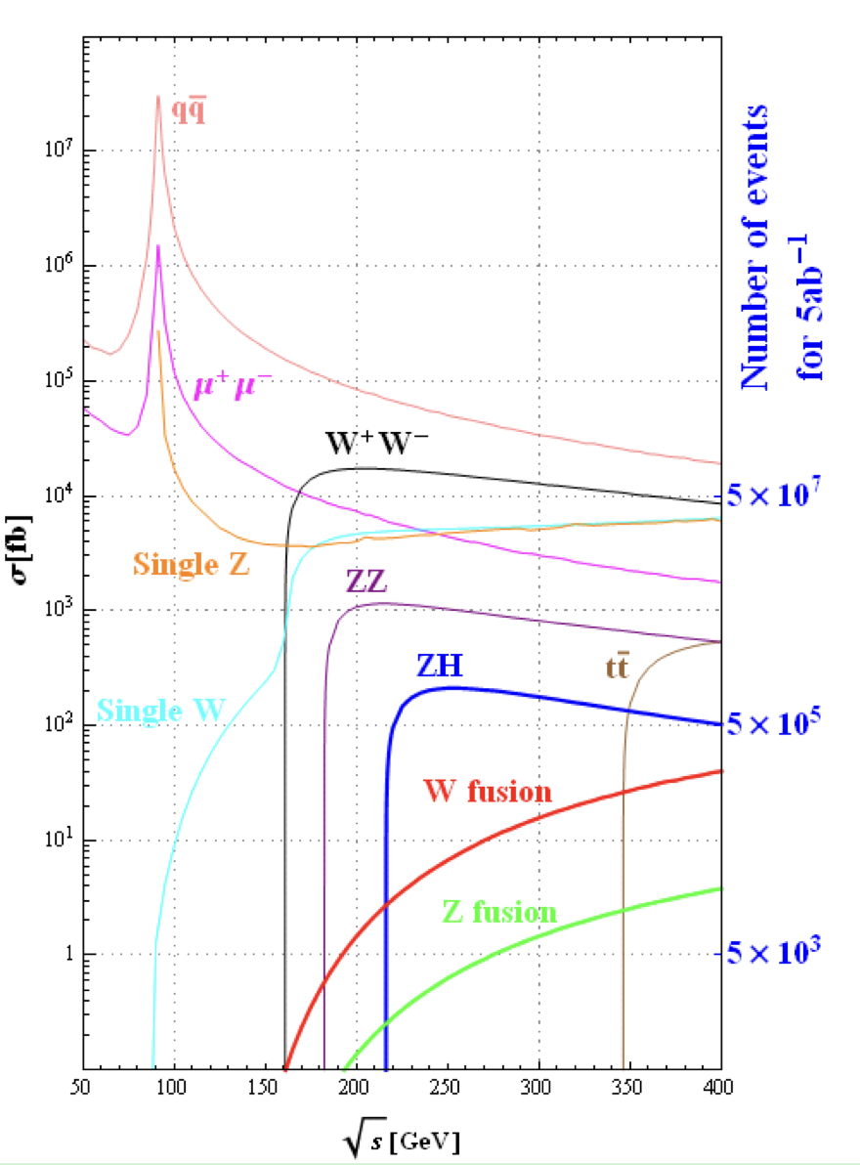
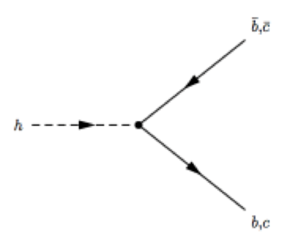
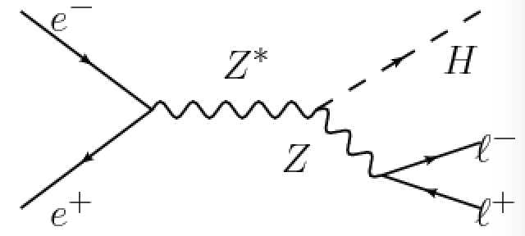
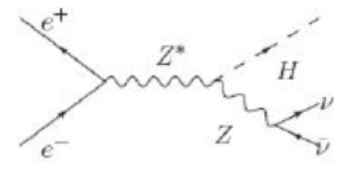
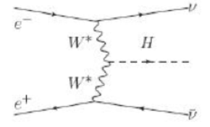
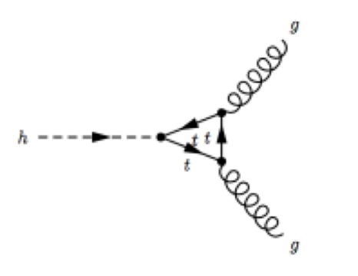
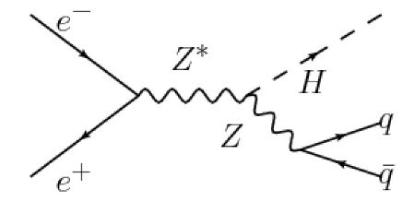
H->bb/cc/gg in CEPC
Higgs Production in CEPC
H->bb/cc/gg
Understanding Yukawa coupling between Higgs boson and quarks
CEPC is an ideal place to precisely measure Higgs decay
An important benchmark measurement of CEPC

Slide 3
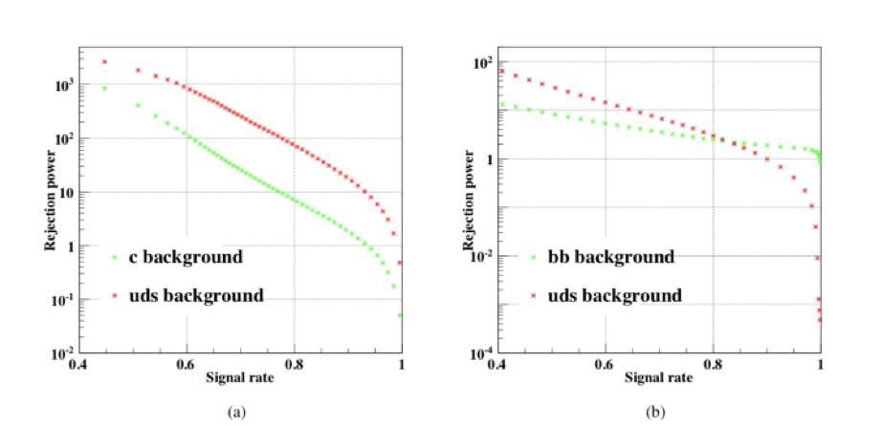
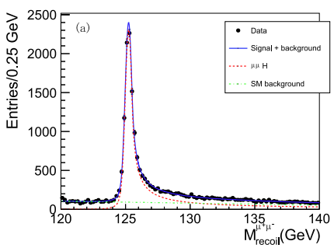
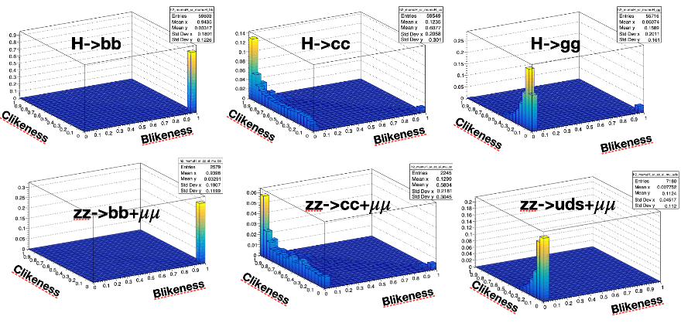
Previous measurement
Chinese Physic C, 043002, 2019
GBDT Flavor Tagging
3D-Fitting
Chinese Physic C, 013001, 2020
B-Tagging
C-Tagging
Merge Jets according to ‘distance’
ee-kt jet algorithm
BDT Flavor tag
Mrecoil◊Flavor Tagging template fit

Slide 4
Key performance to be improved
Jet algorithm
Separation between with different parton multiplicity
H->bb/cc/gg and H->ww/zz->4q/2q+2l
Flavor tagging
B/L separation is good
Improve c-tag performance(especially contaminations from B)
Gluon/quark jet separation

Slide 5
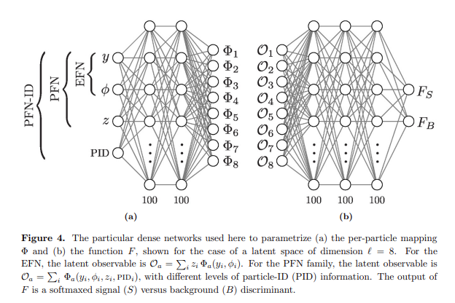
Particle flow network (PFN)
JHEP01, 2019, 121
z : Particle momentum
Variables added as Φ input:
PID (recoded)
D0, Z0
D0, Z0 significance
Track likelihood (from primary vertices)
Energy
Charge
Φ-Layer: DNN layer for each particle
O-Layer: A summation over particles (dot production between z and Φ )

Slide 6
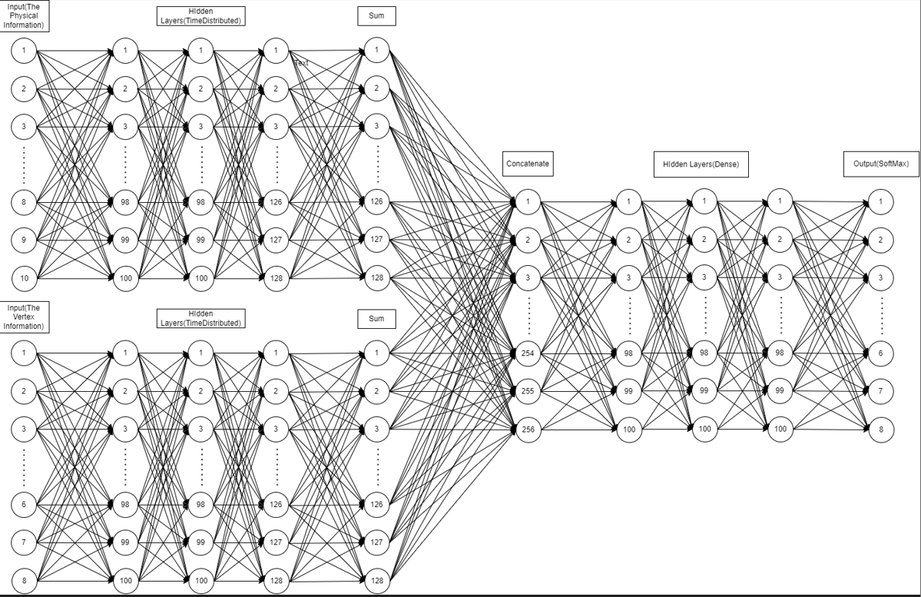
Modification of PFN
z : Particle momentum
Variables added as Φ input:
PID (recoded)
D0, Z0
D0, Z0 significance
Track likelihood (from primary vertices)
Energy
Charge
Secondary Vertices Information:
Vertices position
Vertices momentum
Adding Φ-Layers for vertices to improve tagging performance

Slide 7
Datasets and Pre-selection
Event selection are the same as in previous work
High statistic samples are necessary for model training
400k-700k events for μμH，H->bb/cc/gg/ww/zz each
High statistics ZZ-> μμ +qq background, generated with event filter
sample | ZZ->μμbb | ZZ->μμcc | ZZ->μμss | ZZ->μμuu/dd
Cross section(fb) | 45.45 | 43.73 | 45.48 | 89.20
Events in 5 ab⁻¹ | 227.3k | 218.7k | 227.4k | 446.0k
Generated events | 100M | 100M | 100M | 100M
Filtered Events | 4.807M | 4.492M | 4.812M | 4.649M
Simulated and reconstructed | 4.684M | 4.378M | 4.687M | 454.2M
Passing cut | 1.778M | 1.633M | 1.712M | 1.644M
Selection Eff | 1.825% | 1.676% | 1.758% | 1.630%
Filter Eff 98% reached

Slide 8
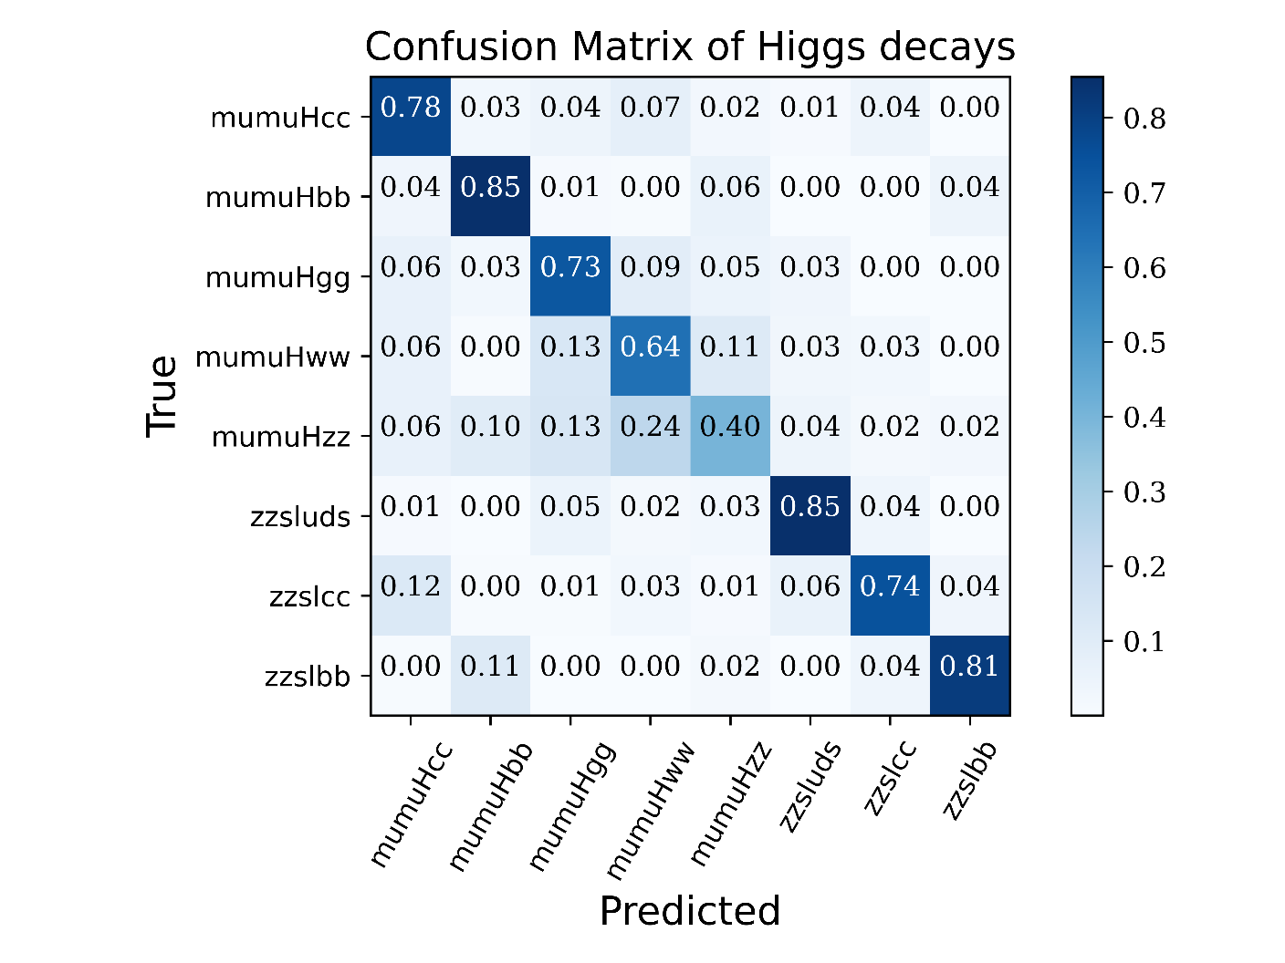
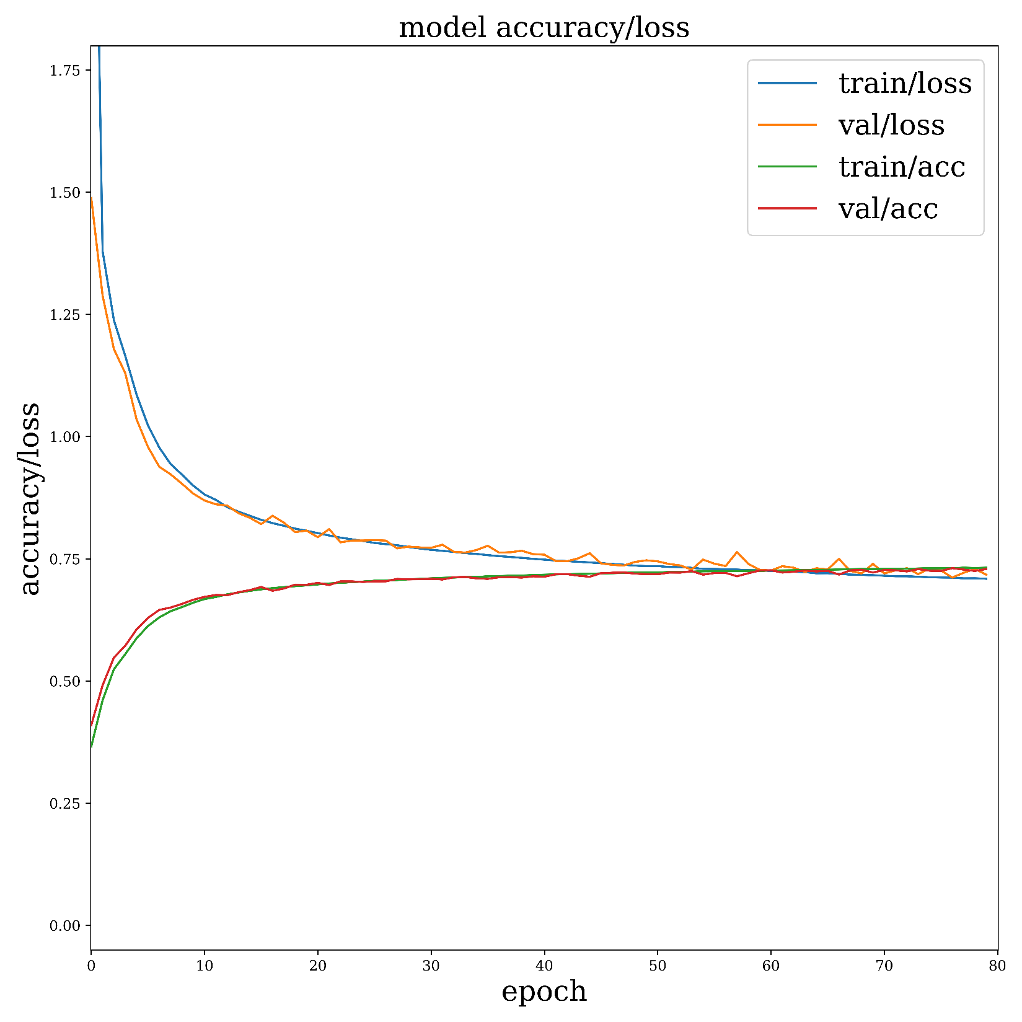
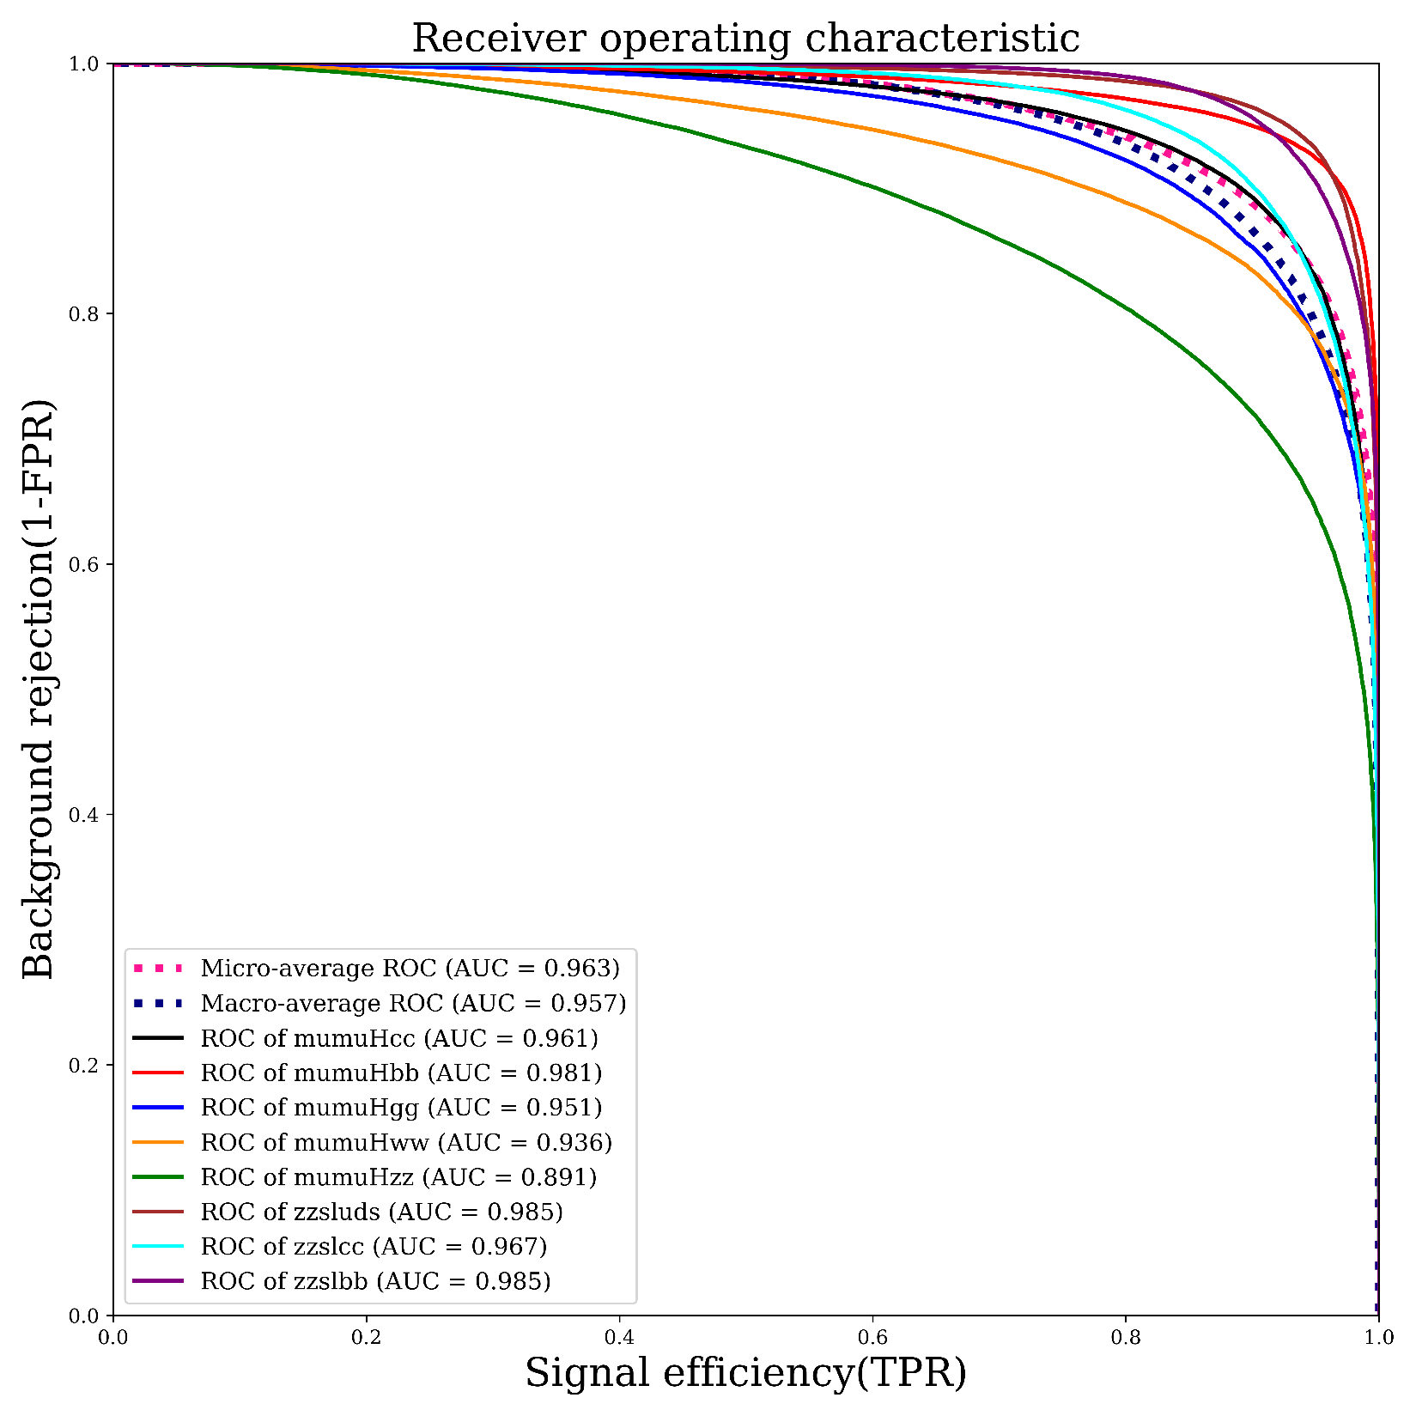
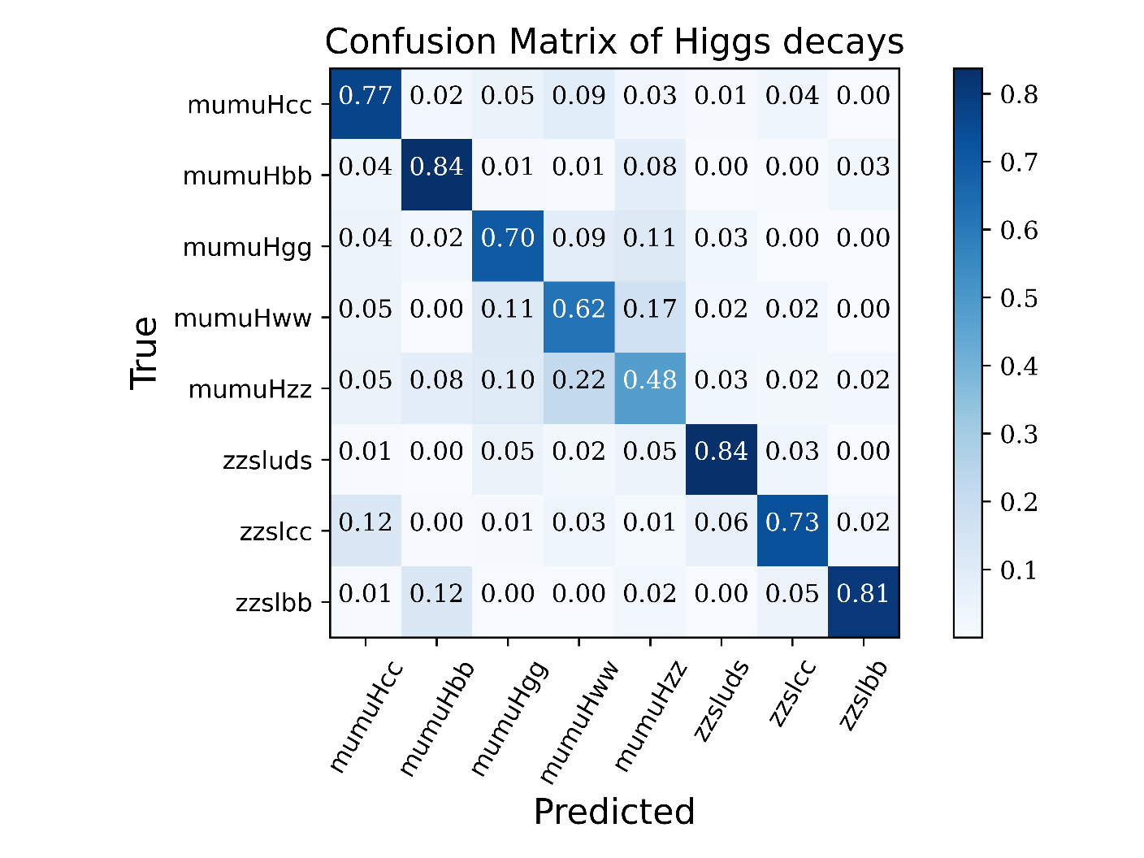
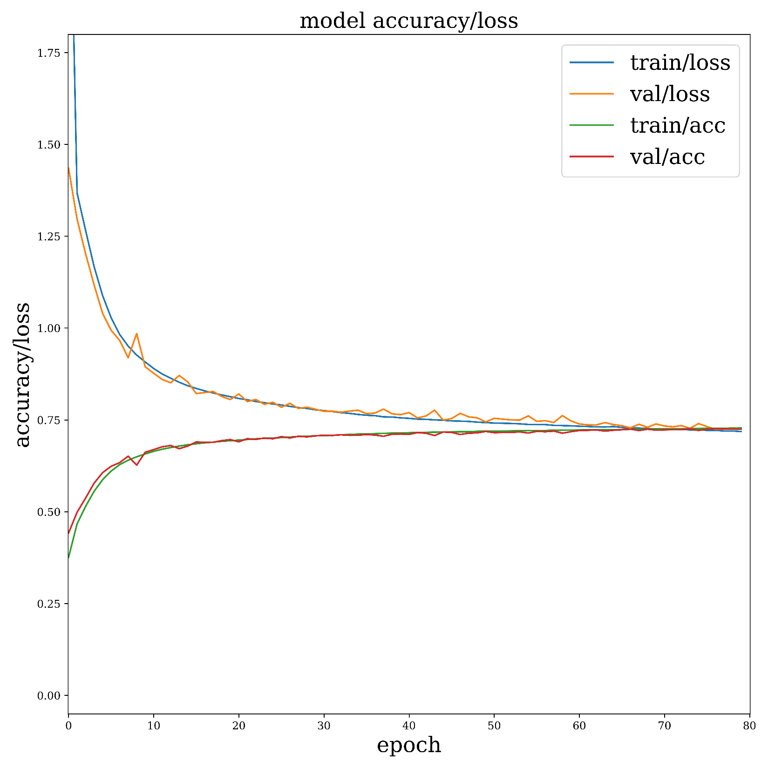
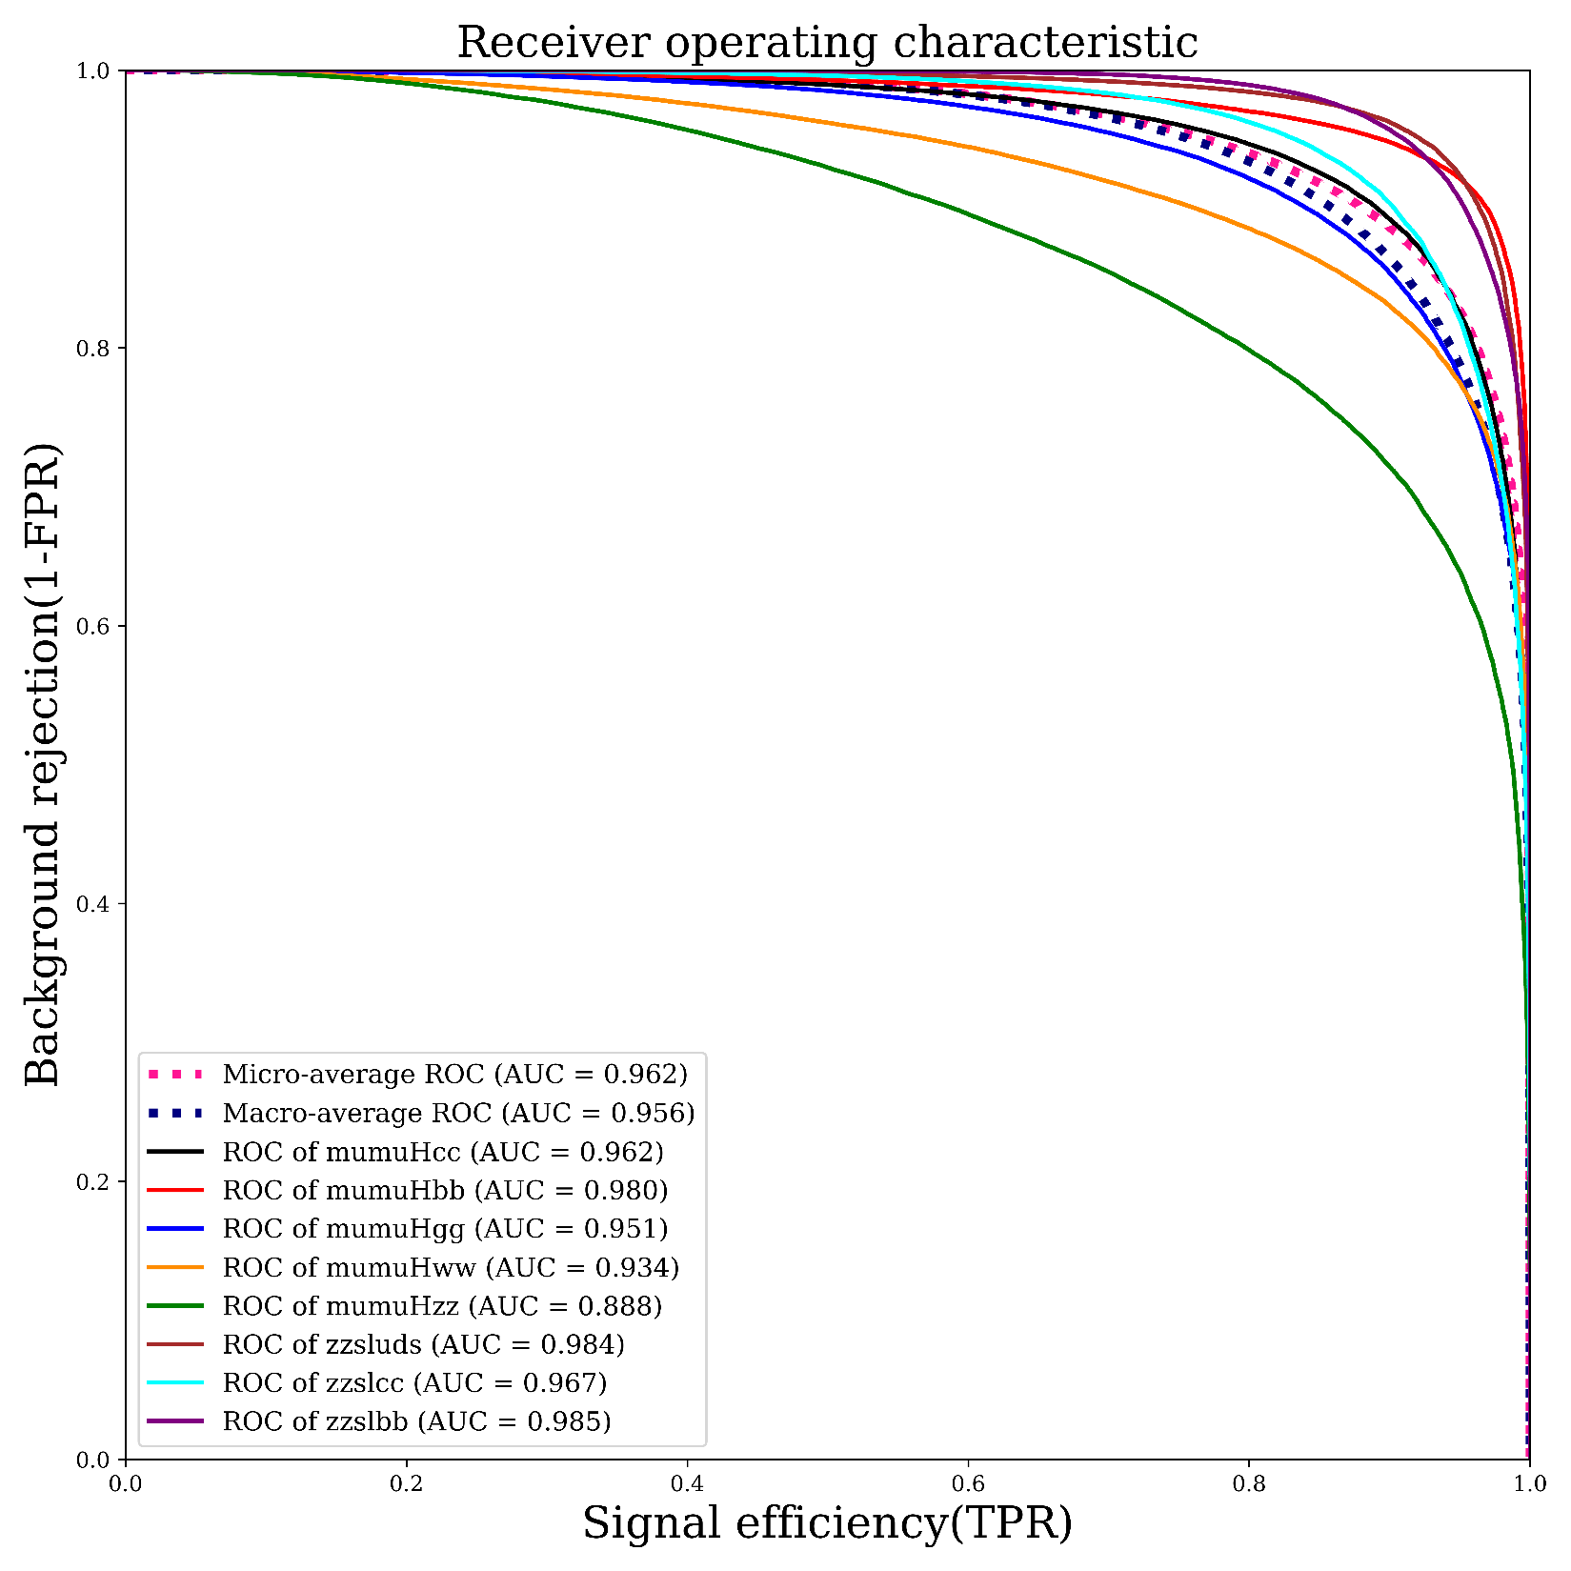
Training Results
1st results
400k events per-sample (3.2M all)
Training:Validation:Test = 8:1:1
2nd results
80 epochs,
72%-73% overall accuracy
no over training is found

Slide 9
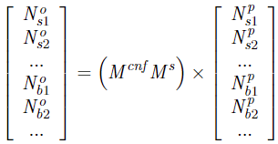
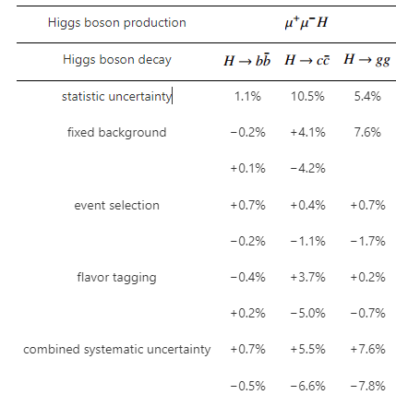
Results of H->bb/cc/gg with Modified PFN
Observed
Process Event Yields
Denoting
Selection Eff
Previous results
Confusion Matrix
Uncertainty of N^{p}
process | μμH->μμbb | μμH->μμcc | μμH->μμgg | μμH->μμww | μμH->μμzz
1st results | 1.0% | 9.1% | 3.5% | 3.1% | 29.%
2nd results | 1.0% | 8.9% | 3.5% | 3.2% | 31.5%
Improvement performance in H->bb/cc/gg, especially for H->gg and H->cc

Slide 10
Some technical notes
工欲善其事，必先利其器 –孔子
To Do something well, sharpen your tools first -Confucius
Model training requires computing power
Solution: Storage server + fiber connection + GPU server + LoadingModular
Storage Server:
A100 GPU Server
10 Gb optical fiber nfs
~30 min training 3.2M events in 80 epoches
Cache(nv m2 ssd raid)
Multiple thread loader modular: loading ~20 GB data in less than 20 seconds (takes more than 20 min by uproot4)
…
Hadd Raid

Slide 11
Summary and Prospect
PFN is demonstrated to be a powerful tool to identify multiple jets FS
Kinematics information: particle momentum/angular distribution, multiplicity etc.
Flavor information: D0/Z0 and their significance
The PFN Φ-Layer can integrate other type of object to improve performance
E.g. vertices information for jet flavor identification
Huge size of training sample are necessary
Event filter is a solution to the problem of huge computing resources required
Fast loading tool is very helpful to cooperate with hardware
Architecture improvement:
A vector of weight implemented in Φ-Layer summation? (1D weight->mult-Dim W)

Slide 12
Backups

Slide 13
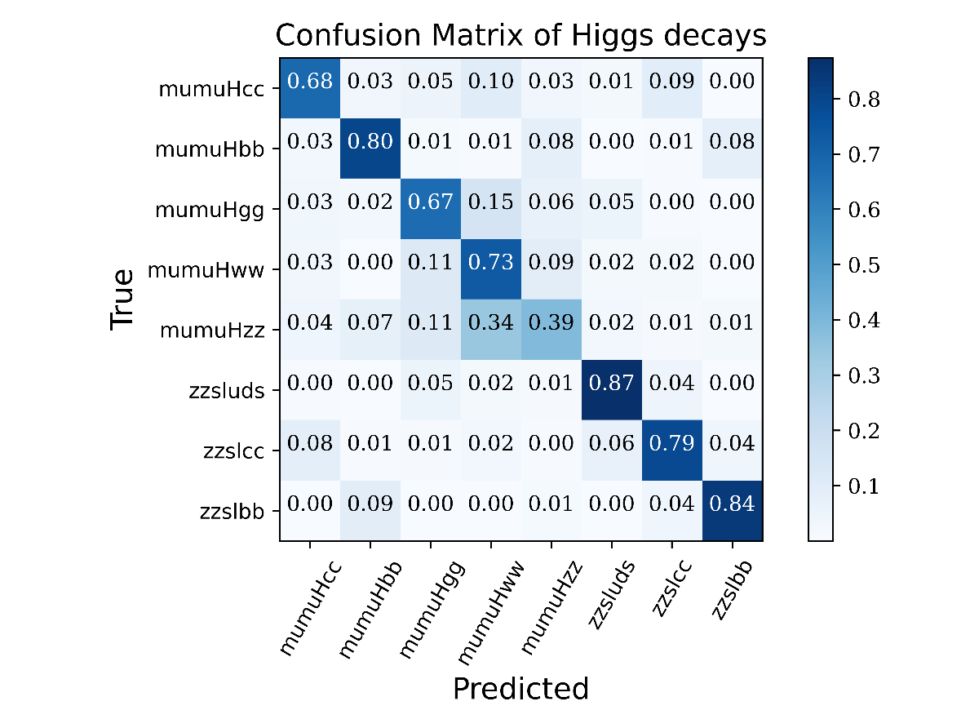
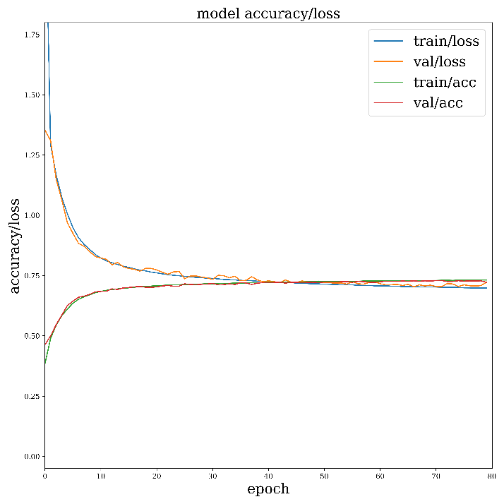
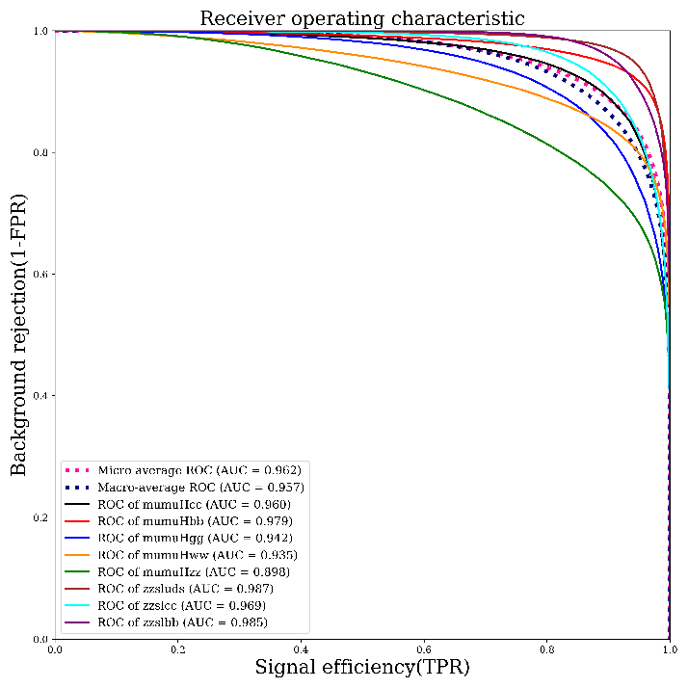
Training results with full hadronic Hww/zz

Slide 14
Comparison between different configuration
Vertex information improve H->gg/cc precision significantly
D0/Z0 is essential to Flavor tagging

