Slide 1
Progress in the design
Of CEPC Detector Beampipe
Ji Quan
July 5, 2023

Slide 2
Content:
General introduction
Detailed structure
Simulation analysis
Summary and Next plan

Slide 3
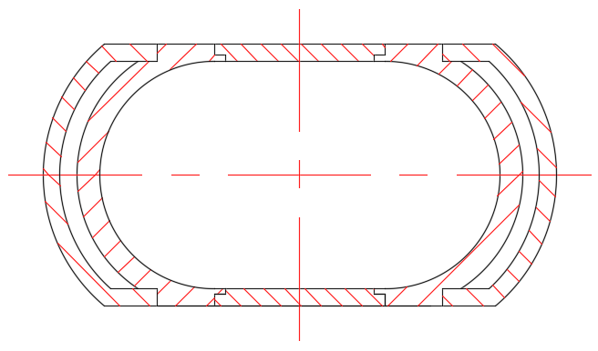
General introduction
General drawing
a. The extending Al pipe
b. The central Be pipe
c. Air channel
d. Carbon fiber cylinder
e. Combination flange
BPM
LumiCal
Vertex
LumiCal
BPM
Extending pipe
Both sides : Double
Top and Bottom : Single
Basic Structure:
1) Components : a, b, c, d and e
2) Detectors : BPM, LumiCal and Vertex
Total length : 1400 mm
Updated design :
1) Added detector : BPM
2) Extending pipe : From Conical pipe to Gradient runway

Slide 4
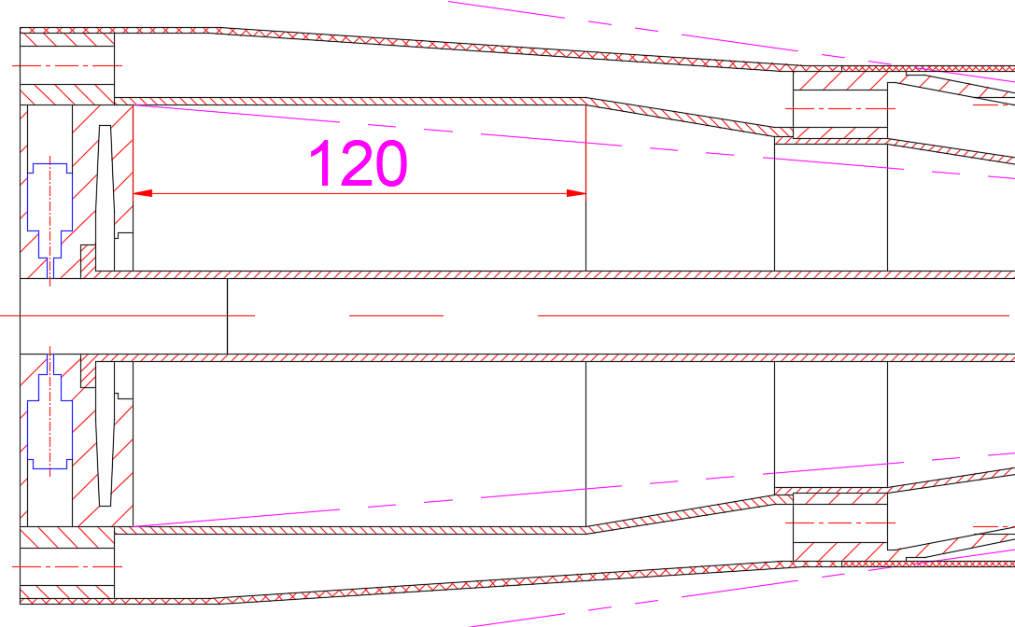
Detailed Structure
Three detectors --- BPM and LumiCal
Installation position
BPM
1. A 2 or 4 electrode-BPM is installed in
each flange
LumiCal
1. Near the flanges, axial length is 120mm
LumiCal
BPM : 2 or 4 electrodes

Slide 5
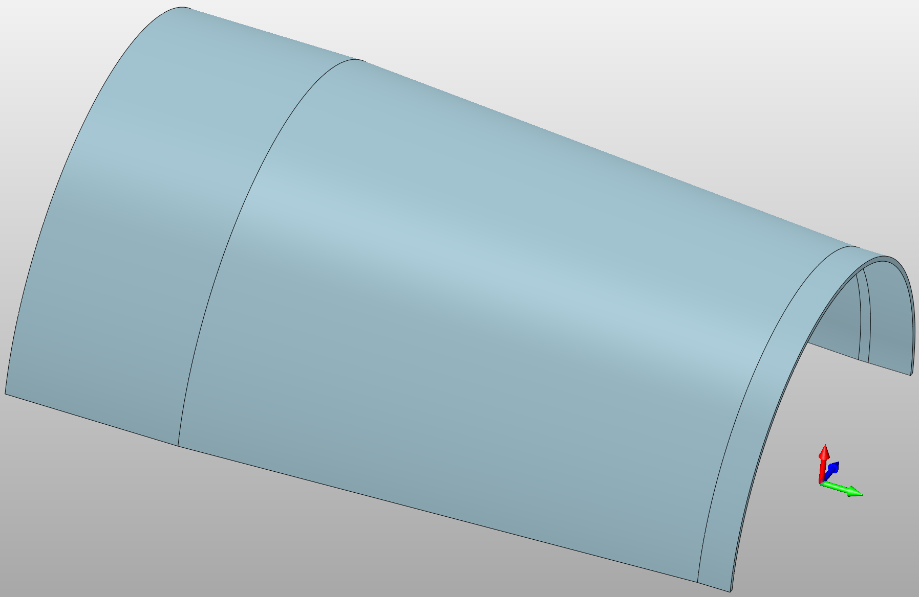
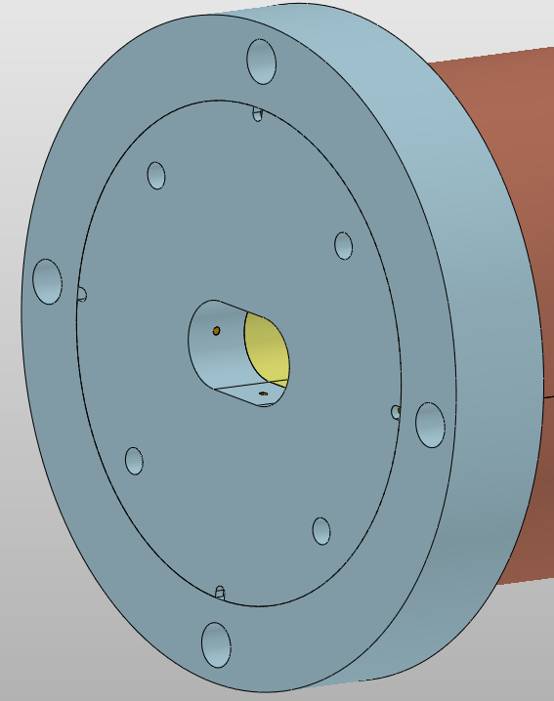
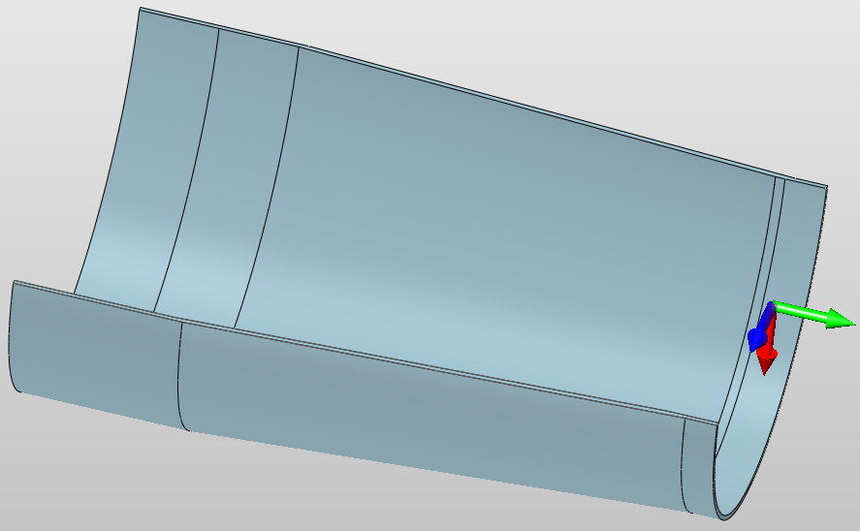
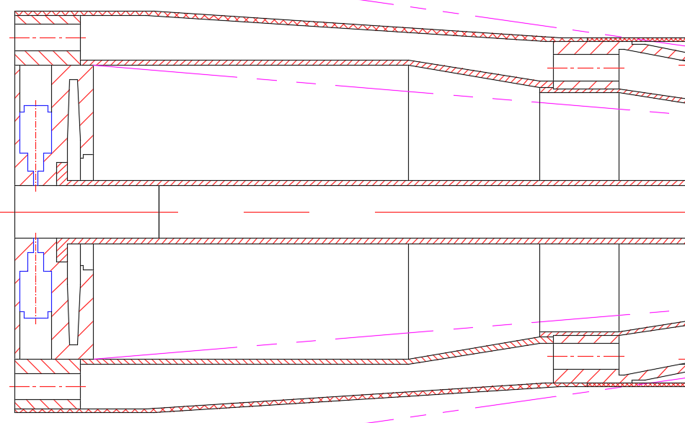
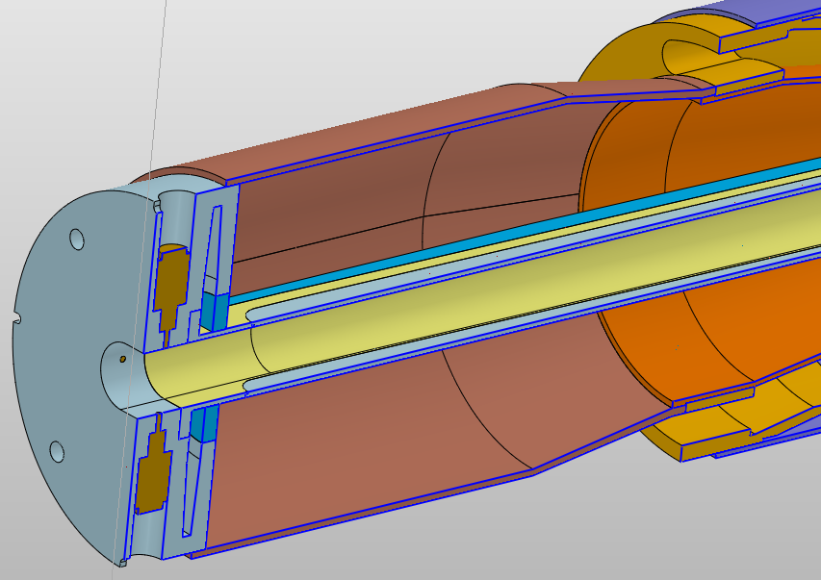
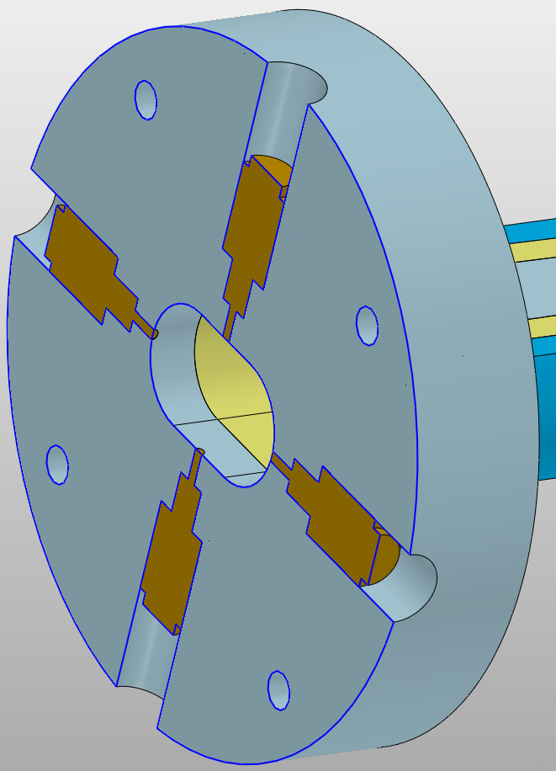
Detailed Structure
Three detectors --- BPM and LumiCal
half-ring protection cylinder
Installation and maintenance --- BPM
Outer big flange
Two or Four
Electrodes
Outer half-ring protection cylinder
BPM Maintenance status
Outer big flange

Slide 6
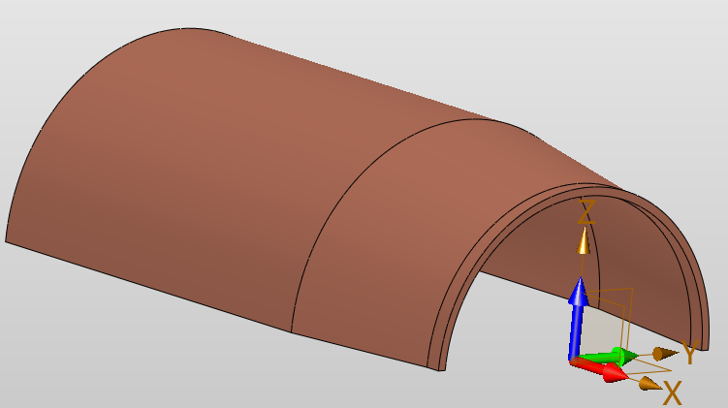
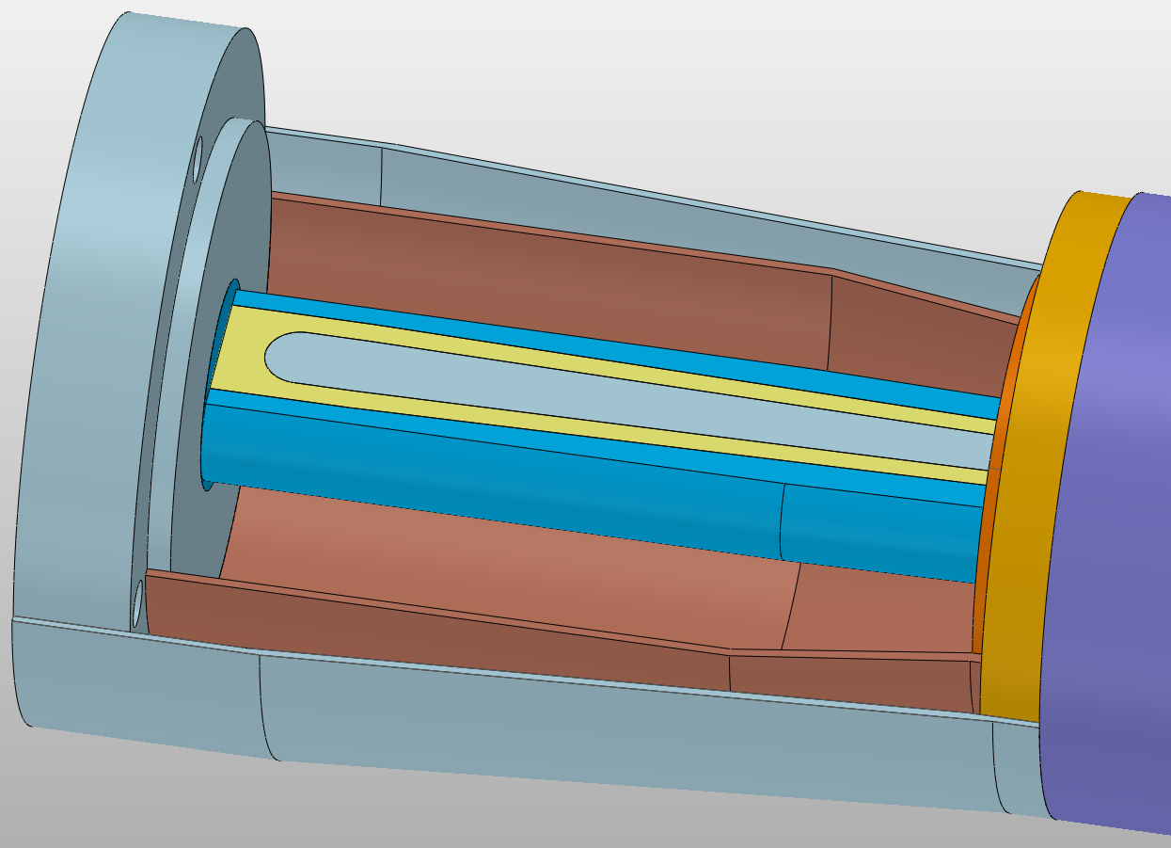
Detailed Structure
Three detectors --- BPM and LumiCal
Installation and maintenance --- LumiCal
Outer half-ring protection cylinder
Inner half-ring protection cylinder
LimuCal Maintenance status

Slide 7
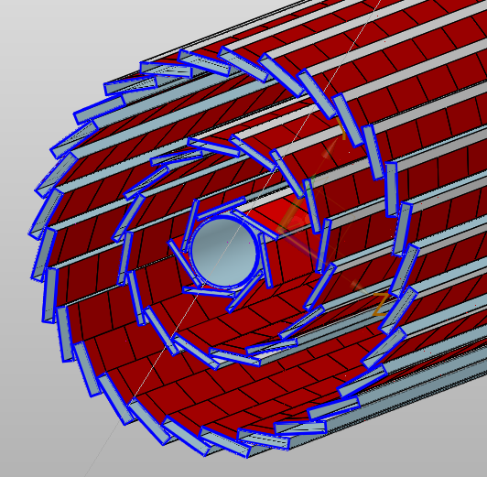
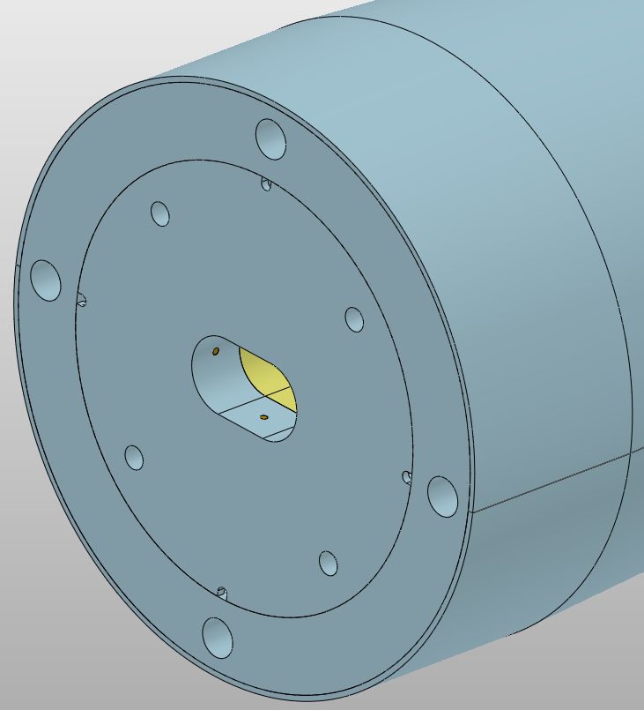
Detailed Structure
Three detectors --- Vertex
The Vertex detector contains only barrel part which
consists of three double layers
Air-cooled inlet
Air-cooled channels and support structures
Air-cooled outlet
Air-cooled inlet
Cooled structure :
Three layer air cooled channel
Air-cooled outlet
Take away
The heat generated
by chips and electronics
Design requirement
T ≤ 20 °C
△T < 10 °C or 7 °C
Vibration < 1μm (?)
Four inlets , four outlets
Three double layers

Slide 8
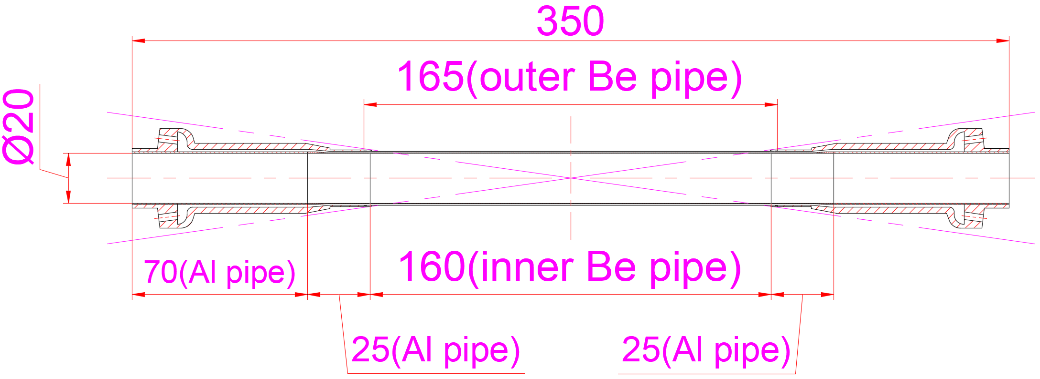
Detailed Structure
The Central Be pipe
Cooling structure :
Double-layer pipe
Total length : 350 mm, Gap : 0.35mm(Coolant)
Coolant :
H₂O or Paraffin
Take away
Thickness of outer Be pipe: 0.15 mm
Thickness of inner Be pipe: 0.20 mm
HOM heat

Slide 9
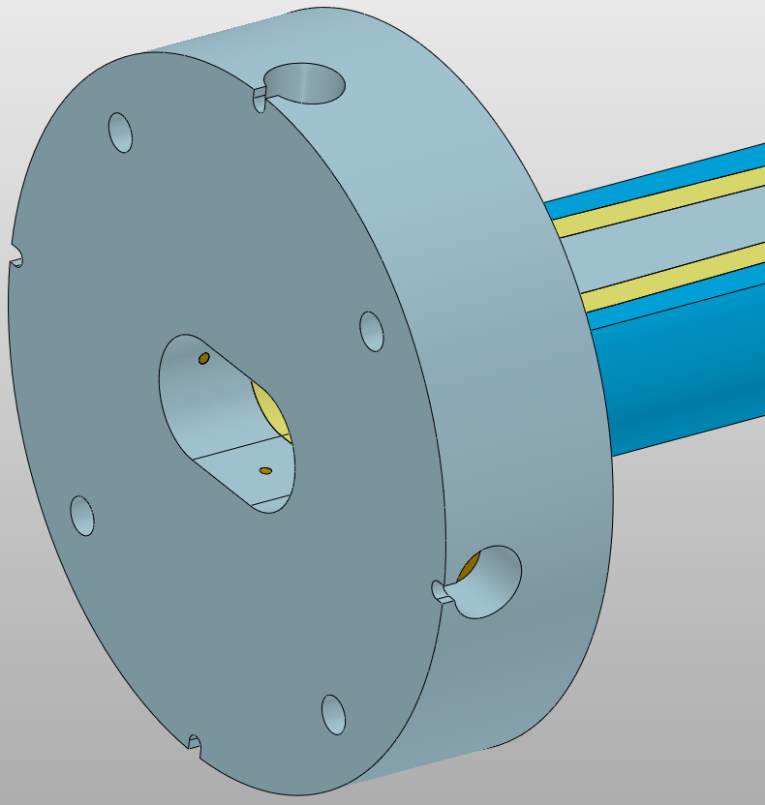
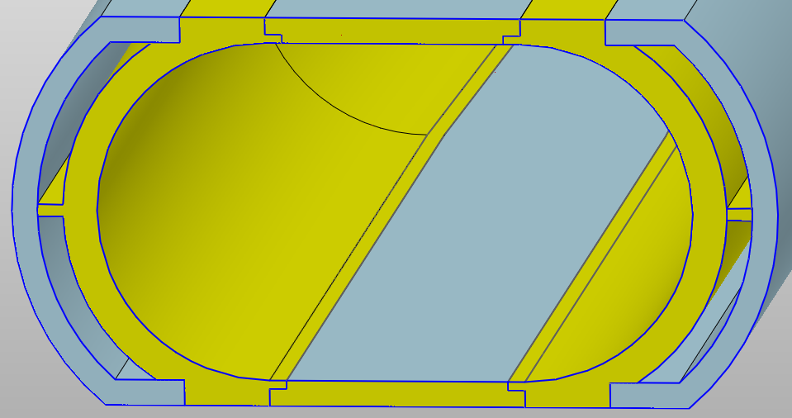
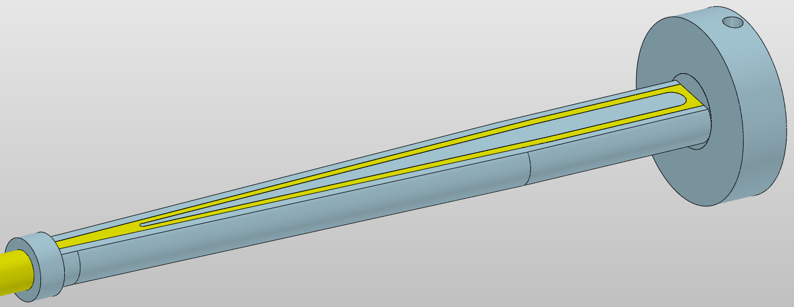
Detailed Structure
The extending Al pipe --- Gradient runway type
Thickness of single layer beryllium sheet : 1.5 mm
Double layer
construction
Double layer
construction
Take away
Take away
HOM heat
HOM heat
Coolant : H₂O
Installation space for LumiCal
Total length : 525 mm
The extending Al pipe

Slide 10
Simulation analysis
Thermal analysis --- Beampipe
The design principle is to keep
the outer surface temperature as low as possible
Try to decrease the surface temperature further to meet the requirements of detectors
Outer surface temperature of the beampipe : ≤ 20 °C

Slide 11
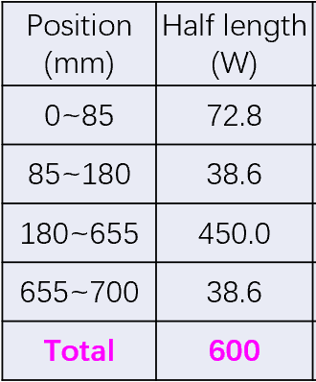
Simulation analysis
Thermal analysis --- Beampipe
HOM heat : (Half length)
Thermal load for calculation (Half length)
From : Liu Yudong
Calculation errors
safety factors
Thermal load on the inner surface of the beam pipe :
600 X 2 = 1200 W

Slide 12
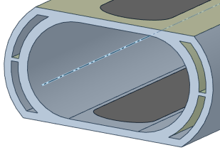
Simulation analysis
Thermal analysis --- Beampipe
Inlet temperature: 16℃
Inlet velocity : 1 m/s
Turbulent
Coolant : H₂O
2 inlet, 2oulet
Inlet temperature: 16℃
Inlet velocity : 0.8 m/s
Laminar
Coolant : Paraffin or H₂O
4 inlet, 4 outlet
Inlet temperature: 16℃
Inlet velocity : 1 m/s
Turbulent
Coolant : H₂O
2 inlet, 2 outlet
Results
Of the overall
Highest temperature position(Transition section)
Coolant : paraffin
Overall temperature field distribution
Coolant : H₂O
T(Max) : 31.1℃
T(Max) : 26.7℃

Slide 13
Simulation analysis
Thermal analysis --- Beampipe (Central Be pipe)
Results
Of the Central Be pipe
Coolant : paraffin
Coolant : H₂O
Δt=2.4 ℃
Δt=1.0 ℃
ΔP=37.3 kPa
Transition section
ΔP= 21kPa
Outer surface temperature
of the outer Be pipe
Outer surface temperature
of the outer Be pipe

Slide 14
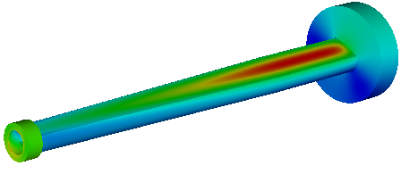
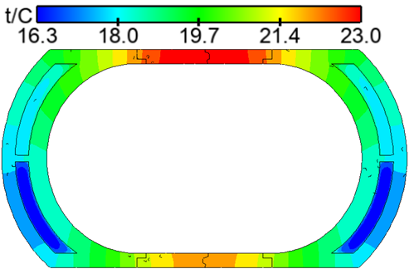
Simulation analysis
Thermal analysis --- Beampipe
Results
Of the extending Al pipe
Outer surface temperature
of the extending Al pipe
Top temperature
Temperature of Be sheet
Bottom temperature
Section temperature distribution(x=585mm)

Slide 15
Summary and Next plan
Summary
1. The preliminary mechanical design of the beam pipe has been finished
2. About three detectors
On the Beampipe, the space has been reserved for LumiCal
Mechanical design of BPM and Vertex have been finished, and the interface design
with the beam pipe has been determined
3. The preliminary study on thermal analysis of beam pipe has been performed, the temperature could
meet the requirements.
Next plan
1. The optimization of the air-cooling scheme would be conducted based on the overall simulation.
2. The impact due to vibration for the Vertex must be studied and simulated
3. The corrosion between the coolant and the Be pipe must be studied

Slide 16
Thanks

