Slide 1
Amplitudes from Scattering Equations and Q-cuts
Amplitudes 2017, Edinburgh
N. Emil J. Bjerrum-Bohr
Based on work together with:
C. Baadsgaard-Jepsen, J. Bourjaily, S. Caron-Huot, P. Damgaard, B. Feng)
(arXiv: 1508.03627 and 1509.02169)

Slide 2
Scattering equation and new representations of amplitudes
We have recently witnessed a number of new formulations of perturbative amplitudes
  A particularly intriguing new concept is the scattering equation formalism
Color trace factor, very alike to cyclic trace in MHV amplitudes
Algebraic solutions
Pfaffian (depends on polarizations
and momenta)

Slide 3
The N-point scalar amplitude
For the N-point scalar amplitude (s = 0) one has
Here
Sum over solutions
Generally complicated solutions
at higher points. N-roots of
Polynomial equations.
(can be complex)
are the scattering equations where
Much like standard Kobe-Nielsen gauge fixing

Slide 4
The N-point gluon amplitude
For gluons (s = 1) we have
Sum over solutions
Cyclic trace
Polarizations and momenta

Slide 5
Some results
5
Some results
Proof of amplitude formulas via BCFW Recursion
(Dolan and Goddard)
Scattering equation formalism from the view point of Ambi-twistor space. (Mason and Skinner; Adamo, Casali and Skinner; Casali and Tourkine) (See Mason’s talk)
Scattering equation formalism from the view point of pure spinor formalism. (Berkovits; Gomez and Yuan)

Slide 6
Using the scattering eq. formalism
Basically currently options for evaluation:
  Direct numerical solutions
    Numerically very hard beyond 7pt .. Normally (real) numerical results from 6pt up. (See also e.g. Dolan and Goddard; Søgaard and Zhang; Bosma, Søgaard and Zhang)
  Using rules for evaluation of residues: scattering eq. rules for scalars, see e.g. (Cachazo, He and Yuan; Baadgaard Jepsen, NB, Bourjaily, Damgaard, Feng; Gomez) and recent extension to gluons (NB, Bourjaily, Damgaard, Feng; Cardona, Feng, Gomez and Huang)

Slide 7
Point of view :
CHY formalism viewed as a very explicit truncation of low-energy string scattering.
  Useful: no need for integrations
  Advantages: Certain string considerations/symmetries can carry over…
    E.g. both CHY formalism and string theory share invariance under Mobius transformations and amplitudes are built up in similar ways.
  Important feature: in our approach the Koba-Nielsen factor is kept partially in derivations..
(NEJB, Damgaard, Tourkine, Vanhove)

Slide 8
Comparison between scattering equations and traditional string theory
String theory
  Integration in an ordered manner along the real line.
  Poles comes from pinching regions.
  Scattering eq. prescription
  Integral saturated by delta-function and amplitude
  becomes localized.
  Solutions not necessarily on real line.

Slide 9
Integration rules for scattering eq.
  The rules
Have integrand H(z) with weight 2 in all variables (Mobius invariance).
The integration rule is
If:
(Baadsgaard-Jepsen, NEJBB, Bourjaily, Damgaard)
Integrand has factors where
Set of points (or compliment set of points)
All pairs of set have to satisfy that either they are nested (or their compliment are).
Starting point: find nested sets in diagram.

Slide 10
Integration rules for scattering eq.
  Example

Slide 11
Some interesting observations in the ’tree’ scattering equation formalism
  Scattering Equation formalism : no specific dimension.
  The CHY approach extendable to many different field theories (for example through dimensional reduction). (Cachazo, He, Yuan)
  E.g. all CHY integrands can be recast into a (not necessarily natural) basis of scalar Feynman diagrams.

Slide 12
Integration rules for scattering eq.
  Scalar theories
Think about the scalar amplitude integrand
This is the double line diagram between points 1 to n.
It will as its result after summing over the (n-3)!
solutions give the result for the n point tree.

Slide 13
Example: 6 point scalar tree
Example
=
6 + 6 + 2
CHY expression
Individual Feynman diagrams
Using partial fractions we can in fact arrive at many
different representations of amplitude

Slide 14
Yang-Mills theory
Analytic expressions for gluon amplitudes can be directly written down using the integration rules as well as the monodromy prescription.
This gives yet a another method for computation of amplitudes in D-dimensions.
Additional feature: monodromy transformation of diagrams.
Results can be refined so that we also can directly generate analytic results for BCJ numerators.

Slide 15








Loop amplitudes
Doing analog of the string theory pinching rules for loop amplitudes is not trivial.
However loop amplitudes in the ambi-twistor-string formalism can be explored by a special rewriting (Casali and Tourkine;Geyer, Mason, Monteiro, Tourkine)
(See Mason’s talk)
This leads to the loop scattering equations on the Riemann sphere

Slide 16

Loop amplitudes
These equations:
Are understood as scattering equations for an ’off-shell’ and
If we can write down amplitude expressions using these scattering equations we arrive at tree expressions for amplitudes with n+2 legs, with forwards limits in the two loop legs: and
E.g.

Slide 17
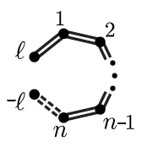

Loop amplitudes
For
Same rules as for trees except:
Any channel with
has to be treated off-shell
We exclude the set
(removes tad-poles)
(Baadsgaard-Jepsen, NEJBB, Bourjaily, Damgaard, Feng)

Slide 18
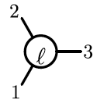
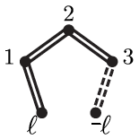



Example 3 point scalar loop amplitude
We will first consider a three point scalar loop amplitude:
We have the diagram
Now using the integration rules we get poles:

Slide 19
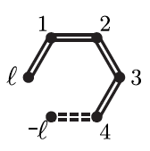
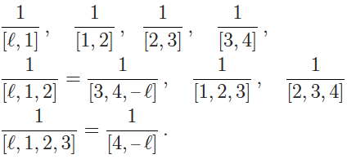

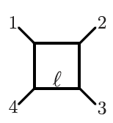
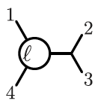
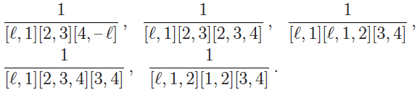
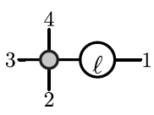
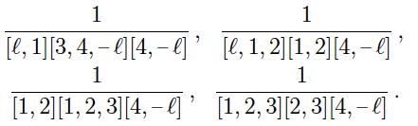
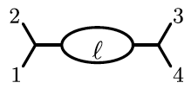
Example 4 point scalar loop amplitide

Slide 20

Observations
The scattering equation formalism gives a different type of representation of the loop integrand
Also in the scattering equation loop formalism for other theories such as Yang-Mills.
Turns out we can understand such transformation from traditional Feynman diagrams via a special type of rewriting. (See also Gomez talk)
Linear propagators
(looks on-shell)
Scattering equation formalism
Traditional Feynman formalism

Slide 21

Scattering equation motivated partial fraction identities
Integrands in the Feynman form and the new scattering equation from can be related via partial fractioning identities
Such identities was also used by (Geyer, Mason, Monteiro, Tourkine)
The explains why the scattering equation formalism is correct but can we work directly with linear propagators without rewriting?
Turns out we can through the introduction of the Q-cut.

Slide 22
Generalization of partial fraction identities
Assume we start from Feynman propagators
Now if we apply the following type of shift
By the deformation we get:
Can think of the ‘loop’ momentum
being put to on-shell in a higher
dimension

Slide 23
Generalization of partial fraction identities
Using Cauchy theorem on the residues we get that terms associated with residue z=0 can be traded for terms of the form:
Thus we can use this to express the integrand in terms of linear propagators.
Now we will exploit the fact that we can do one more partial fraction expansion (because of the linear propagators)

Slide 24
Generalization of partial fraction identities
We have residues in
And in
As well as in
And a number of finite locations where the propagators are.
Now we can define the Q-cut in the following way:
If we consider a given pole in the Feynman integrand we will have a factorization.
The two types of deformations considered above, will land us on the Q-cut.
Recover original
expression
Scale-free integrals

Slide 25
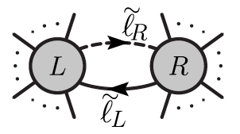
Definition of the Q-cut
We can write the Q-cut down in the following way:
We impose:
denotes a partition of external legs

Slide 26
Definition of the Q-cut
Sum over polarizations in D dimensions, we can e.g. work
with a split up in 4 dimensional components, and scalar
extra dimensional [ (HV) regularization .]
In fact not very different from a generalized D-dimensional
unitarity cut, but with different ‘cut conditions’ and
linear propagators.

Slide 27
Comment: On the contour of integration
In relation to the Q-cut is the need to fix the causal structure.
For the normal (squared) Feynman prescription, the causal structure is fixed by the in the propagator.
If we start from a specific Feynman graph and keep track of the (signs) of contours – we can use the original prescription even in the linear case.
However if we want to start with an expression with only linear propagators – here it turns out that we have to use a principle value prescription.

Slide 28
The Q-cut
The sum over the different Q-cut factorizations at one-loop reproduce any amplitude.
It can be shown that the Q-cut can be mapped to a normal unitarity cut. (See Huang, Jin, Rao, Zhou, Feng).
It is clear that methods is applicable to higher loops as well.
At two loops we can consider a three parameter deformation family in

Slide 29
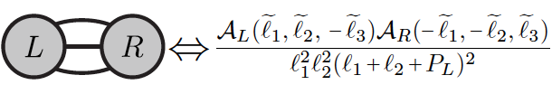








The Q-cut
This leads to the following types of Q-cuts

Slide 30
Conclusions
Q-cuts techniques have wide applicability especially for theories that naturally lead to linear propagators.
Regulates the problems associated with forward limit integrands.
The Q-cut is foremost a computational tool that allow us to eliminate redundancies in a new efficient way.
Opens up new avenues for computation.

Slide 31
Conclusions
Conceptually it is interesting that the scattering equation formalism provides us with expressions that have new features / freedom / symmetry compared to a normal Feynman expansions.
Future work:
  It might be possible to improve the contour prescription of the Q-cut. This would lead to more efficient computation.
  Theory: Origin of linear propagator prescription?
  Q-cuts in Yang-Mills theory and gravity: new light on loop BCJ/KLT type identities from scattering equation prescription?
  (See e.g. He and Schlotterer; He, Schlotterer, Zhang)
(See Gomez’s talk)
(See Schlotterer’s talk)

Slide 34
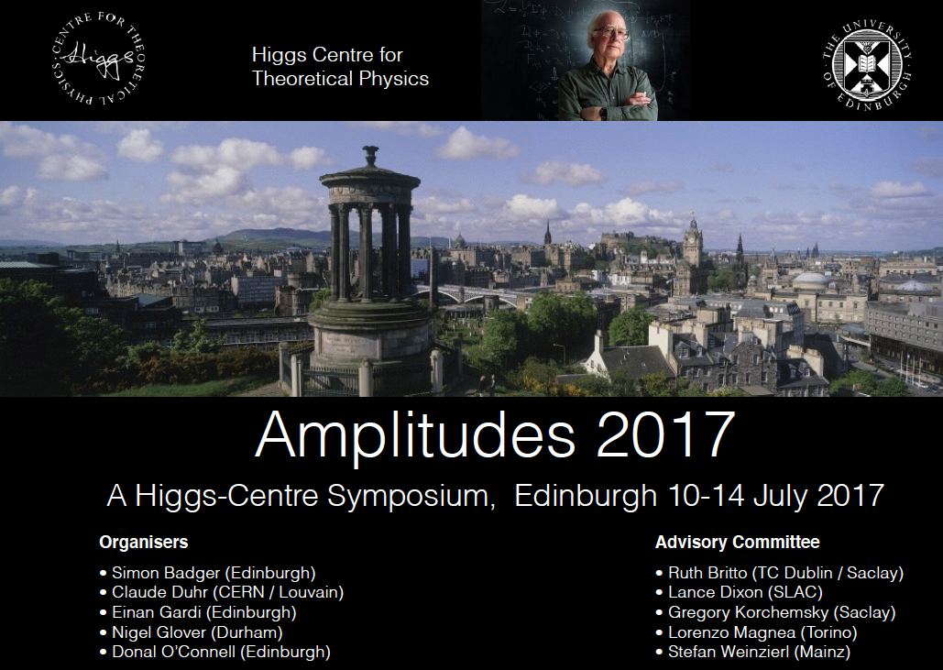
Thank you!

