Slide 1
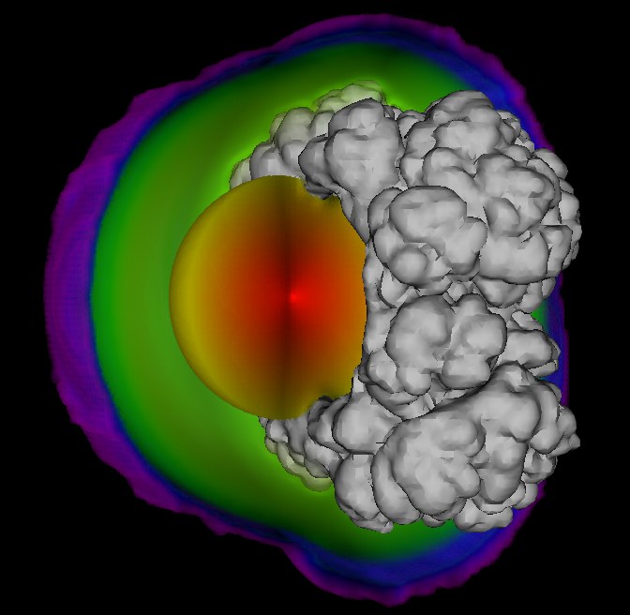

Investigating Observational Signatures of Type Ia Supernovae through 3D Radiative Transfer Simulations
Fionntán Callan¹
Christine Collins²
Stuart Sim¹
¹ Astrophysics Research Centre, Queen’s University Belfast ² GSI Helmholtz Centre for Heavy Ion Research

Slide 2
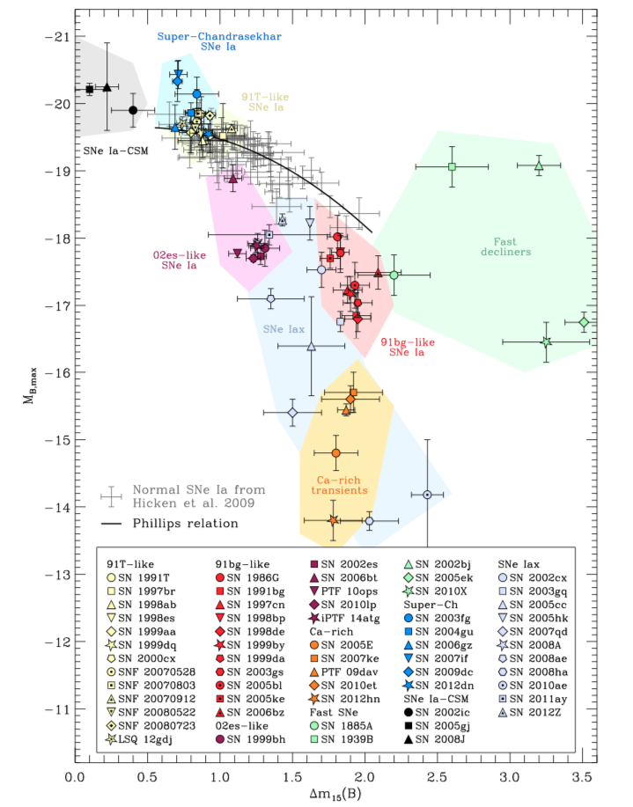
Type Iax Supernovae
In comparison to ‘normal’ type Ia supernovae type Iax:
  Are sub-luminous and span a much larger range of peak luminosities (approx. -14 to -19 mag)
  Show ejecta velocities approximately half that of normal type Ia supernovae
  Show some spectroscopic differences
  Believed to leave behind a bound remnant
2
Taubenberger (2017)

Slide 3
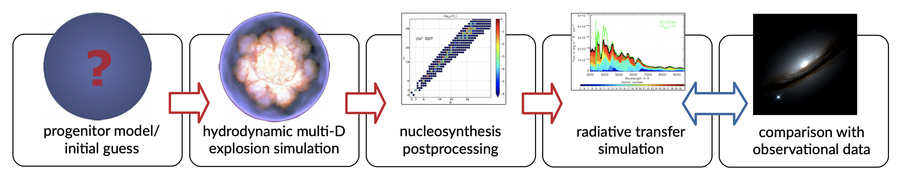
Simulation Pipeline
Röpke and Sim (2018)
3

Slide 4
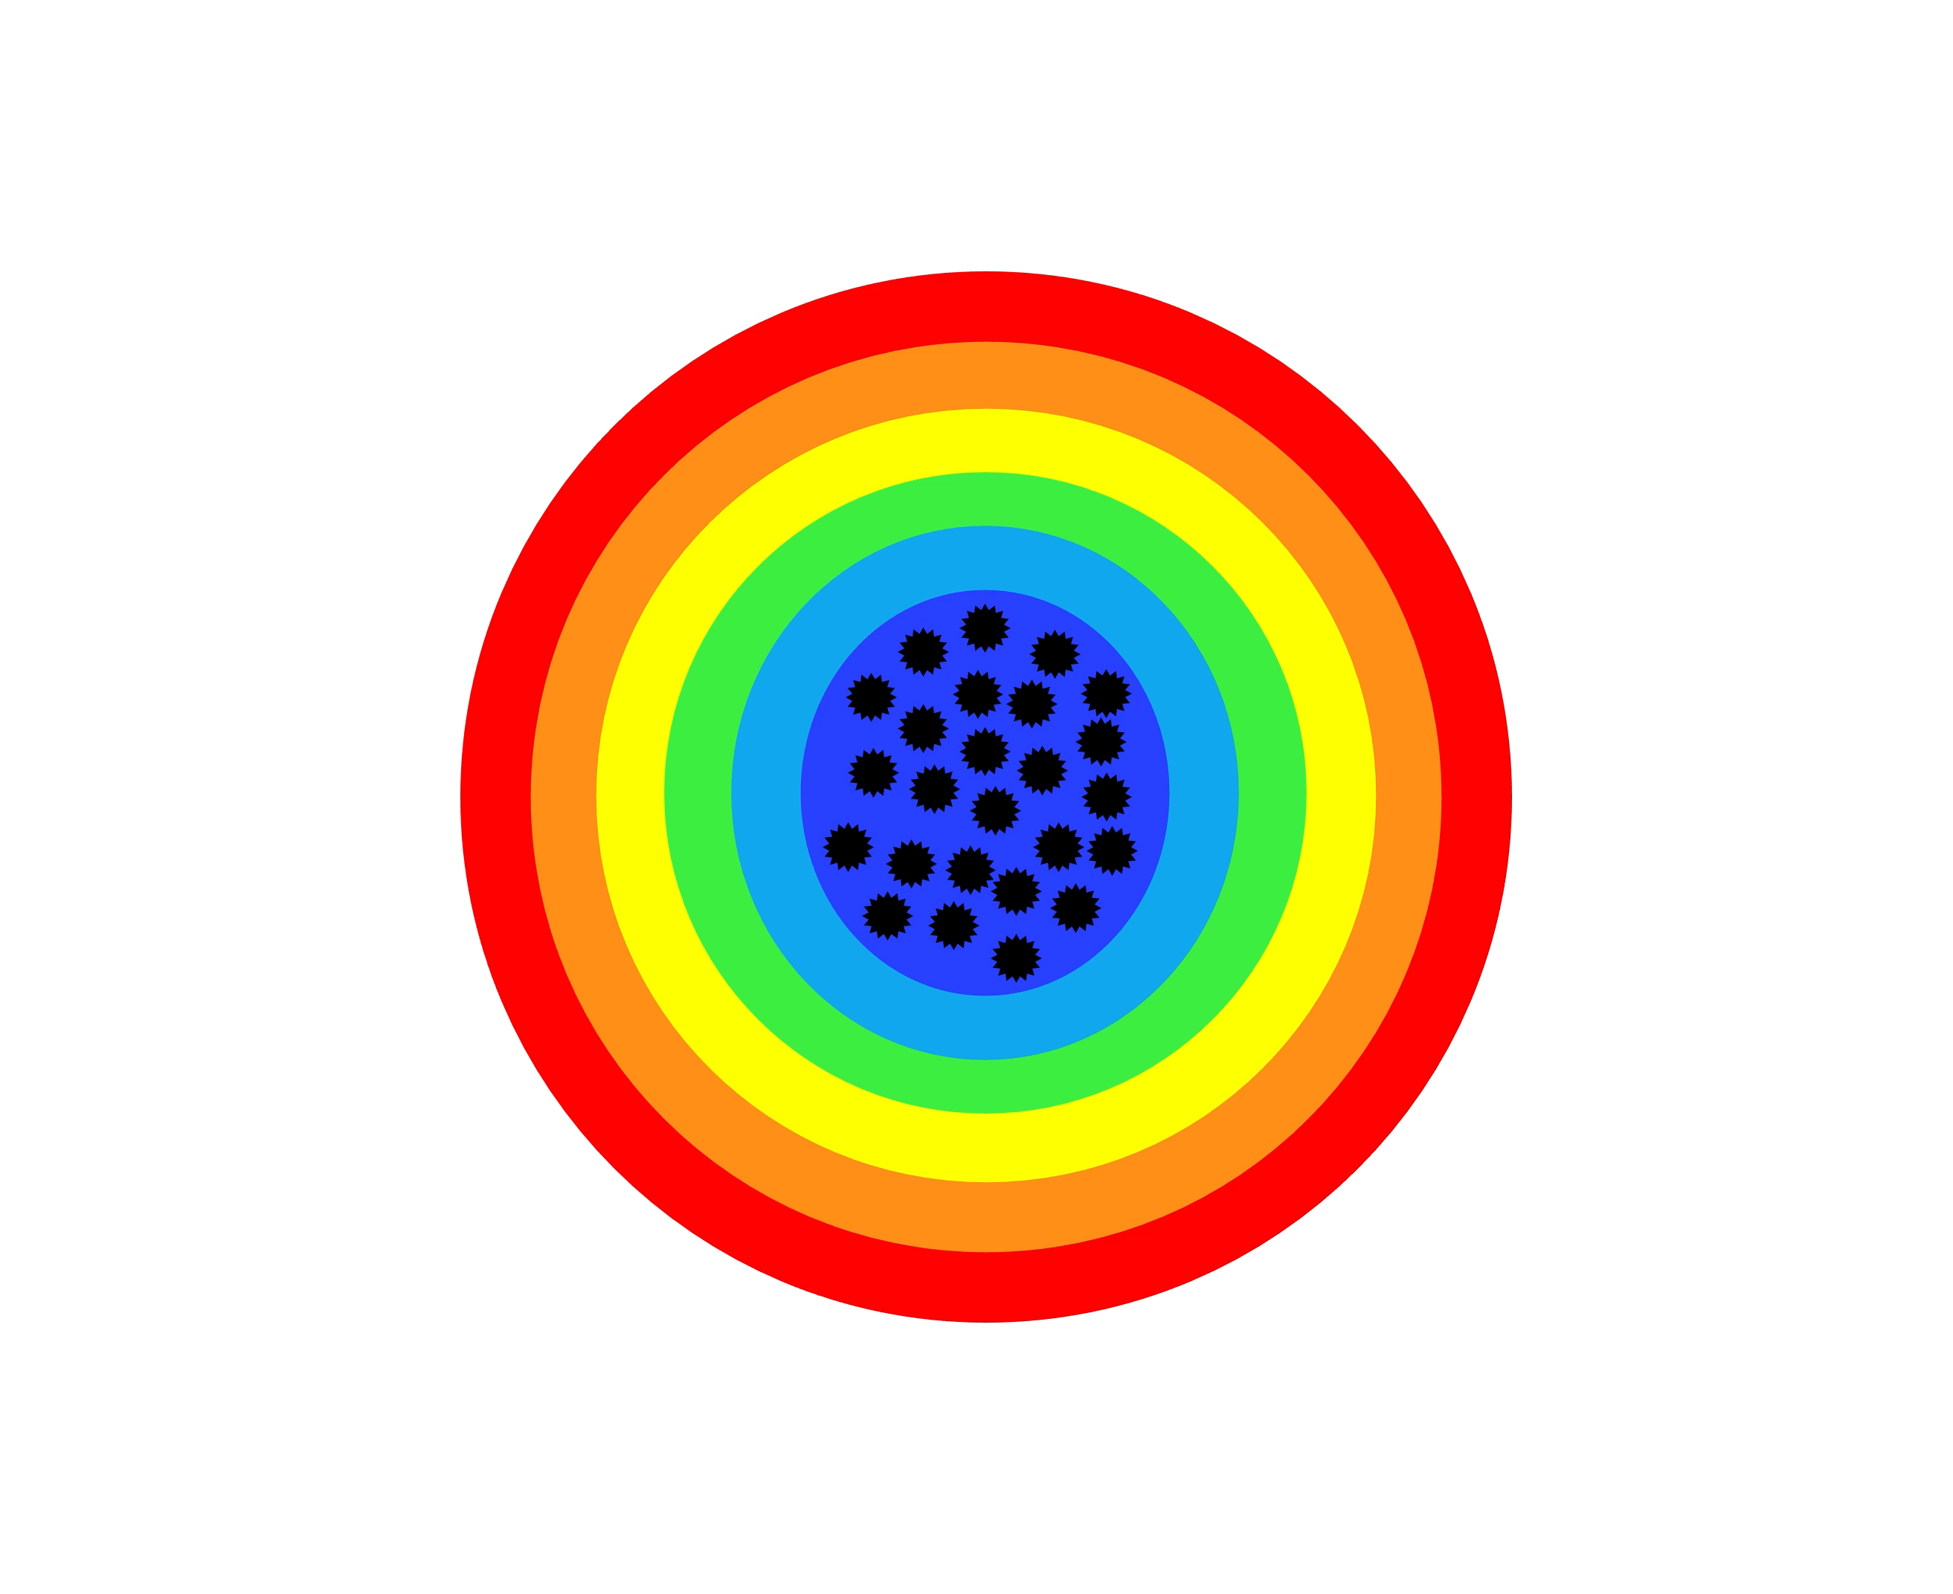
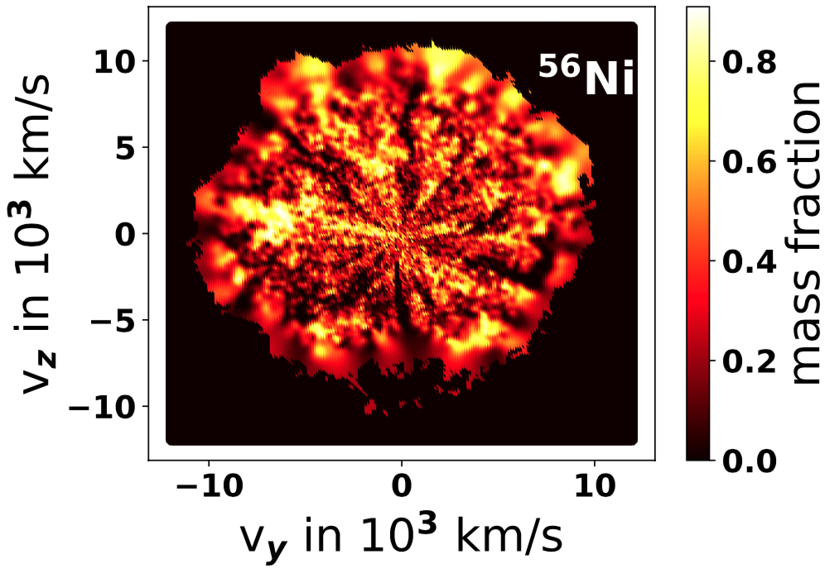
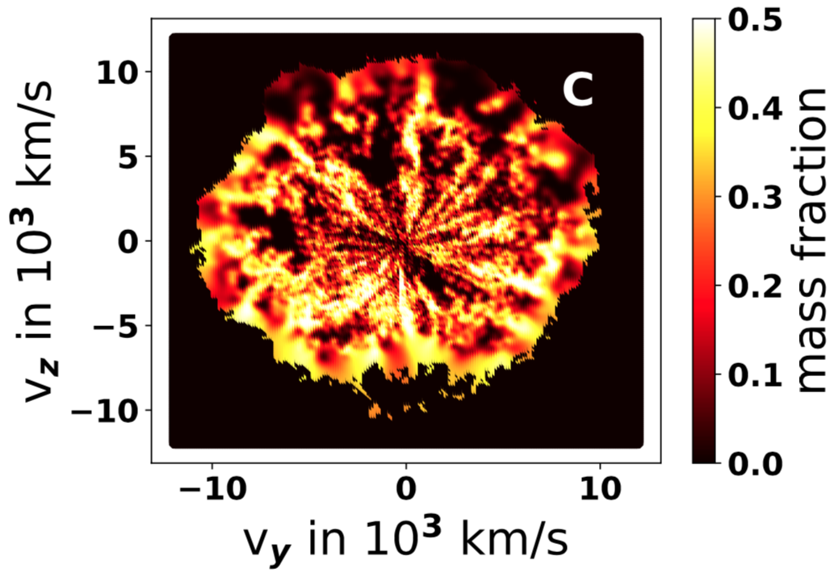
Simulation Pipeline
Röpke and Sim (2018)
ARTIS (Kromer & Sim 2009, Shingles+ 2020):
3

Slide 5
3D Simulations of M_{Ch} CO WD Pure Deflagrations for Type Iax Supernovae
4
Lach, Callan+ (2022a)

Slide 6
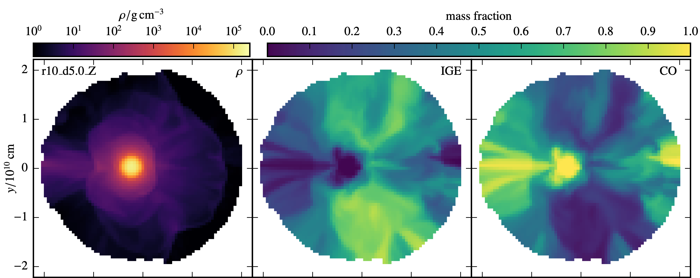
Luminous Remnant
Luminous remnant may have been directly observed for a SNe Iax (Foley+, 2014)
Modelling work suggests this may explain peculiar late time behavior of SNe Iax e.g. Kromer+ (2013, 2015), Shen & Schwab (2017), Maeda+ (2022)
Many deflagration models predict luminous remnant e.g. Jordan+ (2012), Fink+ (2014), Lach, Callan+ (2022)
Structure consists of CO core surrounded by envelope polluted with burning products
Represented in our RT simulations as central ⁵⁶Ni source emitting as a black-body of fixed characteristic temperature
5
Lach, Callan+ (2022)

Slide 7
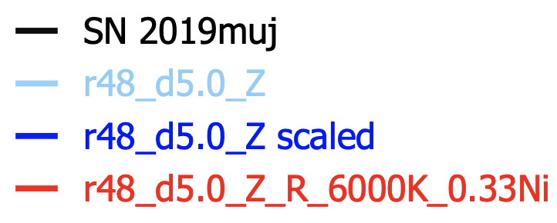
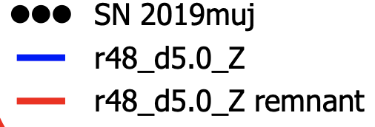


Impact of Including Luminous Remnant in RT
Standard def
Standard def scaled
Remnant included
Standard def
Remnant included
6
Callan+ (in prep)

Slide 8
Pure Deflagrations Summary and Future Work
Conclusions
  Luminous remnant strengthens the case of pure deflagrations of M_{Ch} CO WDs for SNe Iax
  Not all energy injected in the remnant can contribute to optical display – winds, delayed radioactive decays (Shen and Schwab 2017), secondary ejection (Maeda+ 2021)?
Future work:
  These simulations were carried out using an approximate NLTE treatment of the plasma conditions – Shingles+ (2020) recently upgraded ARTIS to including full NLTE treatment of microphysics
  3D NLTE ARTIS simulations spanning early to late (nebular) phase
  Hydro simulations following the remnant in detail
7

Slide 9
Double Detonations in Sub-M_{Ch} CO WDs
Simulations predict fairly high abundances of unburnt He in the ejecta
Radiative transfer simulations simulations that do not consider non-thermal effects do not predict He features
SNe Ia ejecta temperatures are not high enough to thermally populate the He I n = 2 levels sufficiently to produce observable He features
Collisions with non-thermal electrons (produced by γ-rays from the decays of ⁵⁶Ni) may sufficiently increase the level populations (Boyle+ 2017)
He Shell
CO Core
8

Slide 10
Potential Helium Signature for Double Detonations Scenario
+ 5d explosion
Recent upgrades to ARTIS (Shingles+ 2020) simulations include treatment for non-thermal electrons
NLTE ARTIS double detonation simulation of Collins+ (2023) predicts a strong He I 10830Å spectral feature at early times, blended with Mg 10927Å feature
Same He I 10830Å appears to be reproduced in spectra of the SN Ia iPTF13ebh – was previously attributed to carbon (Hsiao+ 2015)
+ 8d explosion
9
Collins+ (2023)

Slide 11
Double Detonations Summary and Future Work
Conclusions
  Non-thermal effects may allow He spectral features to form
  He spectral features may be a signature of the double detonation scenario
Future work:
  Further NLTE ARTIS simulations to determine if He I 10830Å features are predicted in other double detonation models and if the 2 micron feature is also present
10

Slide 12
Approx. NLTE and full NLTE ARTIS Spectral Comparison
Approx NLTE ARTIS
11

