Slide 1
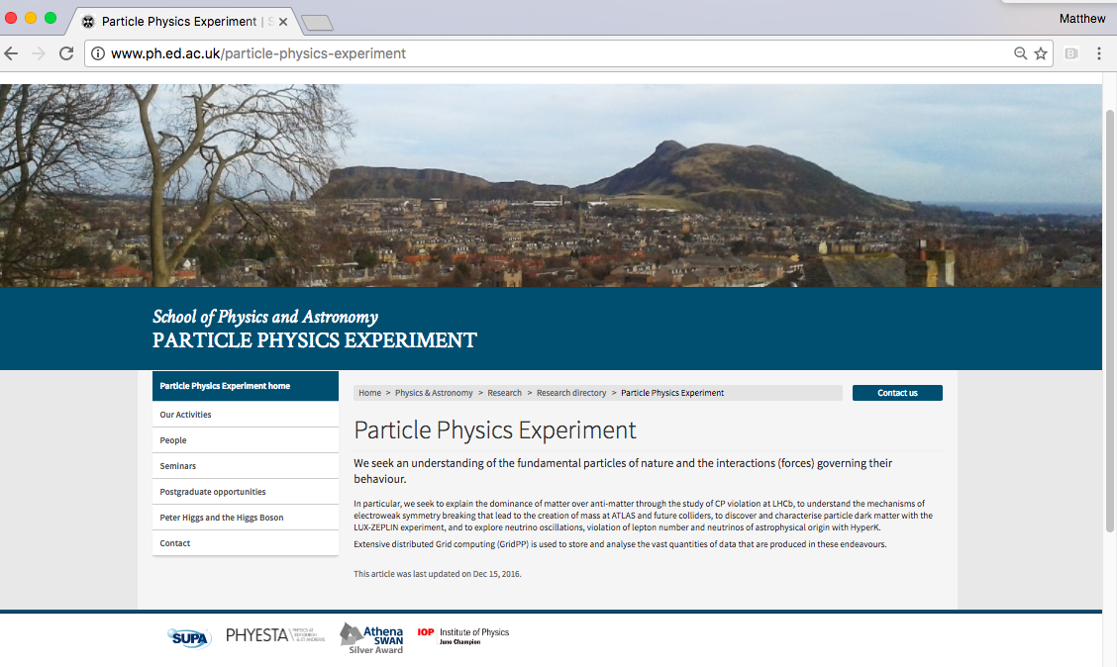
Edinburgh PPE Group
Group overview
Staff and PhD students
Recent successes
Infrastructure
Support
New Web Pages
PPE Activities
ATLAS
LHCb
GridPP
Neutrinos
Dark matter
Detector R&D
Outreach
Franz Muheim
24 May 2017
PPE Group meeting
More information available
Group web pages
http://www.ph.ed.ac.uk/particle-physics-experiment/
***New***

Slide 2
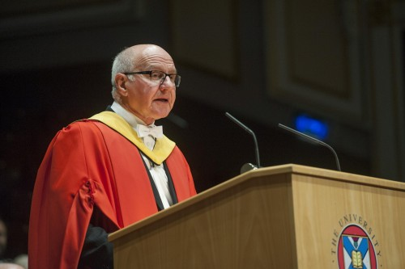
PPE Group Staff
Academics
Phil Clark
Pete Clarke
Christos Leonidopoulos
Victoria Martin
Franz Muheim
Head of Group
Matt Needham
Steve Playfer
Alex Murphy ***
Advanced Fellows
Greig Cowan (STFC ERF)
*** also member of Nuclear Physics group
Honorary & visiting academics
Fabiola Gianotti
Ken Peach
Alan Walker

Slide 3
PPE Group Staff & Students
~15 (soon 18) Senior Scientists / Post docs / Technical Staff
Stephan Eisenhardt, Andy Washbrook,
Jon Webster (technician), Bojan Masic (technician),
Laurence Carson, Ben Wynne, Silvia Gambetta,
Lilia Drakopoulou, Liza Mijovic,
Ahmed Hasib, Rob Currie,
Antonia Struebig, Michele Faucci Gianelli, Jim Stuart (engineer) ***
3 RA positions soon to be filled (Dark Matter, GridPP, LHCb)
~15 PhD Students
Thomas Davison, Adam Morris,
Xanthe Hoad, Iwan Smith, Maria Francesca Marzioni
Konstantin Gizdov, Andres Søgaard and Alan Taylor
Emmy Gabriel, Matthew Heath, Athoy, Nilima, Mahdi Taani, Yixuan Zhang, Jennifer Zonneveld
*** new

Slide 4
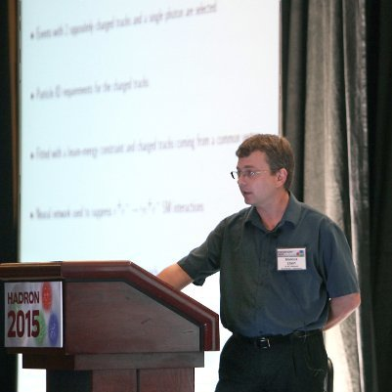
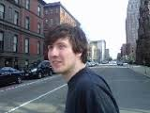
Staff Leaving and Joining
Leaving: Congratulations to
Marcus Ebert → Postdoctoral fellow at University of Victoria,
from April 2017
Daniel Craik → RA at MIT
from May 2017

Slide 5
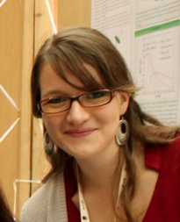
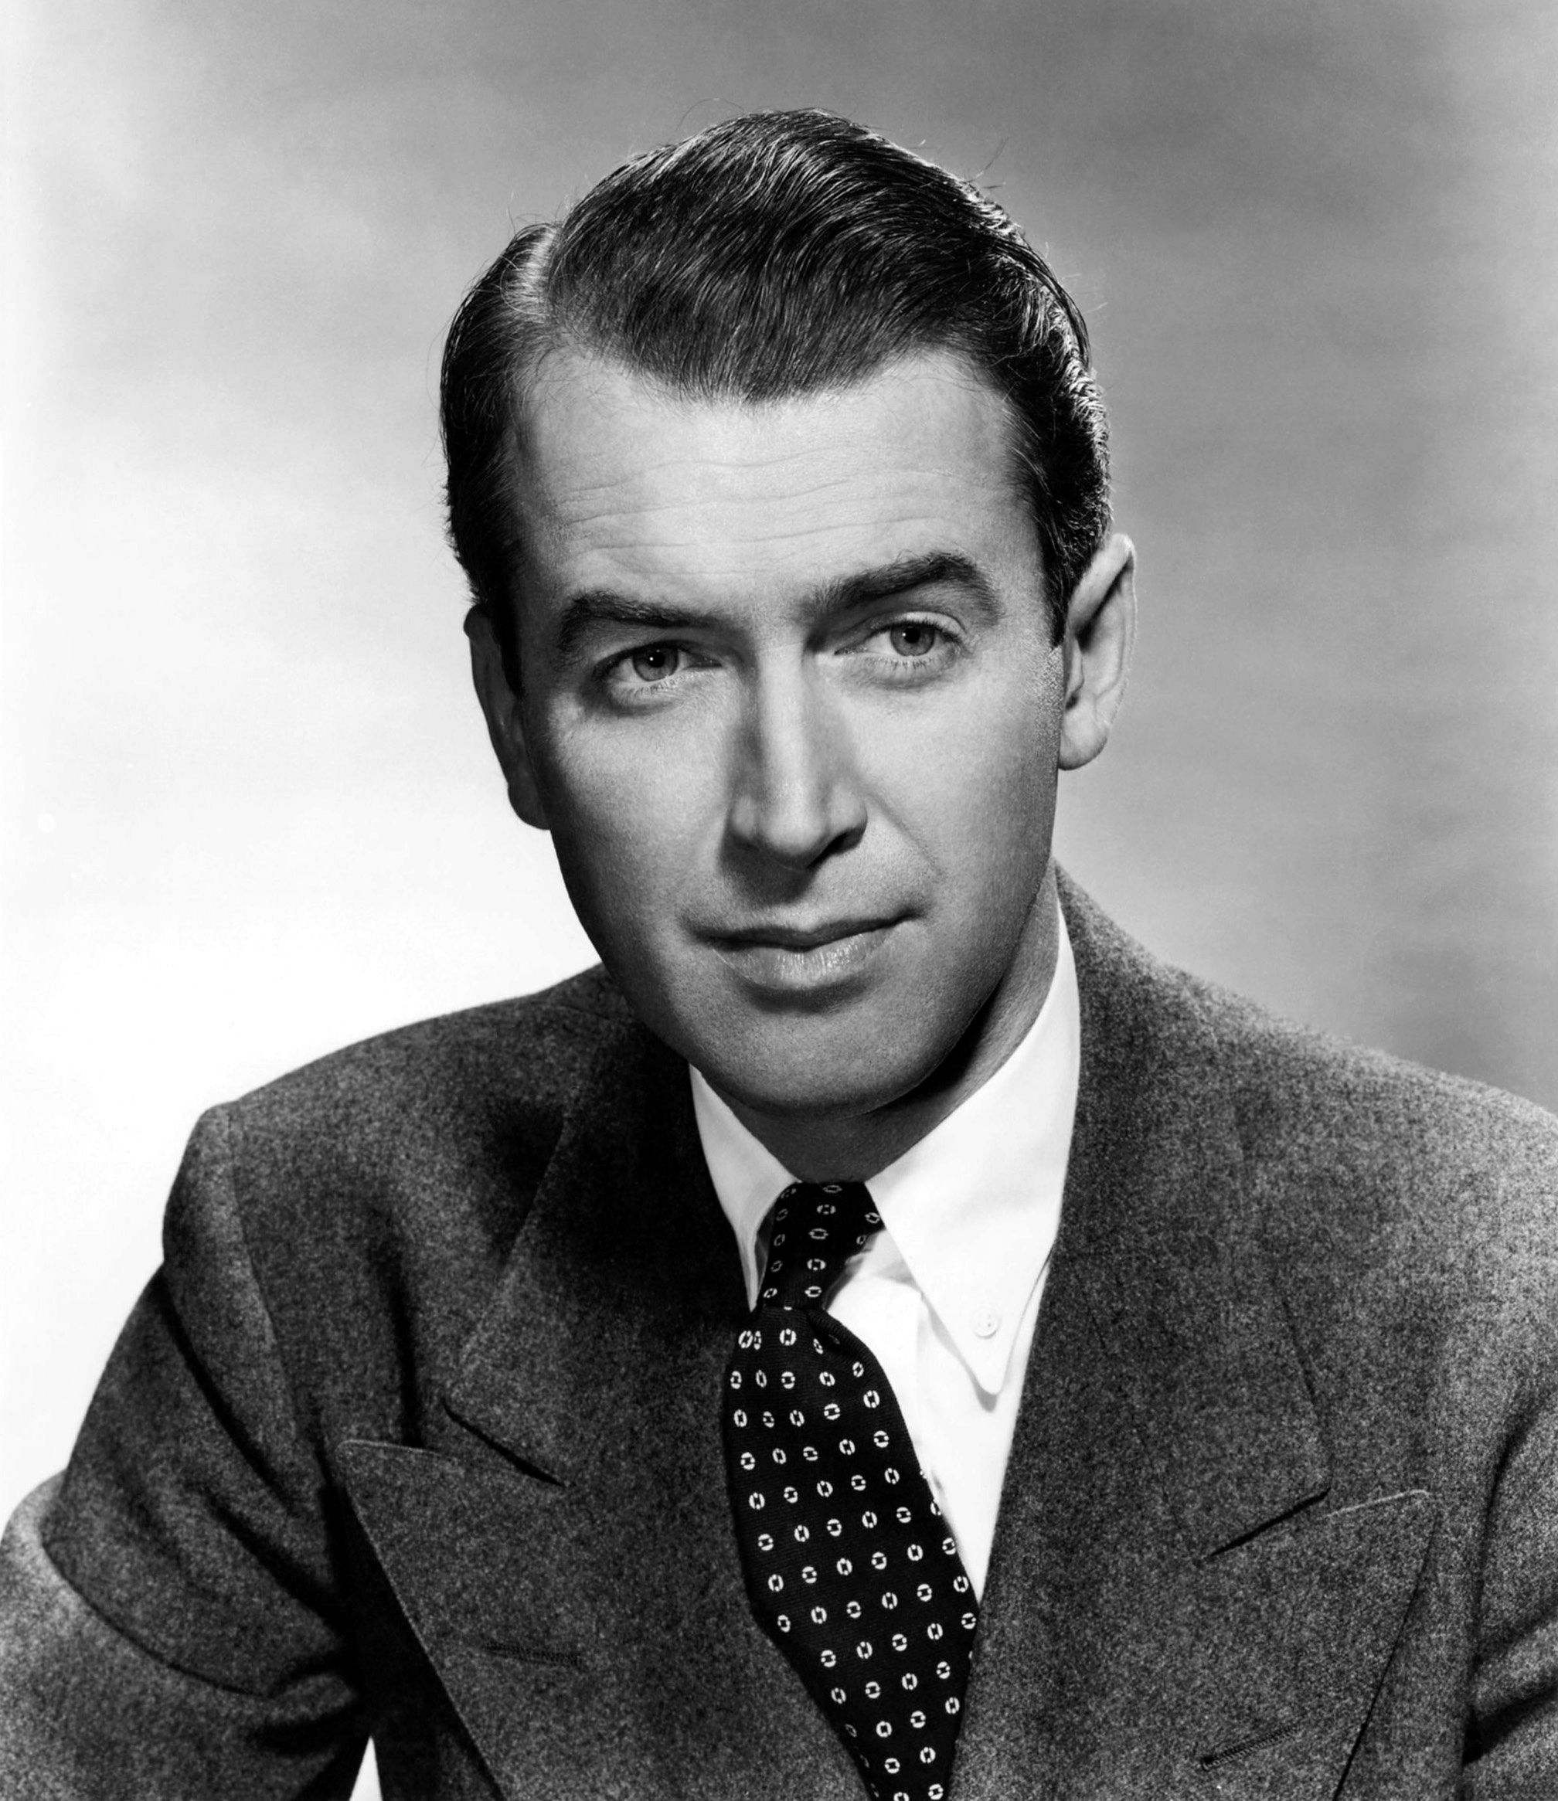
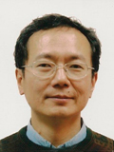
Staff Leaving and Joining
Joining: Welcome to
2 new RAs since last meeting
Antonia Struebig – ATLAS
Michele Faucci Gianelli – ATLAS
Jim Stuart – engineer not him
George Wei-Shu Hou - Visiting scientist 26 April to 9 June

Slide 6
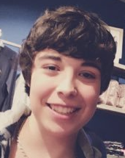
Undergraduate & MSc Teaching
Undergraduate MPhys and MSc students
projects available on ATLAS and LHCb data analysis and detector development
project available on Hyper-K, dark matter and Linear Collider
Current MPhys student about to graduate: Nicolas Angelides
MSc Students about to start project: Georgios Billis (CLIC), Josh Hainge (LHCb)
Visiting project student: Marion Lehuraux (LHCb)
Make them feel welcome
Undergraduate Teaching
Muon lifetime and mass measurements
Testing new detectors - LAPPD
Analysis and computational projects
Had a record ~10 students in 2016/17

Slide 7
Undergraduate & MSc Teaching
Summer students
Opportunies for you
School offers competition for bursaries
Group also offers summer studentships
In total 9 summer students about to start in june
Connor Minnis (DUNE)
Philip Aitken (LHCb)
Ralph Pompeus (LHCb photodetectors)
Craig Robertson (SiPMs)
Marina Sanches-Oro (HyperK photodetectors)
Blaise Delaney (LHCb)
Tran Tu thong - Ryan (LHCb)
Lorenzo Principe (ANNIE)
one more to be added to list
Please make them feel welcome

Slide 8
PhD recruitment
PhD students 2017 intake
Three confirmed for Sept 2017
Blaise Delaney (UCD Dublin) PCD
Emily Takeva (Birmingham) STFC
Elizabeth Leason (Durham) STFC
CDT in Data Intensive Science
Edinburgh was recently awarded a CDT in Data Intensive Science
As part of that we have a further place that we are looking to fill
A candidate, Cristina Martin Perez, is visiting this Friday 26th May
Please make her feel welcome
Note there may be further STFC funded places to come

Slide 9
PPE Group - Infrastructure
Offices
5301, 5302 - PhD students
54nn corridor, 4311 – Academics/Fellows/RAs
Conference room
5202 - Audiovisual equipment for Vidyo, Skype
Book via Google calendar – Edinburgh PPE
Coffee and Tea facility
Laboratories
5201 - HPD Photon Detector Test Facility
5203, 5203b, 5204 - Advanced Detector Development Centre
5207 - Teaching Laboratory – Muon Lifetimes
5207 – MaPMT Photon Detector Test Facility

Slide 10
PPE Group - Support
Admin
General - Gill Maddy, Tracy Brown and team email - admin-general@ph.ed.ac.uk
PhD students - Liz Paterson liz@staffmail.ed.ac.uk
Computing Support
Andy Washbrook (group support)
Sean McGeever and team (School CST)
Finance
Joanna Richards and team (Finance) email accounts - accounts@ph.ed.ac.uk
Procurement
ask us if you need something Andy Washbrook for computers, Jon Webster, Stephan Eisenhardt, FM for kit

Slide 11
PPE Group - Support
Travel
Most of us book our own travel, but you can ask General Admin - Tracy Brown, Gill Maddy and team admin-general@ph.ed.ac.uk
For PhD students, ask Liz Paterson liz@staffmail.ed.ac.uk
For STFC experiment travel (569RAL), may need to fill in UK PP travel notice at https://pprc.qmul.ac.uk/~lloyd/travel/travel.php?page=login
Info on ATLAS and LHCb Wiki will migrate to group Wiki
eExpenses – new system Please make sure you use correct cost centre/job code combinations
New rules &^%$£@
Travel insurance
You need to have travel insurance – provided by university, but each trip has to be arranged by sending email to admin team
If you travel a lot you might consider taking out travel insurance

Slide 12
PPE Group - Roles
Research groups and CERN specifics
Registration and renewals via project leader: Phil for ATLAS and Franz for LHCb
Need Home Institute Declaration - forms
Pete is GridPP group leader
Matt is Hyper-K group leader
Alex is LUX/LZ group leader
Seminars organiser
Greig Cowan
please send him names of possible speakers
PhD recruitment
Matt
Will have 4 or more PhD students for Sept 2017

Slide 13
PPE Activities
ATLAS
ATLAS Edinburgh Exotic Searches, see talk by Ben
Dark Matter
Recent LUX results, see talk by Alex
Hyper-K
Bonsai, see talk by Mahdi
LHCb
Computing, see talk by Rob
Institute seminar on “Lepton Universality tests” this Friday 26 May 2 pm Higgs Centre by Greig Cowan
Invited talk
on ”HGCAL for CMS” by George Wei-Shu Hou

Slide 14
PPE Activities
GridPP
Data Storage
Ask Pete, Rob and Andy Washbrook if you are interested
Detector Development
ATLAS and LHCb Upgrade, Hyper-K, Dune
Excellent facilities in Advanced Detector Development Centre (ADDC)
Have started working with new types of photon detectors - LAPPDs
Ask Stephan et al. if you are interested
Higgs Centre of Innovation (HCI)
HCI Building on Blackford Hill will be ready this autumn
HCI includes CERN Business Incubator → Opportunities for people wishing to start their own company

Slide 15
PPE Activities
MSc Teaching
Currently School has MSc in Mathematical and Theoretical Physics
Works well and brings in money (from overseas students)
Submitted proposal for MSc in experimental particle and nuclear physics
Group web pages
Migrated to new web pages end of last year
Need to keep it “alive”, any volunteers?
Outreach
Peter Higgs web page http://www.ph.ed.ac.uk/higgs maintained by Victoria Martin and Alan Walker
Particle Physics for Scottish Schools (PP4SS) please join Alan when he is asking for volunteers, it is fun!

Slide 16
Final Comments
Regular PPE group fixtures
PPE academics meeting 1st Tuesday each month
All group PPE meeting twice per year
Next will be Christmas meeting 2017
Fri 15 Dec 2017, put this in your diary
Group members are usually going to lunch at 12 noon in School Coffee room 4318
Bring you own food or buy it on Campus or Magnet Café
Other option - Swann building 7th floor
New lunch options on campus - student union has been revamped, engineering
Will start to have group coffee
Every Wed 3pm or after seminar in 5202

Slide 17
Backup slides

