Slide 1
Masters Projects
Christopher Ham – Presented by Michael Fitzgerald

Slide 2
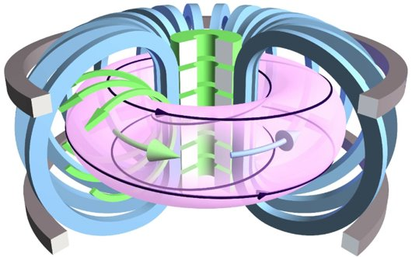
Project One
Multiple Solutions of the Grad-Shafranov Eq
Equation for magnetohydrodynamic (MHD) equilibrium in a torus assuming axisymmetry called the Grad-Shafranov Equation
Plasma held in place with magnetic field coils
Magnetic field coils
Plasma

Slide 3
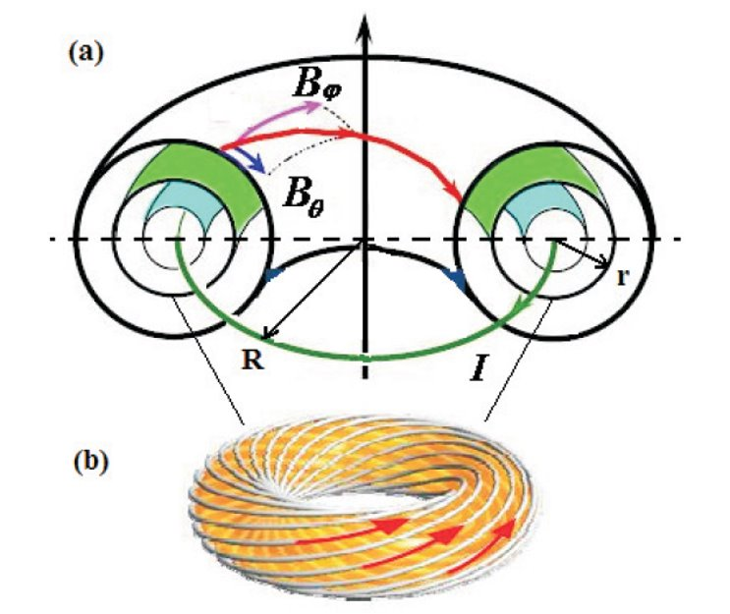
Grad-Shafranov Eq
Solving this equation gives us the geometry of the flux surfaces
And the distribution of current and pressure in the plasma
This is the equilibrium state which we perturb to find the stability
Nested toroidal surfaces of constant poloidal flux

Slide 4
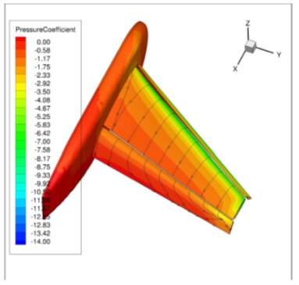
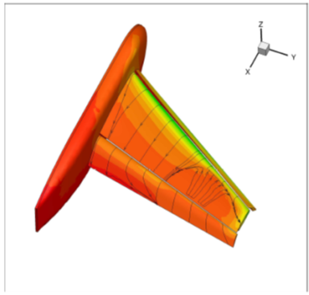
Multiple solutions of PDEs
Multiple solutions of partial differential equations are ubiquitous
They appear in real systems and have a real effect for example in fluid mechanics
There are lots of nonlinear partial differential equations in plasma physics and thus lots of potential for multiple solutions!
Multiple solutions observed in CFD for wing design
“Numerical Evidence of Multiple Solutions for the Reynolds-Averaged
Navier-Stokes Equations for High-Lift Configurations”
Kamenetskiy et al (2013)

Slide 5
Analytic model
We have developed an analytical model to produce multiple solutions
Assume a large aspect ratio plasma (plasma is like a hula hoop rather than a doughnut)
GSE can be approximated by a one dimensional equation
We solve this equation using the shooting method so we can deal with any profile shape.
Grad-Shafranov Equation
In cylindrical coordinates and large aspect ratio
this becomes
We use the following function on the rhs as a first example

Slide 6
Analytic model
We can solve this model for given parameter values
Here we vary C
C ≈ 2.7 we see two new solutions appearing at a fold bifurcation

Slide 7
Analytic model
We can solve this model for given parameter values
Here we vary w
w ≈ 0.88 we see two new solutions appearing at a fold bifurcation

Slide 8
Project
Understand background material such as derivation of the GSE, the large aspect ratio, circular cross section model and solution by shooting method to find multiple solutions of GSE.
We have used one type of profile but generically other nonlinear profiles could produce the same result. Investigate other functions on right hand side and understand their properties
We have assumed a circular cross section but we could try elliptical cross section with various elongations or other shapes such as a rectangle could also be investigated.

Slide 9
Project
We could try including simple transport equations to give profiles of FF’ and p’. This would mean we can evolve the shot more physically
We would try to find a situation where a smooth variation of transport parameters results in a loss of equilibrium solution branch. We speculate that some types of major disruption may be caused by this mechanism
Alternatively, identify experimentally relevant plasma pressure and current profiles where loss of equilibrium is possible. Develop/use simple heuristic models for how the plasma profiles will develop and show how a disruption could result.

Slide 10
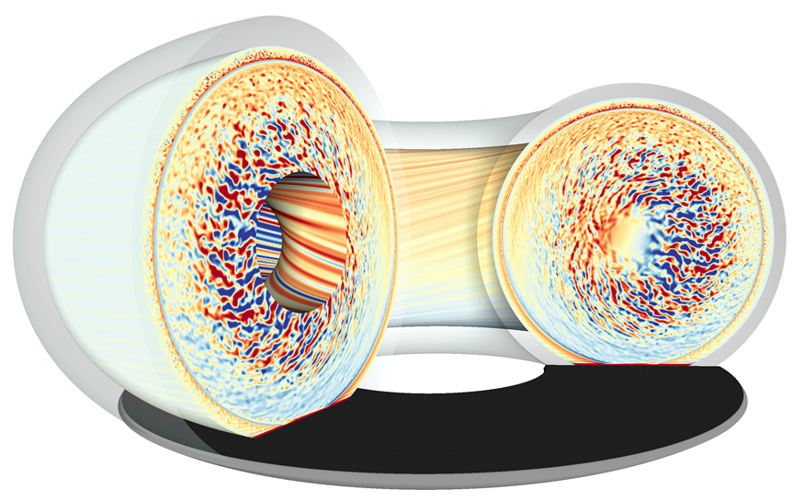
Project Two
Natural current profiles in tokamaks
Tokamak plasmas are known to be turbulent and complex but usually develop large scale current and pressure structure showing good confinement of the plasma.
There are numerous examples of self-organization in tokamak plasmas such as the H-mode.

Slide 11
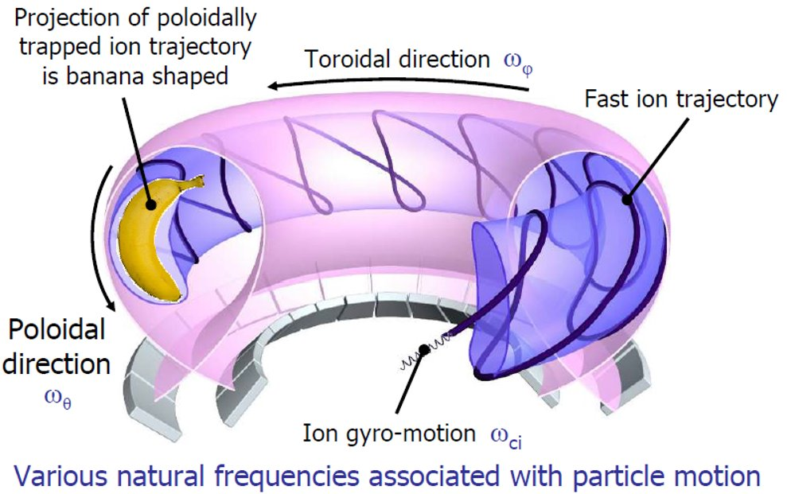
Project Two
Natural current profiles in tokamaks
Our leading model for how current diffuses in the plasma is based on so-called neoclassical resistivity. This is based on understanding the motion of charged particles in a magnetic field with a gradient, as we have in a tokamak.
However, experimental evidence suggests the that neoclassical resistivity does not correctly capture the current diffusion when the plasma current is changing.

Slide 12
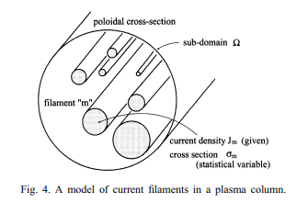
Modelling current filaments
Previous work has been done imagining the plasma is made up of interacting current filaments
The statistical mechanics of these interacting filaments can be investigated
This is analogous to interacting electrostatic rods or vortex lines in fluid mechanics
This model can produce a negative temperature state with a resulting non trivial current profile
Kirk et al Nuclear Fusion 54 114012 (2014)

Slide 13
Project
Understand what we can say about plasma turbulence and the global profiles of current and pressure that are formed from a statistical physics point of view. This should provide robust, high-level constraints and conditions for the profiles.
Complete literature review on the topic and understand the work of Taylor in particular.
Assess if external heating schemes can be included in a model for natural current profiles.
Develop spherical tokamak (MAST-U) relevant model for natural current profiles. Make predictions for MAST-U and test these by looking at MAST-U data.
Make predictions for power plant relevant plasmas.

