Slide 1
Non-local parallel electron transport in the SOL
Robert Kingham
Plasma Physics Group – Imperial
Acknowledgements
IC: Dominic Power , UKAEA: Stefan Mijin
UKAEA Plasma Physics Workshop, Edinburgh – 8–10th Nov. 2023

Slide 2
MCF Team at Imperial & Main Collaborators
Exhaust Physics
– Kinetic Elec. Transport
Dominic Power (PhD)
Stefan Mijin (PhD) [now UKAEA]
Fulvio Militello [UKAEA]
L-H Transition Studies
Yasmin Andrew
Thomas Ashton-Key (PhD)
Eun-jin Kim [Coventry]
Michele Romanelli [Tok. Energy Ltd]
Magnetized Sheath
Physics
Alfie Adhemar (PhD)
Stefan Mijin [UKAEA]

Slide 3
MCF Team at Imperial & Main Collaborators
UKAEA ‘new exhaust code’
Robert Kingham (technical lead)
James Harrison (sponsor)
Stefan Mijin
Sarah Newton
John Omotani
Romain Futtersack
James Cook
Sanket Gadgil
Andrew Snodin
Martin O’Mullane

Slide 4
Contents
Non-local parallel electron transport
Motivation: exhaust problem, divertors, SOL profiles, non-local transport
Kinetic VFP code: SOL-KiT
Equilibrium kinetic effects
  Scaling-law for fluid-code modifications
Impact of kinetic electrons on impurities
Brief overview UKAEA New Exhaust Code project
Summary and conclusions
Acknowledgement
Dominic Power (PhD)
Stefan Mijin (PhD)

Slide 5
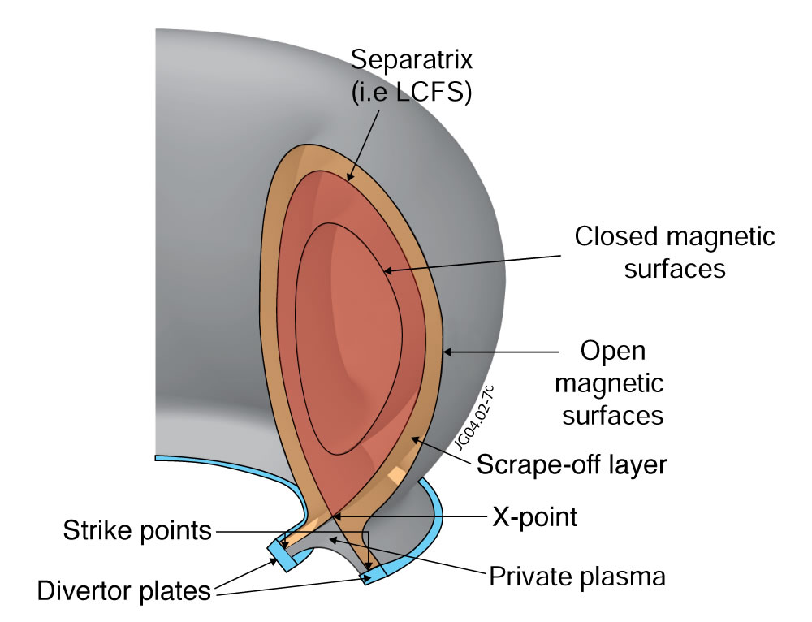
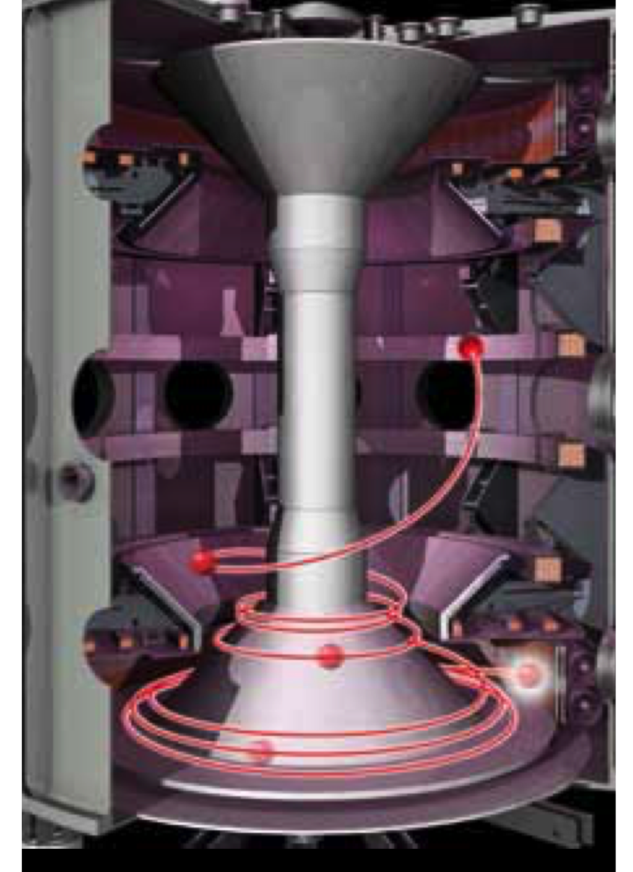

Exhaust physics in MCF
The scrape-off layer & Challenges
Transport along B-field dominates:
  $v_{∥}\sim {10}^{5}ms^{−1}$ , $v_{⊥}\sim 1ms^{−1}$
Survival of massive heat loads on divertor: e.g. ITER
100 MW (20% of 500 MW) → ~ 1 GW m^{–2} ‘upstream’
material limit → 10 MW m^{–2}
Coping strategies
  Expand SOL thickness: ~5 mm upstream → ~few cm divertor
  Absorb power into gas buffer → detachment
  Oblique B-fields, multiple divertors , …
Notes:
Poloidal and toroidal magnetic field (for stable confinement)
(this results in) toroidally nested magnetic flux surfaces
Limiter protects majority of reactor wall from interaction with plasma – sacrificial components expensive, need to make space for lithium blankets, magnetic coils, etc

Slide 6
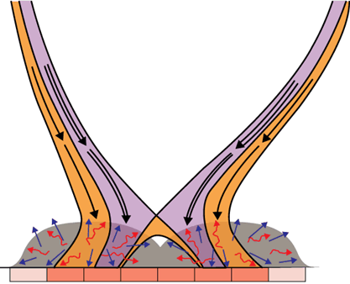
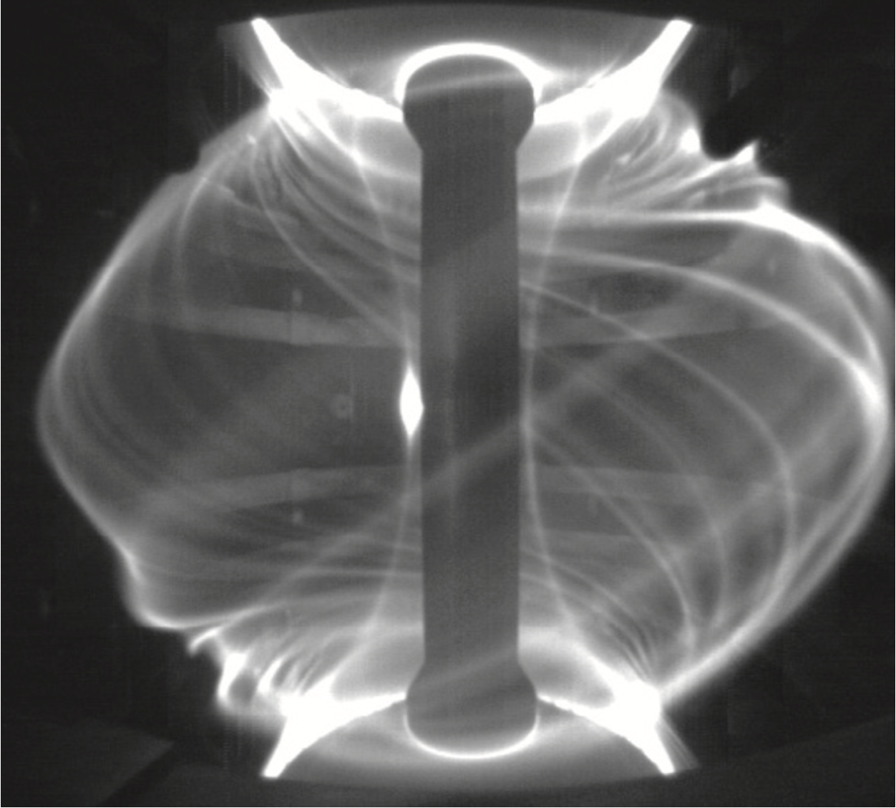
Exhaust physics in MCF
Complexities
Neutral physics (kitchen sink)
  Rich atomic & molecular physics (collisional rad. model)
  Transport kinetic in nature
Plasma physics
  Turbulence → filaments
  Long mean-free-path → transport closure of fluid eqns
  Sheath physics
Impurities
  Dynamics of sputtered wall (W, Be)
  Fusion ash (He) transport and removal
Material physics
SOL-filaments on MAST
Notes:
SOL = scrape-off layer
(Use external coils to) open magnetic field lines culminating at solid targets
Now SOL is defined as region beyond the separatrix
(parallel to B ) length of divertor SOL defined by tokamak geometry and ratio of toroidal and poloidal B field
-> if we were to traverse the SOL along a B field line, we’re also travelling in toroidal direction around the tokamak
Plasma enters upstream, etc. -> we’ll go into this in more detail in the next slide

Slide 7
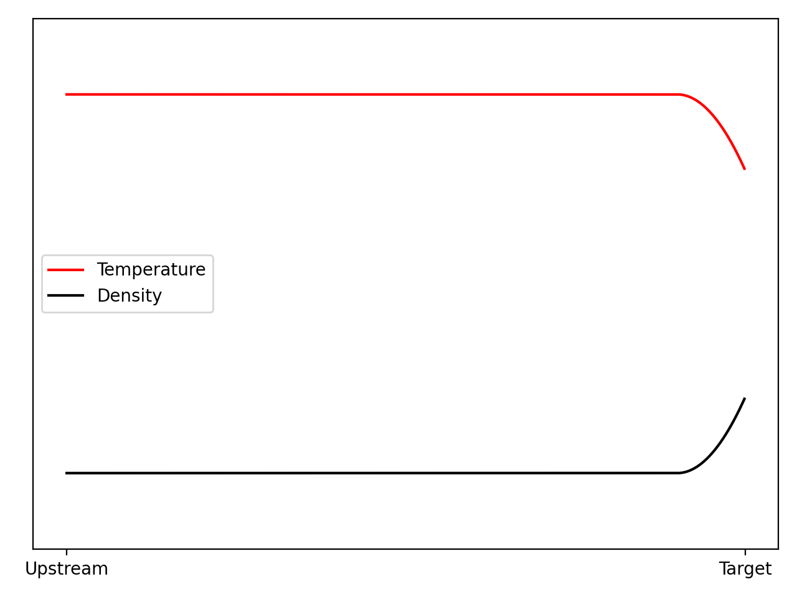
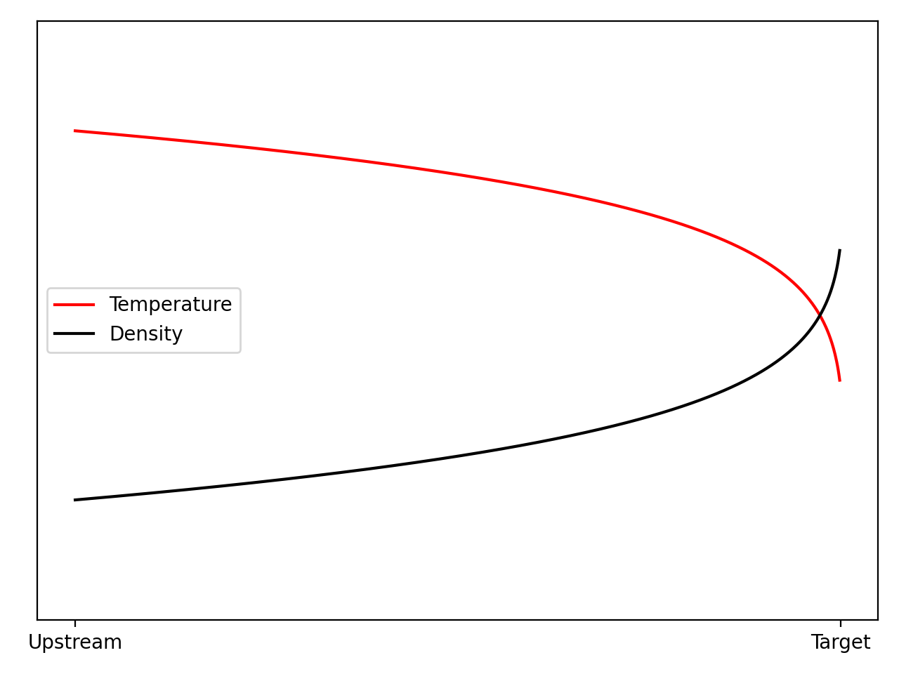
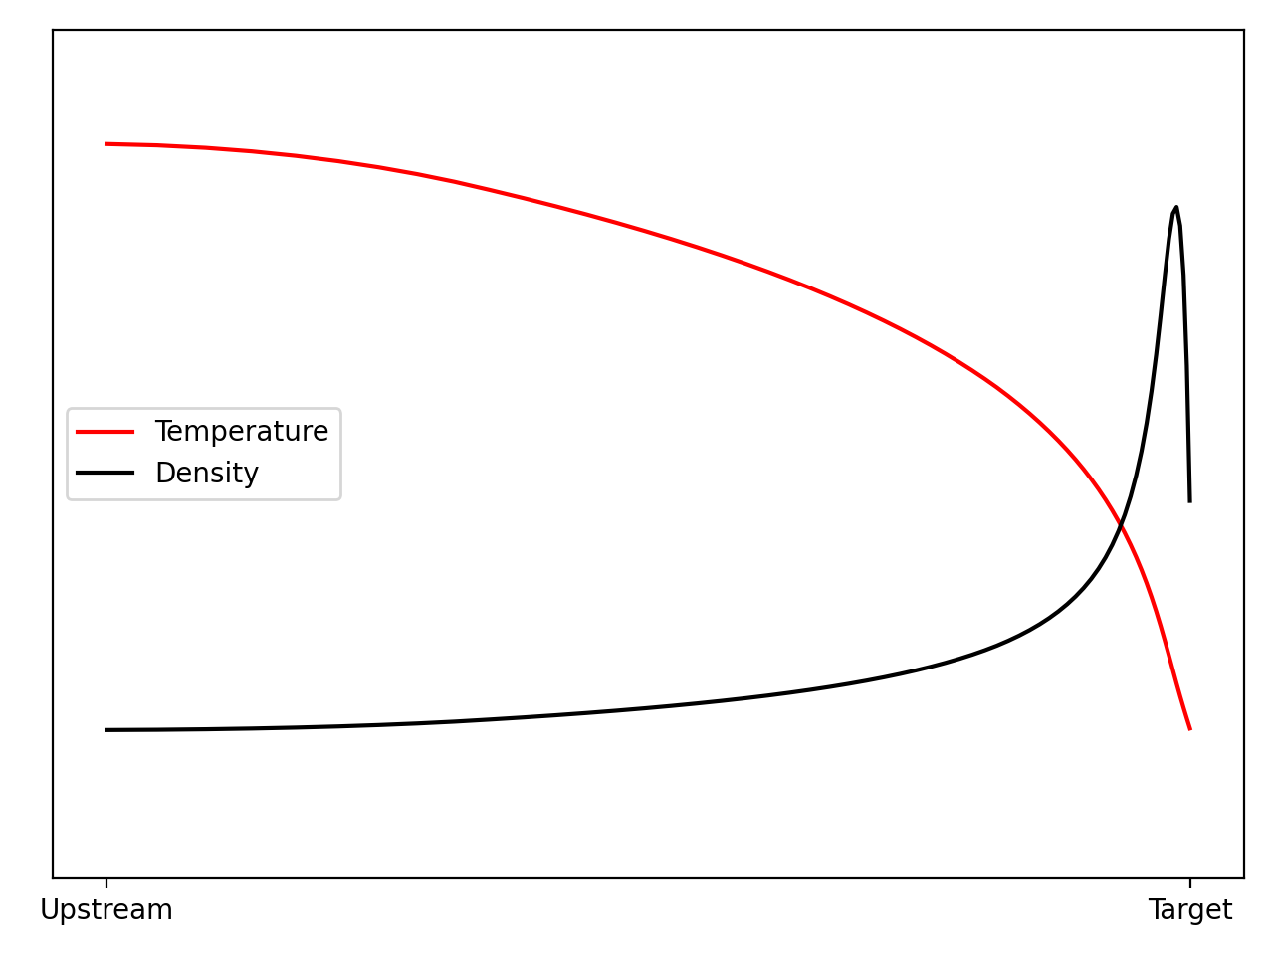
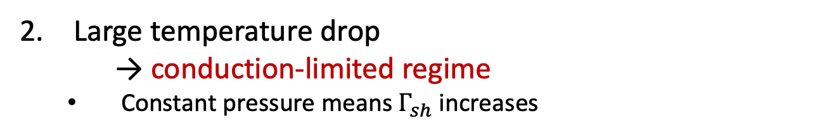
Exhaust physics in MCF
Divertor regimes
Divertors support various operating modes
Isothermal
→ sheath-limited regime
  Heat flow across sheath largely determines SOL properties
Large temperature drop
→ conduction-limited regime
  Constant pressure means $Γ_{sh}$ increases
Increasing collisionality
Large temperature drop and pressure drop at target → detachment
  Targets shielded by neutral cloud
Notes:
Seque – now move towards slightly more realistic scenarios in the scrape-off layer, taking into account plasms neutral interactions
Divertors support various operating modes (characterised mostly by temperature drop along the SOL)
Sheath-limited – heat to target can be carried by conduction (high conductivity + small temperature gradient) or convection (strong plasma flow) – properties of the SOL determined by the heat flow across the sheath. Will occur at low collisionality.
Conduction limited – constant P, increasing T -> increasing plasma density and hence increasing particle flux into sheath (in front of the target)
Detachment – temperature drop causes increased number of recycled neutrals that remain

Slide 8
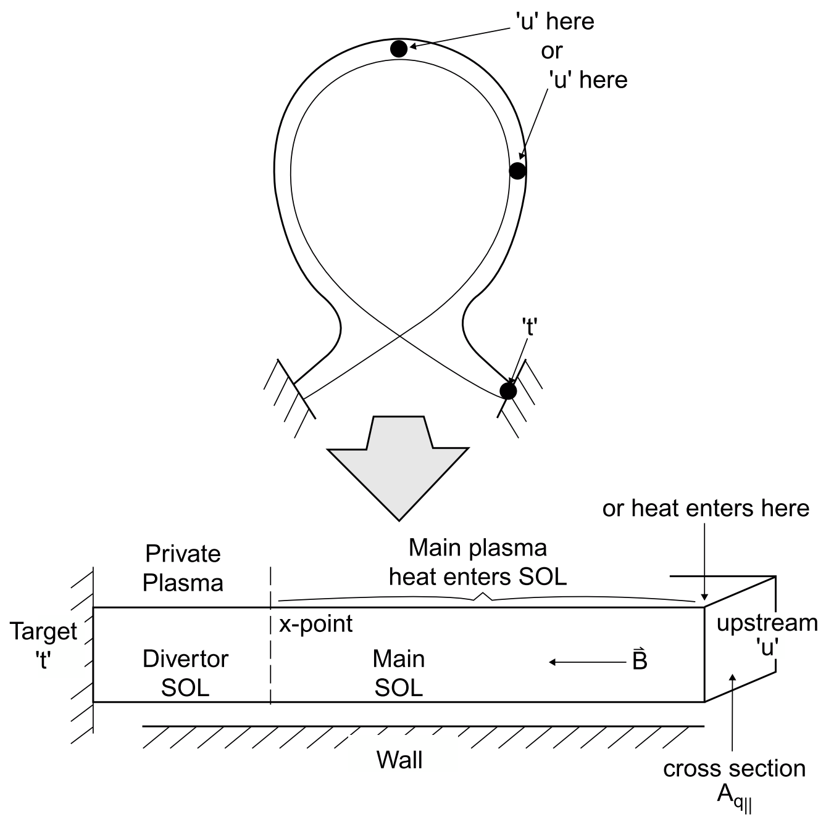
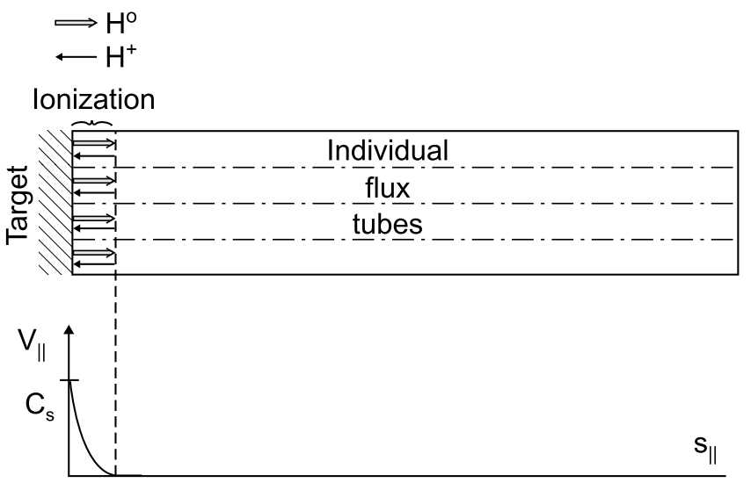

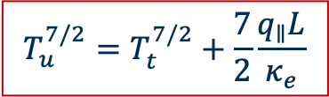



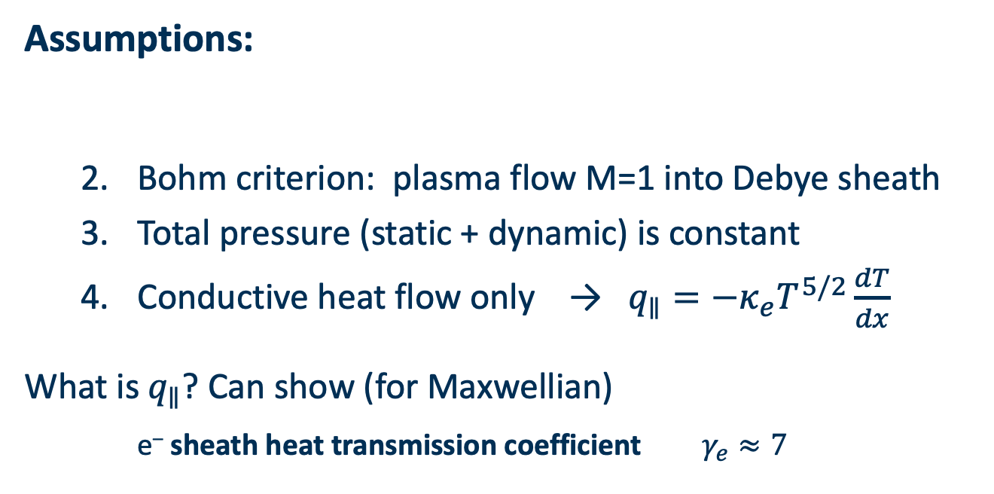

Exhaust physics in MCF
The two-point model
$T_{u}≈{\left(\frac{7}{2}\frac{q_{∥}L}{κ_{e}}\right)}^{2/7}$
$$T_{t}∝\frac{q_{∥}^{10/7}}{L^{4/7}n_{u}^{2}}$$
Simple transport model in divertor SOL [1]
  Relate upstream (u) and target (t) conditions
[1] Stangeby, P. CRC Press (2000)
Assumptions:
  Bohm criterion: plasma flow M=1 into Debye sheath
  Total pressure (static + dynamic) is constant
  Conductive heat flow only → $q_{∥}=−κ_{e}T^{5/2}\frac{dT}{dx}$
What is $q_{∥}$? Can show (for Maxwellian)
e– sheath heat transmission coefficient $γ_{e}≈7$
1. Plasma recycled at target and re-ionised in thin region
$$v_{t}=C_{s}=\sqrt{{{(T}_{e}+T_{i})}_{t}/m_{i} }$$
$$n_{u}T_{u}=2n_{t}T_{t}$$
$$T_{u}^{7/2}=T_{t}^{7/2}+\frac{7}{2}\frac{q_{∥}L}{κ_{e}}$$
$$q_{∥}=γ_{e}n_{t}T_{t}c_{s}$$
Notes:
Plasma recycled at target and re-ionised in thin region in front, so very short region of flow speed acceleration to sound speed at sheath edge
Heat into SOL is removed entirely at the target
Sheath heat transmission coefficient derivation: assume Maxwellian distribution, look at one-way particle flux into sheath, then get heat flux from this expression, then consider that only electrons above a certain velocity make it across the sheath potential drop

Slide 9










Exhaust physics in MCF
Energy fluxes in conduction limited regime
$$E$$
$$q_{e,cond}$$
$$q_{e,cond}$$
$$q_{e}$$
$$q_{in}$$
$$q_{e,conv}$$
target
$$q_{i,conv}$$
$$q_{i}$$
‘upstream’
ionization zone
Debye sheath
(electron repelling)
$$q_{rad}$$
$$q_{in}$$
Notes:
Input: 17/2 units | 1 unit = kT_t.(nu)_t
SE:
e– conduction = 5/2 , e– convection = 5/2
ion convection = 7/2
WALL
e– uni-directional flux = 2
ion energy flux = 13/2

Slide 10
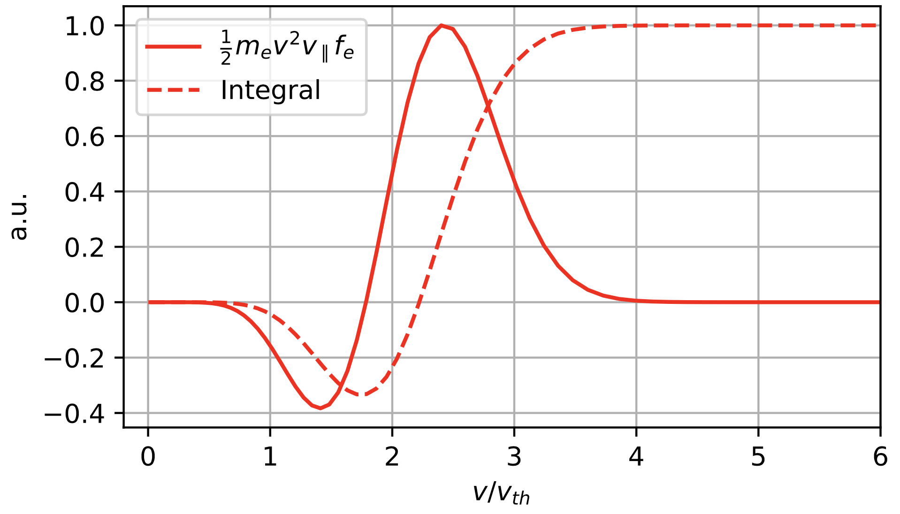
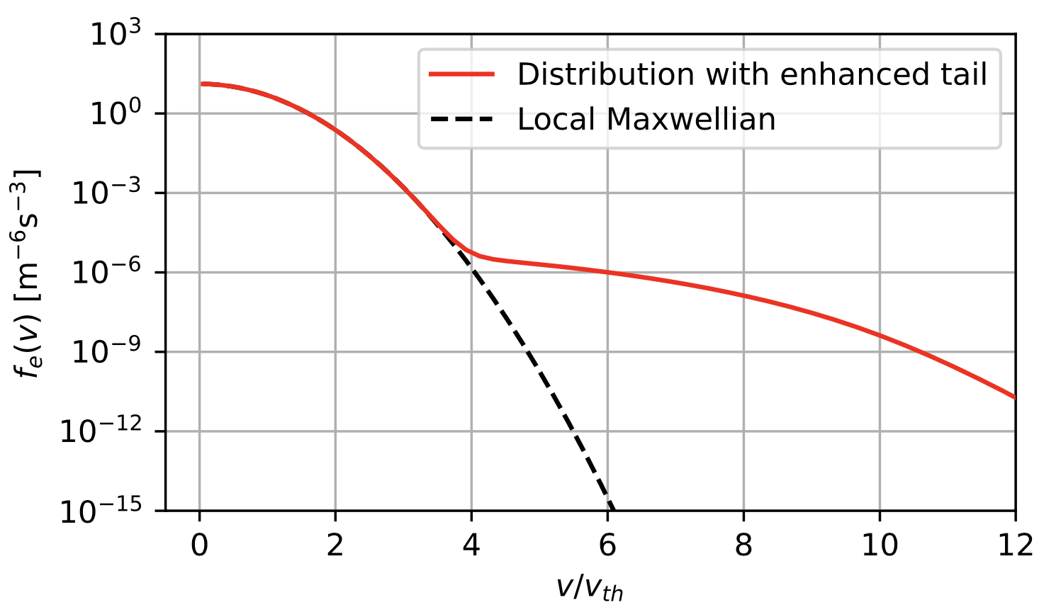
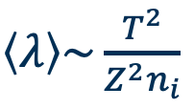
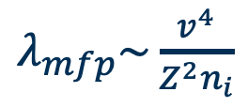


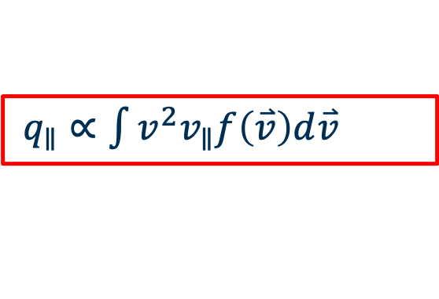

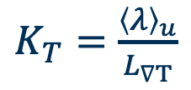
Non-local transport
Coulomb
mean-free-path
$λ_{mfp}\sim \frac{v^{4}}{Z^{2}n_{i}}$
$\left\langle λ\right\rangle \sim \frac{T^{2}}{Z^{2}n_{i}}$
SOL violates
local condition
$K_{T}=\frac{{\left\langle λ\right\rangle }_{u}}{L_{∇T}}$
$$K_{T}≪1$$
where
Breaks down
$$q=−κ∇T$$
$q_{∥}∝\int{v^{2}v_{∥}f\left(\overset{⃑}{v}\right)d\overset{⃑}{v}}$
Maximised for e– with $v/v_{th}≈2−3$
In kinetic simulations, often see distributions like this close to divertor targets
Notes:
JET: L~40m , \lambda ~ 2.5m
Thermal: K ~ 1/16
HCE: K ~ 1–
ITER + Reactors → more non-local!

Slide 11
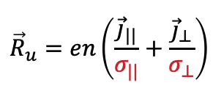








Non-locality in Braginskii closure of fluid equations
Parallel transport – usually classical or limited in fluid codes (SOLPS etc.)
High collisionality assumption – local
$$\frac{∂n_{e}}{∂t}+div\left(n_{e}{\vec{u}}_{e}\right)=0$$
Determines heat loads
$$m_{e}n_{e}\frac{d{\vec{u}}_{e}}{dt}=−\frac{∂p_{e}}{∂\vec{x}}−\frac{∂Π_{e}}{∂\vec{x}}−en_{e}\vec{E}+\vec{R}$$
$${\frac{3}{2}n}_{e}\frac{dT_{e}}{dt}+p_{e}div\left({\vec{u}}_{e}\right)=−div\left({\vec{q}}_{e}\right)−Π_{e}\frac{∂{\vec{u}}_{e}}{∂\vec{x}}+Q_{e}$$
$${\vec{R}}_{u}=en\left(\frac{{\vec{j}}_{||}}{σ_{||}}+\frac{{\vec{j}}_{⊥}}{σ_{⊥}}\right)$$
$$\vec{R}={\vec{R}}_{u}+{\vec{R}}_{T}$$
$${\vec{R}}_{T}=−β_{||}n_{e}∇_{||}T_{e}$$
$${\vec{q}}_{u}=β_{||}n_{e}T_{e}{\vec{u}}_{||}$$
$${\vec{q}}_{e}={\vec{q}}_{u}+{\vec{q}}_{T}$$
${\vec{q}}_{T}=−{κ_{||}∇_{||}T}_{e}$ $−κ_{⊥}∇_{⊥}T_{e}$

Slide 12
Non-local transport: Questions raised
  Are fluid models adequate at capturing parallel transport physics in SOL plasmas?
  Consequences of non-Maxwellian electrons on:
    Properties of sheath at divertor?
    Reaction rates for neutrals & impurities?
    (detachment)
    SOL turbulence? (blobs & filaments)
  Can reduced kinetic models capture the important phenomena?
  Can this enhanced tail be experimentally verified?

Slide 13
Kinetic VFP Code – SOL-KiT
Acknowledgement: Stefan Mijin & Dominic Power

Slide 14
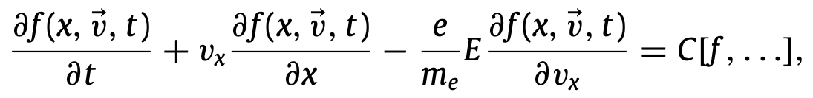
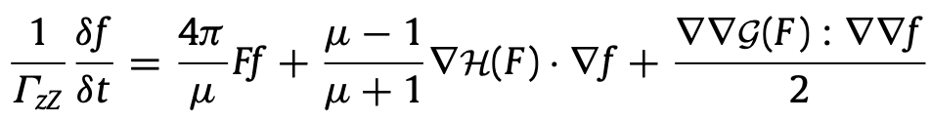
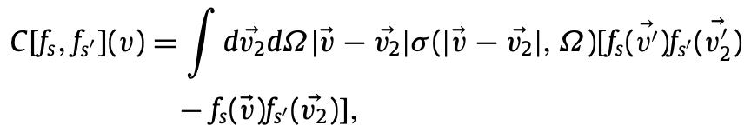

Kinetic model for electrons
Vlasov-Fokker-Planck + Boltzmann e– –neutral
Coulomb collisions
e–e & e–i
Boltzmann collision integral
e–n
v
v
v
v
v
v

Slide 15
SOL-KiT – Overview
Scrape-Off Layer – Kinetic Transport – recent 1D electron kinetic code [ S. Mijin, PhD ]
Goal – identify kinetic effects in parallel e– transp. with as much SOL relevant physics as possible
Requirements:
    Stable and easily modifiable – fully implicit
    Long timescales for equilibria – conservative differencing on a staggered grid
    Collision physics – Coulomb and inelastic collisions
    1-to-1 fluid comparisons for extracting kinetic effects – consistent electron fluid model included
[ Mijin et al., Computer Physics Communications (2020) ]

Slide 16
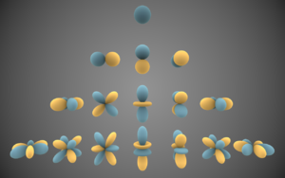
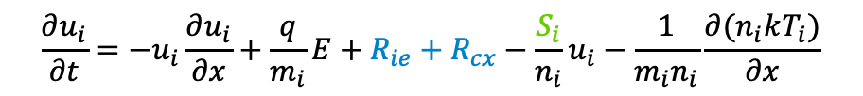


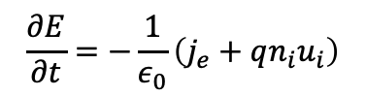



SOL-KiT – Kinetic Elec. + Fluid Ions
Pitch-angle scattering eigenfunctions – spherical harmonics
Ignoring magnetic effects - $m=0$ – Legendre polynomials
$$f_{0}^{m}\underset{→}{}n,T;{ f}_{1}^{m}\underset{→}{}\text{fluxes}\text{; } f_{2}^{m}\underset{→}{}\text{stresses}\text{ (}\text{e}\text{.}\text{g}\text{. }\text{pressure} \text{tensor}\text{)}$$
Kinetic equations become:
E-field from Ampère-Maxwell’s law:
$\frac{∂f_{l}}{∂t}$ = $A_{l}+E_{l}+C_{l}$
$$\frac{∂E}{∂t}=−\frac{1}{ε_{0}}\left(j_{e}+qn_{i}u_{i}\right)$$
only left with displacement current
spatial advection
velocity space advection due to E-field
Ion model to allow for steady state:
other operators (mainly collisions)
$$\frac{∂n_{i}}{∂t}+\frac{{∂(n}_{i}u_{i})}{∂x}=S_{i}$$
source/sink terms (atomic physics)
$$\frac{∂u_{i}}{∂t}=−u_{i}\frac{∂u_{i}}{∂x}+\frac{q}{m_{i}}E+R_{ie}+R_{cx}−\frac{S_{i}}{n_{i}}u_{i}−\frac{1}{m_{i}n_{i}}\frac{∂(n_{i}kT_{i})}{∂x}$$
friction with electrons and charge exchange
+
$T_{i}$ equation with i-e and i-n energy exchange

Slide 17
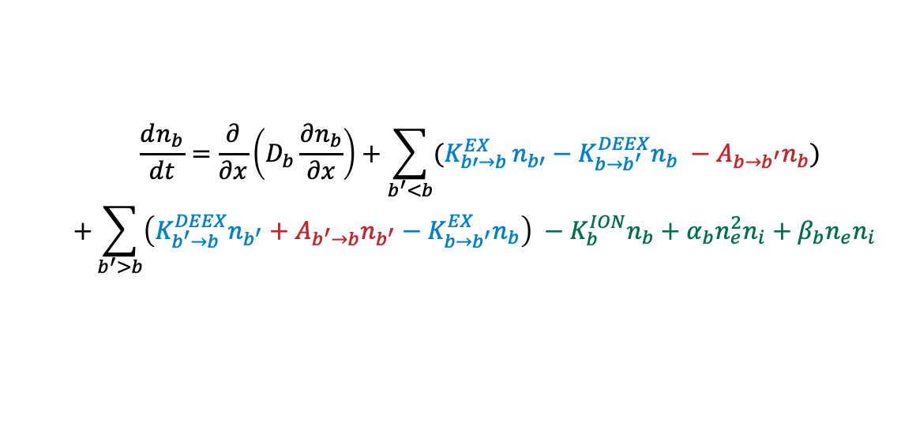
SOL-KiT – Neutral fluid + CRM
Neutral state evolution – diffusive-reactive collisional-radiative model
$$\frac{dn_{b}}{dt}=\frac{∂}{∂x}\left(D_{b}\frac{∂n_{b}}{∂x}\right)+\sum_{b^{′}<b}{(K_{b′→b}^{EX}}n_{b′}−K_{b→b^{′}}^{DEEX}n_{b} −A_{b→b^{′}}n_{b})$$
$$+\sum_{b^{′}>b}{\left(K_{b^{′}→b}^{DEEX}n_{b^{′}}+A_{b^{′}→b}n_{b^{′}}−K_{b→b^{′}}^{EX}n_{b}\right) −K_{b}^{ION}n_{b}+α_{b}n_{e}^{2}n_{i}+β_{b}n_{e}n_{i}}$$
NIST database www.nist.gov/pml/atomic-spectra-database
Janev R. K. et al. www.eirene.de/report_4105.pdf
excitation and deexcitation
ionization and recombination
spontaneous emission
3-body recombination
radiative recombination
Dampen higher harmonics!
Detailed collision operator suite:
  Coulomb collisions – electron-electron and electron-ion
  Inelastic electron-atom collisions – energy and particle conserving scheme
Newly developed Legendre harmonic logical boundary condition at the sheath edge.
Bundling of atomic states to ease computational complexity.
Oblique B-field adaptation: geometrically boosted diffusive neutral flow in B-field dir^{n}.
Dominic
Power,
PhD Thesis

Slide 18

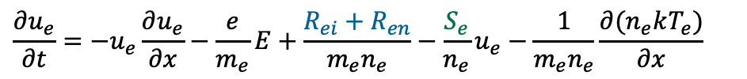
SOL-KiT – Fluid electron mode
Allows us to compare kinetic results to consistent fluid model
Consistency between fluid and kinetic models:
  Same physical processes
  Same atomic data
  Only difference – local closures for friction and heat flux and Maxwellian rates for neutral processes
$$\frac{∂n_{e}}{∂t}+\frac{{∂(n}_{e}u_{e})}{∂x}=S_{e}$$
source/sink terms (atomic physics)
friction with ions and neutrals
conductive heat flux
$$\frac{∂u_{e}}{∂t}=−u_{e}\frac{∂u_{e}}{∂x}−\frac{e}{m_{e}}E+\frac{R_{ei}+R_{en}}{m_{e}n_{e}}−\frac{S_{e}}{n_{e}}u_{e}−\frac{1}{m_{e}n_{e}}\frac{∂(n_{e}kT_{e})}{∂x}$$
external energy source - heating
$$\frac{∂kT_{e}}{∂t} = − u_{e}\frac{∂kT_{e}}{∂x}+ \frac{2}{3}\left[\frac{Q}{n_{e}}−{kT}_{e}\frac{∂u_{e}}{∂x}−\frac{1}{n_{e}}\frac{∂q_{e}}{∂x}−\frac{S_{e}}{n_{e}}\left(\frac{3}{2}kT_{e}−\frac{m_{e}u_{e}^{2}}{2}\right)−\frac{u_{e}(R_{ei}+R_{en})}{n_{e}}\right]$$

Slide 19
Impact of kinetic effects on Impurities
Acknowledgement: Dominic Power

Slide 20
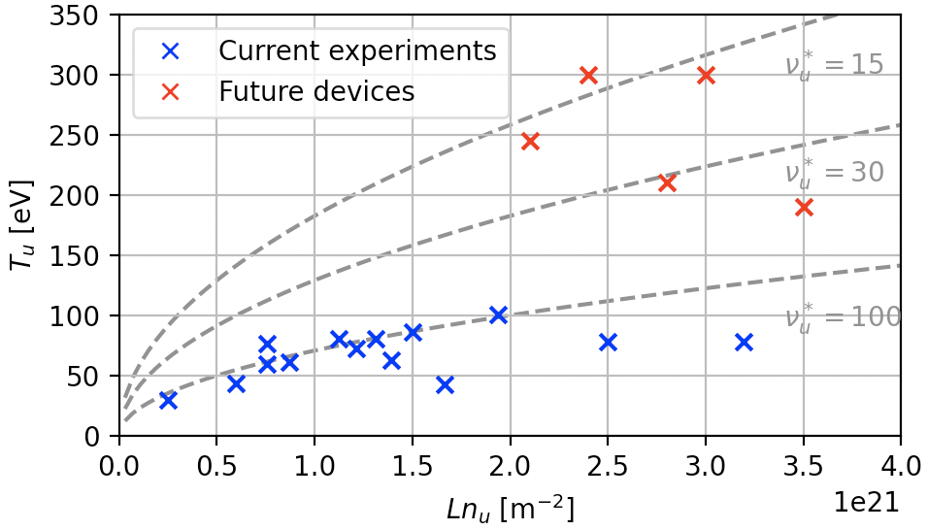
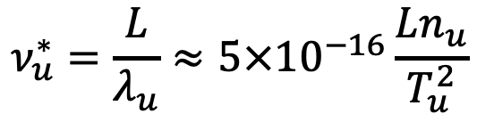
SOL plasma regimes
Upstream collisionality parameter:
Broad range of plasma regimes accessed in current and future experiments
Kinetic effects discussed require low collisionality and large parallel temperature gradients
  How does this map to SOL operating space?
$$ν_{u}^{∗}=\frac{L}{λ_{u}}≈5×{10}^{−16}\frac{Ln_{u}}{T_{u}^{2}}$$
Current experiments: DIII-D and JET
Future experiments: SPARC, ITER and DEMO

Slide 21
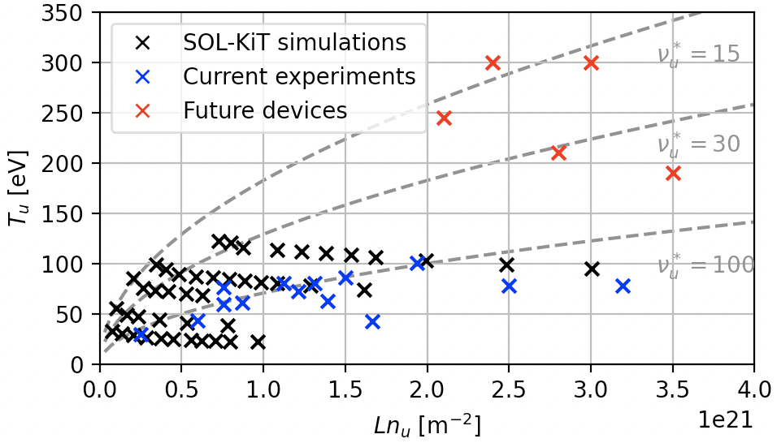
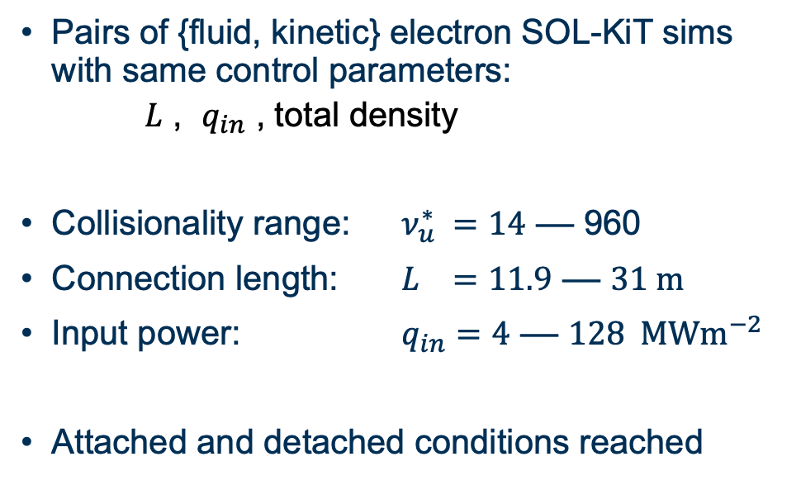
Simulations
Pairs of {fluid, kinetic} electron SOL-KiT sims with same control parameters:
  $L$ , $q_{in}$ , total density
Collisionality range: $ν_{u}^{∗} =14$ –– 960
Connection length: $L =11.9$ –– $31 m$
Input power: $q_{in}=4$ –– $128 MWm^{−2}$
Attached and detached conditions reached
Current experiments: DIII-D and JET
Future experiments: SPARC, ITER and DEMO
[ Power et al., Nuc. Fusion 63, 086013 (2023) ]

Slide 22

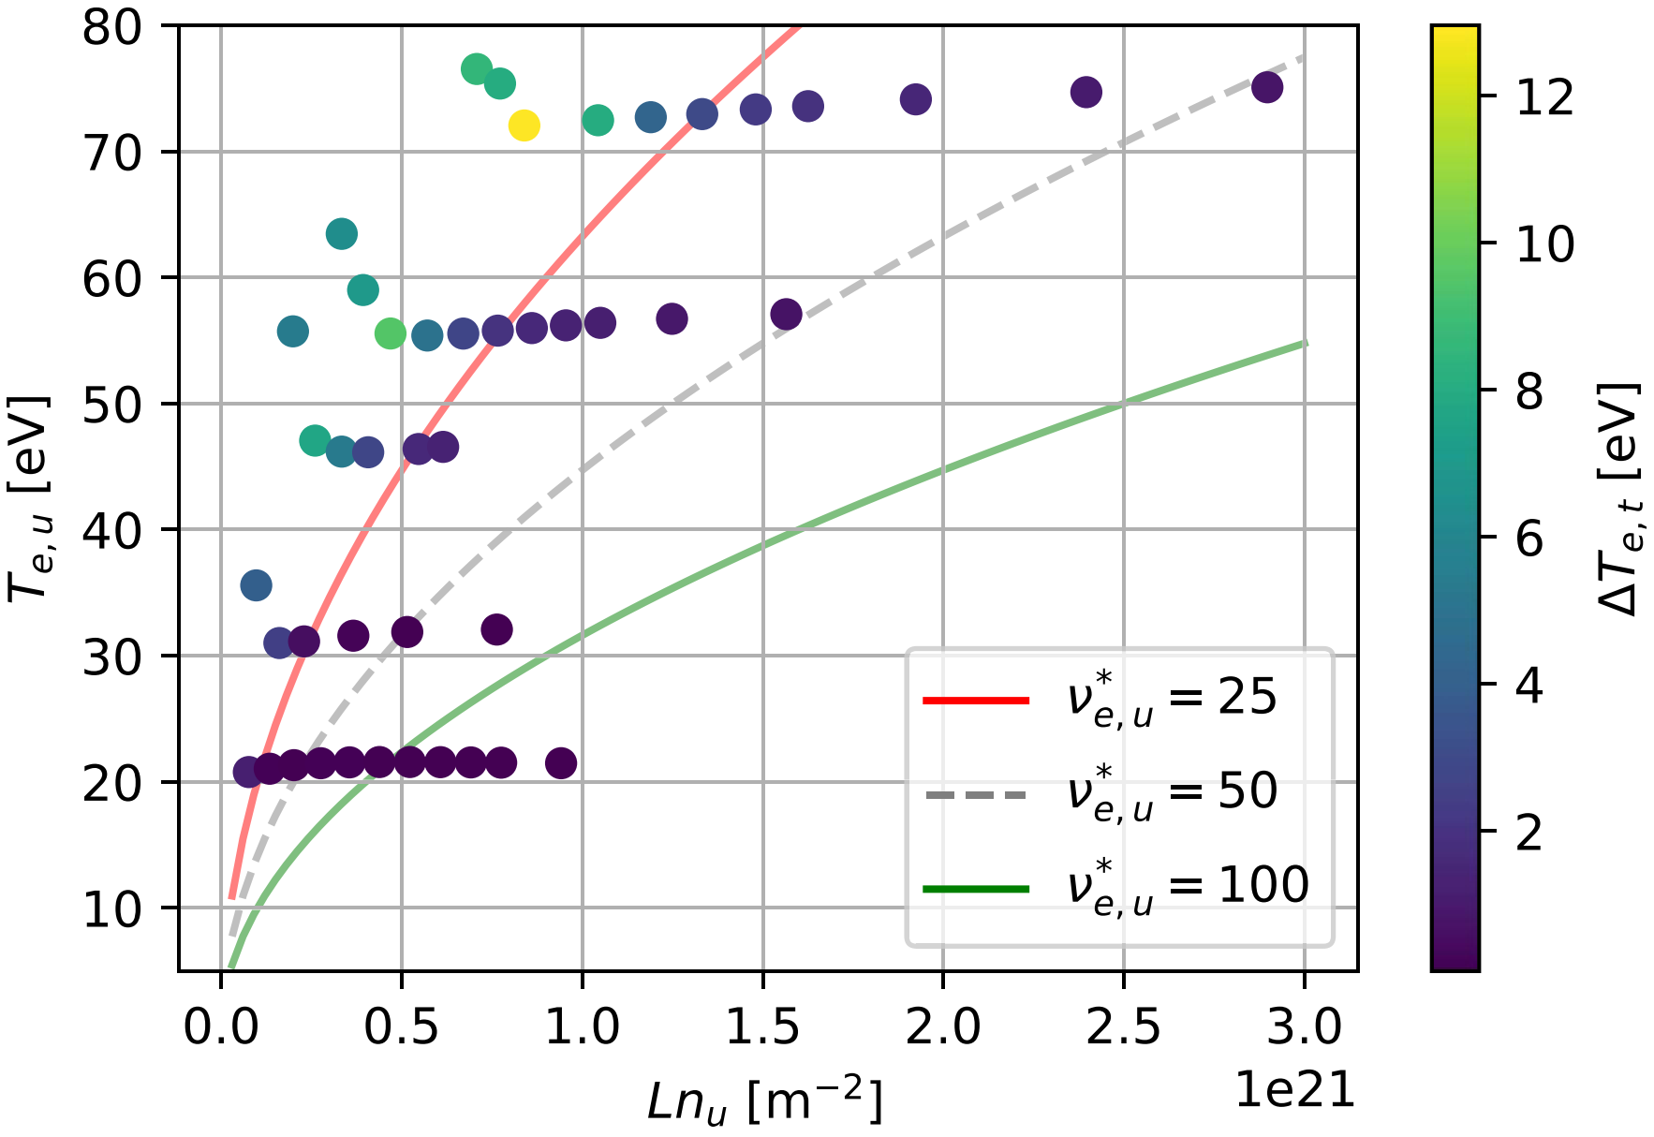
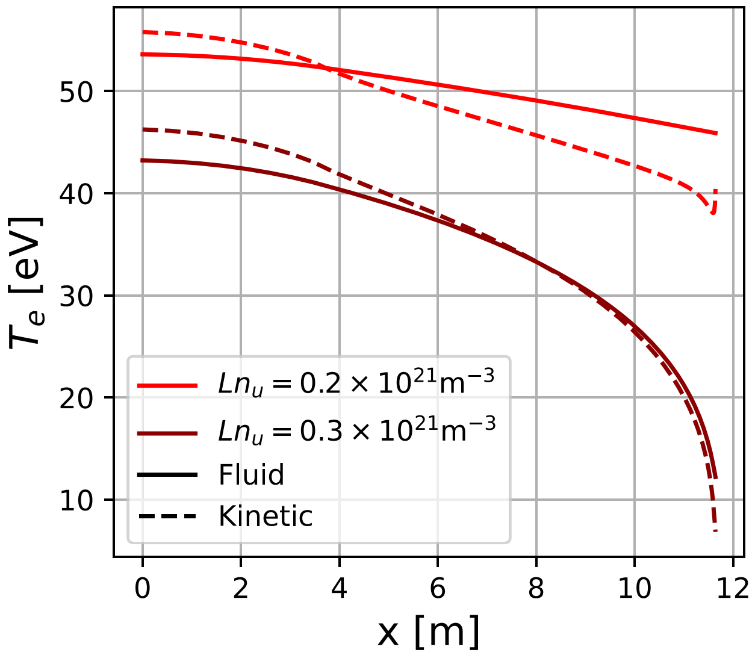

Heat flux suppression leading to steeper $∇T_{e}$
Kinetic simulations show:
  Increased temperature gradients
  due to thermal conductivity suppression
  Reduced target temperatures
  See e.g. [4], [5], [6]
[4] Batishchev, O., et al. Journal of Plasma Physics (1999)
[5] Tskhakaya, D., et al. Contributions to Plasma Physics (2008)
[6] Mijin, S., et al. PPCF (2020)
[ Power et al., Nuc. Fusion 63, 086013 (2023) ]

Slide 23

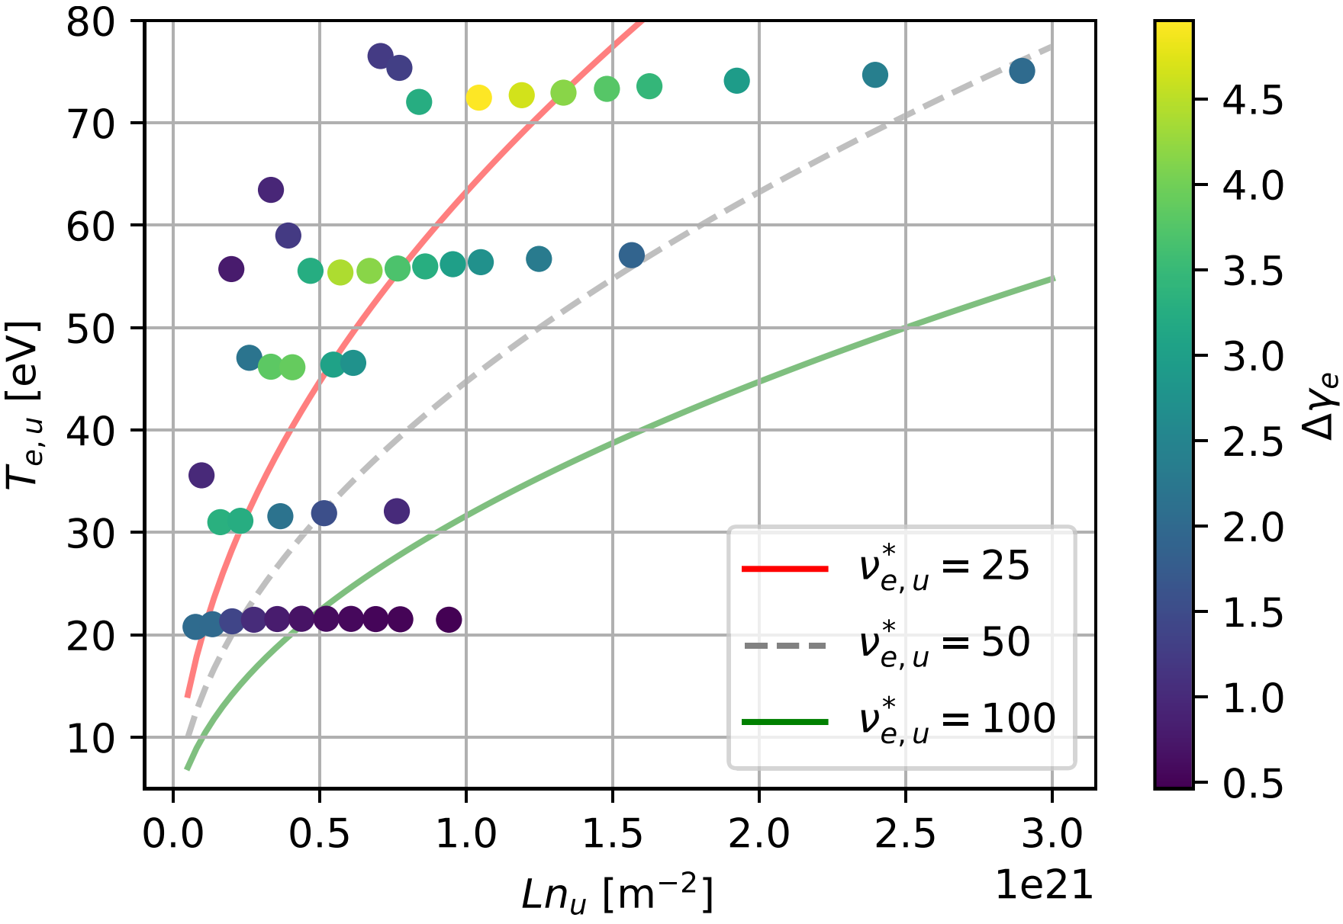
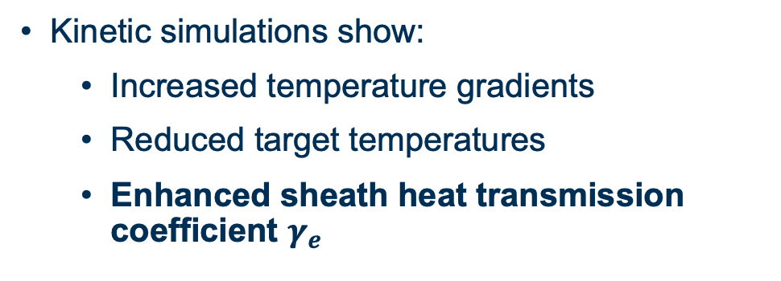

Modified behaviour at the sheath boundary
Kinetic simulations show:
  Increased temperature gradients
  Reduced target temperatures
  Enhanced sheath heat transmission coefficient $γ_{e}$
Classically:
$$≈5$$
Kinetically: calculate self-consistently from logical BC at sheath.
[ Power et al., Nuc. Fusion 63, 086013 (2023) ]

Slide 24
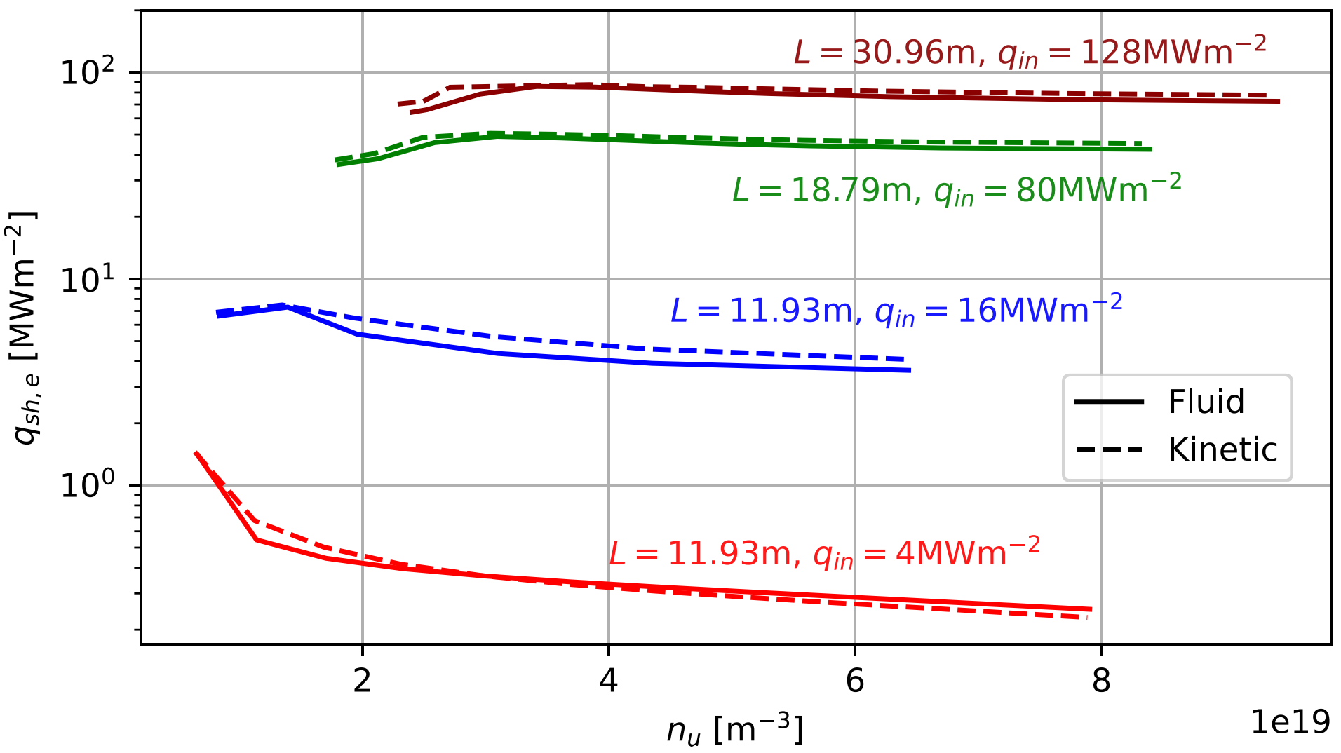
Minimal changes to target heat fluxes
Heat-flux in kinetic & fluid modes surprisingly similar!
… despite marked changes to
  Target temperature
  Sheath heat transmission coefficient
Suggests some degree of cancellation
Both effects needed – capturing only heat flux suppression may lead to worse predictions
[ Power et al., Nuc. Fusion 63, 086013 (2023) ]

Slide 25
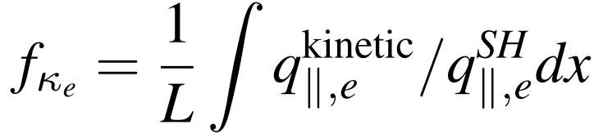
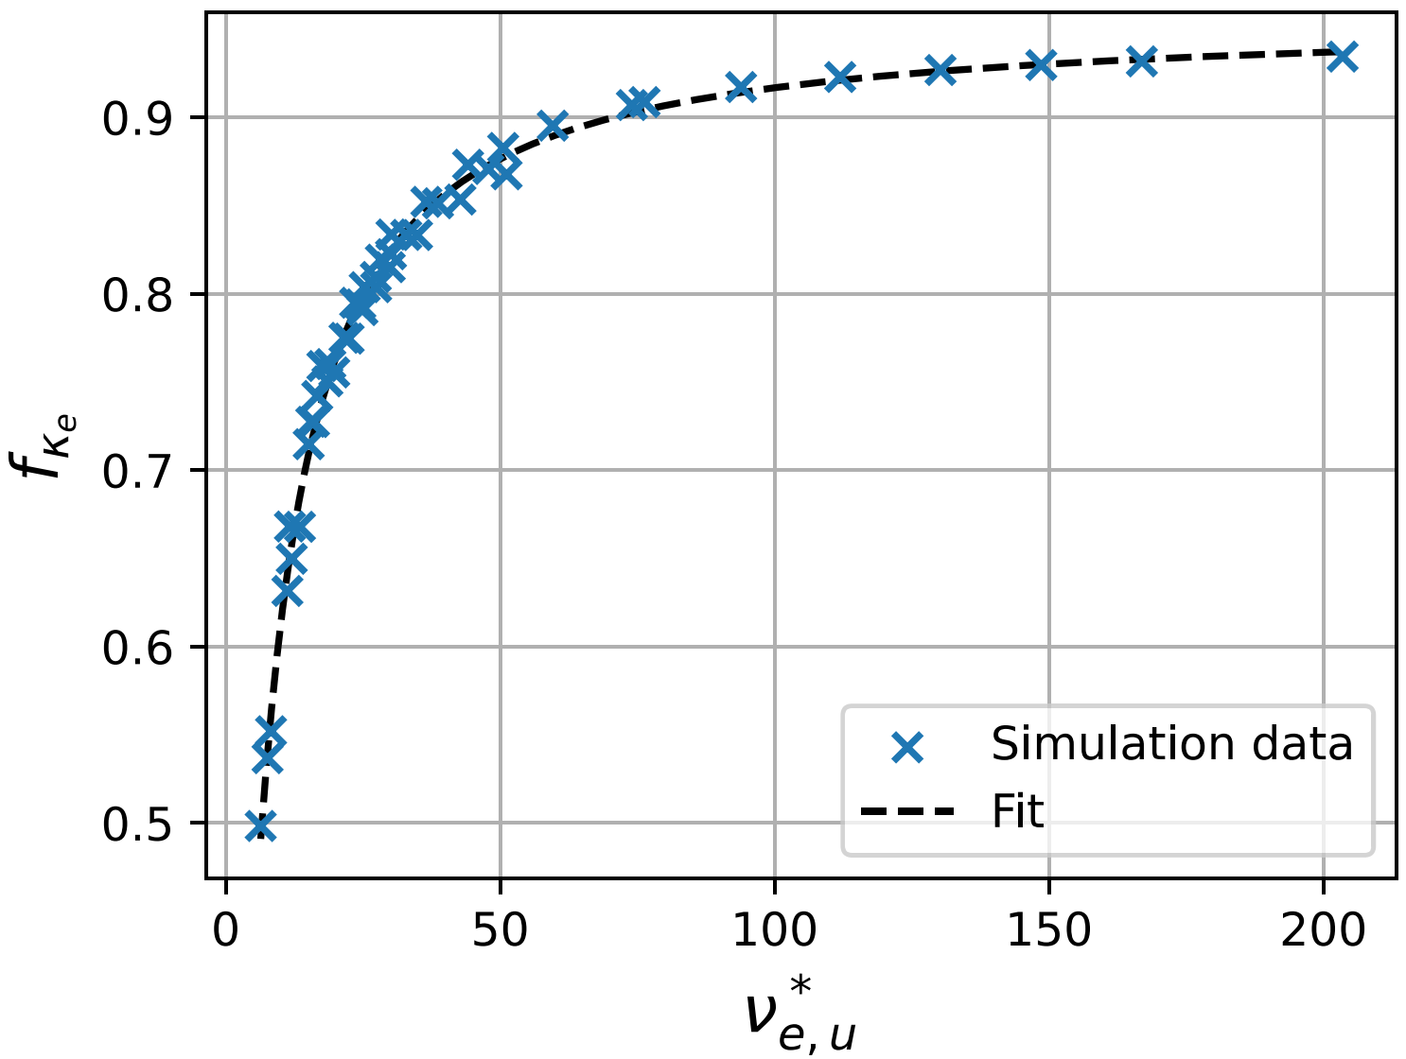

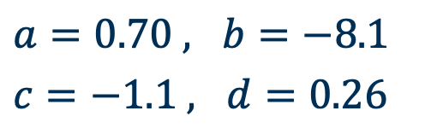

Fitting kinetic modifications to control parameters
1. Heat flux suppression
Fit:
$a=0.70 , b=−8.1$
$c=−1.1 , d=0.26$
(2 s.f.)
Fit is monotonic, a function of $ν_{e,u}^{∗}$ only.
[ Power et al., Nuc. Fusion 63, 086013 (2023) ]
Notes:
a = 0.696 , b = –8.059 , c = –1.074 , d = 0.260 .

Slide 26
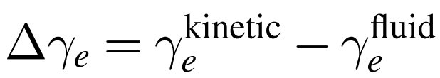
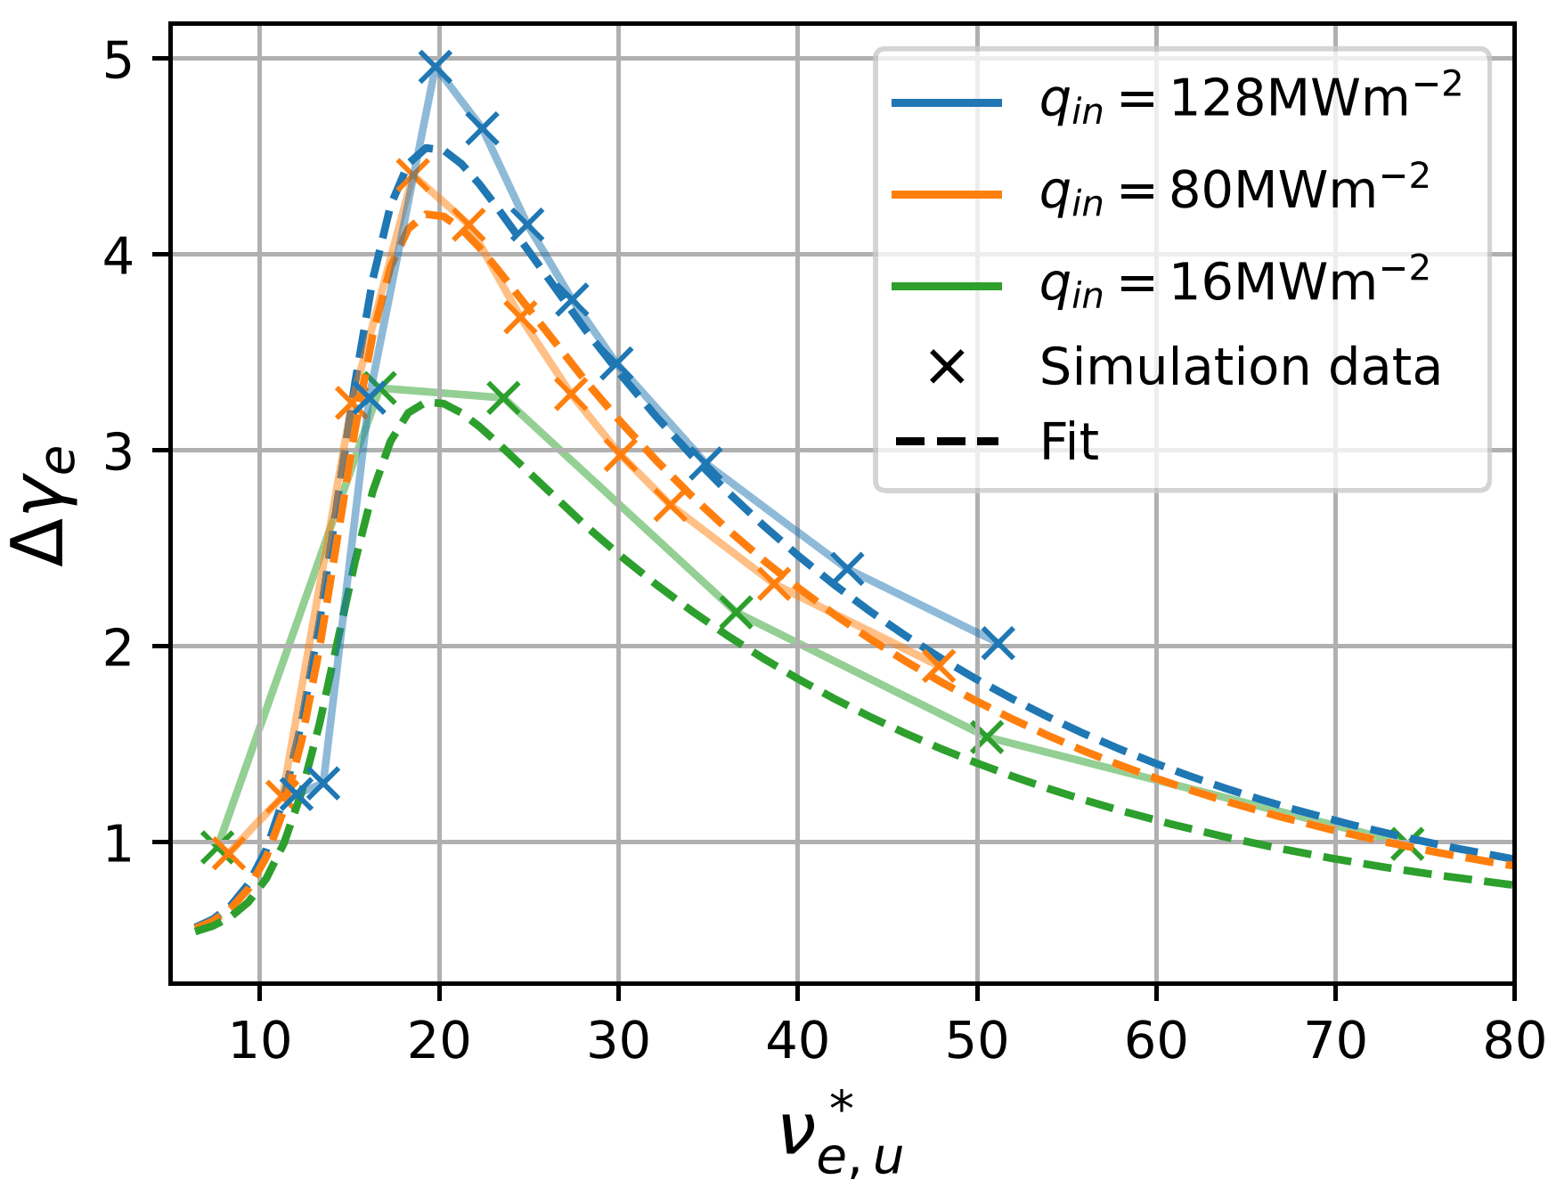
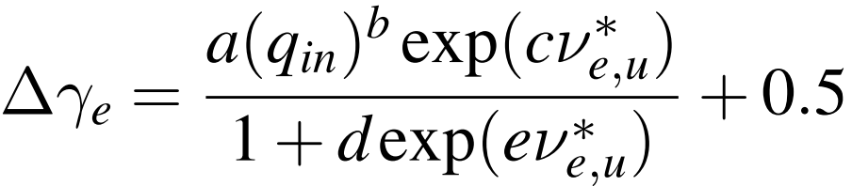
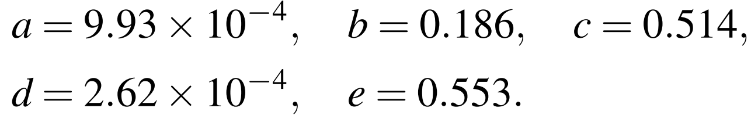
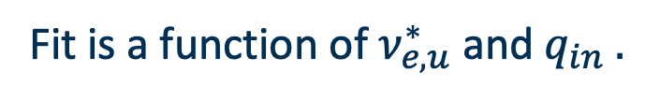
Fitting kinetic modifications to control parameters
2. Sheath heat-transmission coeff. enhancement
Fit:
Fit is a function of $ν_{e,u}^{∗}$ and $q_{in} .$
[ Power et al., Nuc. Fusion 63, 086013 (2023) ]

Slide 27
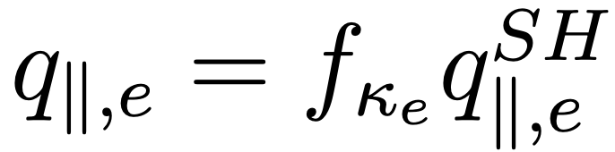
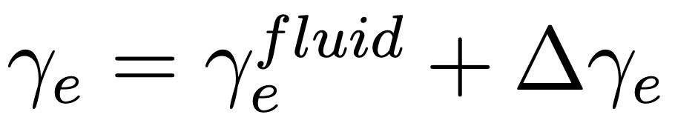
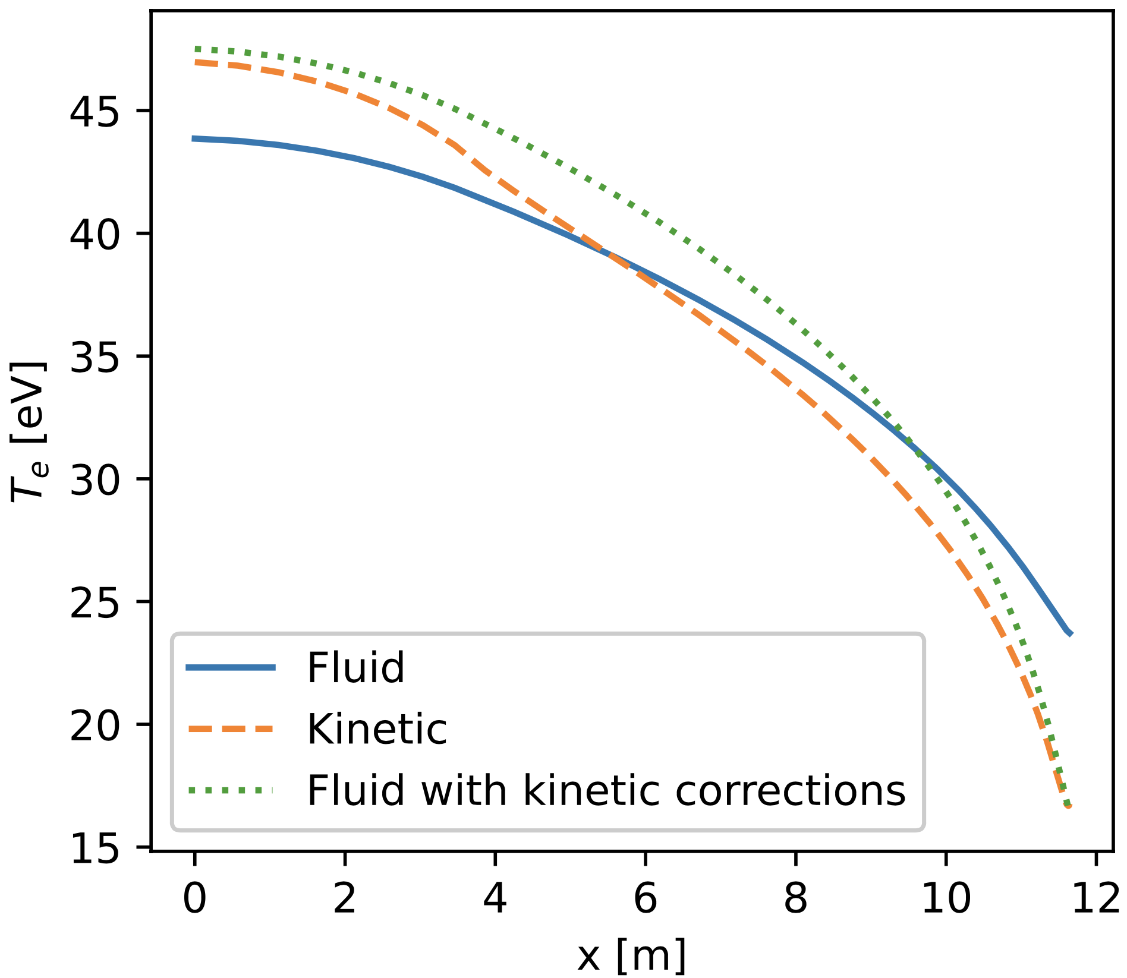

Scaling laws improve fluid simulations
Put these scaling laws in fluid version of SOL-KiT:
Good agreement in target temperatures.
1D model & No impurities or molecules
Extrapolation to higher n_{u}, T_{u}?
Correlation in target temperatures
Temperature
profiles
[ Power et al., Nuc. Fusion 63, 086013 (2023) ]

Slide 28


ITER case
[7] Veselova, I., et al. Nuclear Fusion (2023)

Slide 29
Impact of kinetic electrons on impurities
Acknowledgement: Dominic Power

Slide 30




SIKE
A post-process impurity population-state solver using SOL-KiT electron distribution functions
z = ionization stage index
j = atomic state index
$\frac{∂n_{j}^{z} }{∂t}=S_{z,j}^{ion}+S_{z,j}^{3b−rec}+S_{z,j}^{spont−em}+S_{z,j}^{rad−rec}+$…
Rate coefficient $K=\frac{4π}{n_{e}}\int_{v_{threshold}}^{∞}{v^{3}f\left(v\right)σ(v)dv}$
$$S_{z,j}^{ion}=−n_{e}n_{j}^{z}K_{j,z→z+1}^{ion}+\sum_{j^{′}}{n_{e}n_{j^{′}}^{z−1}K_{j^{′},z−1→z}^{ion}}$$
Electron density
Impurity ion density
Rate matrix
Atomic data for fusion-relevant impurities from FAC, NIST, FLYCHK, screened hydrogenic model:
  Li , Be , C , N , Ne , Ar
[ D. Power, PhD Thesis (2023) ]
* https://github.com/ImperialCollegeLondon/SIKE

Slide 31


Ionization affected by electron kinetics
See enhanced ionization rates in colder SOL plasma near targets
Recombination rates unchanged
See modified ionization balance
[ D. Power, PhD Thesis (2023) ]

Slide 32




Radiative losses reduction
May influence, e.g.,
  power balance ?
  detachment onset from impurity seeding ?
Depends on impurity type & plasma conditions
No self-consistent feedback to plasma (yet) …
$$δq_{z,tot}=(q_{z,tot}^{Maxwellian}−q_{z,tot}^{kinetic})/q_{z,tot}^{kinetic}$$
$q_{z,tot}=$line integrated total radiative losses
Carbon
Argon
[ D. Power, PhD Thesis (2023) ]

Slide 33
Briefly…
… UKAEA New Exhaust Code
Acknowledgement: NEC-Team

Slide 34

UKAEA New Exhaust Code (NEC) – Motivation
Towards addressing one of the most significant challenges facing fusion energy – power exhaust
  Predictive, higher-fidelity modelling essential for fusion power plant concepts.
  Existing modelling tools lack fidelity & scalability for precision & speed for design iterations.
A new exhaust code will be developed to support reactor design
  Designed to scale efficiently to reactor-scale D-T devices
  With models of varying fidelity (reduced models to full turbulence and neutrals)
  Able to simultaneously treat turbulence & neutrals with finesse for detachment
  Modern, well-engineered code with longevity
SOLPS - Detachment
STORM – Turbulence in boundary layer
Notes:
To extrapolate findings from MAST Upgrade and other experiments to future large D-T reactors, we will develop a next-generation exhaust code with Advanced Computing and Materials programmes that combines state-of-the-art numerical techniques and high fidelity physics models to enable efficient simulations of existing devices and future large reactors, to enable us to rigorously test model predictions against experiments and to optimise the exhaust systems in future reactors.

Slide 35
UKAEA New Exhaust Code – Objectives
Aim to use numerical tools developed under NEPTUNE project.
1. Create a low-fidelity 2D design/interpretive code that is fast, easy to use & extendable
  Rationale: Speed up design iteration and experimental support cf. SOLPS-EIRENE & EDGE2D-EIRENE.
  Physics spec:
    Plasma via drift-reduced mean-field fluid, multiple ion species.
    Kinetic neutrals with effective rates (from existing CRMs). Trace impurities.
  Design spec:
    EIRENE replacement engineered for exascale (GPU capable).
    Capable of coupling to integrated modelling frameworks (through pedestal).
    Streamline set-up time, results analysis; reduce nursing runs.
2. Develop exhaust physics models of increased accuracy and scope, suitable for deployment in codes
  Rationale: (1) Drift-fluid has issues with H-mode turb. modeling now. Will be worse at reactor scale.
  (2) Neutral CRM modelling and expt. mismatch (ioniz., MAR). Low impurity conc. approx.
  Further develop moment-kinetic approach (esp. collisional closures) for consist. spanning of fluid–kinetic.
  Develop improved CRM models (i.e. selection atomic levels to include; effective rate calc.)
Notes:
?

Slide 36
UKAEA New Exhaust Code – Objectives
3. Create a high-fidelity turbulence code with neutral–turbulence coupling
  Rationale: For improved predictive modelling of SOL width (due to upstream turbulence) & thus heat-flux
  to divertor. Current codes assume static neutrals over turbulent timescales.
  Spec:
    Resolve over SOL in poloidal plane (2D). Multiple ion species. Fluid plasma + Kinetic neutrals (CRM).
  Stretch sub-objectives:
    Self-consistently resolving neutral dynamics (CRM) as plasma eddies propagate through gas.
    Full 3D resolution to capture departures from axi-symmetric equilibria.
Create a coherent suite of codes offering a range of fidelity, which are easy to maintain & extend
  Strive for a uniform user-feel, compatible input and ouput. As modular as possible. As productive as possible.
Aim to use numerical tools developed under NEPTUNE project.
Notes:
?

Slide 37




Progress: Nektar++ (FEM) proofing
Slab, interchange instability (TOKAM2D eqn-set + periodic BC)
Romain Futtersack
B
density grid
Notes:
TOKAM2D in Nektar++ (interchange instability)
Isothermal
Eqn 1 density (N): RHS, term 1 —> mimics parallel losses (due to sheath/wall)
Eqn 2 vorticity (W): RHS, term 2 --> curvature (one with g),
Eqn 3 potential (φ): missing here(!): determination of φ (potential) in terms
[φ,N] = ∇φ ⨉ ∇N : advection at ExB drift velocity (???)
TOKAM2D equation set
HESSEL , HERMES3 —> similar SOL turbulence codes with similar equations (perhaps also temperature).
Plasma is being injected in a vertical strip with a Gaussion profile (on top of an initial uniform background):
Once a critical density gradient develops, the system – on the unstable side (to the right)– goes unstable.
There the density gradient and curvature are in unfavourable direction.
On the LHS, it is stable, as the ∇n is in a favourable direction w.r.t. curvature.
tokam_HR.jpq
Quadrilateral uniform mesh: ~250 x ~250 , 2nd order FEM
270 x 1000 time steps , explicit , 9min per save (i.e. 1000 time steps).
Periodic BCs.

Slide 38
Summary
Growing team at Imperial: working on exhaust physics & L-H transitions.
Exhaust Physics – Electron kinetics
SOL-KiT: 1D2V Vlasov-FP–Boltzmann & neutral state population solver:
  Kinetic or fluid electrons, fluid ions, fluid neutrals
Kinetic effects seen at equilibrium (& in transients) in 1D simulations: f_{e}(v)≠f_{M} .
Scaling laws suggest ways in which they might be captured in fluid models.
Preliminary: modifications to e– - impurity reaction rates due to enhanced tail of f_{e}(v) .
Potential Further Work
  Self-consistent impurity & plasma evolution , better geometry (flux tube expansion).
  Incorporate derived reduced-transport models into SOL design codes.
  Couple to kinetic ion & neutral solvers.
Other work – L-H transitions, UKAEA exhaust code, magnetized sheaths

Slide 39
Extras

Slide 40




Exhaust physics in MCF
Consequences of the two-point model
3 equations but 5 unknowns …
  $n_{u}$ and $q_{∥}$are easiest to control experimentally
Modest temperature drops give
$T_{t}^{7/2}≪T_{u}^{7/2}$ → $T_{u}≈{\left(\frac{7}{2}\frac{q_{∥}L}{κ_{e}}\right)}^{2/7}$
Combine (1) and (3) and result above → $T_{t}∝\frac{q_{∥}^{10/7}}{L^{4/7}n_{u}^{2}}$
  Some good news: $T_{t}∝1/n_{u}^{2}$
  More good news: $T_{t}∝1/L^{4/7}$
  Some bad news: ${ T}_{t} ∝q_{∥}^{10/7}$
(1)
$$n_{u}T_{u}=2n_{t}T_{t}$$
$$T_{u}^{7/2}=T_{t}^{7/2}+\frac{7}{2}\frac{q_{∥}L}{κ_{e}}$$
(2)
(3)
$$q_{∥}=γ_{e}n_{t}T_{t}c_{s}$$
Notes:
Important point – all this applies to a conduction-dominated regime
T_u being independent of n_u is because heat (or electrical) conductivity in plasmas is ~not a function of number of charge carriers, a property of plasmas not present in normal materials
T_u being insensitive to all params is consequence of fact heat conductivity is a strong function of temperature - small changes in conductivity can accommodate large changes in other params
Good news: increasing density reduces target temperature, also good for fusion
Bad news: target temperature increases quite fast with increasing power into SOL

Slide 41




Exhaust Physics in MCF
Simplest fluid equations along field lines
$$\frac{∂ρ}{∂t}+\frac{∂}{∂x}\left(ρu\right)=S(x)$$
Mass continuity:
$$m_{i}Γ$$
Momentum:
$$\frac{∂(ρu)}{∂t}+\frac{∂}{∂x}\left(ρu^{2}+P\right)=S^{(p)}(x)$$
Total energy:
$$\frac{∂}{∂t}(ρu^{2}+\frac{3}{2}P)+\frac{∂}{∂x}\left(\frac{1}{2}ρu^{3}+\frac{5}{2}Pu+q\right)=S^{(E)}(x)$$
KE flux
enthalpy
thermal conduction
Nb: These are in conservative form (rather than primitive form;$ρ\frac{du}{dt}$ , $c_{v}\frac{dT}{dt}$

Slide 42



Kinetics in the divertor SOL
Evidence
from [4]
Fluid codes overestimate $T_{t}$
  Kinetics may be the cause [﻿2, 3]
Kinetics a strong candidate. Heat flow argument
  Define $K_{T}=\frac{λ_{mfp}}{L_{∆T}}$ → if $K_{T}$ not small, expect nonlocal heat flow
Maxwellian e–
Kinetic electrons
  In SOL, often violate $K_{T}≪1$
from [5]
[2] Chankin & Coster, J. Nucl. Mater. (2009)
[3] Churchill et al, Nucl. Mater. and En. (2016)
[4] Allais, F. et al., ﻿J. Nucl. Mater. (2005)
[5] ﻿Chankin et al., PPCF (2018)
﻿
Notes:
Fluid codes (such as SOLPS, UEDGE) overestimate target temperatures… relative to experiment
Havlickova result shows differences in heat flow during transient showing profile differences but fairly broad agreement. Note no plasma-neutral interaction here and fluid code was viscosity-limited

Slide 43




Current and future research
Ion temperature equation
Braginskii form:
$$\frac{∂kT_{i}}{∂t}=−u_{i}\frac{∂kT_{i}}{∂x}+\frac{2}{3}\left[\frac{Q}{n_{i}}−kT_{i}\frac{∂u_{i}}{∂x}−\frac{1}{n_{i}}\frac{∂q_{i}}{∂x}−\frac{u_{i}}{n_{i}}R\right]$$
Ion-electron energy exchange:
$$Q_{ei}=−Q_{ie}=\int{\frac{1}{2}m_{e}v^{2}C_{ei}d\overset{⃑}{v}}$$
$Q=Q_{ie}+Q_{in}$
Spitzer-Harm
$$R=R_{ie}+R_{in}$$
Notes:
Going to try and go some way to answering the first of those questions

