Slide 1
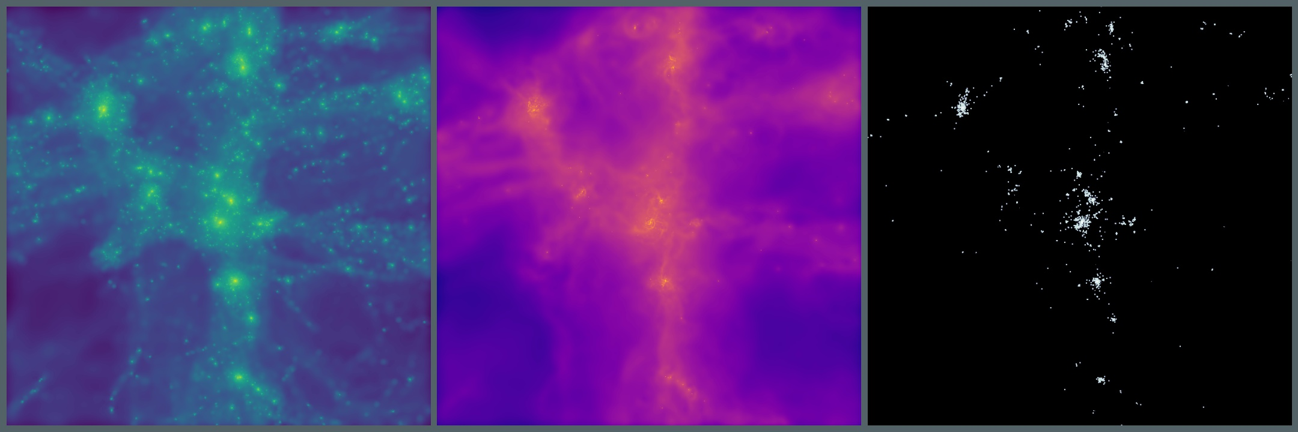

Predicting non-linear effects in matter clustering from changes in cosmology and baryons using multi-fidelity simulations.
Jonah Conley
Astrophysics Research Institute – Liverpool John Moores University
Theoretical Modeling of Large-Scale Structure of the Universe Workshop, Edinburgh, 2024
Collaborators: Ian McCarthy, Andreea Font, Juliana Kwan, Jaime Salcido Negrete, Amol Upadhye

Slide 2
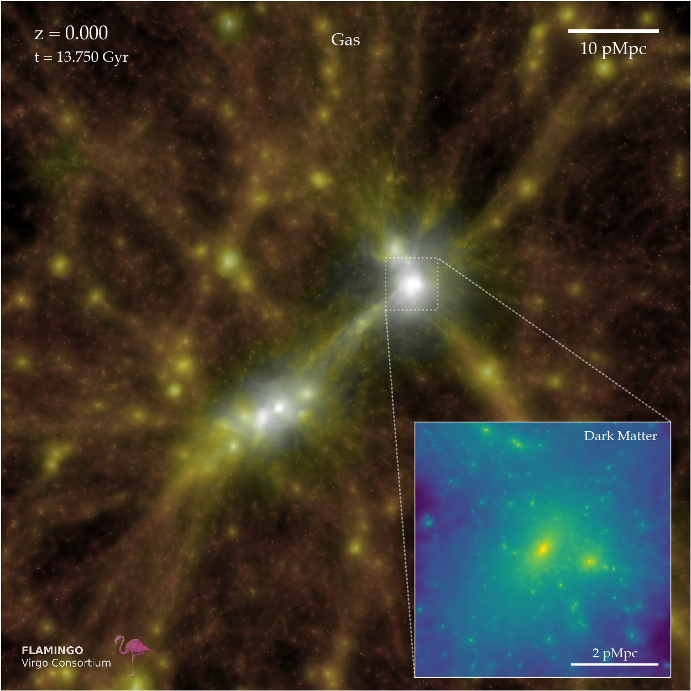
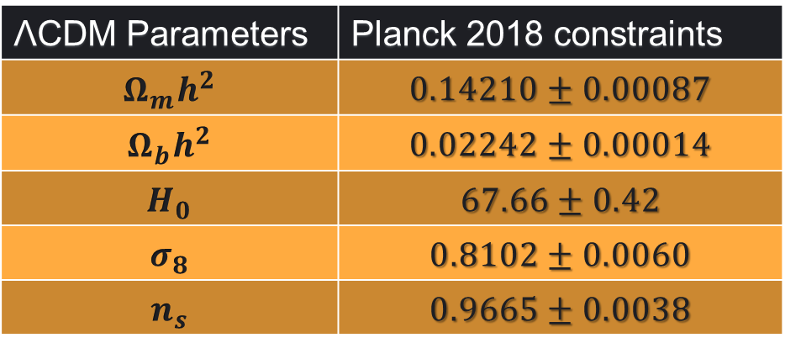
Large scale structure & ΛCDM
Constraints for ΛCDM from Planck 2018 CMB power spectra (TT, TE, EE+lowE), including CMB lensing and BAO measurements:
ΛCDM Parameters | Planck 2018 constraints
$$Ω_{m}h^{2}$$ | $$0.14210±0.00087$$
$$Ω_{b}h^{2}$$ | $$0.02242±0.00014$$
$$H_{0}$$ | $$67.66±0.42$$
$$σ_{8}$$ | $$0.8102±0.0060$$
$$n_{s}$$ | $$0.9665±0.0038$$
See Planck Collaboration VI (2020a)
Credit: Virgo Consortium.

Slide 3
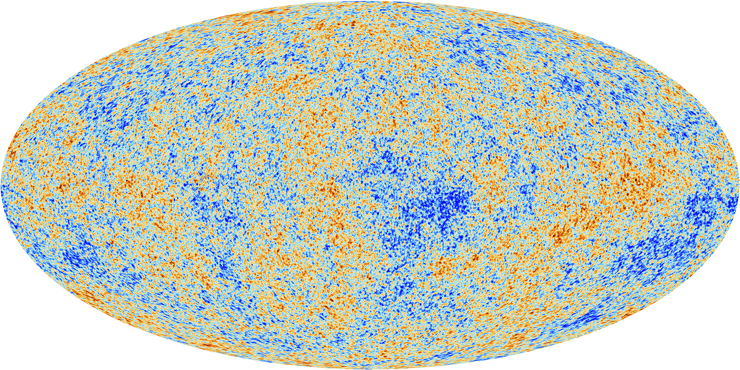
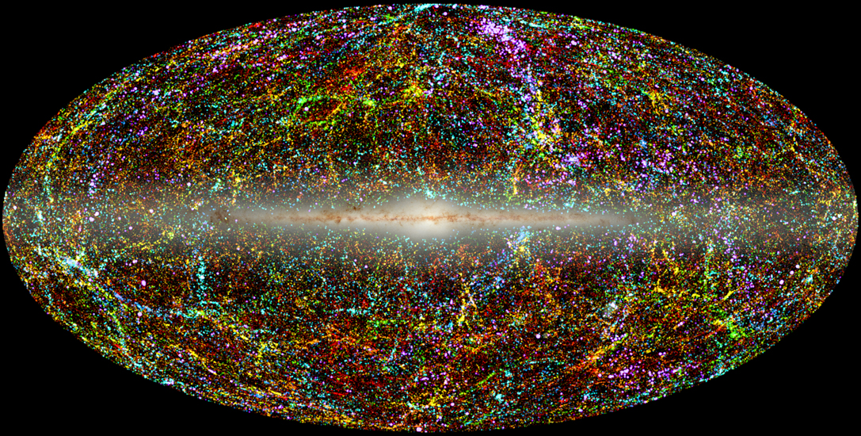
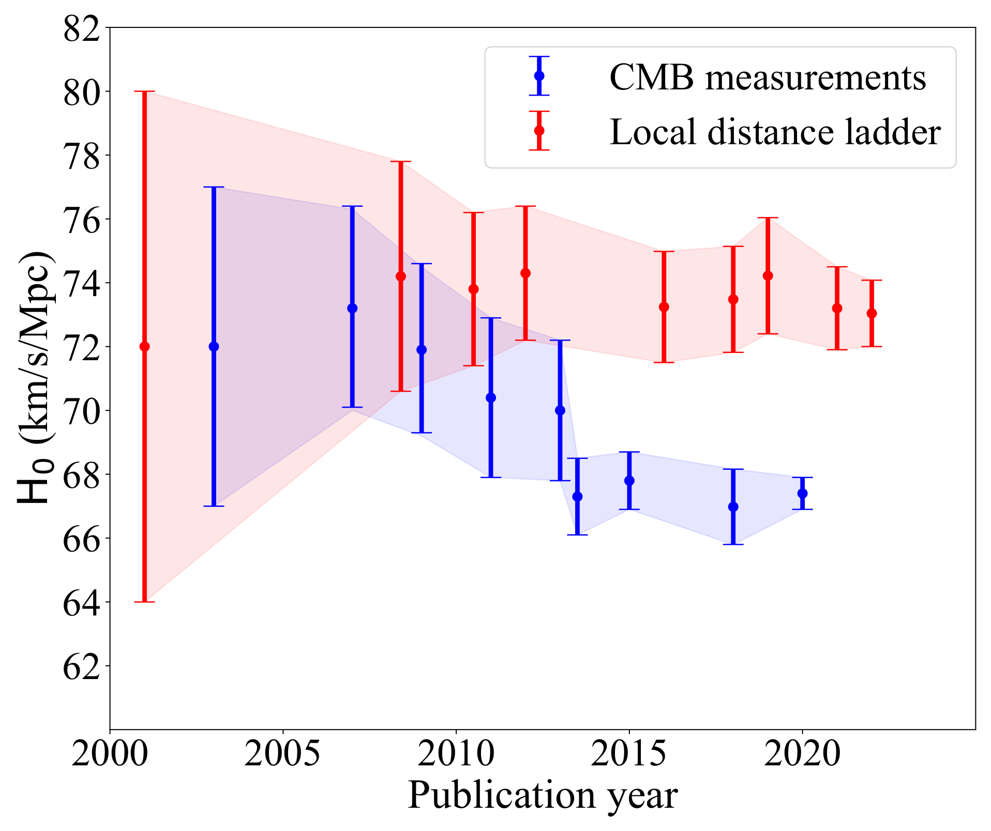
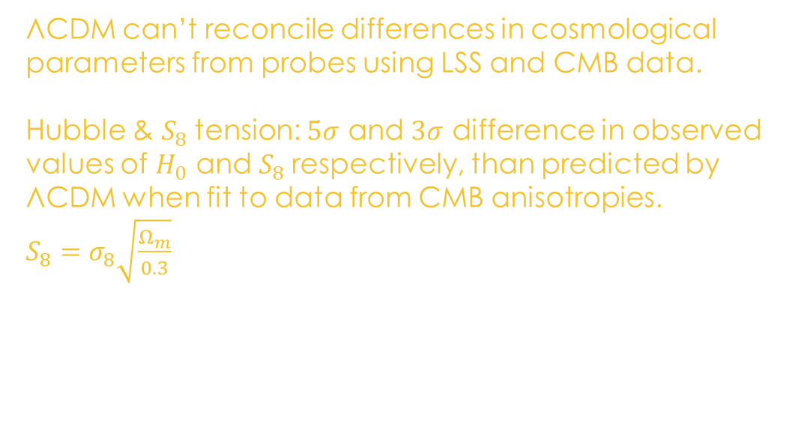
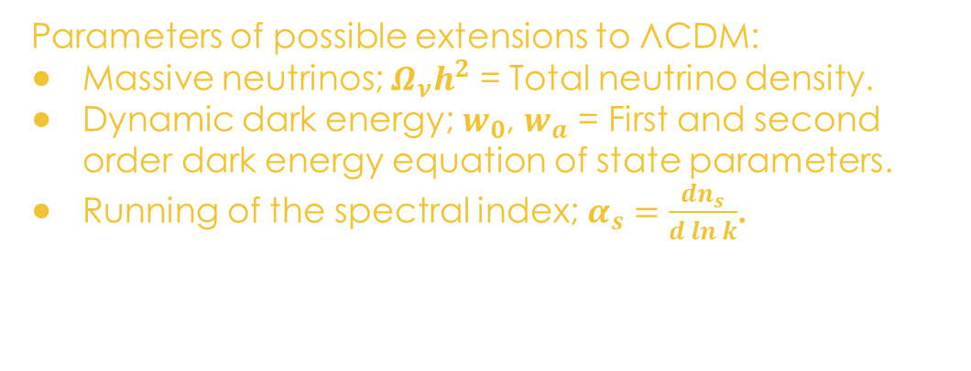
Model Tensions & Extensions
VS
ΛCDM can’t reconcile differences in cosmological parameters from probes using LSS and CMB data.
Hubble & $S_{8}$tension: $5σ$ and $3σ$ difference in observed values of $H_{0}$ and $S_{8}$respectively, than predicted by ΛCDM when fit to data from CMB anisotropies. $S_{8}=σ_{8}\sqrt{\frac{Ω_{m}}{0.3}}$
Credit: ESA and the Planck Collaboration & Jarrett (2004).
See Riess et al. (2022) & Abbott et al. (2022)
Parameters of possible extensions to ΛCDM:
Massive neutrinos; $Ω_{ν}h^{2}$ = Total neutrino density.
Dynamic dark energy; $w_{0}$, $w_{a}$ = First and second order dark energy equation of state parameters.
Running of the spectral index; $α_{s}=\frac{dn_{s}}{d\ln{k}}$.
Hu and Wang (2023).

Slide 4
Hydrodynamic Simulations
Simulations are computationally expensive in terms of both time and resources required:
Simulation Suite (Machine used) | Core Hours Required | Real-world computational time | Memory Requirement | Storage Requirement
FLAMINGO (COSMA8) | 17 Million (1Gpc box) 31 Million (2.8Gpc box) | ~46 days (1Gpc box) 42 days (2.8Gpc box) | Data not publicly available yet. | Data not publicly available yet. (~8PB allocated to full project.)
BAHAMAS (COSMA5) | ~300 thousand (400Mpc box) ~6 Million (for 20 simulations) | Information not available. | Information not available. | 3TB to store one simulation. 60TB for full suite.
MilleniumTNG (SuperMUC-NG)* | 170 Million (740Mpc box) | 57 days (740Mpc box) | 180TB to run. | 1.1PB data output.
*MilleniumTNG data from Pakmor et al. (2022)

Slide 5
Gaussian Process Emulators
Rasmussen and Williams (2006)
Emulators:
Form of machine-learning.
Trained on data to approximate the function that maps an input/s parameter to an output statistic.
Gaussian Process (GP):
A Bayesian statistics method.
Generates functions from many-dimensional Gaussian.
Resulting model can be used to make predictions from unseen inputs.

Slide 6
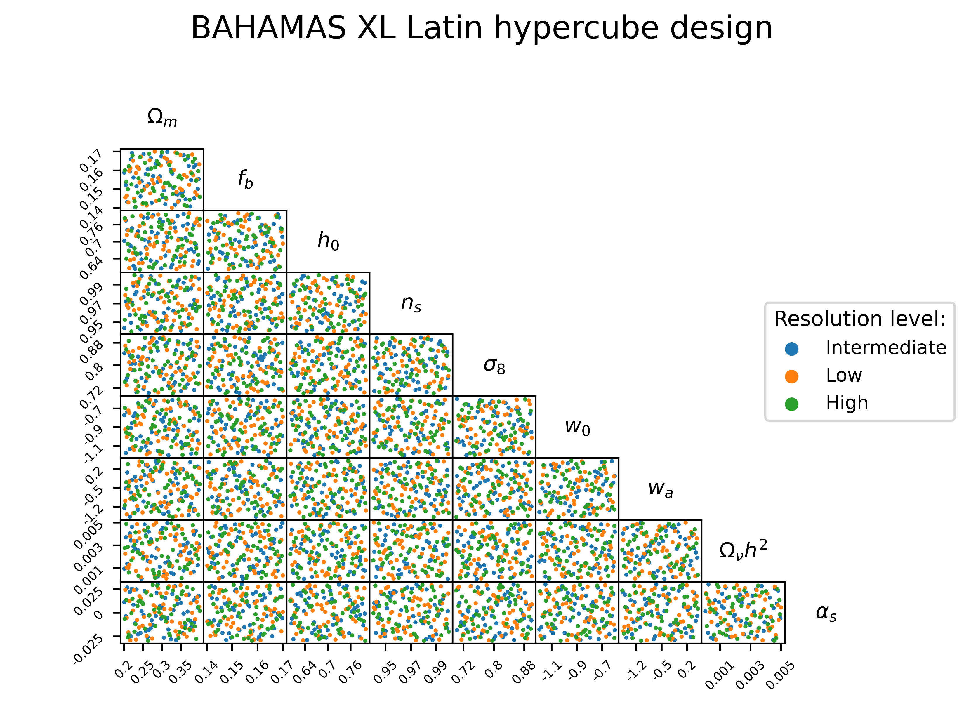
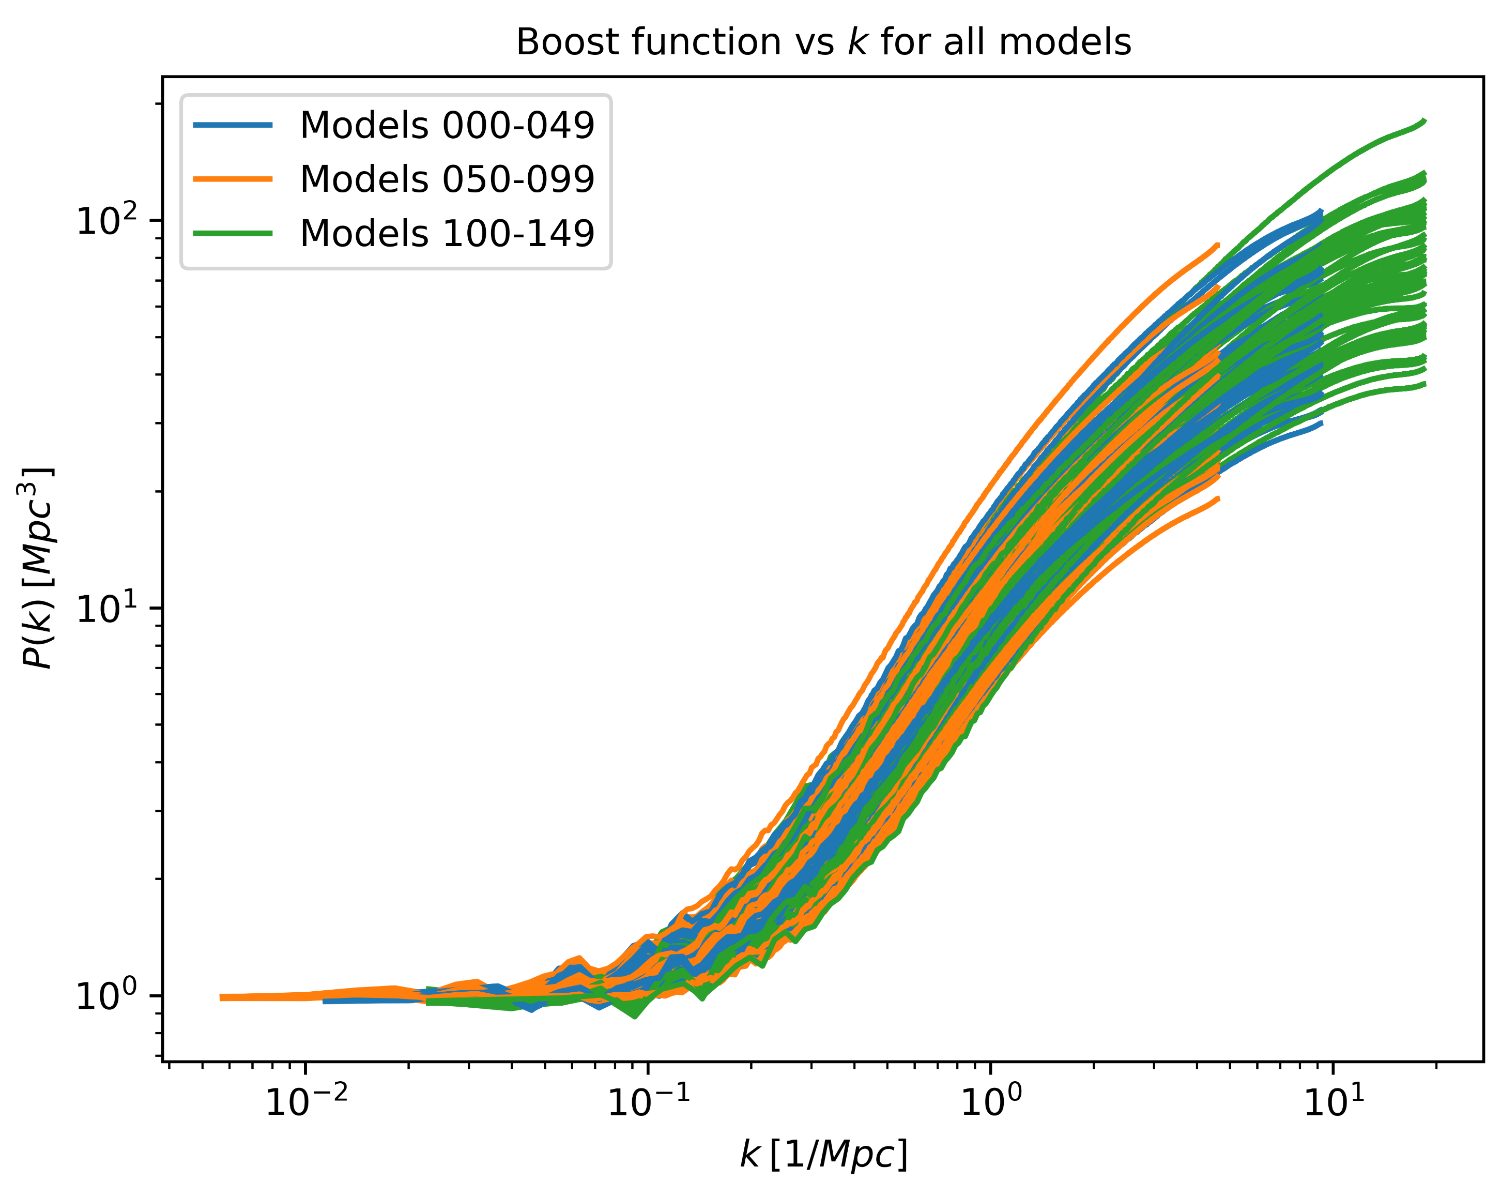
BAHAMAS XL Simulations
BAHAMAS XL contains 150 dark matter-only simulations, sampled from a Latin hypercube, that combines parameters from ΛCDM and various model extensions.
Models are distributed across 3 different box sizes, 350, 700, & 1400Mpc on a side, with a fixed particle resolution of 1260³ particles.
Equivalent to having 3 sets of 50 models that have high (HR, 350Mpc box), intermediate
(IR, 700Mpc) and low resolution (LR, 1400Mpc) simulations from the same nested hypercube.
Large scales
Small scales

Slide 7
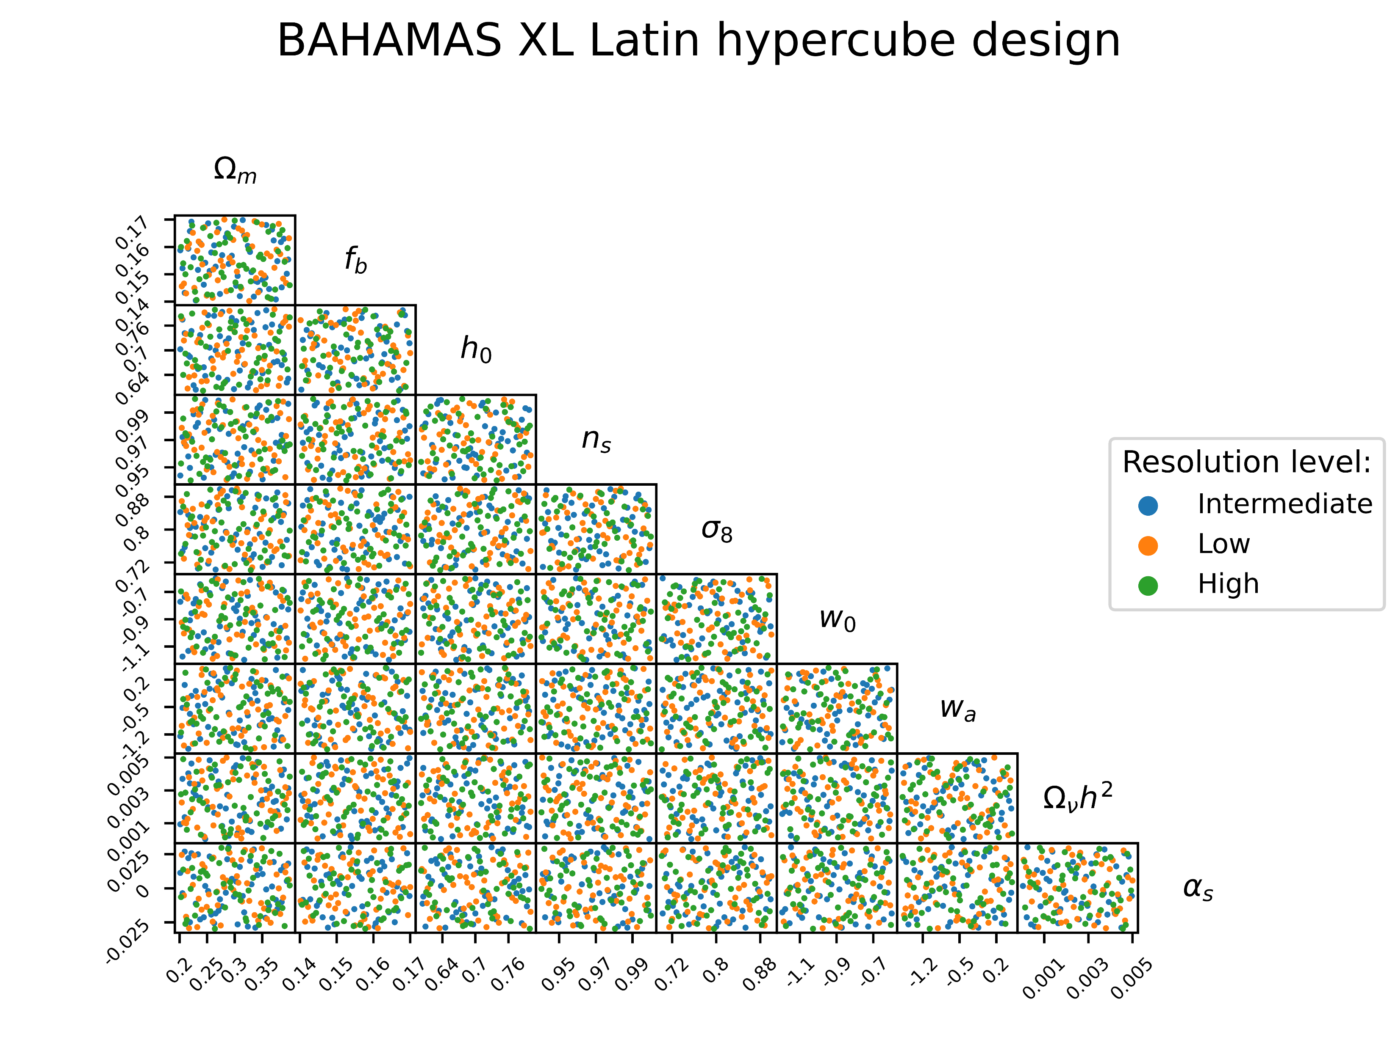

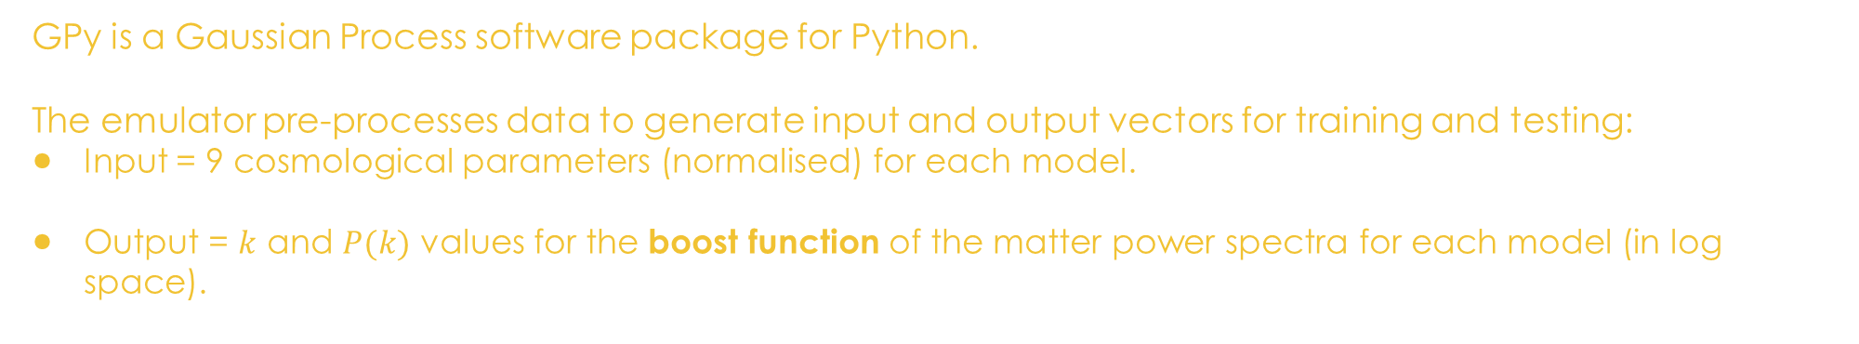
GPy emulator
GPy is a Gaussian Process software package for Python.
The emulator pre-processes data to generate input and output vectors for training and testing:
Input = 9 cosmological parameters (normalised) for each model.
Output = $k$ and $P(k)$ values for the boost function of the matter power spectra for each model (in log space).
Large scales
Small scales

Slide 8
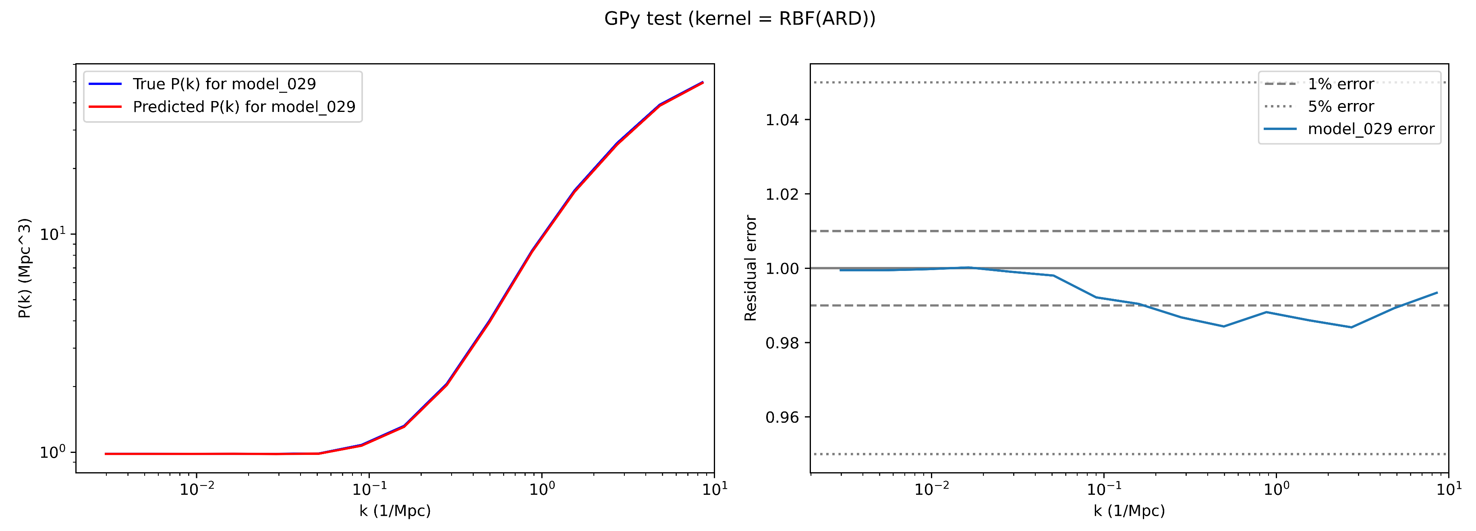
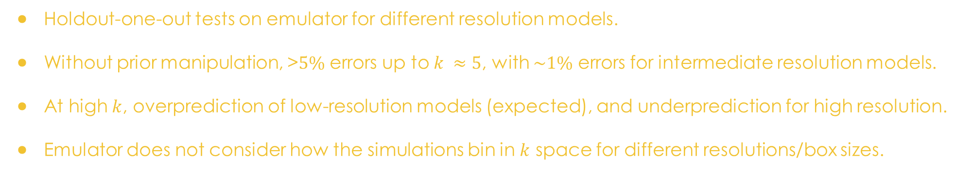
Initial Results
Holdout-one-out tests on emulator for different resolution models.
Without prior manipulation, >$5\%$ errors up to $k ≈5$, with $\sim 1\%$ errors for intermediate resolution models.
At high $k$, overprediction of low-resolution models (expected), and underprediction for high resolution.
Emulator does not consider how the simulations bin in $k$ space for different resolutions/box sizes.

Slide 9
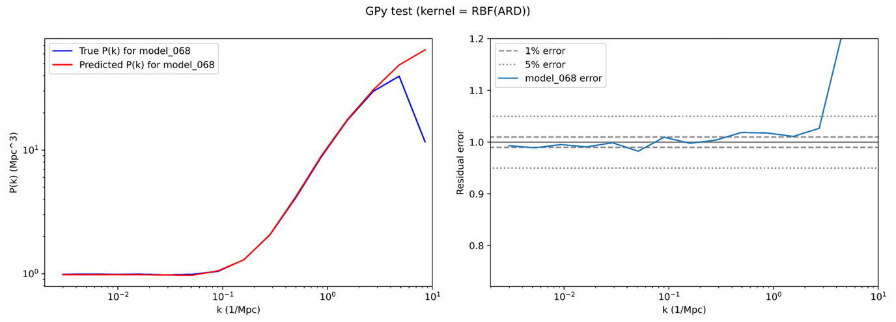

Initial Results
Holdout-one-out tests on emulator for different resolution models.
Without prior manipulation, >$5\%$ errors up to $k ≈5$, with $\sim 1\%$ errors for intermediate resolution models.
At high $k$, overprediction of low-resolution models (expected), and underprediction for high resolution.
Emulator does not consider how the simulations bin in 𝑘 space for different resolutions/box sizes.

Slide 10
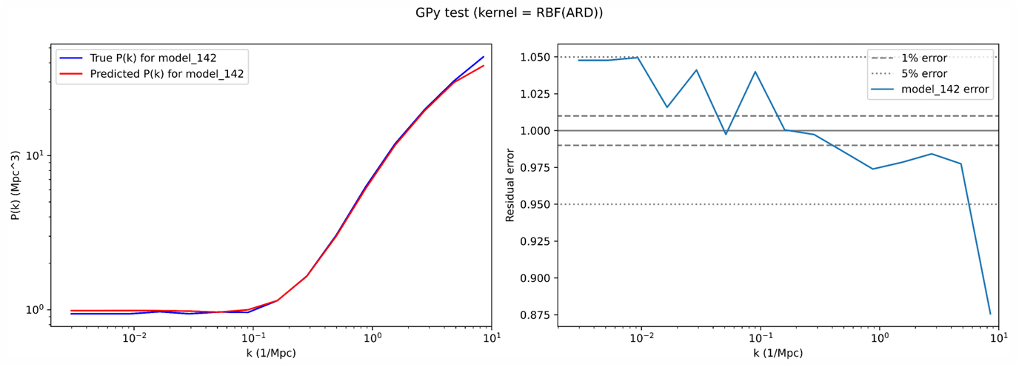
Initial Results
Holdout-one-out tests on emulator for different resolution models.
Without prior manipulation, >$5\%$ errors up to $k ≈5$, with $\sim 1\%$ errors for intermediate resolution models.
At high $k$, overprediction of low-resolution models (expected), and underprediction for high resolution.
Emulator does not consider how the simulations bin in $k$ space for different resolutions/box sizes.

Slide 11
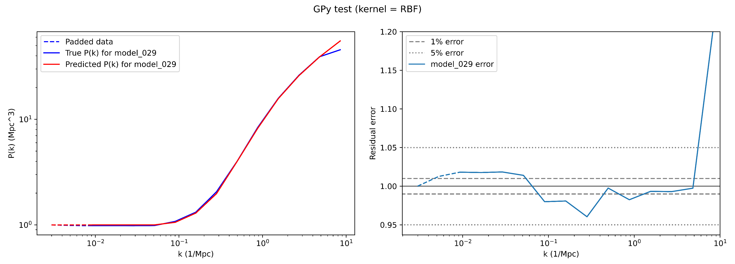
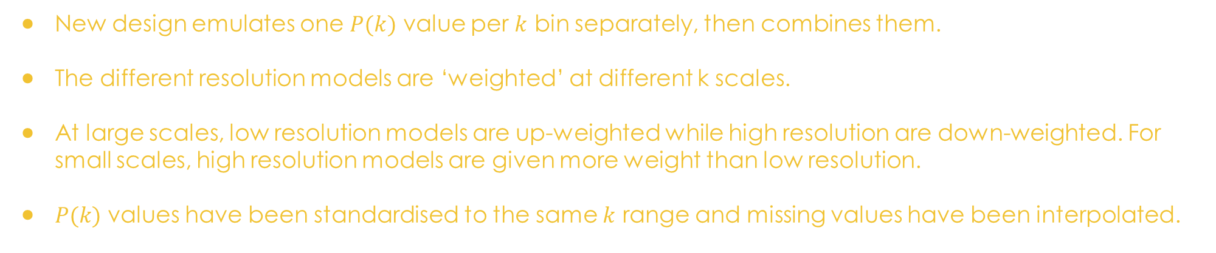
Improved emulator results
New design emulates one $P(k)$ value per $k$ bin separately, then combines them.
The different resolution models are ‘weighted’ at different k scales.
At large scales, low resolution models are up-weighted while high resolution are down-weighted. For small scales, high resolution models are given more weight than low resolution.
$P(k)$ values have been standardised to the same $k$ range and missing values have been interpolated.

Slide 12
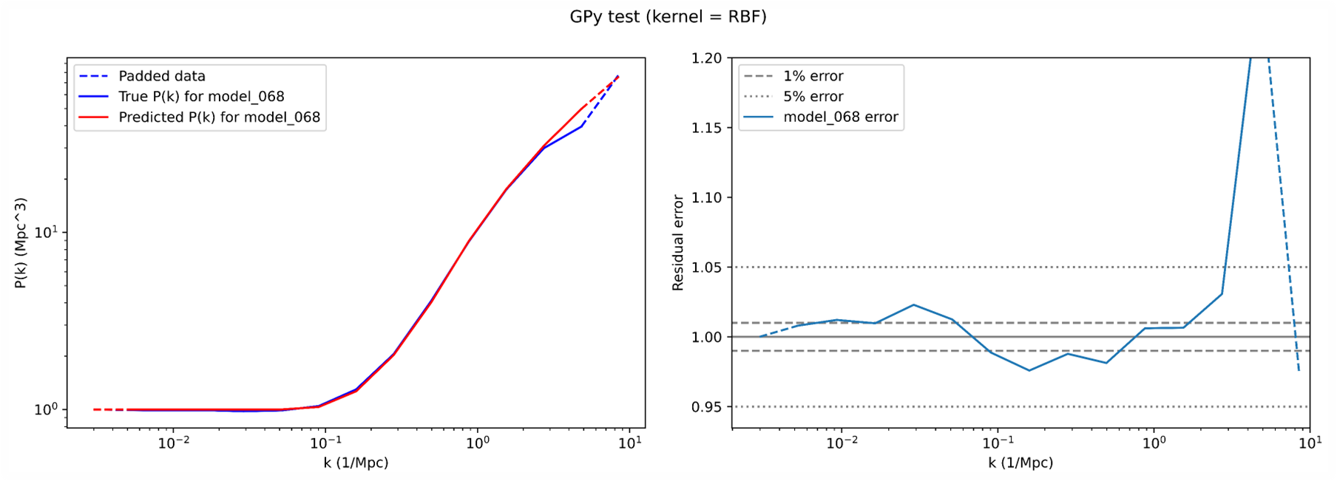
Improved emulator results
New design emulates one $P(k)$ value per $k$ bin separately, then combines them.
The different resolution models are ‘weighted’ at different k scales.
At large scales, low resolution models are up-weighted while high resolution are down-weighted. For small scales, high resolution models are given more weight than low resolution.
$P(k)$ values have been standardised to the same $k$ range and missing values have been interpolated.

Slide 13
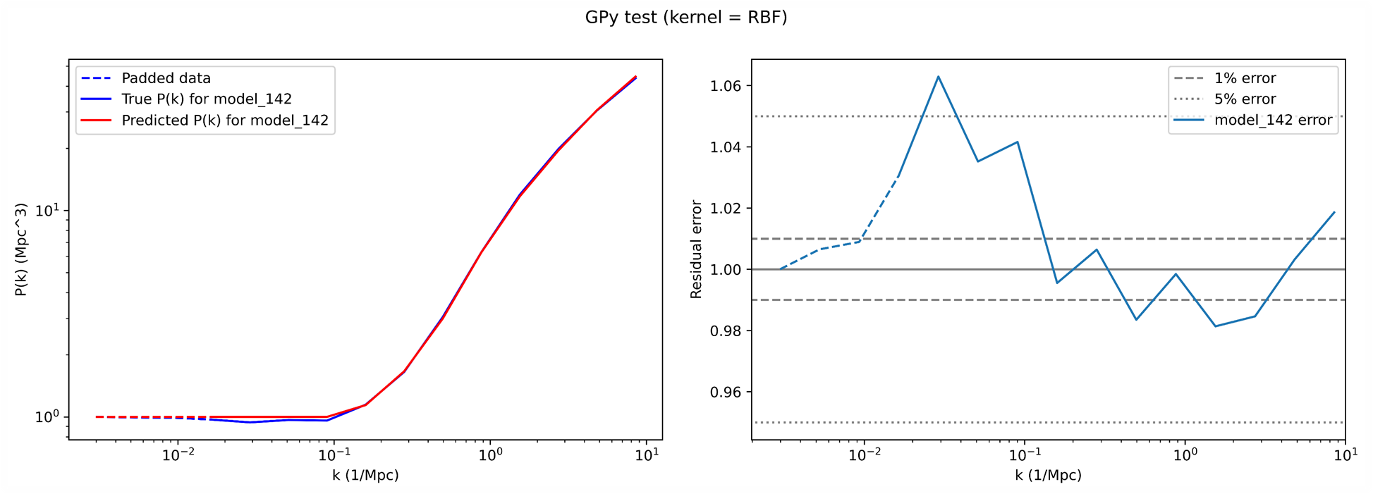
Improved emulator results
New design emulates one $P(k)$ value per $k$ bin separately, then combines them.
The different resolution models are ‘weighted’ at different k scales.
At large scales, low resolution models are up-weighted while high resolution are down-weighted. For small scales, high resolution models are given more weight than low resolution.
$P(k)$ values have been standardised to the same $k$ range and missing values have been interpolated.

Slide 14
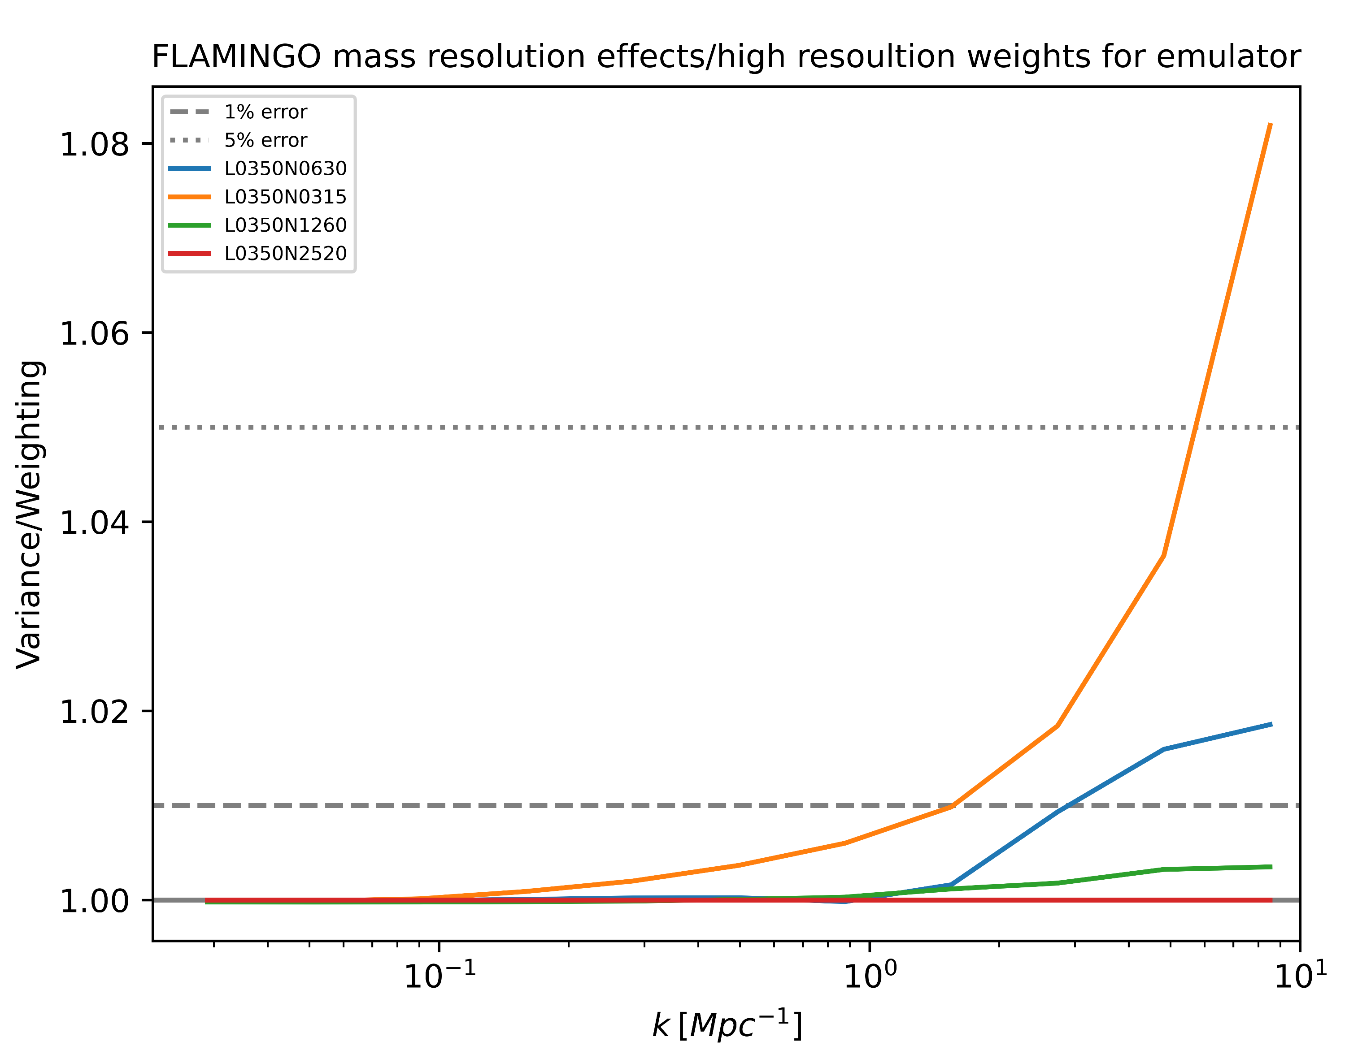
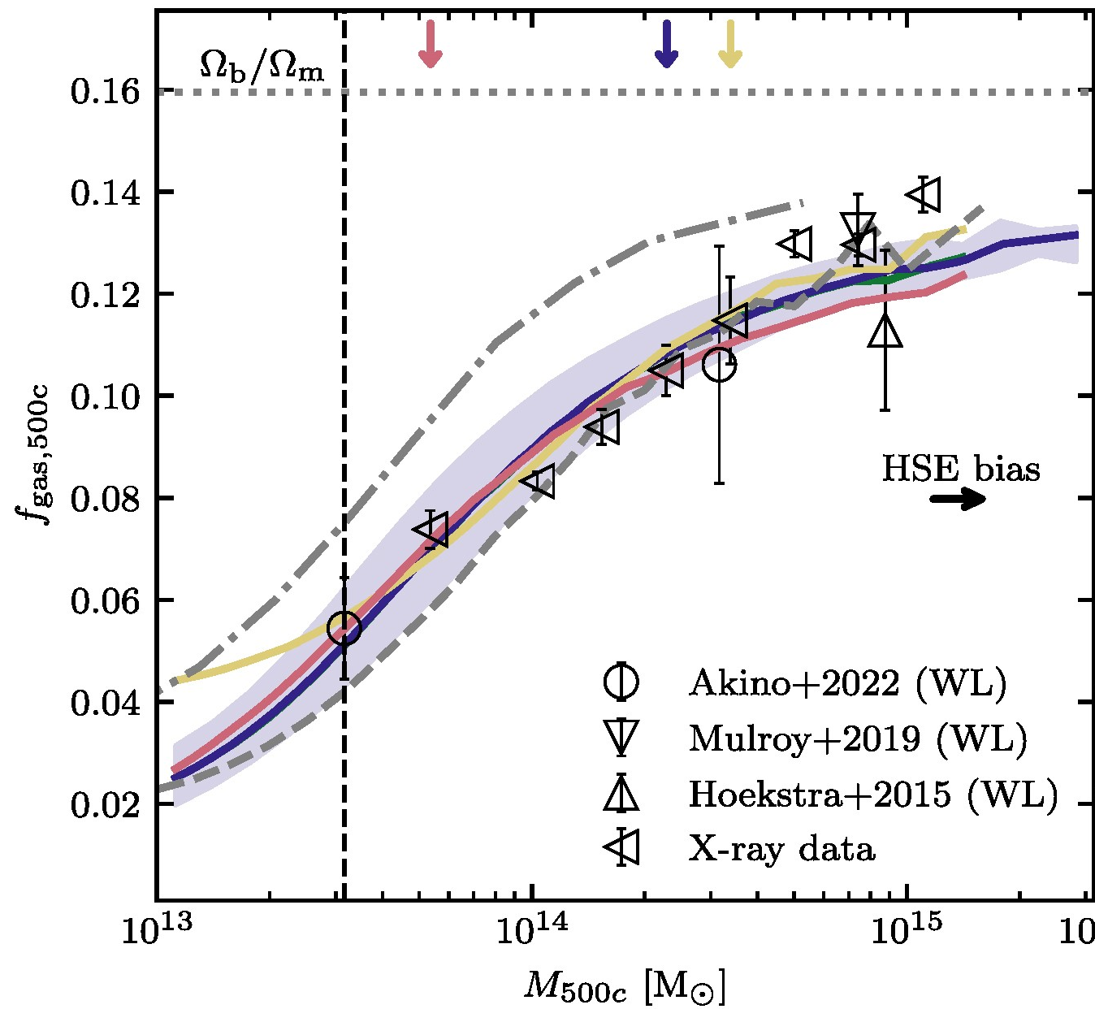

Future work
Investigating optimal weighting scheme for DMO emulator.
Aim to achieve $\sim 1\%$ level precision.
Run hydrodynamic versions of BAHAMAS XL simulations.
Emulating Baryonic Effects
Resolution Weighting
Schaye et al. (2023)
Train and refine emulator on hydrodynamic simulations.
Include astrophysical parameters as inputs to account for baryonic effects.
Additional Statistics
Incorporate more observables, e.g. gas fraction of clusters.

