Slide 1
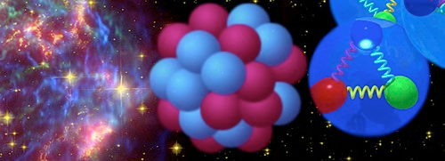
EDINBURGH NUCLEAR PHYSICS GROUP
in 15 mins

Slide 2



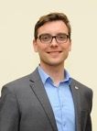




Academic Staff
Core Research Staff
Marialuisa Aliotta
(Head of Group)
Carlo Bruno
Chancellors Fellow
Claudia Lederer-Woods
Moritz Pascal Reiter
Phil Woods
Alex Murphy
(joint with PPE)
Tom Davinson
Alan Shotter
(Emeritus)
Postdoctoral Researchers
PhD Students
Technician
Lucia Barbieri
Alexandra Zadvornaya
Jordan Marsh
Tayemar Fowler-Davies
Annie Rooney
Ragandeep Singh Sidhu
Emmanuel Odusina
Ashley Tattersall
Nikolay Sosnin
Callum Brown
Peter Black
Grants Awards:
- STFC CG (PI Aliotta, 2024: all core and PDRA posts awarded)
- 2 ERC Starting Grants (Bruno, Lederer-Woods)
- UK ISOL-SRS, STFC Project (PI Woods, PM Davinson)

Slide 3
Research
Properties of Exotic Nuclei
r-process nuclei
New magic numbers
Rare/new decay modes – e.g. 2 α, bound state β-decay, proton decay
Radioactive Molecules
Study of nuclear reaction processes in:
The Big Bang
Early Universe Stars
Massive Stars
Neutron Star Mergers
Highlights
Expertise:
Advanced Silicon detection systems, e.g. CARME array on CRYRING at FAIR AIDA Advanced Implantation Detector Array (RIKEN/Japan and FAIR)
Ion Trap Systems (TRIUMF, FAIR, Edinburgh lab.)
Rare event / low background measurements (e.g. LUNA, FAIR)
Stellar Modelling

Slide 4

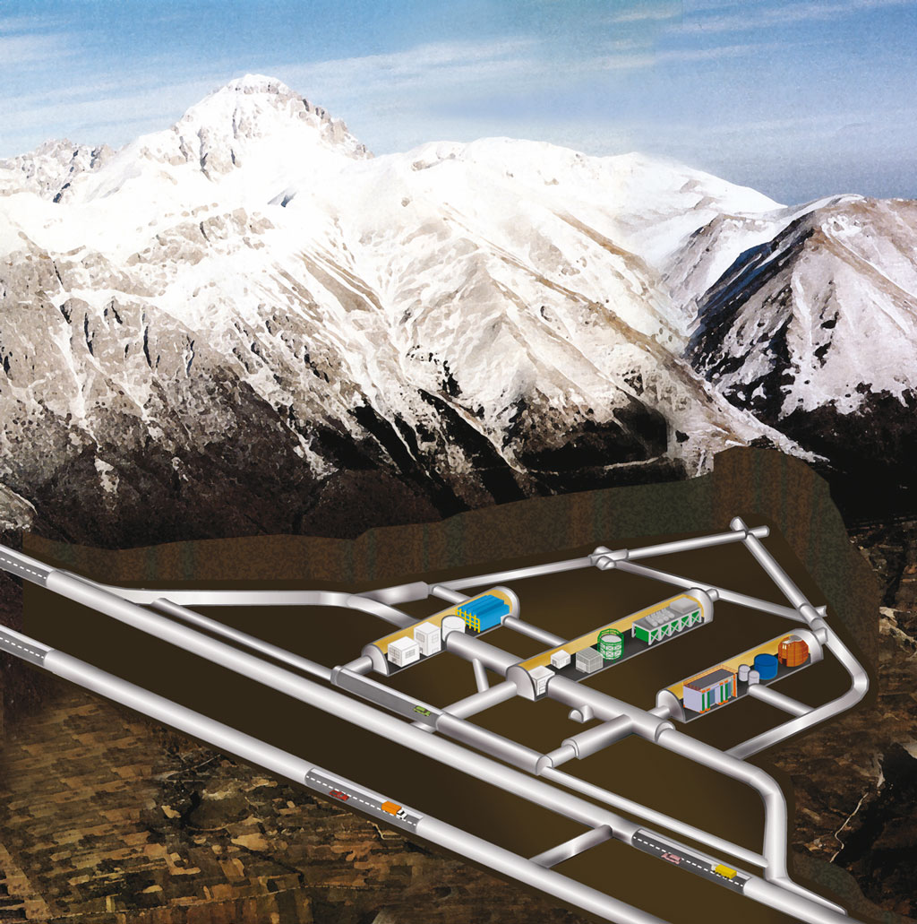
Big Bang Nucleosynthesis
LUNA: Laboratory for Underground Nuclear Astrophysics
Very precise (% level) astronomical observations of deuterium abundance
highly uncertain BBN predictions of deuterium abundance (poorly known d(p,γ)³He reaction cross section)
Cosmic ray attenuation: μ → 10⁻⁶
n → 10⁻³
~ 1400 m
(3800 m.w.e.)
LUNA 1
50 kV
(1991-2001)
LUNA 2
400 kV
(2000 → …)
LUNA MV
(2023 -> …)
Gran Sasso, Italy

Slide 5
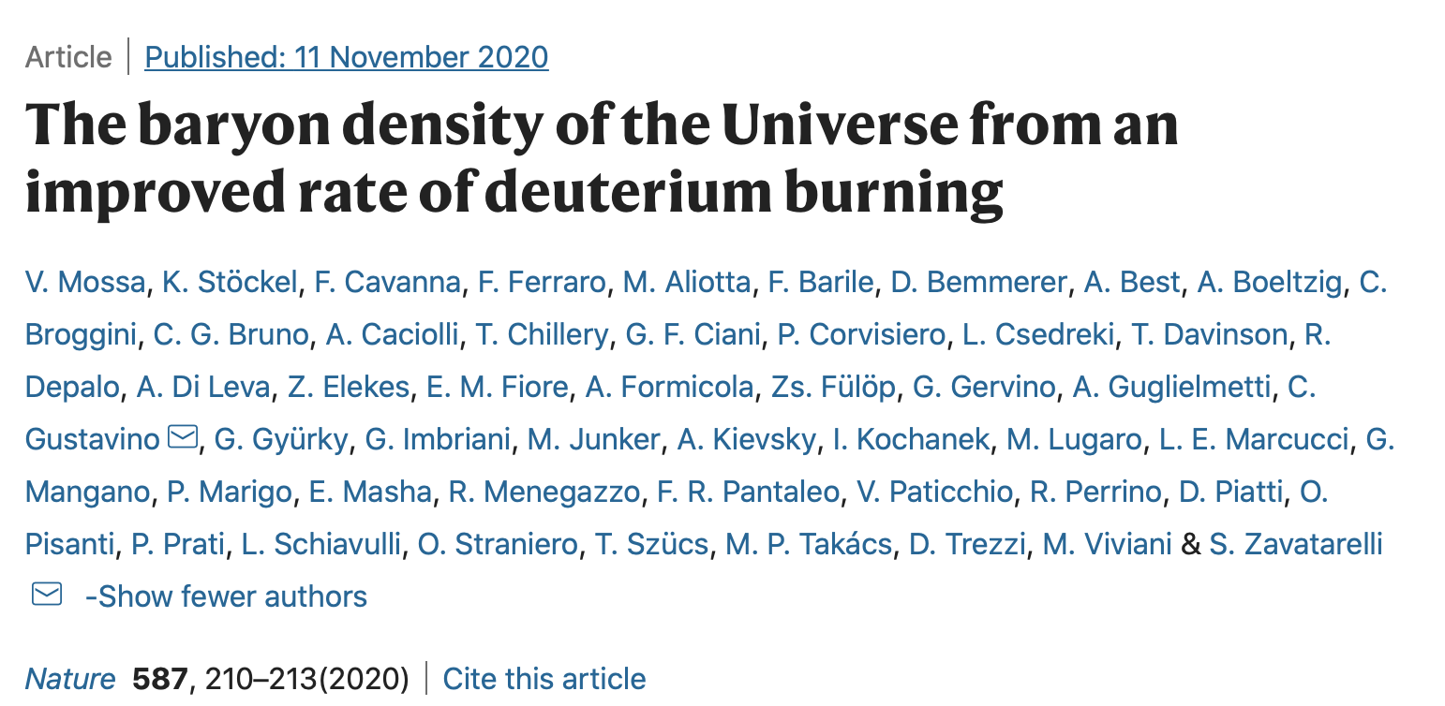
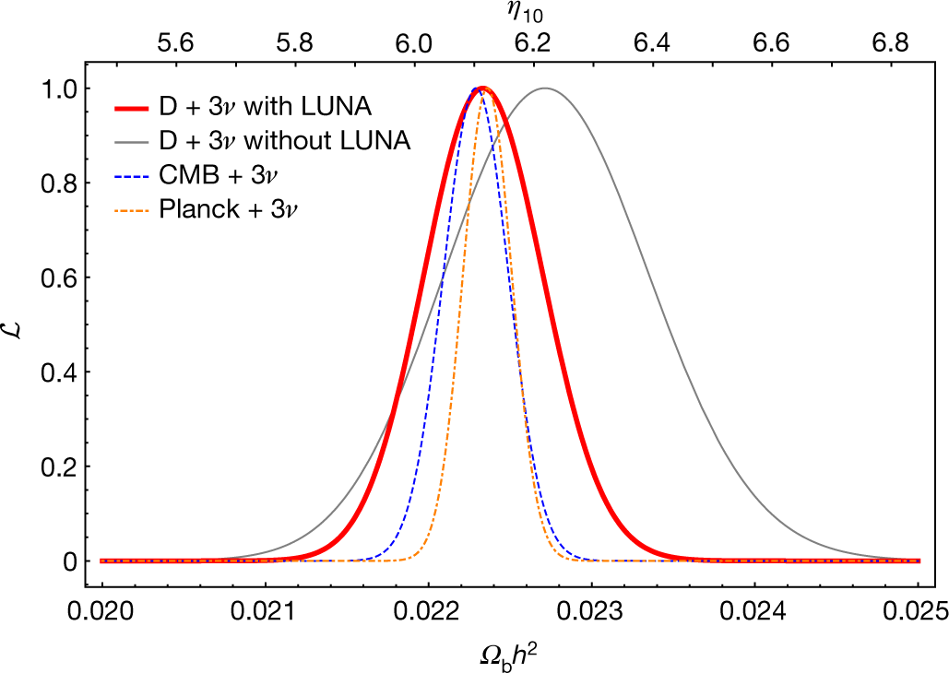
Big Bang Nucleosynthesis
LUNA: Laboratory for Underground Nuclear Astrophysics
Cosmic ray attenuation: μ → 10⁻⁶
n → 10⁻³
~ 1400 m
(3800 m.w.e.)
faster deuterium destruction
LUNA 1
50 kV
(1991-2001)
LUNA 2
400 kV
(2000 → …)
LUNA MV
(2023 -> …)
Gran Sasso, Italy
excellent agreement with baryon density from Planck

Slide 6

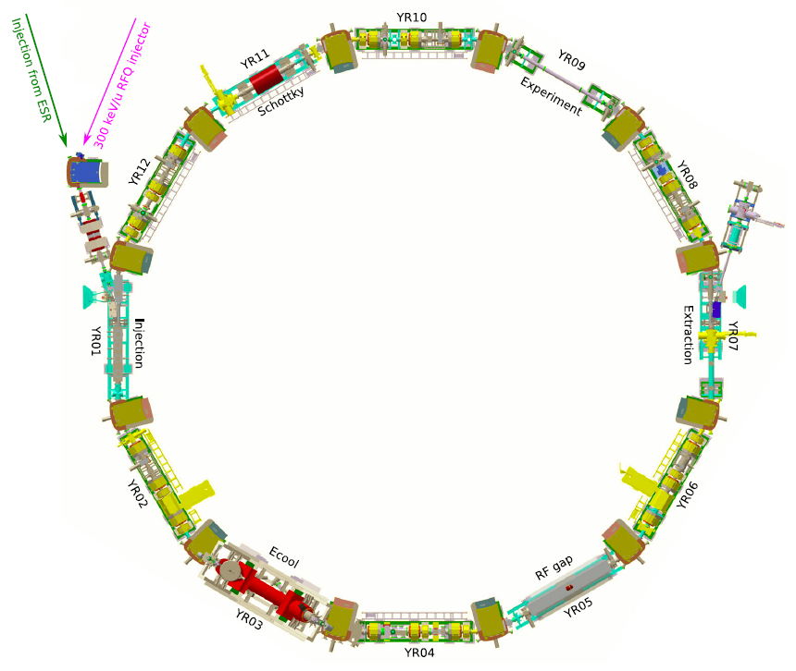
CARME @ CRYRING
world unique Heavy Ion Storage Ring facility for nuclear astrophysical reaction measurements
Radioactive beam from FAIR
Stable beam from local source
Target
revolving ions
CRYRING must be operated in Extreme High Vacuum (XHV) conditions, i.e. 10⁻¹² mbar. Very challenging!

Slide 7
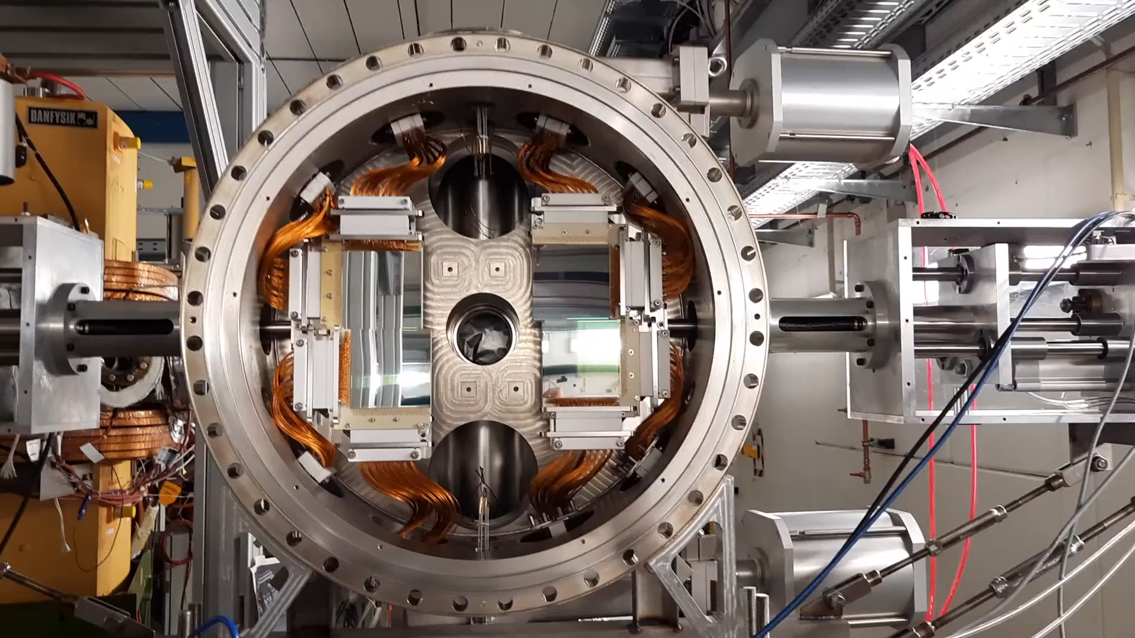
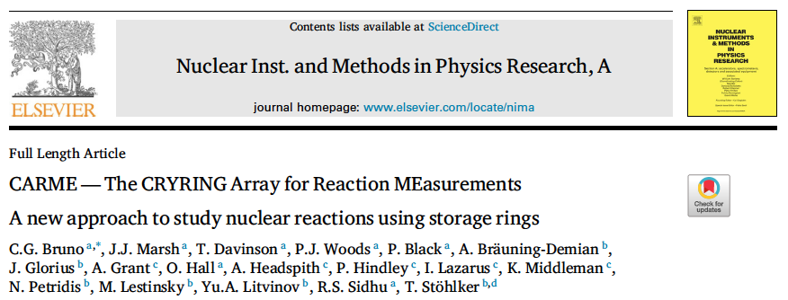
CARME: The CRYRING Array for Reaction MEasurements

Slide 8
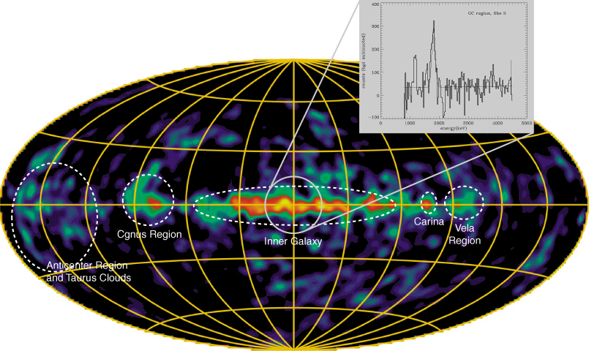
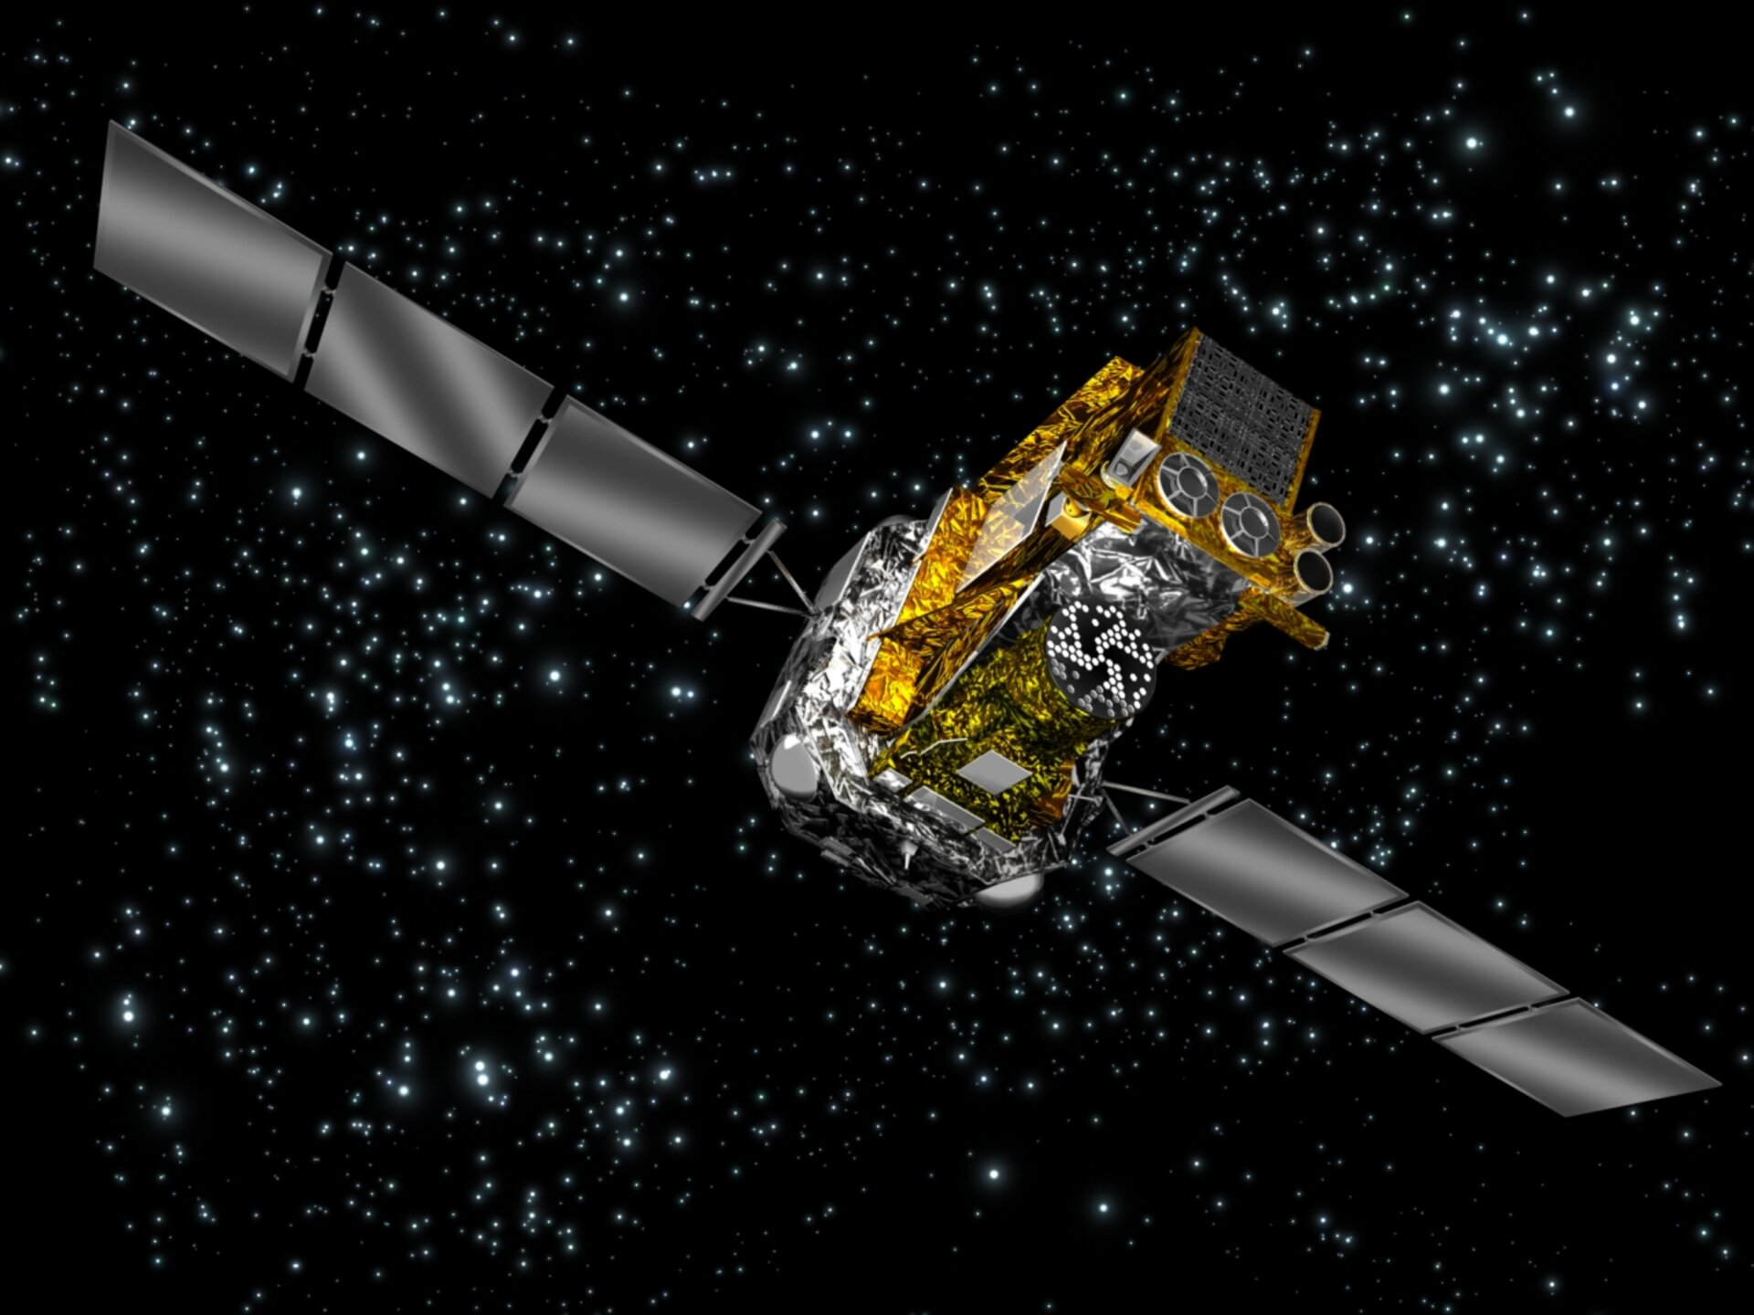

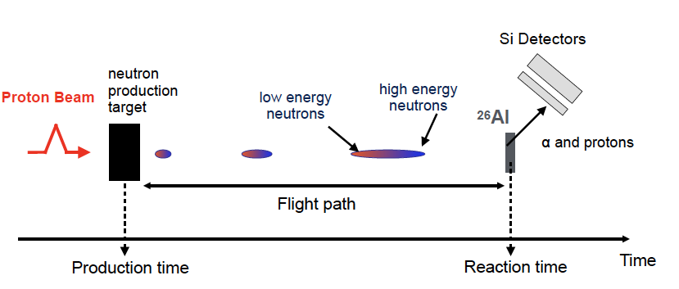
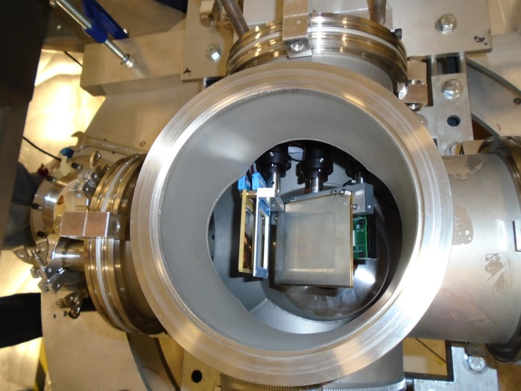
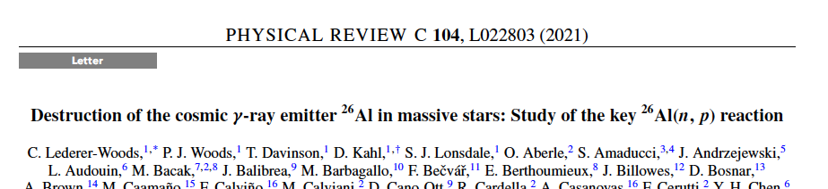
Cosmic γ-ray emitter ²⁶Al
Galactic ²⁶Al (T_{1/2}~7x10⁵ y) can be detected by satellite telescopes via its characteristic γ-ray emission
Measurement of key neutron destruction reactions at neutron time of flight facility n_TOF with purpose-built Silicon Detection System
Si telescope
Radioactive ²⁶Al target

Slide 9
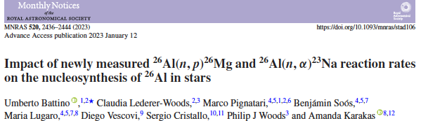
Cosmic γ-ray emitter ²⁶Al
Galactic ²⁶Al (T_{1/2}~7x10⁵ y) can be detected by satellite telescopes via its characteristic γ-ray emission
Measurement of key neutron destruction reactions at neutron time of flight facility n_TOF with purpose-built Silicon Detection System
Results followed by astrophysical modelling
Si telescope
Radioactive ²⁶Al target

Slide 10
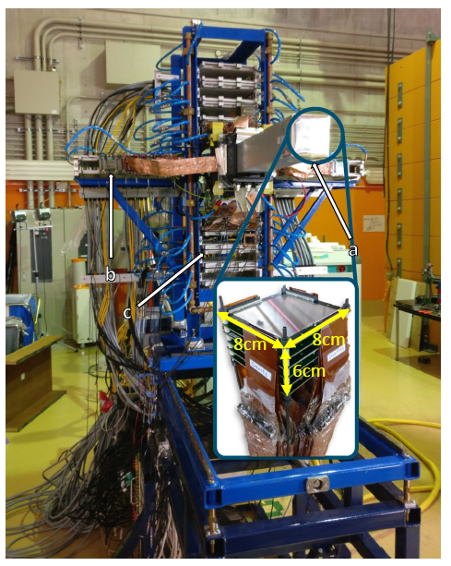


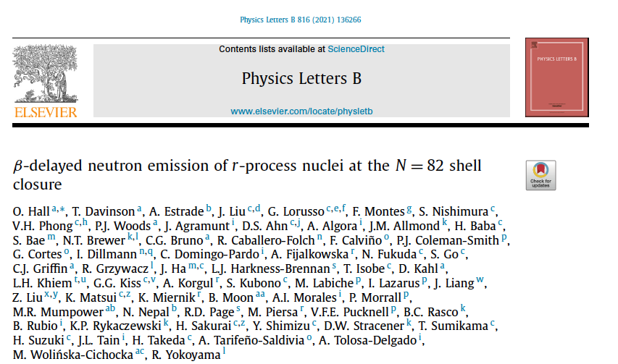
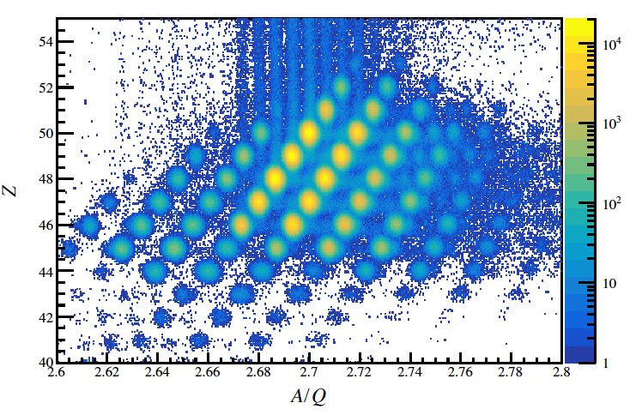
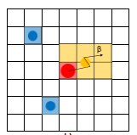
Decays of r-process Nuclei:
AIDA@RIKEN
Measurement of β-decay half lives and β-delayed neutron emission of very n-rich nuclei on r-process path
Neutron Star Merger

Slide 11
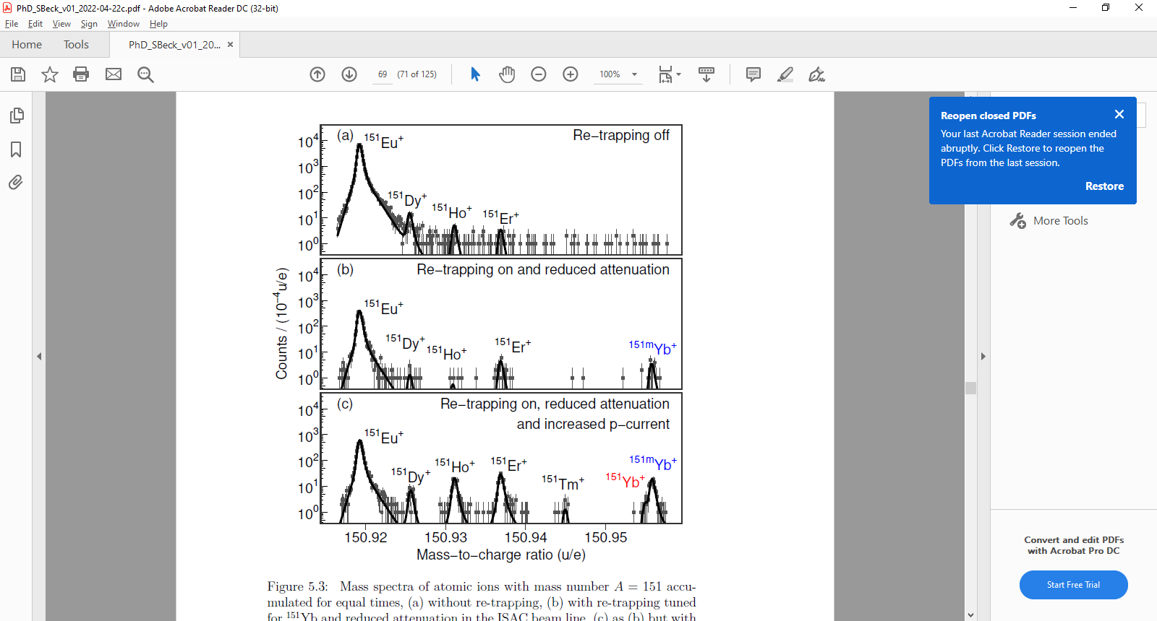
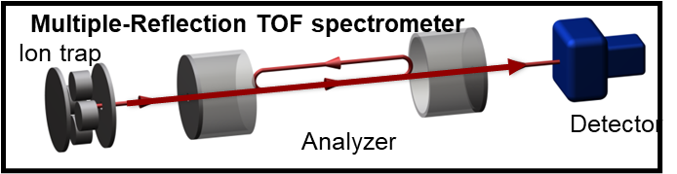
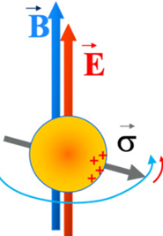
Ion Trap Measurements
High precision mass/binding energy measurements of r-process nuclei, TRIUMF
For standard model and beyond (with MIT):
Spin procession measurements
using ion traps
Radioactive molecules with strong internal E field (GV/cm) and polarizability
→ Boost sensitivity for eEDM
In-house developments for next generation Ion Trap devices and collaboration on trace analysis measurements with School of Biology

Slide 12
THE END

