Slide 1


Dibaryon production and structure
Mikhail Bashkanov

Slide 2
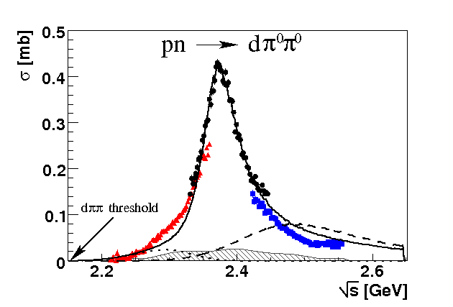
Total cross section pn → dπ⁰π⁰
“d* resonance”
Γ∼70 MeV
ΔΔ
NN*(1440)
P. Adlarson et. al Phys. Rev. Lett. 106:242302, 2011

Slide 3

$d^{∗}(2380)$ dibaryon
$$Γ_{d^{∗}}=70 MeV≪Γ_{ΔΔ}=240 MeV$$
u
u
u
d
d
d
Threshold
I(J^{p}) = 0(3⁺)
80 MeV
d*
Δ
Δ
$$M_{d^{∗}}=2.38 GeV≈2M_{Δ}−80 MeV$$

Slide 4
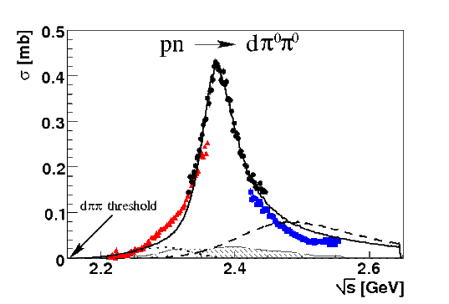






Dibaryon: hadronic decays
PRL 106 (2011) 242302
PLB 721 (2013) 229
WASA data
$$dπ^{0}π^{0}$$
$$dπ^{+}π^{−}$$
pn → d*(2380)
$$pn$$
$$ppπ^{−}π^{0}$$
$$pnπ^{0}π^{0}$$
$$pnπ^{+}π^{−}$$
PRL 112 (2014) 202301
PRC 90, (2014) 035204
d*
d*
PRC 88 (2013) 055208
PLB 743 (2015) 325
d*

Slide 5
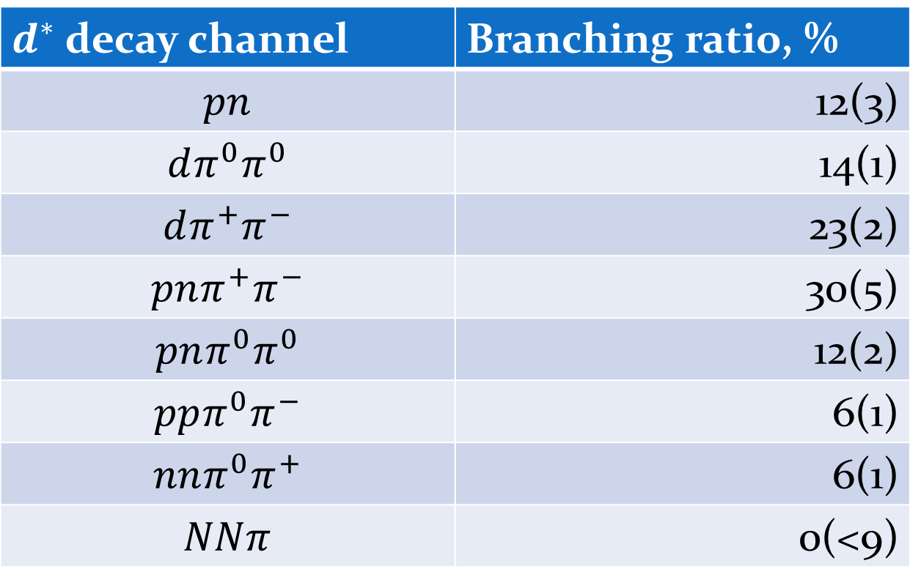

$d^{∗}(2380)$ decay branches
$d^{∗}$ decay channel | Branching ratio, %
$$pn$$ | 12(3)
$$dπ^{0}π^{0}$$ | 14(1)
$$dπ^{+}π^{−}$$ | 23(2)
$$pnπ^{+}π^{−}$$ | 30(5)
$$pnπ^{0}π^{0}$$ | 12(2)
$$ppπ^{0}π^{−}$$ | 6(1)
$$nnπ^{0}π^{+}$$ | 6(1)
$$NNπ$$ | 0(<9)
Eur.Phys.J. A51 (2015) 7, 87

Slide 6
d* Internal Structure

Slide 7
d* internal structure
Hexaquark
Molecule
Diquark dominated
Meson assisted
σ-dressed
σ

Slide 8

$d^{∗}(2380)$ - Deltaron?
L=0
Δ
Δ

Slide 9
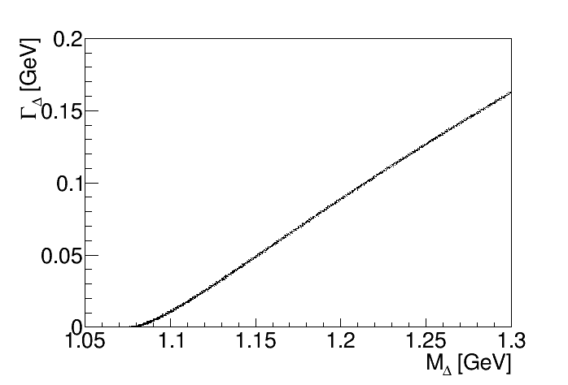
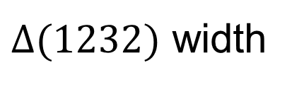
Deltaron: the width quest
$Δ(1232)$ width

Slide 10
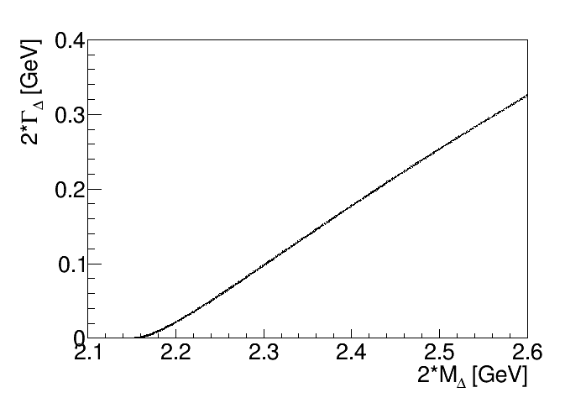
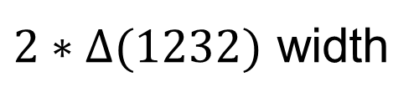
Deltaron: the width quest
$2∗Δ(1232)$ width

Slide 11
Deltaron: the width quest
$2∗Δ(1232)$ width

Slide 12
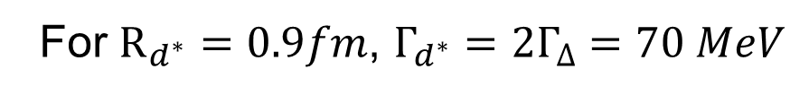

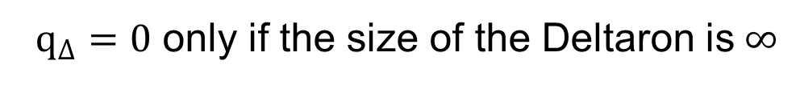
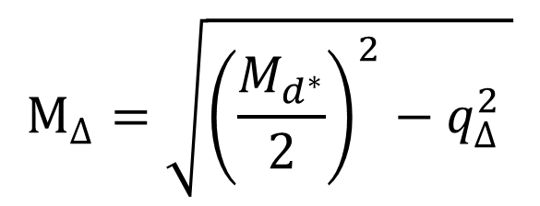
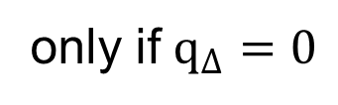
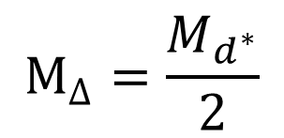
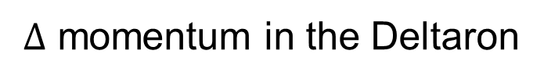
Deltaron: the width quest
$$M_{Δ}=\sqrt{{\left(\frac{M_{d^{∗}}}{2}\right)}^{2}−q_{Δ}^{2} }$$
The mass of the bound $Δ$
in the Deltaron
$Δ$ momentum in the Deltaron
$$M_{Δ}=\frac{M_{d^{∗}}}{2}$$
only if $q_{Δ}=0$
$q_{Δ}=0$ only if the size of the Deltaron is$∞$
For $R_{d^{∗}}=0.9fm$, $Γ_{d^{∗}}=2Γ_{Δ}=70 MeV$
see A. Gal, Phys.Lett. B769 (2017) 436 for details

Slide 13
Fluffy vs compact molecules
Long life due to small
Wave Function overlap
Long life due to large Wave Function overlap
High Fermi momentum ⇔ small Phase space

Slide 14
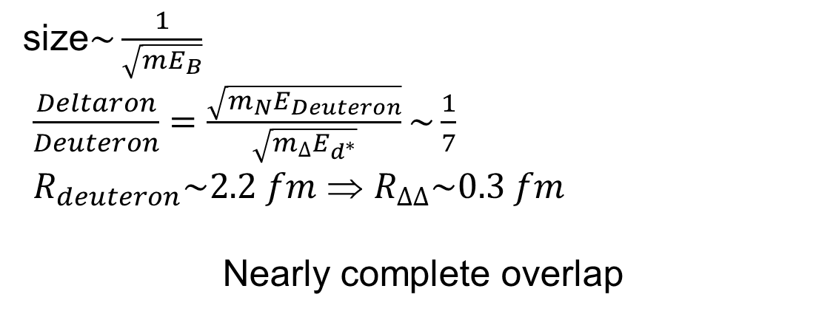
Deuteron vs Deltaron
size$\sim \frac{1}{\sqrt{mE_{B}}}$
$\frac{Deltaron}{Deuteron}=\frac{\sqrt{m_{N}E_{Deuteron}}}{\sqrt{m_{Δ}E_{d^{∗}}}}\sim \frac{1}{7}$
$R_{deuteron}\sim 2.2 fm$ ⇒ $R_{ΔΔ}\sim 0.3 fm$
Nearly complete overlap

Slide 15
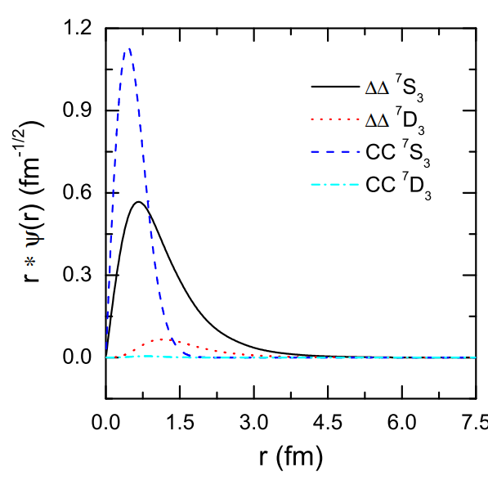
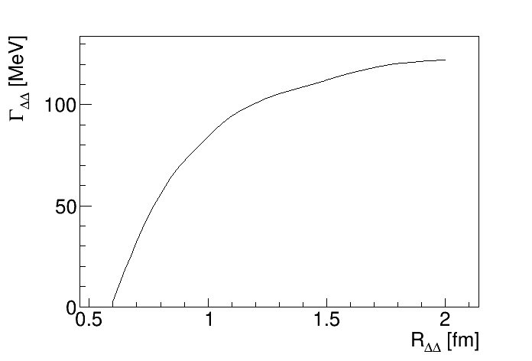

$d^{∗}$size and width
A. Gal, Phys.Lett. B769 (2017) 436
F. Huang et al,
Chin.Phys. C39 (2015) 7, 071001

Slide 16
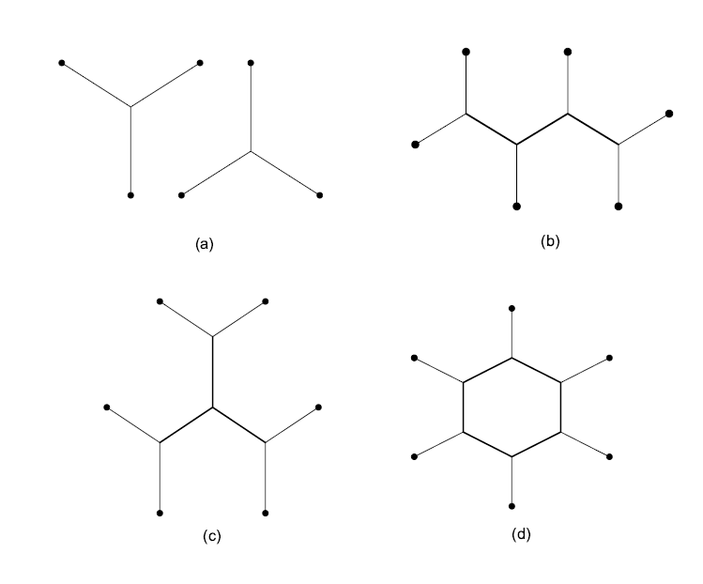
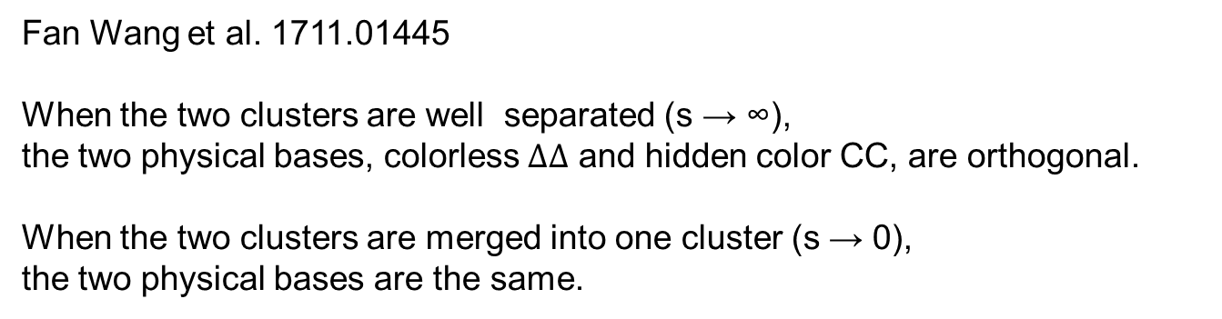
Effective degrees of freedom
Fan Wang et al. 1711.01445
When the two clusters are well separated (s → ∞),
the two physical bases, colorless $ΔΔ$ and hidden color CC, are orthogonal.
When the two clusters are merged into one cluster (s → 0),
the two physical bases are the same.
Possible 6q configuration

Slide 17

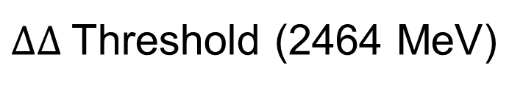


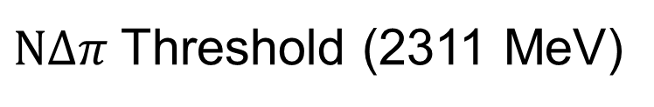


Possible $d^{∗}$internal structure
$ΔΔ$Threshold (2464 MeV)
$$ΔΔ_{D−wave}$$
fluffy
compact
$$ΔΔ_{S−wave}$$
80 MeV
80 MeV
$$6q+ΔΔ_{S−wave}$$
d*(2380)
compact
$$NΔπ$$
fluffy
$NΔπ$Threshold (2311 MeV)

Slide 18

$d^{∗}$ in-medium
$ΔΔ$Threshold (2464 MeV)
$$ΔΔ_{D−wave}$$
fluffy
compact
$$ΔΔ_{S−wave}$$
80 MeV
80 MeV
$$6q+ΔΔ_{S−wave}$$
d*(2380)
compact
$$NΔπ$$
fluffy
$NΔπ$Threshold (2311 MeV)

Slide 19








Possible $NΔπ$ configuration in $d^{∗}$
82%
$$NNπ$$
$$NΔ$$
18%
$$NN$$
82%
$$NNππ$$
$$NΔπ$$
18%
$$NNπ$$
$${\left|Ψ_{NΔπ}\right|}^{2}\sim 5⋅Br(d^{∗}→NNπ)$$

Slide 20
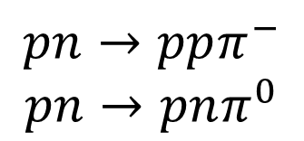

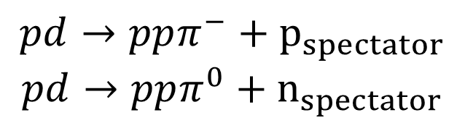
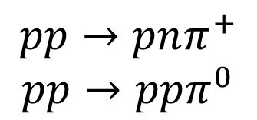
$d^{∗}→NNπ$ decay in experiment
$$pp→pnπ^{+}$$
$$pp→ppπ^{0}$$
Pure isovector (I=1)
$$pn→ppπ^{−}$$
$$pn→pnπ^{0}$$
Mixed (I=1& I=0)
Predominantly isovector
Interested in isoscalar part only
$σ_{NN→NNπ}\left(I=0\right)=3(2σ_{pn→ppπ^{−}}−σ_{pp→ppπ^{0}})$
Proton beam
Deuteron target
$$pd→ppπ^{−}+p_{spectator}$$
$$pd→ppπ^{0}+n_{spectator}$$

Slide 21
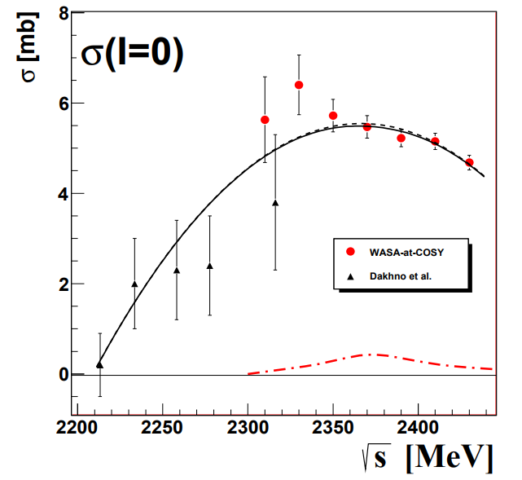

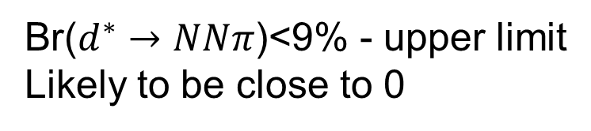
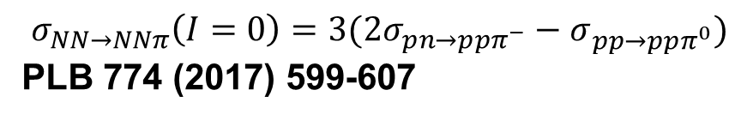
$d^{∗}→NNπ$ decay in experiment
$NN→NNπ$ isoscalar cross section
$σ_{NN→NNπ}\left(I=0\right)=3(2σ_{pn→ppπ^{−}}−σ_{pp→ppπ^{0}})$
PLB 774 (2017) 599-607
Systematical errors!!!!
Same beam
Same detector
Same deuteron target
Two protons in final state measured in the same kinematics
Br($d^{∗}→NNπ$)<9% - upper limit
Likely to be close to 0

Slide 22

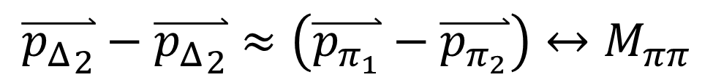



$d^{∗}→dππ$ decay and D-wave $ΔΔ$ component
pn → d* → ΔΔ → dππ
π
p
Δ
$$N_{1}$$
d
n
$$N_{2}$$
Δ
π
$$\overset{⃑}{{p_{Δ}}_{2}}−\overset{⃑}{{p_{Δ}}_{2}}=\left(\overset{⃑}{p_{N_{1}}}+\overset{⃑}{p_{π_{1}}}\right)−\left(\overset{⃑}{p_{N_{2}}}+\overset{⃑}{p_{π_{2}}}\right)=\left(\overset{⃑}{p_{N_{1}}}−\overset{⃑}{p_{N_{2}}}\right)+\left(\overset{⃑}{p_{π_{1}}}−\overset{⃑}{p_{π_{2}}}\right)≈\left(\overset{⃑}{p_{π_{1}}}−\overset{⃑}{p_{π_{2}}}\right)$$
$$\overset{⃑}{p_{N_{1}}}≈\overset{⃑}{p_{N_{1}}}$$
$$\overset{⃑}{{p_{Δ}}_{2}}−\overset{⃑}{{p_{Δ}}_{2}}≈\left(\overset{⃑}{p_{π_{1}}}−\overset{⃑}{p_{π_{2}}}\right)↔M_{ππ}$$

Slide 23
d*(2380) internal structure and the ABC effect
L=0
Δ
Δ
Δ
Δ
L=2
M. Bashkanov et al, Nucl.Phys. A958 (2017) 129

Slide 24







$d^{∗}(2380)$ Hexaquark
0.7 fm
$$≈66\%$$
$$≈33\%$$
$$?$$
Narrow width
L=0
Branching ratios
Dalitz plots
Δ
Δ
Δ
Δ
L=2
$$≈90\%$$
$$≈10\%$$
$M_{ππ}$, see Nucl.Phys. A958 (2017) 129-146
F. Huang et al, Chin.Phys. C39 (2015) 7, 071001

Slide 25
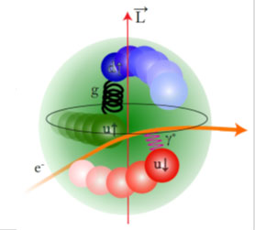

$d^{∗}$size
e⁻
e⁻
γ*
d*(2380)
d
Transition form factor
Charge distribution
Internal structure

Slide 26
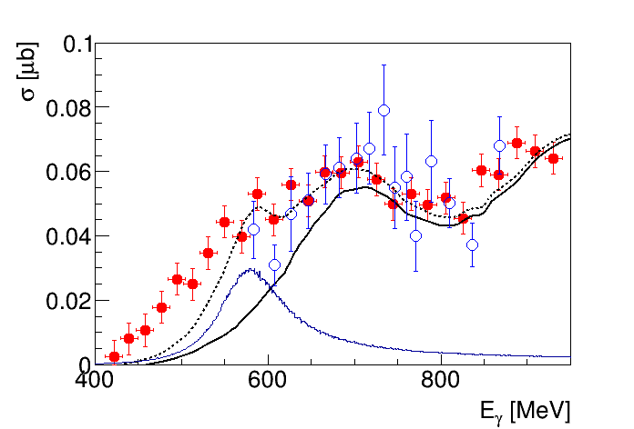




d*(2380) in photoproduction?
$$π^{0}$$
γ
p
$$π^{0}$$
d*
γ
d*
d
d
d
n
$γd→dπ^{0}π^{0}$
$γd→dπ^{0}π^{0}$
Conventional Background
M. Egorov, A. Fix,
Nucl.Phys. A933 (2015) 104-113
$$d^{∗}$$
M. Guenther, Hadron 2017
T. Ishikawa et al. Phys.Lett. B772 (2017) 398

Slide 27
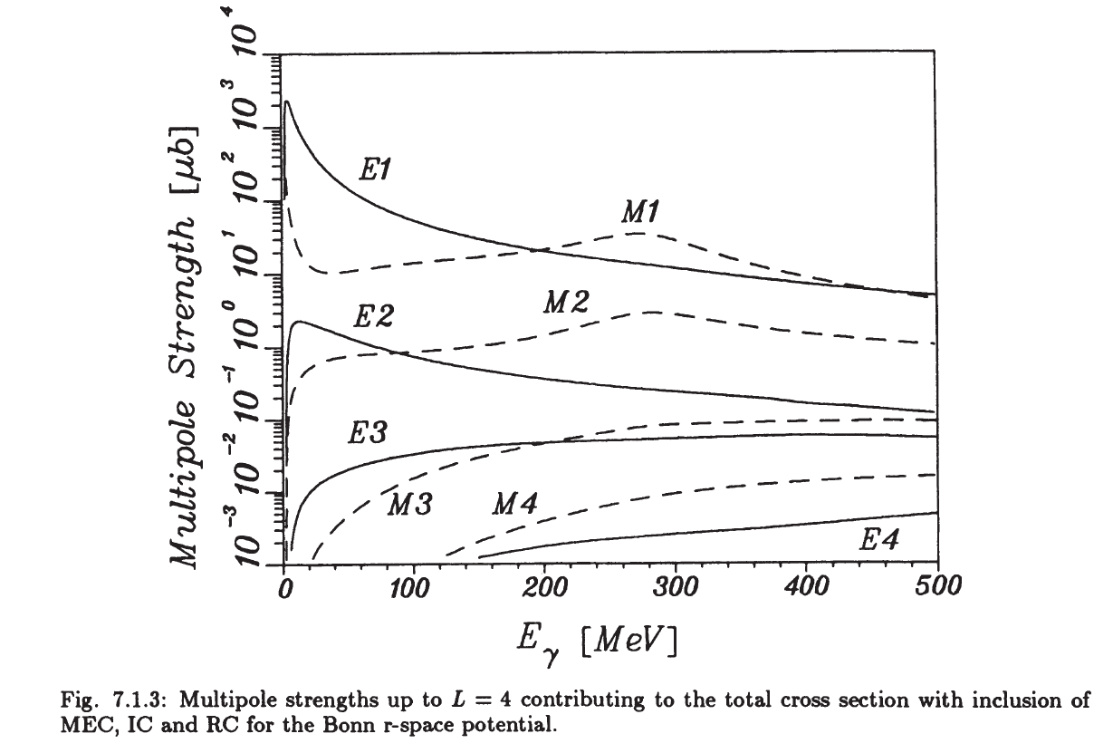


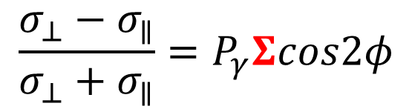
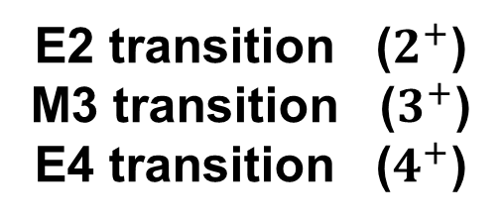
$d^{∗}$ and beam asymmetry $Σ$
E2 transition ($2^{+}$)
M3 transition ($3^{+}$)
E4 transition ($4^{+}$)
γ
$$d^{∗}$$
p
d
n
$$\frac{σ_{⊥}−σ_{∥}}{σ_{⊥}+σ_{∥}}=P_{γ}Σcos2φ$$
H. Arenhoevel, M. Sanzone “Photodisintegration of the deuteron”

Slide 28
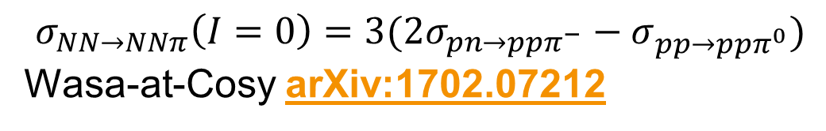

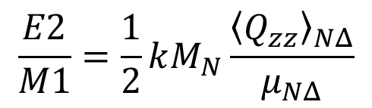

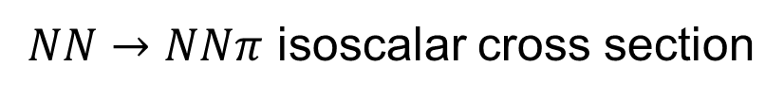
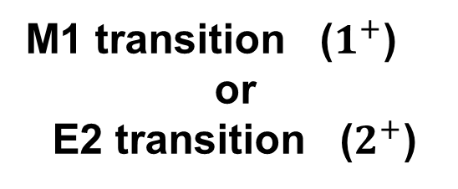

Beam asymmetry $Σ$
γ
$$Δ$$
$$π$$
M1 transition ($1^{+}$)
or
E2 transition ($2^{+}$)
p
N
$$\frac{σ_{⊥}−σ_{∥}}{σ_{⊥}+σ_{∥}}=P_{γ}Σcos2φ$$
E2/M1 ratio for the $γN→Δ$
$$\frac{E2}{M1}=\frac{1}{2}kM_{N}\frac{{\left\langle Q_{zz}\right\rangle }_{NΔ}}{μ_{NΔ}}$$
T. Watabe et al.
hep-ph 9502244
$$\frac{E2}{M1}=2.5\%$$
R. Beck et al. (MAMI-A2)
Phys.Rev. C61 (2000) 035204
Analysis of beam asymmetry

Slide 29
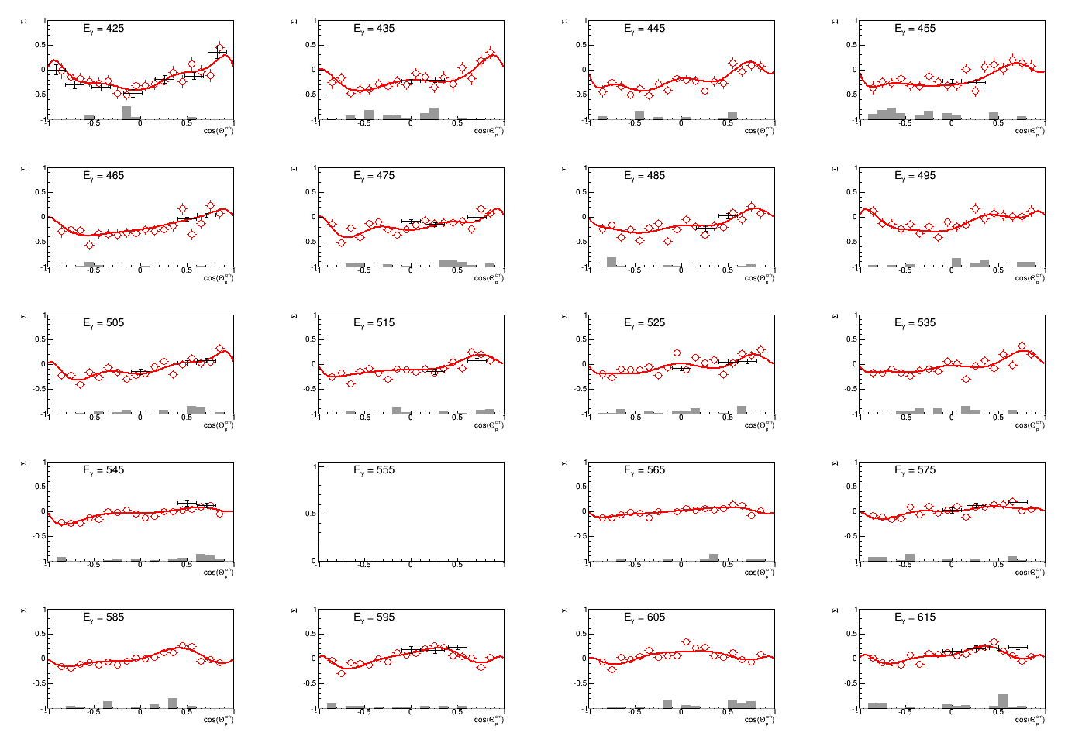


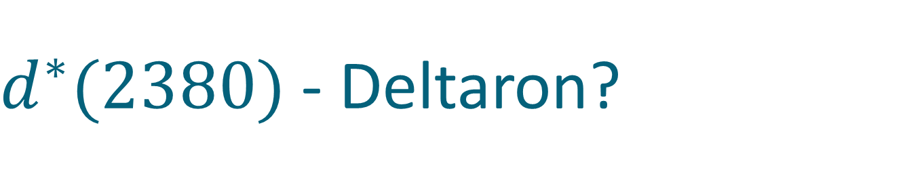

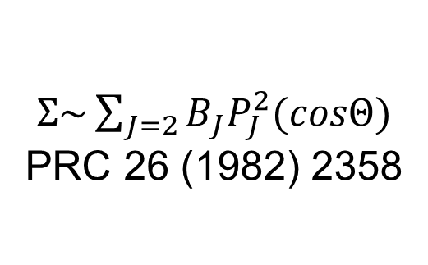
Deuteron photodisintegration, $Σ$
γ
p
$Σ\sim \sum_{J=2}{B_{J}P_{J}^{2}(cosΘ)}$
PRC 26 (1982) 2358
d
n
$$Σ$$
$E_{γ}\sim 420−620MeV$
$$cosΘ_{n}^{∗}$$

Slide 30
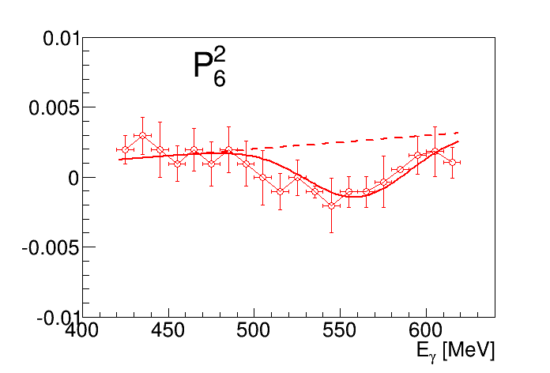
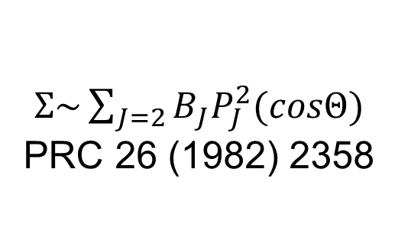

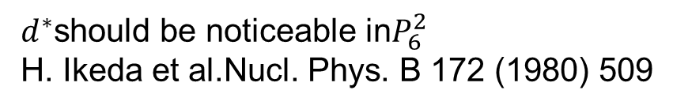
Deuteron photodisintegration: beam asymmetry $Σ$
$d^{∗}$should be noticeable in$P_{6}^{2}$
H. Ikeda et al.Nucl. Phys. B 172 (1980) 509
γ
p
d
n
$Σ\sim \sum_{J=2}{B_{J}P_{J}^{2}(cosΘ)}$
PRC 26 (1982) 2358

Slide 31
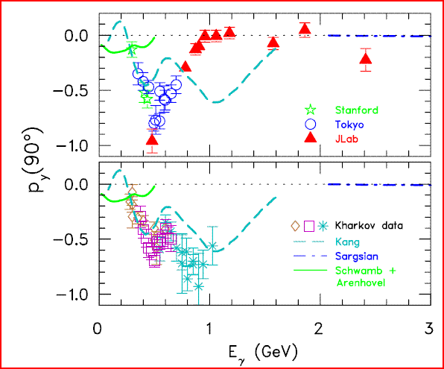

d*(2380) in photoproduction?
R. Gilman and F. Gross nucl-th/0111015 (2001)
d*
γ
p
T. Kamae, T. Fujita Phys. Rev. Lett. 38, Feb 1977, 471
d
n
H. Ikeda et al., Phys. Rev. Lett. 42, May 1979, 1321
I(J^{p}) = 0(3⁺)
$$M=2.38 GeV$$

Slide 32
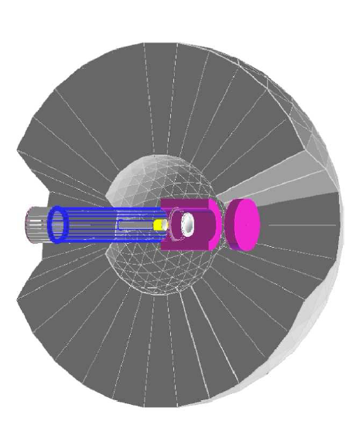

The benchmark measurement
Edinburgh polarimeter
$$\vec{γ}$$
d*
p
d
n
Measure polarization of both
proton and neutron !

Slide 33





Experiment
$$\vec{γ}d→p\vec{n}$$
$$γ$$
p
$$n$$
$$Θ,φ,E$$
p
Target
$$Θ^{′},φ′$$
Polarimeter

Slide 34
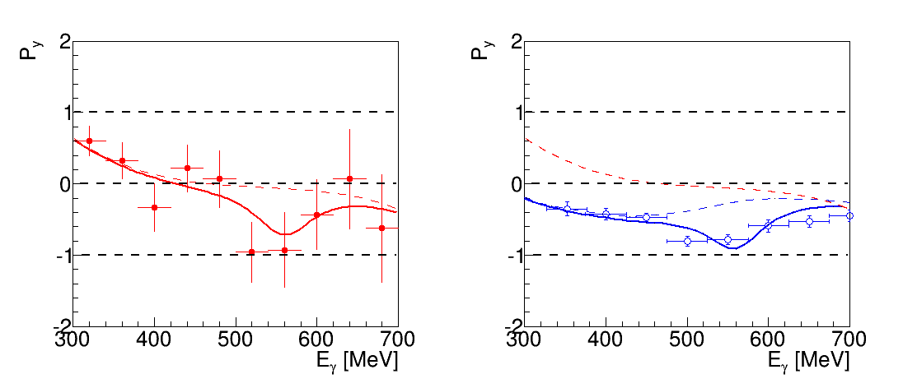
Recoil polarization at 90 degree
proton
Conventional background, Kang et al
background+ d*
H. Ikeda et al., Phys. Rev. Lett. 42, May 1979, 1321

Slide 35
Recoil polarization at 90 degree
neutron
proton
Conventional background, Kang et al
Very preliminary
background+ d*
background+ d*
H. Ikeda et al., Phys. Rev. Lett. 42, May 1979, 1321

Slide 36
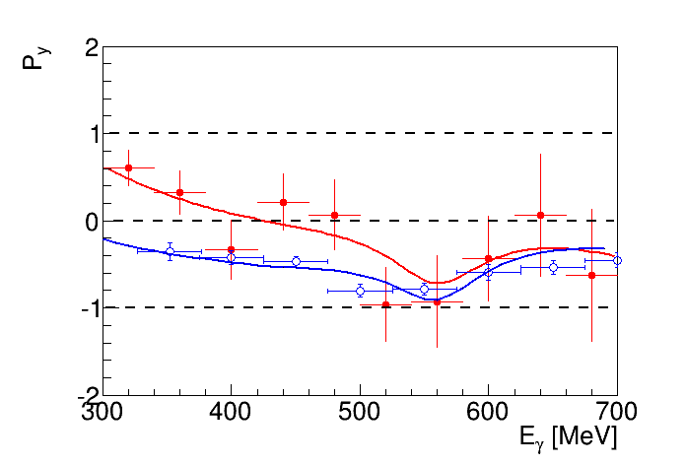
Recoil polarization at 90 degree
neutron
proton
Very preliminary

Slide 37

$$d^{∗}in nuclear medium$$

Slide 38

Nuclear matter at high density
d*
n
p

Slide 39
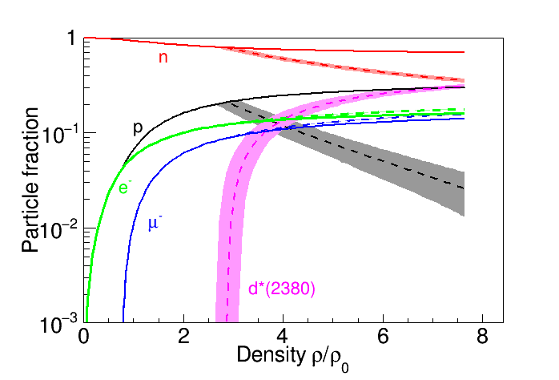
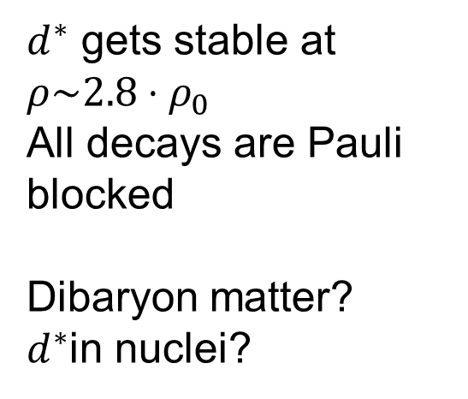
The d*(2380) in neutron stars a new degree of freedom?
$d^{∗}$ gets stable at $ρ\sim 2.8⋅ρ_{0}$
All decays are Pauli blocked
Dibaryon matter?
$d^{∗}$in nuclei?
I. Vidaña, M. Bashkanov, D.P. Watts, A. Pastore
arXiv:1706.09701v1

Slide 40




d*(2380) SU(3) multiplet
J^{p} = 3⁺
ΔΔ
$$d^{∗}(2380)$$
$$M_{d^{∗}}−M_{Δ}+M_{Σ^{∗}}<M_{d_{s}^{∗}}≤M_{Δ}+M_{Σ^{∗}}$$
ΔΣ*
$$d_{s}^{∗}(2.53−2.60)$$
ΔΞ*
$$d_{ss}^{∗}(2.68−2.76)$$
ΔΩ
$$d_{sss}^{∗}(2.82−2.90)$$

Slide 41
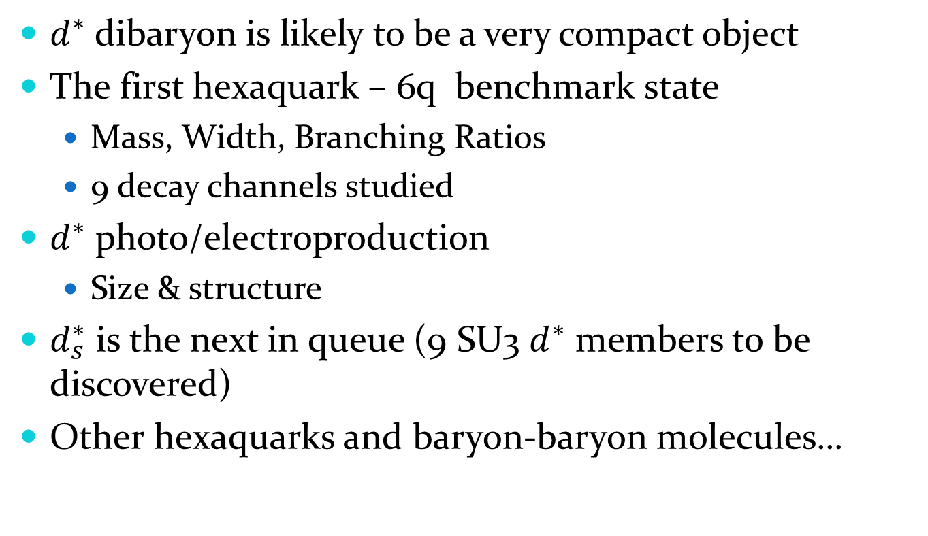
Conclusion
$d^{∗}$ dibaryon is likely to be a very compact object
The first hexaquark – 6q benchmark state
  Mass, Width, Branching Ratios
  9 decay channels studied
$d^{∗}$ photo/electroproduction
  Size & structure
$d_{s}^{∗}$ is the next in queue (9 SU3 $d^{∗}$ members to be discovered)
Other hexaquarks and baryon-baryon molecules…

Slide 42

ΔΔ
$$d^{∗}(2380)$$
Thank you
ΔΣ*
ΔΞ*
ΔΩ

Slide 43

Neutron stars EoS
I. Vidaña, M. Bashkanov, D.P. Watts, A. Pastore
arXiv:1706.09701v1

Slide 44

The d ∗ (2380) in neutron stars - a new degree of freedom?
I. Vidaña, M. Bashkanov, D.P. Watts, A. Pastore
arXiv:1706.09701v1

Slide 45

The d ∗ (2380) in neutron stars - a new degree of freedom?
I. Vidaña, M. Bashkanov, D.P. Watts, A. Pastore
arXiv:1706.09701v1

Slide 46

The d ∗ (2380) in neutron stars
I. Vidaña, M. Bashkanov, D.P. Watts, A. Pastore
arXiv:1706.09701v1
GW170817 from arXiv:1710.05938v1

Slide 47



$d^{∗}(2380)$ medium modifications?
Trivial modifications:
Fermi smearing
Collision damping
N
N
N
Δ
N
$$d^{∗}$$
Δ
Δ
BUT!
Pauly blocked in
infinite nuclear matter
$d^{∗}$ is stable!
N

Slide 48

$d^{∗}(2380)$ medium modifications?
$d^{∗}$ interaction with nuclear matter
Attractive/Repulsive?
Mass change?
Changes in size?

Slide 49








$d^{∗}$ in neutron stars
Urca cooling
$$d^{∗}→nn+e^{+}+ν_{e}$$
$$ρ\sim 2.8ρ_{0}$$
$$ρ>2.8ρ_{0}$$
Neutron stars mergers
$$d^{∗}→pn$$
$$nn→d^{∗}+e^{−}+\overline{ν_{e}}$$
Ejecta
HMNS->black hole
nucleosynthesis

Slide 50
The benchmark measurement
Newly installed
Edinburgh polarimeter
γ
p
d*
d
n
Measure polarization of both
proton and neutron !

Slide 51


$Λ−Δ$ competition in neutron star
Phys.Rev. C90 (2014) no.6, 065809

Slide 52

$$d^{∗}→NNπ$$

Slide 53



$NN→NNπ$ isoscalar cross section
$σ_{NN→NNπ}\left(I=0\right)=3(2σ_{pn→ppπ^{−}}−σ_{pp→ppπ^{0}})$
$pp→ppπ^{0}$
$np→ppπ^{−}$
Complete cancellation of $Δ$ resonance in isoscalar case

Slide 54




$NN→NNπ$ isoscalar cross section
$pp→ppπ^{0}$
$np→ppπ^{−}$

Slide 55

$d^{∗}→NNπ$ decay in experiment
Br($d^{∗}→NNπ$)<9%
An upper limit
Likely to be close to 0
Can be further reduced by careful PWA
$d^{∗}→NNπ$ should have very distinctive angular distributions
$$π^{−}$$
P-wave
p
d*
D-wave
p

Slide 56


$A_{y}$ energy dependence at $83°$
p
p
n
n
SAID
New SAID
solutions
P. Adlarson et al. Phys. Rev. Lett. 112, 202301, (2014)

Slide 57


Dimensionless partial wave amplitudes
Pole at $(2380±10)−i(40±5) MeV$
Dimensionless partial wave amplitudes
Im
SP14
SP07
Re
$${}_{}^{3}{D_{3}}$$
$$ε_{3}$$
$${}_{}^{3}{G_{3}}$$
Resonance in the pn system
P. Adlarson et al. Phys. Rev. Lett. 112, 202301, (2014)

Slide 58
Argand plot
P. Adlarson et al. Phys. Rev. Lett. 112, 202301, (2014)
P. Adlarson et al. Phys. Rev. C 90, 035204 , (2014)

Slide 59
Total pn cross-section
Devlin et al, PRD8, 136 (73)
LisowskI et al, PRL49, 255(82)
SAID SP07
SAID new solution
P. Adlarson et al. Phys. Rev. Lett. 112, 202301, (2014)
P. Adlarson et al. Phys. Rev. C 90, 035204 , (2014)

Slide 60

NN vs ΔΔ
I = 1, J =0
$${}_{}^{1}{S_{0}}$$
I = 3, J =0
Z=+4
p
n
Δ
Δ
66 keV
Threshold
?
2.2 MeV
p
n
80 MeV
deuteron
d*
Δ
Δ
I = 0, J =1
I = 0, J =3

Slide 61







Z=+4 dibaryon isospin coefficients
$$π$$
$$π$$
p
p
p
p
$$π$$
I
$$π$$
$${pp→π^{−}π^{−}d}^{4+}→π^{−}π^{−}Δ^{++}Δ^{++}→ppπ^{+}π^{+}π^{−}π^{−}$$
$$1$$
$$2∙{\left(\frac{1}{15}\right)}^{2}$$
$${pp→π^{+}π^{−}d}^{2+}→π^{+}π^{−}Δ^{++}Δ^{0}→ppπ^{+}π^{+}π^{−}π^{−}$$
$${\left(\frac{1}{15}\right)}^{2}$$
$${pp→π^{+}π^{+}d}^{0} →π^{+}π^{+}Δ^{+}Δ^{−} →ppπ^{+}π^{+}π^{−}π^{−}$$

Slide 62






$pp→ppπ^{+}π^{+}π^{−}π^{−}$data
$$T_{p}=2.063 GeV$$
$$T_{p}=2.541 GeV$$
$$M_{ppπ^{+}π^{+}}$$
Double-Roper
$$M_{ppπ^{−}π^{−}}$$
$$d^{4+}$$

Slide 63




Charge Z=+4 dibaryon upper limit
$$T_{p}=2.063 GeV$$
$$T_{p}=2.541 GeV$$
$$Γ=150 MeV$$
$$Γ=100 MeV$$
$$Γ=50 MeV$$
20 nb of possible $Z=+4$dibaryon vs 1.500.000 nb of $d^{∗}(2380)$

Slide 64

$pp→pp{2π}^{+}2π^{−}$ total X-section

Slide 65

The d ∗ (2380) in neutron stars
I. Vidaña, M. Bashkanov, D.P. Watts, A. Pastore
arXiv:1706.09701v1
GW170817 from arXiv:1710.05938v1

Slide 66


