Slide 1
IPNP Monthly Meeting PPE Lightning talk
Bea Andrews – PhD student
Supervisor: Dr Catriona Wimberley and Professor Paul Clegg

Slide 2
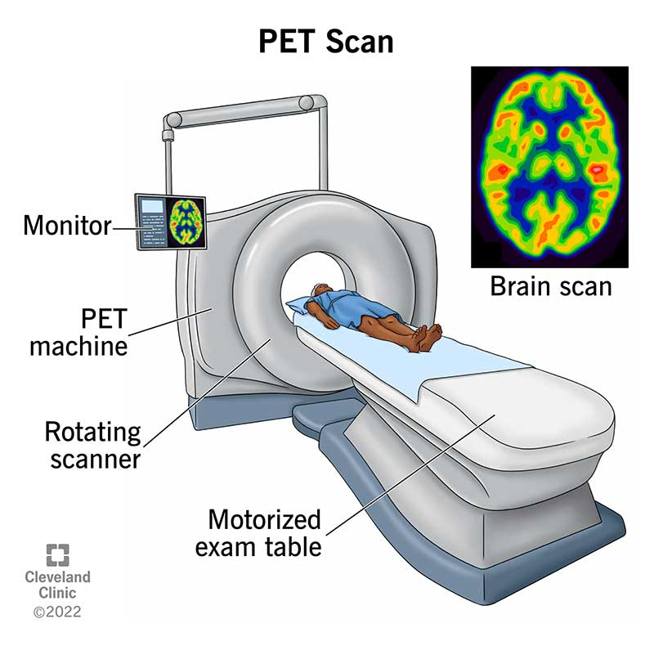
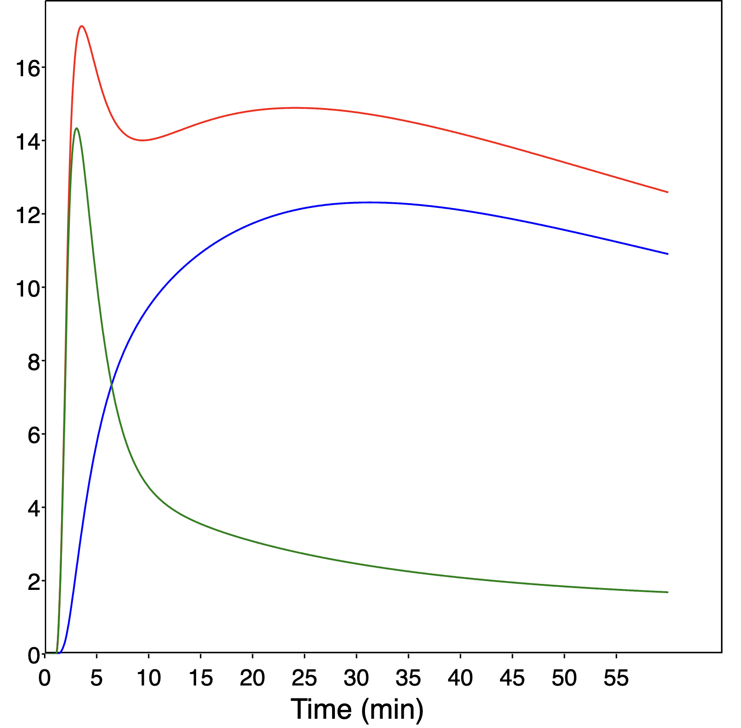
What is PET scanning?
Functional imaging modality
Track specific biological molecules
Temporal and spatial distributions
Positron decay and matter-antimatter annihilation
Activity [kBq/cc]
Notes:
Definition: PET is a non-invasice imaging technique that provides 3D images of functional processes in the body
Core principles – PET utilises the physics of positron decay ad matter – antimatter annihilation
Radiotracers which are specifically manufactures, radioisoptopes bound to biomolecules, are injected and then emit positrons which annihilate with the nearby electron to produce two 511keV gamma photons travelling anti-paralell
These photons are detected by the PET scanner and the site of the annihilation is found through coincidence detection and time of flight methods
PET is widly used in oncology e.g. tumor detection and staging, neurology e.g. brain metabolism mapping and cardiology e.g. assessing mycocardial viability

Slide 3
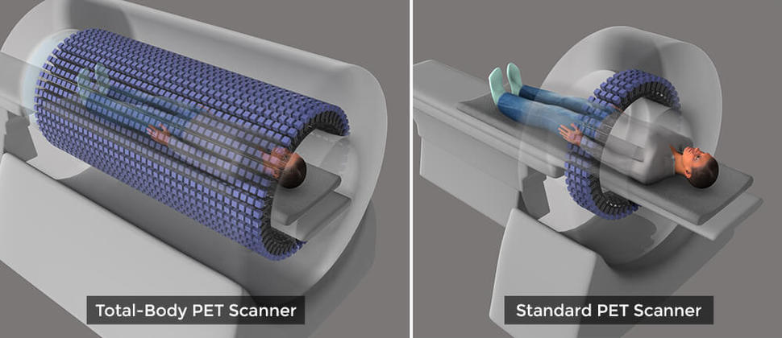
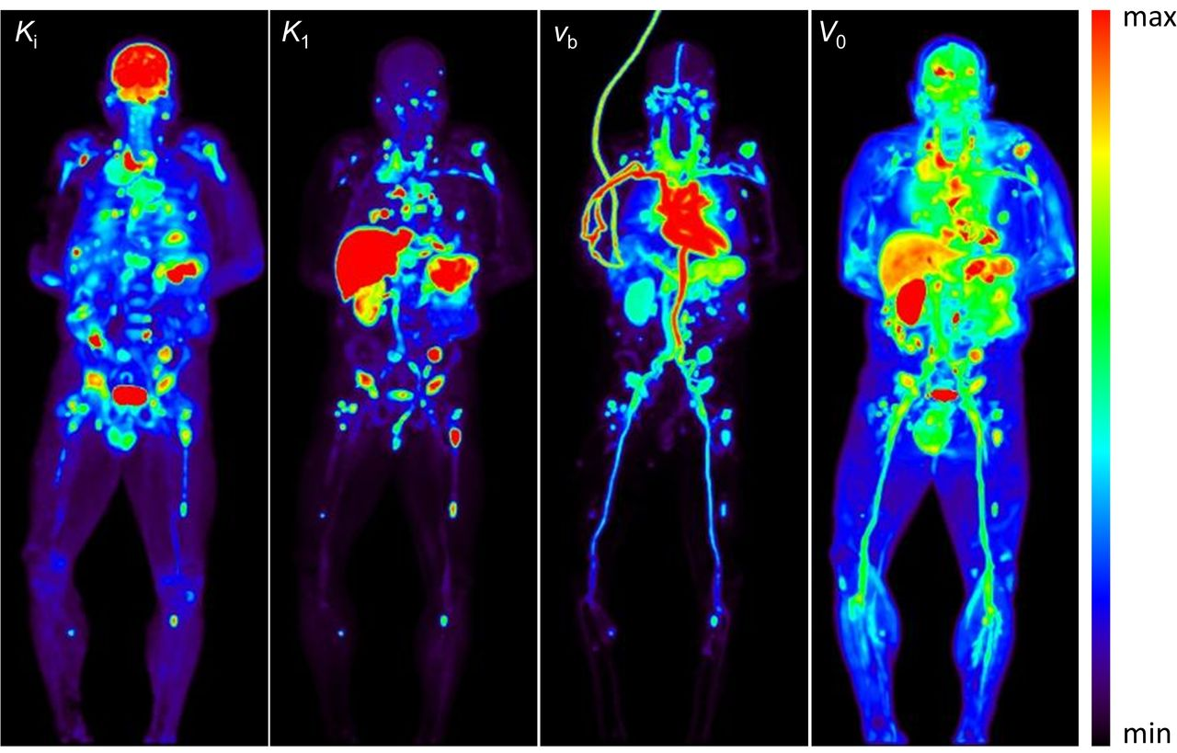
Total body PET
Extended field of view scanning
Increased sensitivity x40
Observe all organs simultaneously and dynamically
Visible excretion organs which play vital role in metabolism and excretion
Wang G et al. 2022: JNM

Slide 4
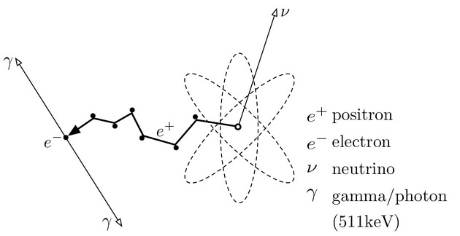
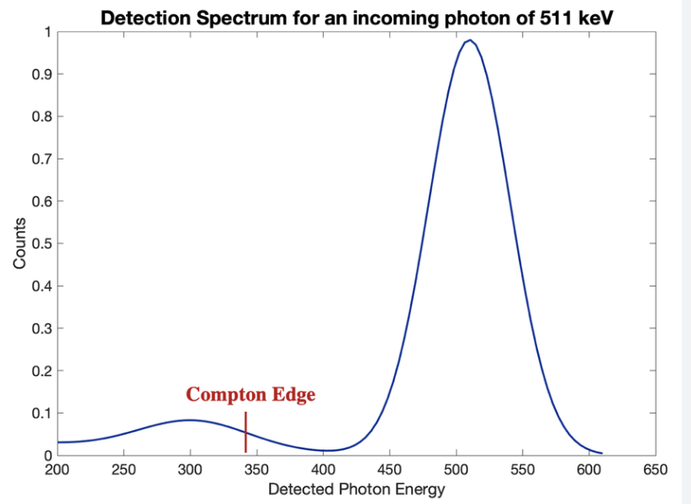
PET technology in particle and nuclear physics
Physics challenges of PET:
Radiotracer development
Radioisotope selection and production
Detector and scanner development
Image reconstruction
Algorithm development
Physiological modelling
Notes:
PET is underpinned by fundamental nuclear decays (e.g. β⁺ decay), gamma photon detection demans precision instrumentation e.g. scintillation crystals and photodetectors. Coincidence detection also reflect common particle physics methodologies many of us know and use
There are many challenges and research opportunities within PET including radiotracer development: radioisotopes with optimal half-lives and decay properties. Detector innovations: improving spatial and energy resolution using advanced materials and electronics which other members of the total body PET team in PPE use. And finally algorithm and quantification development which focuses on refining image reconstruction and quantification methods to improve the research that can be done with PET as well as patient comfort and clinical use

Slide 5
Image derived input functions
Blood
Tissue
Bound
Kinetic modelling requires blood sampling to get radioactive concentration in the blood
Research push – deriving input functions directly from image
Aim 1: investigate input function methods and the impact on kinetic modelling micro and macro parameters

Slide 6
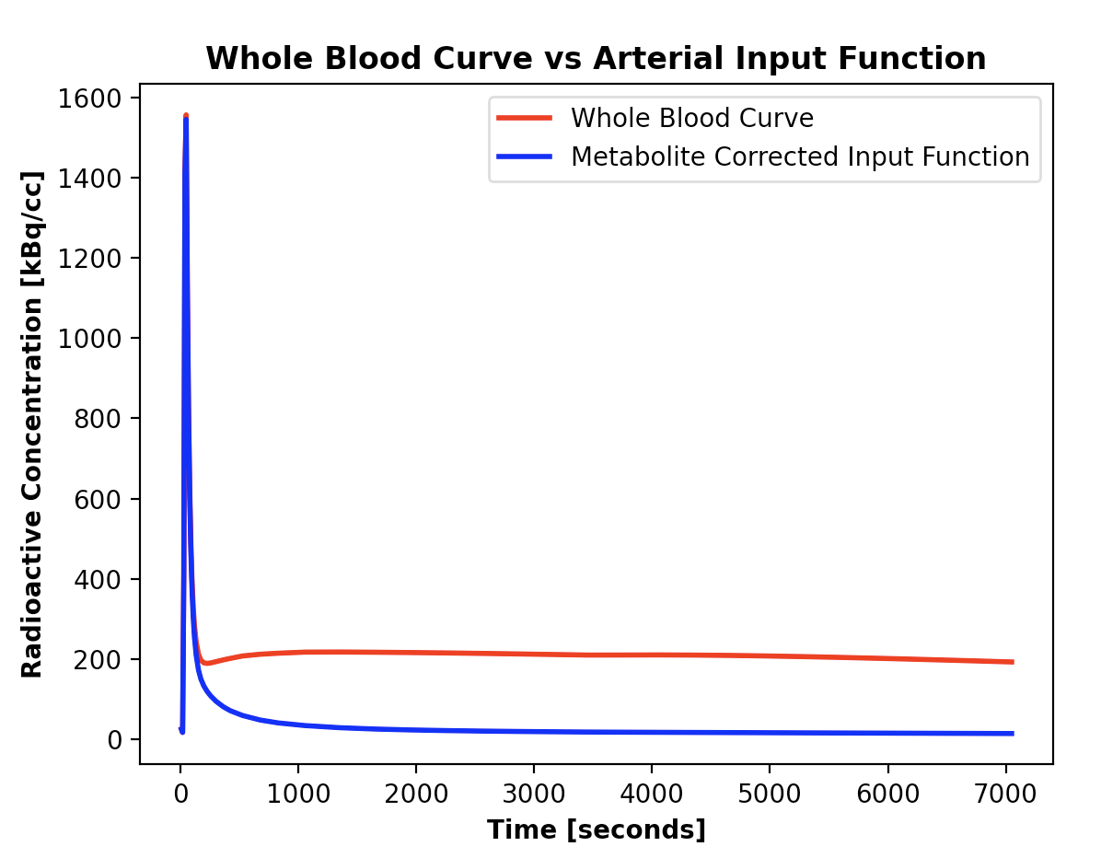
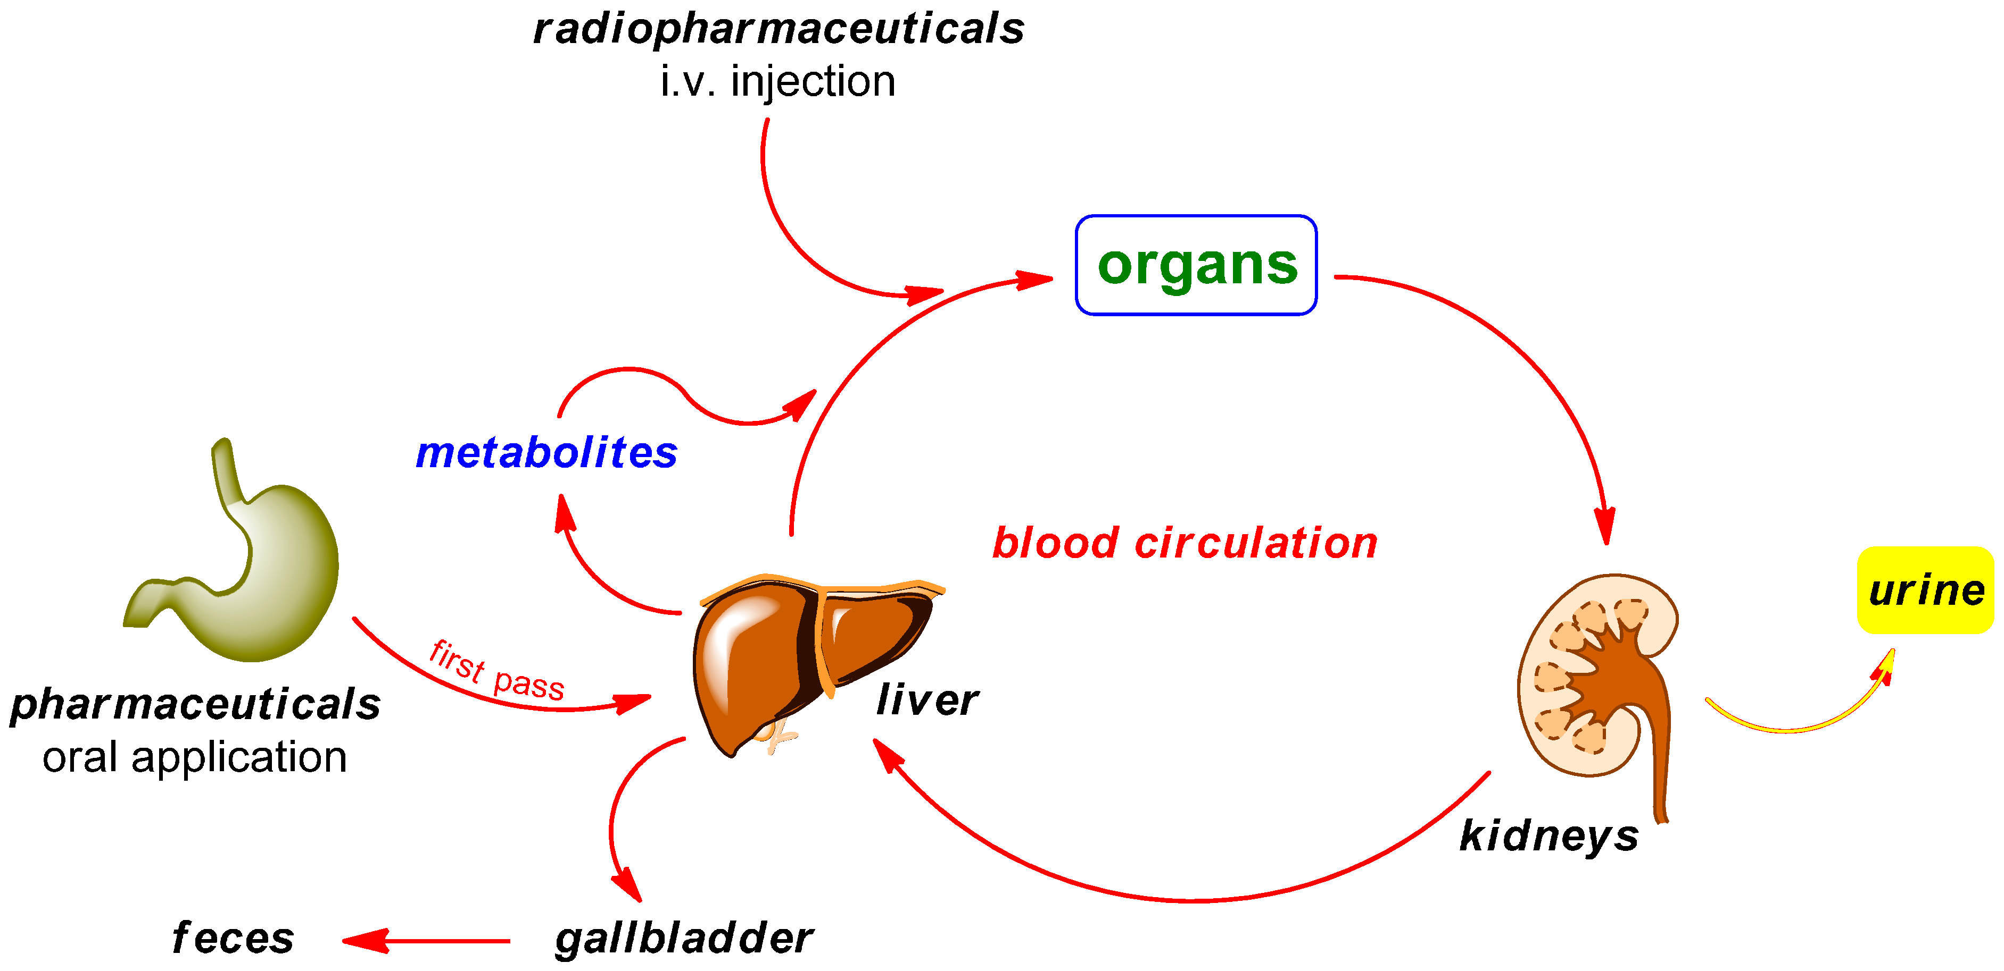
Radiometabolites – big challenge
Kuchar M and Mamat C. 2015: Molecules
Aim 2: develop novel kinetic models using total body PET which allow for image derived radiometabolite correction

Slide 7
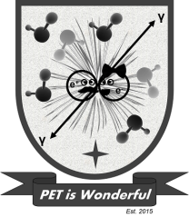
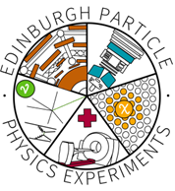
Thanks
Dr Catriona Wimberley
Professor Paul S Clegg
Dr Adriana Tavares
Particle Physics Experiment group
University of Edinburgh
PET is Wonderful group:
Adriana Tavares
Carlos Alcaide-Corral
Dániel Réti
Islay Cranston
Kali Pandya
Kerry O’Rouke
Liam Carr
Mark G Macaskill
Robert Shaw
Tim Morgan
Victoria Reid

Slide 8
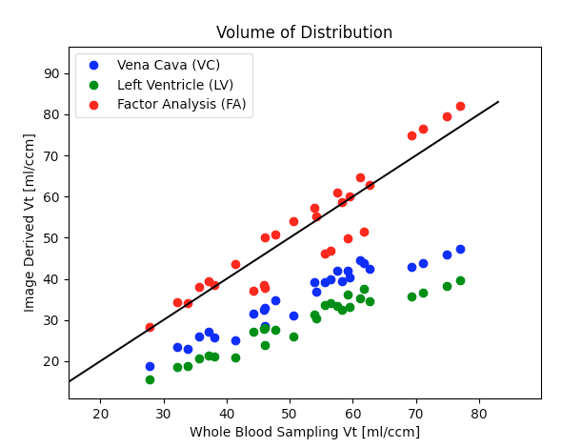
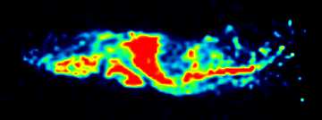
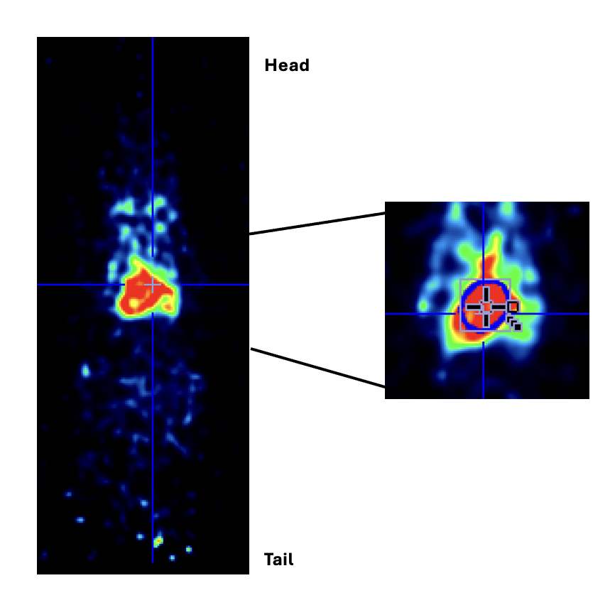
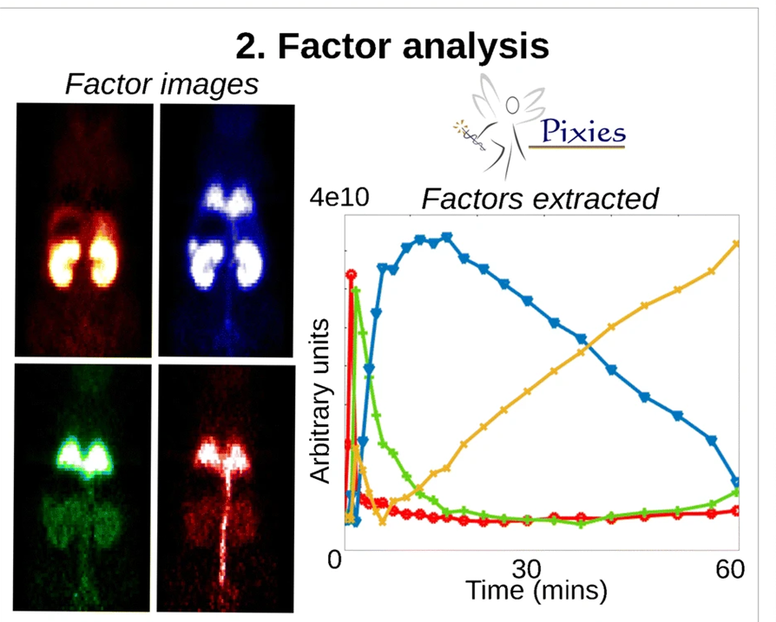
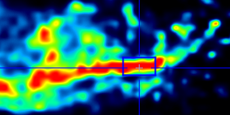
Key Results: Aim 1
Rate constants: K₁, k₂, k₃, k₄. Binding potential: = $\frac{k_{3}}{k_{4}}.$ Volume of distribution = $\frac{K_{1}}{k_{2}}\left(1+ \frac{k_{3}}{k_{4}}\right)$
Anatomical
Data driven
Vena cava VOI
Left Ventricle VOI
Factor Analysis (FA)
Notes:
Key results of the PhD so far have been establishing to optimal method to obtain the radioactive concentration in the blood as a whole over time directly from the image – this was done by comparing the modelling results of multiple image derived input function methods against the gold standard blood sampling method. By creating a region of interest over the vena cava we can establish the radioactive concentration in the whole blood over time and the parameters from the vena cava blood pool were highly correlated with the gold-standard method. Most often within the quantification of the field people do a limited review of all returned parameters – generally those which agree most however there is little full analysis of all possible parameters
We have established time activity curves for a range of excretory organs for a tracer that metabolises rapidly and one that does not travelling. Using these we are producing a compartmental model which describes the movement of the metabolites through the body. Monte carlo simulations of blood curves with different levels of metabolism allow us to assess the impact that the metabolism has on the kinetic results
In addition to this is looking at reducing scan time for Alzheimers patients by using simultaneous PET-MRI and a machine learning approach called support vector regression – from this we have successfully been able to predict the early phase of the TACs

Slide 9
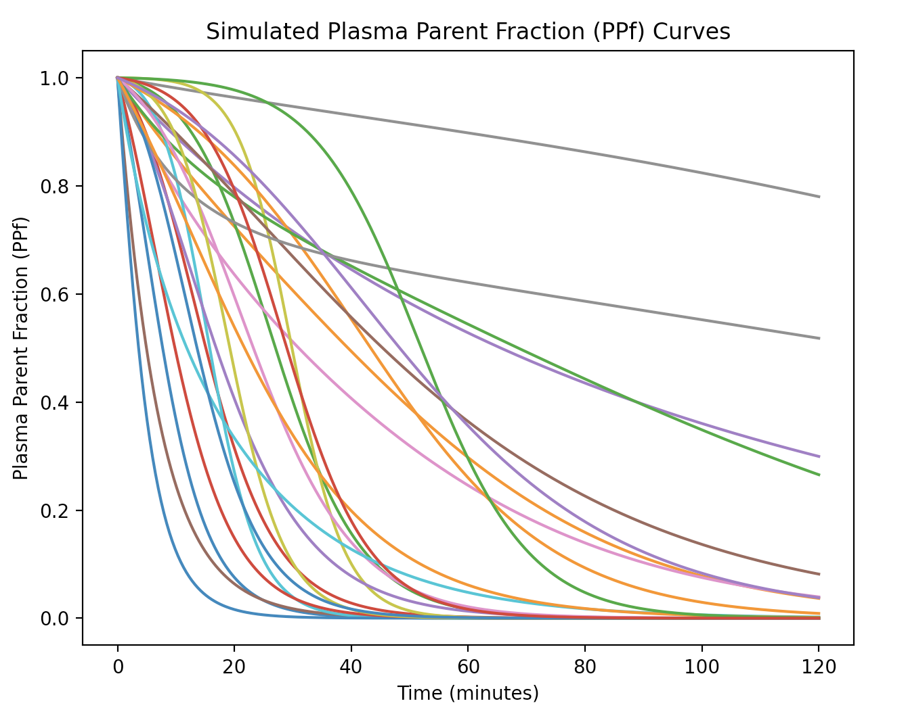
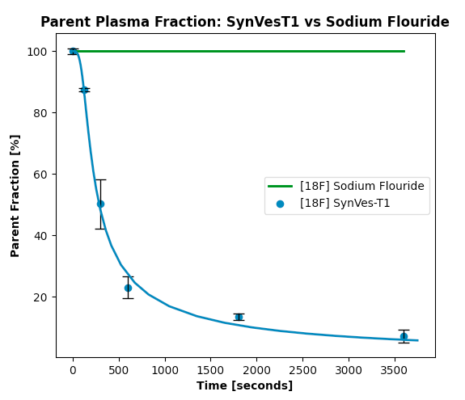
Key Results: Aim 2
$\frac{dC_{C}(t)}{dt}= K_{1 }∗C_{B}\left(t\right) −\left(k_{2}+k_{3}\right)∗C_{C}\left(t\right)+ k_{4 }∗ C_{M}(t)$
$\frac{dC_{M}(t)}{dt}= k_{3 }∗C_{C}\left(t\right) − k_{4 }∗ C_{M}(t)$
Notes:
Key results of the PhD so far have been establishing to optimal method to obtain the radioactive concentration in the blood as a whole over time directly from the image – this was done by comparing the modelling results of multiple image derived input function methods against the gold standard blood sampling method. By creating a region of interest over the vena cava we can establish the radioactive concentration in the whole blood over time and the parameters from the vena cava blood pool were highly correlated with the gold-standard method. Most often within the quantification of the field people do a limited review of all returned parameters – generally those which agree most however there is little full analysis of all possible parameters
We have established time activity curves for a range of excretory organs for a tracer that metabolises rapidly and one that does not travelling. Using these we are producing a compartmental model which describes the movement of the metabolites through the body. Monte carlo simulations of blood curves with different levels of metabolism allow us to assess the impact that the metabolism has on the kinetic results
In addition to this is looking at reducing scan time for Alzheimers patients by using simultaneous PET-MRI and a machine learning approach called support vector regression – from this we have successfully been able to predict the early phase of the TACs
While the aspect of PET that I focus on is more biological compared to the detector development etc the application of physics techniques and systems which haven’t been previously applied to PET data can allow us to get more information than previously possible and allow researchers and clinicians to improve comfort of patient and possibly also further our knowledge of diseases

