Slide 1

Searching for low-mass Higgs bosons with the ATLAS detector
PPE Annual Christmas Meeting
Giorgos Christou 1st year PhD student

Slide 2
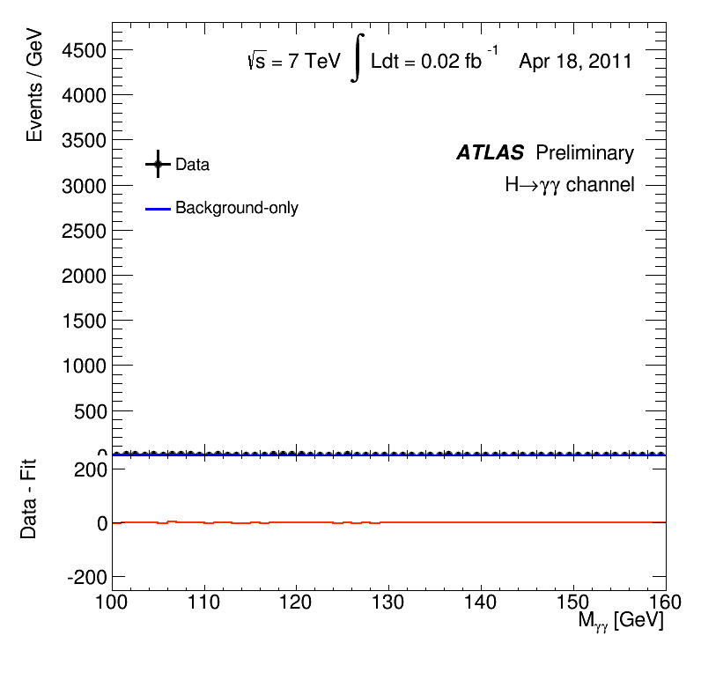
Introduction – The Higgs Boson
It was discovered back in 2012 by the ATLAS and CMS experiments
After the discovery, a lot of effort has been put into measuring its properties.
A lot of experimental results suggest that there was agreement with the Standard Model (SM)
What about Beyond the Standard Model (BSM) Higgs boson models?

Slide 3


Low-mass Higgs
bosons
SM Higgs
boson
Searching for low-mass Higgs bosons
What is a low-mass Higgs boson?
The truth is we don’t know! It can be either SM-like, or something completely different!
But we can perform low-mass searches in various channels such as the di-photon channel.
The final state consists of two photons originating from the Higgs boson

Slide 4
The CMS 95 GeV excess
In 2023 the CMS collaboration published a paper on Run 2 data suggesting an excess of events in the di-photon channel at about 95 GeV
The global significance was 2.9σ, not enough for a discovery
Large enough to study it further with ATLAS
95 GeV excess

Slide 5

CMS vs. ATLAS
CMS and ATLAS are the two general purpose detectors at the LHC $→$ Can measure the same properties of particles
We can look at the low-mass region with the ATLAS detector and find a larger excess
Spoiler: We found an even smaller excess…

Slide 6
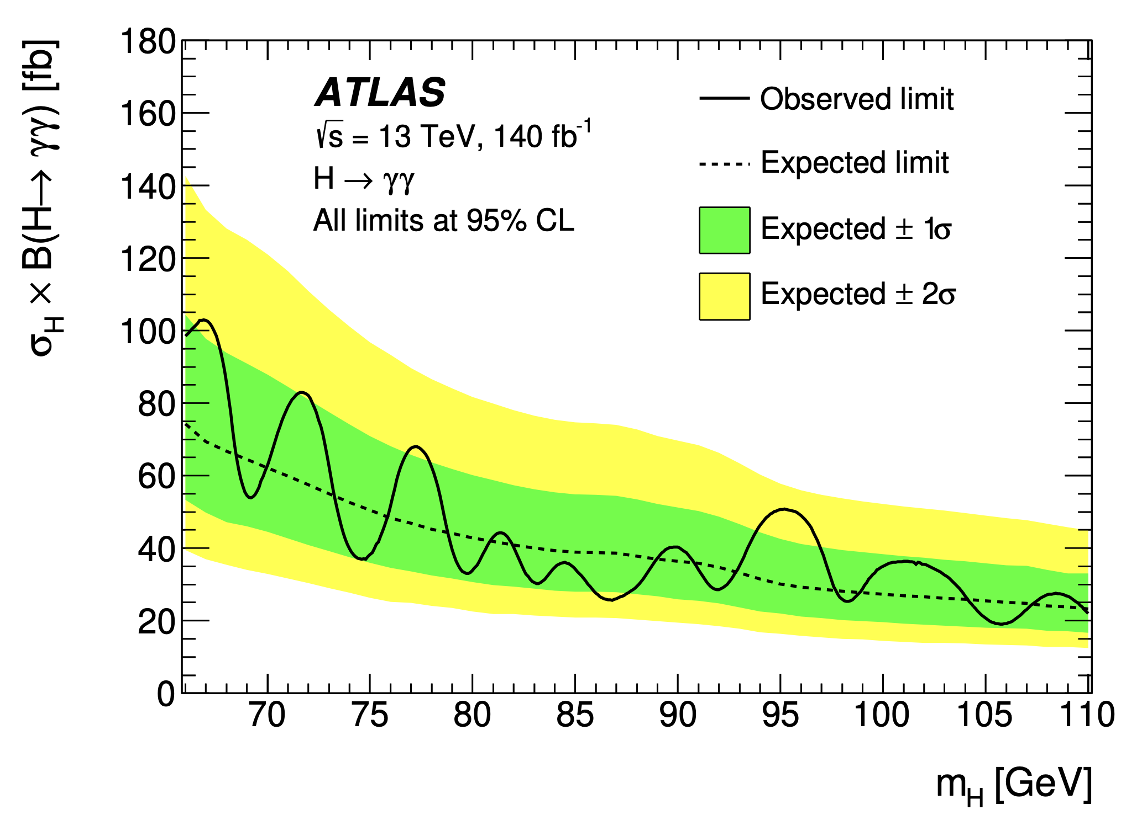
ATLAS Run 2 Results
In 2024 we published a search for low-mass Higgs bosons decaying into two photons
The Run 2 data didn’t show any significant excess (or even similar to the CMS excess) above the SM expectation
We got 1.7σ significance
CMS Run 2 excess
Small excess
What can we do to improve this?
Look at Run 3 data!

Slide 7
ATLAS Run 3 Analysis
We are implementing the same analysis as in Run 2
We use an Ambiguity BDT to separate electrons from photons
Di-photon BDT (DNN now) to separate signal from background
So far I’ve been working on the di-photon DNN training and optimisation

Slide 8
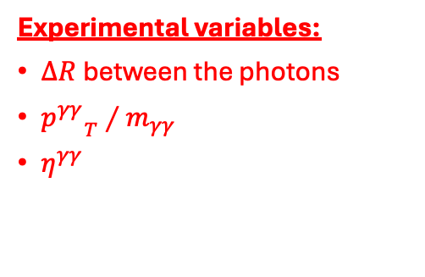

ATLAS Run 3 Analysis
For the di-photon DNN we use information from both photons to assign a value to the event
Closer to 0 is background-like, and closer to 1 is signal-like
Training variables:
${p_{T}}/{m_{γγ}}$ for both photons
Pseudorapidity of each photon
Ambiguity BDT score for each photon and the minimum of the two
$\cos{Δφ}$ between the two photons
Experimental variables:
$ΔR$between the photons
${p^{γγ}}_{T}∕m_{γγ}$
$η^{γγ}$

Slide 9
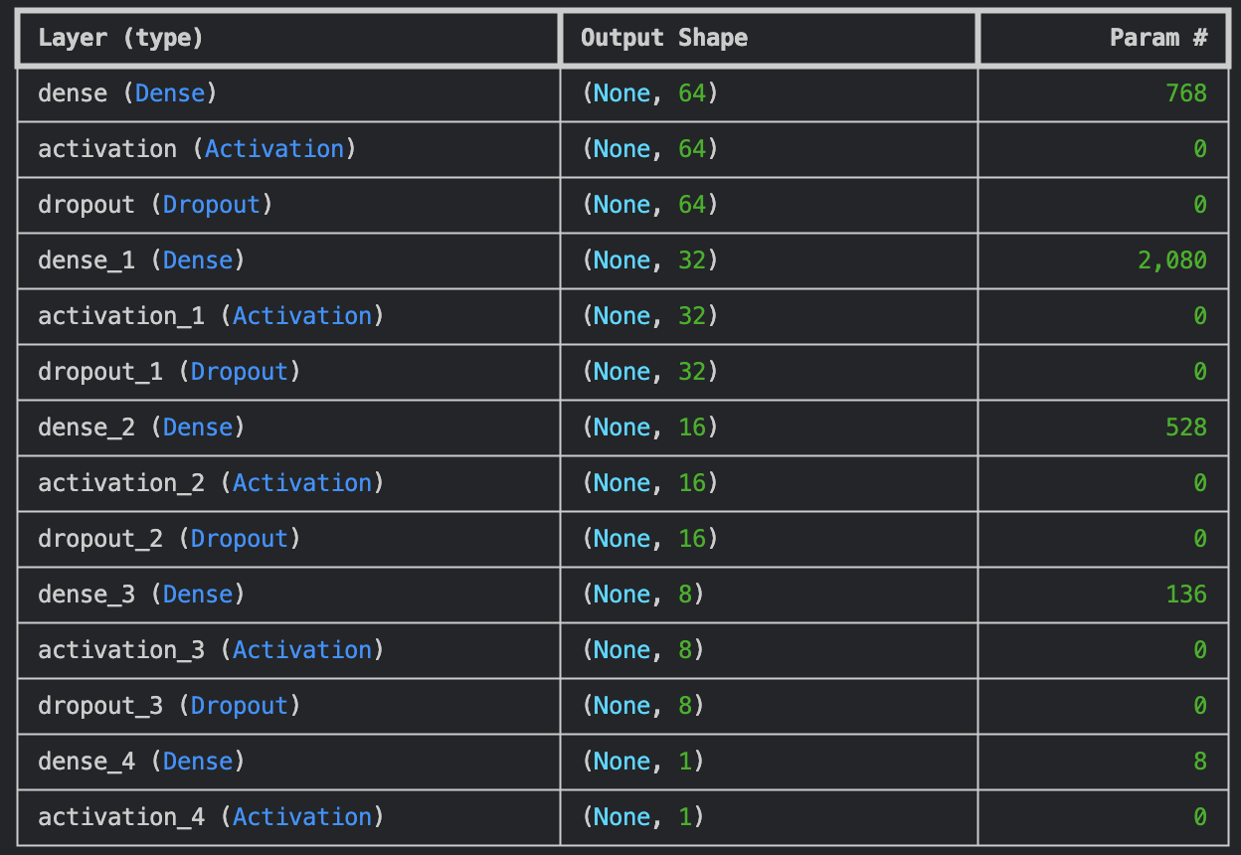

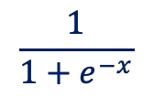
Model Architecture
A few hidden layers are used, but the architecture is fairly simple without affecting performance
Dropout and Regularisation to avoid overfitting
Sigmoid activation function on the last layer to constrain the output in $[0, 1]$
$$\frac{1}{1+e^{−x}}$$
0 is bkg.-like and 1 is sig.-like

Slide 10
Model Training and Performance
Not the best performance… but slightly better with the addition of the new training variables

Slide 11

Model Training and Performance
Previously $\cos{Δφ}$was the most important feature and the amb. scores were the least important
Now the photon and di-photon kinematics play a bigger role in classifying the event as sig/bkg

Slide 12
Model Training and Performance
We want to separate the data into 3 categories by maximising the discovery significance ratio (comparison of sig/bkg amounts before and after categorisation)
Smooth distributions
we can fit a bkg. model

Slide 13
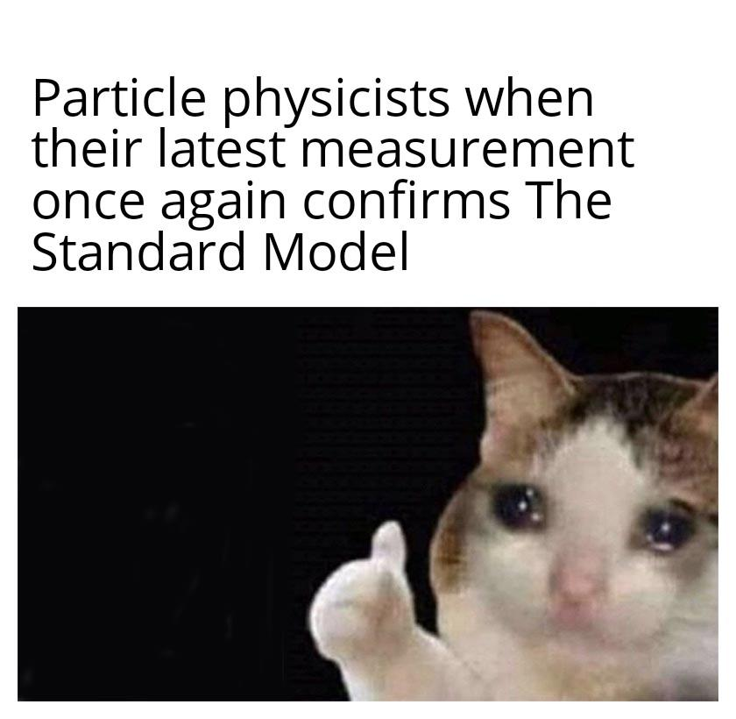
Conclusions
A second attempt to observe a low-mass Higgs boson using the ATLAS detector and compare with the CMS result
Analysis of Run 3 data
Implementation of a Deep Neural Network to classify di-photon events with new training variables
Improvements: Further model optimisation, exclude signal masses, reduce complexity
Perform more checks to verify that the model is working properly

