Slide 1
HOW MUCH DARK MATTER* IS IN A PINT OF
?
*Based on LZ’s optimal wimp search results

Slide 2
Relic WIMP Distribution
WIMPs are distributed in isothermal spherical halos with Maxwellian velocity distribution
$$f\left(v\right)=\frac{1}{\sqrt{2π} σ}\exp\left(−\frac{\left|v^{2}\right|}{2σ^{2}}\right)$$
DM Halo
Solar System
Speed dispersion is related to the local circular speed by
$$σ= \sqrt{\frac{3}{2} } v_{c}$$
where
$$v_{c}=230 km/s$$
Galactic Disk
The density profile of the sphere is
and
$$ρ_{0}=0.3 \frac{GeV/c^{2}}{cm^{3}}$$
$$ρ\left(r\right)∝r^{−2}$$

Slide 3
Relic WIMP Distribution
$$ρ_{0}=0.3 \frac{GeV/c^{2}}{cm^{3}}$$
Local dark matter density is
DM Halo
$$v_{c}=230 km/s$$

Slide 4
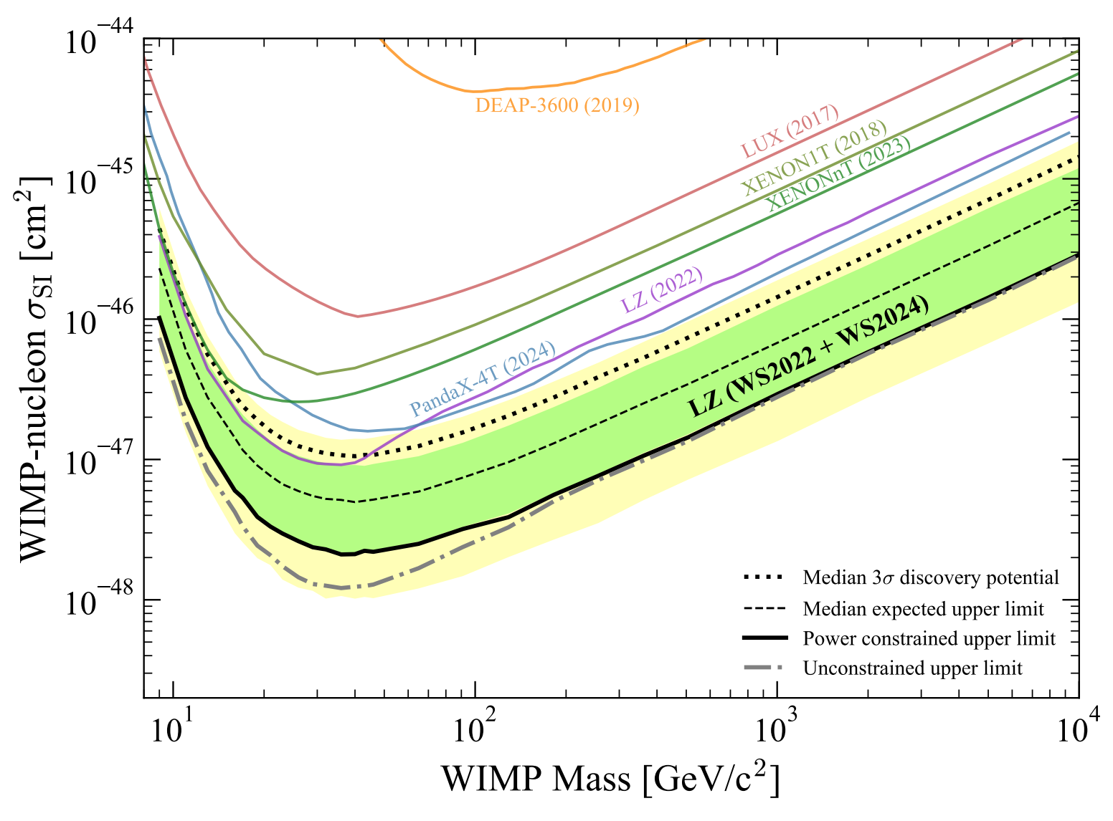
Density of WIMPs in our area
$$ρ_{0}=0.3 \frac{GeV/c^{2}}{cm^{3}}$$
Local dark matter density is
We need to pick a favoured mass for the dark matter particle…
Let’s use the WIMP mass for LZ’s optimal sensitivity!
Upper limit on spin-independent WIMP-nucleon cross section is $2.2×{10}^{−48}$ cm² at 43 GeV/c²
Plug in the numbers
$$N$$
$$=\frac{ρ_{0}V}{m_{χ}}=\frac{0.3 GeV cm^{−3} × 568 cm^{3}}{43 GeV}$$
$$≈4$$
WIMPs per pint!

Slide 6
Thanks for listening!
Merry Christmas / Happy Holidays!

