Slide 1
Towards the Discovery of New Elements: Production of Livermorium (Z=116) with ⁵⁰Ti
Rodi Herzberg
University of Liverpool
Phys. Rev. Lett. 133, 172502 (2024)

Slide 2
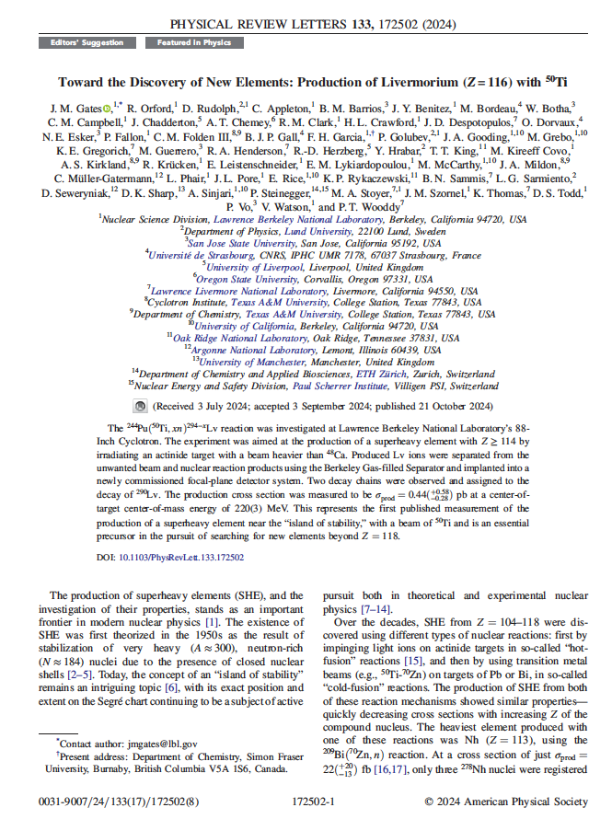
Outline
Superheavy Elements
The paper itself
Context and Collaboration
Strategy
Discussion

Slide 3
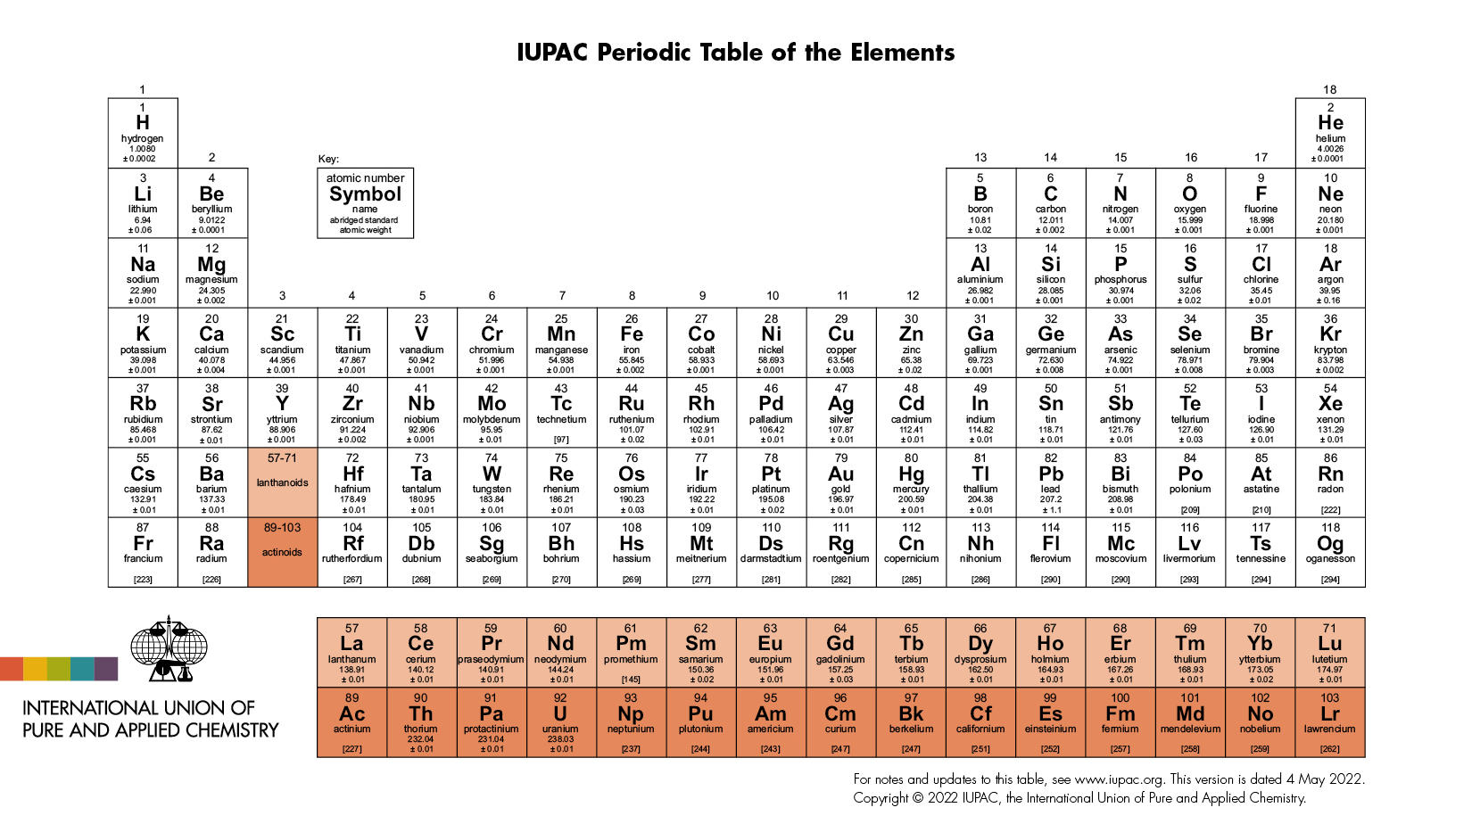
Superheavy Elements – how many can we make?

Slide 4
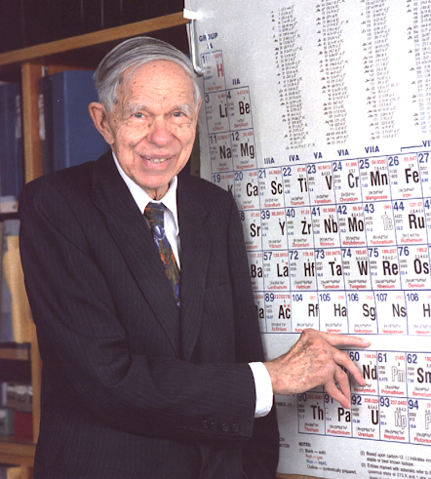
A LOT of History

Slide 5
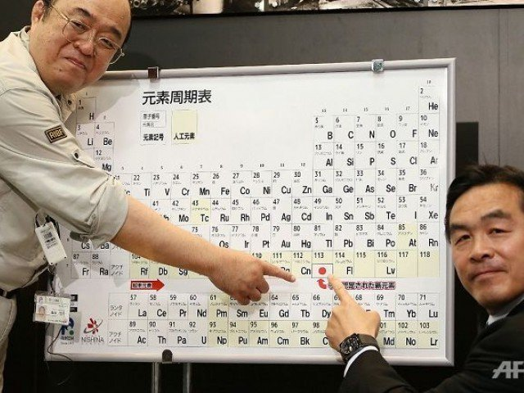
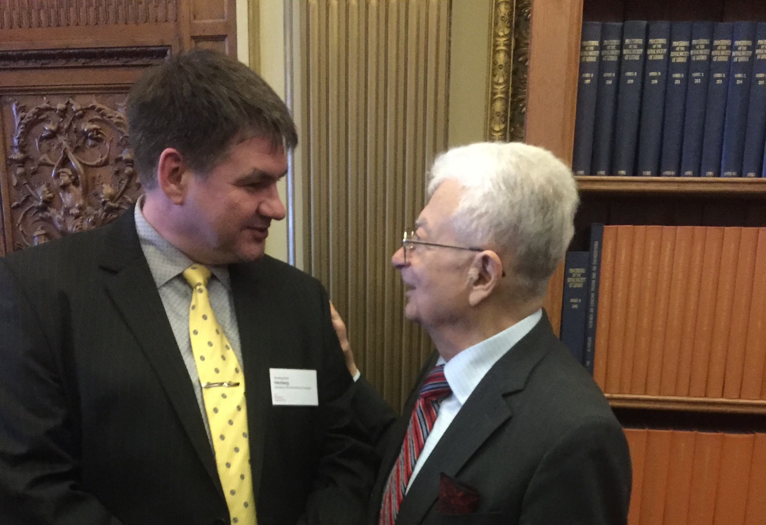
New Elements
1
18
1
H
2
He
2
13
14
15
16
17
3
Li
4
Be
5
B
6
C
7
N
8
O
9
F
10
Ne
1
H
13
Al
14
Si
1
H
11
Na
12
Mg
15
P
16
S
17
Cl
18
Ar
3
4
5
6
7
8
9
10
11
12
1
H
34
Se
1
H
19
K
20
Ca
21
Sc
22
Ti
23
V
24
Cr
25
Mn
26
Fe
27
Co
28
Ni
29
Cu
30
Zn
31
Ga
32
Ge
33
As
35
Br
36
Kr
37
Rb
38
Sr
39
Y
40
Zr
41
Nb
42
Mo
43
Tc
44
Ru
45
Rh
46
Pa
47
Ag
48
Cd
49
In
50
Sn
51
Sb
52
Te
53
I
54
Xe
55
Cs
56
Ba
72
Hf
73
Ta
74
W
75
Re
76
Os
77
Ir
78
Pt
79
Au
80
Hg
81
Tl
82
Pb
83
Bi
84
Po
85
At
86
Rn
87
Fr
88
Ra
104
Rf
105
Db
106
Sg
107
Bh
108
Hs
109
Mt
110
Ds
111
Rg
112
Cn
113
Nh
114
Fl
115
Mc
116
Lv
117
Ts
118
Og
Rg
57
La
58
Ce
59
Pr
60
Nd
61
Pm
62
Sm
63
Eu
64
Gd
65
Tb
66
Dy
67
Ho
68
Er
69
Tm
70
Yb
71
Lu
89
Ac
90
Th
91
Pa
92
U
93
Np
94
Pu
95
Am
96
Cm
97
Bk
98
Cf
99
Es
100
Fm
101
Md
102
No
103
Lr

Slide 6
The paper: Creating Livermorium using ⁵⁰Ti
The ²⁴⁴Pu(⁵⁰Ti,𝑥𝑛)^{294−𝑥}Lv reaction was investigated at Lawrence Berkeley National Laboratory’s 88-Inch Cyclotron. The experiment was aimed at the production of a superheavy element with 𝑍 ≥114 by irradiating an actinide target with a beam heavier than ⁴⁸Ca. Produced Lv ions were separated from the unwanted beam and nuclear reaction products using the Berkeley Gas-filled Separator and implanted into a newly commissioned focal-plane detector system. Two decay chains were observed and assigned to the decay of ²⁹⁰Lv. The production cross section was measured to be 𝜎_{prod}=0.44^{(+0.58}_{−0.28}) pb at a center-of-target center-of-mass energy of 220(3) MeV. This represents the first published measurement of the production of a superheavy element near the “island of stability,” with a beam of ⁵⁰Ti and is an essential precursor in the pursuit of searching for new elements beyond 𝑍 =118.

Slide 7
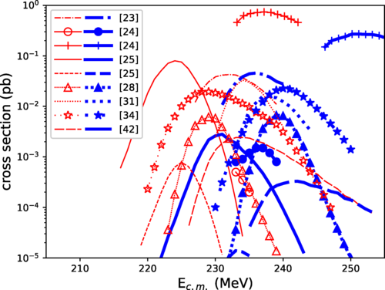
Cross Section matters a lot!
Narrow Excitation Functions
Low Count rates
Unclear theoretical input
Variable literature
Limited beamtime

Slide 8
Setup in Berkeley

Slide 9
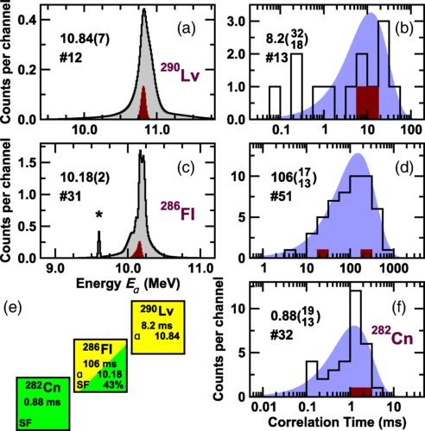
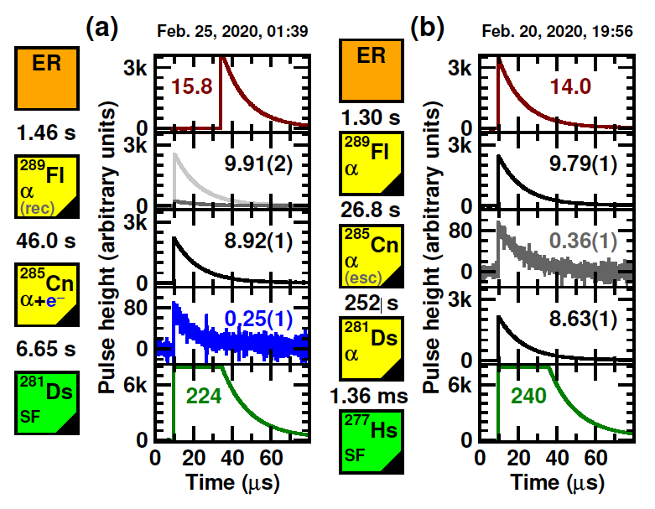
Data ²⁹⁰Lv
How to compare different experiments?
Resolution differs
Dead time differs
Readout differs
We saw two events in 3 weeks.

Slide 10
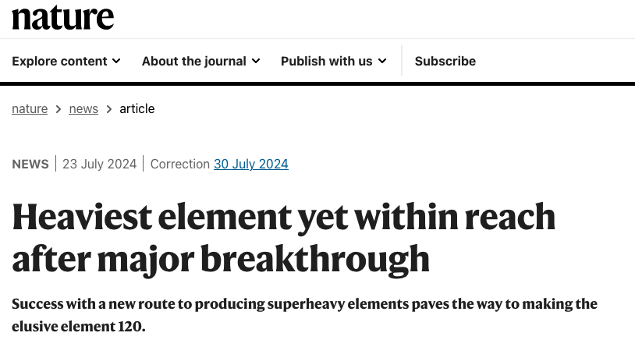
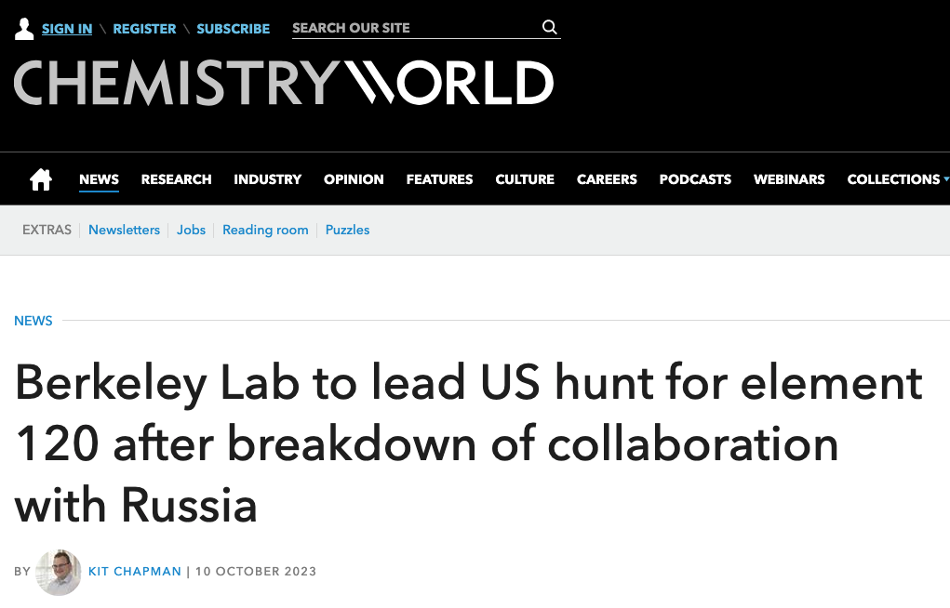
So What?

Slide 11
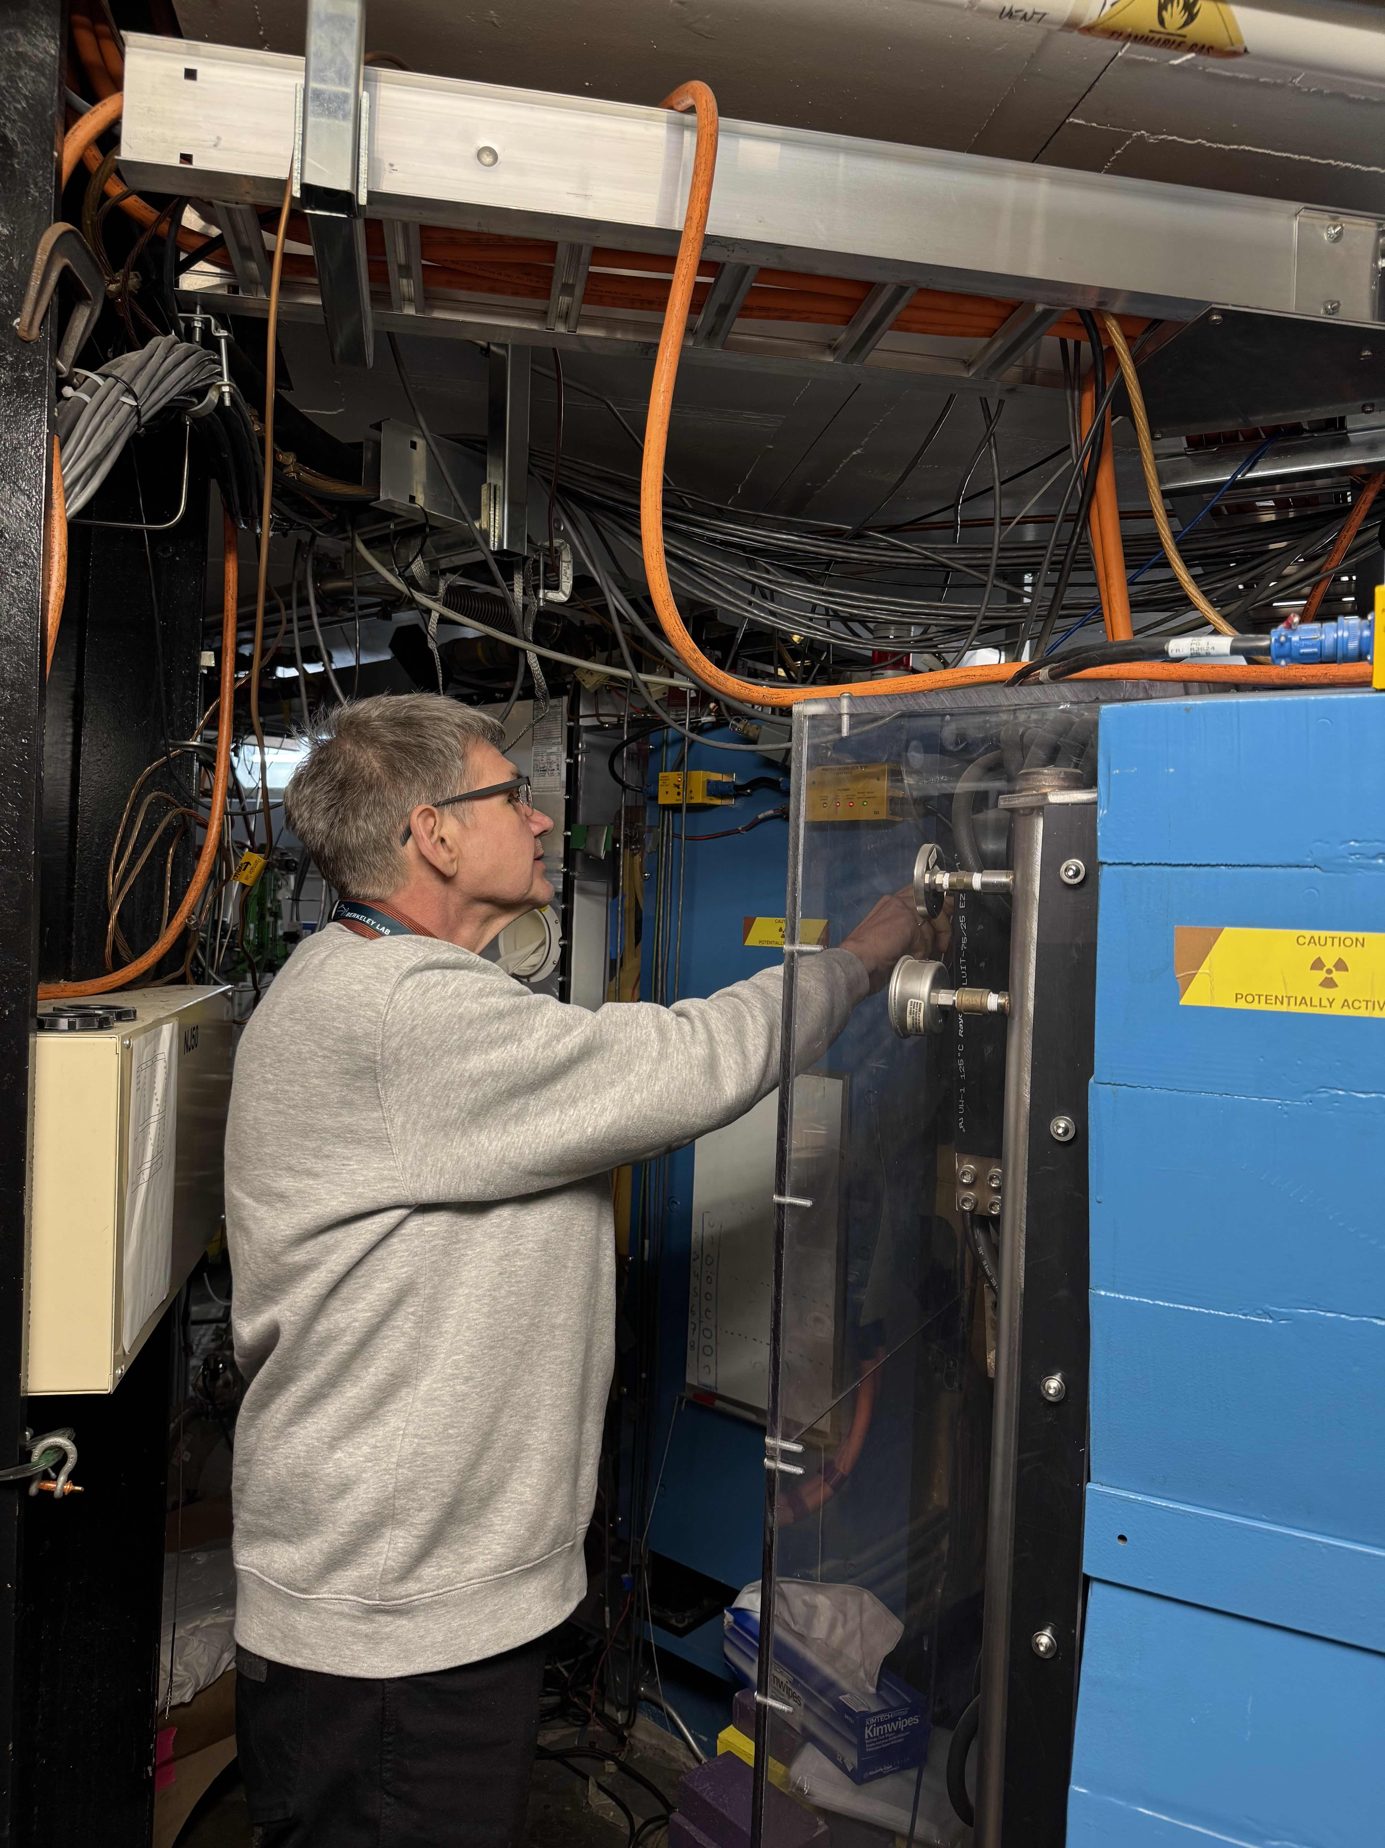
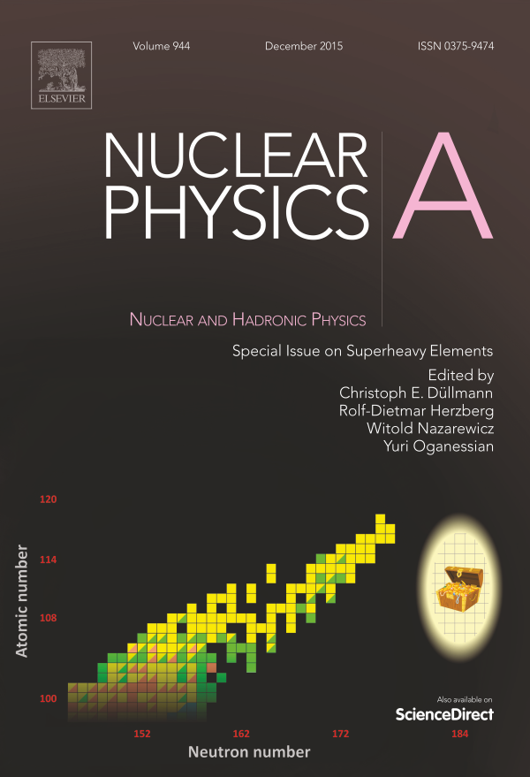
My place in this world
UK has no appropriate facility
Collaboration is key!
Spokesperson SHE@NUSTAR
Editor Review Collection
Member of TASCA Collaboraton
(We confirmed Z=117 Ts)
Member of LBNL Collaboration

