Slide 1
Can you bring your whole self to work?
Dr Katie Nicoll Baines (she/her)
Equality, Diversity & Inclusion Manager
Future Leaders Fellow Development Network
17th January 2025
Notes:
I will talk though:
What we know about diversity in research and innovation
Why it is important to UKRI and how we are thinking about this
And how we would like to work with you and the sector to bring about long-term transformational change.
Whilst we have developed an approach for cohorts 1-3 working with Sara and colleagues through the existing FLF Network, we are keen to work with and shape this with all cohorts and therefore, for those in cohorts 5 & 6 then please do follow up with me direct following the workshop on ways we can do this.

Slide 2
Chatham house rules apply
Actively participate in all aspects of the session
Feel free to ask questions at any time
Respect each other’s contributions
Principled spaces guide

Slide 3
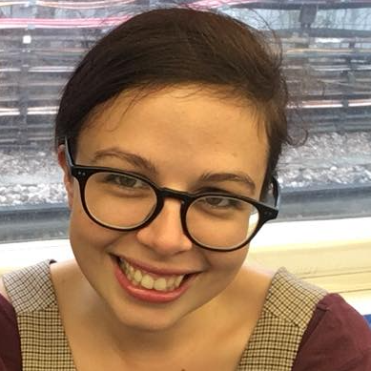
Who am I?
Katie is an equality, diversity and inclusion specialist and experienced facilitator/trainer with expertise in researching barriers to career progression experienced by women and LGBT+ people related to grant funding.
Katie created and implements our EDI strategy. She is responsible for embedding principles of equality, diversity and inclusion across all network programmes and activities. She supports our training and development team to embed EDI in the leadership training for fellows and develops bespoke training to respond to specific EDI needs within the Network. Katie also works with UKRI on strategies to support Inclusive Research Design.

Slide 4
Self-awareness: identity map
Unpredictable caring responsibilities
Cisgender Woman
White
Earn a salary above national average
Neurotypical
Standard body type (not fat)
Bisexual/
queer
British
RP Accent
Distinctly left-wing political beliefs/socially conscious
English is my first language
Not religious
Educated to PhD level
Not disabled

Slide 5
Self-awareness: identity map
Sex
Caring responsibilities
Gender identity
Race
Salary/wealth
Neuro-type
Body type
Nationality
Sexuality
Accent
Political beliefs
Language
Religion
Education
Other quirks/skills?
Disability

Slide 6
Activity: Folding Paper
I regularly see people that look like me represented as leaders in my scientific field
One or both of my parents went to University
I can choose blemish cover or bandages in “flesh” colour and have them more less match my skin
I can hold hands with my romantic partner in public without fear of experiencing negative comments/glances from other people
I didn’t need a visa to work/study where I am now
When going to a new place I am not concerned about whether I can physically access the space
I can go for a walk at night without worrying for my personal safety

Slide 7
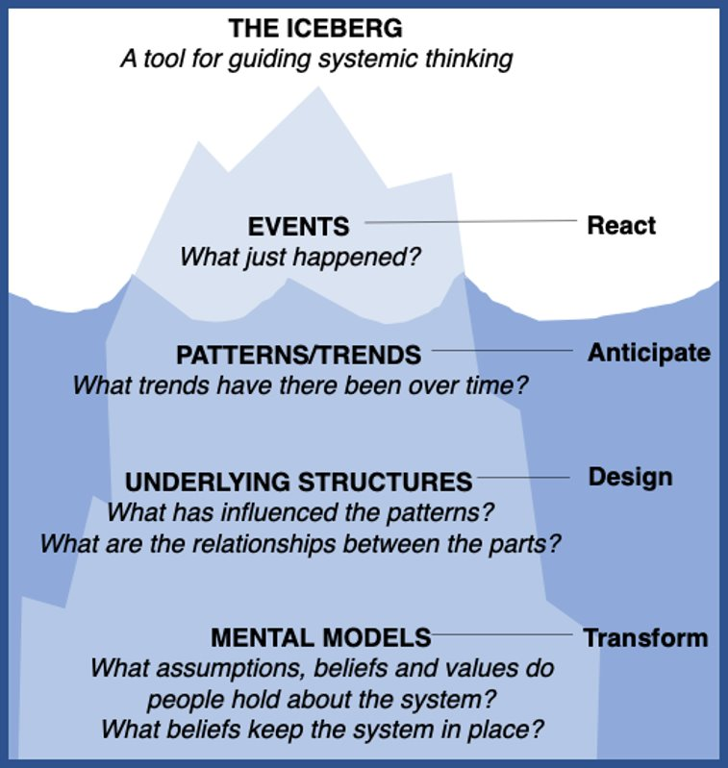
Understanding the system
Institutions
Individuals
Funders
Community
Crisis
Government
International
Notes:
Systems are complex beings consisting of many parts including individuals, institutions, funders (which are also institutions), government bodies (again, also institutions), the international context and also the challenge and opportunity of crisis. These components all contribute to the types of communities we operate in and they all interact and can have influence on each other.
Understanding this complexity can be a challenge. The iceberg model can be a useful tool to guide systemic thinking:
The tip of the iceberg is what you can see that is visible above the surface, in reality this might be the awareness of some form of under-representation, perhaps through being simply observed or through quantitative data.
This is the part we are often reacting to, but the challenge of reacting is that we are often not fully aware of what lies beneath the surface, the aspects that have lead to this event or caused it to happen
They layer below the surface is are the patterns and trends that have existed over time, are we measuring the data in a manner that enables us to examine change and determine how it influences events, this helps us to anticipate change
Beneath that are the underlying structures, the features of a system that have been designed. These features influence the patterns and trends that we measure and we must question the relationships between these parts
Finally there is the base of the iceberg, the mental models that exist that people hold about the system. It is important to consider how these values and beliefs keep the system in place and often is it hear we must try to make change in order the transform the way in which systems operate.

Slide 8
Understanding the system
LGBT+ people more likely to leave STEM fields (28% compared to 16% non-LGBT+)
Notes:
Explain approach to understanding the system and working with people involved at different levels to understand the complexity
- Highlight Involvement of professional services

Slide 9
Understanding the system
Funders
Institutions
Government
Notes:
Explain approach to understanding the system and working with people involved at different levels to understand the complexity
- Highlight Involvement of professional services

Slide 10
Understanding the system
Section 28/Clause 2a
Government
Equality Act 2010
Gender Recognition Act
How many openly LGBT+ leaders in your field do you know?
What does a leader in STEM look like?
Notes:
Explain approach to understanding the system and working with people involved at different levels to understand the complexity
- Highlight Involvement of professional services

Slide 11
Understanding your values
Review the list of workplace values and select those that are important to you

Slide 12
Work Values
Derived from Brian Hopson and Mike Scally, Build Your Own Rainbow: A Workbook for Career and Life Management (2009).
Place of work: It is important that you work in the right part of the country for you.
Peace: You prefer to have few pressures or uncomfortable demands.
Variety: You enjoy having lots of different things to do.
Competition: You enjoy competing against other people or groups.
Independence: You like being able to work in the way you want, without others telling you what to do.
Time freedom: You prefer to be able to choose your own times for doing things, not having rigid working hours.
Friendship: You would or do like close friendships with people at work.
Fast pace: You enjoy working rapidly at a high pace.
Status: You enjoy being in a position which leads others to respect you.
Making decisions: It is important to you to have to make decisions about how things should be done, who should do them, and when they should be done.
Creativity: Thinking up new ideas and ways of doing things is important to you.
Risk: You like to take risks.
Excitement: It is important to you to have a lot of excitement in your work.
Money: Earning a large amount of money is important to you.
Helping others: It is important to you to help other people either individually or in groups, as part of your work.
Challenge: You enjoy being ‘stretched’ and given new problems to work on.
Routine: You like a work routine which is fairly predictable.
Pressure: You like working to deadlines.
Community: You like to live in a place where you can get involved in the community.
Work with others: You like to work in a team alongside others.
Physical challenge: You enjoy doing something that is physically demanding.
Work alone: You like to work on your own.
Artistic: You enjoy work involving drawing, designing, making music, making models, etc.
Communication: You enjoy being able to express ideas well in writing or in speech.
Recognition: You do like people to appreciate you for the work you do.
Security: It is important to know your work will always be there for you.
Contact with people: You enjoy having a lot of contact with people.
Precise work: You like working at things which involve great care and concentration.
Help society: You like to think that your work is producing something worthwhile for your society.
Supervision: You enjoy being responsible for work done by others.
Persuading people: You enjoy persuading people to do something or change their minds about something.
Learning: It is important for you to learn new things.
Being expert: You like being known as someone with special knowledge or skills.\
A well-known organisation: You like being part of a well-known organisation.
Promotion: You like to work where there is a good chance of promotion.

Slide 13
Honouring your values
To what extent are your top three values honoured right now, in your current role?
Give them each a score x/10
If you have a low score, what small thing could increase it by one point?
If you have a high score, what (if anything) needs to happen to maintain it
To what extent do your colleagues see/hear/feel your values in your words and actions?
Could your core values help you to make a choice or decision you are facing?

Slide 14
Understanding bullying & harassment
Incidences of bullying & harassment in HEIs
25% of faculty members self-identify as having been bullied*
40-50% say they have witnessed others being bullied*
Survey of Irish HEIs shows that minority groups (e.g. LGBTQ+, ethnic minorities, those with a disability) are more likely to endure negative acts at work, bullying & cyber bullying compared to majority group
Almost 400 sexual misconduct claims were filed at Scottish Universitiees since 2016
*data from a synthesis of studies (Nature 11 May 2021)
Notes:
Poll questions:
Have you witnessed bullying & harassment in your workplace?
Have you heard about bullying & harassment in your workplace?

Slide 15
What is bullying?
There is no legal definition of bullying.
It can be described as unwanted behaviour from a person or group that is either:
Offensive, intimidating, malicious or insulting
An abuse or misuse of power that undermines, humiliates, or causes physical or emotional harm to someone

Slide 16
What is harassment?
Harassment is when bullying or unwanted behaviour is about any of the following ‘protected characteristics’ under discrimination law:
Age
Disability
Gender reassignment
Race
Religion or belief
Sex
Sexual orientation
Harassment because of pregnancy or maternity is treated differently and could be direct discrimination

Slide 17
Principles of being an active bystander
Someone who safely intervenes to support a person experiencing harm or distress caused by the actions of another person/group.
Understand your own personal boundaries.

Slide 18
The 5 Ds of bystander intervention
Direct Action: Directly intervene in a situation. Speak up about the harm. Be firm and clear.
Distract: Take an indirect approach to de-escalate the situation. Distracting attention away from the person causing harm to give the person experiencing harm time to move away
Delay: After the incident is over, check in with the person who was harmed. This is essential because it shows the individual that they are valued. Delay also could mean continuing to educate ourselves about ways to help in future
Delegate: Get help from someone else. Scan the situation to assess risk and determine how to best intervene. Then, delegate tasks to others around you.
Document: Find ways to make a record of what has happened. E.g. If someone is already intervening and you believe the person causing harm behaviour has escalated, or you think a record of the action would be useful, you can document the situation.

Slide 19
Some example phrases
Calling-in
I’m curious, what was your intention when you said that?
How might the impact of your words differ from your intent?
How might someone else see this differently/interpret your words/actions?
What do you assume to be true about…?
Calling-out
I need to stop you right there
I need to push back against that, I disagree, I don’t see it that way
I wonder if you’ve considered the impact of your words
It sounds like your just said… is this really what you mean

Slide 20
Activity: scenarios for discussion
You will be put into small groups (3-5 people) and given a scenario to discuss
Think about the way in which you might respond to the situation presented
Consider which of the 5Ds might be your preferred or most appropriate intervention
If you are considering a direct approach When is calling-in or calling-out more effective?

Slide 21
Example scenarios: Team meeting
One of your research team members, a postdoc who has been in the group for over 3 years, asks a lot of questions during one of your PhD student’s project update talks. They first few questions are clarifying ones that you perceive to be necessary to understand their work properly but then the questions seem to become more pressing. The PhD student is visibly flustered during their talk and appears thrown off by being interrupted by the questions.

Slide 22
Example scenarios: Conference
You join a group discussion during one of the break periods at a conference. Everyone is standing around drinking coffee and discussing their childcare commitments. The group is composed of an equal number of men and women in addition to you. While talking about the impacts of parental leave on career prospects, one of the men says, ”But it's ultimately a woman's choice if she wants to take time away so it's only fair that it impact her opportunities for promotion."

Slide 23
Example scenarios: Online space
You have a well-respected colleague who you have met in person a few times at conferences. You have followed their research and respect their scholarship, and have recently followed them on Twitter. Today, they have tweeted reacting to the CRUK Black Leaders in Cancer PhD Programme, criticizing this initiative for creating inequalities for white working class candidates.

Slide 24
Example scenarios: Job interview panel discussion
You are sitting on a recruitment panel to appoint a new technician to your team. You are joined on the panel by your Head of School, an HR manager and another senior researcher from your team. As part of their applications the candidates were invited to submit a CV and cover letter. None of the candidates mentioned their publication history during the course of their interview and there wasn't a specific question on this subject asked by the panel. While the panel is drawing up the shortlist, the HoS mentions that they had googled one of the candidates and discovered a rich publication history. The HoS argues that this makes the candidate a stronger applicant for the role.

Slide 25
Example scenarios: Industry awards dinner
You have shortlisted for an award and the ceremony is taking place at a 5-star London hotel. The dress code is black tie. You decide to ask one of your postdocs to join you as your partner is unavailable. At the reception there is an open bar, and it seems like the other guests are drinking heavily. You are aware that your postdoc doesn't drink.

Slide 26
k.nicollbaines@ed.ac.uk

