Slide 1
Putting the “Nuclear” in Nuclear Post Processing Codes: A Crash Course in Nuclear Post Processing Codes
Sophie Abrahams (she/her)
Supervisors: Prof Alison Laird, Dr Christian Diget
(seda500@york.ac.uk)
Nuclear Physics ECR workshop Edinburgh 16.01.25

Slide 2
Goals of talk
Bridge potential knowledge gaps that nuclear astrophysicists skip over
Provide a broad introduction to how nuclear post processing codes function
Point to where new reaction rate data can be shared to be used in nuclear astrophysics
Sophie Abrahams
Nuclear Physics ECR workshop Edinburgh 16.01.25

Slide 3
Nuclear post processing codes
A nuclear post processing code simulates nucleosynthesis based on temperature and density time evolution of the astrophysical system of interest using nuclear data
Sophie Abrahams
Nuclear Physics ECR workshop Edinburgh 16.01.25

Slide 4
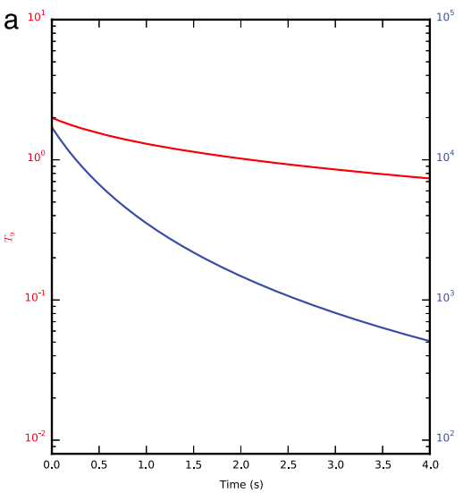
Nuclear post processing codes
A nuclear post processing code simulates nucleosynthesis based on temperature and density time evolution of the astrophysical system of interest using nuclear data
temperature and density time evolution
Sophie Abrahams
Mumpower + 2015 Physical Review C, Volume 92, Issue 3, id.035807
Nuclear Physics ECR workshop Edinburgh 16.01.25

Slide 5
Nuclear post processing codes
A nuclear post processing code simulates nucleosynthesis based on temperature and density time evolution of the astrophysical system of interest using nuclear data
nuclear post processing code
temperature and density time evolution
nuclear data from nuclear library
Sophie Abrahams
Mumpower + 2015 Physical Review C, Volume 92, Issue 3, id.035807
Nuclear Physics ECR workshop Edinburgh 16.01.25

Slide 6
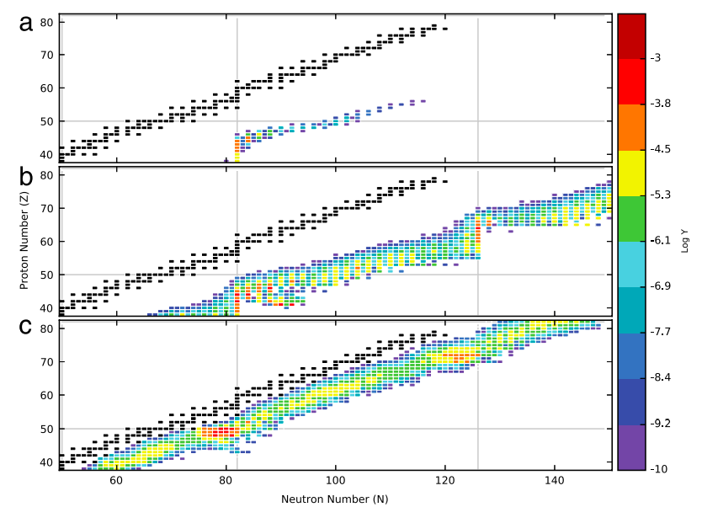
Nuclear post processing codes
A nuclear post processing code simulates nucleosynthesis based on temperature and density time evolution of the astrophysical system of interest using nuclear data
nucleosynthesis evolution over time
temperature and density time evolution
nuclear data from nuclear library
Sophie Abrahams
Mumpower + 2015 Physical Review C, Volume 92, Issue 3, id.035807
Nuclear Physics ECR workshop Edinburgh 16.01.25

Slide 7
Uses of nuclear post processing codes
Can be used to explore:
Isotope production in astrophysical scenarios
Observational light curves of astrophysical explosions (e.g. X-ray bursters)
Energy generation in astrophysical scenarios
Evolution of stars
Examples of nuclear post processing codes
Codes which incorporate nuclear post processing
TORCH
Sophie Abrahams
Nuclear Physics ECR workshop Edinburgh 16.01.25

Slide 8
Introducing Y_{i}(t)
Track time evolution of the abundance Y_{i}(t) of each isotope X_{i} in the network
Abundance: Y_{i}(t) = n_{i}(t)/ρN_{A} where n_{i}(t) is the number density of the isotope
Assume that ρ changes very slowly compared to Y_{i}(t)
Solves an ordinary differential equation over a set of points in time for each isotope
For each isotope:
J
Where each summation includes all reactions which produce and destroy isotope X_{i}
Number of isotopes tracked controlled by user
Network size can range from 13 isotopes (Timmes 1999 ApJss) to 5000 (Keegans + 2019 MNRAS)
Sophie Abrahams
Nuclear Physics ECR workshop Edinburgh 16.01.25
Hix et Thielemann 1999

Slide 9
Bring in the nuclear physics!
“Nuclear physics is the language of nucleosynthesis” - Matthew Mumpower
Examples of reactions with:
one reactant: alpha decay, beta decay, photodisintegration
two reactants: X_{i}(p,n), X_{i}(p,a), X_{i}(n,g), X_{i}(g,p)
three reactants: triple alpha reaction
Examples of nuclear data required for summation of reactions with:
one reactant: half life
two/three reactants: integrated cross section, nuclear mass
For theoretical reaction rate calculations: level density, alpha potential, isospin
Hix et Thielemann 1999
Sophie Abrahams
https://www.matthewmumpower.com/static/presentations/FRIB-1stexp/index.html#/nuclear-physics-inputs
Nuclear Physics ECR workshop Edinburgh 16.01.25

Slide 10
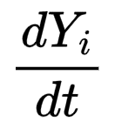
Solving
Many potential ways to solve for Y_{i}(t) but considerations:
Constrained here by the variation in timescales over which processes happen
Need the time evolution of Y_{i} to be broken into short intervals to account for changing temperature and density conditions
Common methods to solve for Y_{i}(t):
Backwards Euler method
Bader-Deuflhard method
Kaps-Rentrop method
Each method has advantages and disadvantages
Accuracy, efficiency and ease of implementation are all considerations
Sophie Abrahams
Hix et Thielemann 1999, Timmes 1999
Nuclear Physics ECR workshop Edinburgh 16.01.25

Slide 11
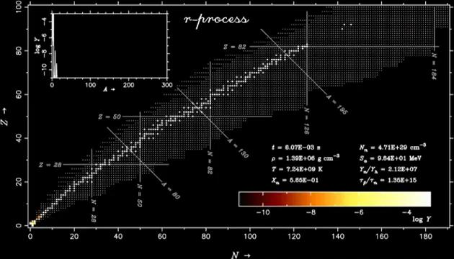
Output from solving
Wanajo + 2004 ApJl, Volume 606, Issue 2, pp. 1057-1069.
Time evolution of abundances of isotopes!
Depending on the code can also output:
Energy generation due to nucleosynthesis
Mass fractions (where sum of all mass fractions of all isotopes = 1)
Sophie Abrahams
Nuclear Physics ECR workshop Edinburgh 16.01.25

Slide 12
Nuclear Reaction Libraries
Many different nuclear reaction libraries, each nuclear post processing code uses a different combination
JINA reaclib - widely used, has a set “recommended rates”
ChANUREPS - allows for authors to upload their own rates
NACRE II - charged body reactions
STARLIB - calculates probability density for total reaction rate, helps with calculation of Y_{i}(t) (Iliadis + 2015 JoP G, Vol 42, 3)
ASTRAL - specialises in neutron capture rates
Each library has their own process for adding rates
Sophie Abrahams
Nuclear Physics ECR workshop Edinburgh 16.01.25

Slide 13
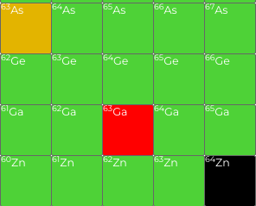
Adjusting the ⁶³Ga(p,g) reaction rate
Ongoing work for Sivi Uthayakumaar (FRIB)
Used JINA reaclib library
Potential competing (p,g) and (p,a) rates
Impact for how quickly material can move up the chart of nuclides to the p-nuclides
Decreased (p,g) rate by an order of magnitude
Goal: to observe impact on final abundances
Sophie Abrahams
Nuclear Physics ECR workshop Edinburgh 16.01.25

Slide 14
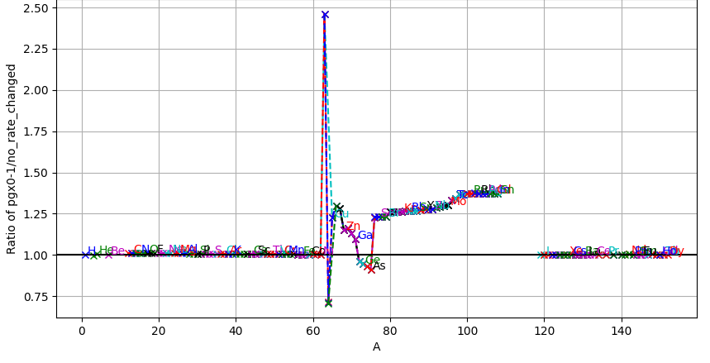
⁶³Ga(p,g) decreased by an order of magnitude
PRELIMINARY
Sophie Abrahams
Nuclear Physics ECR workshop Edinburgh 16.01.25

Slide 15
Summary
Nuclear post processing codes use nuclear reaction rate from nuclear reaction libraries and temperature and density information to solve for the time evolution for the abundance Y_{i} of X_{i}
There are multiple nuclear post processing codes
Can be used to understand energy generation, observational light curves, isotope production
There are multiple ways to solve for Y_{i}(t)
Each method has advantages and disadvantages
Nuclear inputs are vital for nuclear post processing codes
New data from the nuclear experimental community drives nuclear astrophysics
Sophie Abrahams
Nuclear Physics ECR workshop Edinburgh 16.01.25

Slide 16
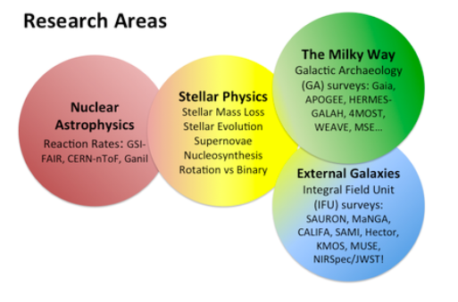
BRIDGCE-IReNA annual meeting - University of York 4th June - 6th June 2025
BRIdge the Disciplines related to the Galactic Chemical Evolution
Nuclear experimental folks strongly encouraged to attend
Master’s/PhD students encouraged to submit abstracts
Scan for more info
Sophie Abrahams
Nuclear Physics ECR workshop Edinburgh 16.01.25

Slide 17
Thank you to Andrés Yagüe López and Sam Jones Thank you for your attention!
Sophie Abrahams
Nuclear Physics ECR workshop Edinburgh 16.01.25

Slide 18
References
Hix et Thielemann 1999, J. Comput. Appl. Math., Vol. 109, No. 1 - 2, p. 321 - 351 https://ui.adsabs.harvard.edu/abs/1999JCoAM.109..321H/abstract
Mumpower + 2015, Physical Review C, Volume 92, Issue 3, id.035807 https://ui.adsabs.harvard.edu/abs/2015PhRvC..92c5807M/abstract
Timmes 1999 ApJss Volume 124, Issue 1 https://ui.adsabs.harvard.edu/abs/1999ApJS..124..241T/abstract
Keegans + 2019, MNRAS, vol 485, Issue 1 https://ui.adsabs.harvard.edu/abs/2019MNRAS.485..620K/abstract
Iliadis + 2015, Journal of Physics G, Vol 42, 3 https://ui.adsabs.harvard.edu/abs/2015JPhG...42c4007I/abstract
Sophie Abrahams
Nuclear Physics ECR workshop Edinburgh 16.01.25

Slide 19
Goal of talk
Sophie Abrahams
Nuclear Physics ECR workshop Edinburgh 16.01.25

