Slide 2
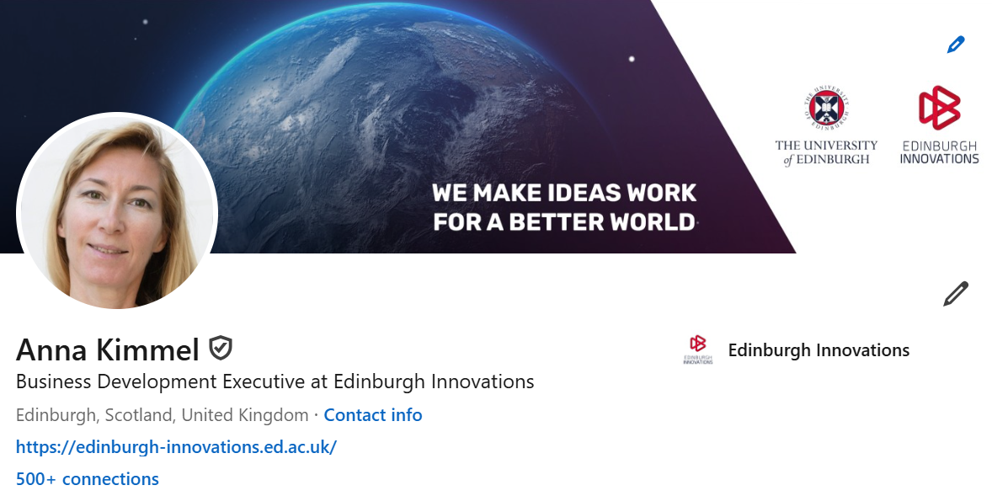

Slide 3
The foundation of the AIMday concept is to match questions from businesses and organisations with relevant research competence.
An AIMday consists of several one-hour workshops where exchange of knowledge on these challenges and problems takes place.
Companies
Academics
Up to three questions per company can be registered to meet experts from the University of Edinburgh.
After company registration has concluded, researchers and academics can review the list if questions and will be able to register to participate in AIMday.
https://aimday.se/digital-frontiers-edinburgh-2025/aimday-concept/

Slide 4
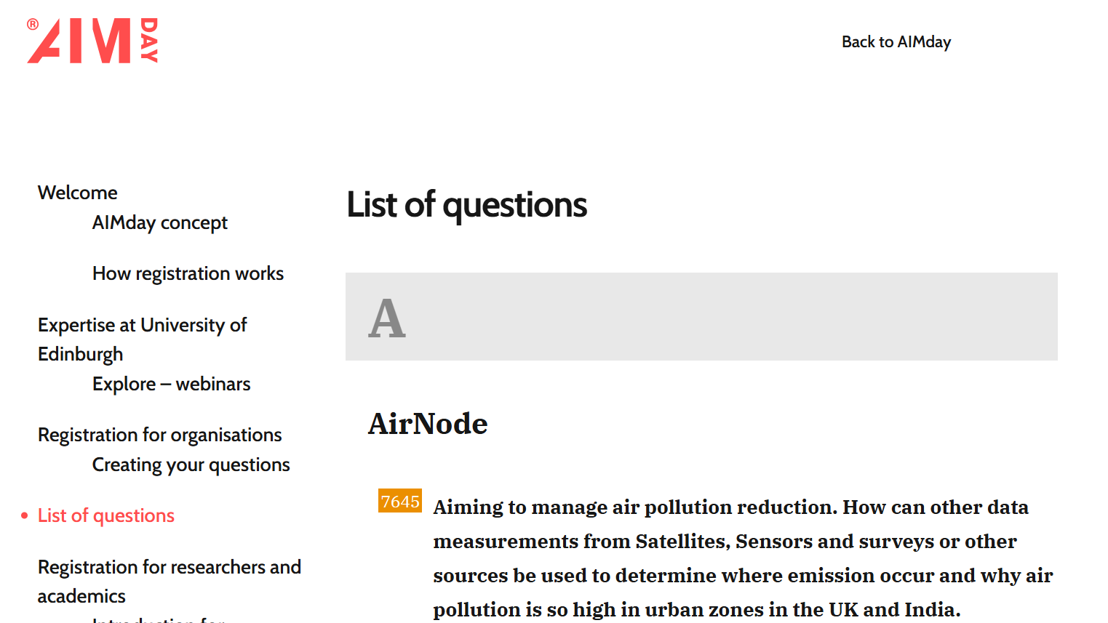
https://aimday.se/digital-frontiers-edinburgh-2025/questions-listing/
How can AI be used to enhance fraud detection systems in industries with complex regulatory environments, such as finance and transportation?
To conserve energy (and perhaps also improve robustness) of machine learning models, we would like to move from single, trillion parameter, models to systems of smaller models distributed on networks - what optimisation methods might be applied to this process (independently of specific infrastructure)?
Non-determinism in Compiler Optimization with LLM. How to design a workflow based on an LLM to ensure that the same input generates the same top-N results for all code optimization tasks.
We would like to know what areas of AI would help us to build more accurate workflow predictions, and how to use AI to monitor current trends to help alert resource planners of issues with resourcing before they become critical and create blockages.

Slide 5
Join us at AIMday® taking place in Edinburgh on 26 February 2025 to meet with participating professionals and discuss an unprecedented range of questions covering topic areas such as:
AI and machine learning
Data science
Internet of Things
Data and sustainability
Digital health
Cybersecurity
Synthetic data
Digital communications
Interested? Register by 7 February 2025.
https://aimday.se/digital-frontiers-edinburgh-2025/registration-for-researchers/
Anna.Kimmel@ei.ed.ac.uk

Slide 6
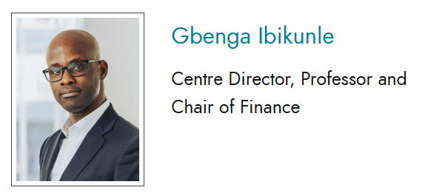
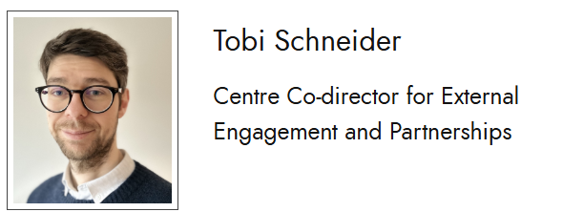
ECFI
https://www.ecfi.business-school.ed.ac.uk/
BDE for FinTech sector

