Slide 1
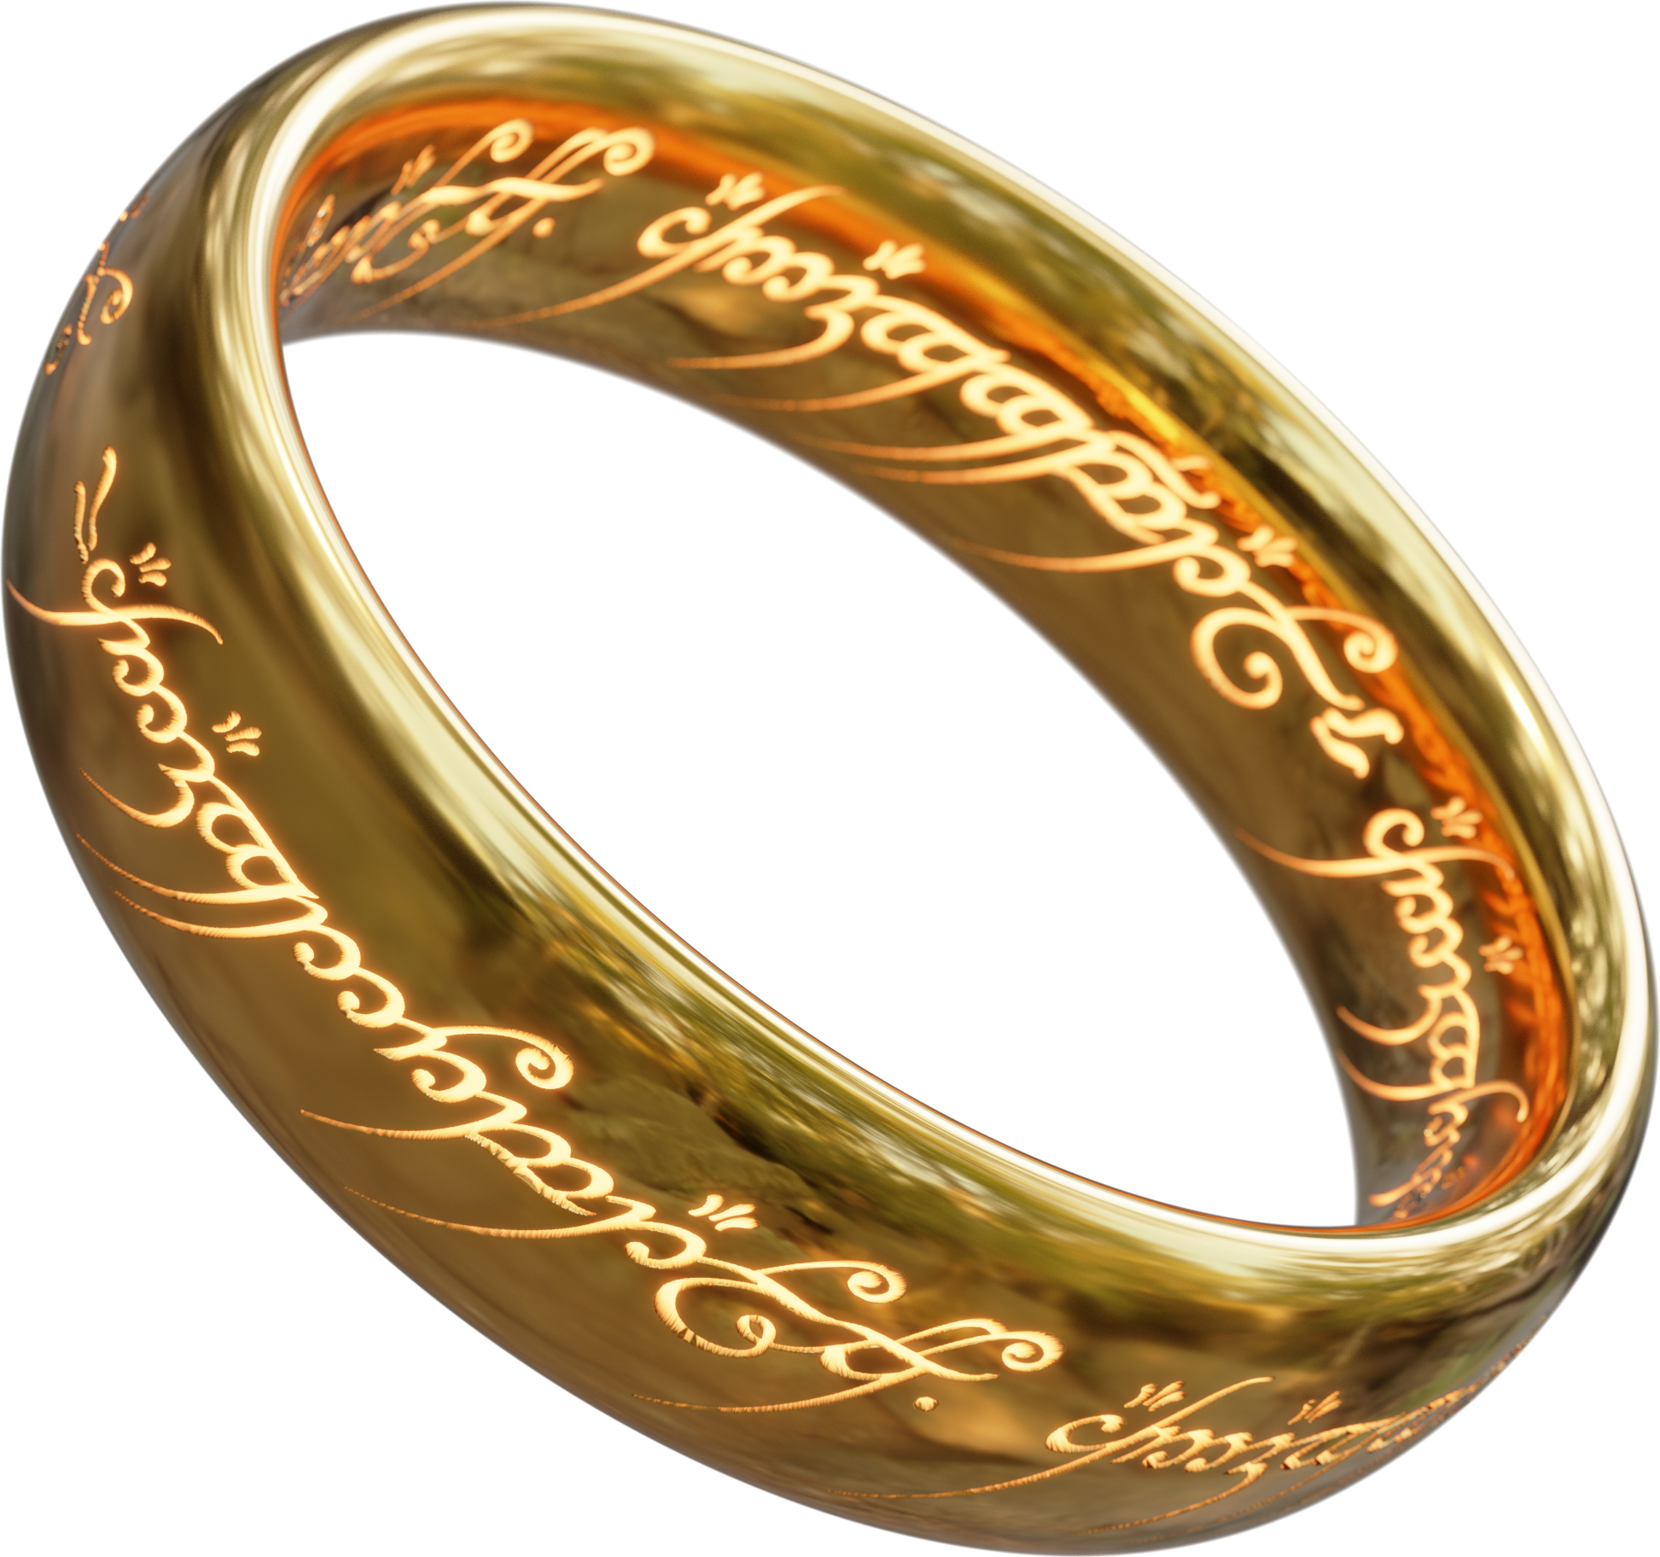

Slide 2
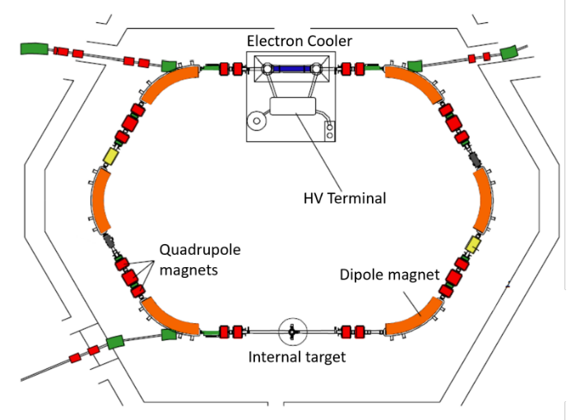
Heavy ion storage rings
Storage rings are devices which can store ions for long periods of time
They are made up of straight sections separated by dipole magnets which steer ions around the ring
Ultra/Extreme high vacuum required to store ions (10⁻¹¹/10⁻¹² mbar)

Slide 3
Rings of men
ESR
R3
CSRe

Slide 4
What can we do with them?

Slide 5
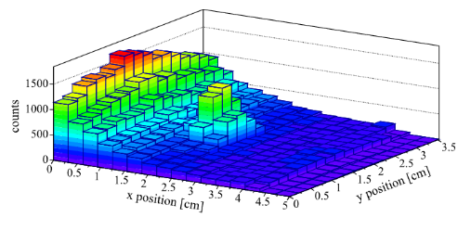
Nuclear Reactions in rings
We can also use rings to study nuclear reactions for astrophysics
This involves storing our ion beam in the ring and then interacting it with a gas target
We can study direct reactions or use indirect methods to study nuclear properties of interest

Slide 6
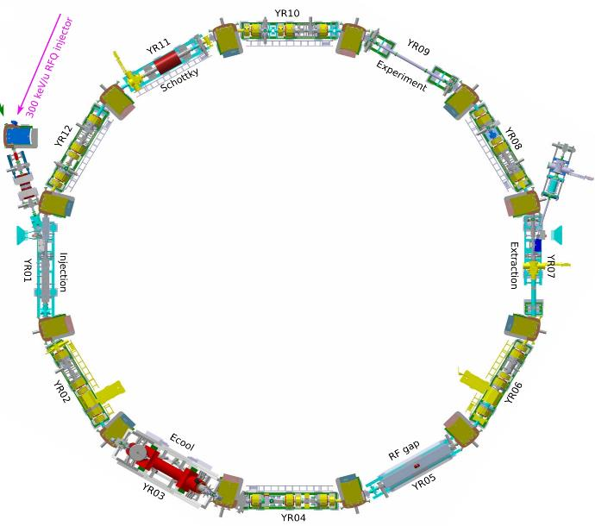
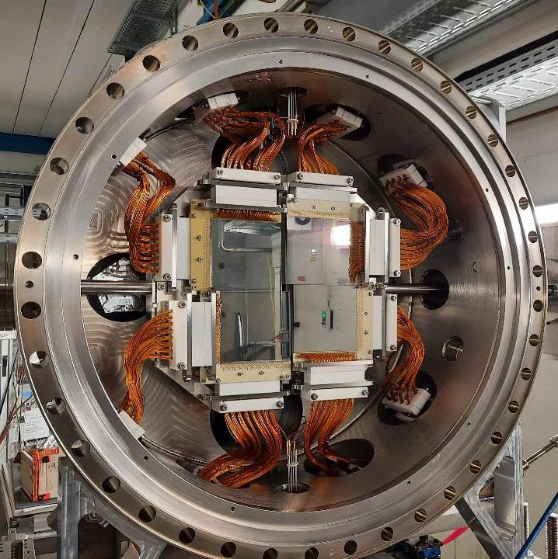
CRYRING: the one ring to rule them all
CARME
Moving detectors!
Beam
In
Ions revolve 10⁶ Hz

