Slide 1
a minimal cosmology with Latham Boyle
and
Maegan Andersen, Sam Bateman, Franz Herzog, Pablo Morande,
Kostas Tsanavaris, and Vatsalya Vaibhav

Slide 2
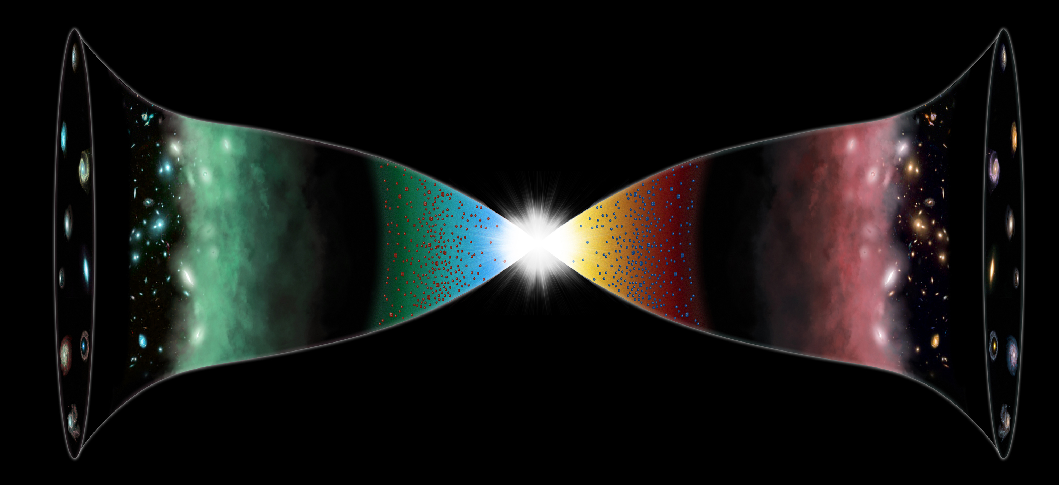


hypothesis: the universe is CPT symmetric
consistent with the maximal analytic extension of hot big bang cosmology
Boyle, Finn, NT (2018)
radiation epoch
de Sitter boundary
$$a(t)∝\frac{1}{t_{∗}−t}$$
simple pole
$$a(t)∝t$$
simple zero

Slide 3
Boyle & NT Phys. Lett. B849 (2024) 138442; Phys. Lett. B849 (2024) 138443
We calculated the gravitational entropy S_{g} , i.e., Log N_{states}. It favours
homogeneous, isotropic, spatially flat universes
a small, positive cosmological constant
Stat mech requires state counting, not equilibrium or ergodicity.
Inflation is not required.

Slide 4
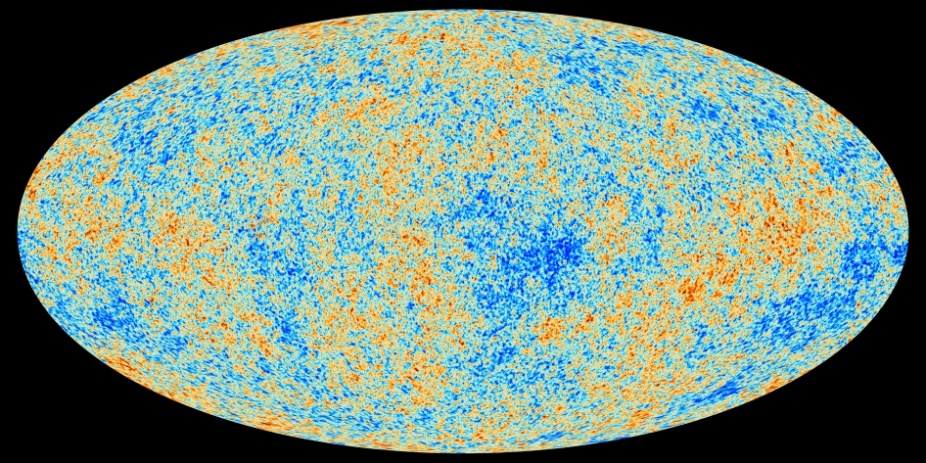
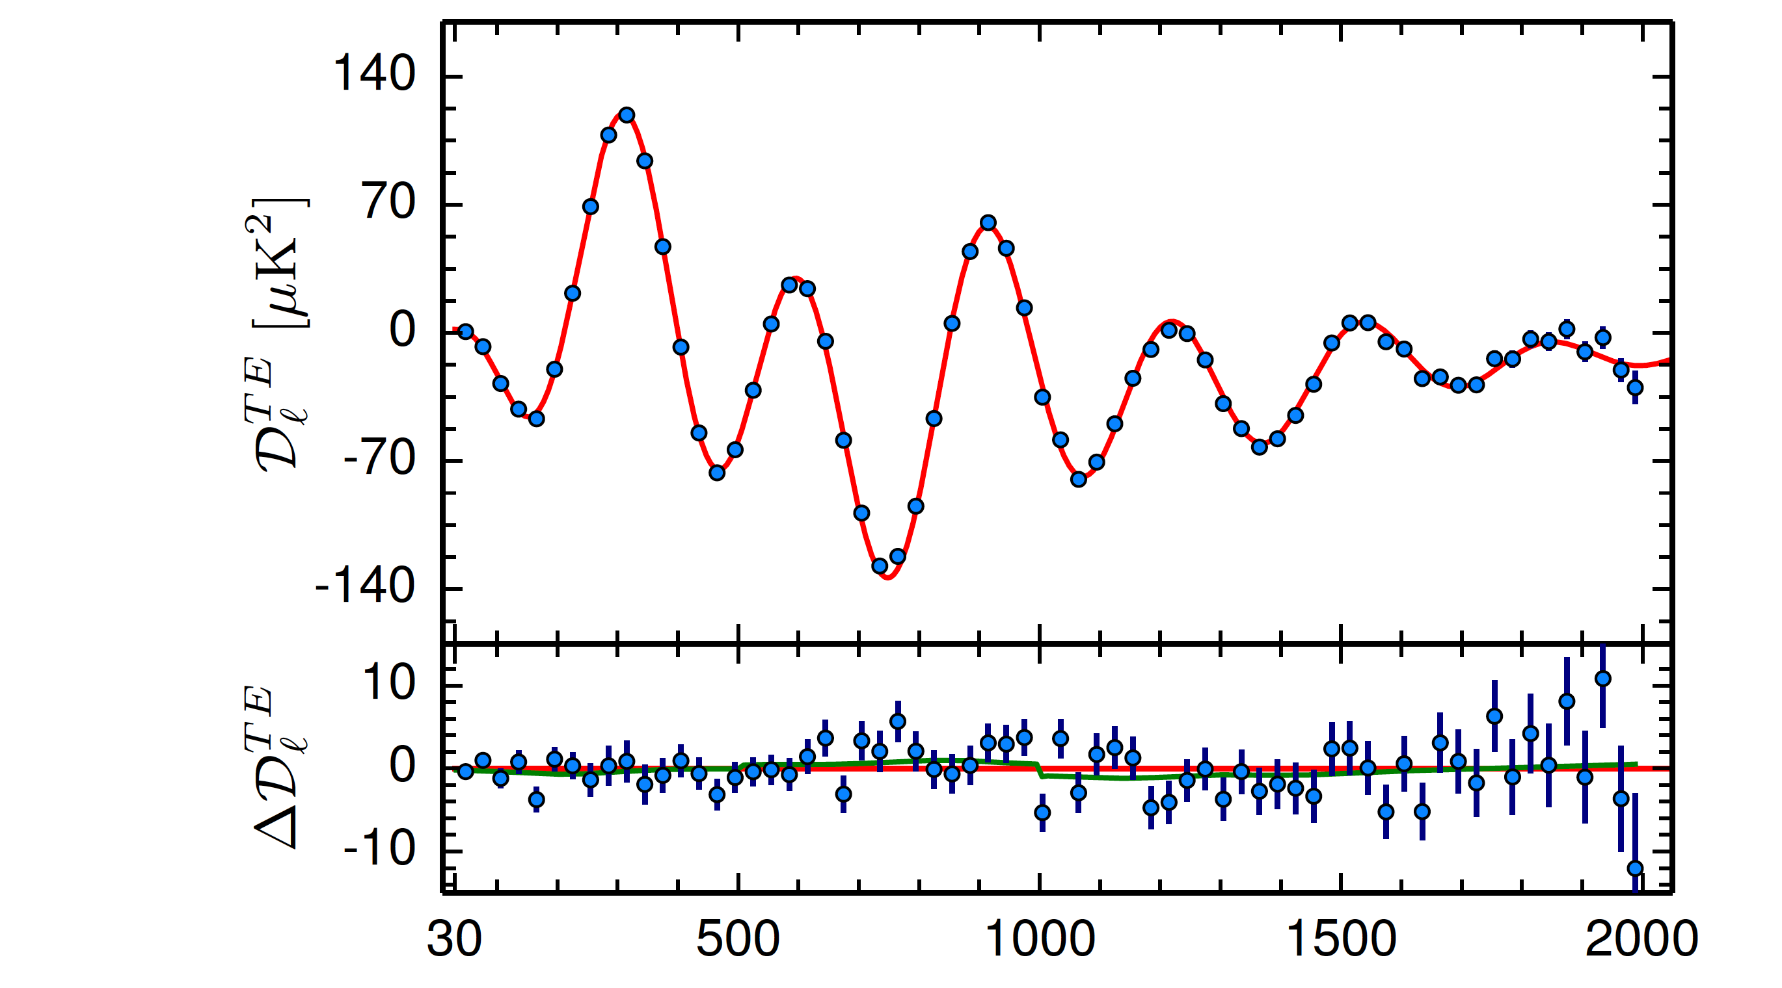
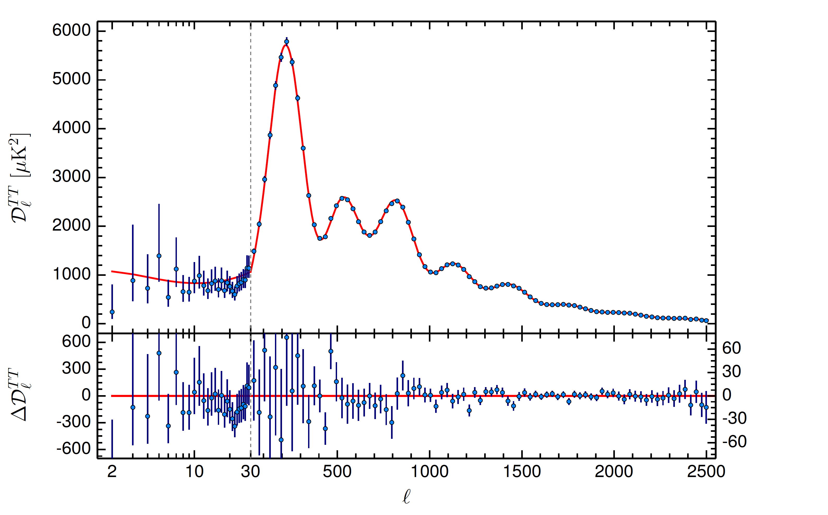


whence the inhomogeneity?
Polarization
Coulson
Crittenden
NT (1994)
no free parameters!
Temperature
$$l$$
ESA Planck satellite

Slide 5


dimension zero scalars
The primordial perturbations provide a direct image of the initial conditions
What kind of field has this distribution in its vacuum?
A four-derivative, scale-invariant action:
$S=−\frac{1}{2}\int{d^{4}x\left( ( φ\right)2}+..)⟹\left\langle φ\left(0,x\right)φ\left(0,y\right)\right\rangle =\int{\frac{d^{3}k}{{(2 π)}^{3}}} \frac{e^{ik.(x−y)}}{4 k^{3}}$
Also:
cancel gravitational anomalies (explains why there are 3 generations)
provide an emergent Higgs (asymptotically free -> solves the hierarchy puzzle)
$\left\langle φ\left(0,x\right)φ\left(0,y\right)\right\rangle =\int{\frac{d^{3}k}{{(2 π)}^{3}}}$ $\frac{e^{ik.(x−y)}}{4 k^{3}}$

Slide 6
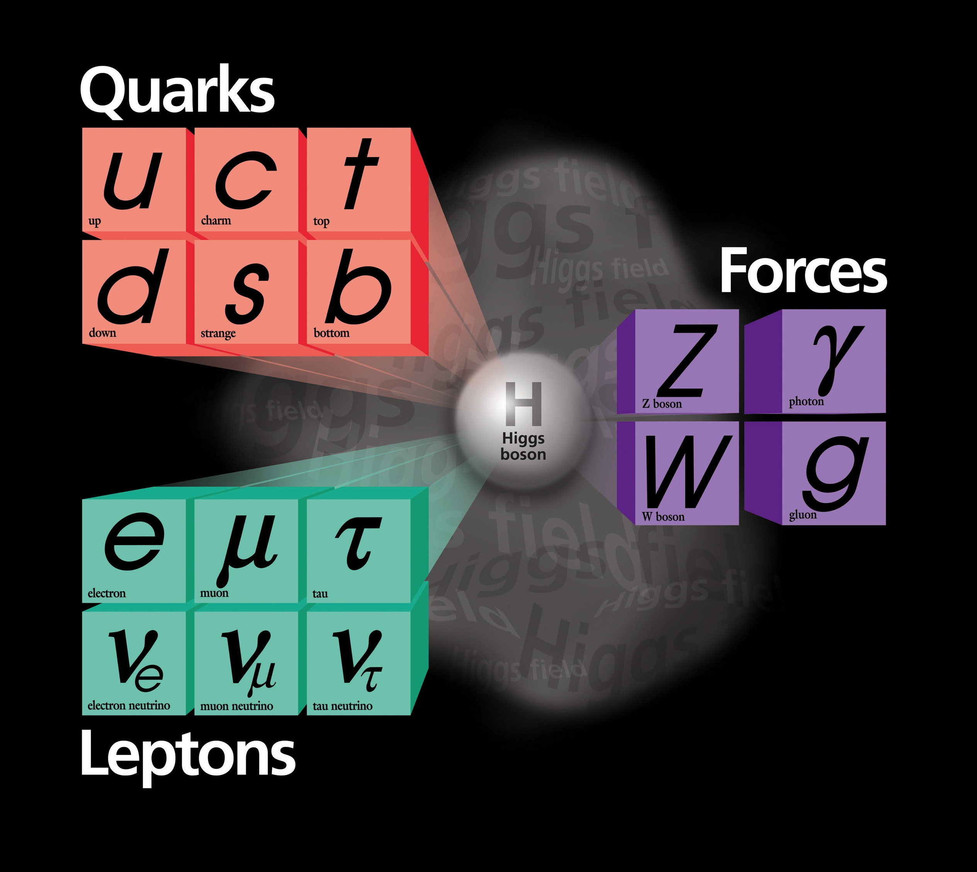
Generations 1 2 3
Gravity
SU3xSU2xU1
L
L
L
Minimal Dark Matter and the Standard Model

Slide 7
Generations 1 2 3
Gravity
SU3xSU2xU1
Minimal Dark Matter and the Standard Model

Slide 8
We are attempting to build a new,
simple and predictive unified theory,
connecting the smallest and largest
observable scales in the universe.
Planck time

Slide 9
thank you for listening!

Slide 10


dim zero fields can cancel gravitational anomalies
L. Boyle+NT
number of
dim one scalars
2. Conformal anomaly (Euler) $∝n_{s,1}+\frac{11}{2} n_{F}+62 n_{A}−28{ n}_{s,0}$
3. Conformal anomaly (Weyl²) $∝n_{s,1}+3 n_{F}+12{ n}_{A}−8 n_{s,0}$
chiral fermions
gauge bosons
dim zero scalars
1. Vacuum energy $∝n_{s,1}−2n_{F} +2n_{A } + 2n_{s,0}$
1) All three vanish iff $n_{s,1}=0⟹$the Higgs must be composite*
2) Any two equations give $n_{F}=\text{4}n_{A}$ and $n_{s,0}{=3n}_{A}$
3) For SM $SU3×SU2×U1,n_{A}=12⟹n_{F} \text{=48},$
i.e., 3 fermion generations each with a RH $ν$
* Dim zero scalars are asymptotically free: may explain the gauge/gravity hierarchy

