Slide 1
Dynamical generation of 4d space-time in nonperturbative superstring theory
Jun Nishimura (KEK & SOKENDAI)
Workshop on “Numerical approaches to holography,
quantum gravity and cosmology”
Higgs Centre for Theoretical Physics,
Edinburgh, UK, May 21-24, 2018
Ref.) Nagata-J.N.-Shimasaki, PRD 94 (2016) no.11, 114515 [arXiv:1606.07627 [hep-lat]]
Ito-J.N., JHEP 12 (2016) 009 [arXiv:1609.04501 [hep-lat]]
Anagnostopoulos-Azuma-Ito-J.N.-Papadoudis, JHEP 02 (2018) 151 [arXiv:1712.07562[hep-lat]]

Slide 2
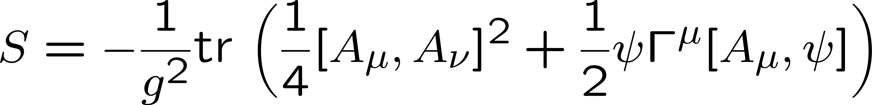
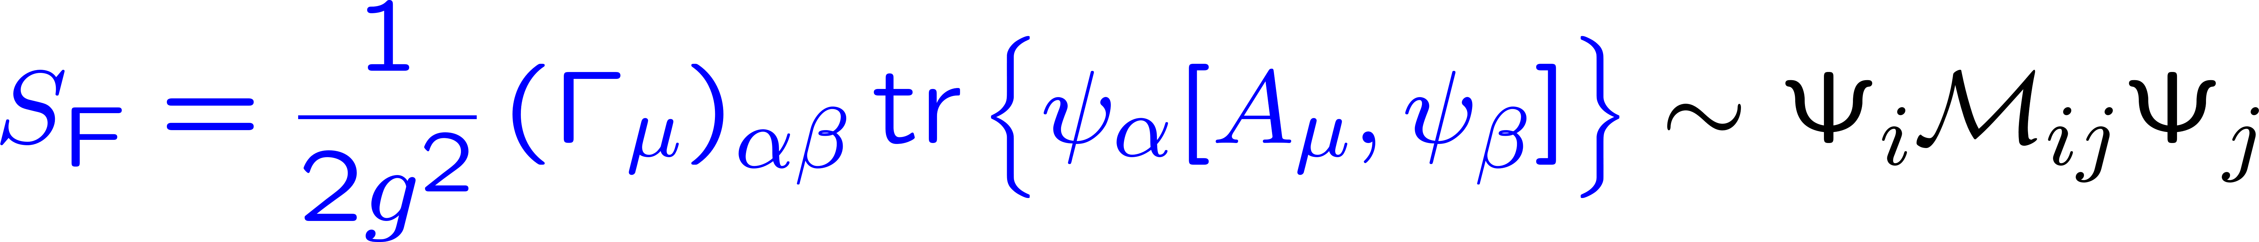
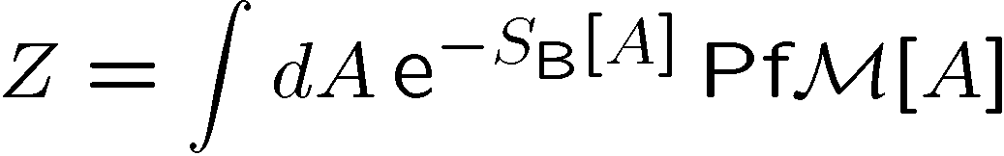

IKKT matrix model
Ishibashi-Kawai-Kitazawa-Tsuchiya 1997
a nonperturbative formulation of superstring theory
Here we consider the Euclidean version.
c.f.) Lorentzian version
Kim-JN-Tsuchiya PRL108 (2012) 011601
SSB of SO(10) → SO(4) speculated to occur
complex in general
The phase of the Pfaffian is expected to
play a crucial role in the speculated SSB.

Slide 3
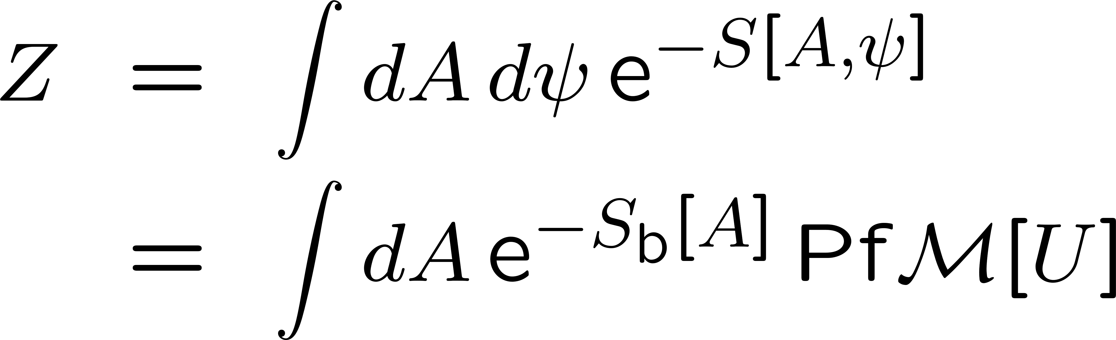
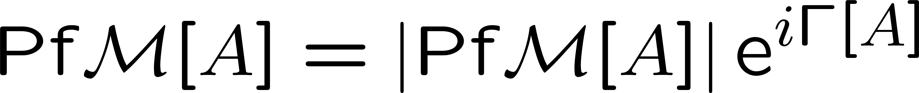
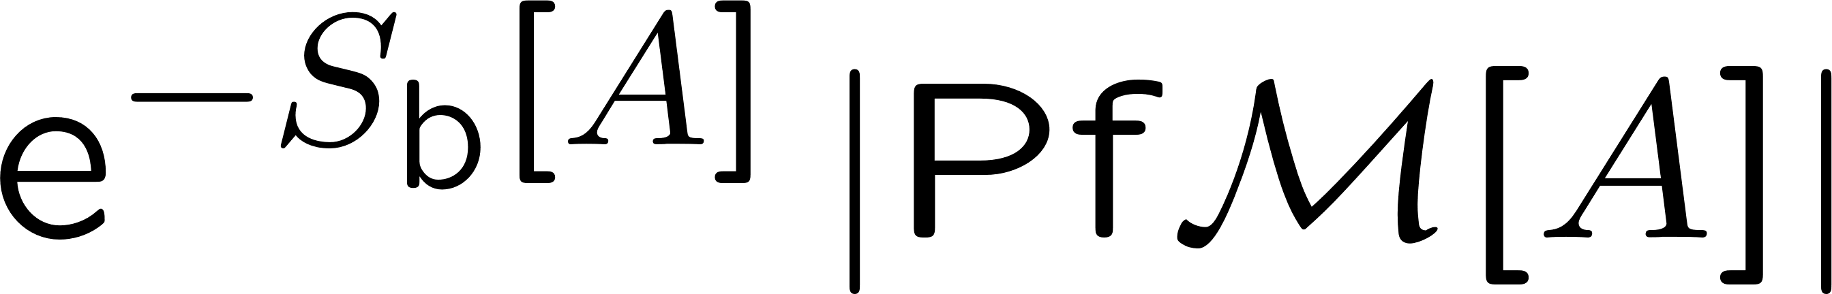
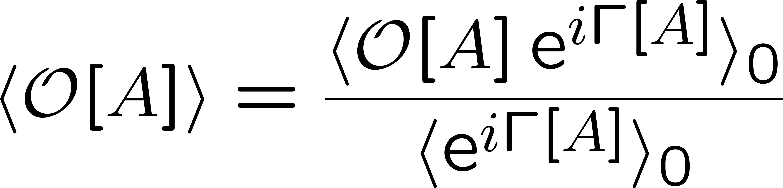

The sign problem in Monte Carlo methods
The Pfaffian is complex in general.
Generate configurations A with the probability
and calculate
(reweighting)
become exponentially small as the volume increases
due to violent fluctuations of the phase
Number of configurations needed to evaluate <O> increases exponentially.
“sign problem”

Slide 4
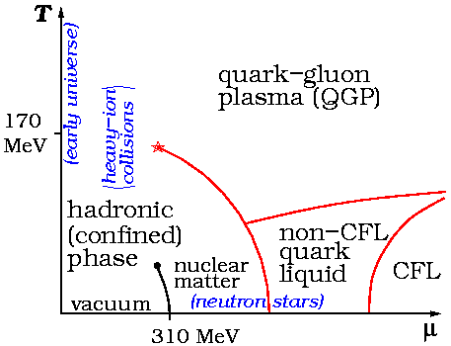
The sign problem occurs also in simulating, e.g., finite density QCD
temperature
chemical potential
for the baryon
number density
First principle calculations are difficult due to the sign problem

Slide 5
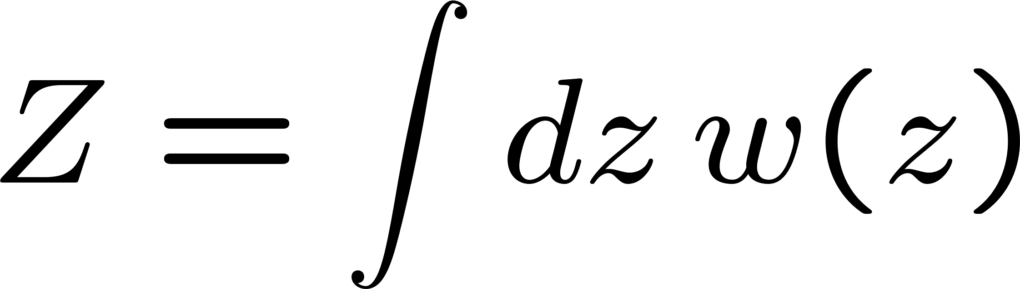
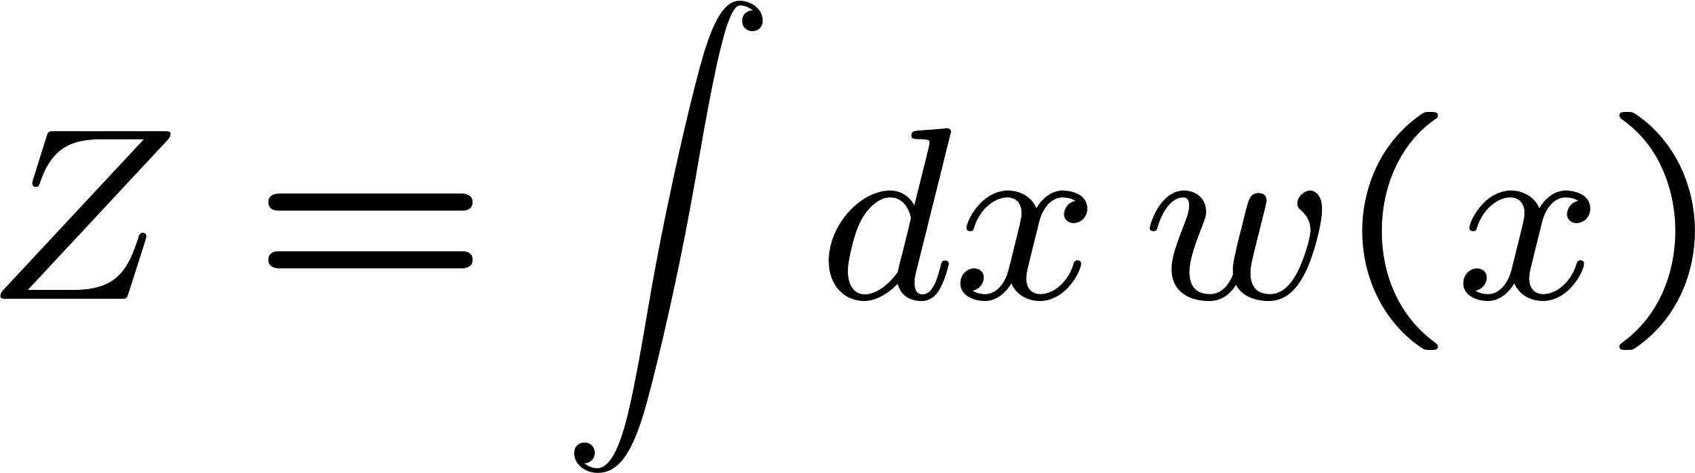
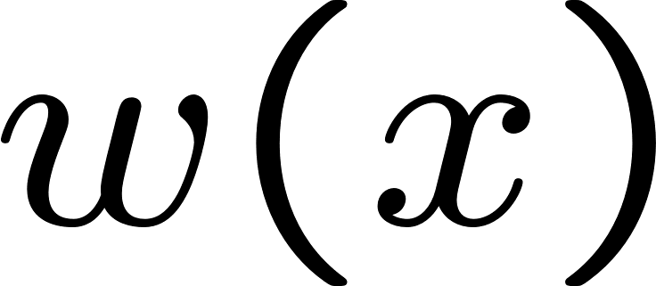
A new development toward solution to the sign problem
2011～
Key : complexification of dynamical variables
The original path integral
Minimize the sign problem by
deforming the integration contour
“Lefschetz thimble approach”
This talk
An equivalent stochastic process
of the complexified variables
(no sign problem !)
The phase of
oscillates violently
(sign problem)
“complex Langevin method”
The equivalence to the original path integral
holds under certain conditions.

Slide 6
Plan of the talk
Complex Langevin method
Argument for justification and
the condition for correct convergence
Application to the IKKT matrix model of superstring theory
Summary and future prospects

Slide 7
1．Complex Langevin method

Slide 8

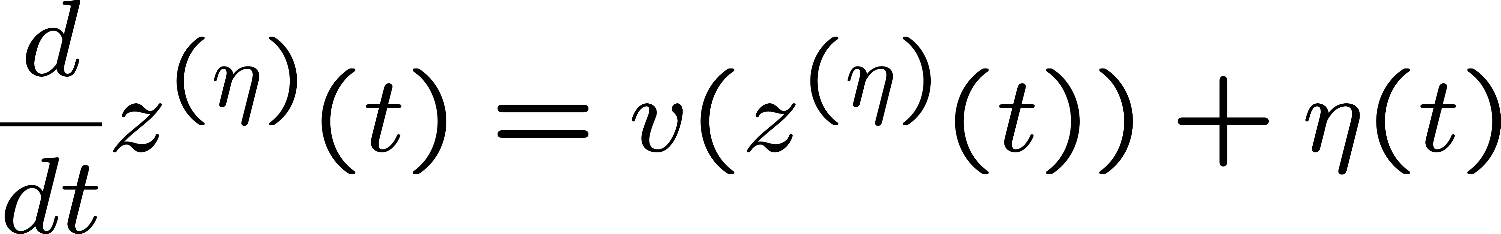
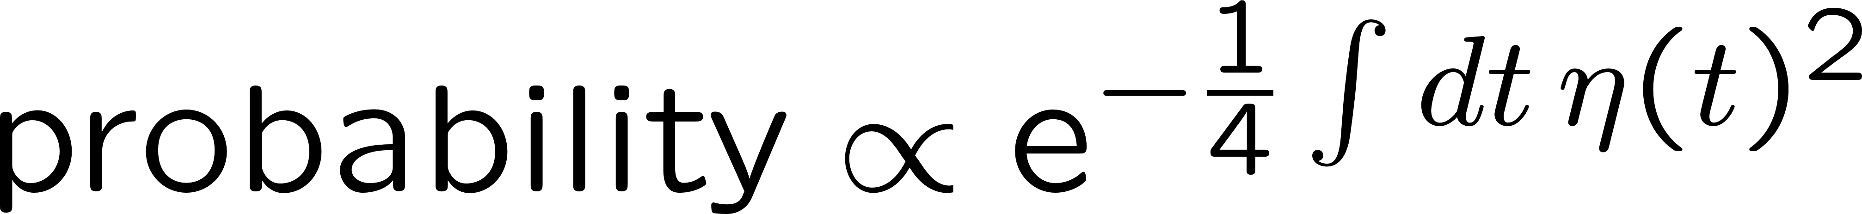
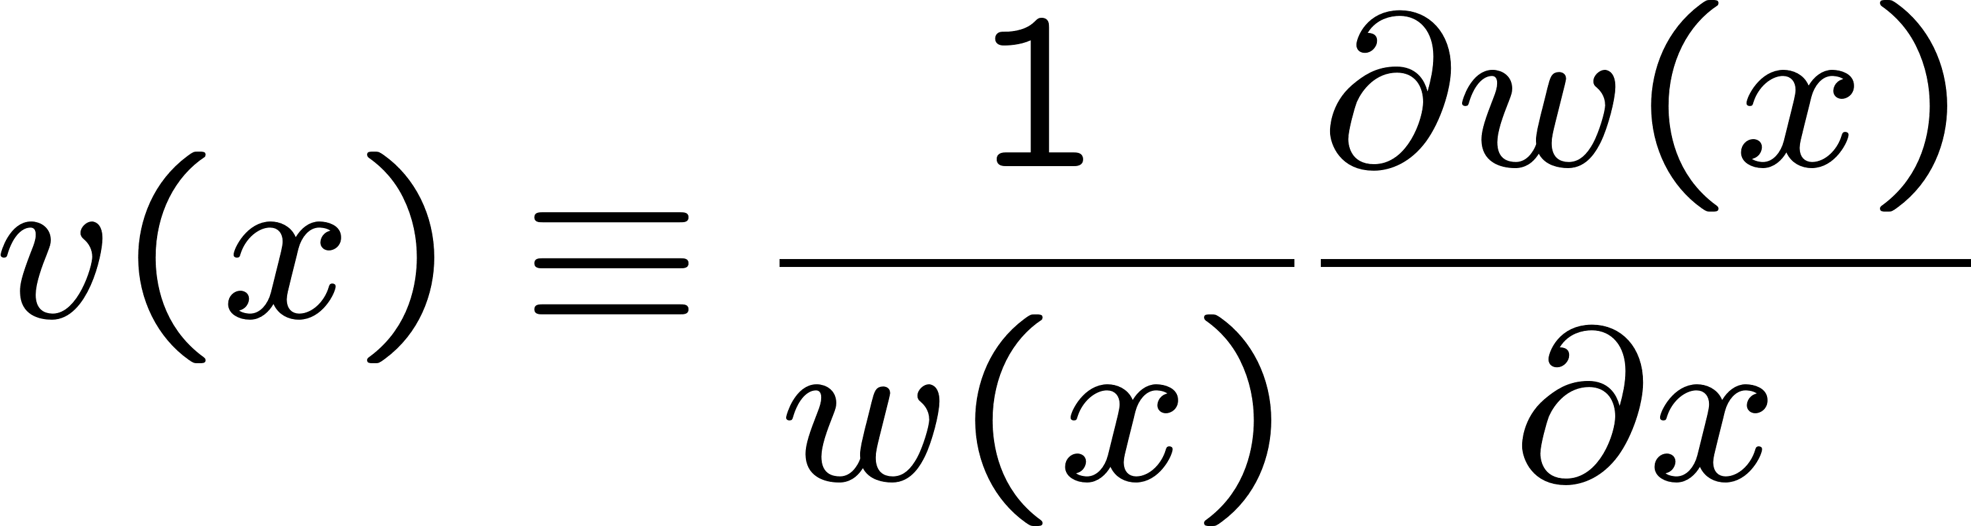
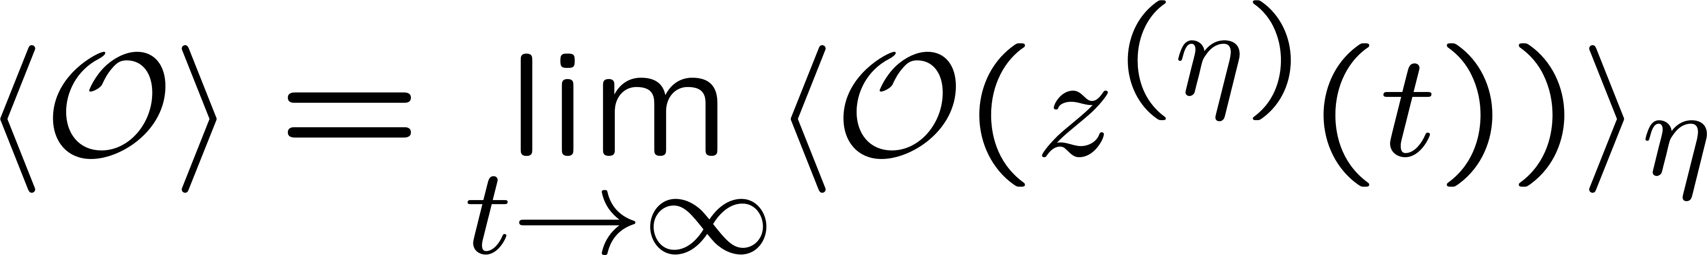
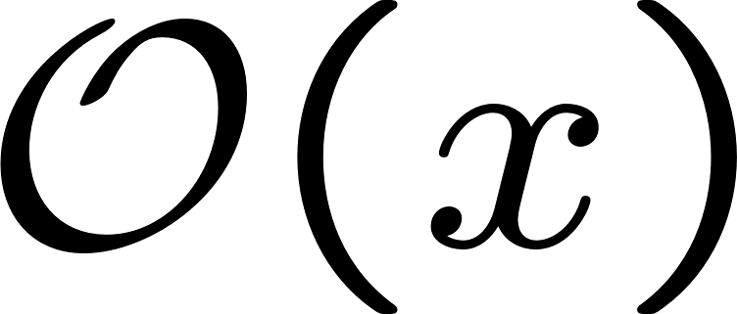
The complex Langevin method
Parisi (’83), Klauder (’83)
complex
Complexify the dynamical variables, and consider their
(fictitious) time evolution :
defined by the complex Langevin equation
Gaussian noise
?
Rem 1 : When w(x) is real positive, it reduces to one of the usual MC methods.
Rem 2 : The drift term and the observables
should be evaluated for complexified variables by analytic continuation.

Slide 9
2. Argument for justification and the condition for correct convergence
Ref.) Nagata-J.N.-Shimasaki,
Phys.Rev. D94 (2016) no.11, 114515 [arXiv:1606.07627 [hep-lat]]

Slide 10

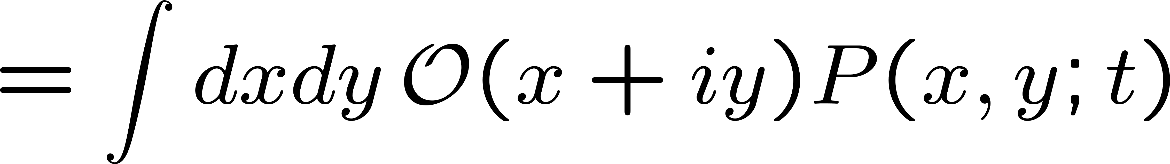
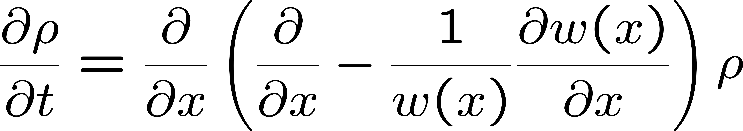
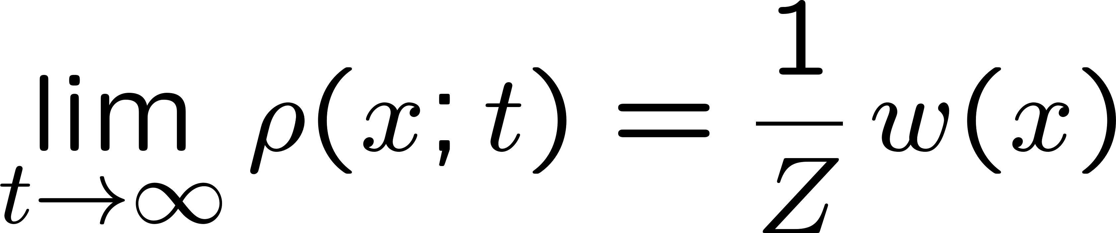
The key identity for justification
?
?
・・・・・・(#)
Fokker-Planck eq.
This is OK provided that eq.(#) holds.
c.f.) J.N.-Shimasaki, PRD 92 (2015) 1, 011501 [arXiv:1504.08359 [hep-lat]]

Slide 11
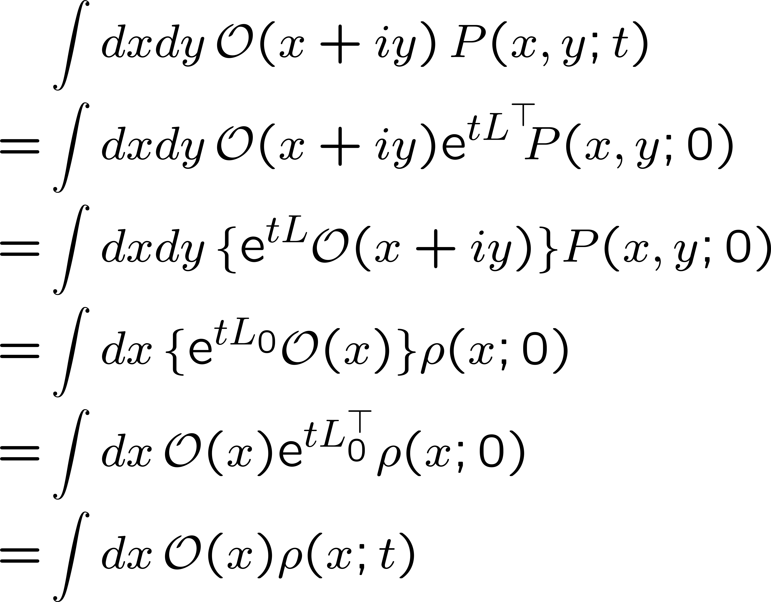
Previous argument for the key identity
Aarts, James, Seiler, Stamatescu:
Eur. Phys. J. C (’11) 71, 1756
There are 2 subtle points in this argument !
Subtlety 1
The integration by parts used here cannot be always justified.
e.g.) when P(x,y;t) does not fall off fast enough at large y.
It was implicitly assumed that
this expression is well-defined for infinite t.
Subtlety 2

Slide 12
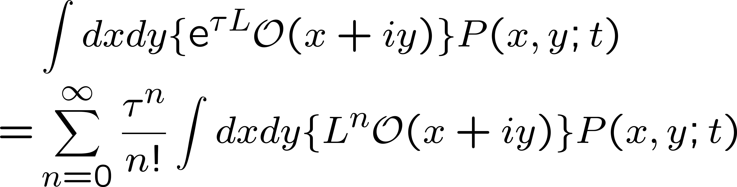
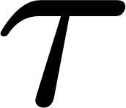
The condition for the time-evolved observables to be well-defined
Nagata-J.N.-Shimasaki, Phys.Rev. D94 (2016) no.11, 114515 [arXiv: 1606.07627 [hep-lat]]
In order for this expression to be valid for finite ,
the infinite series should have a finite convergence radius.
This requires that the probability of the drift term should be suppressed exponentially at large magnitude.
This is slightly stronger than the condition for justifying the integration by parts;
hence it gives a necessary and sufficient condition.

Slide 13
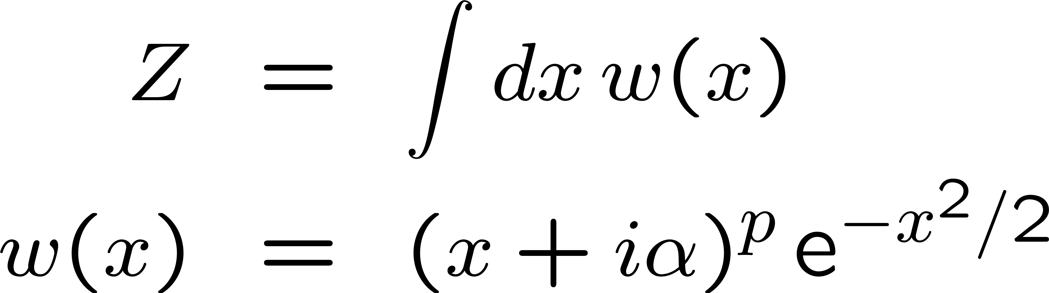

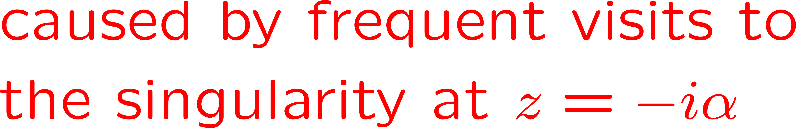
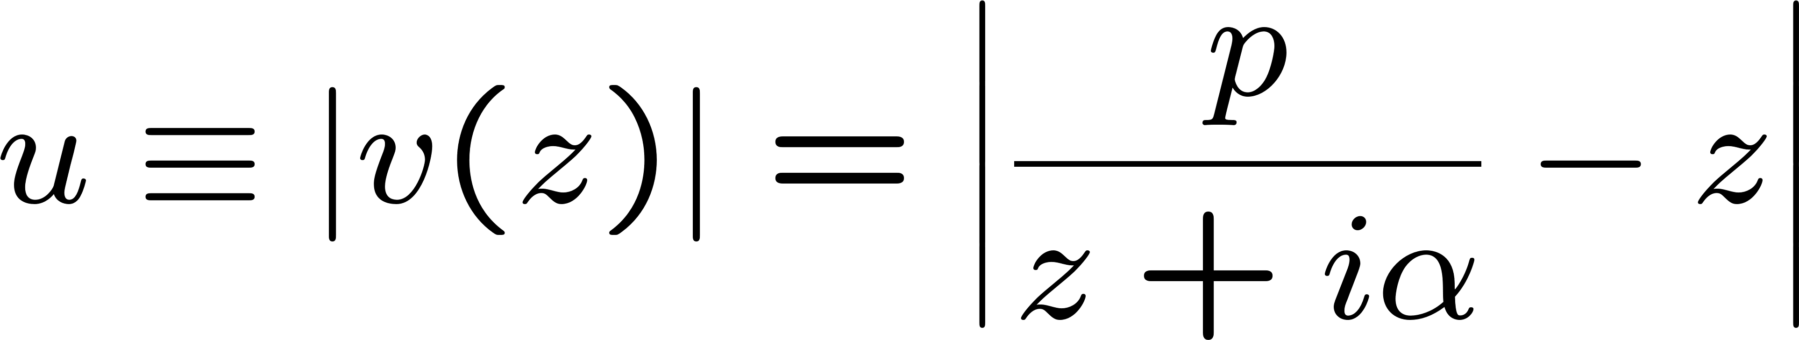
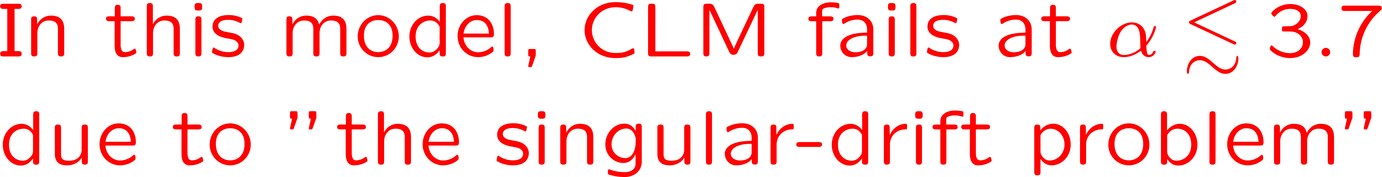
Demonstration of our condition
semi-log plot
log-log plot
power-law fall off
The probability distribution of the magnitude of the drift term

Slide 14
3. Application to the IKKT matrix model of superstring theory

Slide 15






Models with similar properties
(SSB of SO(D) expected due to complex fermion det.)
10d IKKT model
6d IKKT model
4d toy model (non SUSY)
J.N. (’01)

Slide 16
3.1 Application to a toy model with SSB due to complex fermion determinant
Ito-J.N.: JHEP 12 (2016) 009 [arXiv:1609.04501 [hep-lat]]

Slide 17
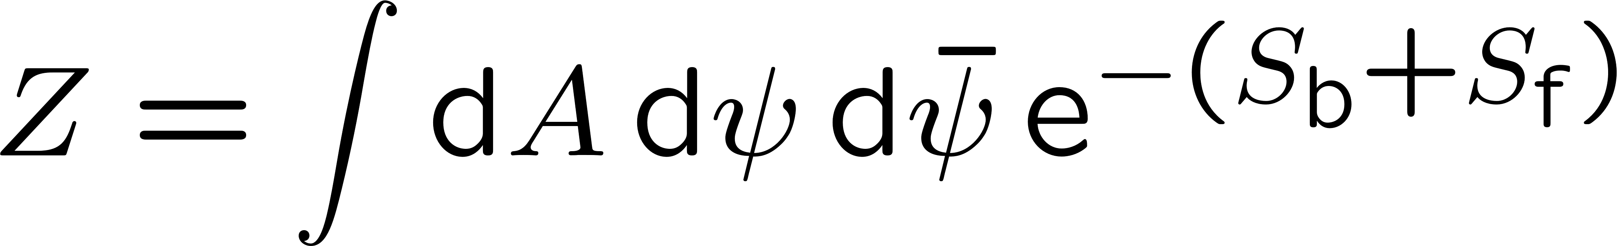
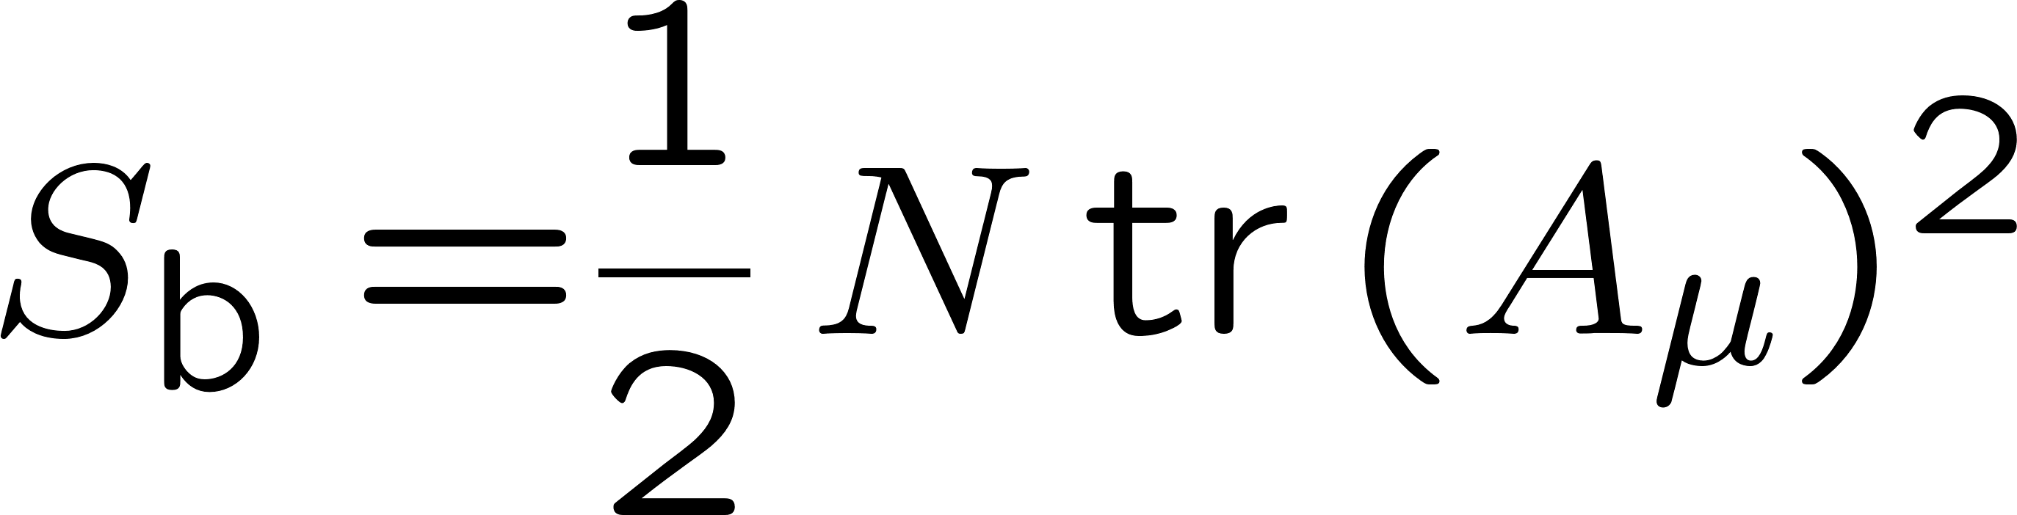

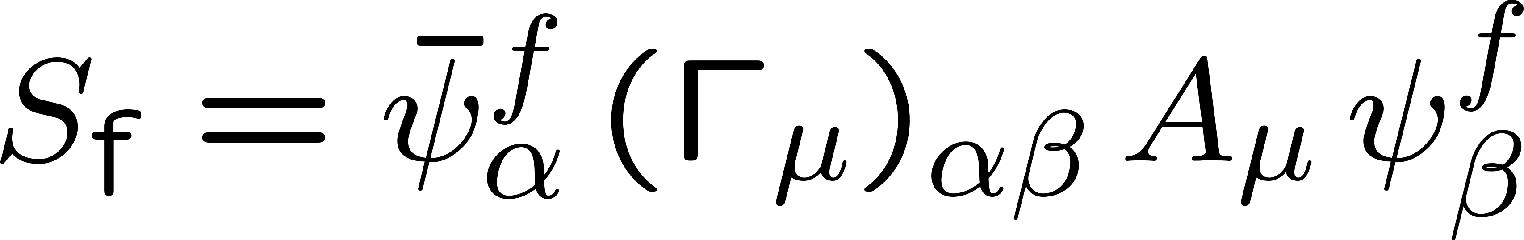
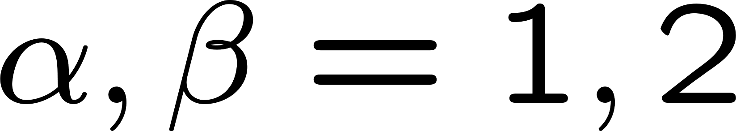
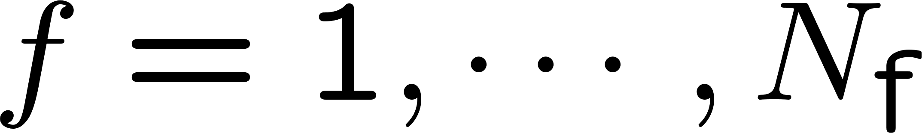
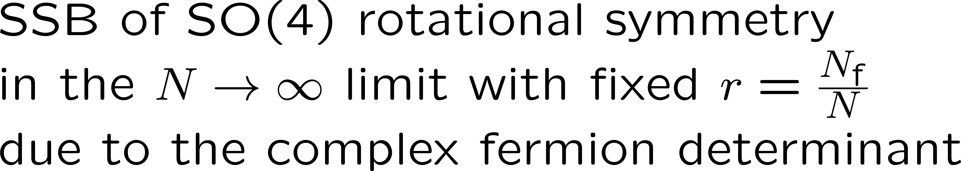
a simplified IKKT-type matrix model
J.N. PRD 65, 105012 (2002), hep-th/0108070

Slide 18
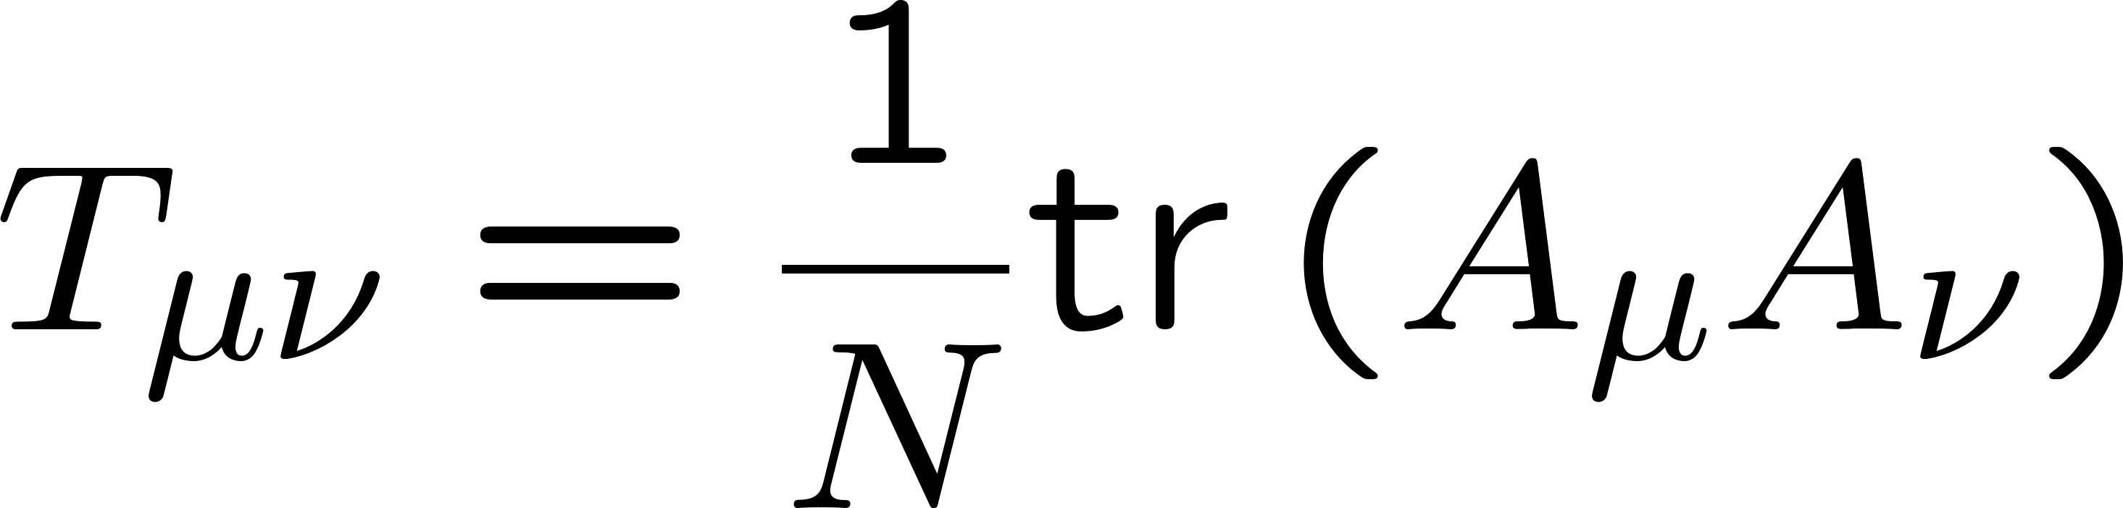
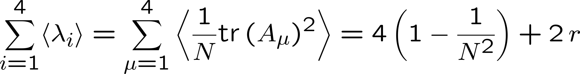
order parameters of the SSB of SO(4) symmetry
SSB of SO(4) symmetry
Note :
for the phase-quenched model

Slide 19
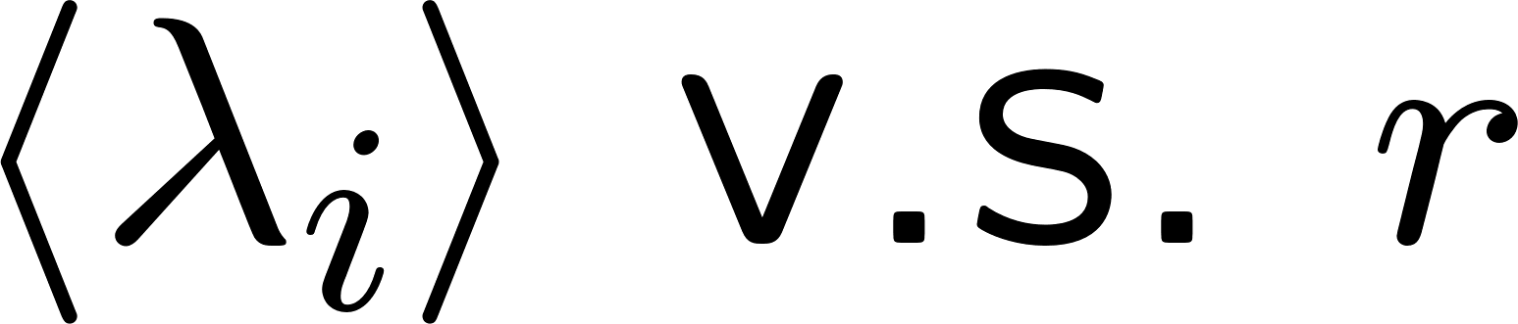
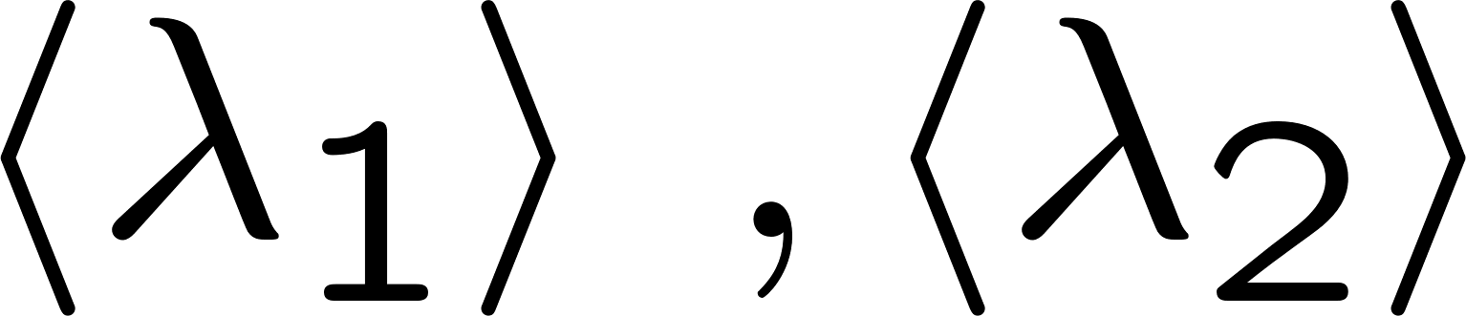
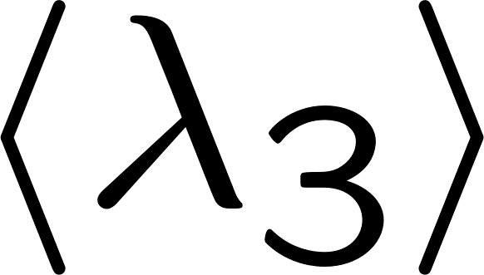
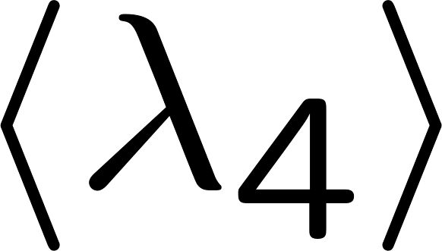
Results of the Gaussian expansion method
J.N., Okubo, Sugino: JHEP 10 (2002) 043 [hep-th/0205253]

Slide 20
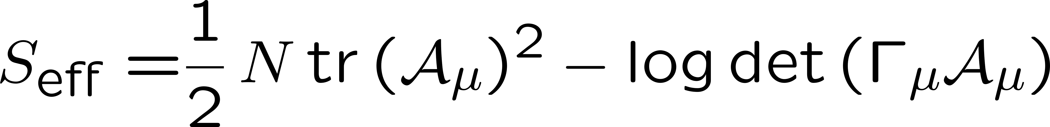
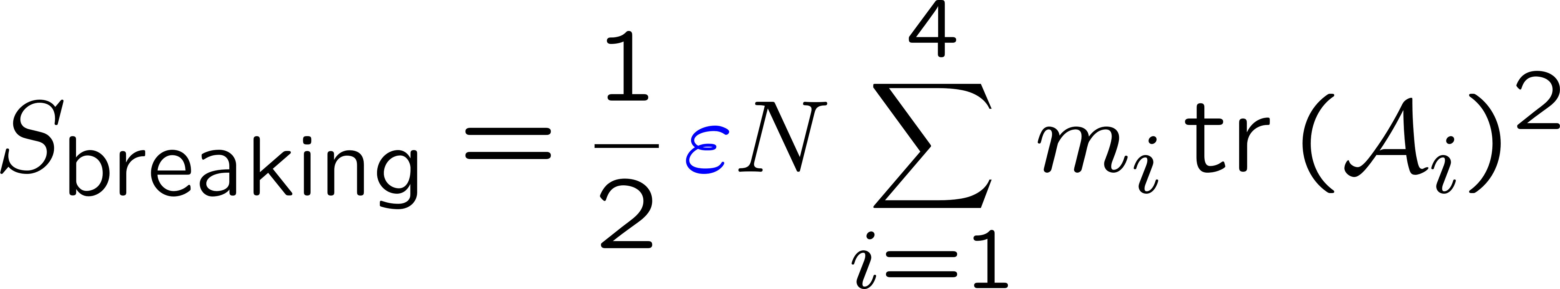
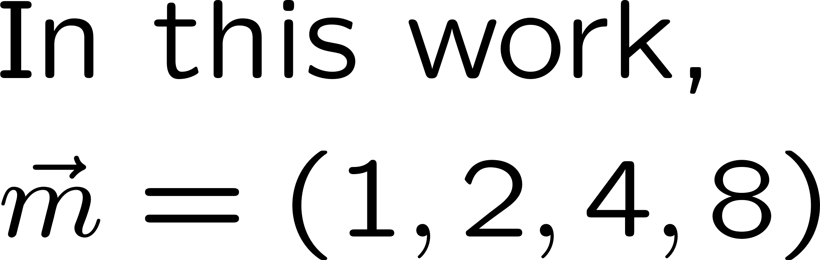
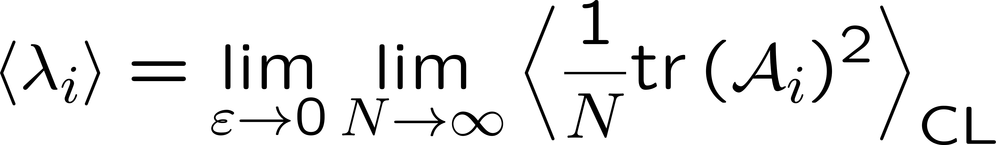
Application of the complex Langevin method
Ito-J.N., JHEP 12 (2016) 009
In order to investigate the SSB, we introduce
an infinitesimal SO(4) breaking terms :
and calculate :

Slide 21
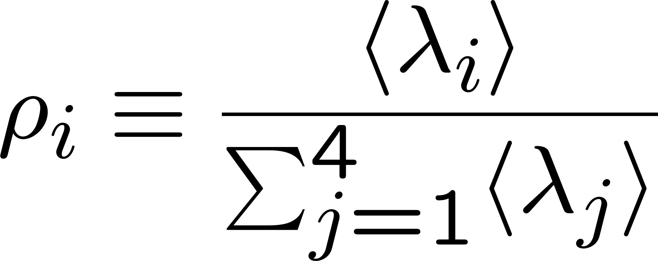
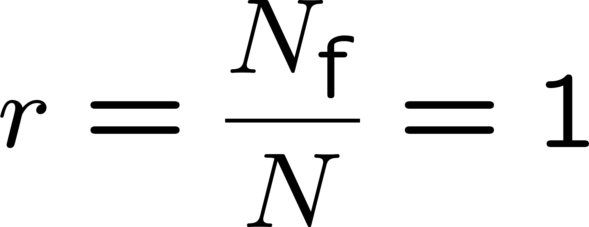
Results of the CLM
Ito-J.N., JHEP 12 (2016) 009
In order to cure the singular-drift problem, we deform the fermion action as:
CLM reproduces the SSB of SO(4) induced by complex fermion determinant !

Slide 22
3.2 Application to the 6d version of the IKKT matrix model
Anagnostopoulos-Azuma-Ito-J.N.-Papadoudis, JHEP 02 (2018) 151 [arXiv:1712.07562[hep-lat]]

Slide 23
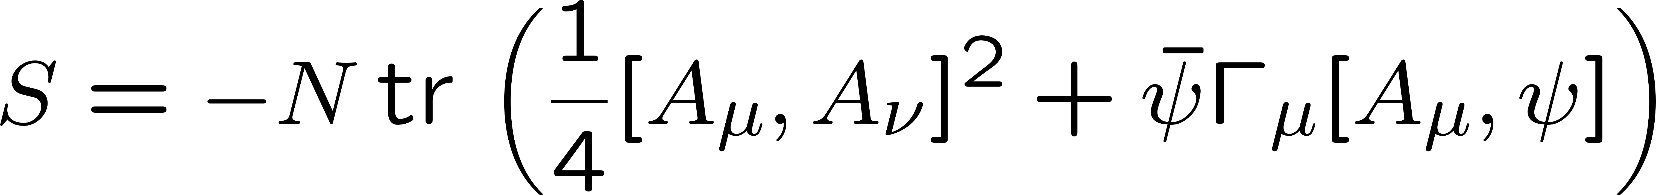
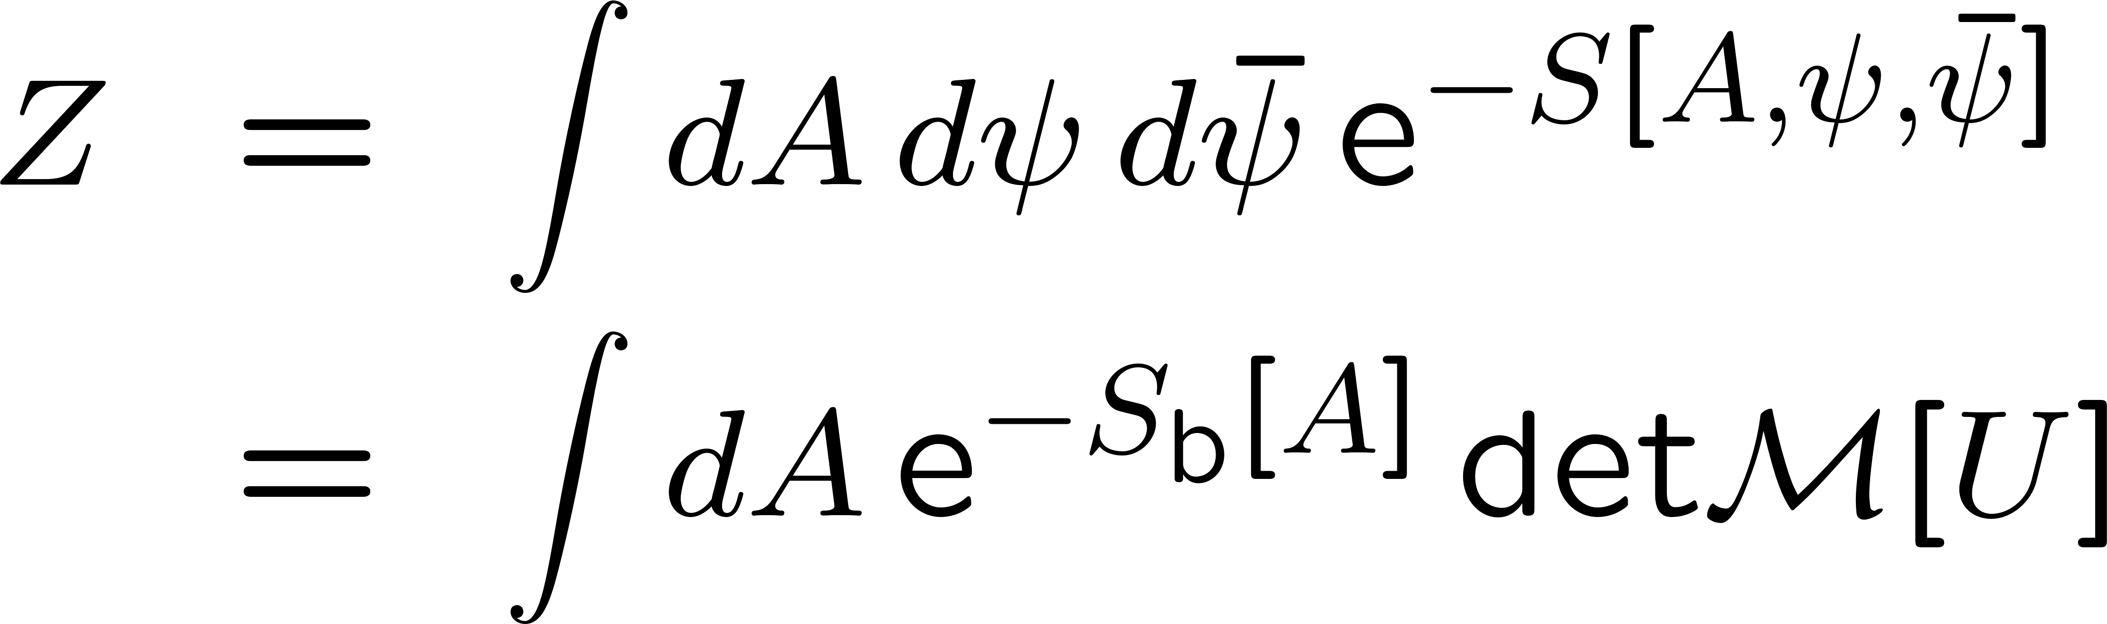
6d version of the IKKT matrix model
complex in general
The phase of the determinant is expected to
induce the SSB of SO(6).

Slide 24
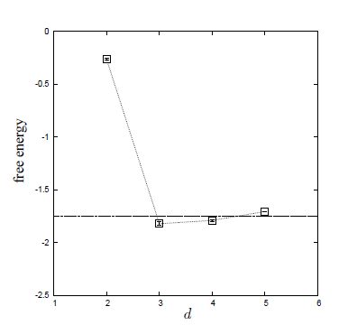
GEM results for 6d IKKT model
Aoyama-J.N.-Okubo, Prog.Theor.Phys. 125 (2011) 537
Krauth-Nicolai-Staudacher
Free energy becomes minimum at d=3.
ＳＳＢ
ＳＯ(6) ＳＯ（3）

Slide 25
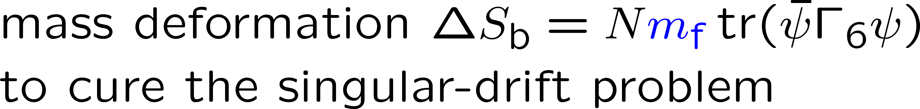
The application of CLM to the 6d IKKT model
In order to investigate the SSB, we introduce
an infinitesimal SO(6) breaking terms :
and calculate :

Slide 26
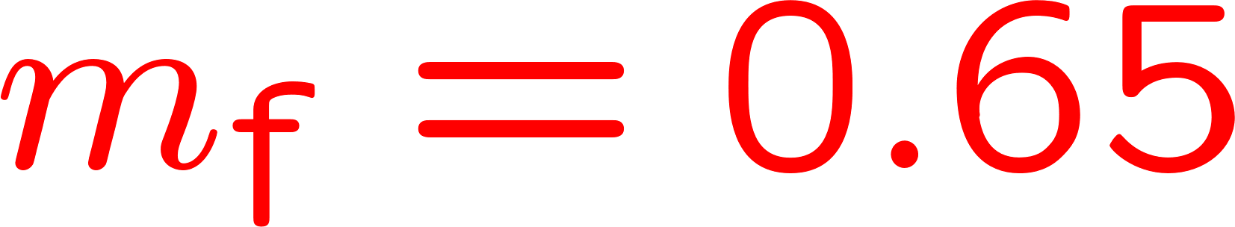
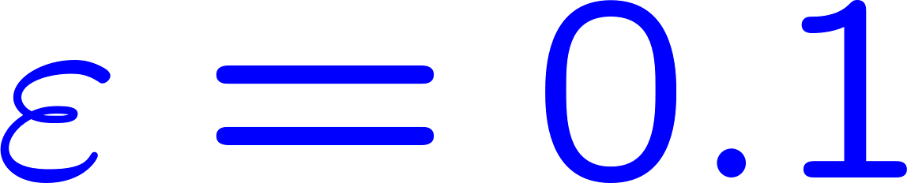




Solving the singular-drift problem by deformation
singularity of
the drift term
singularity of
the drift term
CLM fails in these cases.

Slide 27

Large N extrapolations
Reliable large N extrapolations are possible with N=24, 32, 40, 48.

Slide 28




Extrapolations to reveals various SSB patterns
SO(3)
SO(4)
SO(5)
SO(6)
equivalent to the bosonic model,
hence no SSB

Slide 29

The results obtained by extrapolations
GEM predictions
SO(3)
SO(4)
SO(5)

Slide 30

Quantitative consistency check with the GEM predictions
constrained to pass through
the points from the GEM predictions
Note that the GEM predictions are subject to uncontrollable systematic errors.

Slide 31
3.3 Application to the (10d) IKKT matrix model
Anagnostopoulos-Azuma-Ito-J.N.-Okubo-Papadoudis, work in progress

Slide 32
GEM results for 10d IKKT model
J.N.-Sugino (’02), J.N.-Okubo-Sugino,
Kawai, Kawamoto, Kuroki, Matsuo, Shinohara, Aoyama, Shibusa,…
J.N.-Okubo-Sugino, JHEP1110(2011)135
extended direction
Krauth-Nicolai-Staudacher
shrunken direction
Free energy becomes minimum at d=3.
The extent of space-time is finite in all directions
SSB : SO(10) → SO(3) is suggested
as opposed to original expectations…

Slide 33





Preliminary results
after large-N extrapolations with N=16,20,24,32
SO(3) ?
SO(4)
SO(5)

Slide 34
4. Summary and future prospects

Slide 35
Summary and future prospects
The complex Langevin method is a powerful tool
to investigate interesting systems with complex action.
The argument for justification was refined,
and the condition for correct convergence was obtained.
The singular-drift problem may be avoided by the deformation technique.
IKKT matrix model of superstring theory (Euclidean ver.)
The SSB SO(10) → SO(4) can be investigated using CLM with deformation.
(Successful applications in simplified models reported.)
Euclidean v.s. Lorentzian
In the Lorentzian version, SSB of SO(9) → SO(3) is observed to occur
at some point in time. Kim-J.N.-Tsuchiya, PRL 108 (2012) 011601
If Euclidean version shows SSB SO(10) → SO(3) as predicted by GEM,
we should pursue the Lorentzian version. (CLM is needed here as well.)

Slide 36


Application of CLM to finite density QCD
Nagata-J.N.-Shimasaki : arXiv:1805.03964 [hep-lat]
Ito-Matsufuru-J.N.-Shimasaki-Tsuchiya-Tsutsui, work in progress
plateau indicating
nuclear matter phase
transition to
quark matter phase (?)
the results for
phase-quenched model

