Slide 1
Quark-Gluon Plasma: Recreating matter of the early universe on earth
Raju Venugopalan
Brookhaven National Laboratory and University of Edinburgh
New Directions in Theoretical Physics, Edinburgh, January 6th-9th, 2026

Slide 2
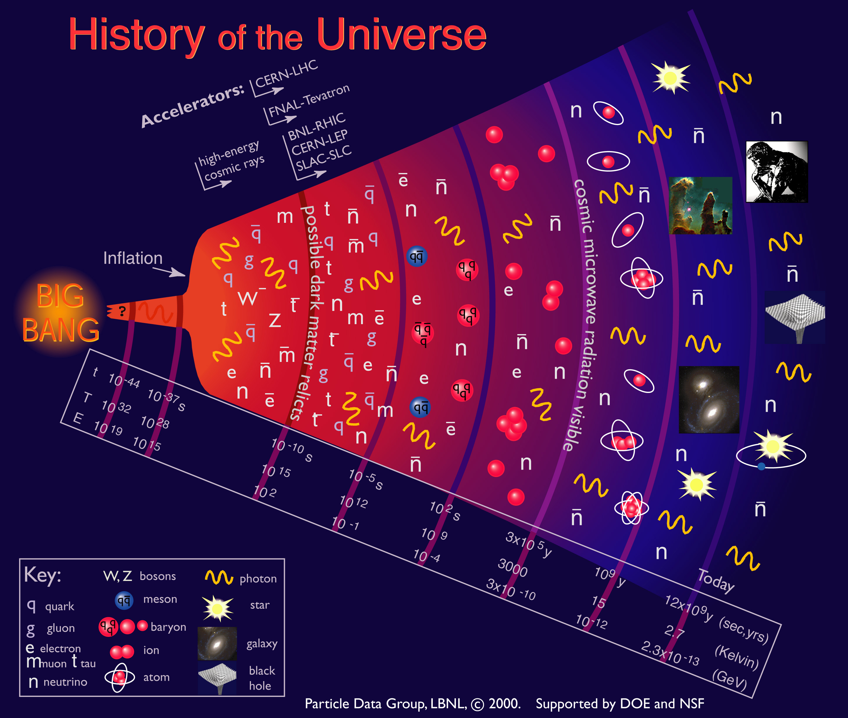
Early Universe

Slide 3
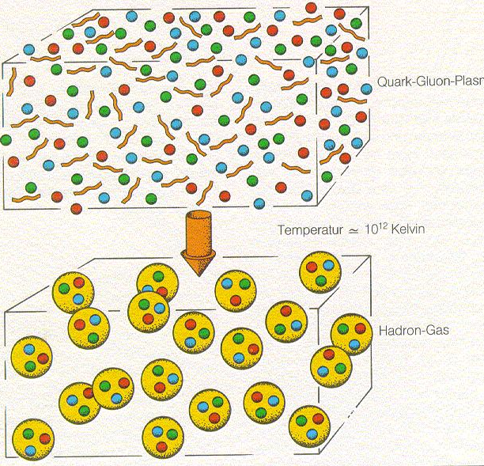
Universe evolved from a Quark-Gluon Plasma to a Hadron Gas
How did this happen ?
Is there a phase transition (a la vapor to liquid) transition ?
What are the properties of this matter ?

Slide 4
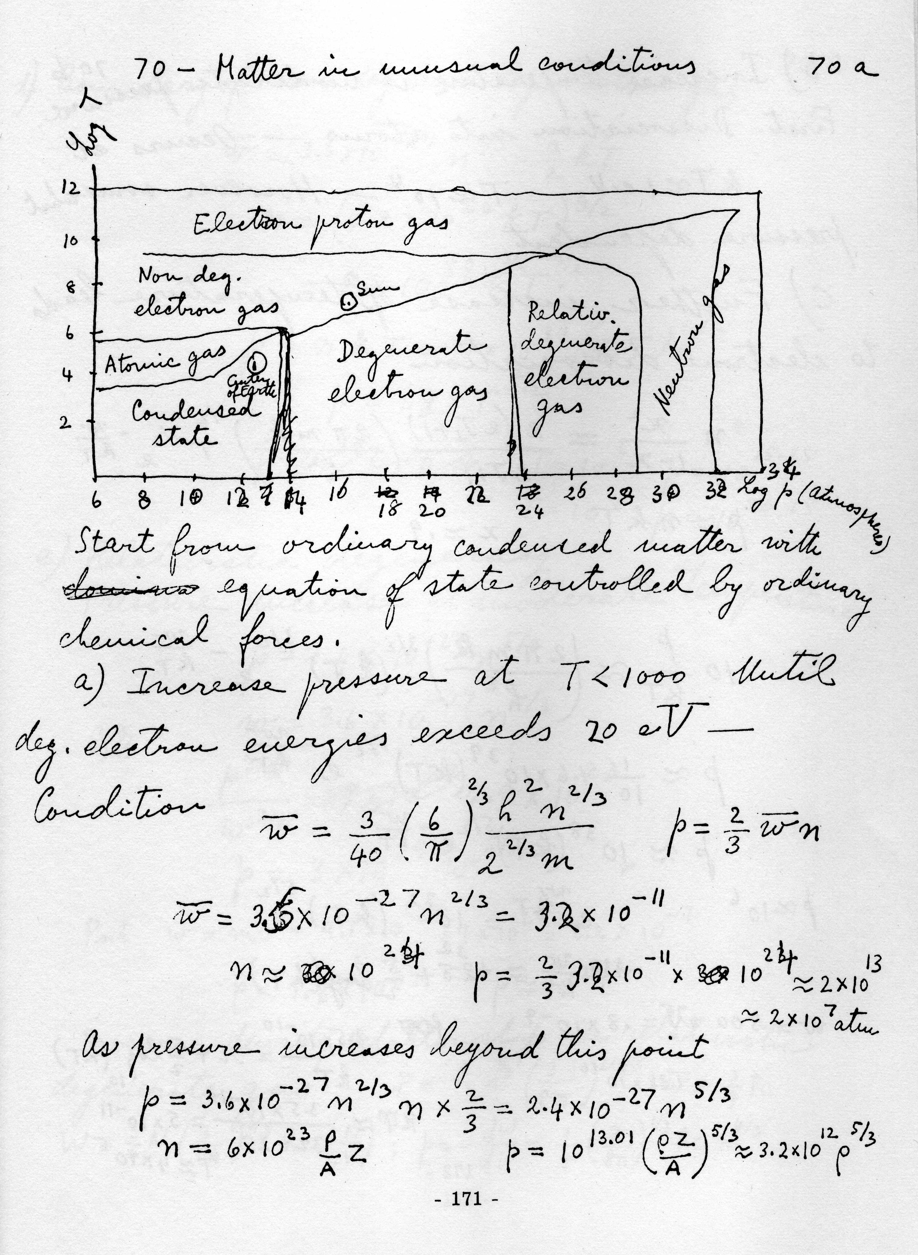
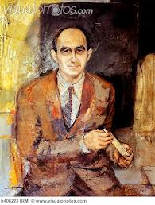
An old quest: Strongly interacting matter in unusual conditions
E. Fermi: Notes on Thermodynamics
and Statistics ” (1953)

Slide 5
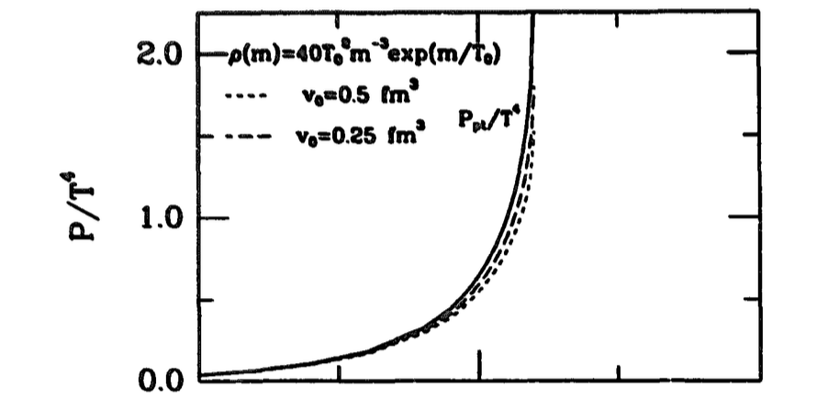
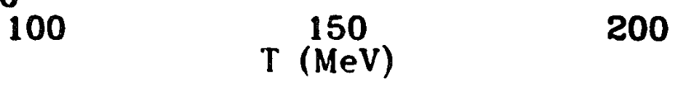
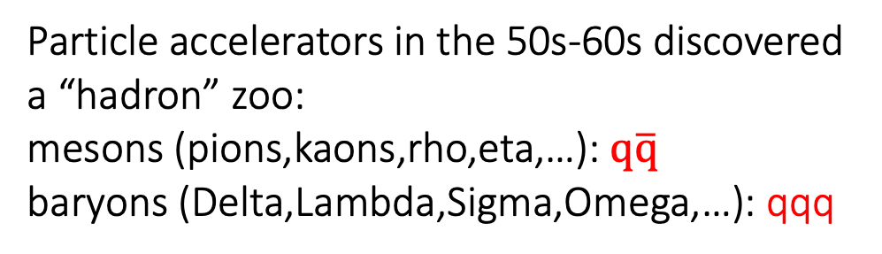
Hagedorn catastrophe: A limiting temperature for the early universe?
Particle accelerators in the 50s-60s discovered
a “hadron” zoo:
mesons (pions,kaons,rho,eta,…): $q\overline{q}$
baryons (Delta,Lambda,Sigma,Omega,…): qqq
Apparent exponential increase in the density of hadron states suggested the pressure of strongly interacting matter diverged at
a limiting temperature
Hagedorn (1965)

Slide 6
Hagedorn catastrophe: A limiting temperature for the early universe?
Apparent exponential increase in the density of hadron states suggested the pressure of strongly interacting matter diverged at
a limiting temperature
Hagedorn (1965)
Thus, our ignorance of microscopic physics stands as a veil,
obscuring our view of the very beginning
Steven Weinberg, The First Three Minutes (1973)

Slide 7
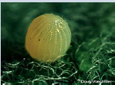


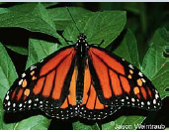

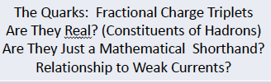


QCD: Fundamental quantum theory of nature’s strong force whose fundamental constituents are color charged quark and gluon fields
A “nearly perfect” paradigmatic quantum field theory
– rich in symmetries -where all phenomena are “emergent”
QCD lifts the veil – allowing us to peer back in time
From larva to iridescent butterfly: Gell-Mann’s 8-fold way to QCD
Jeffrey Mandula (2014)

Slide 8
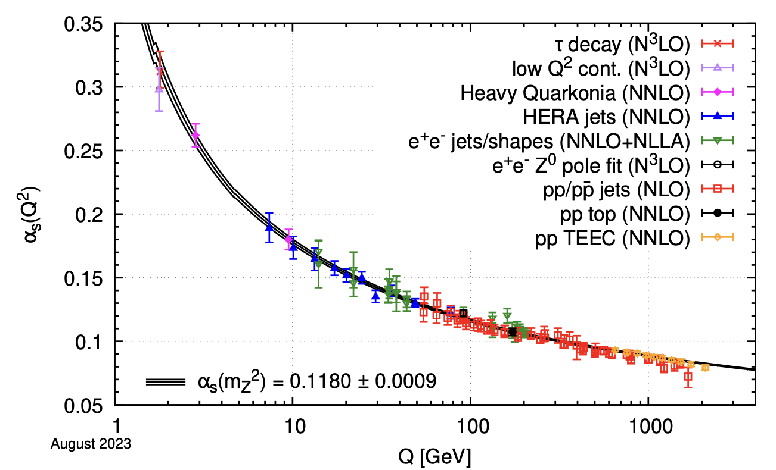
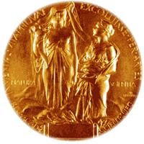
Key features of QCD: 1) Asymptotic freedom
Quarks and gluons are increasingly weakly
coupled (”asymptotically free”) at shorter
distances due to the self-interactions
of gluons - force carriers of color charge
Gross, Wilczek, Politzer (2004)
Particle Data Group (2024)
shorter distances
Higher Temperatures / Matter Densities

Slide 9
Key features of QCD: 1) Asymptotic freedom
Quarks and gluons are increasingly weakly
coupled (”asymptotically free”) at shorter
distances due to the self-interactions
of gluons - force carriers of color charge
Gross, Wilczek, Politzer (2004)
shorter distances
Higher Temperatures / Matter Densities
Major consequence: phase change of super-dense and super-hot QCD matter to a weakly coupled gas of quarks and gluons -- thus lifting the putative veil on the early universe
Quark matter at the core of neutron stars?
Cabibbo, Parisi (1975)
Collins, Perry (1975)

Slide 10
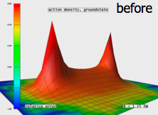
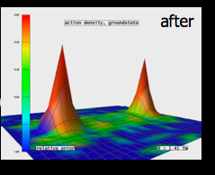


Key features of QCD: II) Quark (and gluon) confinement
Potential between static
quark-anti-quark pair grows linearly
at large distances -
intuitive picture of confinement of
color charge
Chromoelectric flux between
quark-antiquark pair
Flux tube ”snaps” at
larger distances creating
color-less mesons

Slide 11
Key features of QCD: II) Quark (and gluon) confinement
Potential between static
quark-anti-quark pair grows linearly
at large distances -
intuitive picture of confinement of
color charge
Chromoelectric flux between
quark-antiquark pair
Flux tube ”snaps” at
larger distances creating
color-less mesons
QCD matter at low temperatures and densities is an interacting meson/baryon gas
Tremendous progress in lattice QCD simulations at finite Temp. and Baryon chemical potential
Wilson (1982)

Slide 12
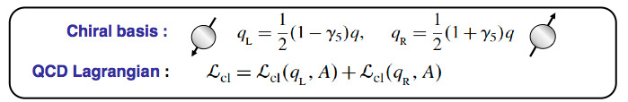
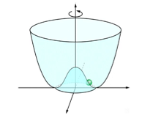

Key features of QCD: III) Chiral symmetry breaking
QCD equations of motion (if quarks are massless)
separately describe motions of ”left” and “right”
-handed quarks
Quantum QCD vacuum
spontaneously breaks
this chiral symmetry:
The vacuum forces left & right-handed quarks to march lockstep
Nambu (2008)

Slide 13
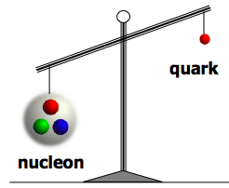
Key features of QCD: III) Chiral symmetry breaking
QCD equations of motion (if quarks are massless)
separately describe motions of ”left” and “right”
-handed quarks
Quantum QCD vacuum
spontaneously breaks
this chiral symmetry:
The vacuum forces left & right-handed quarks to march lockstep
The existence of 99% of visible matter in
the universe is due to the spontaneous
breaking of chiral symmetry
…with a little assist from Prof. Higgs
m_{N} /m_{q} ~ 100

Slide 14

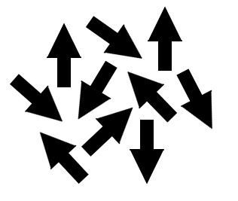

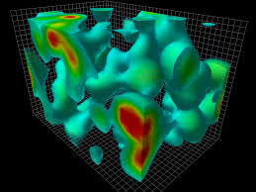
Key features of QCD: III) Chiral symmetry breaking
Chiral condensate melts at high temperature restoring chiral symmetry
“Order parameter” characterizing phase transitions
- sensitive to # of quark species (“flavors”), colors, and masses
Analogous to the destruction of magnetization due to
thermal fluctuations above the Curie temperature
For experts: IV)
Quantum violation of an “axial” symmetry due to topology
of the QCD vacuum is also restored at high temperatures
Topological
configurations
Lattice Gauge simulation
Derek Leinweber

Slide 15
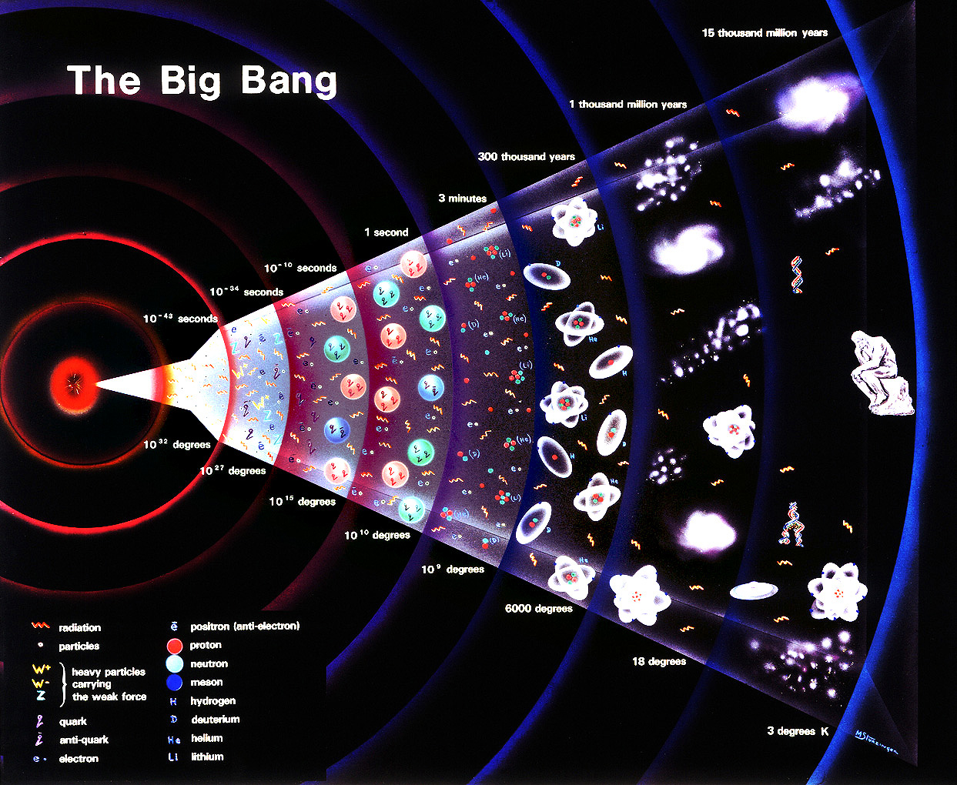
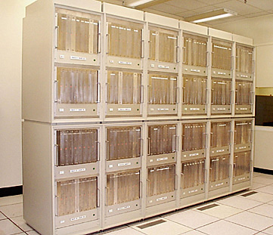
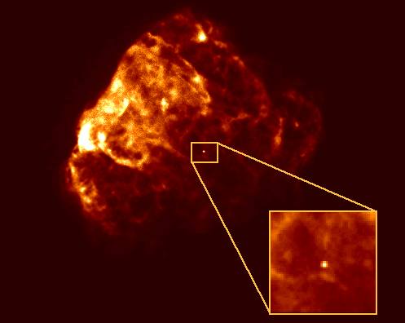
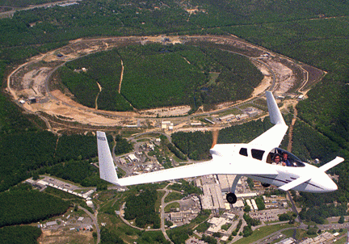
Where to study QCD matter
How can we study QCD matter ?
Big Bang
Big Bang
Only one chance…
Lattice QCD
Who wants to wait?…
200 GeV/nucleon heavy-ion collisions
RHIC
Peter Steinberg (circa 2008)
Neutron stars

Slide 16

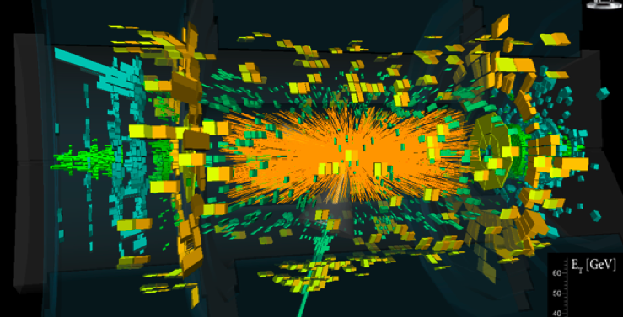
Where to study QCD matter
How can we study QCD matter ?
Big Bang
Big Bang
Only one chance…
Exascale Era of High Performance Computing
Tremendous progress in
multi-messenger nucl. astrophysics…
ATLAS DETECTOR
Neutron stars
LHC Heavy-Ion Collision at 5.5 TeV/nucleon

Slide 17
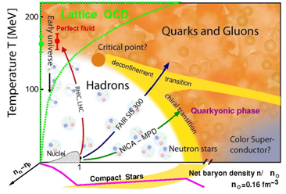
Conjectured QCD phase diagram
K. Fukushima

Slide 18
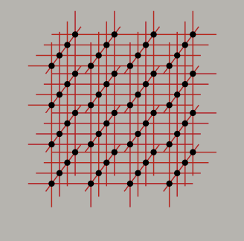
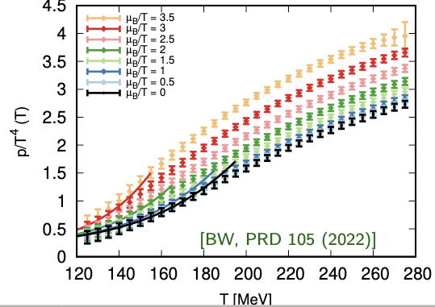
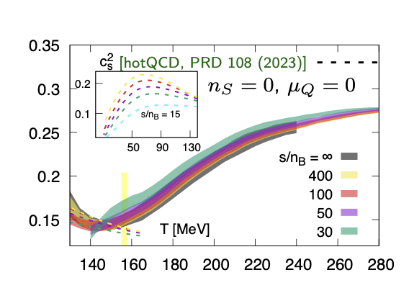
First principles Lattice QCD results
The pressure and the speed of sound in a Quark-Gluon Plasma
as a function of Temperature (150 MeV ~ 1.75 Trillion Kelvin !)
Hypercubic Lattice
Pressure normalized to temperature
QGP speed of sound relative to that of light
B. Brandt,
Quark Matter 2025

Slide 19
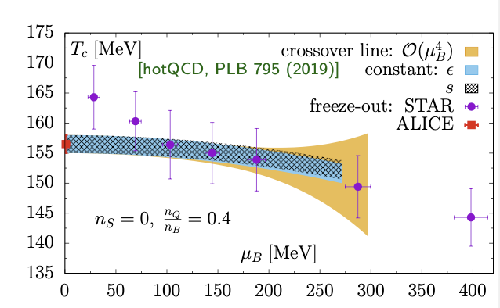
First principles Lattice QCD results
Critical (cross-over) Temperature from LQCD
compared to Heavy-Ion collision results
Hypercubic Lattice
Increasing baryon density/
Decreasing collision energy
Heavy-Ion collisions create the hottest/densest matter on earth in excess of 5.5 trillion Kelvin
Guinness Book of World Records

Slide 20
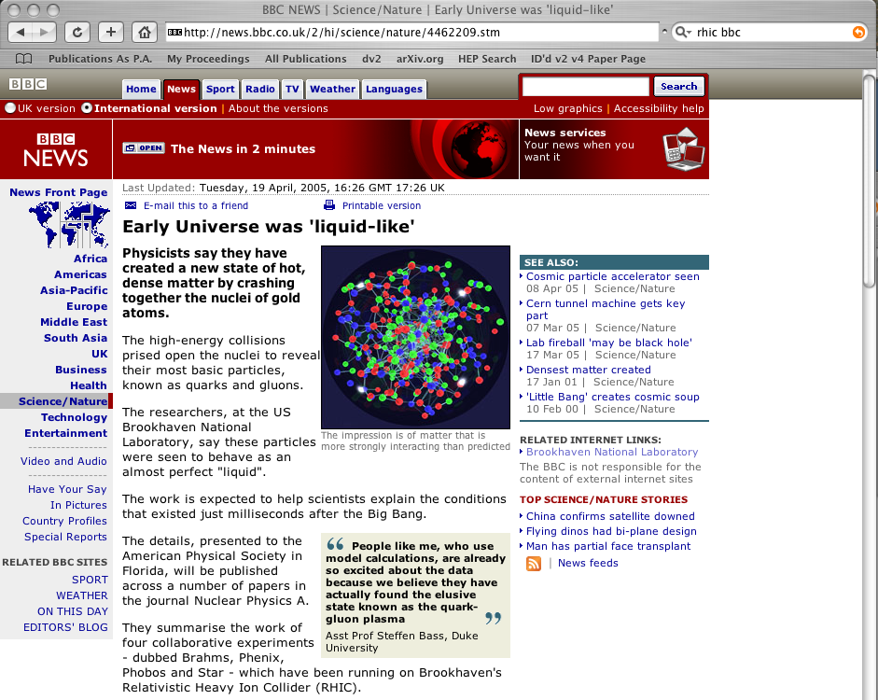
The QGP is a nearly perfect fluid

Slide 21
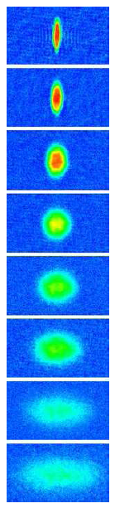
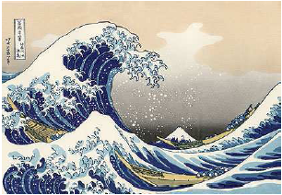
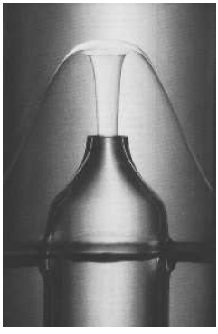
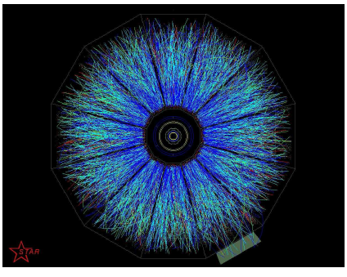
Perfect fluidity at RHIC and the LHC
Change in QGP energy density $ε$due to gradients in the pressure P and the fluid velocity ($∝viscosity η)$
“Bjorken” relativistic hydrodynamics
Viscous term smaller than ideal term for
From kinetic theory
H₂O
⁴He
⁶Li
sQGP

Slide 22
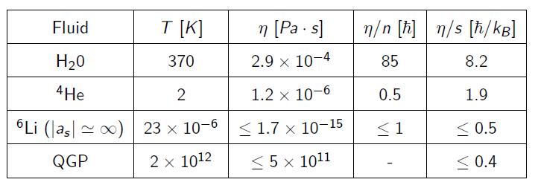
Perfect fluidity at RHIC and the LHC
Ultra-cold matter
Ultra-hot matter
Teaney, Schafer (2009)
Conjectured universal lower bound (employing the AdS/CFT correspondence) $\frac{η}{s}=\frac{1}{4π} =0.08$
Kovtun, Son,Starinets (2005)

Slide 23
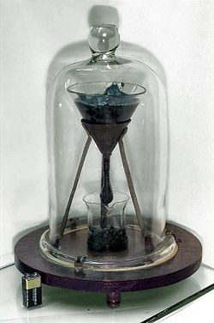
Perfect fluidity at RHIC and the LHC
Pitch drop experiment (1927-)
-world’s longest running lab
experiment
QGP is 10,000 times more viscous than tar but…has nearly perfect response
to external forces (pressure gradients)

Slide 24
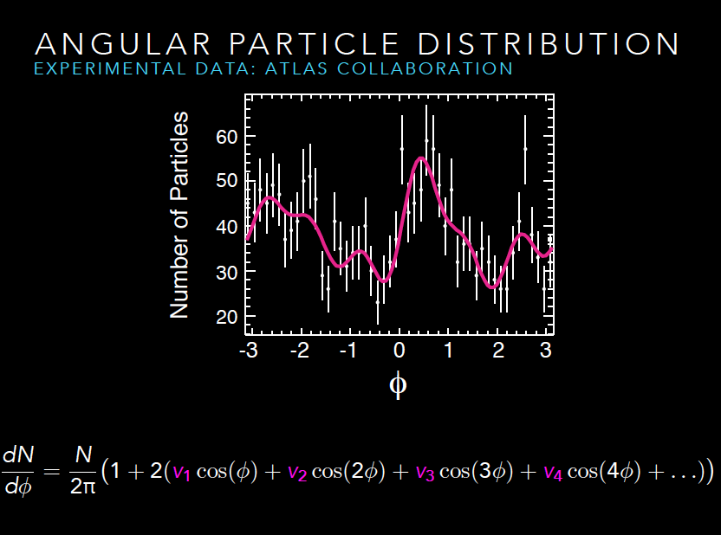

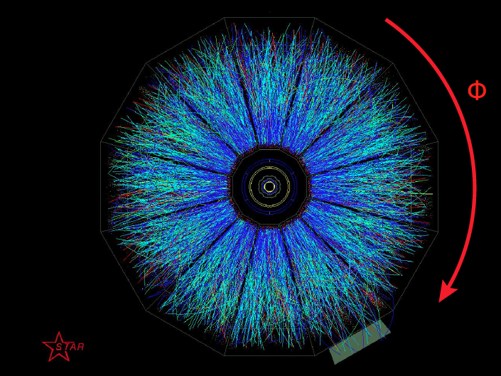

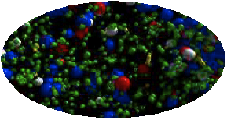
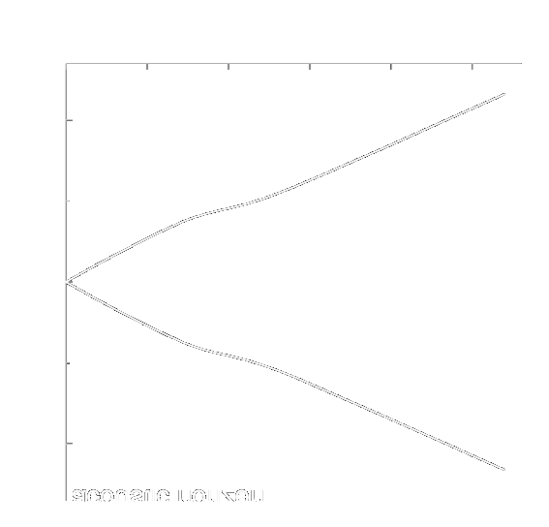
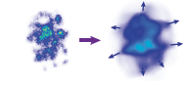
The unreasonable effectiveness of hydrodynamics
From lumpy glue (and quarks) to shower of pions, kaons,
protons – including traces of anti-matter
distributions and correlations of produced particles
time in fermi/c
Efficient transfer of spatial anisotropy to momentum anisotropy:
Characterized by flow moments – v₂,v₃,…v₈,…

Slide 25
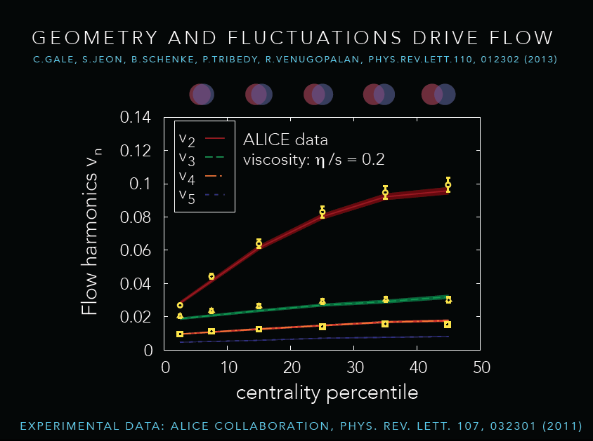
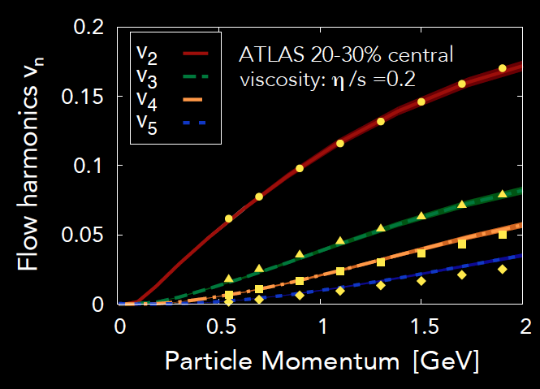
The unreasonable effectiveness of hydrodynamics
Theory curves: 3+1-D relativistic viscous hydrodynamics simulations: “IP-Glasma model”
Gale,Jeon,Schenke,Tribedy,Venugopalan, PRL 110, 012302 (2013)
Experimental data: ALICE & ATLAS Coll.
PRL 107, 012301 (2011) & Phys. Rev. C86, 014907 (2012)

Slide 26
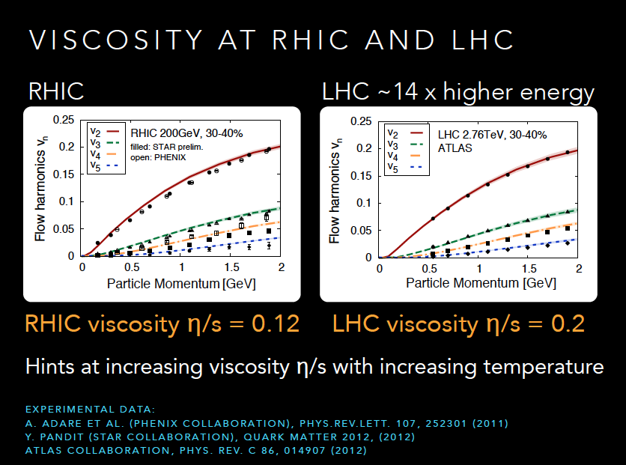
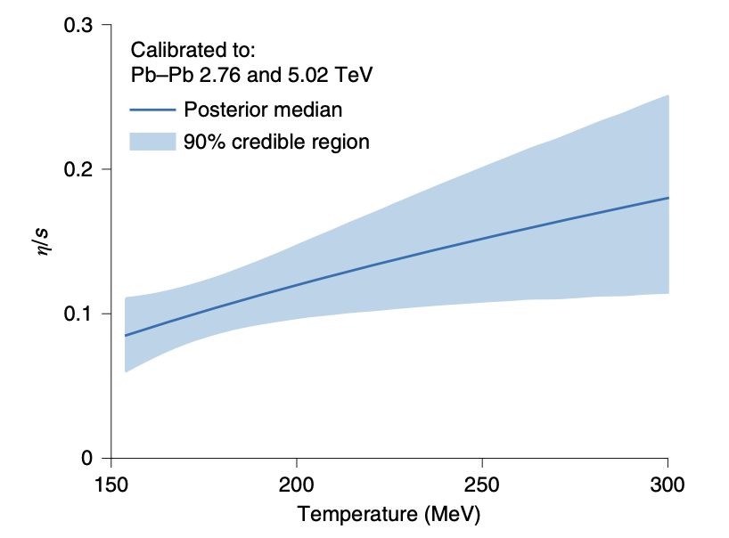
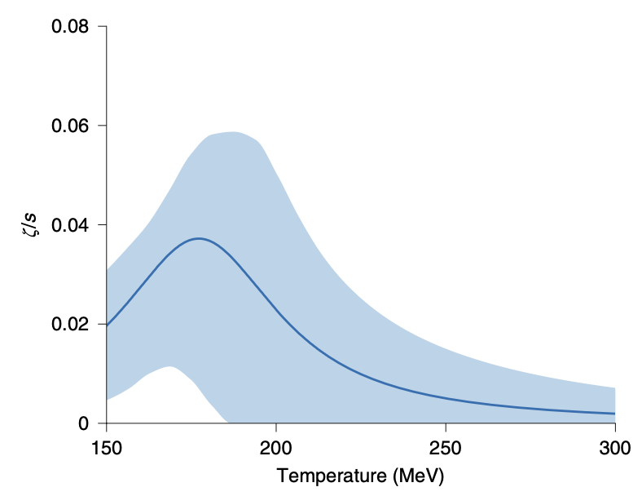
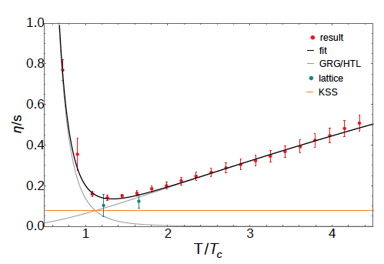
Temperature dependence of QGP transport coefficients
Bayesian analysis of combined RHIC & LHC data
Bulk viscosity
Shear viscosity
Bernhard,Moreland,Bass, Nature Physics Letters (2019)
FRG
Theory approaches to transport properties of
the QGP: Functional renormalization group ,
Lattice QCD, Hard Thermal loop perturbation theory,…
Christiansen,Haas,Pawlowski,Strodthoff,PRL115 (2015)112002

Slide 27
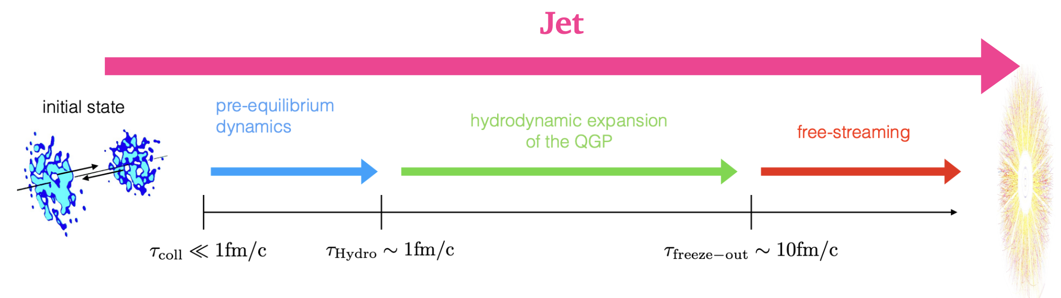
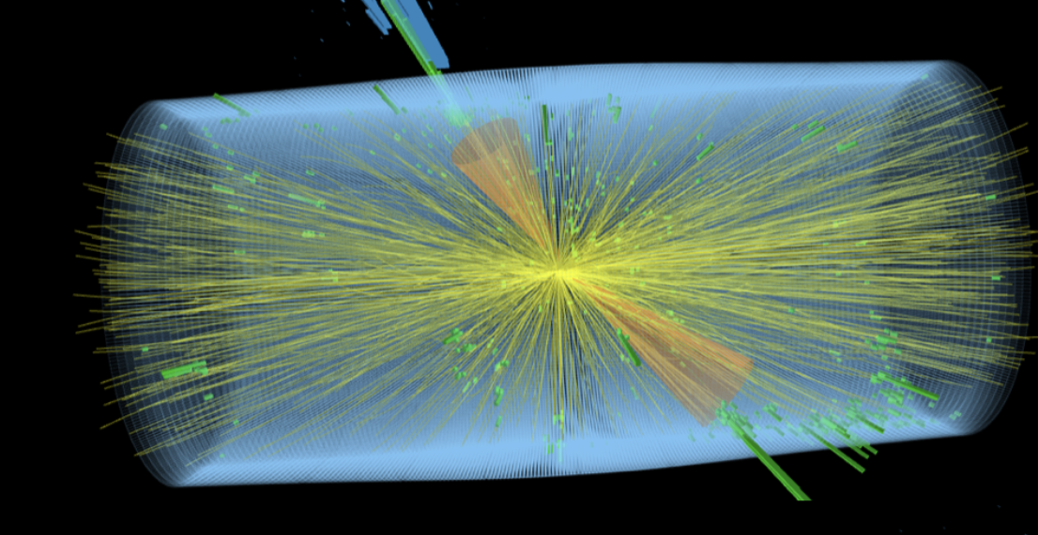
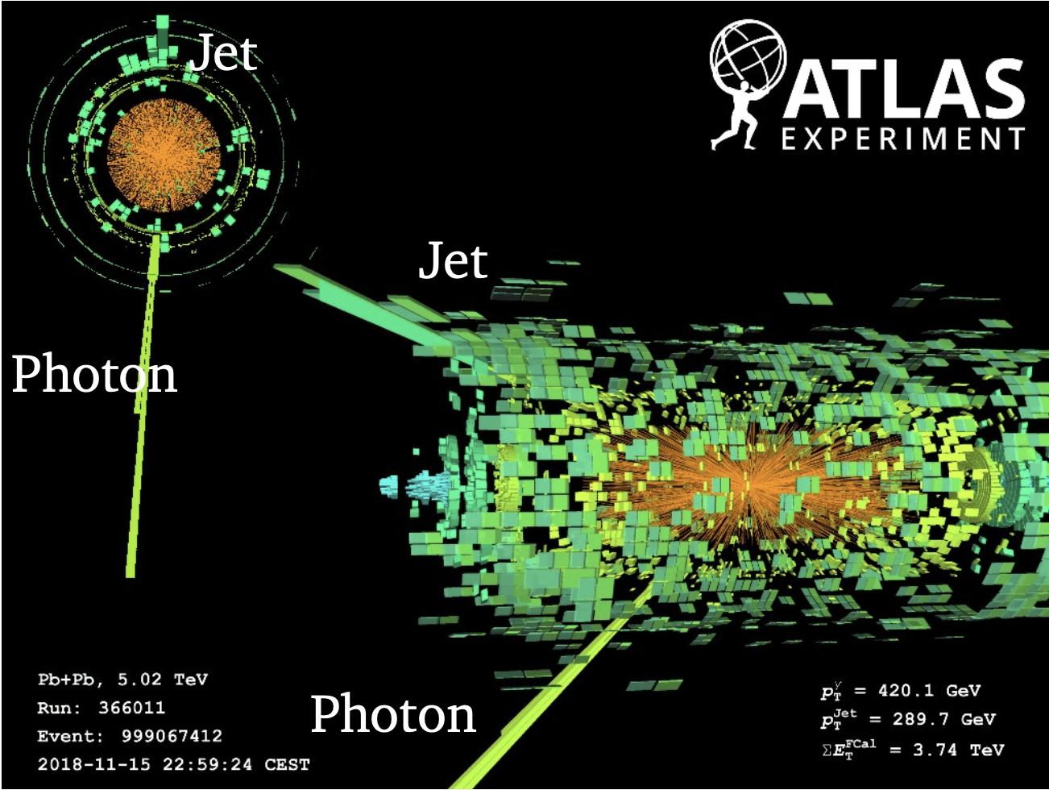

Hard probes of the QGP: many-body structure at fine resolution
Di-jets in Lead-Lead (Pb+Pb) collisions at the LHC
Photon+jet event in Pb+Pb collisions at the LHC

Slide 28


Hard probes of the QGP: many-body structure at fine resolution
Radiative and collisional energy loss of quark/gluon
jets as they traverse the expanding QGP
Jet in medium

Slide 29


Hard probes of the QGP: many-body structure at fine resolution
Radiative and collisional energy loss of quark/gluon
jets as they traverse the expanding QGP
Other probes: Heavy-Quarks, Hard Photons, Z-bosons,…
Jet in medium
Energy loss in Pb+Pb / p+p versus
size of QGP fireball
Energy loss in Pb+Pb / p+p
versus momentum
Quenched jets

Slide 30

How does the QGP thermalize?
time
Relevant d.o.f
in wave-fn.?
How is entropy
generated?
Univeral features of
non-equil. dynamics?
Transport in the
sQGP perfect fluid
Hadron Gas
QCD thermalization: Ab initio approaches and interdisciplinary connections
Jürgen Berges, Michal P. Heller, Aleksas Mazeliauskas, and R. V.
Rev. Mod. Phys. 93, 035003 (2021)

Slide 31

How does the QGP thermalize?
time
Relevant d.o.f
in wave-fn.?
How is entropy
generated?
Univeral features of
non-equil. dynamics?
Transport in the
sQGP perfect fluid
Hadron Gas
Novel insight from the Electron-Ion Collider (EIC):
Intense beams of high energy electrons collide
with protons and heavy-ions
to uncover their many-body quark-gluon structure
Under construction at Brookhaven
- start date ~ mid. 2030s

Slide 32

QGP

Slide 33


