Slide 1
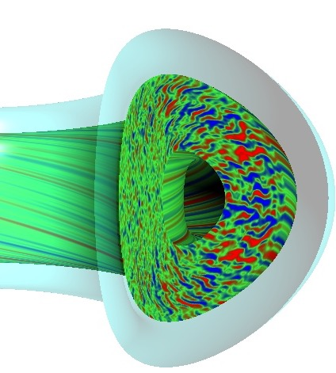
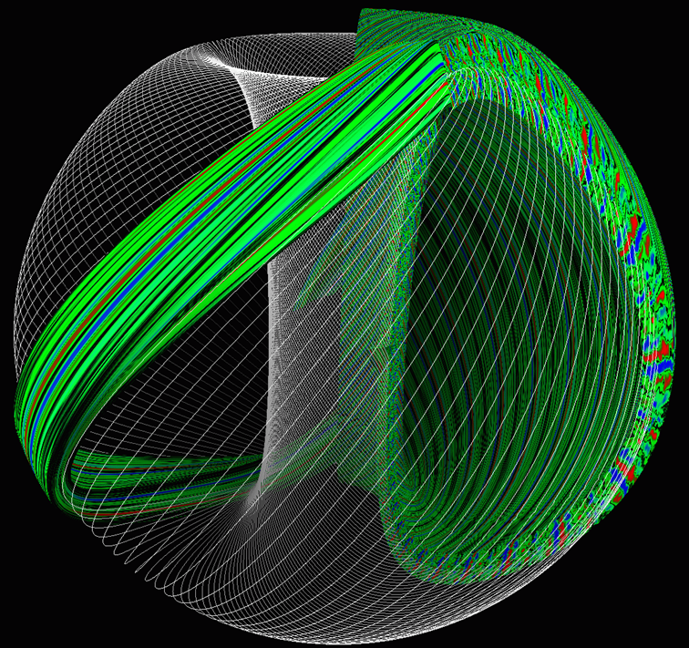
Multiscale Fusion Plasmas and AI
Steve Cowley, Toby Atkins Princeton Plasma Physics Lab. 2025
Thanks to Bill Dorland, Nuno Loureiro, Greg Hammett, Alex Schekochihin …….
W. Dorland
2006
Candy and Waltz 2010

Slide 2
What do we need to know? – Mostly large scale-evolution.
Almost all plasmas have dynamics at many scales – i.e. turbulence. I will discuss how we deal with this in magnetic fusion.
Fusion plasmas – turbulence is small-scale (but multiple small scales). It determines the slow evolution of the large scales. Because we have scale separation a kind of mean field theory is appropriate and accurate (we think). Still a huge computational challenge.
I will discuss how we are beginning to solve this problem with Multi-scale Techniques and AI.

Slide 3
Basic Equations
Distribution function for species “s” – ions or electrons
Obeys the Fokker-Planck equation:
Collisions smooth
Structure in velocity
space often very weak.
6-Dimensional (r-v) phase space with multi-scale structure possible in all dimensions

Slide 4
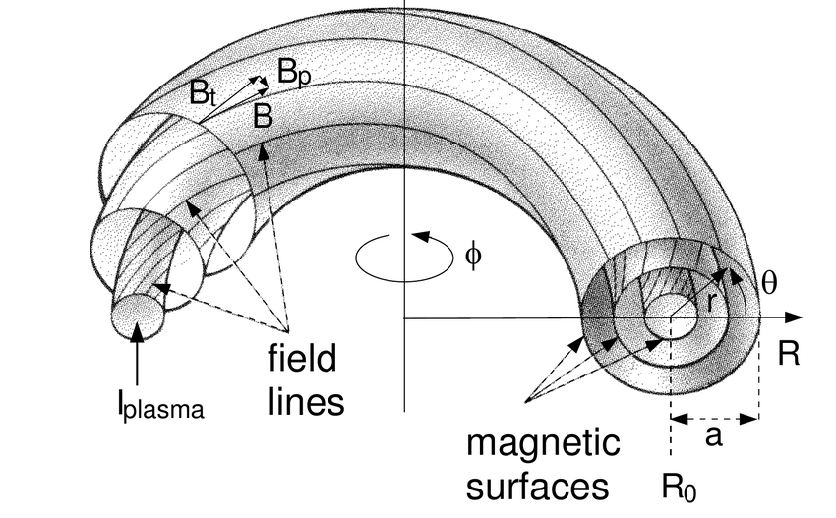
Nested flux surfaces – almost.
Turbulent particle flux
Across the flux surface
Surfaces are usually
Labelled by the
poloidal flux enclosed 𝜓.
The mean density and
temperature are flux
functions. n(𝜓,t), T(𝜓,t)
How do they evolve?
THIS IS OUR
PROBLEM
Turbulent heat flux
Across the flux surface
V=V(𝜓) is the
Volume inside
a flux surface

Slide 5
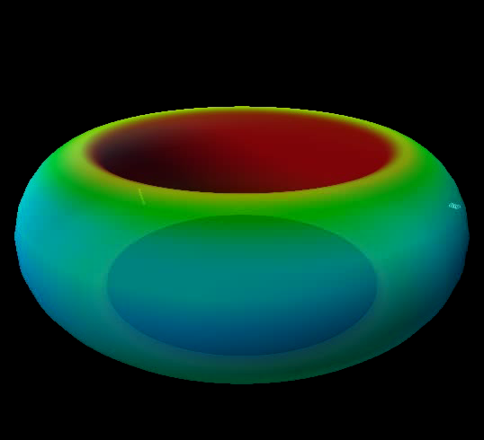
Numbers for ITER
Ion/electron
Larmor
Radius =
𝜌_{i} /𝜌_{e}
Ion/electron
Thermal
Velocity =
v_{thi.} /v_{the}
Ion/electron
Cyclotron
Frequency =
𝛺_{i}/𝛺_{e}
R =6m

Slide 6
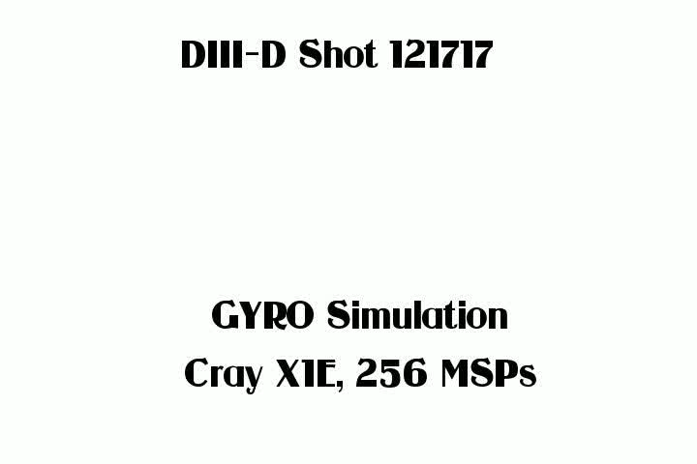

Supercomputing the Plasma
Ion scales
only
Fluctuation
amplitude
Small
Scale along
field ~ R.
Scale across
field ~ 𝛒_{i}
Larmor
radius
Thanks to Ron Waltz, Geoff Candy

Slide 7
Large scale effect -- Energy Confinement -- Random walk of heat/particles.
N random turbulent steps to leave machine
Eddy size ρ_{i} – Larmor radius
V_{thi} = ion thermal velocity
For ITER N ~ 10⁶⁻⁸.
Eddy turnover time =
Discharge length is fractions of an hour
R
Ignoring subtleties of the geometry

Slide 8
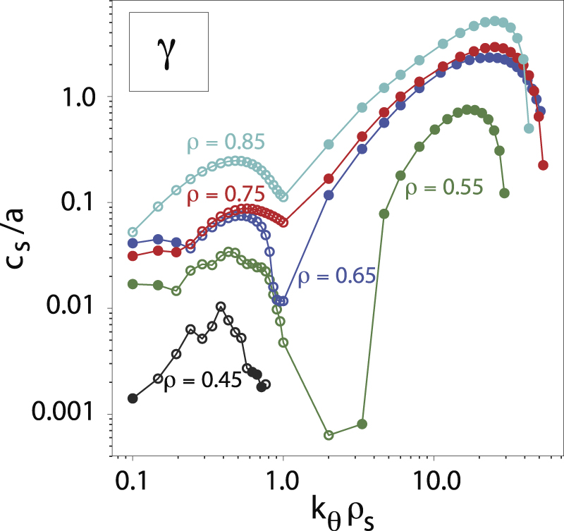
And beneath that…electron scales!
Growth rates at ion and electron scales:
So, we must resolve the
Electron scales in time and space.
A few (3) grid-points per
Number of spatial grid points = N_{s}
????
But there are no large-scale instabilities
since we avoid them
Nathan Howard et. al. Nuclear Fusion 2021

Slide 9
Resolution in Velocity Space?
f(v)
Mixing by Landau Damping etc. vs Smoothing by Collisions
ITER
Number of points in 3D velocity space N_{v}
v_{x}
Very crude treatment here see Alex’s work on velocity space cascades

Slide 10
Multiscale - Time-scales – ITER numbers
Discharge
Length
3000s?
Turbulent timescales
Average over cyclotron
Motion obtain 𝛿f(r,v,b,t)
And fluctuating fields , E, B.
Transport timescales
Average over turbulence
Evolve mean distribution
F(r,v,t) and Fields, E, B

Slide 11
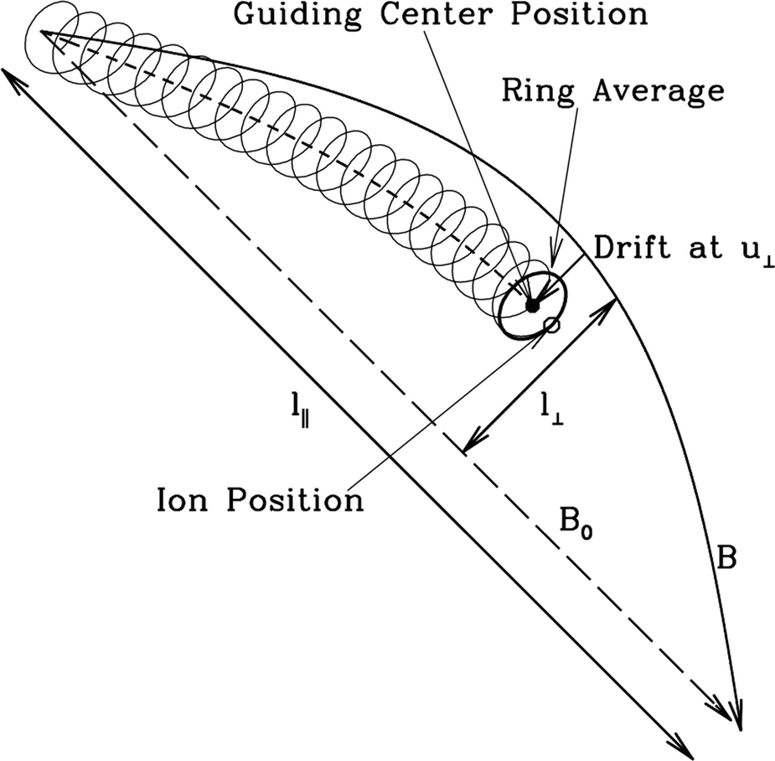
Ring Average – Gyro-kinetics
Particles ring average
the fluctuations (Electric
and magnetic field)
Longer timesteps
by 𝜖_{i}⁻¹
Larger grid spacing
along the magnetic
Field a factor of 𝜖_{i}⁻¹
Velocity space
Reduced to 2
Dimensions.
Slowly evolving density and temperature
Multiscale approach – full gyro-kinetics
Equations are too complicated to show
Howes et. al. picture

Slide 12



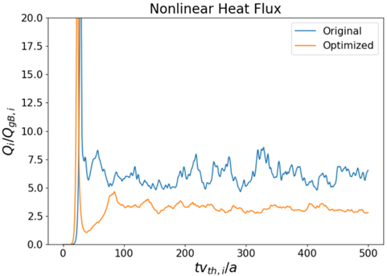
Flux Tube -- Minimum Simulation Volume
Beer, Hammett, Dorland, SC,
Solve for the gyro-kinetic
ring distributions h_{s} in a flux tube
that is a few correlations lengths
across and wraps around tokamak.
Schematically we solve a nonlinear
PDE for the ring distribution
With Maxwell’s equations for the
Potentials 𝜑 etc. 5D calculation
Evolve on turbulence timescale to
a statistically saturated state. Calculate
the average heat flux, particle flux etc.
Noah Mandel, Patrick Kim, Bill Dorland …

Slide 13
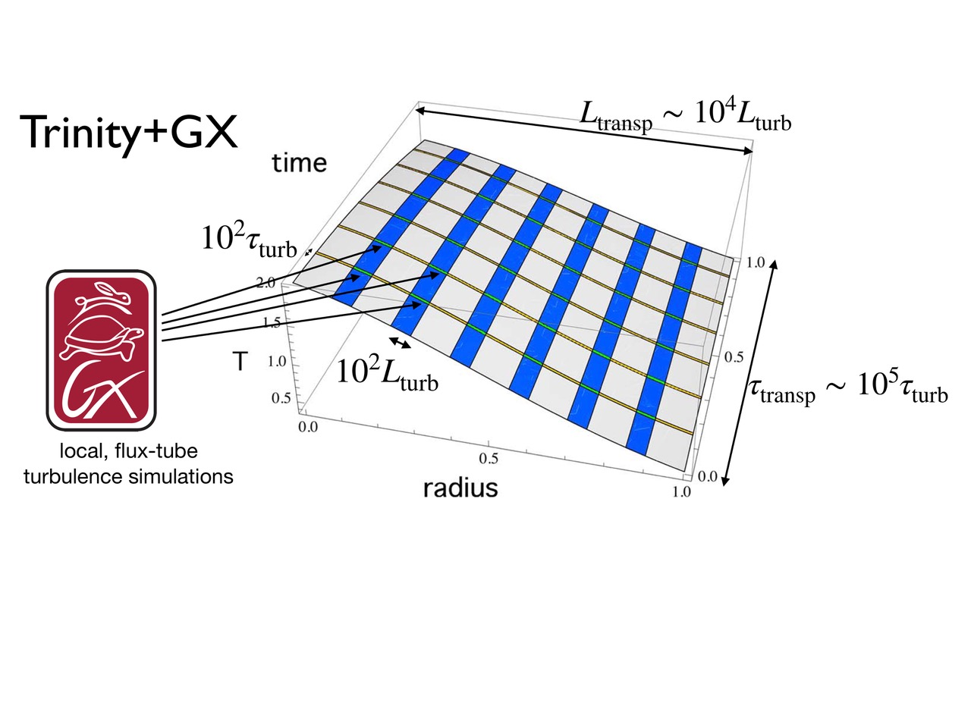
Slow Evolution of the Mean fields and F(r, v, t) – Multiscale.
Michael Barnes, Dorland, Mandel, Abel – evolve the slow evolution if n_{s}(𝜓,t) and T_{s}(𝜓,t)

Slide 14
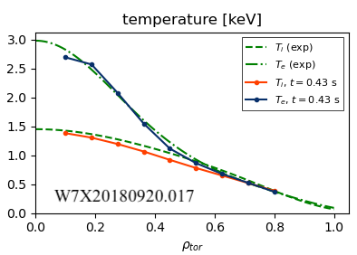
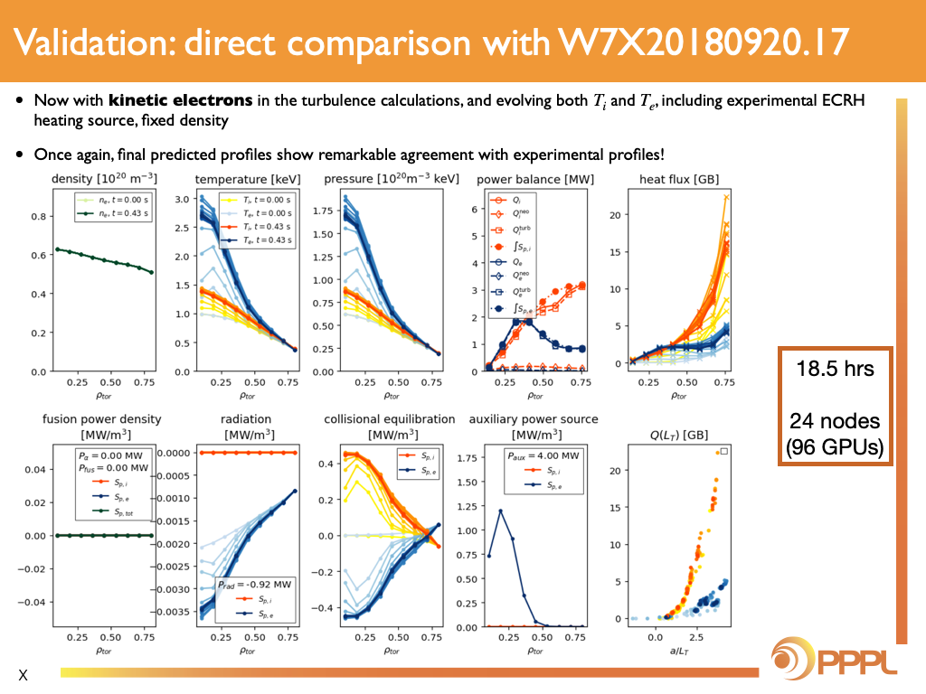
It works. Comparison with experiment – Wendelstein 7X
Noah Mandel
Bill Dorland
Patrick Kim

Slide 15
AI Replacement.
Can we learn the fluxes as functions of the thermodynamic variables and the flux tube geometry?
Learn from simulation and experiment?
For example, ion heat flux:
How many parameters? How much do they change?
We are trying to do this. UK-US collaboration.

Slide 16
Conclusion – sort of.
Can we optimize shapes and profiles to find the optimum fusion configuration?
THANK YOU

Slide 17
Ion Temperature Gradient Instability.
Cartoon physics – just a flavour.

Slide 18
B
B
B
Hot Plasma in the
Middle colder at
the edge

Slide 19
B
B
B
Hot
Cold
Hot
Start the instability by making the trapped particles hotter and colder in stripes on the surface

Slide 20
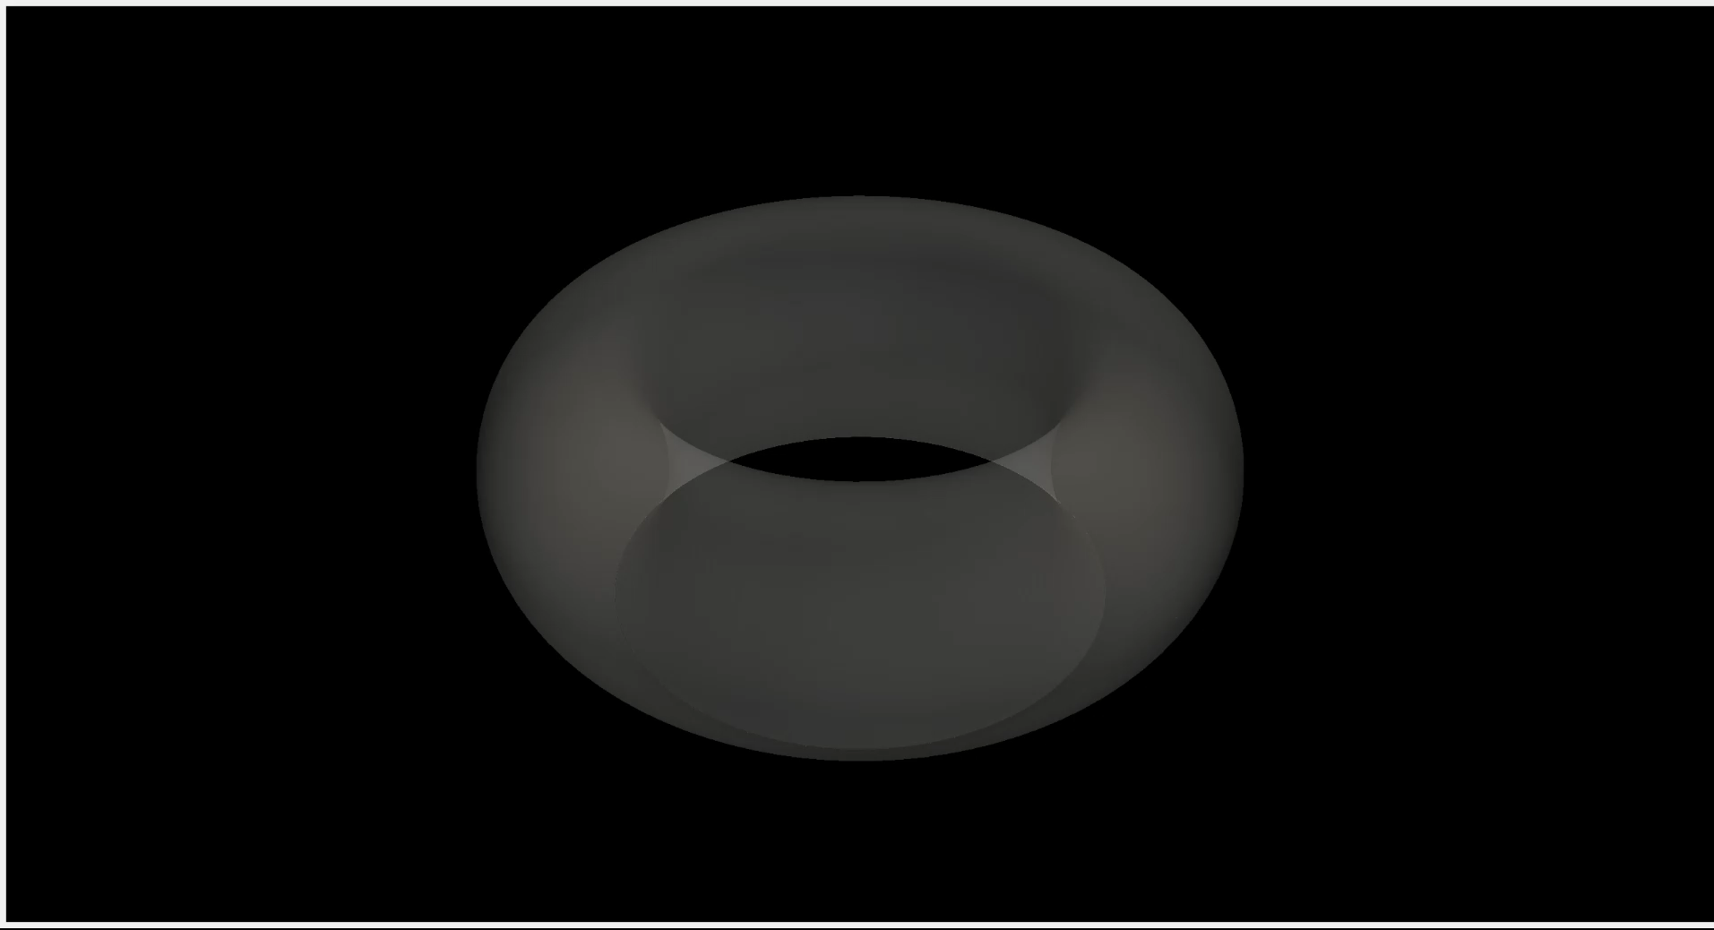

Slide 21
B
B
B
v_{D}
v_{D}
Hot
v_{D}
v_{D}
Cold
Hot
v_{D}
v_{D}
Hotter trapped particles precess faster than the cold trapped particles and catch up.
This causes a compression/expansion of plasma between the stripes

Slide 22
Ion density lowered –
negative charge
B
B
B
-
-
-
-
-
-
-
-
-
-
-
-
+
+
-
+
+
+
+
+
+
+
+
-
-
-
-
-
-
-
-
Ion density raised –
positive charge
Ion density lowered - negative charge

Slide 23
Electric field in the surface
Ion density lowered
negative charge
B
B
B
-
-
-
-
-
-
-
-
-
-
-
-
-
-
E
E
-
E
+
+
+
E
-
+
+
+
+
+
+
+
+
-
-
-
-
-
-
E
-
-
E
Ion density raised
positive charge
Ion density lowered - negative charge

Slide 24
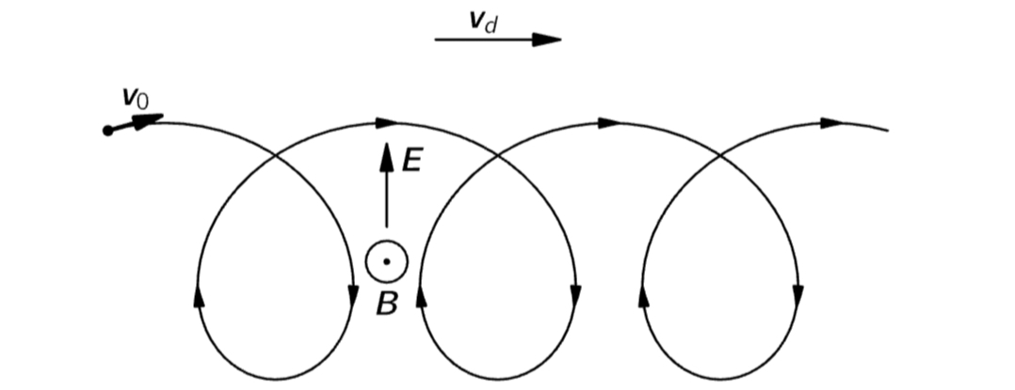
E X B drift – ion in magnetic and electric fields
The electric field in the surface causes
particle motion across the flux surface
v_{EXB}= EXB
E
B field pointing at you

Slide 25
B
B
B
-
-
-
-
E
-
-
-
-
-
-
-
-
-
-
E
-
E
+
+
+
E
-
+
+
+
+
+
+
+
+
-
-
-
-
-
E
-
-
-
E
EXB. Flow Outward
Brings hot plasma
EXB. Flow Inward
Brings cold plasma

Slide 26
B
B
B
E
-
-
-
-
-
-
+
+
+
+
+
+
+
+
+
-
-
-
E
-
-
-
E
EXB. Flow Outward
Brings hot plasma
EXB flows take hot
plasma out and cold
plasma in. Enhancing the original
Temperature stripes
EXB. Flow Inward
Brings cold plasma

