Slide 1
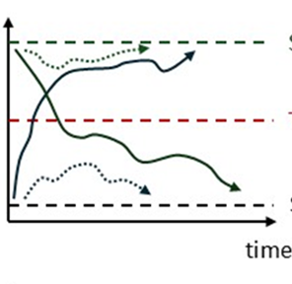
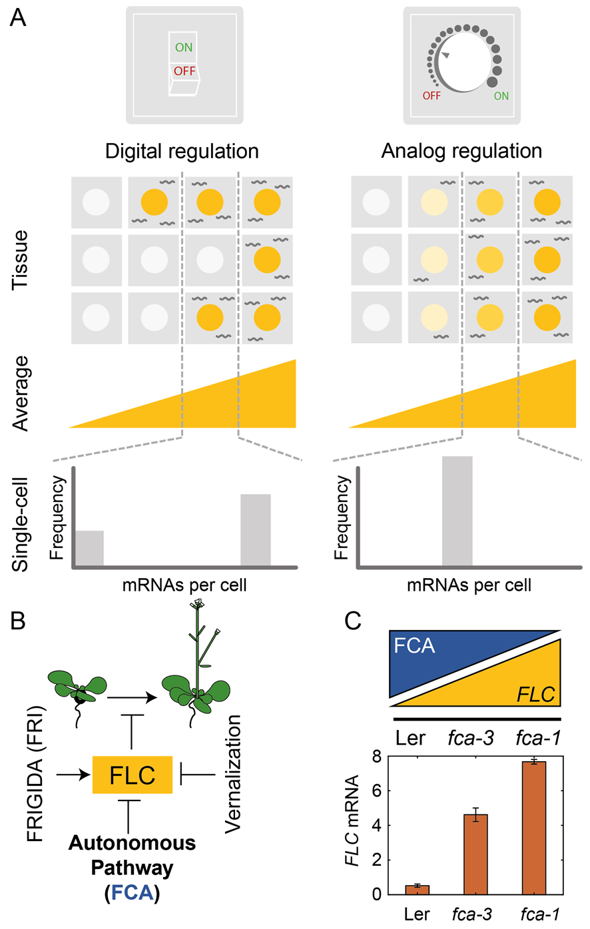
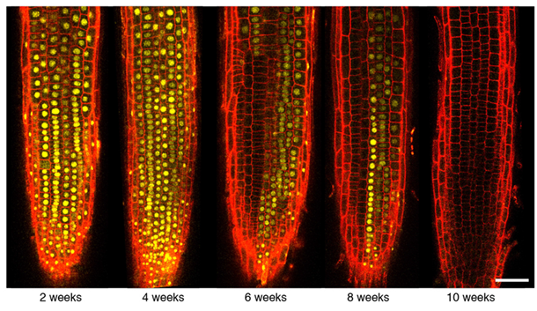
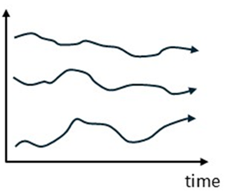
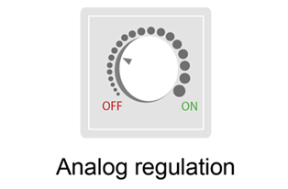



Dissecting analogue and digital modes of gene regulation
Martin Howard

Slide 2
How to control quantitative gene expression?
Input signal
RNA output
Gene expression (RNA levels)
gene
Input signal

Slide 3
How to control quantitative gene expression?
Two ways: Analogue versus Digital
50% expression: half copies at full expression, half copies at zero expression
50% expression: all copies express at 50% of maximum
All-or-nothing
Smoothly varying

Slide 4
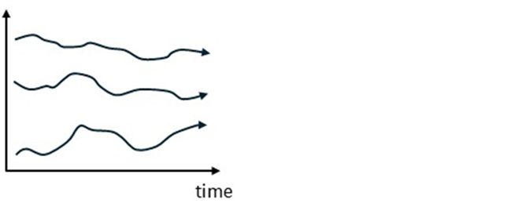

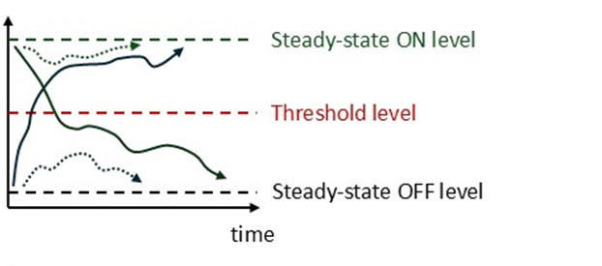

What determines which modality is used?
Suppose a gene needs to “remember” a particular expression level: epigenetic memory
Analogue:
Digital:
Drift NOT corrected
Expression
1
Drift corrected
Expression
0

Slide 5
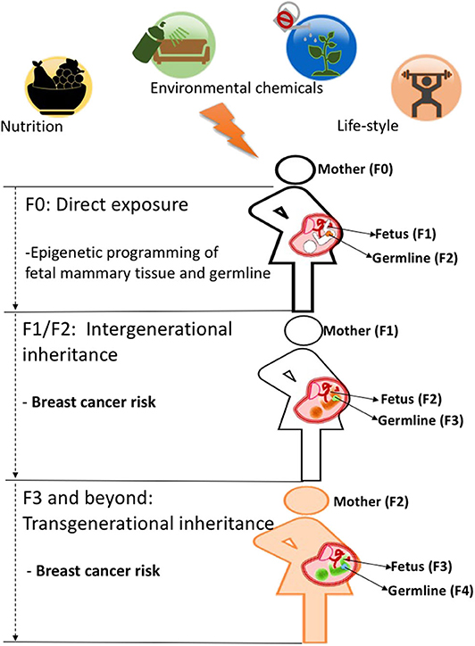
Epigenetic memory: an introduction
Epigenetic inheritance:
Inheritance of phenotype from one generation to the next that does not depend on changes in DNA sequence
da Cruz et al: Frontiers Nutrition (2020)

Slide 6
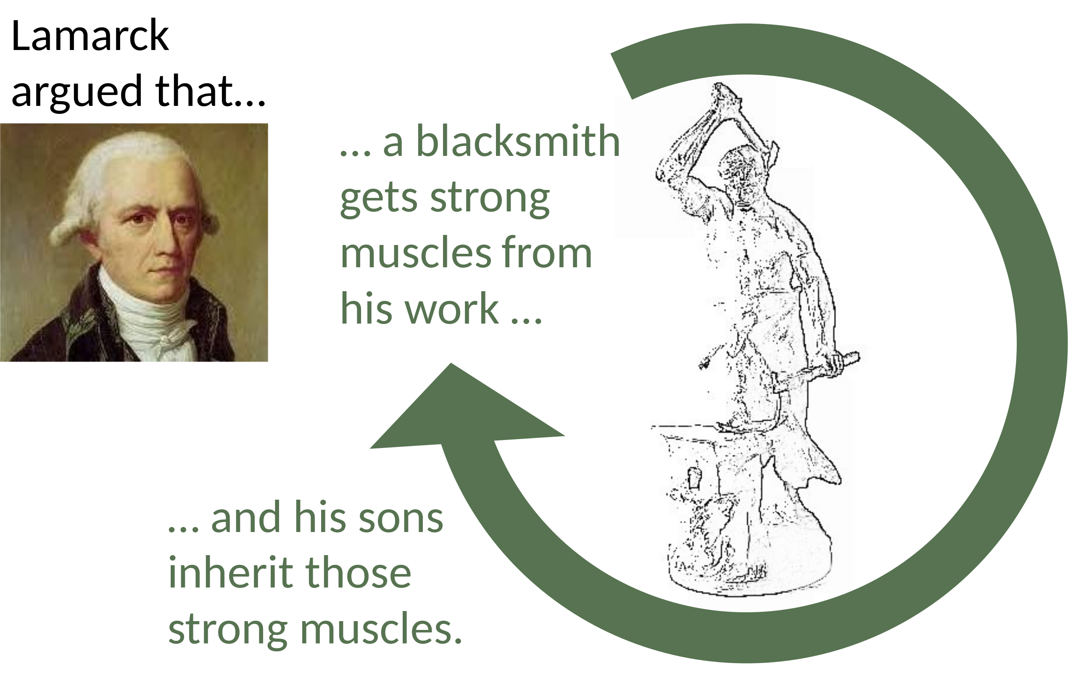
Lamarckism
Lamarckism (or Lamarckian inheritance): hypothesis that an organism can pass on characteristics that it has acquired through use or disuse during its lifetime to its offspring
Also known as the inheritance of acquired characteristics or soft inheritance
Seemingly discredited by Darwinian revolution
Jean-Baptiste Lamarck (1744–1829)

Slide 7
Epigenetic memory: an introduction
Epigenetic inheritance:
Inheritance of phenotype from one generation to the next that does not depend on changes in DNA sequence
Or, weaker:
Inheritance of phenotype through mitotic cell division that does not depend on changes in DNA sequence
da Cruz et al: Frontiers Nutrition (2020)

Slide 8
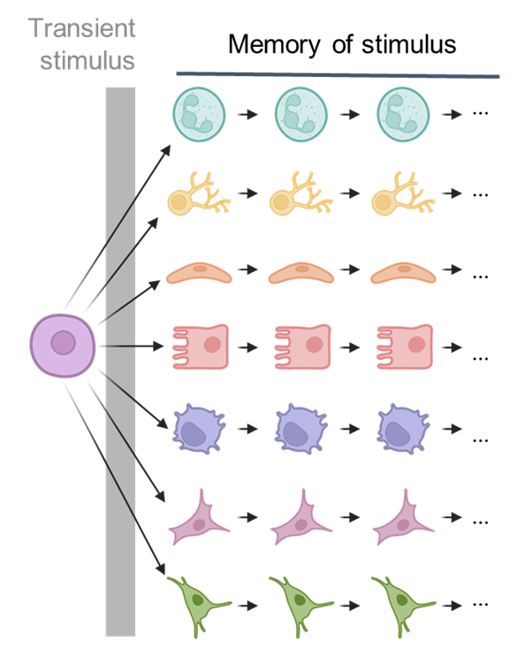
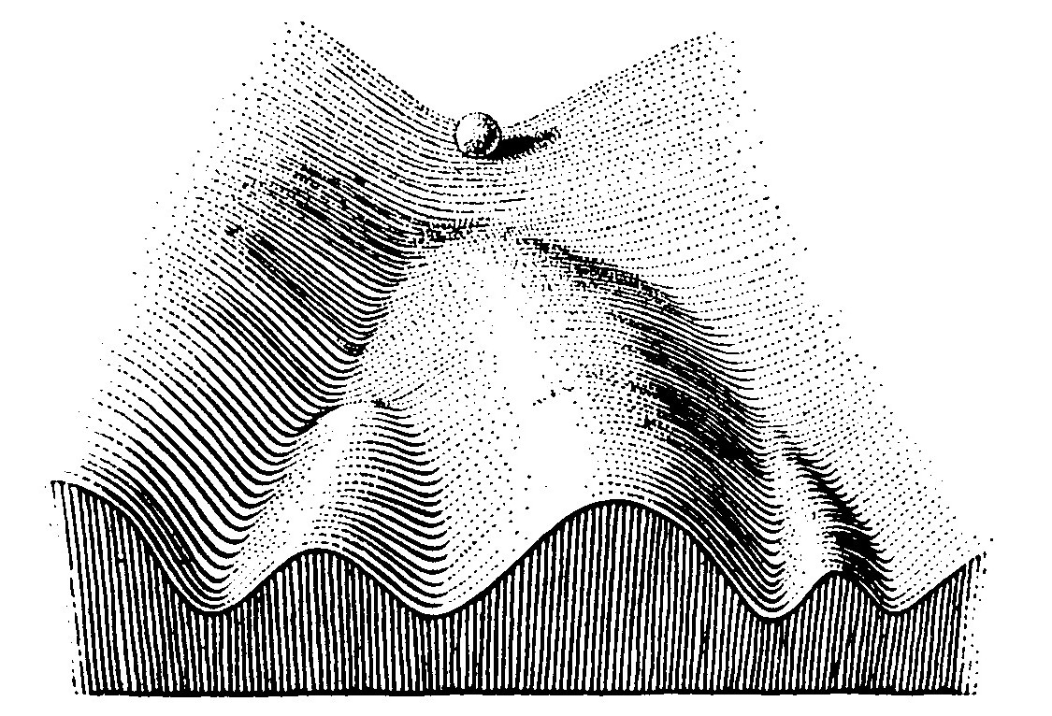
Epigenetic landscape
How do clonal cells acquire different cell fates in development or environmental response?
Waddington landscape

Slide 9
What mechanisms might be able to store digital memory?

Slide 10
How to store epigenetic information
Diffusible factors
Required ingredients:
- positive feedback and nonlinear kinetics
- e.g., cooperative binding of transcription factors
Veening, Smits, Kuipers: Annu. Rev. Microbiol. (2008)
Classic example: lambda repressor
Encodes an auto-activating positive feedback loop, maintaining lysogeny

Slide 11
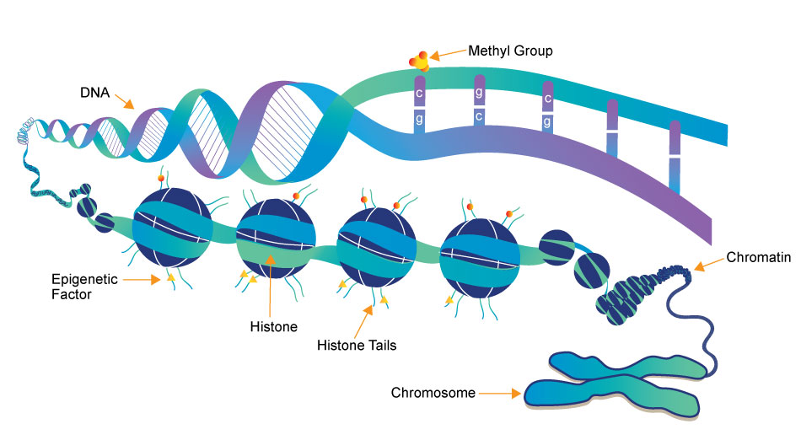
How to store epigenetic information
Whatisepigenetics.com
Histone modifications (e.g., H3K27me3) and DNA methylation
H3K27me3 silences gene expression

Slide 12
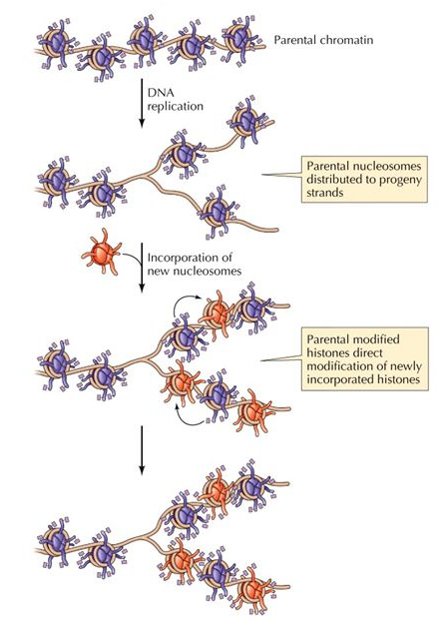
A hurdle for histone-based memory
On average, on one strand, half are lost at DNA replication!

Slide 13
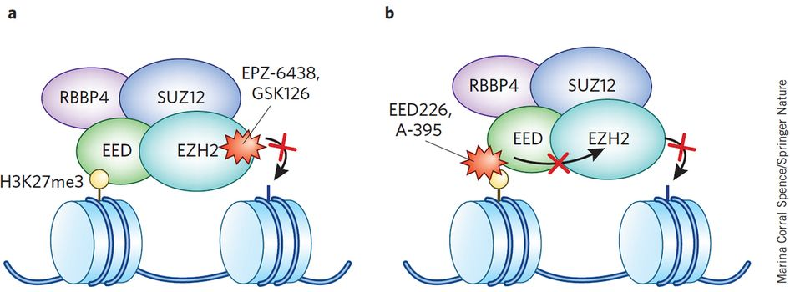
Read-write feedback for histone modifications
Memory element H3K27me3 added by Polycomb Repressive Complex 2 (PRC2)
Holoch & Margueron: Nature Chemical Biology (2017)
Strong non-linear positive feedback!

Slide 14
A hurdle for histone-based memory
On average, on one strand, half are lost at DNA replication!
High level of feedback allows histone modification levels to bounce back
Easy to restore digital state, very tricky for analogue (would have to double histone modification number)
Forces memory to be digital

Slide 15
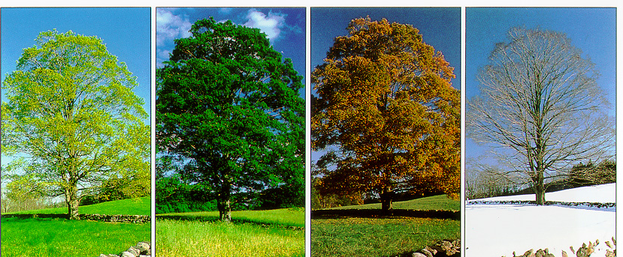

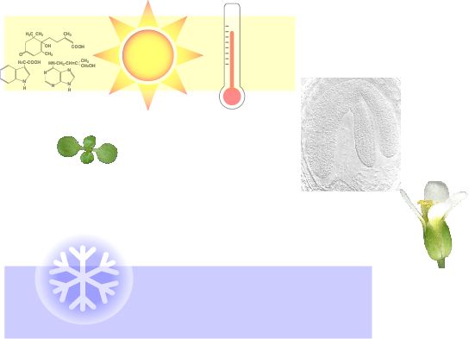
The FLC repression system
Arabidopsis FLOWERING LOCUS C (FLC)
Alignment of plant development with the seasons
with Caroline Dean
Switch to flowering
Vernalization
Floral
Repressor
FLC
Transcription-coupled repression

Slide 16


Why study epigenetic regulation at FLC?
Non-epigenetic regulation before cold
Switching during the cold
Epigenetic maintenance after cold
FLC
FLC
FLC
FLC
COLD
autumn
winter
spring
summer
Multiscale, nonlinear, out of equilibrium problem!

Slide 17
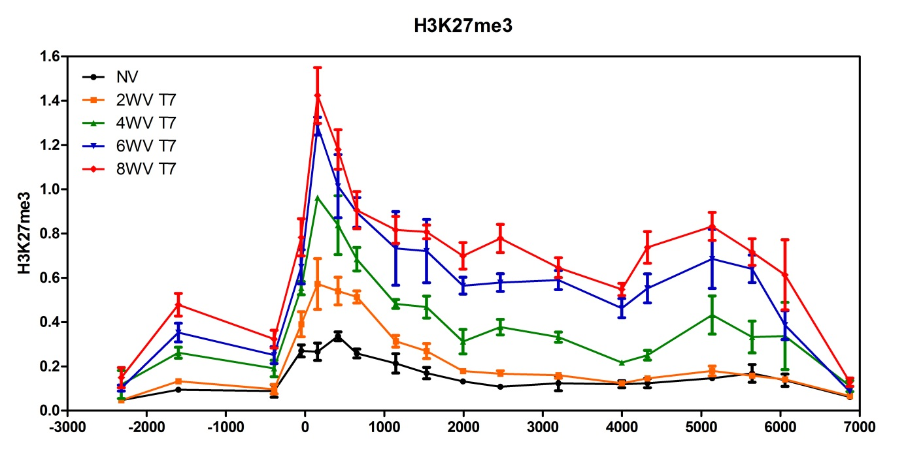
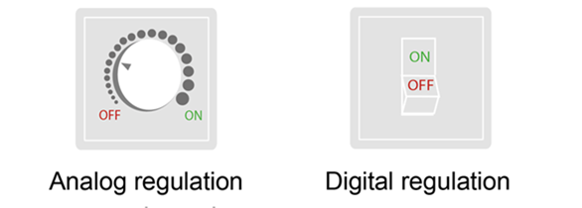
FLC epigenetic dynamics
7d in the warm after cold
More cold
FLC
Population level H3K27me3 levels at FLC reflect duration of cold exposure
Is response analog or digital?

Slide 18
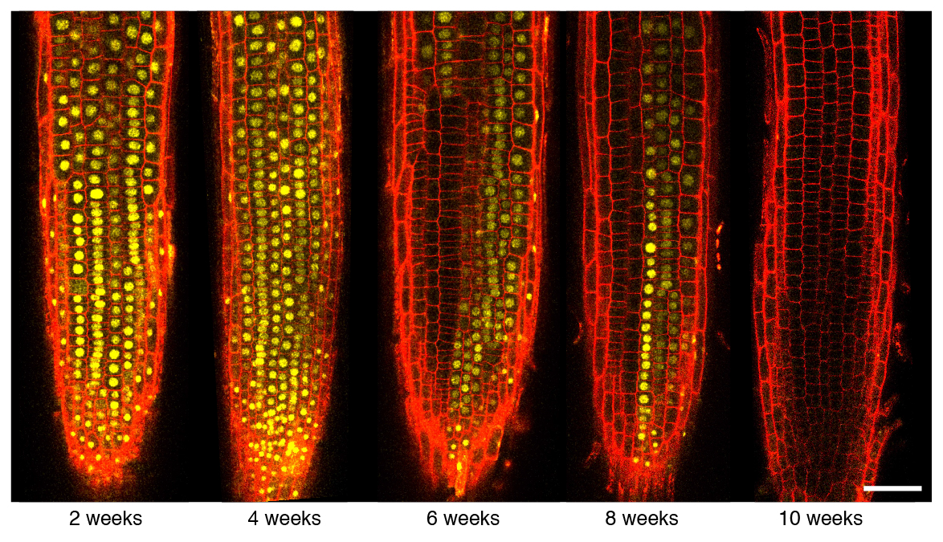
Testing the model: FLC-Venus timecourse
Digital bistability
Fraction of silenced cells increases with cold duration
Angel, … Dean, Howard: Nature (2011); Berry, … Dean, Howard: eLife (2015)

Slide 19
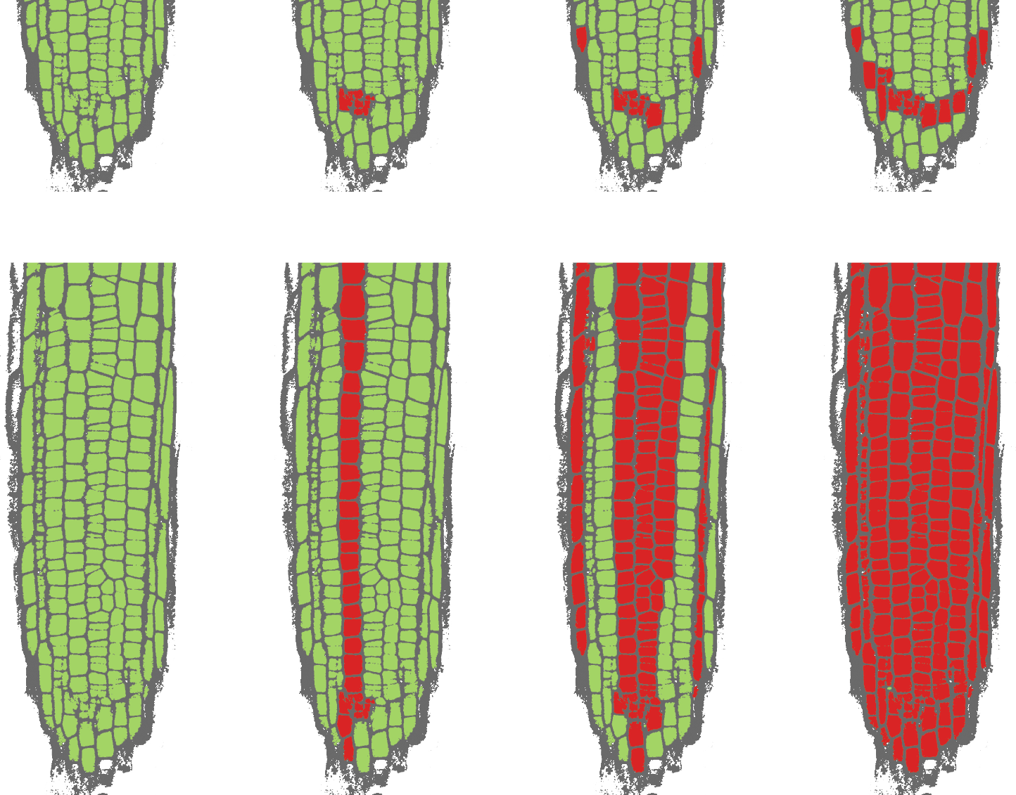
Direct visualisation of epigenetic memory
Weeks in cold –
stem cells
0
4
8
10
Green: ON
Red: OFF
Expression state of stem cells mitotically inherited in cell files
Switching
Growth back in warm
Maintenance
Angel, … Dean, Howard: PNAS (2015)

Slide 20
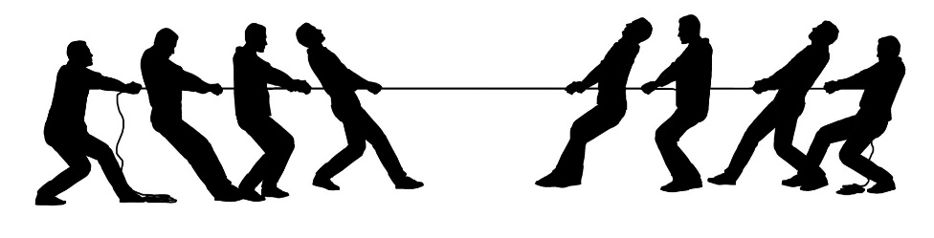


Simple model for epigenetic memory
ON
OFF
Transcription
Systems are bistable (digital)! Can only remember a or

Slide 21
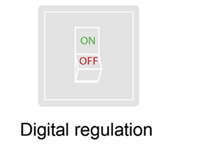

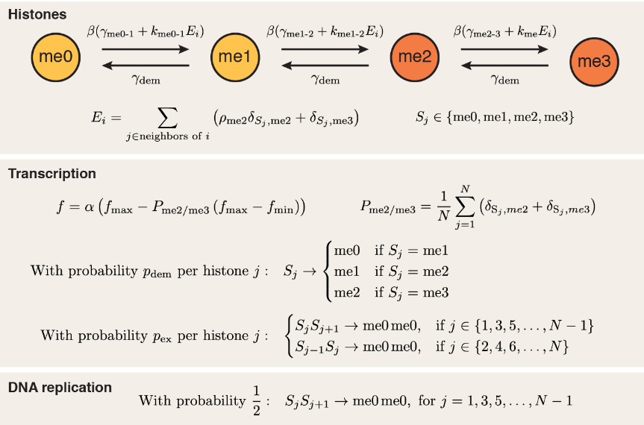
Model: transcription antagonises silenced state
Transcription factors
Berry, Dean, Howard: Cell Systems (2017)
Numerical simulations: stochastic spatiotemporal Gillespie algorithm

Slide 22
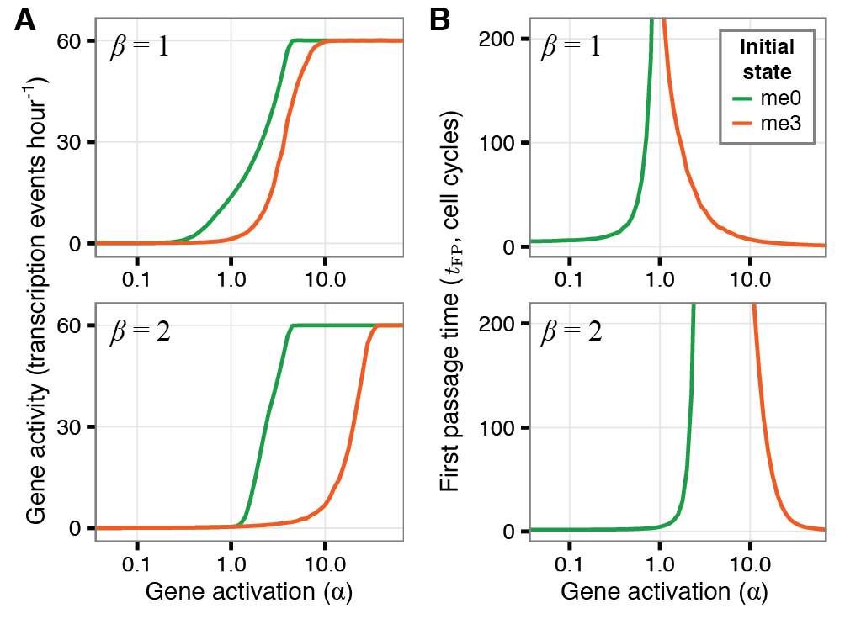
Consequences of integrating local and global gene regulation
Bistable states only exist within a range of transcription factor activation strengths
Berry, Dean, Howard: Cell Systems (2017)
Memory window
Transcription factor activation
Outside this region, global transcription factor regulation overrules local chromatin-based expression control

Slide 23

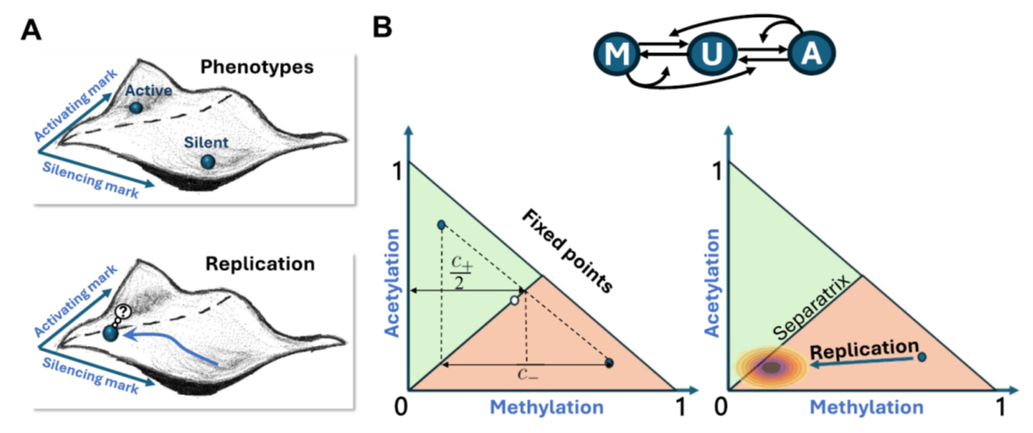
Model: simplified analytic approach
Can we analytically compute the switching rate from one epigenetic state to another?
Tough! System with “mesoscopic” number of memory elements (tens) and large fluctuations
Use simplified, symmetric model
Waddington landscape
activating
silencing
Movilla-Miangolarra & Howard: Phys. Biol. (2024)

Slide 24
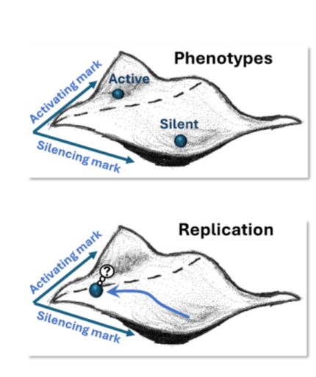
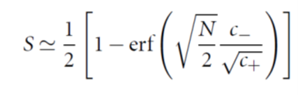
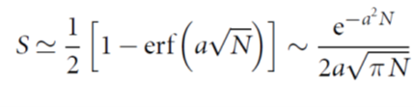
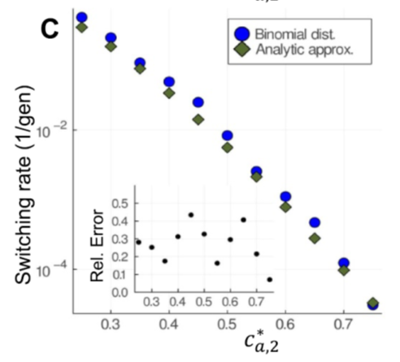
Model: simplified analytic approach
Assume only fluctuations are at replication, otherwise deterministic
Errors not too bad …
Movilla-Miangolarra & Howard: Phys. Biol. (2024)

Slide 25
Summary
Analogue versus digital gene expression
Epigenetic memory is usually digital
Nonlinear read-write feedbacks
FLC has been an excellent system to dissect mechanism
Additional biophysical problems: temperature sensing, extra memory elements, condensates, compaction …
Other types of memory: other histone modifications, DNA methylation
Application of non-equilibrium, multiscale, non-linear physics in a vital biological context

Slide 26
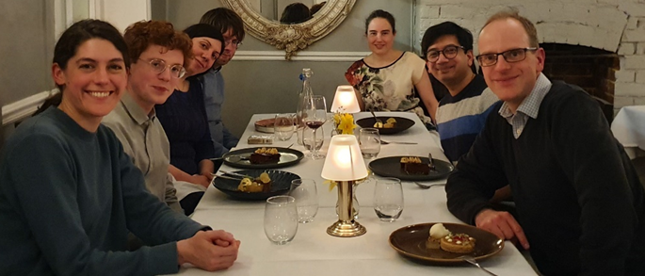

Howard Group (John Innes Centre)
Andrew Angel (Aberdeen) Scott Berry (UNSW Sydney) Robert Ietswaart (Harvard) Rea Antoniou-Kourounioti (Glasgow) Cecilia Lövkvist (Copenhagen)
Ander Movilla-Miangolarra (Barcelona)
Govind Menon (John Innes Centre)
Caroline Dean (John Innes Centre)

