Slide 1
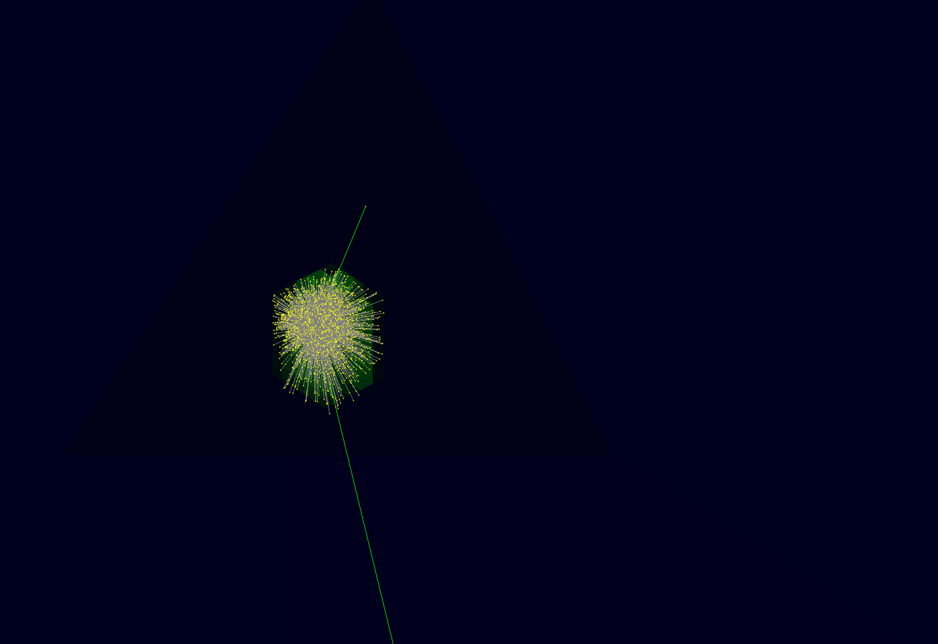
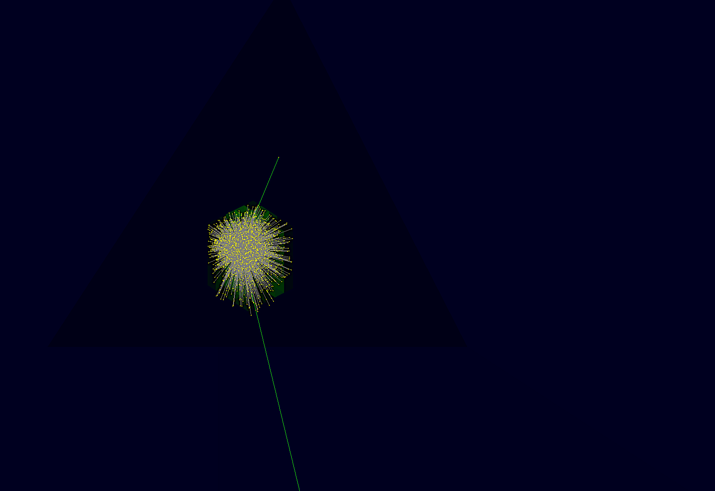
Detecting Steep Photons for Full Body PET
FJOnori

Slide 2
The Problem at Hand
Current PET systems can assume that photons arrive perpendicularly to the scintillator material.
This is not true for full body PET systems, meaning that the line of response is ambiguous.
If the scintillator could detect incoming angle of the steep photon, this ambiguity would be resolved.

Slide 4
?

Slide 5
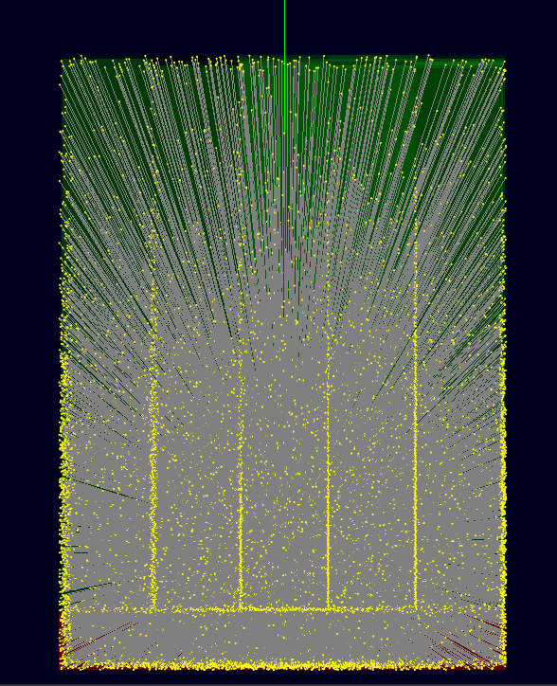

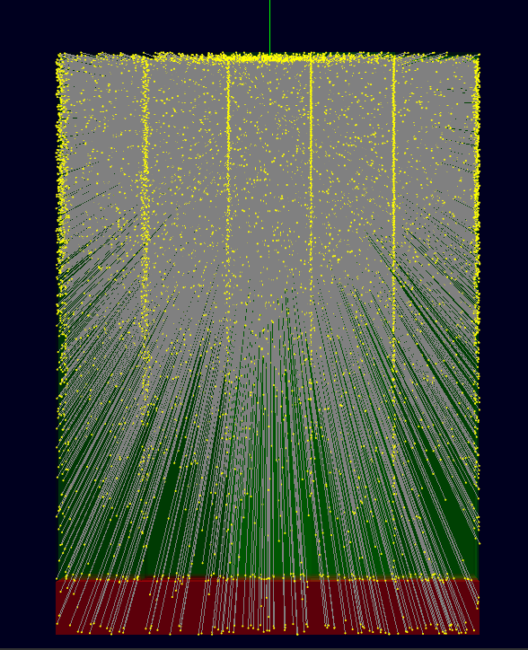

Slide 6
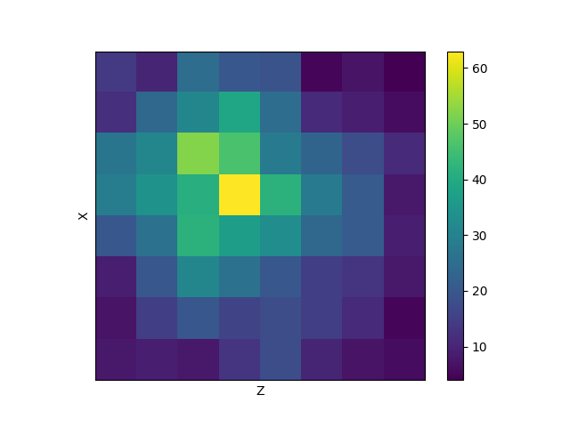
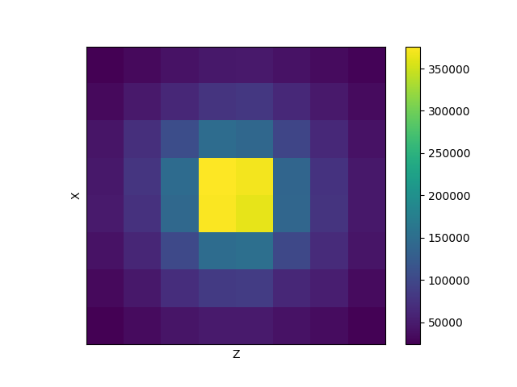
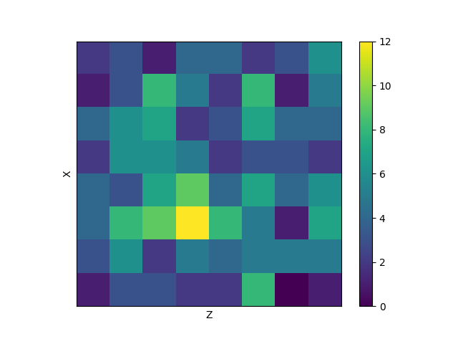
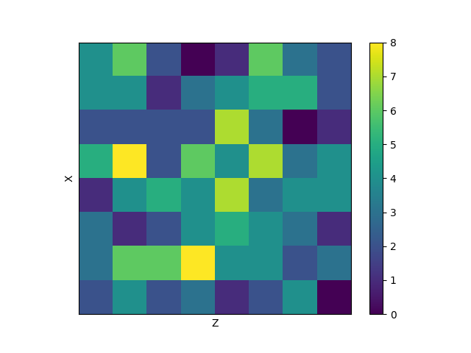

Slide 7
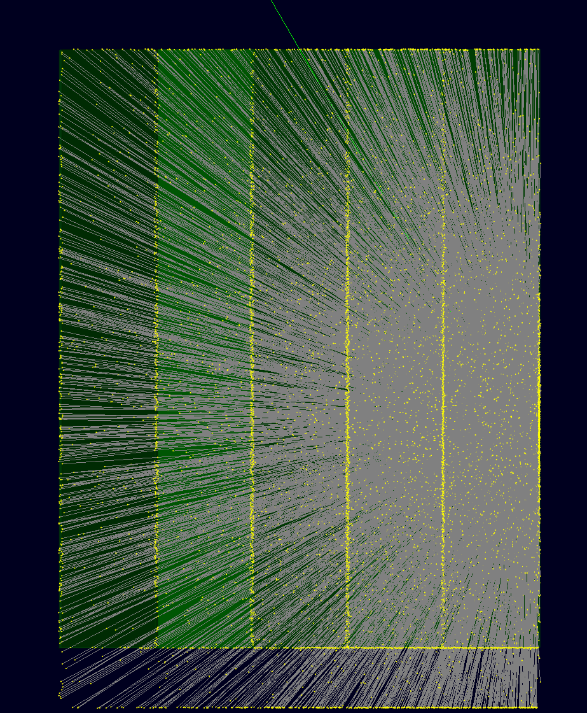

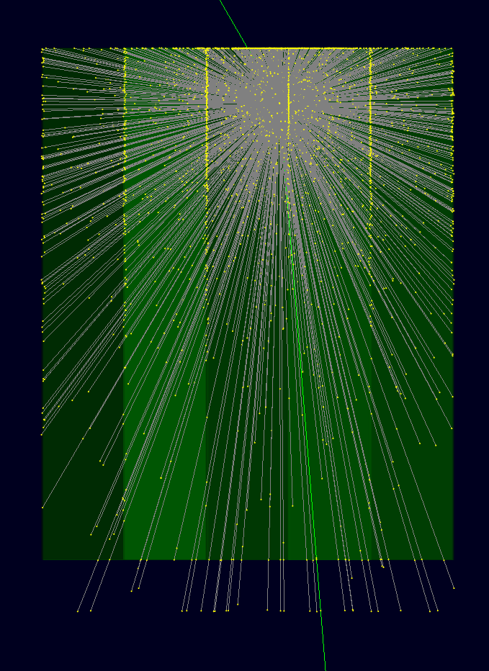

Slide 8
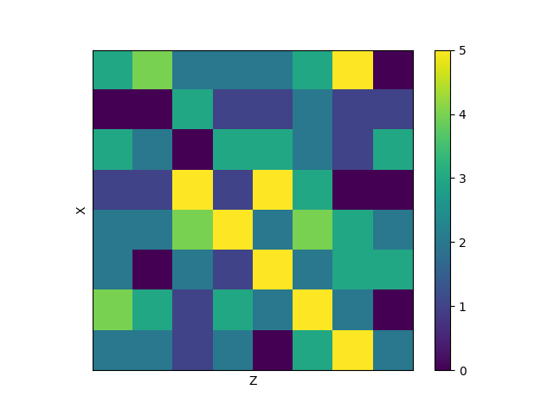
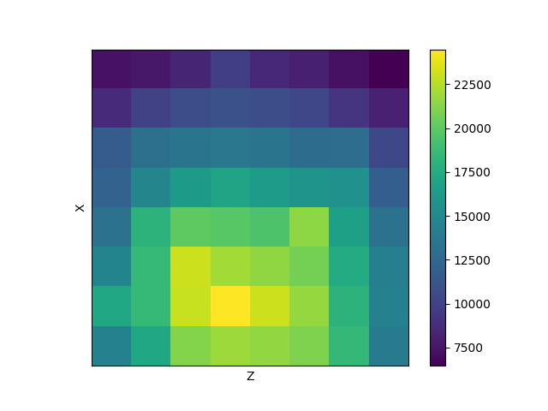
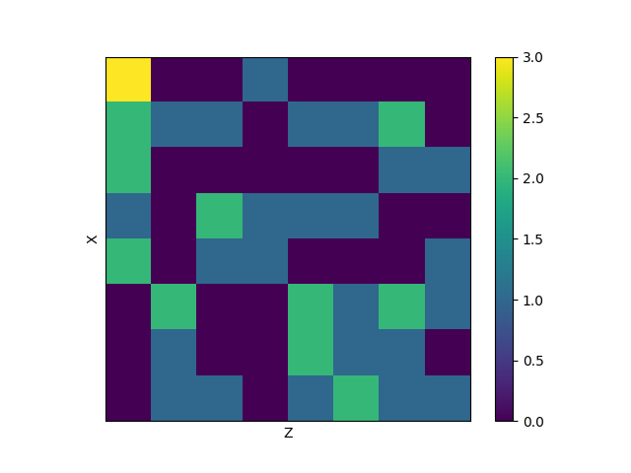
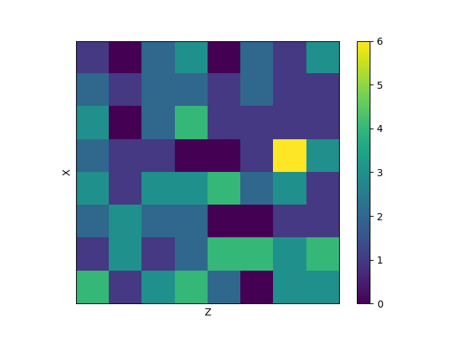

Slide 9
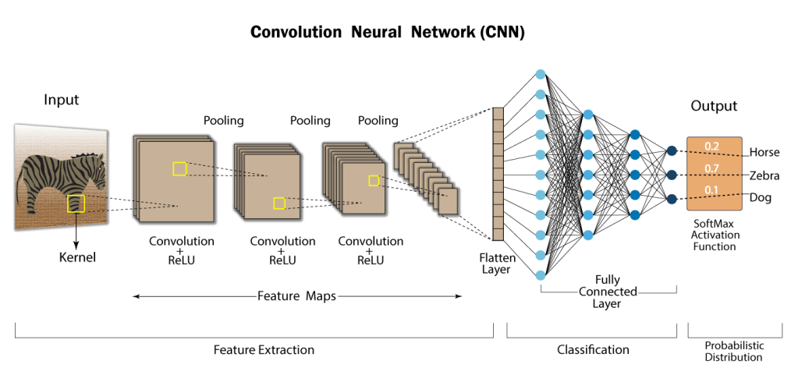
A Possible Solution
Each incident photon produces a distinct signal on the detector.
This signal is complex, but nevertheless, each incoming angle has a distinct but subtle signature.
Using new machine learning (ML) techniques and simulation software to generate training data, these signals could be classified.

Slide 10

Progress so Far
So far, I have explored the system analytically with theory.
I have generated the appropriate training data with GEANT4, and I am experimenting with DNNs, CNNs, and K nearest neighbor classification systems.
I have visualized simulated signals with 2D histograms and analyzed the data to understand possible bugs.

Slide 11
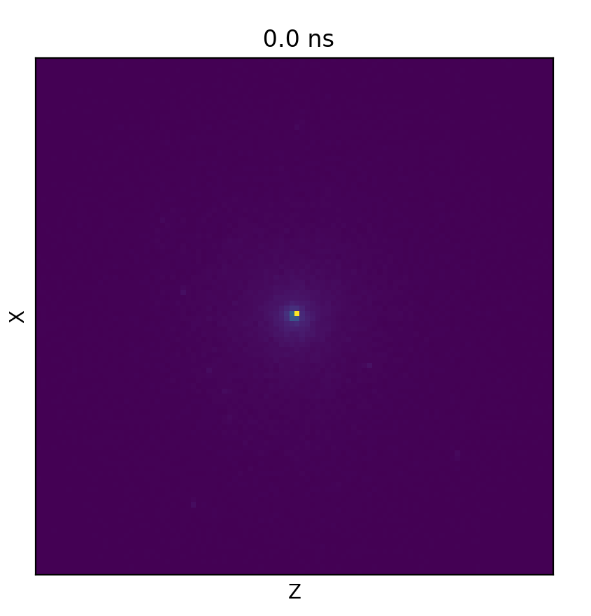
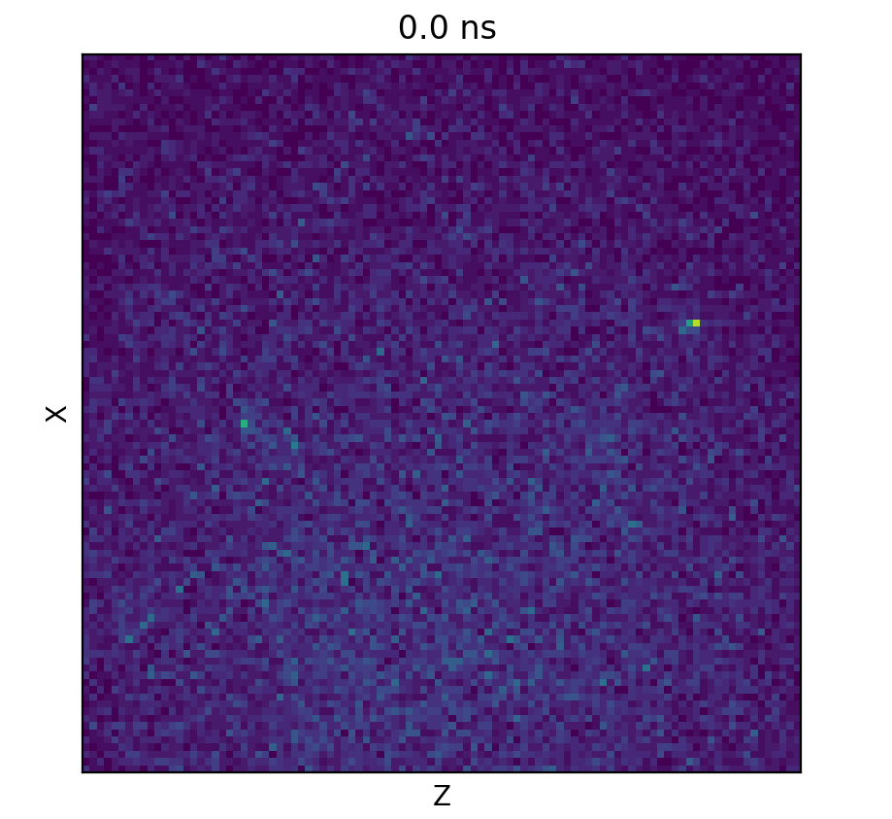
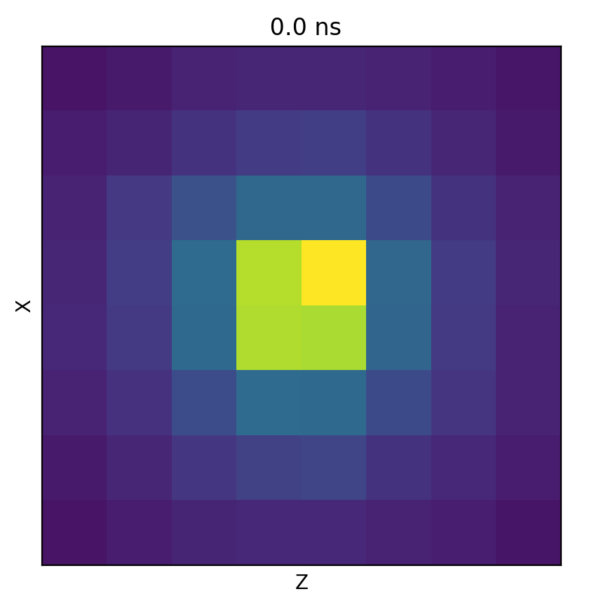
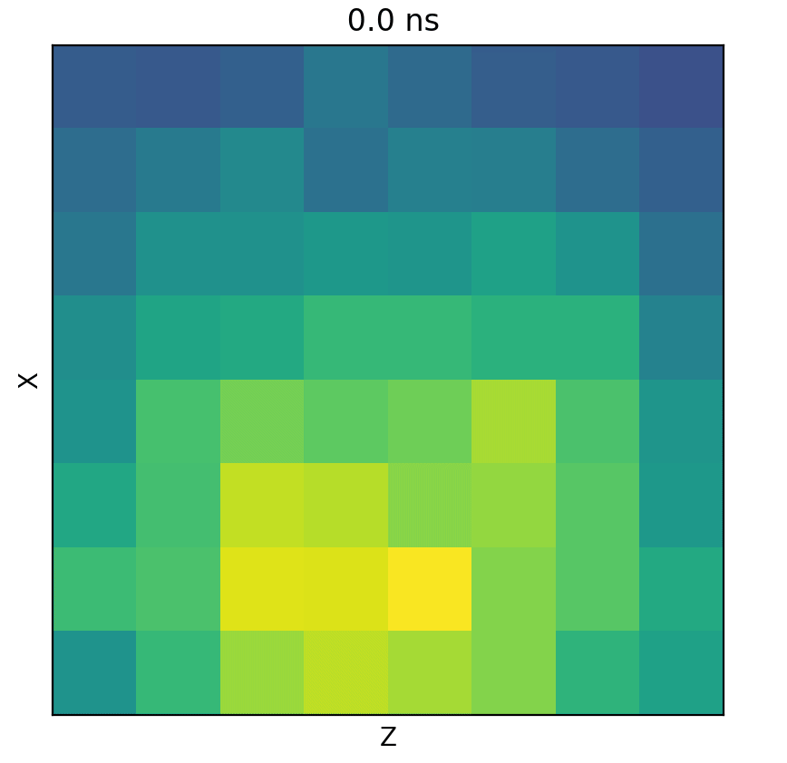
The normalized 3D signal distribution for a perpendicular entry and an entry 40 degrees from the vertical.
The different in signature should make the data separable by ML algorithms.
However, instabilities in the data must be considered for steep angles.

Slide 12
Future Plans
Find an optimal Neural Network architecture that has a high level of accuracy.
Experiment to find a lower bound on resolution without sacrificing accuracy.
Expand the system to understand DOI and entry position by implementing theoretical analysis.

