Slide 1
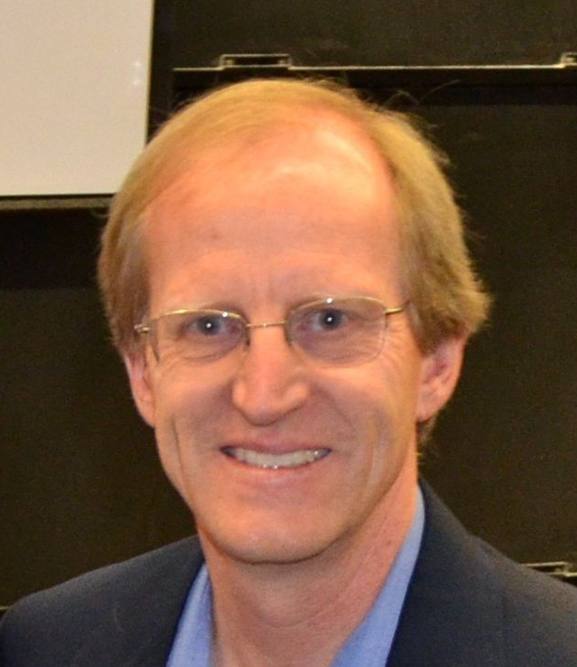



From Seeds to Fruit
David A. Kosower
Institut de Physique Théorique, CEA–Saclay
LanceFest
Higgs Center, University of Edinburgh
June 24–26, 2026

Slide 2
Happy Birthday, Lance!

Slide 3
Happy 65th Birthday, Lance!

Slide 4
Pursuit of Precision

Slide 5
Happy 65.0082nd Birthday, Lance!

Slide 6
Estimating Uncertainty

Slide 7
Happy 65.0082±0.0013th Birthday, Lance!

Slide 8
Let’s rewind three and a half decades

Slide 9
Rewind
The Cold War is over
No smartphones
No Google
Michael Jordan is starting an incredible run of titles with the Chicago Bulls
arXiv was just getting started

Slide 10
Rewind
Computing helicity amplitudes had been introduced by Lance’s colleague James Bjorken; but they were exotica
  Quiz: besides SLAC, how were Bj and Lance colleagues?
The Parke–Taylor amplitude was known
—but it was thought of as an unusual special case
Mangano & Parke Physics Report captured the state of the art
There were a variety of spinor-helicity formalisms
We had the Xu–Zhang–Chang representation of polarization vectors “Chinese magic”

Slide 11
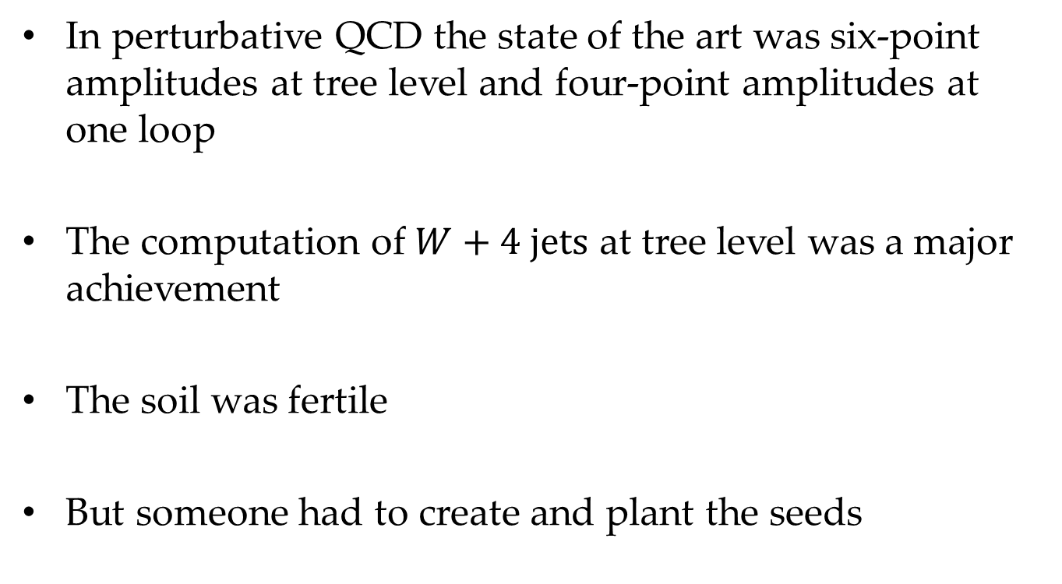
Rewind
In perturbative QCD the state of the art was six-point amplitudes at tree level and four-point amplitudes at one loop
The computation of $W+4 jets$ at tree level was a major achievement
The soil was fertile
But someone had to create and plant the seeds

Slide 12
Rewind
Lance was a young faculty member at SLAC
Zvi & I had been toiling towards using string amplitudes to calculate the one-loop four-point amplitude in Yang–Mills
  This irritated Keith Ellis greatly
  He eventually got over it
On the way, we showed (in a now-forgotten paper) how to derive color factors from string theory

Slide 13
Seeds
A secret: Lance was the referee
He could see the potential lying beyond a very technical yet ultimately not very profound paper
He got interested — helped also by Witten’s letter for Zvi
A bit of serendipity: Zvi visited SLAC because his in-laws lived nearby; Lance & Zvi started talking
We started working together

Slide 14
Context
Jet algorithms were in their infancy
Approximations to tree-level amplitudes were the subject of research papers
The SSC was coming!
(until it wasn’t)
Lance & friends took the next step: compute the five-gluon amplitude

Slide 15
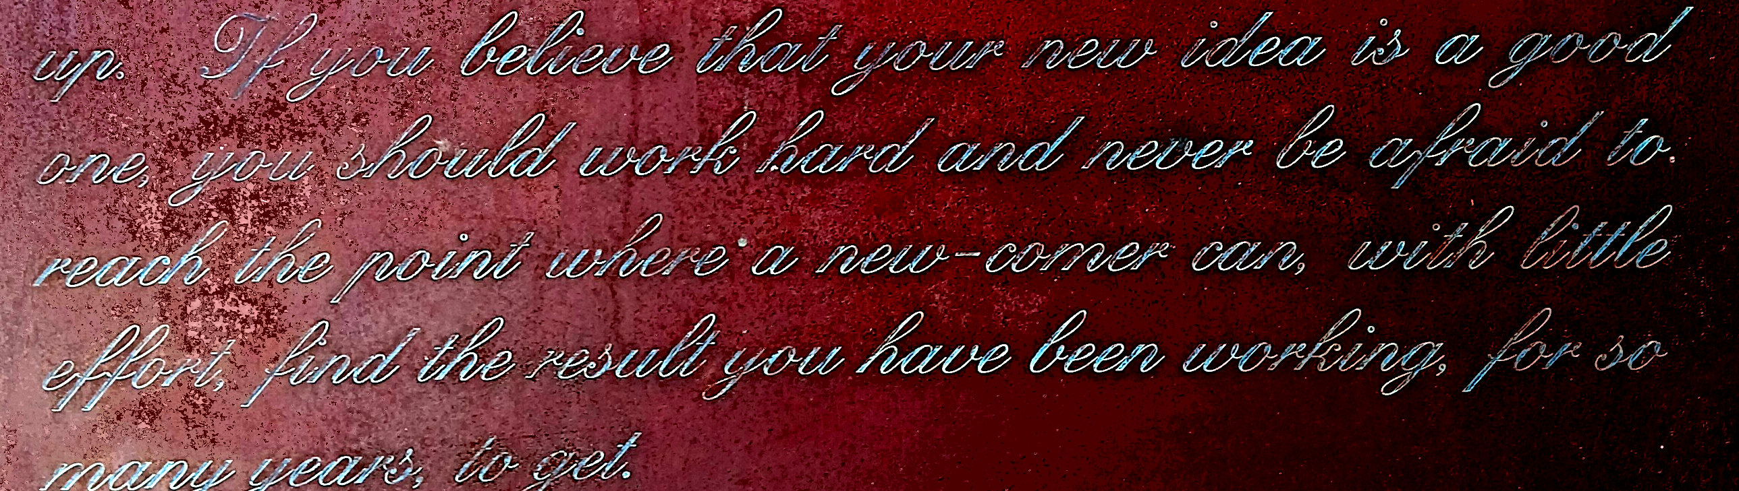
A First Step
Today it would be considered a straightforward starting exercise for a beginning graduate student
That’s a sign of progress and advance in technology
—I. I. Rabi
A journey of a thousand miles begins with a single step
— Chinese proverb

Slide 16
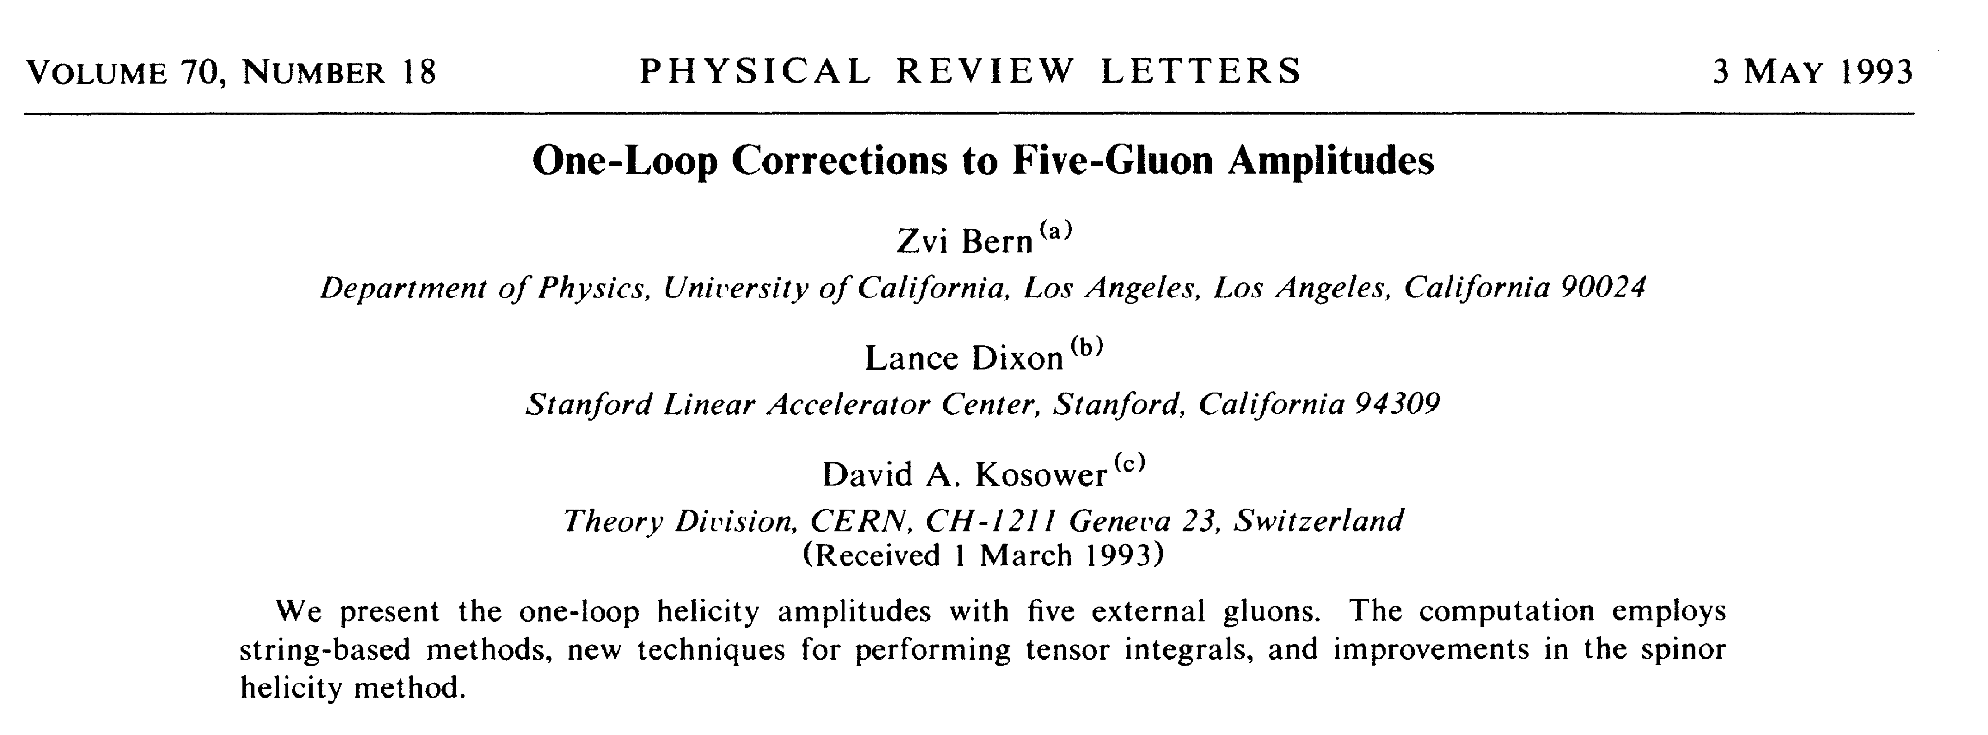
The first step was understanding five-point one-loop integrals
And then
Now-overlooked paper (still #22 on Lance’s citation list)
But an important seed

Slide 17
Five Gluons
String-based calculation
Set the state of the art at the time
Eliminated rather than favored spinor products to simplify expressions
Still checking gauge invariance
Supersymmetric decomposition
Infrared separation
Functions built out of polylogarithms to eliminate spurious singularities

Slide 18
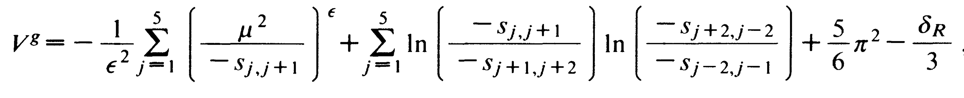
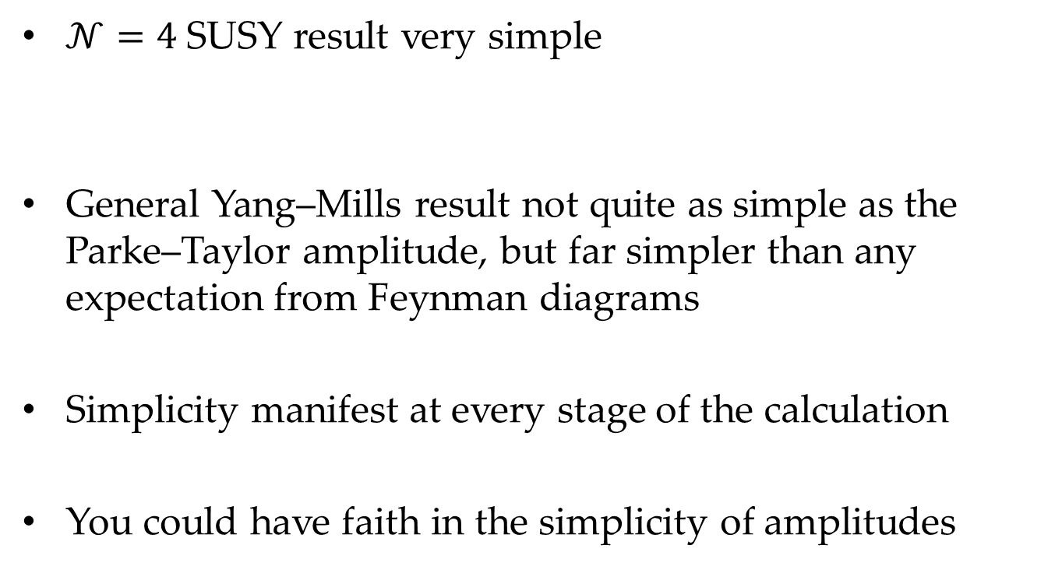
Five Gluons: Lessons
$𝒩=4$ SUSY result very simple
General Yang–Mills result not quite as simple as the Parke–Taylor amplitude, but far simpler than any expectation from Feynman diagrams
Simplicity manifest at every stage of the calculation
You could have faith in the simplicity of amplitudes

Slide 19
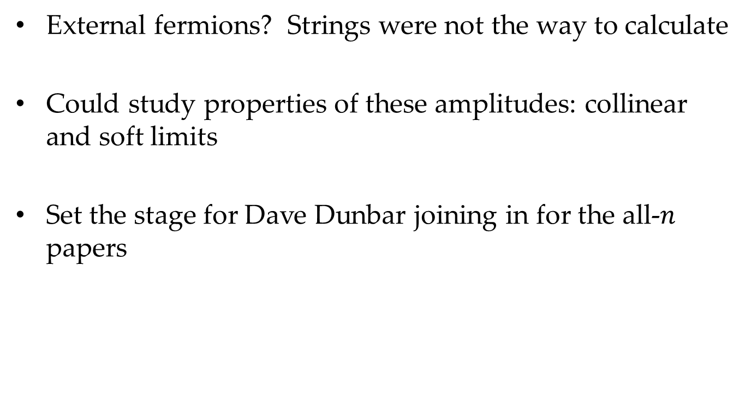
Five Gluons: Lessons
External fermions? Strings were not the way to calculate
Could study properties of these amplitudes: collinear and soft limits
Set the stage for Dave Dunbar joining in for the all-$n$ papers

Slide 20
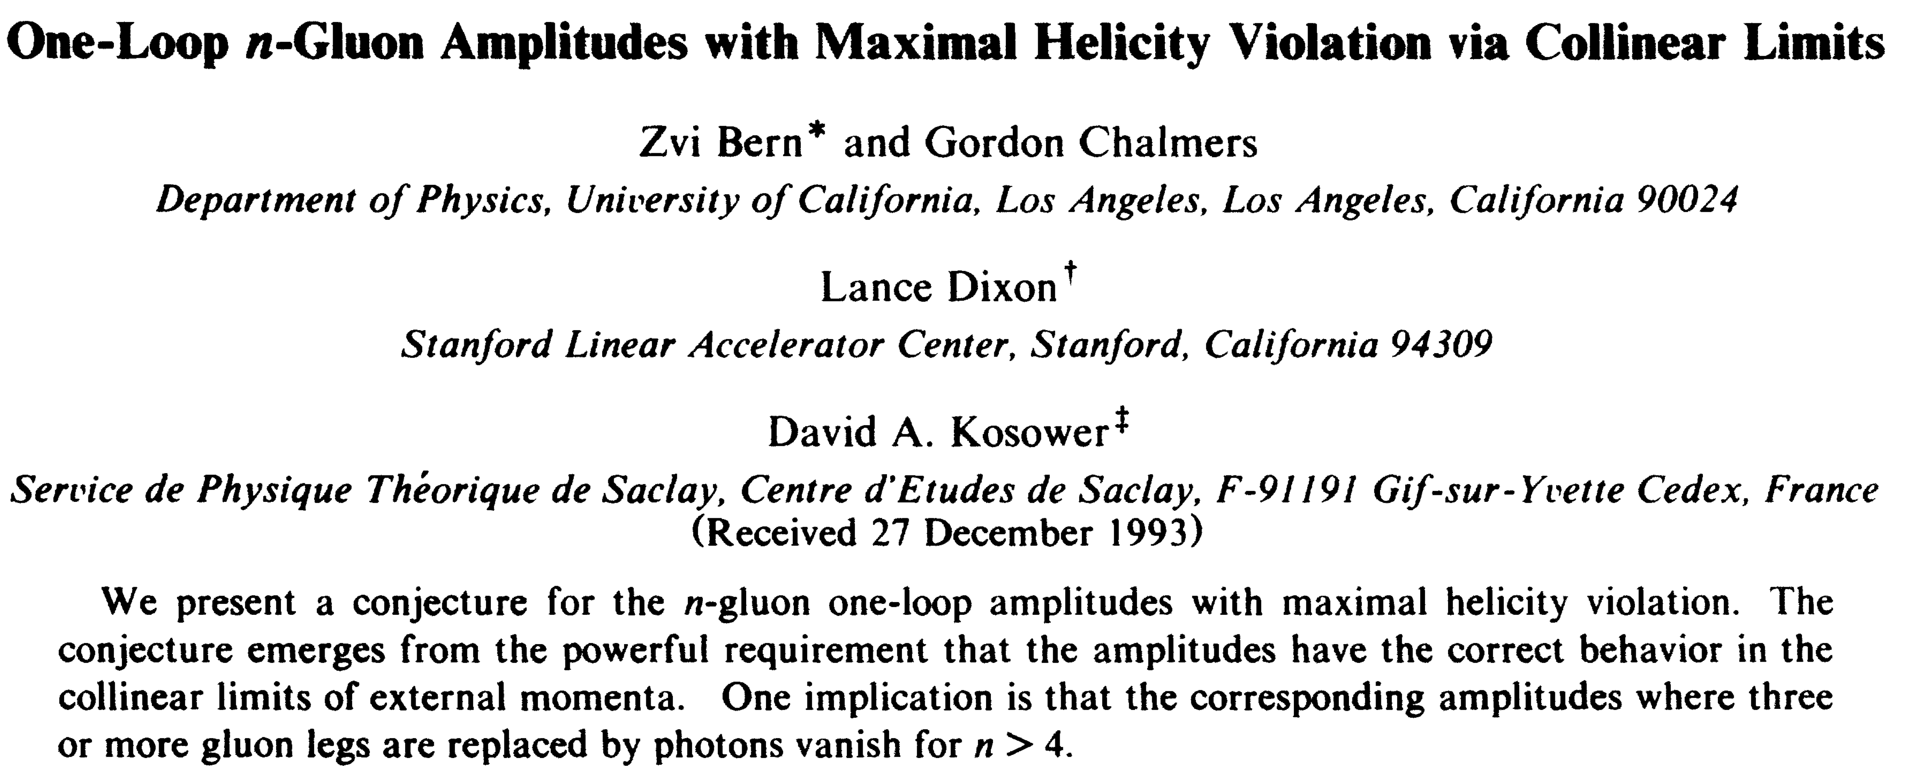

All-$n$ Amplitudes
But before that, with Zvi’s student Gordon Chalmers
Lesser-known paper (#48 on Lance’s list)
All-plus amplitude
Collinear limits + five-point amplitude ⇒ “conjecture”
(Proven by Mahlon, with an amusing priority skirmish)

Slide 21
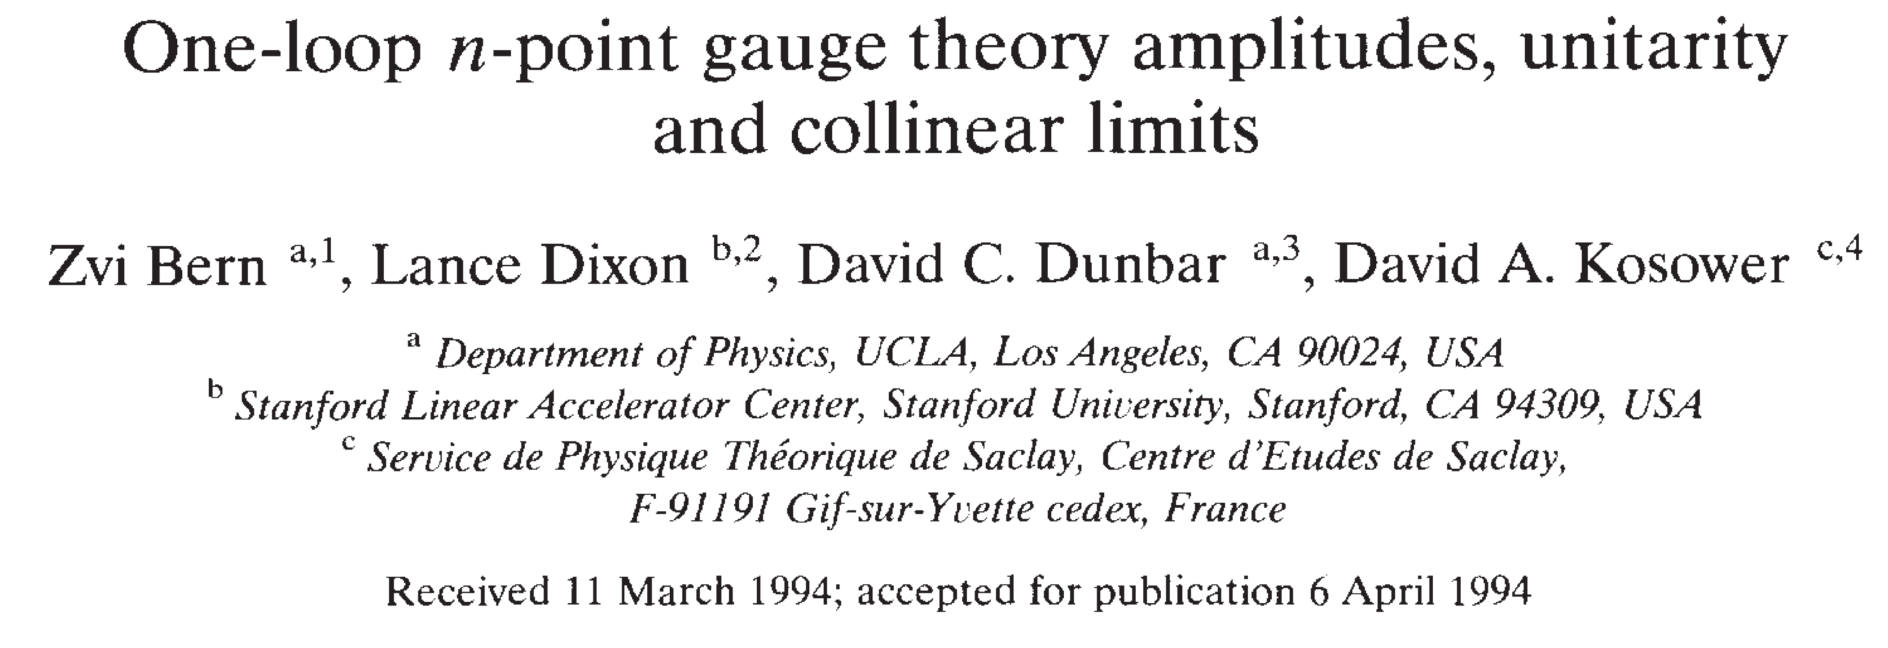
All-$n$ Amplitudes
#3 on Lance’s most-cited papers
Trace development of amplitude techniques

Slide 22
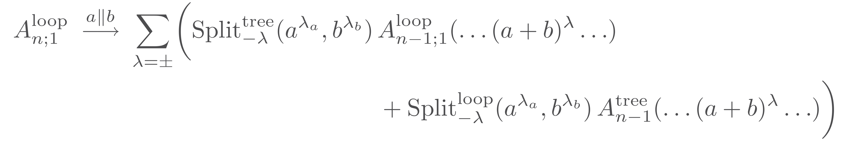
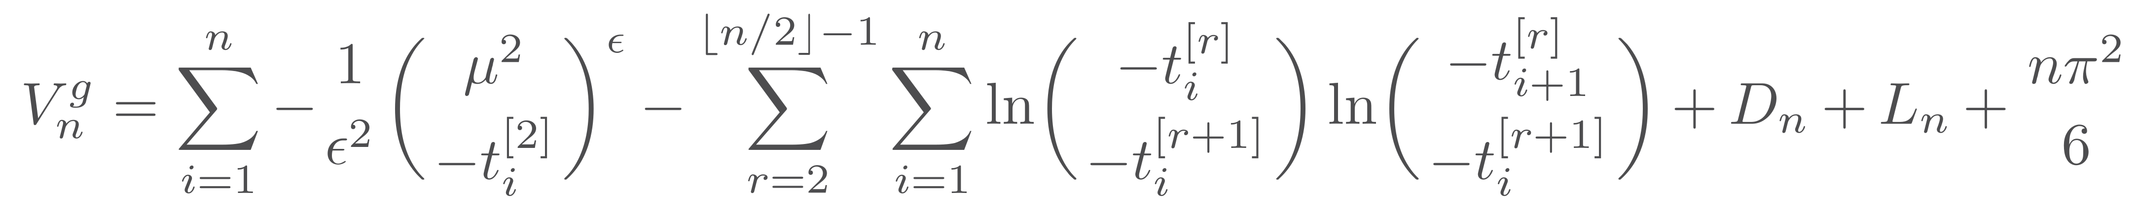
All-$n$ Amplitudes
Collinear limits from five-point amplitude
Universality of collinear behavior
Knowledge of which integrals can appear
⇒ Ansatz

Slide 23
All-$n$ Amplitudes
Ordinary unitarity as a check
Supersymmetry to rule out polynomial terms
Color identities to reduce computational load in subleading color terms

Slide 24
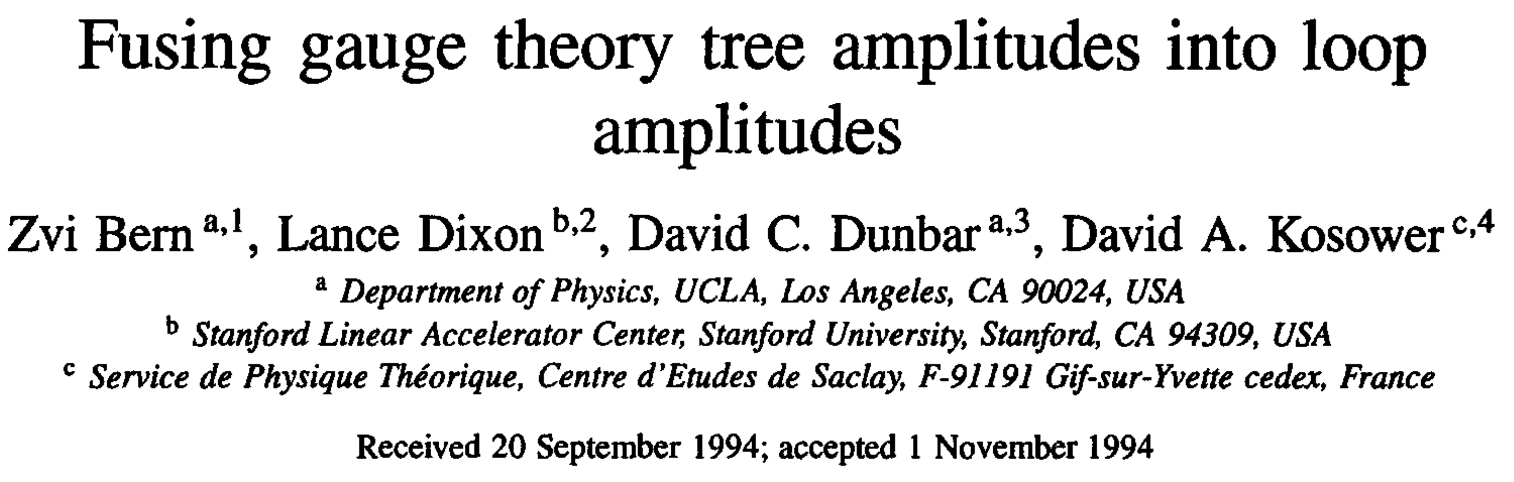
All-$n$ Amplitudes
#5 on Lance’s most-cited papers
Growing confidence in unitarity as a means of calculating
Cut constructibility

Slide 25
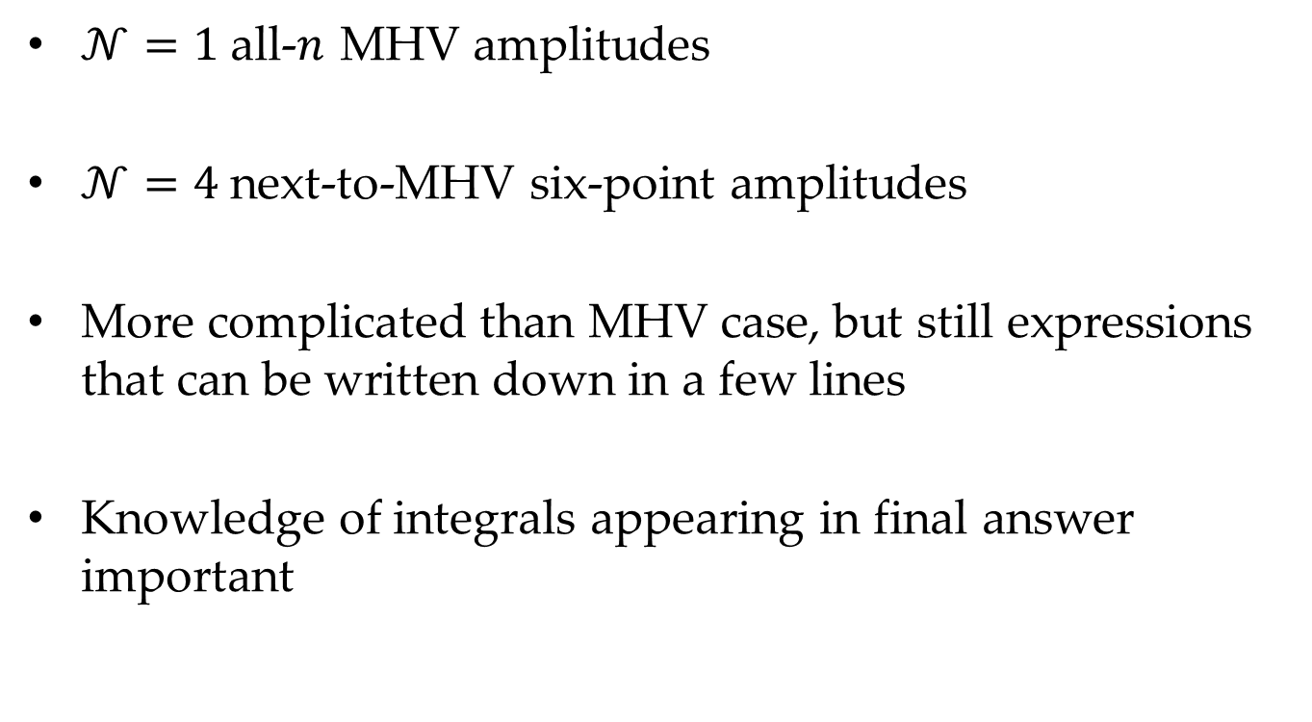
All-$n$ Amplitudes
$𝒩=1$ all-$n$ MHV amplitudes
$𝒩=4$ next-to-MHV six-point amplitudes
More complicated than MHV case, but still expressions that can be written down in a few lines
Knowledge of integrals appearing in final answer important

Slide 26
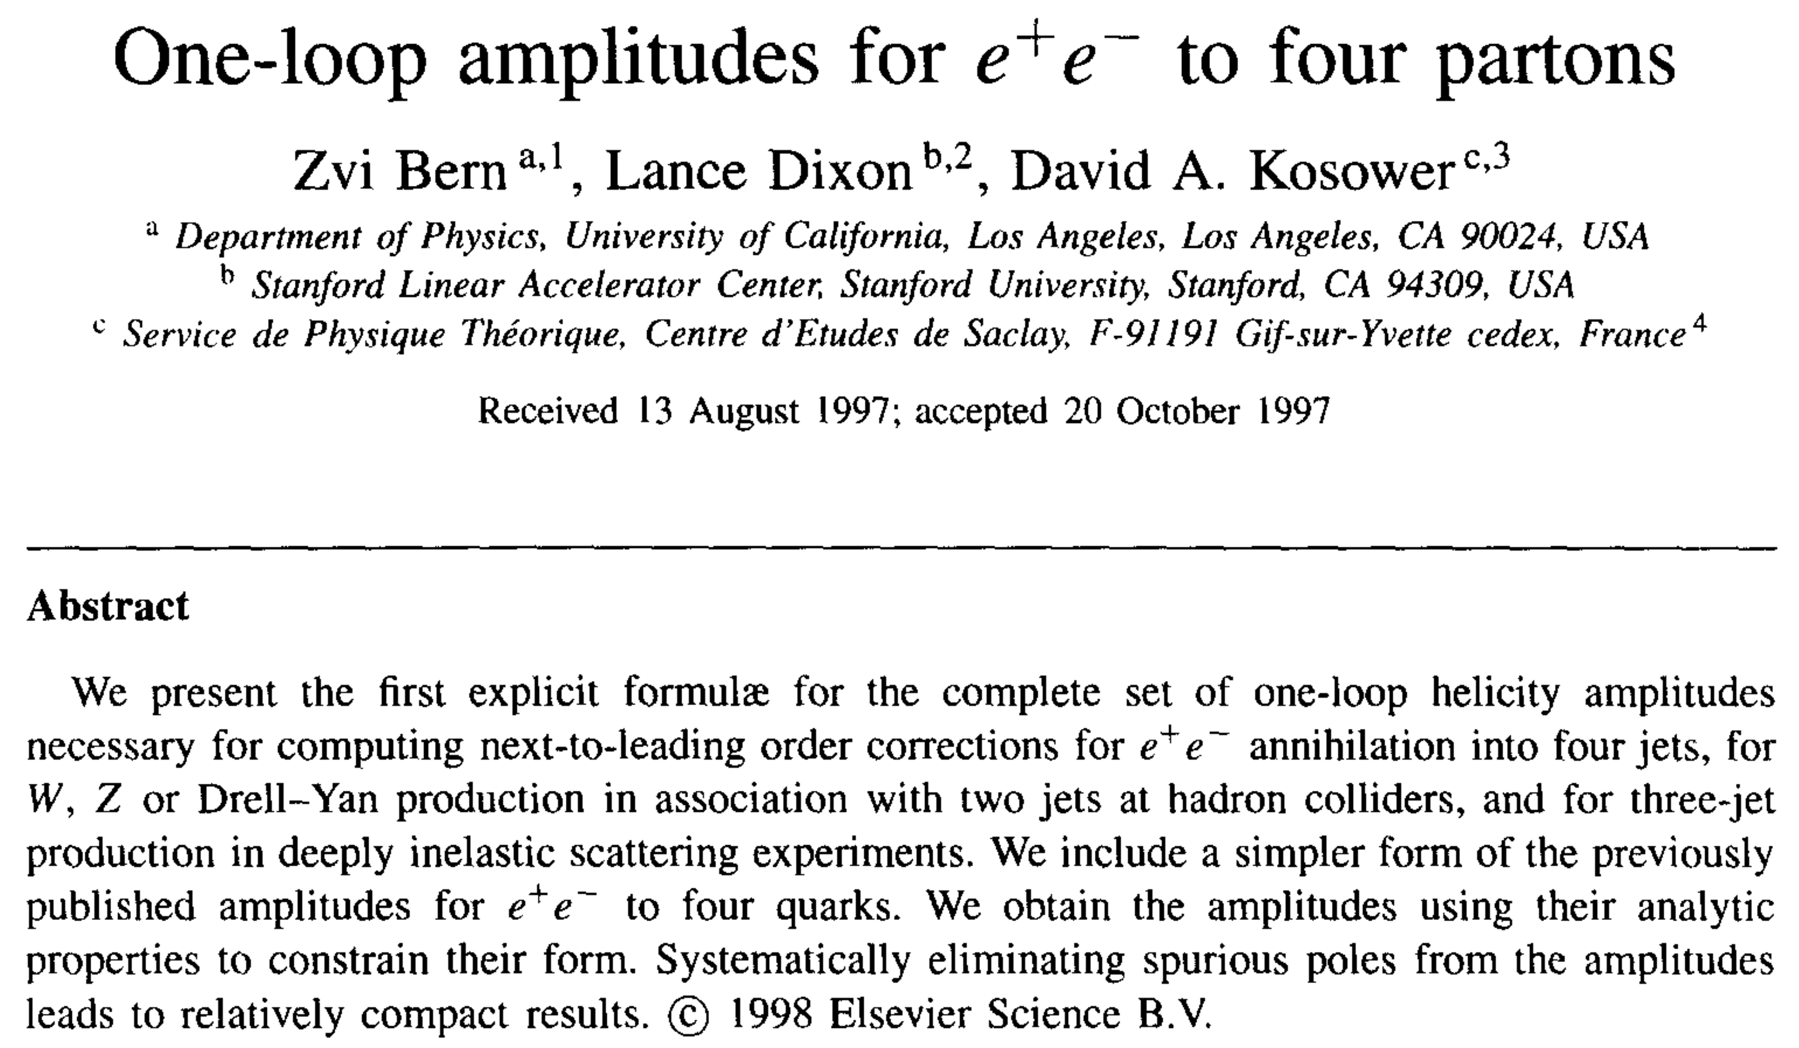
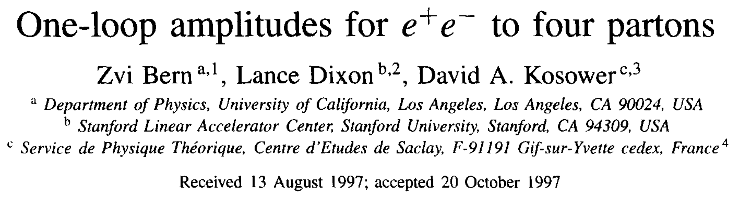

QCD
Supersymmetry was fun and instructive
Needed QCD for applications to real-world physics
It was the LEP era
#13 on Lance’s list
(An earlier paper with Stefan Weinzierl as well did $e^{+}e^{−}→\overline{q}q\overline{Q}Q$)

Slide 27
QCD
Amplitudes philosophy is taking shape: “amplitudes directly from their analytic properties instead of from Feynman diagrams”
Ordinary unitarity for cut-constructible terms
Factorization for rational terms
Functions designed to remove spurious singularities

Slide 28
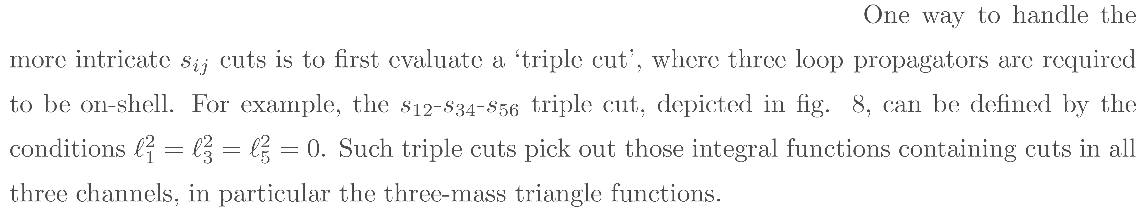
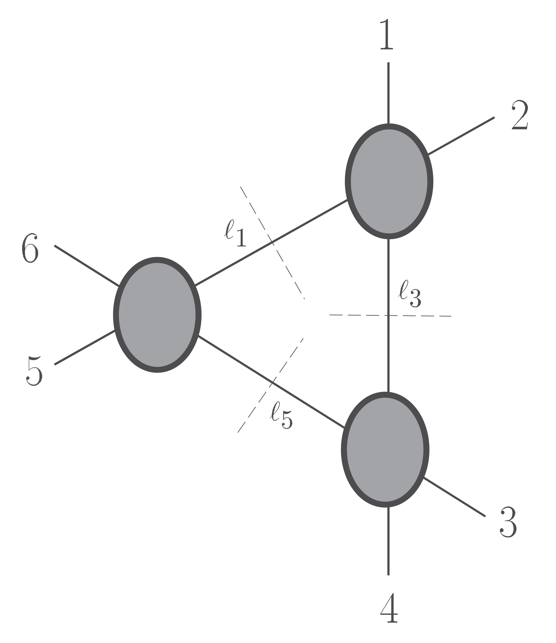
Seeds of Generalized Unitarity
Triple cuts as a means of separating contributions
Figure not only long before ChatGPT,
but also before JaxoDraw, tikz, …
Not yet a core part of a calculation

Slide 29
Crossing the Desert
Most of the QCD community ignored these calculations
Some senior figures were supportive – Al Mueller, George Sterman – but they weren’t working directly on multijet physics
Zoltan Kunszt took the ideas seriously, and started competing (alongside student Adrian Signer and postdoc Zoltan Trocsanyi)

Slide 30
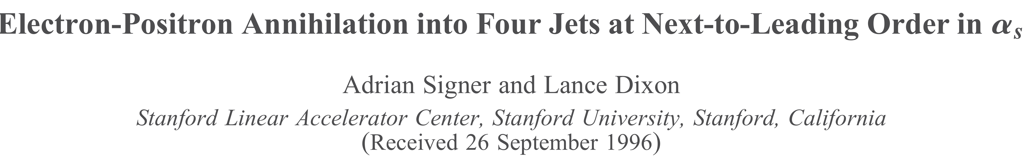
Phenomenology
Competition was friendly enough that Lance invited Signer as a postdoc to SLAC and of course collaborated with him
Four jets (leading color)
First start-to-finish application of Amplitudes technology

Slide 31
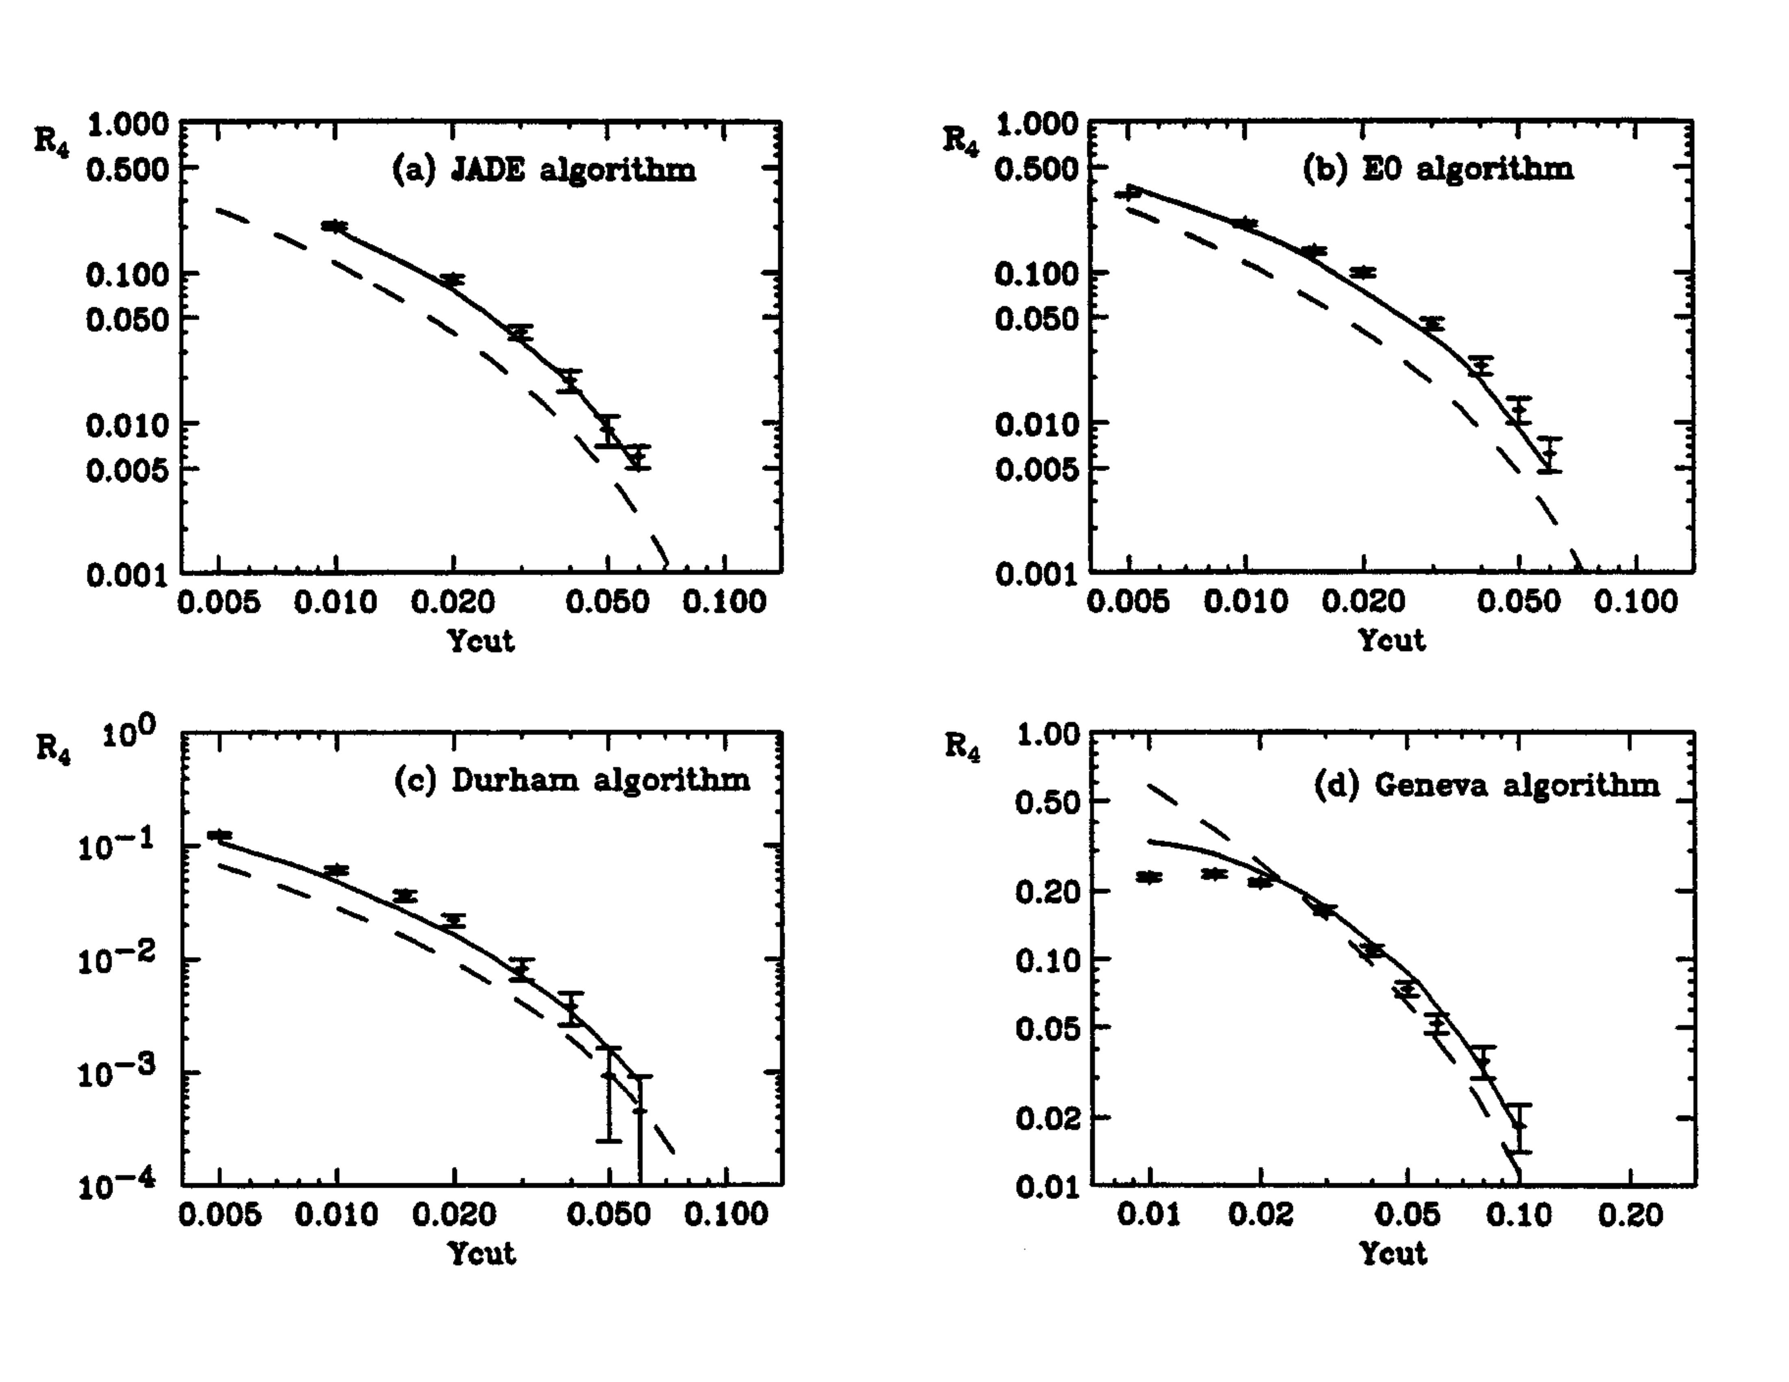

Phenomenology
Differential cross sections as a function of jet cut $y$ for several different algorithms
Selection of jet algorithms were still immature, even in $e^{+}e^{−}$

Slide 32
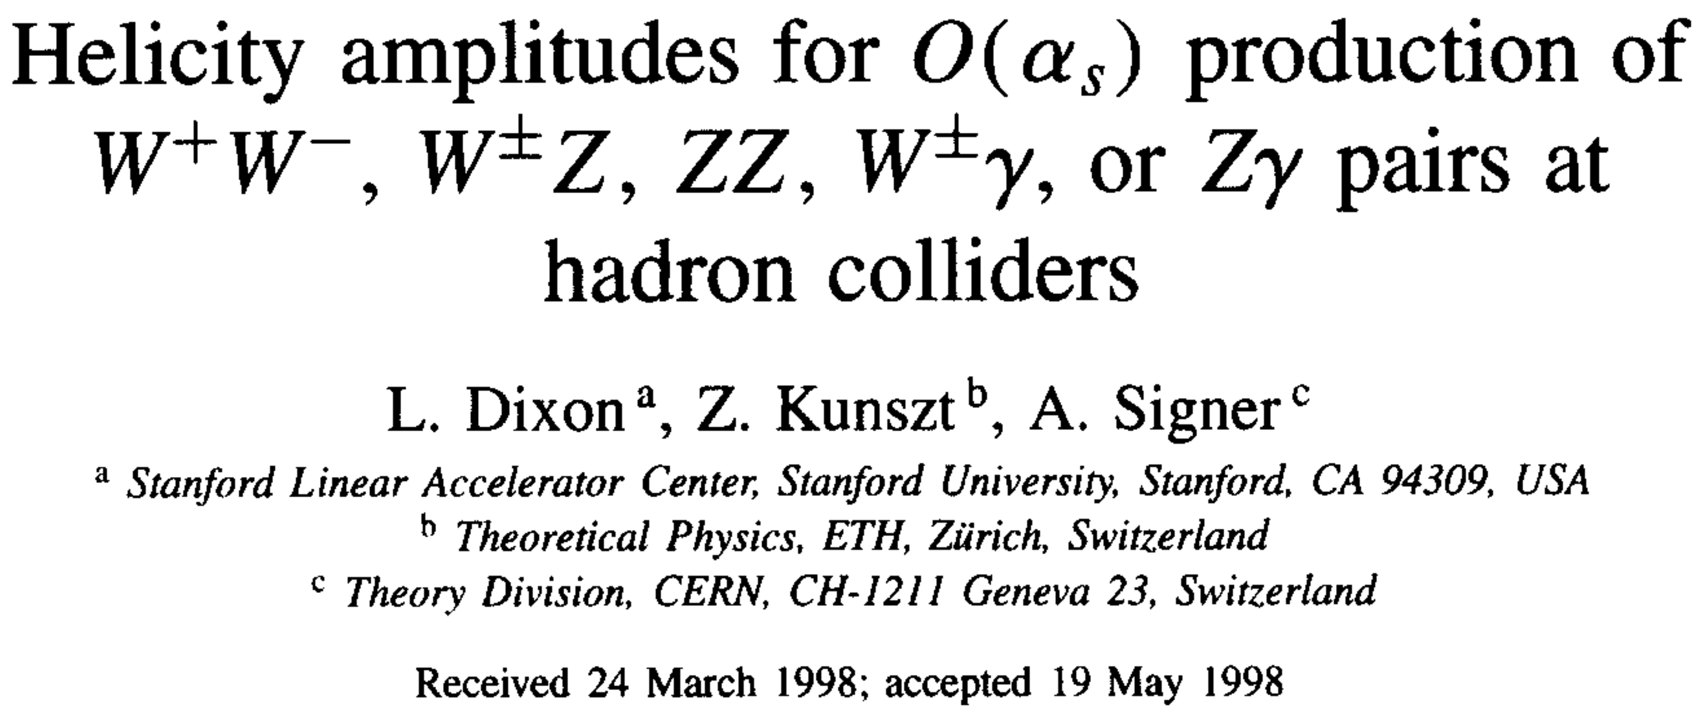
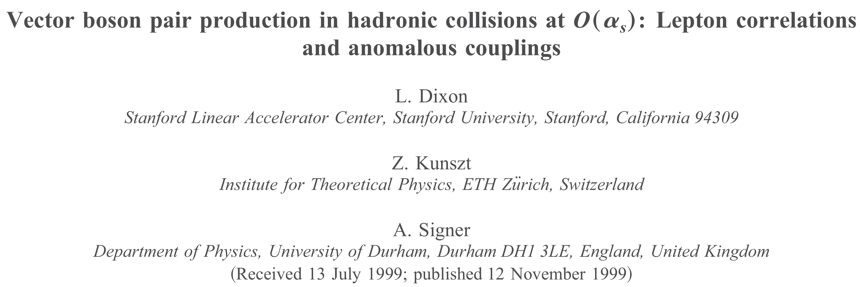
Phenomenology
Di-vector production amplitudes with Kunszt and Signer
and Tevatron phenomenology

Slide 33
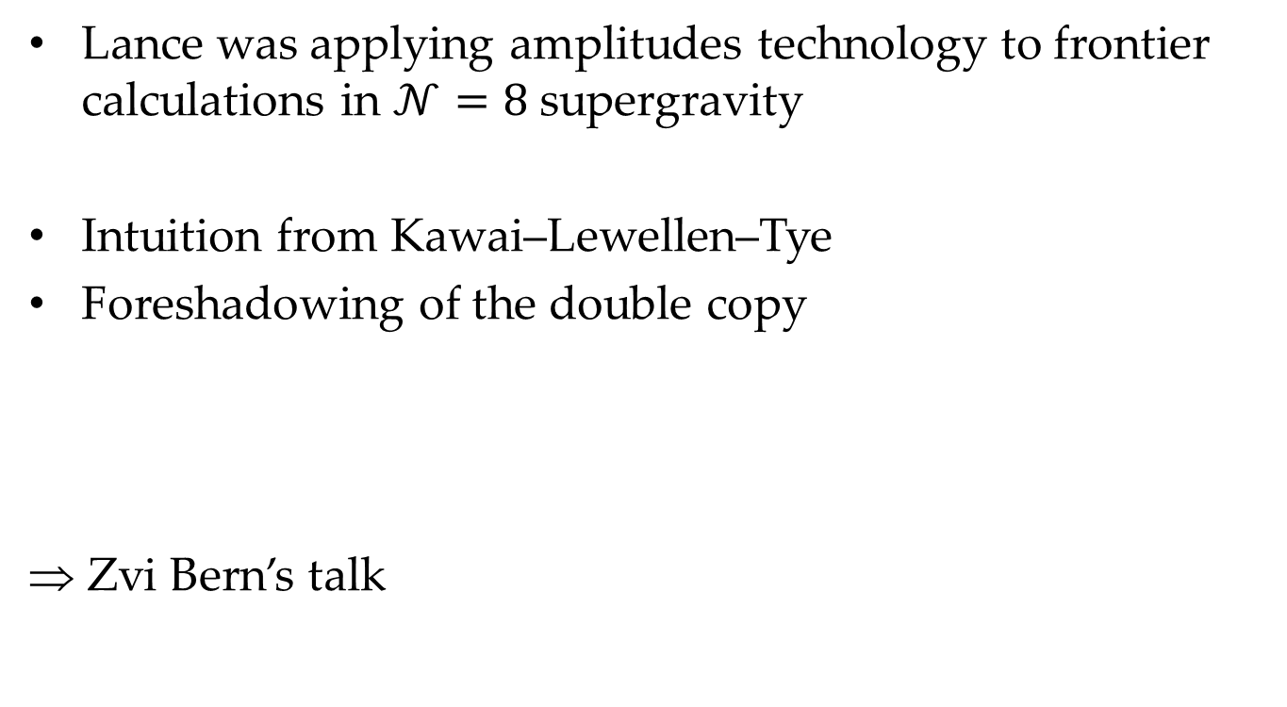
Supergravity
Lance was applying amplitudes technology to frontier calculations in $𝒩=8$ supergravity
Intuition from Kawai–Lewellen–Tye
Foreshadowing of the double copy
⇒ Zvi Bern’s talk

Slide 34
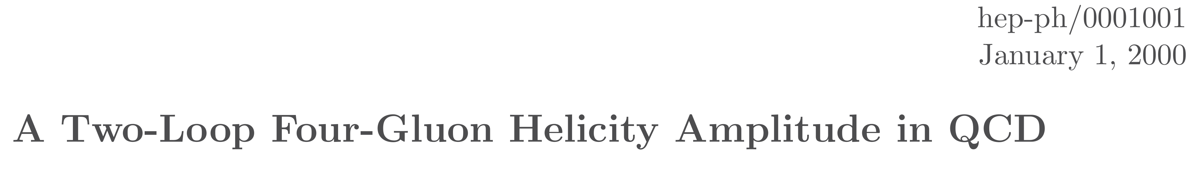

A Two-Loop QCD Foray
To usher in the new millenium, a calculation of the two-loop contributions to $A_{4}(+ + ++)$
Still noting that Feynman diagrams were not used

Slide 35
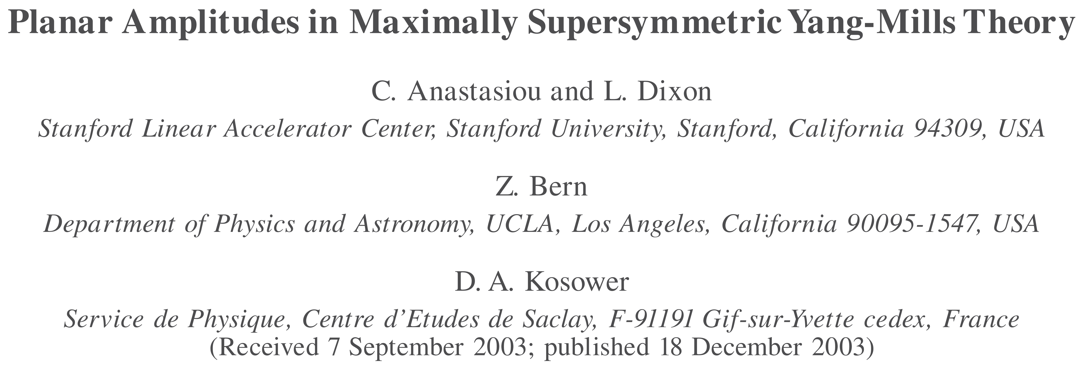

Seeds of All-Loop Behavior
Another lesser-known paper (#25 on Lance’s list)
Knew two-loop four-point result from Zvi, Rozowsky & Yan
Knew one-loop collinear splitting amplitude in $𝒩=4$ sYM
With the addition of Babis Anastasiou, Lance & friends computed the two-loop collinear splitting amplitude in $𝒩=4$ sYM

Slide 36
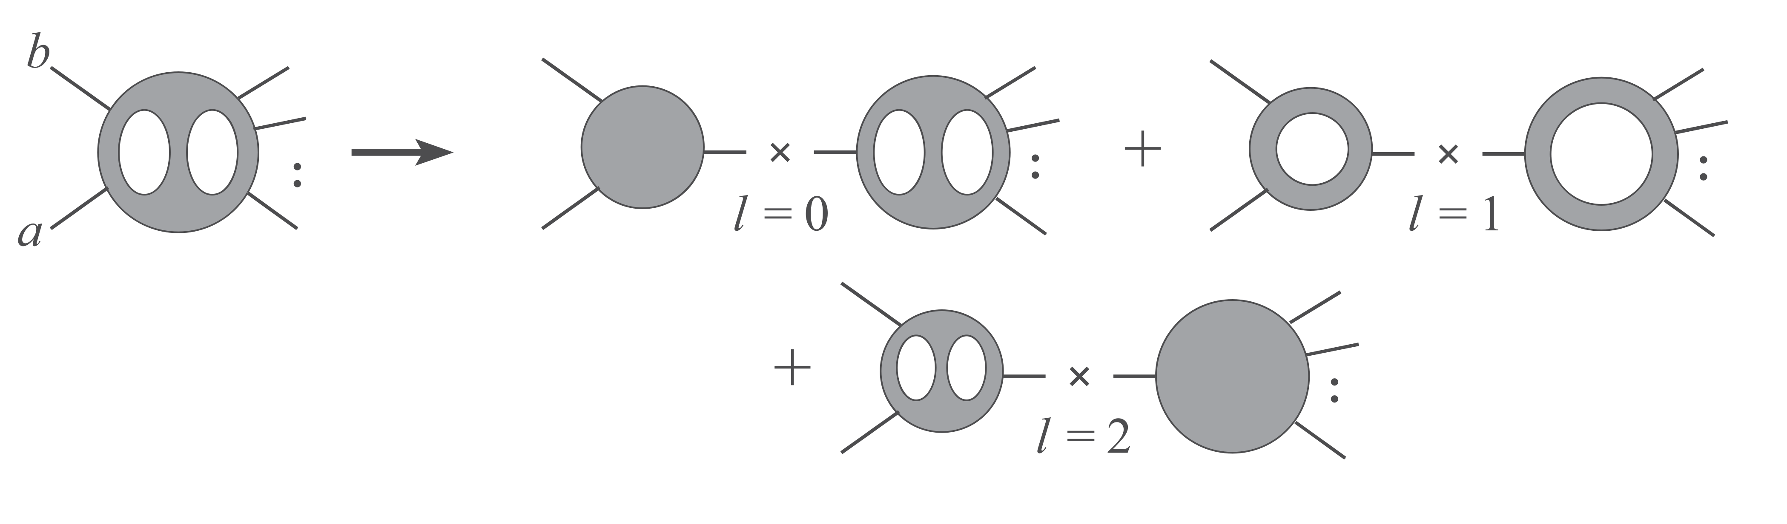
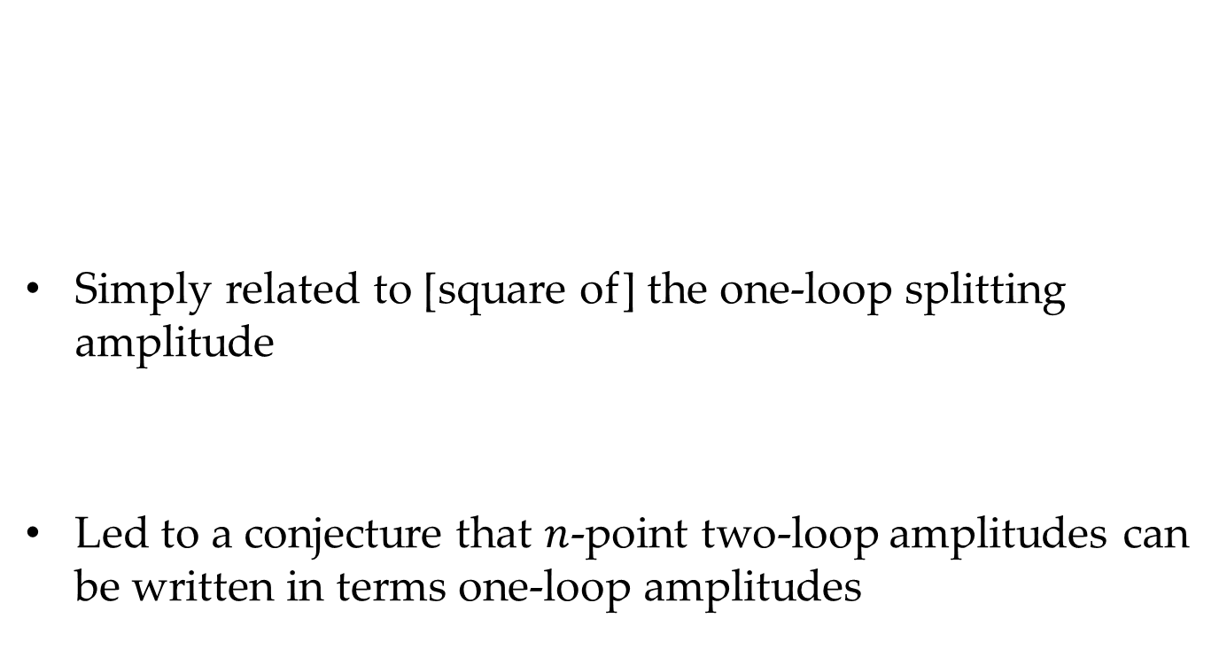
Seeds of All-Loop Behavior
Simply related to [square of] the one-loop splitting amplitude
Led to a conjecture that $n$-point two-loop amplitudes can be written in terms one-loop amplitudes
Notes:
David Gross story at KITP

Slide 37
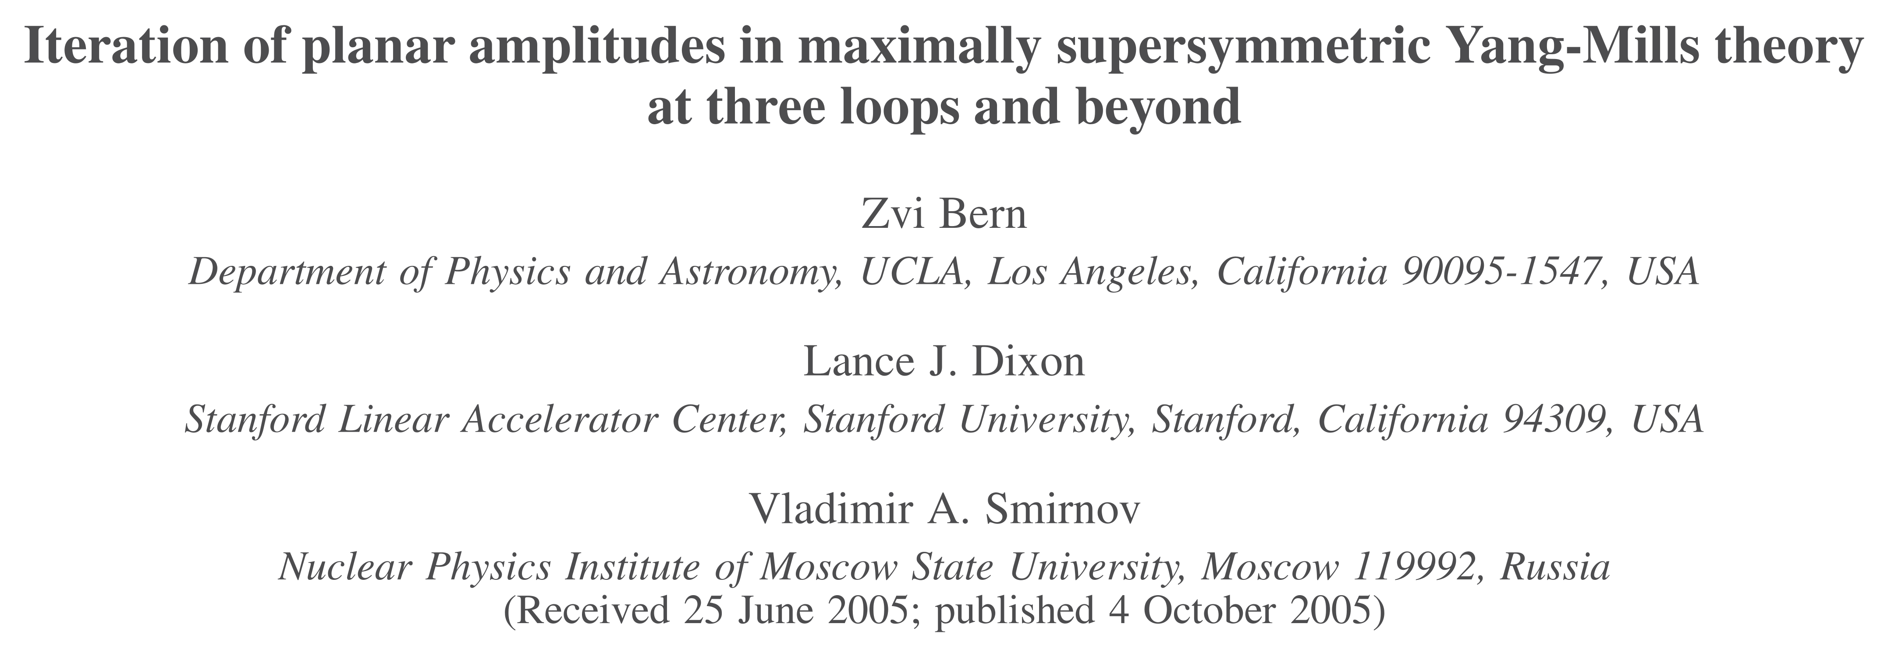

All-Loop Behavior
With Zvi and Volodya Smirnov, Lance calculated the planar three-loop MHV amplitude in $𝒩=4$ sYM
It has an iterative structure: can be expressed in terms of one- and two-loop amplitudes

Slide 38
All-Loop Behavior
Conjectured simple all-loop exponentiated form for the planar amplitude
Conjecture turns out to be true for the four- and five-point amplitudes!
Conjecture turns out to be false beyond five points

Slide 39
All-Loop Behavior
Yet false conjectures can sometimes be more fruitful than true ones
This one has been
It opened an entirely new research direction for Lance
⇒ Drummond’s talk

Slide 40
What Are Scattering Amplitudes?
“Quantum Field Theory without the quantum fields”
—Lance

Slide 41
Out of the Desert
In the meantime, Witten had gotten interested
  He had understood how to generalize an important 1988 paper of Nair’s
  Twistor string theory
In happy serendipity, Zvi, Joey Huston, Zoltan Kunszt, and Kirill Melnikov organized a workshop at the KITP in Santa Barbara in 2004
Many young people got interested
The field acquired a stamp of respectability

Slide 42
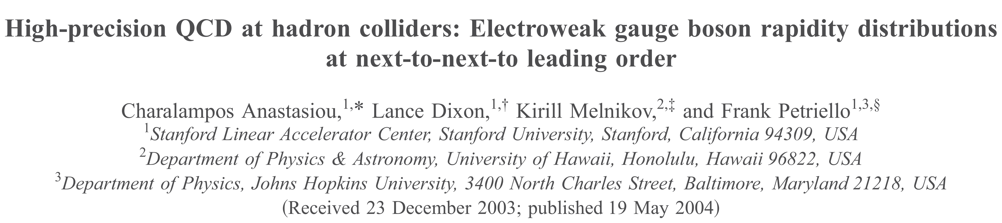
NNLO Phenomenology
Rapidity distribution of EW vector bosons at Tevatron and LHC
With Anastasiou (postdoc at SLAC), Melnikov, Frank Petriello (#4 on Lance’s list)
Two-loop virtual can be extracted from total cross section
Introduced reverse unitarity for distributions
Precision result: <1%

Slide 43
Many-Jet Production
By 2007 the limits of analytic calculation were becoming clear
The possibility of numerical calculation of amplitudes was becoming clear
Daniel Maître was a postdoc at SLAC and had the software skills key to such an effort
Another SLAC postdoc, Carola Berger, and postdocs at UCLA (Fernando Febres Cordero and Harald Ita) and Saclay (Darren Forde) joined too

Slide 44
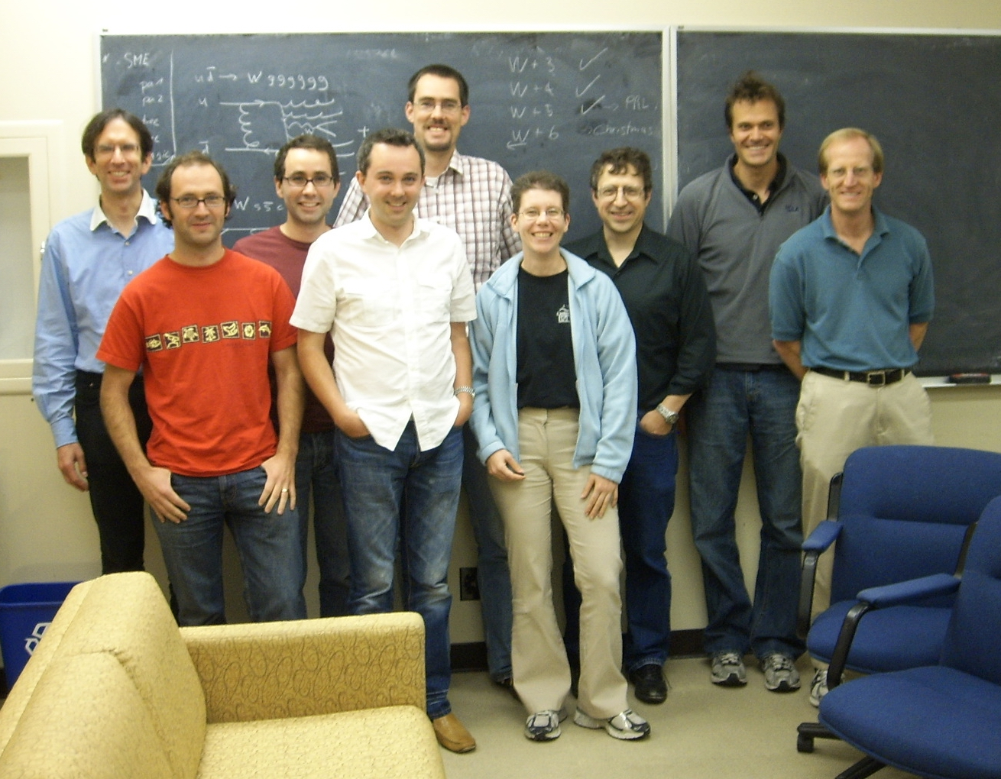
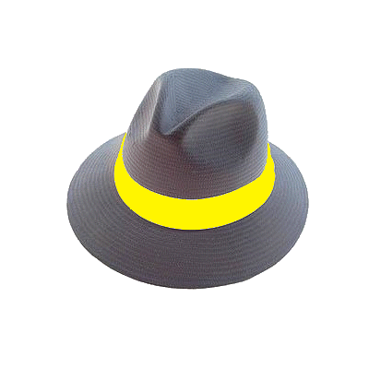
Many-Jet Production
Later Tanju Gleisberg, Giovanni Diana, Kemal Ozeren, Nicola Lo Presti, and Stefan Höche also joined
The team produced Blackhat

Slide 45
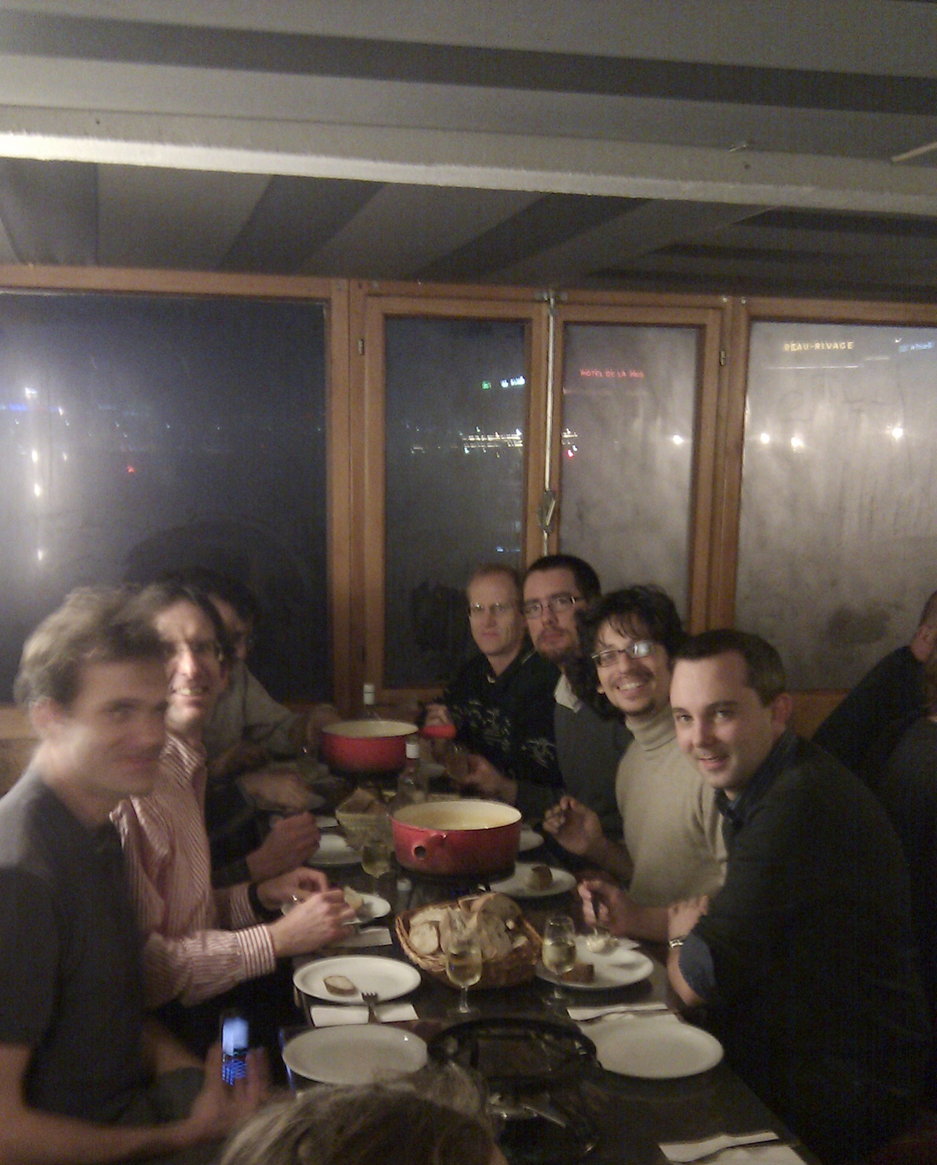
Cheese & Wine Were Involved Too

Slide 46
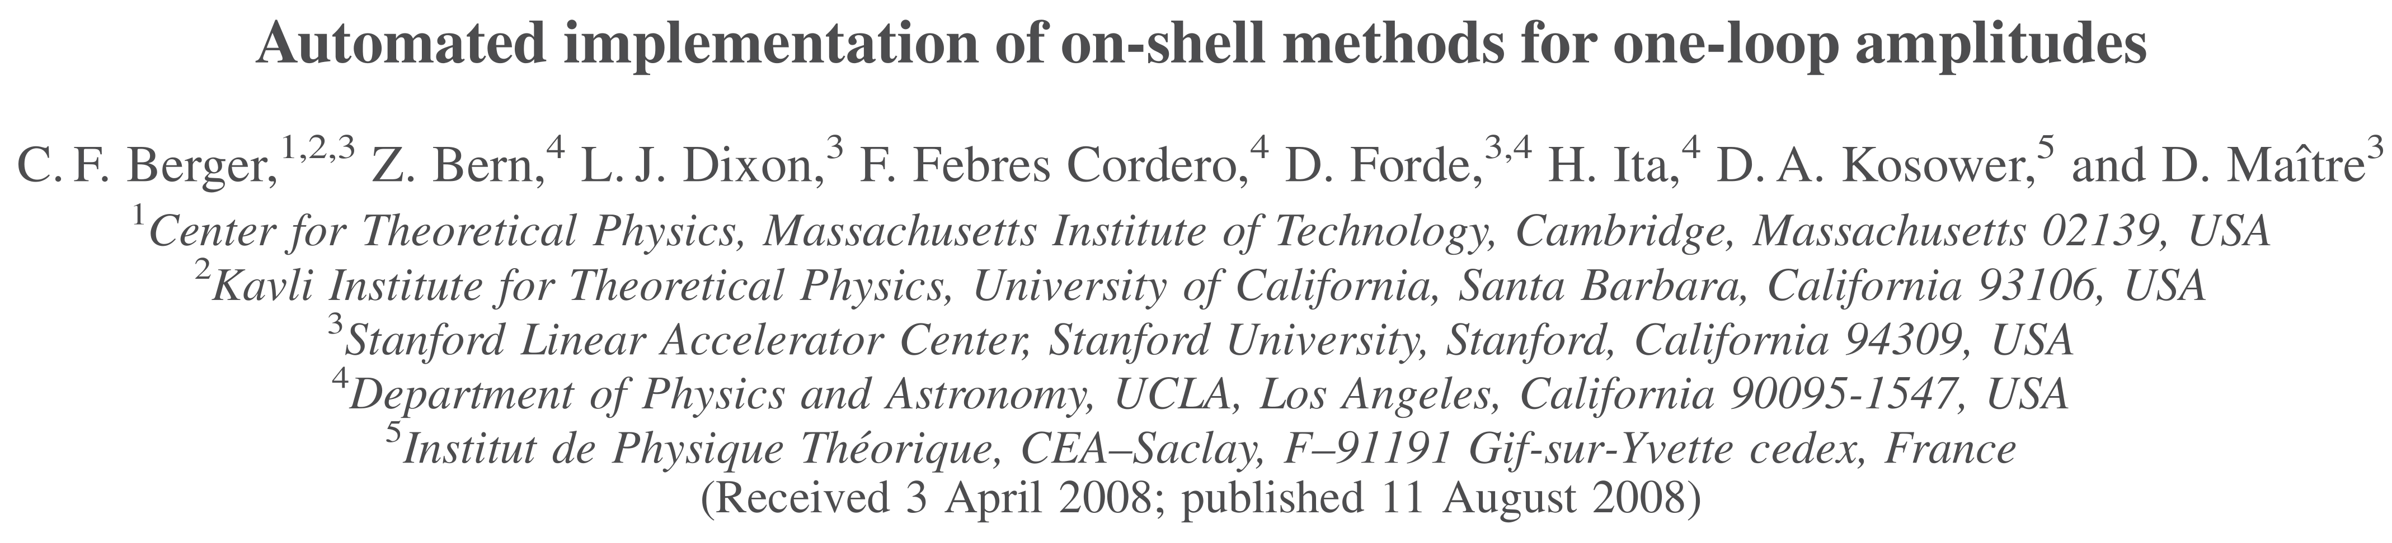
Many-Jet Production
Later Tanju Gleisberg, Giovanni Diana, Kemal Ozeren, Nicola Lo Presti, and Stefan Höche also joined
The team produced Blackhat
On-shell techniques used in a mature form
⇒ Fernando’s talk

Slide 47


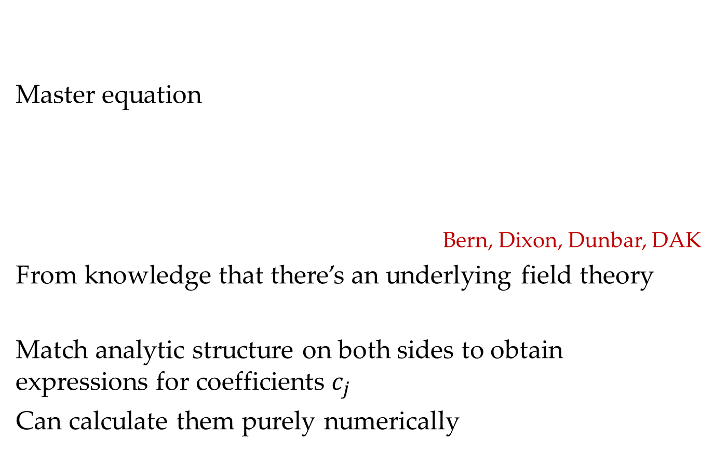
NLO Revolution: Unitarity at One Loop
Master equation
Bern, Dixon, Dunbar, DAK
From knowledge that there’s an underlying field theory
Match analytic structure on both sides to obtain expressions for coefficients $c_{j}$
Can calculate them purely numerically

Slide 48

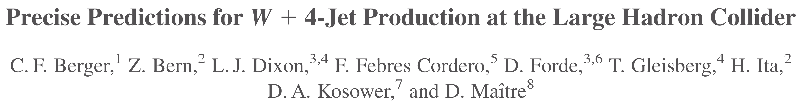
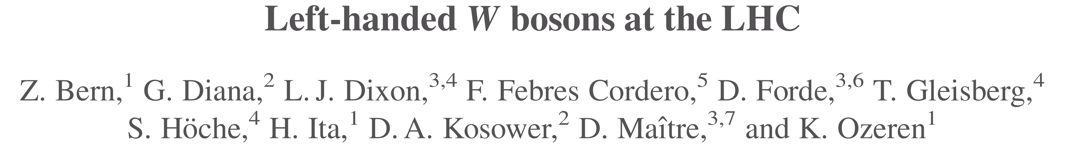
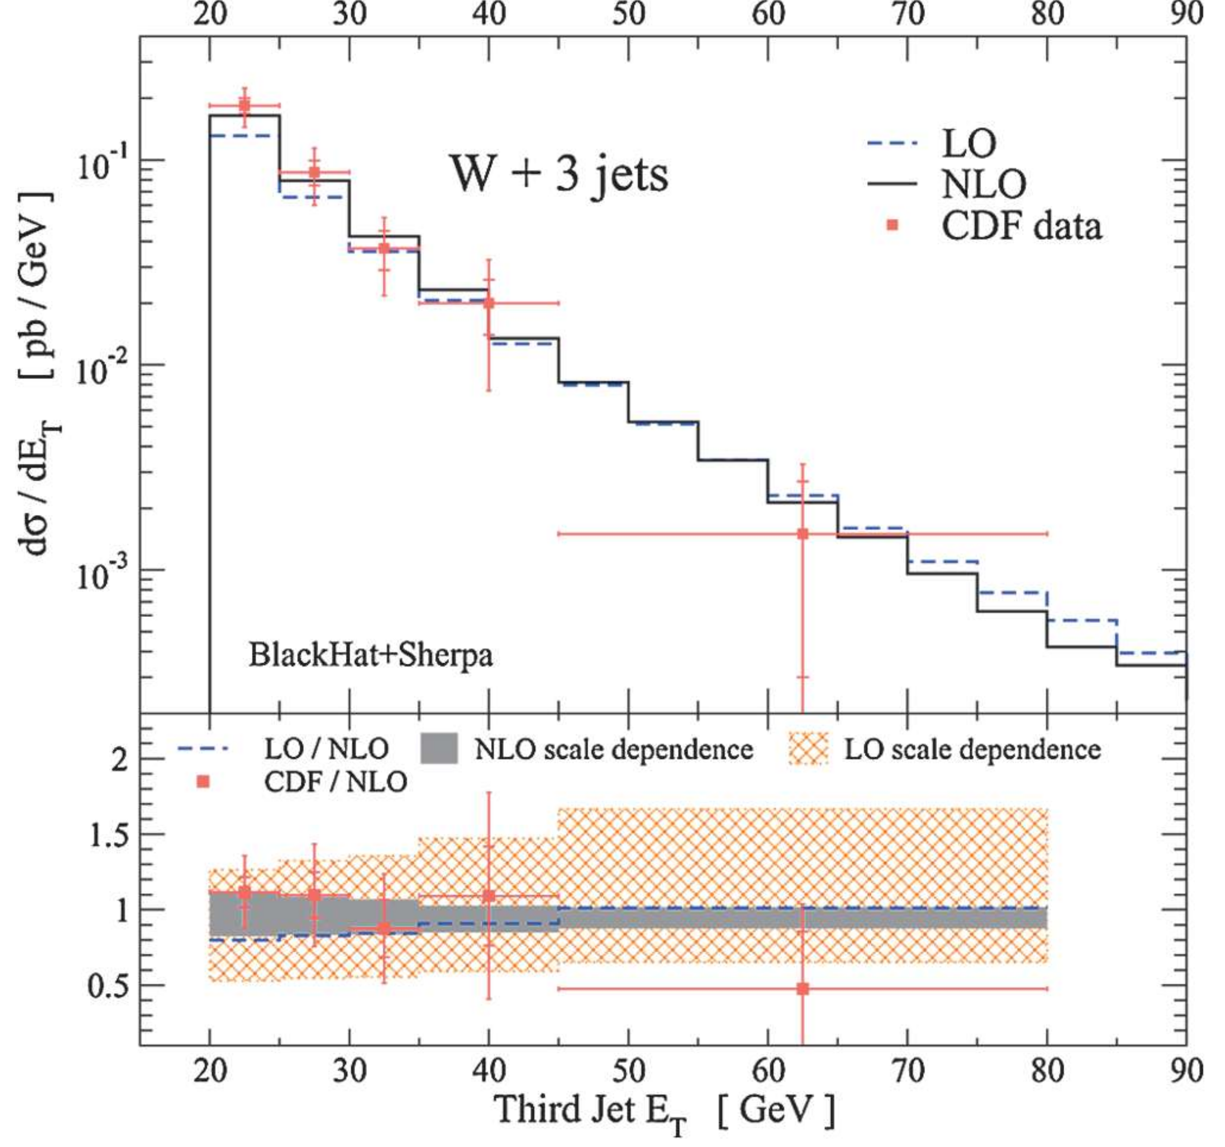
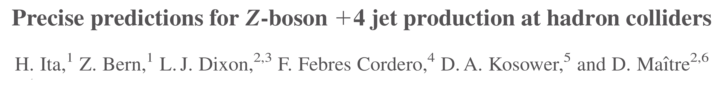
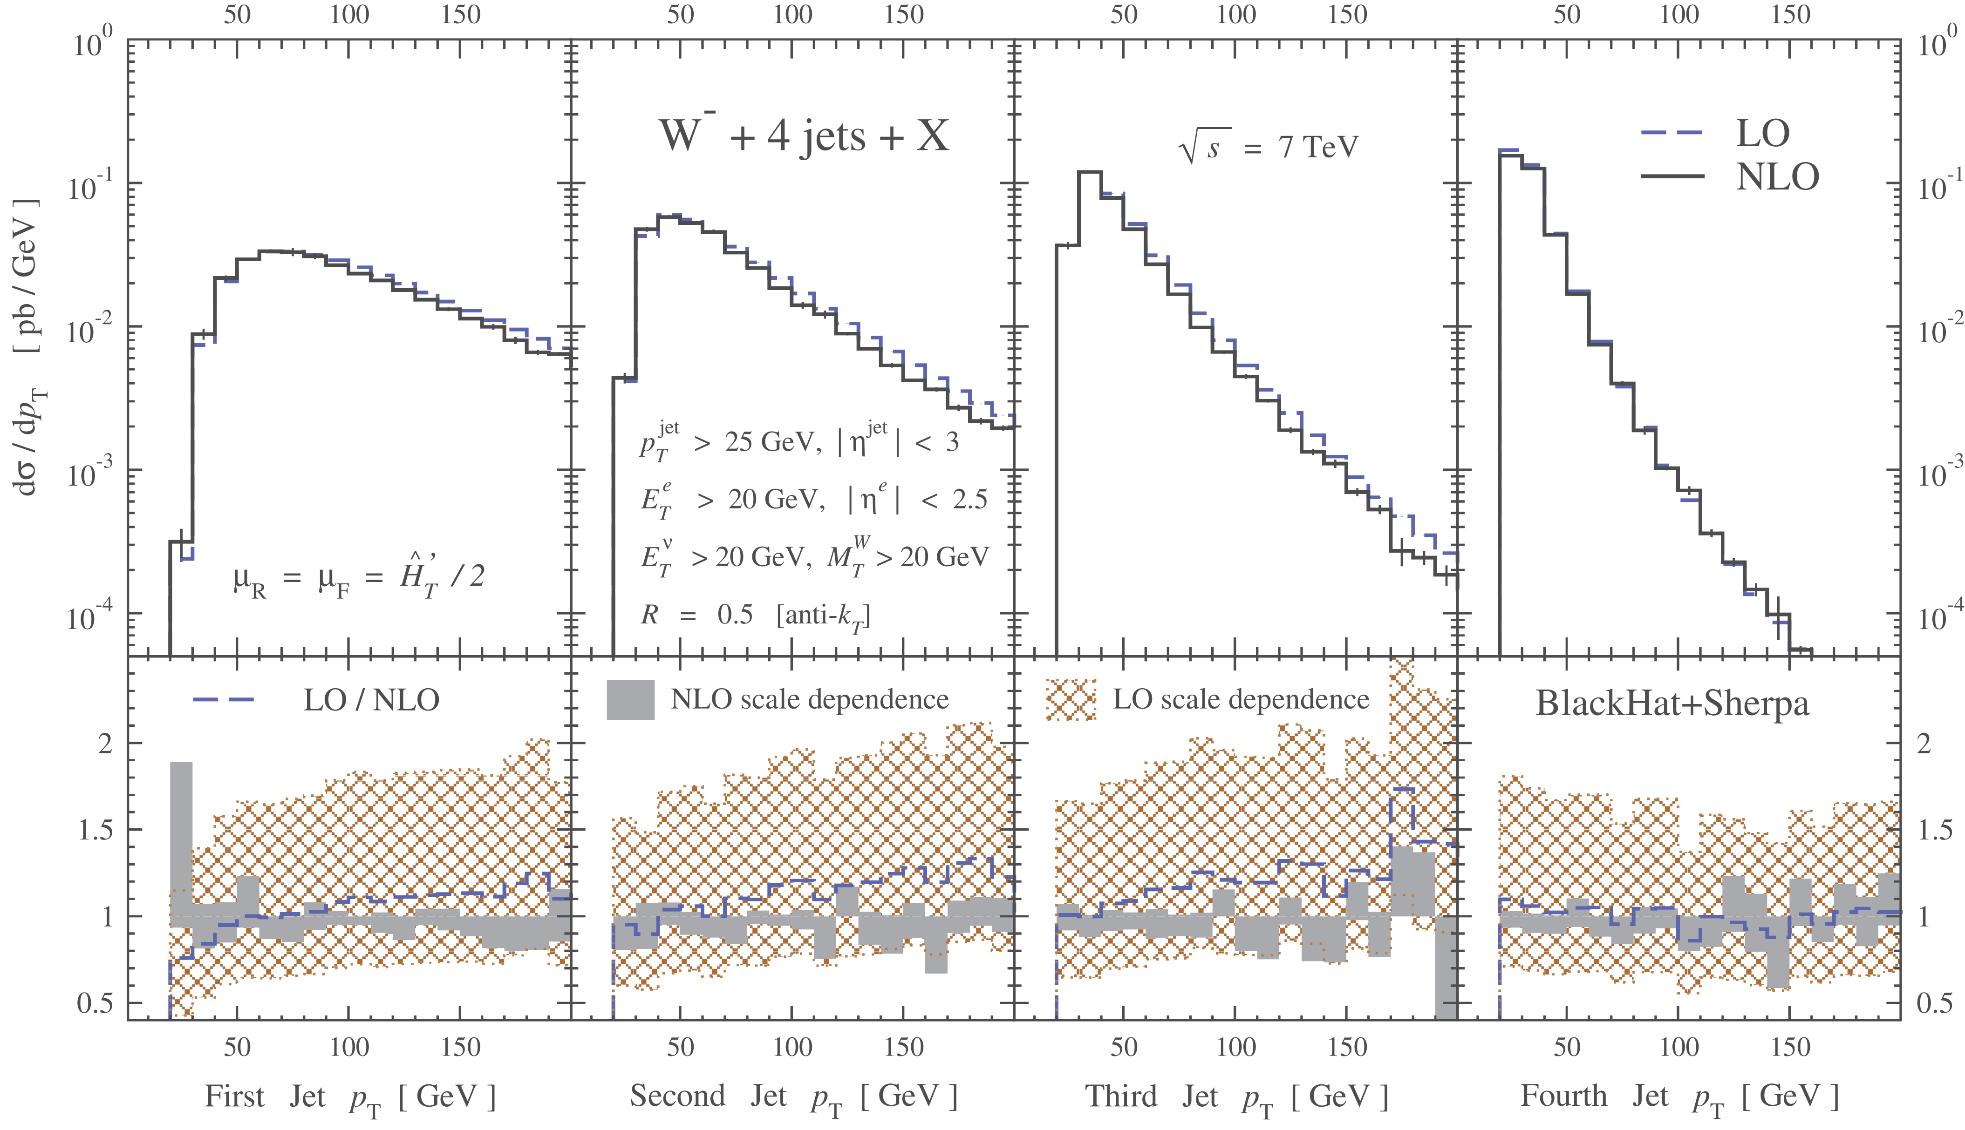
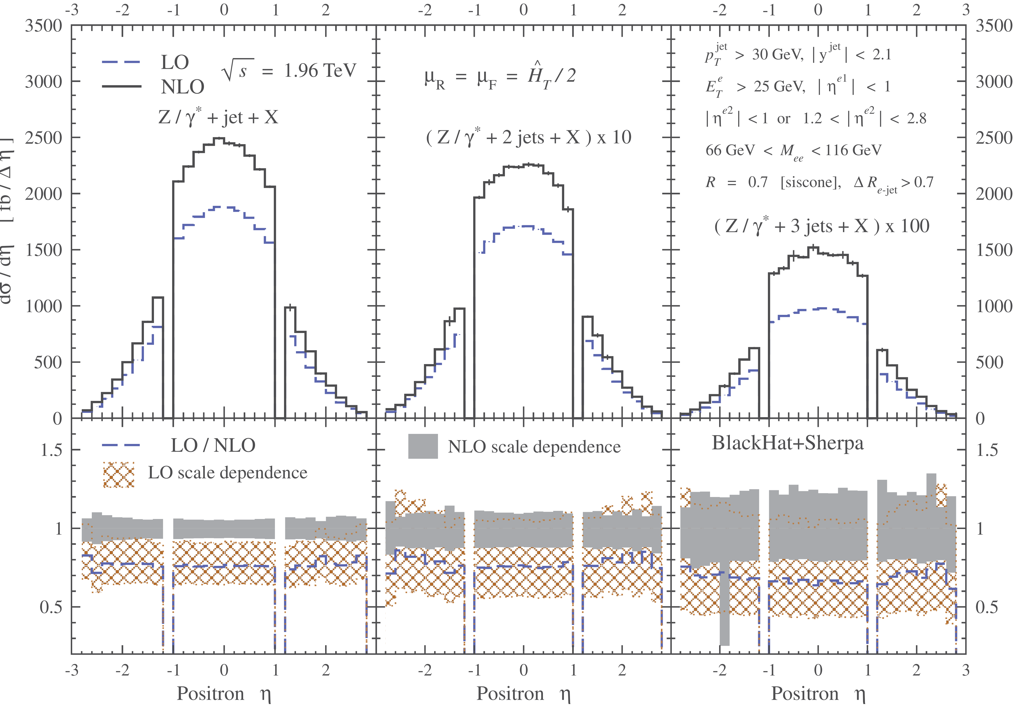

Industrialization of Predictions
A sequence of papers focusing on $W,Z+jets$ followed
14 publications & 12 conference talks in just over 6 years
Through $W+5 jet$ production

Slide 49
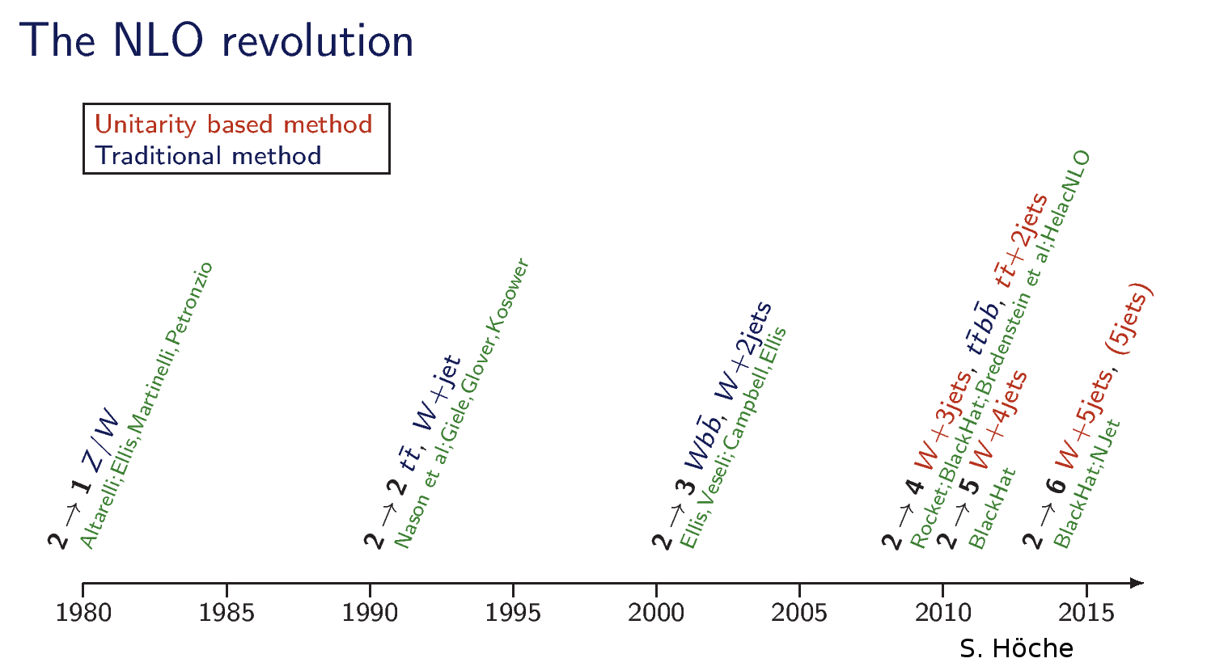
Industrialization of Amplitudes
BlackHat: Berger, Bern, Dixon, Febres Cordero, Gleisberg, Hoeche, Ita, DAK, Maître, Ozeren

Slide 50
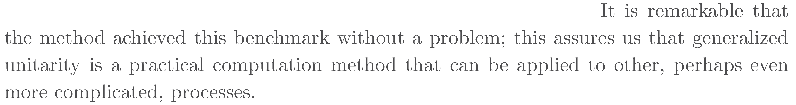
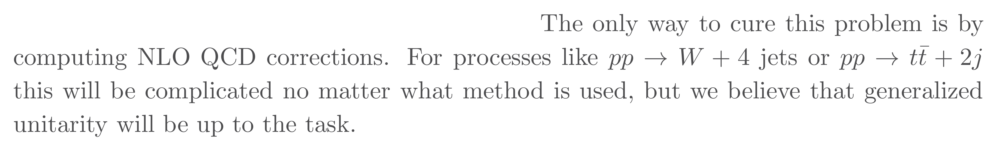
Even the strongest skeptics waved the white flag
Ellis, Zanderighi, & Melnikov

Slide 51
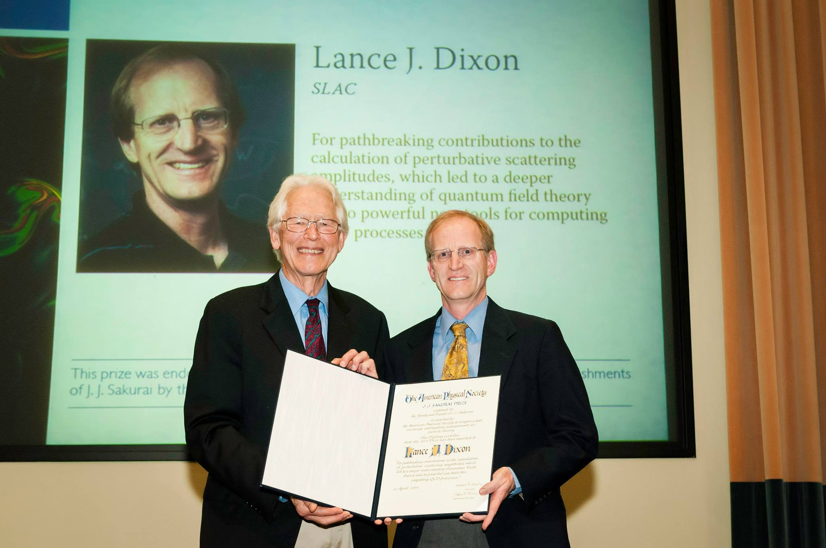
Wider Recognition
In 2014, Lance & friends were awarded the APS’s J.J. Sakurai Prize,
For pathbreaking contributions to the calculation of perturbative scattering amplitudes, which led to a deeper understanding of quantum field theory and to powerful new tools for computing QCD processes
Apologies to Sheldon, but I think getting the Sakurai Prize is cooler.
—Lance

Slide 52
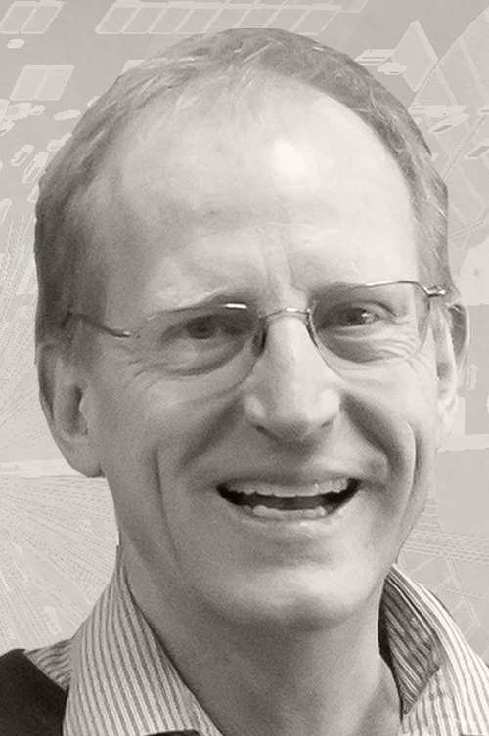
Wider Recognition
and in 2023, the Galileo Medal,
for the development of powerful theoretical computational methods for collision processes at large particle accelerators

Slide 53

New Measurement Tools
Use interferometry from QCD corrections to measure the Higgs width

Slide 54
Soft Gluons
⇒ Lorenzo’s talk

Slide 55


Teaching the Next Generation
In addition to PhD students and postdocs, Lance has also taught at many summer schools
Lecture notes of enduring popularity
Inspiring and serving as role model to the next generation of scientists

Slide 56




Energy-Energy Correlators
A very old quantity in $e^{+}e^{−}$ annihilation to hadrons
Lance with two young postdocs studied its collinear limit, opening the way to resummation & much more
The two would go on to advocate EEC as a means of studying jet substructure
⇒ Ian’s talk

Slide 57

Caravel
Apply unitarity to a variety of two-loop amplitudes
Fernando Febres Cordero and Harald Ita
  And a new generation of students and postdocs

Slide 58

T. D. Lee’s 60th birthday celebration
Happiness is when old friends come from far away
to enjoy the fruits of your work

Slide 59
Happy Birthday, Lance!

